Slide 1
How do different levels of detergent and fertilizer affect the process of eutrophication in Ell Pond (Melrose, MA) and Spot Pond (Middlesex County, MA)?
Apollolee Bidgood
Campus Academy High School
GLOBE Mentor Katherine Brown
2024 GLOBE Virtual Science Symposium
March 4, 2024

Slide 2
Research Questions
Do different amounts of detergents affect the levels of oxygen in Spot and Ell Pond?
Do different amounts of fertilizer affect the levels of oxygen in Spot and Ell Pond?
How did ponds’ levels of oxygen relate to eutrophication?

Slide 3
Abstract
Eutrophication is overwhelmed with nutrients causing algae blooms and an increase in activity (BYJU’S).
Spot and Ell pond are both local to Massachusetts
The samples are mixed with Miracle-Gro which is high in nitrogen
The samples are also mixed with borax
The main part of of the experiment was using titration to measure DO levels
Detergent levels showed little to no pattern
Fertilizer levels of nitrogen affected eutrophication giving a more noticeable pattern

Slide 4
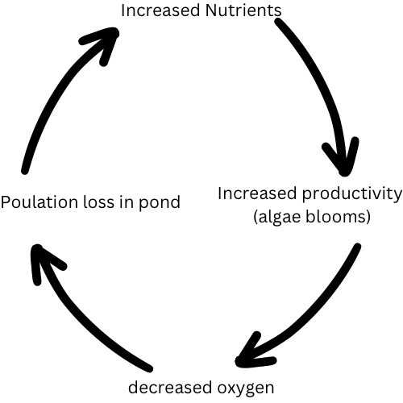
Introduction
Both Spot and Ell pond have different levels of DO but both have algae blooms
Ell Pond has a history of pollutants and invasive species
Spot Pond is part of the middlesex reservation so is protected
The reason eutrophication is a problem is because the oxygen levels go down which damages productivity.

Slide 5
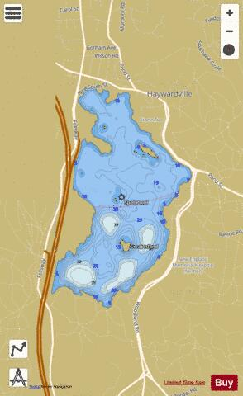
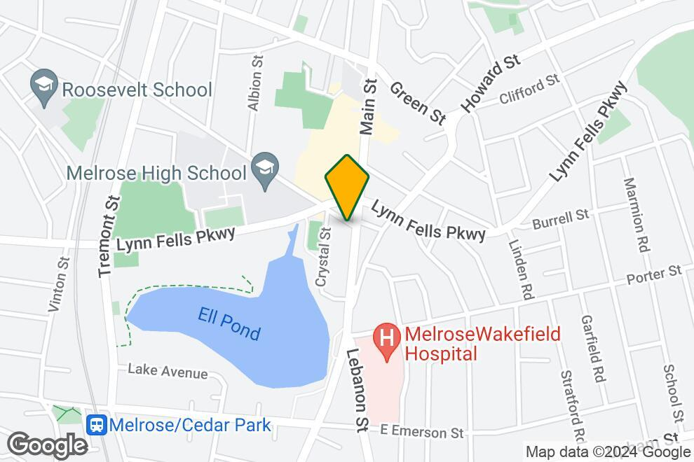
Maps
Image 2. Map of Spot Pond
Spot Pond is part of the Middlesex Reservation in Stoneham leaving it protected. The pond is home to many fish and other wildlife, both in and surrounding the pond. Little to no runoff enters the pond
Image 1. Map of Ell Pond
Ell Pond is located in the middle of a town, surrounded by much industrialization. The pond is surrounded by invasive animals and plants. Runoff is normal for the pond.

Slide 6
Results
detergent and borax were chosen because they have nutrients that affect eutrophication
Spot Pond had more varied results
The level of detergent had little effect on the DO
Commonly the 1 tsp of fertilizer wet above the measurable limit

Slide 7
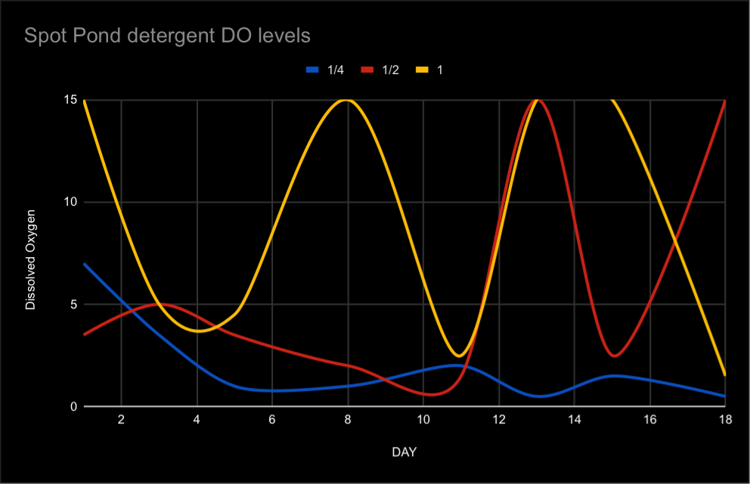
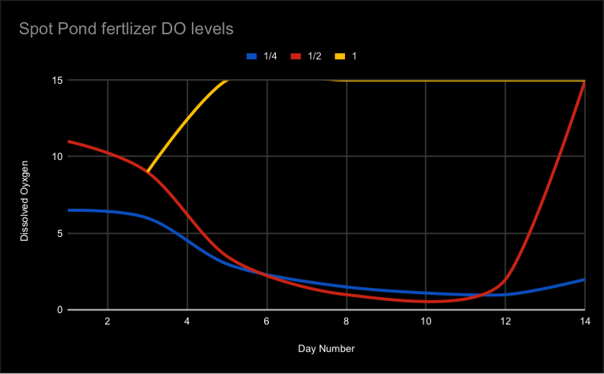
Graphs
Spot Ponds fertilizer DO levels
Spot Ponds detergent DO levels

Slide 8
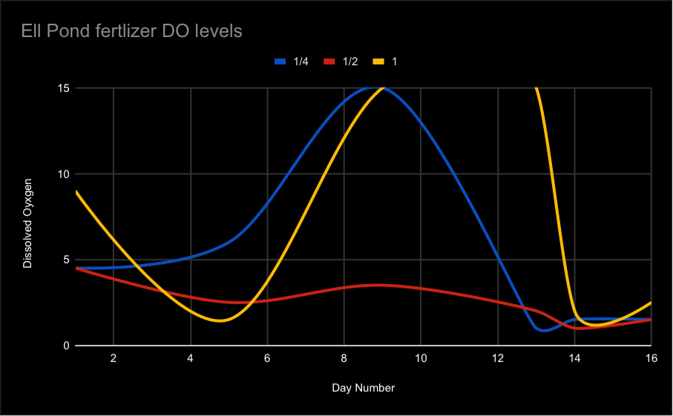
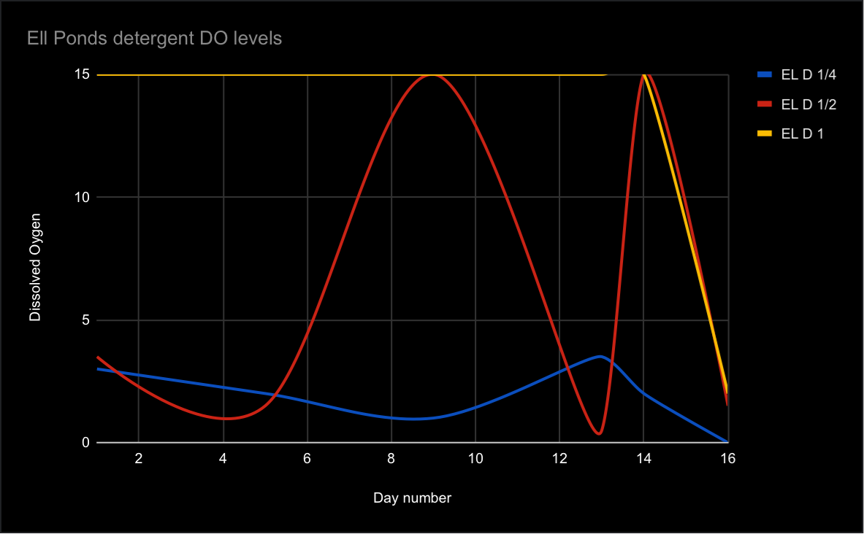
Ell Pond Charts
Ell Ponds detergent DO levels
Ell POnds fertilizer DO levels

Slide 9
Discussion
Both ponds are located in Middlesex County Massachusetts
The ponds were originally inhabited by Indigenous people
Across the charts 1 tsp commonly went above the readable limit
There are similar trends of runoff due to the Industrial Revolution
The DO of the original samples are 5 -10 DO levels

Slide 10
Conclusion
When combined pond water with fertilizer and detergent DO levels changed
There are little to no pattern across all results
Titration was used to measure DO levels
Nitrogen was a major factor

Slide 11
Citations
Beck, Kristen M, et al. Drivers of Change in a 7300-Year Holocene Diatom Record from the Hemi-Boreal Region of Ontario, Canada. Vol. 11, no. 8, 17 Aug. 2016, pp. e0159937–e0159937, www.ncbi.nlm.nih.gov/pmc/articles/PMC4988699/, https://doi.org/10.1371/journal.pone.0159937. Accessed 23 May 2023.
BYJU'S. “What Is Eutrophication? - Definition, Classification, Causes, & Effects.” BYJUS, byjus.com/chemistry/eutrophication/#:~:text=Eutrophication%20is%20the%20process%20in.
Saros, J. E., Michel, T. J., Interlandi, S. J., & Wolfe, A. P. (2001). Resource requirements of
asterionella formosa and fragilaria crotonensis in oligotrophic alpine lakes: Implications
for Aquatic Sciences, 62(7), 1681–1689. https://doi.org/10.1139/f05-077
recent phytoplankton community reorganizations. Canadian Journal of Fisheries and
Stager, J. C., Harvey, L., & Chimileski, S. (2020). Long-term cultural eutrophication in White
and Walden Ponds (Concord, Massachusetts, USA), Thoreau’s lakes of light. Lake and
Reservoir Management, 37(1), 2–18. https://doi.org/10.1080/10402381.2020.1839606

