Slide 1



Monitoring environmental changes through satellite imagery

Slide 2
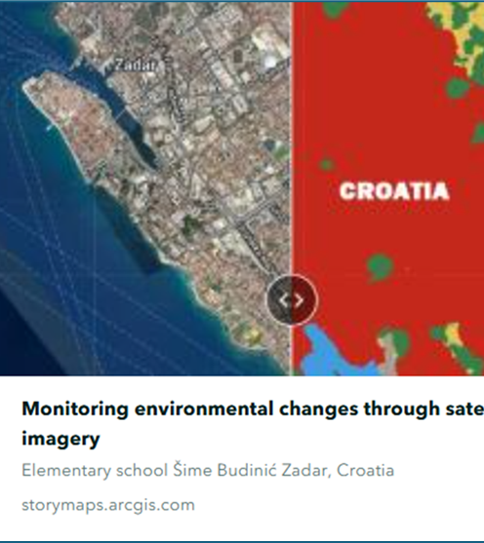
Monitoring environmental changes through satellite imagery
Elementary school Šime Budinić Zadar, Croatia
Students: Ana Alvir, Tara Tošić, Lana Perić, Ena Marija Štrk
Mentor: Zrinka Klarin, geography teacher

Slide 3

VSS Theme: GLOBE Data Detectives- Using Data to Explore Change in Your Local Environment

Slide 4


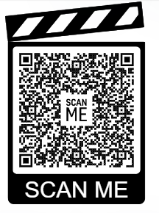


https://storymaps.arcgis.com/stories/e552fa66da5b4965ad85650b2f5ea100
Open link:

