Slide 1


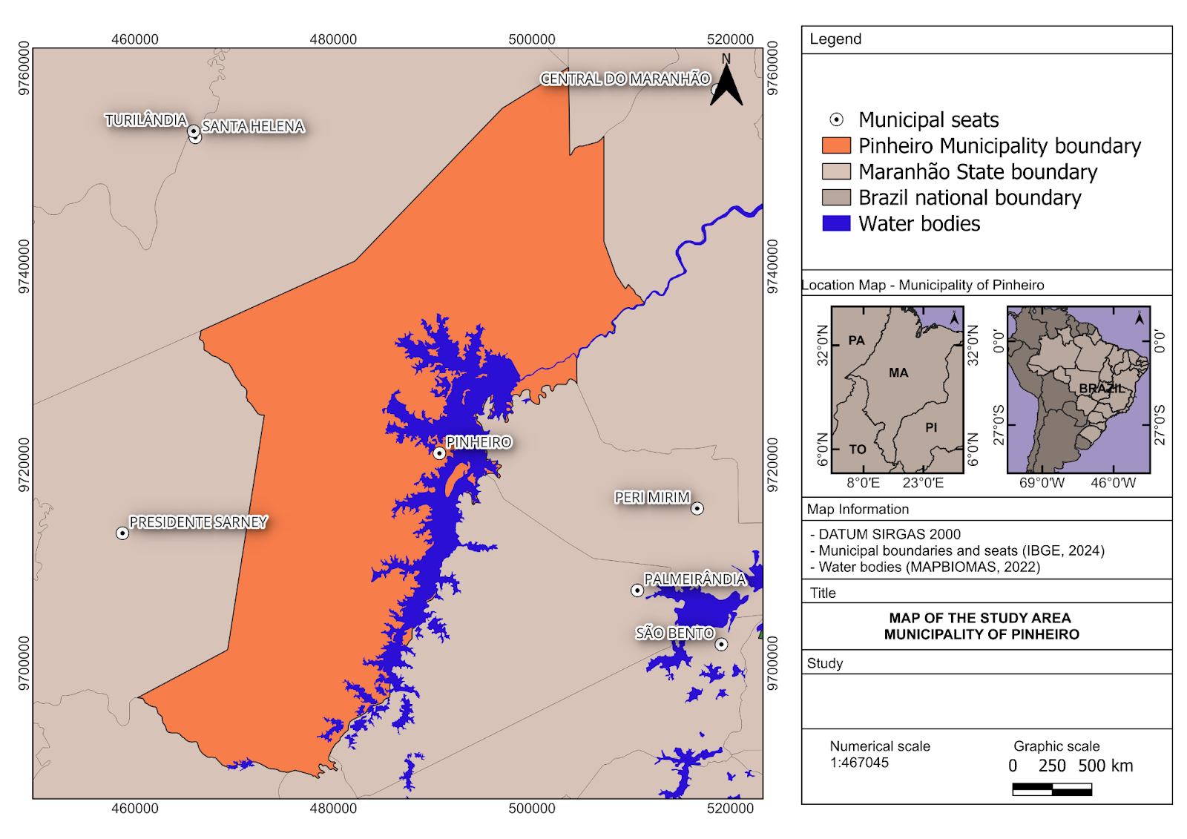
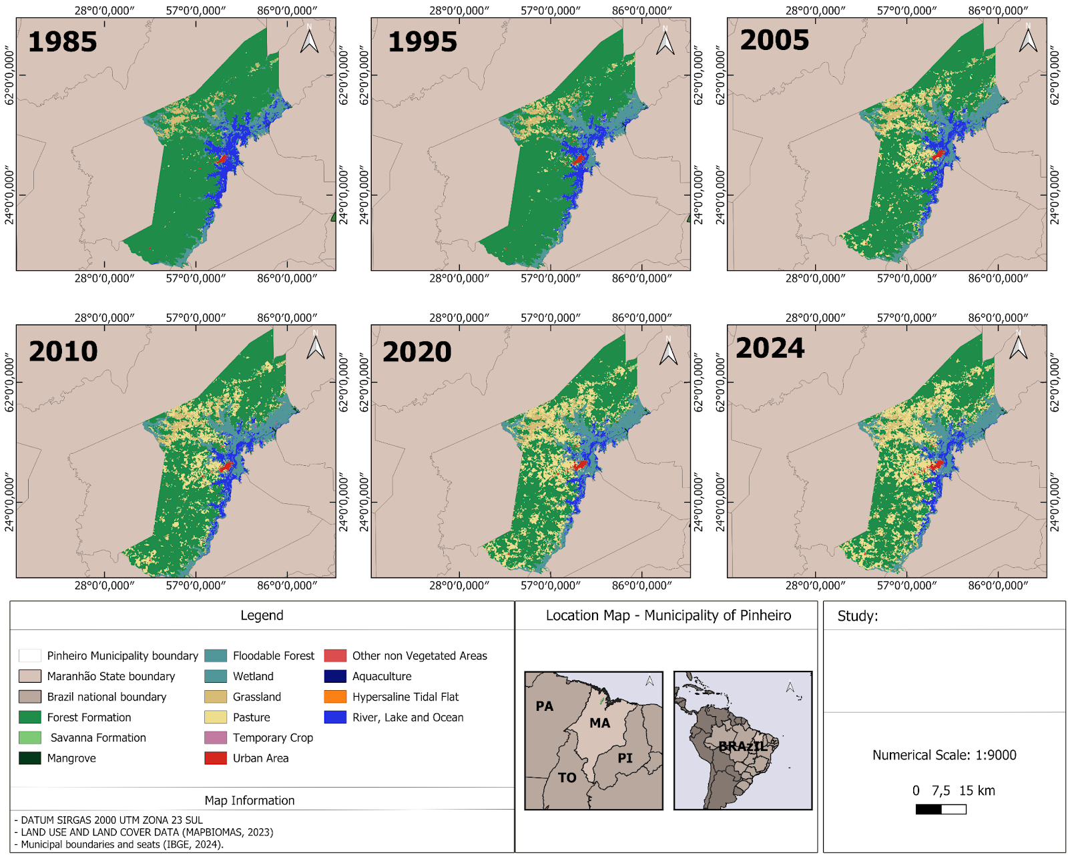
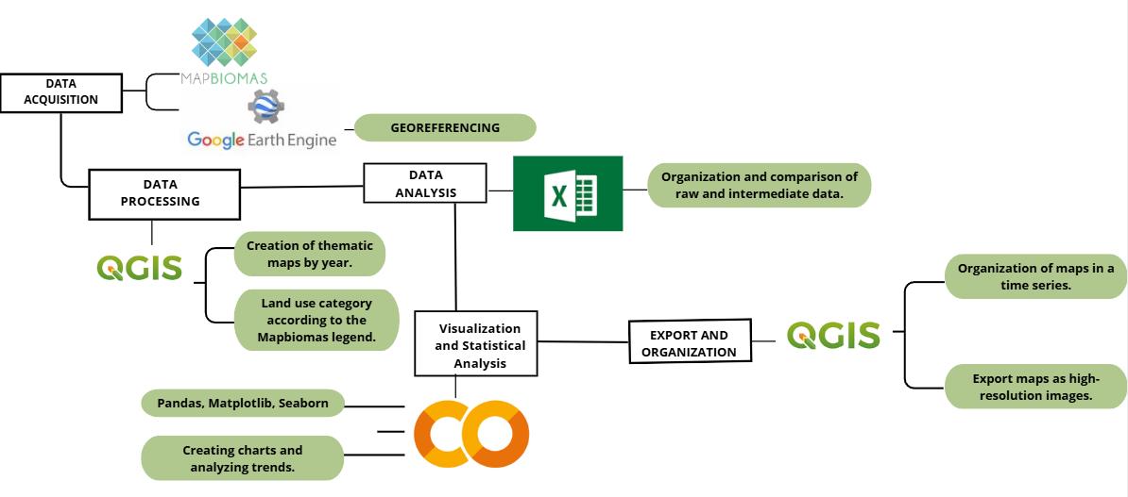
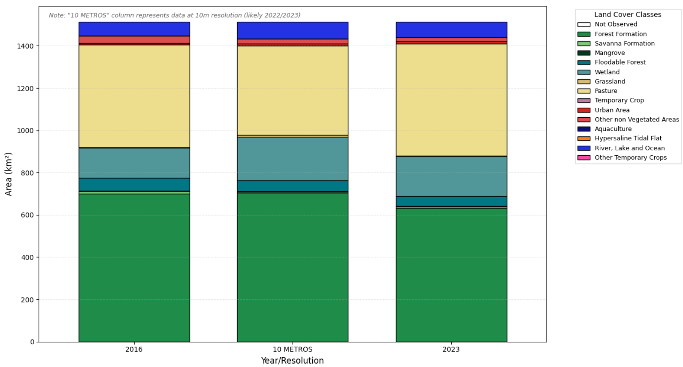
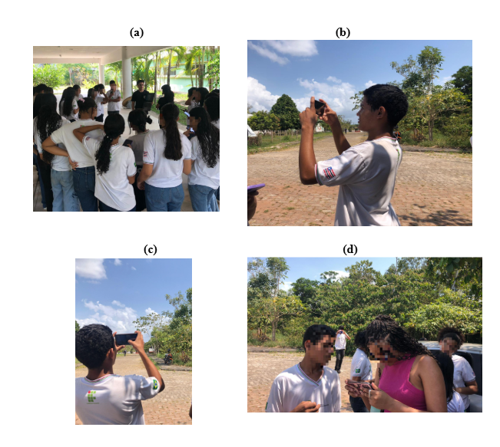
Changes in land use and land cover in Pinheiro, Maranhão (1985–2024): integration between remote sensing and citizen science
Maria Eduarda Ferreira Moraes¹, Livia Lourrane Dias de Araújo¹, Geisiane Sousa Moraes¹, Bruna Eduarda Pinto¹, Wendel Monteiro Braga¹, Emilly Sophia Gaspar Borges¹, Tayná Almeida Bouéres¹, Sérgio Serra Silva², Anderson Diego da Silva Araújo², Emanuele Silva Costa², Jefferson Juan Silva Sá², Efraim Ribeiro Correia², Emmily Suellem Rodrigues Dias, Aslei Andrade da Silva³, Aline Bessa Veloso³, Joel Artur Rodrigues Dias⁵, Yllana Ferreira Marinho⁵, Hilton Costa Louzeiro⁴, Adilson Matheus Borges Machado⁵, Denise Rodrigues Santiago⁶
1 – Estudantes de graduação em Engenharia de Pesca, Universidade Federal do Maranhão (UFMA), Campus Pinheiro, Estado do Maranhão, Brasil; 2 – Professora, Escola Centro Educa Mais Aquiles Batista, Alcântara, Estado do Maranhão, Brasil;
3 – Agência Espacial Brasileira (AEB), Brasil; 4 – Professores, Universidade Federal do Maranhão (UFMA), São Luís, Estado do Maranhão, Brasil; 5 – Professores, Universidade Federal do Maranhão (UFMA), Campus Pinheiro, Estado do Maranhão, Brasil; 6 – Doutoranda em Arquitetura e Urbanismo, Universidade Federal de Uberlândia, Estado de Minas Gerais, Brasil;
Abstract
Figure #1
Results
Discussion
This study analyzes spatio-temporal changes in land use and land cover in the municipality of Pinheiro, Maranhão, from 1985 to 2024, integrating remote sensing data, geoprocessing techniques, and citizen science observations. The dynamics of land use and land cover were assessed using MapBiomas data derived from Landsat images (spatial resolution of 30 m) for the entire time series and Sentinel-2 images (10 m) for the most recent years, enabling the identification of long-term trends and more detailed spatial patterns. The results indicate the predominance of forest formations throughout the period analyzed, accompanied by a progressive reduction in natural vegetation and floodplains, in contrast to the significant expansion of pasture areas and the gradual growth of urban areas, highlighting the increase in anthropogenic pressures on the municipal landscape. As a complementary approach, field activities were carried out with high school students from IFMA – Campus Pinheiro, using the GLOBE Observer application. In total, 363 georeferenced observations were recorded, which contributed to the visual validation of land use and land cover classes and to the interpretation of local dynamics. The integration of remote sensing and citizen science proved to be a robust approach for monitoring changes in land use and land cover at the local scale. In addition to generating environmental data, the study highlights the educational potential of citizen science in strengthening scientific literacy, environmental awareness, and student engagement, providing relevant inputs for territorial planning and sustainable environmental management in the Baixada Maranhense region.
Throughout the analyzed period, forest formations and aquatic environments remained predominant in Pinheiro, Maranhão, with mangroves, flooded fields, wetlands, and pastures forming a heterogeneous landscape mosaic. Higher spatial resolution data revealed increased fragmentation of natural formations and their gradual conversion to pasture, highlighting the influence of anthropogenic activities. Between 1985 and 2024, forest and savanna formations experienced significant reductions, while wetlands expanded and urban areas became more defined, reflecting notable changes in land use and land cover dynamics.
  Interpreting Data
The results reveal marked changes in land use and land cover in Pinheiro between 1985 and 2024, highlighted by a substantial reduction in forest (−345.19 km²), savanna (−8.85 km²), floodplain forest (−39.91 km²), and grassland formations (−15.10 km²). In contrast, pasture areas expanded significantly (+365.05 km²), accompanied by urban growth (+5.95 km²). Wetlands exhibited an opposite trend, increasing by 107.28 km², while mangroves showed minimal variation (+0.71 km²).
Analyses based on Landsat (30 m) and Sentinel-2 (10 m) data indicate that, despite the continued predominance of forest formations, the landscape has undergone progressive anthropogenic conversion, particularly toward pasture expansion since 2005. This pattern is consistent with regional and national studies that document the replacement of native vegetation by agricultural and livestock activities (Alvim et al., 2025; Souza Jr. et al., 2020). Urban expansion follows recent demographic trends in Maranhão, intensifying pressure on natural ecosystems and water resources (MapBiomas, 2024; IBGE, 2024), reinforcing the need for territorial planning instruments such as the Ecological-Economic Zoning of Maranhão (ZEE-MA).
Figure #3
Research Question
Hypothesis: How does the integration of spatio-temporal analyses of land use and land cover (LULC), derived from remote sensing data, and field observations obtained through citizen science, through the GLOBE Program, contribute to understanding land use dynamics and supporting territorial planning in the municipality of Pinheiro, Maranhão?
Question: It is hypothesized that, in the municipality of Pinheiro, Maranhão, between 1985 and 2024, there was a significant expansion of pasture and urban areas, to the detriment of forest formations and wetlands, reflecting anthropogenic conversion processes associated with the intensification of agricultural activities and urban expansion.
  Figure #2
  Methodological workflow of the study.
Conclusions
Pastureland showed the greatest expansion, increasing by 365.05 km² between 1985 and 2024, indicating the intensification of agricultural activities. Urban areas also expanded, with an increase of 5.95 km², reflecting ongoing urban growth. Other non-vegetated areas showed a slight increase, while the Unobserved class presented a minimal reduction over the analyzed period.
This study analyzed spatial and temporal changes in land use and land cover in the municipality of Pinheiro, Maranhão, between 1985 and 2024, based on the integration of remote sensing data and geoprocessing techniques. The results showed changes in the landscape, with a reduction in natural formations and a significant expansion of pasture and urban areas, indicating increased anthropogenic pressures on the territory over the last few decades. The use of MapBiomas data at different spatial resolutions enabled a more detailed understanding of land use dynamics, revealing conversion patterns mainly associated with agricultural activities and urban expansion. These transformations reinforce the need for continuous monitoring and territorial planning instruments that consider the environmental specificities of the Baixada Maranhense.
The incorporation of field observations made by high school students using the GLOBE Observer app demonstrated the potential of citizen science as a complementary tool to orbital analysis, especially in supporting local interpretation and visual validation of land use and land cover classes. Photographic records and georeferenced observations broadened the understanding of the spatial dynamics observed and highlighted the contribution of citizen science to environmental monitoring at the municipal level.
Finally, the study shows that the integration of remote sensing, field data, and environmental education is a promising approach for monitoring changes in land use and land cover. This strategy contributes both to the production of scientific knowledge and to the training of more aware and engaged students, providing relevant support for sustainable environmental management and planning actions in the municipality of Pinheiro.
Introduction
Figure #4
  Content Knowledge
Soil plays a fundamental role in sustaining ecosystems by supporting biodiversity, regulating biogeochemical cycles, and providing essential ecosystem services that underpin environmental balance and human well-being. However, anthropogenic land use and land cover (LULC) changes driven by urban expansion, agricultural conversion, and deforestation have significantly altered environmental processes, resulting in soil degradation, increased erosion, carbon losses, and disruptions in hydrological regimes and ecosystem services.
In regions such as the municipality of Pinheiro, Maranhão, where agricultural expansion and urban growth intensify environmental pressures, LULC analysis is essential for supporting sustainable land management and territorial planning. The integration of remote sensing data with field observations collected through the GLOBE Program and the GLOBE Observer application provides an effective approach for monitoring land use dynamics, while also promoting citizen science, environmental education, and community engagement in local-scale environmental monitoring and conservation.
GLOBE Badges
Be a Collaborator : The project was carried out collaboratively with high school students from the first year of the technical course in Environment at IFMA, Pinheiro campus, applying citizen science tools to record land use and land cover data. Students participated in all stages, from training in GLOBE protocols to field data collection using the GLOBE Observer app. The initiative demonstrated the potential of digital technologies and citizen science to support local environmental monitoring, strengthen scientific education, and contribute to sustainable land management.
Be a Data Scientist: The project involved the collection and organization of land use and land cover data through field observations and georeferenced photographic records following GLOBE Program protocols using the GLOBE Observer application. The data were recorded in a digital environment and analyzed to identify spatial patterns, local variations, and changes in land cover, supporting the interpretation of local-scale environmental processes. Despite limitations related to the sampling period and spatial representativeness, the study demonstrated the critical and systematic use of citizen science data as a complementary tool to remote sensing analyses, contributing to a better understanding of Earth system dynamics..
Be an impact maker: The project integrated remote sensing and citizen science to monitor land use and land cover changes in Pinheiro, Maranhão, addressing local environmental challenges associated with anthropogenic activities. Using the GLOBE Observer app, georeferenced field observations were systematically collected, supporting spatial analyses and data validation. The initiative also promoted the active participation of high school students from IFMA–Pinheiro, strengthening scientific skills, environmental awareness, and local engagement in sustainable land management.
The photographic records collected by students using the GLOBE Observer app complemented satellite-based spatial analyses by enabling the visual documentation of local land use and land cover classes, such as pastures, vegetation, wetlands, and urban areas. These images supported the interpretation and validation of mapped classes and strengthened students’ understanding of landscape changes, highlighting the educational and scientific value of citizen science for local environmental monitoring and land use and land cover studies.
Research Methods
References
  Planning Investigations
  Study area
The research was conducted in the municipality of Pinheiro, Maranhão, located in the Baixada Maranhense region, characterized by humid environments with floodplains and a transition between the Amazon and Cerrado biomes, under a tropical climate with distinct rainy and dry seasons. The study combined quantitative and qualitative approaches to analyze land use and land cover changes, integrating field observations from the GLOBE Program—especially the Land Cover protocol—with remote sensing data. LULC dynamics from 1985 to 2023 were assessed using MapBiomas Collection 10 derived from Landsat imagery (30 m resolution), processed through Google Earth Engine and QGIS, with area calculations and statistical analyses supported by Excel Online and Python in Google Colab. To enhance spatial detail, results were compared with MapBiomas BETA Collection data (2016–2023), based on Sentinel-2 imagery with 10 m resolution, enabling the identification of spatial patterns and temporal trends in land cover changes.
Souza, C. M., Jr., Shimbo, J. Z., Rosa, M. R., Parente, L. L., Alencar, A. A., Rudorff, B. F. T., Hasenack, H., Matsumoto, M., Ferreira, L. G., Souza-Filho, P. W. M., de Oliveira, S. W., Rocha, W. F., Fonseca, A. V., Marques, C. B., Diniz, C. G., Costa, D., Monteiro, D., Rosa, E. R., Vélez-Martin, E., & Azevedo, T. (2020). Reconstructing three decades of land use and land cover changes in Brazilian biomes with Landsat archive and Earth Engine. Remote Sensing, 12(17), 2735.
MapBiomas. (2024). Coleção 9 – MapBiomas. Projeto MapBiomas.
Alvim, P. S., Miller, H. A., & Baptista, G. M. M. (2025). Detecção de mudanças no uso da terra nos territórios especiais AMACRO e MATOPIBA. Revista Brasileira de Geomática, 13(2), 285–303.
The GLOBE Program. (2024). About the GLOBE Program.
Seixas, H. T., Silveira, H. L. F. D., Mendes, A. P. D. S. F., Soares, F. D. S., & da Silva, R. F. B. (2025). Conversion from forest to agriculture in the Brazilian Amazon from 1985 to 2021. Land, 14(2), 300.
Silva, R. F. B., et al. (2026). Land use and land cover dynamics and their association with fire in Indigenous Territories of Maranhão, Brazil (1985–2023). Land, 15(1), 132.
Singh, S. (2024). Land use and land cover change: A comprehensive review of environmental implications. International Journal of Land, 1(2), 1–5.
Figure #5
Acknowledgements
The authors acknowledge the Federal Institute of Maranhão (Instituto Federal do Maranhão – IFMA), Pinheiro campus, for institutional support and for enabling the development of the activities with high school students. The authors also acknowledge the GLOBE Program for providing the protocols and digital platform that supported the data collection and citizen science activities carried out in this study.

