Slide 1



Ministry of Education
Directorate General of Education in Musandam Governorate
Khawla Bint Al-Azwar Basic Education School
Research study titled:
Analysis of the impact of local climate changes on air temperature, soil temperature, and humidity in the Wilayat of Khasab during the year 2025.
Student Name
Fajr Al-Shahya
Miyar Al-Shahya
Supervised by: Fatima Al-Shahya

Slide 2
Outline
Research summary
Research questions & hypothesis
Equipment and tools used
Data analysis:
Comparison of meteorological data
Results
Discussion of the results
References

Slide 3
Research summary
This research comes within the framework of the growing interest in studying local climate changes and the direct and indirect environmental impacts they cause on natural systems and human societies, as climate changes have become one of the most prominent environmental issues preoccupying the world at the present time, because of their clear effects on temperatures, humidity, soil, water, and various human activities. This research aims to study and analyze the impact of local climate changes on air temperature, soil temperature, and humidity levels in the Wilayat of Khasab during the year 2025 AD, as it is one of the coastal regions with distinct environmental and climatic characteristics in the Sultanate of Oman. And the mountainous.
From this standpoint, the research seeks to understand the nature of local climate changes in the state, and to analyze how these changes are reflected in basic climate elements such as temperature, Air, soil temperature, and relative humidity.

Slide 4
Research summary- CONt.
The research is based on a scientific approach that combines field work and descriptive analysis, where field data is collected directly from the study site using simple and available measuring tools such as a digital thermometer, an alcohol thermometer, and a hygrometer to measure humidity. This data is recorded periodically and regularly during different time periods from the year 2025 AD, allowing monitoring of daily and seasonal changes in the climate elements studied. The data is also documented in organized tables to ensure accuracy and ease of analysis.
These data also contribute to giving a more comprehensive picture of the prevailing climate characteristics, and help explain possible differences between field measurements and official measurements. As for the data of the Environment Agency in the Sultanate of Oman, which is available through the open data portal, it is an important supporting source for the study, as it provides access to environmental information.

Slide 5
Research questions & Hypothesis
1. What is the impact of local climate changes on air temperature in the state of Khasab in 2025? What is the impact of local climate changes on air temperature in the Wilayat of Khasab in 2025?
2. What is the nature of the relationship between air temperature and soil temperature during the study period? What is the nature of the relationship between air temperature and soil temperature during the study period?
Hypothesis
There are significant differences in some meteorological variables (such as temperature, relative humidity, and atmospheric pressure) between the Khasab station and the GLOBE station during the study period, due to the differing locations of the two stations and the measurement methods used in each.

Slide 6
Research plan.
The research relies on the descriptive-analytical method, where the studied climatic phenomena are described and analyzed based on data collected both field-wise and officially.
A timeline is prepared for data collection throughout the year 2025, covering different time periods, allowing for the monitoring of daily and seasonal changes.
After collecting the data, it is organized into clear tables, then analyzed using simple statistical methods and graphs to illustrate the trends and relationships between the different climatic variables.
In the final stage, the final research results are extracted and interpreted in light of the research questions and proposed hypotheses, followed by the presentation of a set of recommendations

Slide 7
Introduction and Literature Review
Climate change is a major environmental issue, influencing temperature, humidity, ecosystems, and human activities. Studies show rising temperatures and changing humidity patterns, especially in coastal and semi-arid regions.
In Oman, recent research confirms significant increases in temperature and shifts in humidity levels (Al-Suqaf et al., 2024), supported by meteorological data from the National Center for Statistics and Information. These changes also affect agricultural productivity (Hussein et al., 2025). This study builds on previous findings by examining local climate changes in the Wilayat of Khasab using official data.

Slide 8
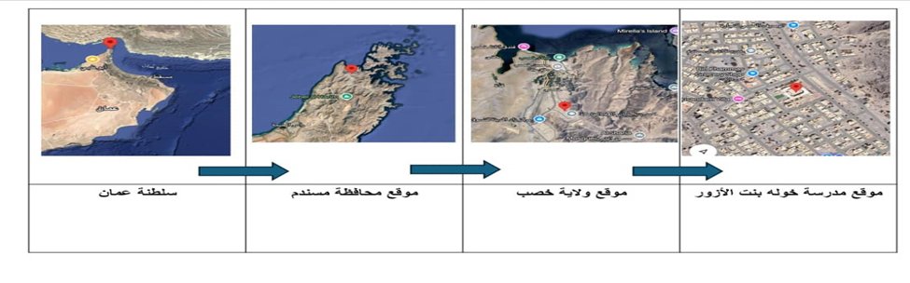
Search location:
Search location: Khawla Bint Al-Azwar School at these coordinates:
The Wilayat of Khasab is characterized by high relative humidity, especially during the summer, in addition to the variation in temperatures between the different seasons. This site was chosen due to its environmental and climatic significance, and its suitability for studying local climate changes and their impact on various climatic elements.
Elevation: 216 m
• Longitude: 56.15133 East
• Latitude: 26.10094 North
• Location ID 103912:
• Source of the location GPS:

Slide 9
Research methods
The research relied on collecting direct field data according to the protocols of the global GLOBE program, using precise measuring tools including: a digital thermometer (for calibration and backup measurements), a hygrometer for humidity, and soil depth measuring tools. Tasks were distributed to the team daily to ensure coverage of the school week (from Sunday to Thursday).
Table No. (1): Measurement Schedule for the GLOBE Team. The table above was updated daily on the official THE GLOBE PROGRAM website (with the timing set to UTC), and the process was documented with screenshots of the entries (such as entering the current temperature on 07-10-2025, and Multi-Day Soil Temperature). The data was also recorded locally in Excel spreadsheets for statistical analysis and comparison with the official data from the weather station in Khasab.

Slide 10
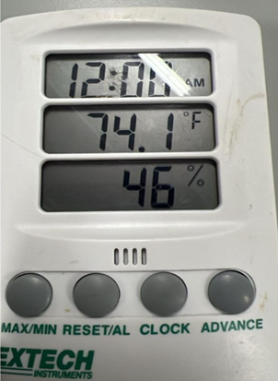

Data collection
Data was collected in this research using two main methods: field data collection and reliance on official data.
Field data collection included measuring air temperature, soil temperature, and relative humidity using a digital thermometer, an alcohol thermometer, and a hygrometer. The readings were recorded periodically according to a specific schedule to ensure the accuracy of the results.
As for the official data, it was obtained from the meteorological station in the Wilayat of Khasab, in addition to the data available thru the open data portal of the Environment Authority and the National Center for Statistics and Information.

Slide 11
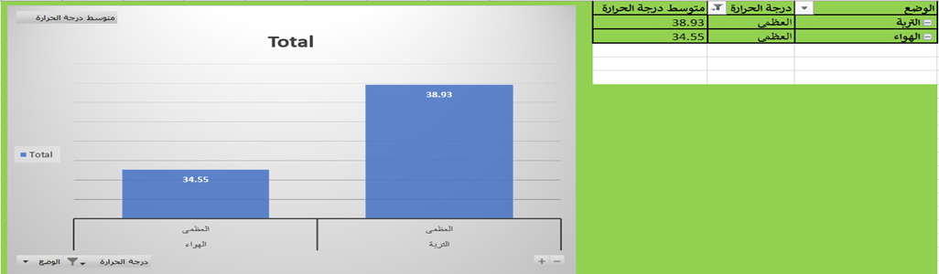
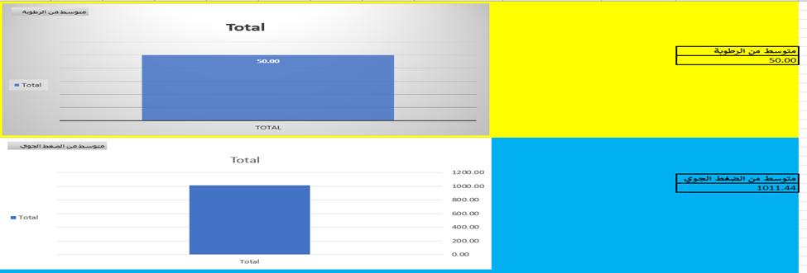
Data analysis:
Microsoft Excel was used to analyze the climatic data collected from the weather station during October 2025. By entering daily measurements and averages of various weather elements such as air and soil temperatures, relative humidity, and atmospheric pressure, tables and bar charts were created to illustrate trends and comparisons between the different elements.

Slide 12
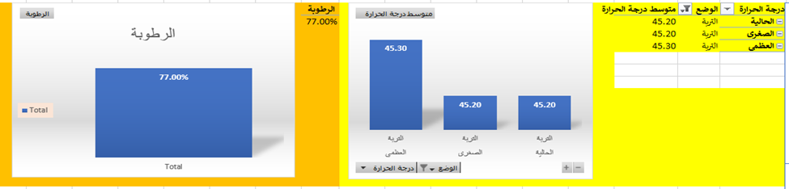
Comparison of meteorological data between Khasab Station and GLOBE Station
The data revealed that there were differences in the temperatures of the air and soil between the two stations. On 2025-10-02, the maximum temperature was 35.9°C at the Khasab station, while it was 37.7°C at the GLOBE station, possibly because of the location of the stations or the time of measurement. The GLOBE station had higher soil temperatures on some days, possibly because of the soil type or its exposure to solar radiation.

Slide 13

Comparison of meteorological data between Khasab Station and GLOBE Station
Atmospheric pressure Atmospheric pressure
Atmospheric pressure data showed a relative convergence between the two stations, with slight differences that could be due to variations in geographic elevation or the precision of the measuring instruments
. General Averages General Averages
The first file contained statistical averages on a separate sheet, such as the average maximum temperature of 34.64°C, which supports the overall trend of the daily recorded data during the study period

Slide 14
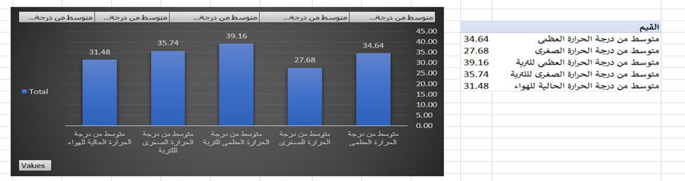
Results:
According to the results, the average maximum air temperature was 34.64°C, the average minimum was 27.68°C, and the average air temperature was 31.48°C. The soil temperatures were relatively high, averaging 39.16°C as the maximum and 35.74°C as the minimum. The average relative humidity was 49.84%, with some instances of high values.

Slide 15
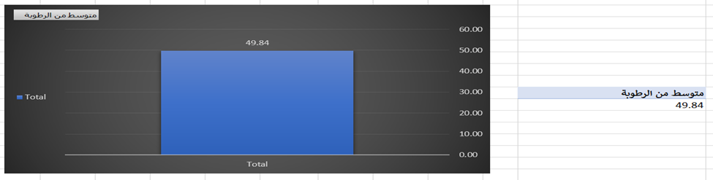
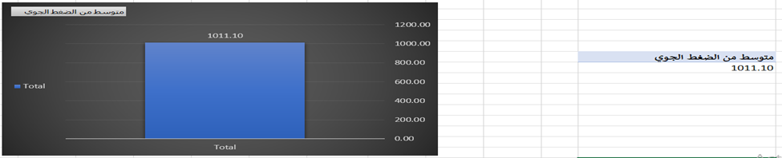
Results:
The atmospheric pressure was stable at 1011 hPa. The data was collected on certain days in October 2025, with some instances omitted. The study was conducted based on student data with the help and guidance of teachers, along with previous studies on climate change and official meteorological data.

Slide 16

Discussion of the results:
The high air temperature of 34.64°C and high soil temperature of 39.16°C in October 2025 indicate that the month was warmer than usual compared to the past. This shows that the region experienced a positive temperature anomaly. The high soil temperature compared to the high air temperature is characteristic of coastal and semi-arid environments. The average relative humidity of 49.84% was lower than the past values.
This indicates that the region experienced dry conditions. However, the high relative humidity recorded at some points in the month contributed to heat discomfort.

Slide 17

Discussion of the results-Cont.
The atmospheric pressure was within the normal range. This indicates that the region experienced favorable weather conditions.
These findings indicate the effects of climate change and the potential dangers that the region faces. Climate change may affect the region’s agricultural activities and water resources.

Slide 18
References
Al-Saqqaf, A. S., Zhang, J., Yao, F., Al-Maamari, A., Hizam, M. H., Hamed, M. M., & Shaheed, S. D. (2024). Spatiotemporal trends and significance of climate extremes in the Sultanate of Oman: A comprehensive assessment using ERA5 reanalysis. Theoretical and Applied Climatology, 155, 10051–10067.
https://doi.org/10.1007/s00704-024-05222-z
https://link.springer.com/article/10.1007/s00704-024-05222-z
National Centre for Statistics and Information (NCSI). (2023). Weather and climate indicators data in the Sultanate of Oman. Sultanate of Oman.
https://data.gov.om/armmvmb/weather
https://www.data.gov.om/
Hussein, M. M., Suleiman, S. S., & Ibrahim, M. (2025). Impact of temperature and humidity changes on wheat growth and productivity in Kom Ombo. Journal of African Research and Nile Basin Countries, 9(2), 124–138.
https://doi.org/10.21608/mbddn.2025.368748.1267
https://journals.ekb.eg/article_428552_0.html
Ejik, O., Ndzi, D., & Shakir, M. Z. (2025). A comparative study of rainfall prediction using machine learning techniques in tropical and temperate climates. Climate, 13(8), Article 167.
https://doi.org/10.3390/cli13080167
https://www.mdpi.com/2225-1154/13/8/167

Slide 19


