Slide 1
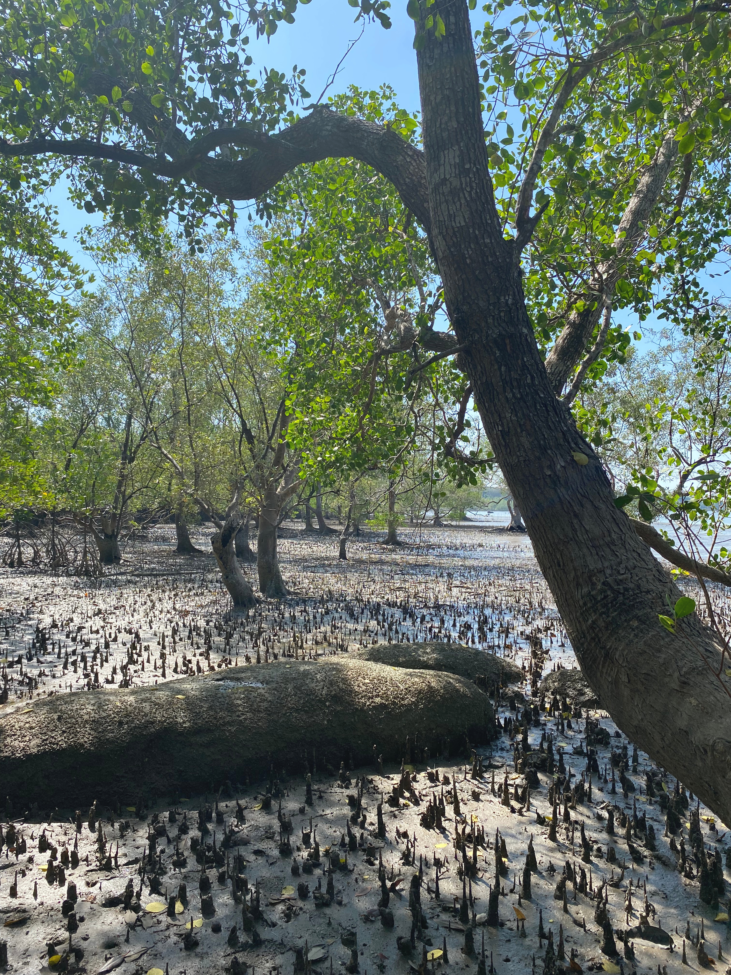


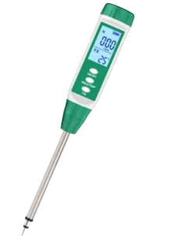
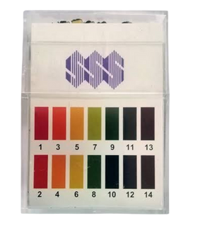
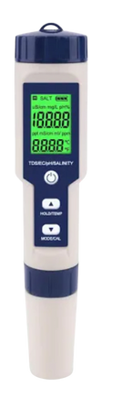
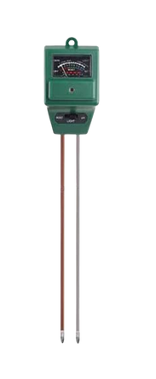
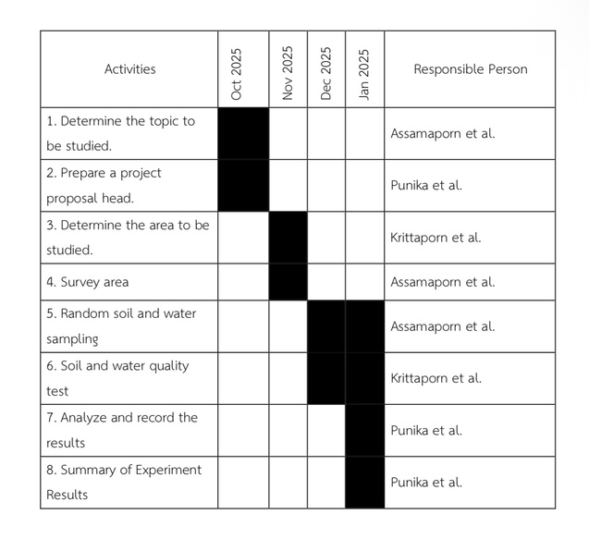
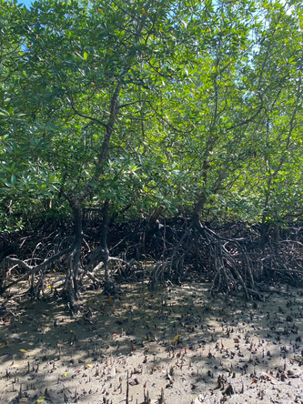
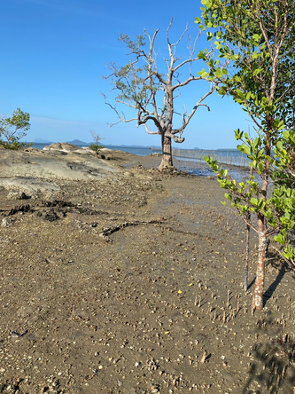
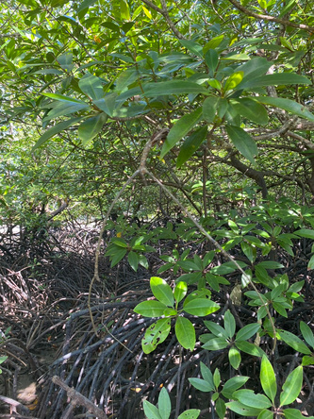
A STUDY OF WATER AND SOIL FACTORS AFFECTING THE DIVERSITY
OF FIDDLER CRABS IN THE HIN HUA CHANG MANGROVE FOREST,
THA KHAM SUBDISTRICT, PALIAN DISTRICT, TRANG PROVINCE
Researcher :
Miss Krittaporn Kaewlamun , Miss Aussamaporn Chumruang , Miss Punika Inchum
Level :
Grade 11
Advisor :
Miss Jiraporn Sirirat , Miss Naeriya Tonkrongchan
School :
Wichienmatu School
Abstract
Material and equipment
Results
This study investigated water and soil factors affecting the diversity of fiddler crabs in the Hin Hua Chang mangrove forest, Tha Kham Subdistrict, Palian District, Trang Province. Water quality was measured at two sites and soil properties at three sites. Five fiddler crab species were identified: Uca perplexa, Uca urvillei, Uca annulipes, Minuca vocator, and Minuca marguerita, with Uca perplexa being the most abundant species across all areas.Water quality measurements showed that the southern mangrove area had an average salinity of 22.1 ppt, temperature of 30.5°C, pH of 6.5, and dissolved oxygen of 6 mg/L, while no water was detected in the rocky area. In the northern mangrove area, the average salinity was 17.7 ppt, temperature 31°C, pH 6.5, and dissolved oxygen 5 mg/L. Soil analysis revealed notable differences in soil salinity (7260–9470 ppm) and fertility, including nitrogen (459.5–632.5 ppm), phosphorus (589.5–746.5 ppm), and potassium
(1351–1640.5 ppm). Other factors such as temperature, pH, and humidity showed minimal variation and no clear effect on fiddler crab populations.In conclusion, five species of fiddler crabs were found in the study area, with soil salinity and fertility identified as the main factors influencing their distribution.
pH test kit
Dissolved oxygen test kit
Water temperature measuring instrument
thermometer
Soil sampling equipment
Soil fertility test kit for determining soil N, P, and K
Distilled water
Moisture meter
Water quality measurements were taken twice in the southern mangrove forest area. The
average salinity was 22.1 ppt, the average water temperature was 30.5°C, the average pH was
6.5, and the average dissolved oxygen was 6 mg/L. No water was found in the rocky area during
the study period. In the northern mangrove forest area, water quality measurements showed an
average salinity of 17.7 ppt, an average water temperature of 31°C, an average pH of 6.5, and an
average dissolved oxygen of 5 mg/L.
From a study of environmental factors and soil properties in areas where fiddler crabs are
found, a total of 2 experiments were conducted. The values obtained were then averaged. It
was found that areas where fiddler crabs are found have soil salinity values ranging from 7260
to 9470 ppm, and soil fertility with N values ranging from 459.5 to 632.5 ppm, P values ranging
from 589.5 to 746.5 ppm, and K values ranging from 1351 to 1640.5 ppm, to be higher than
areas where fiddler crabs are not found. The values for temperature, pH, and humidity showed
only slight differences or no difference at all between areas where fiddler crabs were found and
areas where they were not found.
Expected Outcomes
Research Methods
1. We hope to understand the diversity and distribution of fiddler crabs in the mangrove forest at Hin Hua Chang, Trang Province.
2. We aim to learn how soil properties and water quality, including temperature, salinity, pH, and soil fertility, affect the presence or absence of fiddler crabs.
3. This study will help raise awareness in the local community about the importance of mangrove ecosystems and provide useful scientific information for mangrove conservation and environmental management.
Research Question and Hypothesis
From the survey of the study area, fiddler crabs were found distributed in different habitats. In
the mangrove forest on the southern side, several species of fiddler crabs were found, including
Uca perplexa, Uca urvillei, Uca annulipes, and Minuca marguerita.
While in the rocky areas, only Uca perplexa was found in the mangrove forest on the northern
side, 3 species of fiddler crabs to be found Uca perplexa, Minuca vocator, and Minuca
marguerita. In summary, a total of 5 species of fiddler crabs were found in the study area, with
their distribution correlated with the characteristics of the habitats in each area.
1. Research Preparation Phase
Studying the diversity of fiddler crabs in the
Hin Hua Chang mangrove forest, Tha Kham
Subdistrict, Palian District, Trang Province.
1.1 Research and collection of relevant data
and theories
1.2 Defining the objectives of the study
2. Implementation Phase
1) Plan the research work.
Research Questions
1. Do soil properties, including temperature, moisture, salinity, fertility, and pH, affect the
diversity of fiddler crabs ?
2. Do water properties, including dissolved oxygen, temperature, salinity, and pH, affect the
diversity of fiddler crabs ?
Research hypothesis
1. Soil properties include temperature, humidity, salinity, fertility and different pH values that
affects the variety of different sword claw crabs.
2. Water properties include the amount of oxygen dissolved in water, temperature, salinity and
different pH values that affects the variety of different sword claw crabs.
Conclusion
Optional Badges
This study investigated the diversity of fiddler crabs in the Hin Hua Chang mangrove forest, Tha
Kham Subdistrict, Palian District, Trang Province. Water quality data was collected from 3 points
and soil characteristics from 6 points. Five species of fiddler crabs were found: Uca perplexa,
Uca urvillei, Uca annulipes, Minuca vocator, and Minuca marguerita. Uca perplexa was found
throughout the area, demonstrating its adaptability to diverse environments, while the other
species were found only in areas with suitable environmental conditions. Water quality
measurements showed salinity ranging from 17.7–25.0 ppt, water temperature from 29–32°C, pH
approximately 6–6.5, and dissolved oxygen ranging from 4.5–6 mg/L, all within suitable ranges
for the survival of benthic marine animals. This indicates that the study area can support several
species of fiddler crabs. Environmental factors and soil properties in the fiddler crab-infested
areas revealed that the soil structure was predominantly sandy loam and sandy loam. Two
experiments were conducted and the values obtained were averaged. It was found the areas
where fiddler crabs were found differed significantly in two factors: soil salinity, ranging from
7260 to 9470 ppm, and soil fertility, with N values ranging from 459.5 to 632.5 ppm, P values
ranging from 589.5 to 746.5 ppm and K values ranging from 1351 to 1640.5 ppm. Temperature,
pH, and humidity showed only minor or no differences, and therefore did not significantly affect
the presence of fiddler crabs.In conclusion, five species of fiddler crabs were found in the studied
area and the factors affecting their habitat primarily depend on soil salinity and fertility.
1. I am an Earth System Scientist
This project aligns with the I am an Earth System Scientist badge because it clearly demonstrates the interconnectedness of Earth’s systems. The research investigates how water and soil factors influence the diversity of fiddler crabs in a mangrove ecosystem, linking the hydrosphere, pedosphere, and biosphere. Multiple GLOBE protocols were applied to collect and analyze environmental data. Through analysis and interpretation, the research team explained the dynamic relationships between abiotic factors and living organisms, showing how changes in one Earth system affect others. This project reflects a comprehensive understanding of Earth system science and its interconnected processes.
2. I am a Problem Solver
This project is aligned with the I am a Problem Solver badge because it investigates how water and soil factors affect the diversity of fiddler crabs in a mangrove ecosystem. By studying environmental parameters such as water quality and soil characteristics, the researchers gained a deeper understanding of how environmental conditions influence living organisms. The results of this study can be used to support ecosystem conservation and sustainable management of mangrove areas. This project demonstrates how Earth system science can be applied to identify environmental problems and contribute to possible solutions for protecting biodiversity.
3.I am a Collaborator
Our team operates efficiently by clearly defining roles and responsibilities. Each member
performs their duties to the best of their abilities and provides mutual support
throughout the working process. Additionally, our team values listening to feedback and
exchanging ideas, promoting unity, and encouraging each other.
When faced with obstacles, the team collaborates effectively to resolve them, ensuring
that the work is completed successfully and on target. This experience has been crucial
in developing our teamwork skills and strengthening our ability to collaborate with
others in the future
Introduction
Mangrove forests are vital coastal ecosystems that support biodiversity by providing habitats, food sources, and nursery grounds for numerous organisms. They also play an important role in preventing coastal erosion,filtering pollutants, improving water quality, and maintaining ecological balance. Among the organisms inhabiting mangrove ecosystems, fiddler crabs (Genus Uca) are important benthic animals that contribute to nutrient cycling, sediment aeration, and soil structure through their burrowing activities, making them useful indicators of mangrove ecosystem health.The Hin Hua Chang mangrove forest, located in Tha Kham Subdistrict, Palian District, Trang Province, is characterized by diverse environmental conditions, including variations in soil texture, moisture content, waterlogging, and salinity levels. These environmental differences influence the distribution, density, and survival of fiddler crabs, as they require suitable soil conditions for burrowing and appropriate water quality for daily activities and survival. Therefore, studying the relationship between fiddler crab diversity and environmental factors such as soil characteristics and water quality is essential for understanding habitat suitability within the mangrove forest. This study aims to investigate the diversity and distribution of fiddler crabs in the Hin Hua Chang mangrove forest and to analyze soil properties and water quality in the study area. The results will contribute to assessing mangrove ecosystem health and provide baseline information for sustainable management and conservation of coastal natural resources.
2) Conduct a survey of the area to be used for research.
References
Kittima Pahurat, Nittaya Lauhachinda, Chokchai Senawong, and Thiamjai Tulayathorn (1983).
A study of some behavioral and biological aspects of two species of fiddler crabs.
From https://kukr.lib.ku.ac.th/kukr_es/index.php?/BKN/search_detail/result/3253
Jamlong To-on (1999). Large benthic marine animals and the distribution of fiddler crabs.
From https://shorturl.asia/17PSB
Phusdee Sukpibul, Samakkee Bunyawatt and Naruchit Dampin (2015). Soil properties affecting
the increase of mangrove forest area.
From https://www.thaiscience.info/Journals/Article/NUST/10973207.pdf
The Institute for the Promotion of Teaching Science and Technology (IPST), GLOBE Project
(Temporary Office), from https://globefamily.ipst.ac.th/globe-protocols/biosphere
3) Measure water and soil quality using the GLOBE method, including soil structure,
temperature, moisture, salinity, fertility, and soil pH. Also, measure dissolved oxygen,
temperature, salinity, and pH of the water as follows

