Slide 1
Maison Bint Ahmed School for Basic Education (5-12) Research title: Parthenium effect on soil properties & its impact on environmental & climatic changes in Dhofar
Preparing by the students:
Aya Said Al-mashni Nojood Said Al-mashni
Supervisors:
Asma Zaitoun & Fatima Al-Mashikhi
(2022 - 2021)

Slide 2
Abstract:
Many countries of the world suffer from the problem of invasive plants, which are harmful and poisonous, ravaging and controlling ecosystems, thus causing a massive loss of biodiversity and exacerbate environmental and climatic problems, and negatively affect health and the economy.
There are many types of these plants, including the parthenium, which infiltrated Dhofar Governorate, and spread rapidly during the past ten years, despite governmental and civil efforts to extract the plant from its roots, the local plants did not grow again in the affected areas.
This field study aims to know the impact of the parthenium on soil properties and how its spread contributes to environmental and climatic changes, and these properties include: surface temperature and at different soil depths, conductivity, salinity, acidity, and moisture.

Slide 3
Abstract:
A time plan was set for the implementation of the study, by choosing the study site, which is Jebel Shihit, two adjacent sites were selected, one infested with Parthenium and the other not infested, and the measurements were repeated at each site three times, and then the results and data were collected and discussed within the team.
After applying the protocols and comparing the results between the two sites, the team found that some properties of the soil in the infested area differ significantly from the non-infested area, the results showed a decrease in salinity, conductivity and humidity and an increase in soil acidity within the infested area, as well as the difference in the appearance of the soil and the extent of its cohesion between the two areas. The results showed that the soil change prevented the native plants from growing again, which led to an increase in the temperature in the infested site and thus contributing to climate change in the area.

Slide 4
Research questions:
1- What is the effect of the parthenium plant on soil properties?
2- What are the effects of the parthenium plant on environmental and climate change?

Slide 5
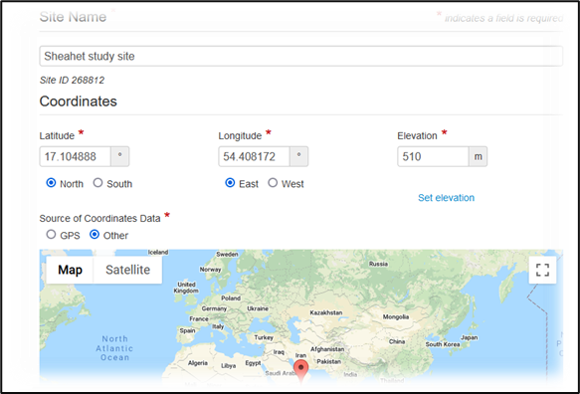
Search methods:
1) A study plan has been developed to organize work, fill gaps and redress potential errors.
2) the study site:

Slide 6
Search methods:
3) Data collection and analysis:
After selecting the site affected by the parthenium plant, the Globe team visited the site and collected samples, with three samples from a parthenium infested place, and another site about 200 meters away from the first site, and not infested with the plant. The team collected 3 samples from each site to ensure greater accuracy of the results The measurements and protocols used were:
Surface temperature using an infrared thermometer.
The temperature inside the soil at a depth of 5 cm and 10 cm using a soil thermometer.
Soil moisture by weighing it accurately and then drying it in a thermal oven and calculating the percentage of water in it.
Soil pH, soil salinity, soil conductivity, by making a soil extract by adding water and then measuring it with a pH and conductivity device.

Slide 7
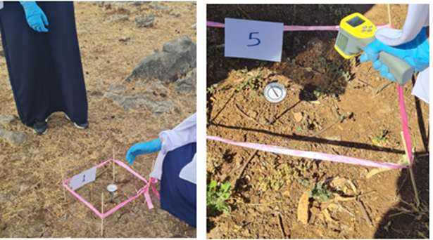
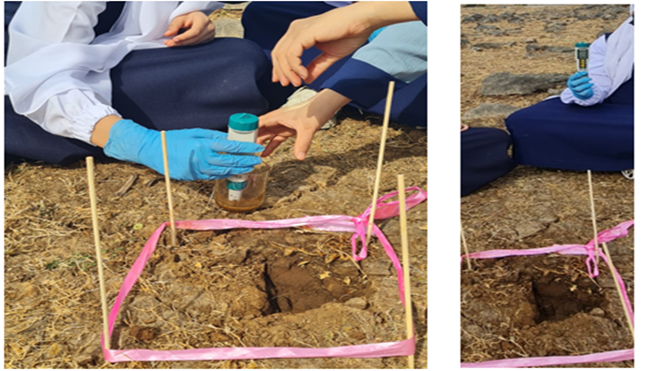
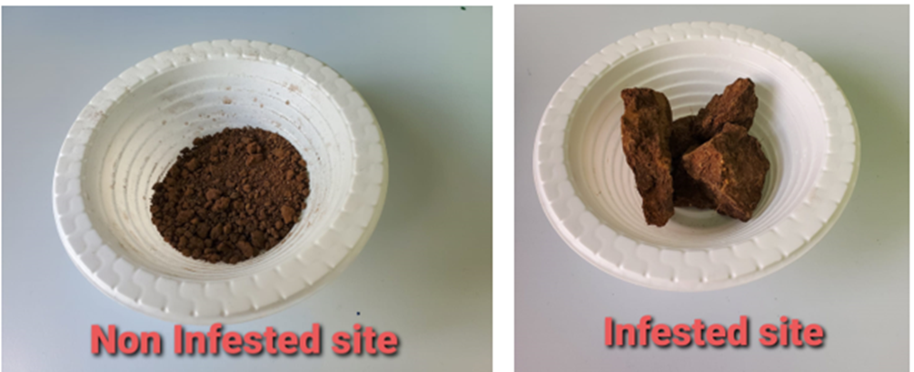
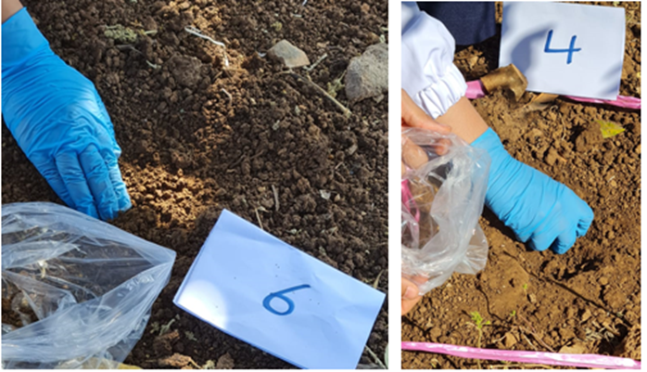

Slide 8
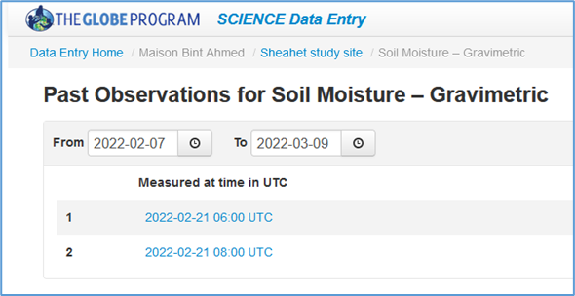
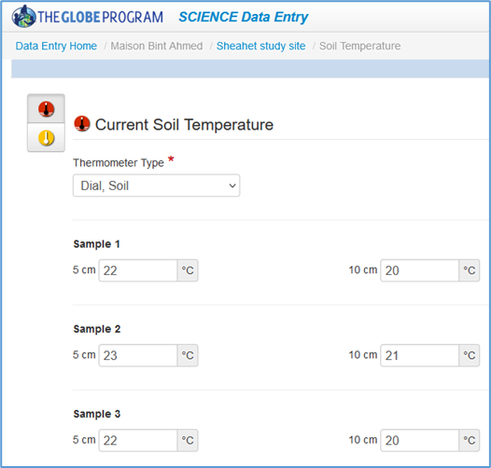
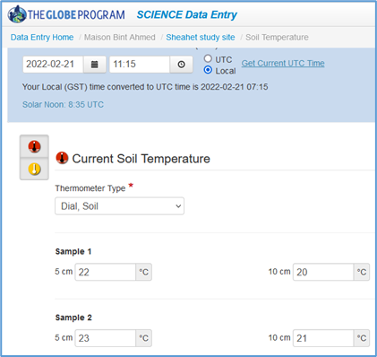
Data entry to the GLOBE website:

Slide 9
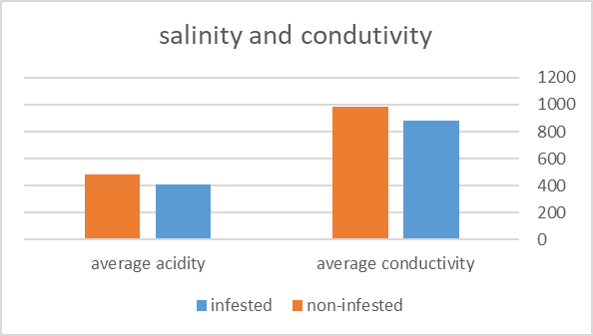
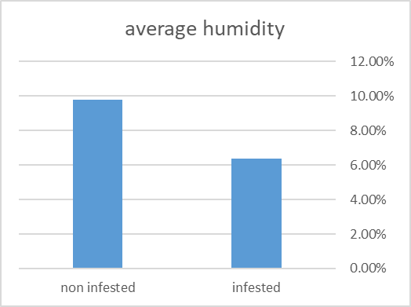
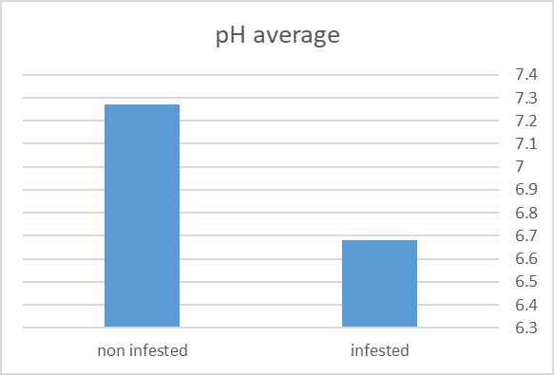
Results:
higher in the infested area | temperature
Less in infested area (acid soil) | pH
Less in the infested area | Humidity
Less in the infested area | conductivity
Less in the infested area | salinity

Slide 10
Recommendations and Suggestions:
After the team’s work was completed, a brainstorming session was held to discuss the next step, what should we do with these results, and the answer was to go to the responsible government agencies such as municipalities, to submit proposals and get rid of the effects of the plant, even removing the plant from its roots is not enough, the soil must also return to its previous nature, by:
1- Breaking up the soil by plowing the land, for example.
2- Restore the chemical composition of the soil to its previous nature by adding fertilizers or other materials.
3- Cultivation of infested areas after treatment. Government and civil efforts can be combined, and even tourists who visit the governorate, by spreading good seeds while touring in mountainous areas.
As for proposals to develop research, it is possible to repeat the work and add other soil tests, and this can be achieved by cooperating with research institutions, universities, or municipalities to obtain more accurate tools, equipment, and results.
Of course, it is possible to re-search over a larger area of the governorate and by choosing multiple locations for work.

Slide 11
A page has also been created on social networking sites to publicize this problem, suggested solutions, and recommendations to eliminate it. Please visit us!
https://instagram.com/2no_ay?utm_medium=copy_link

Slide 12
References:
1-Rizwana Aleem Qureshi, Syed Aneel Gilani , Muhammad Asad Ghufran and Kishwar Nazir Sultana ,(2006). Effects of Parthenium hysterophorus L. on Soil Characteristics Initially Inhabited to Cannabis sativa L.. Pakistan Journal of Biological Sciences.
2- Tafese Bezuneh, T., (2015). Phytochemistry and Antimicrobial Activity of Parthenium hysterophorus L.: A Review. Science Journal of Analytical Chemistry.
3-Ansong, M. and Pickering, C., (2013). Are Weeds Hitchhiking a Ride on Your Car? A Systematic Review of Seed Dispersal on Cars. PLoS ONE.
4- GLOBE Technical Office, (2012), Soil Protocol Note for the GLOBE Teacher Training Program.

