Slide 1
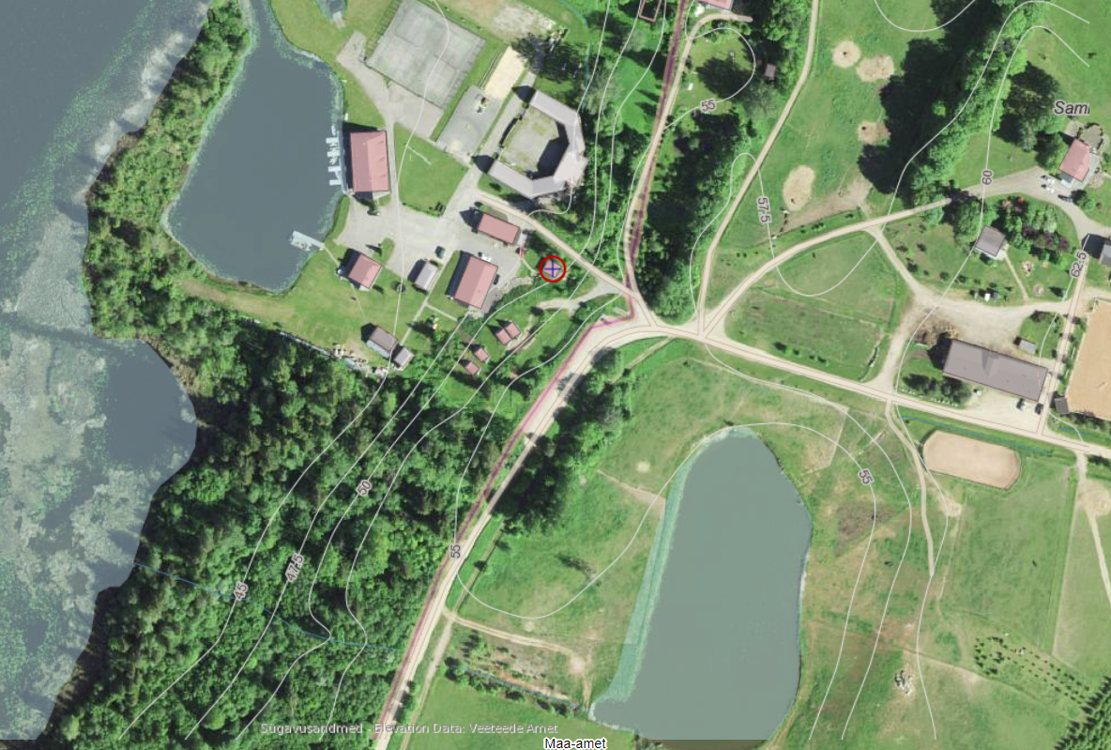
Soil
Sebrad
Viljandimaa
Sammuli
10.-13. August

Slide 2
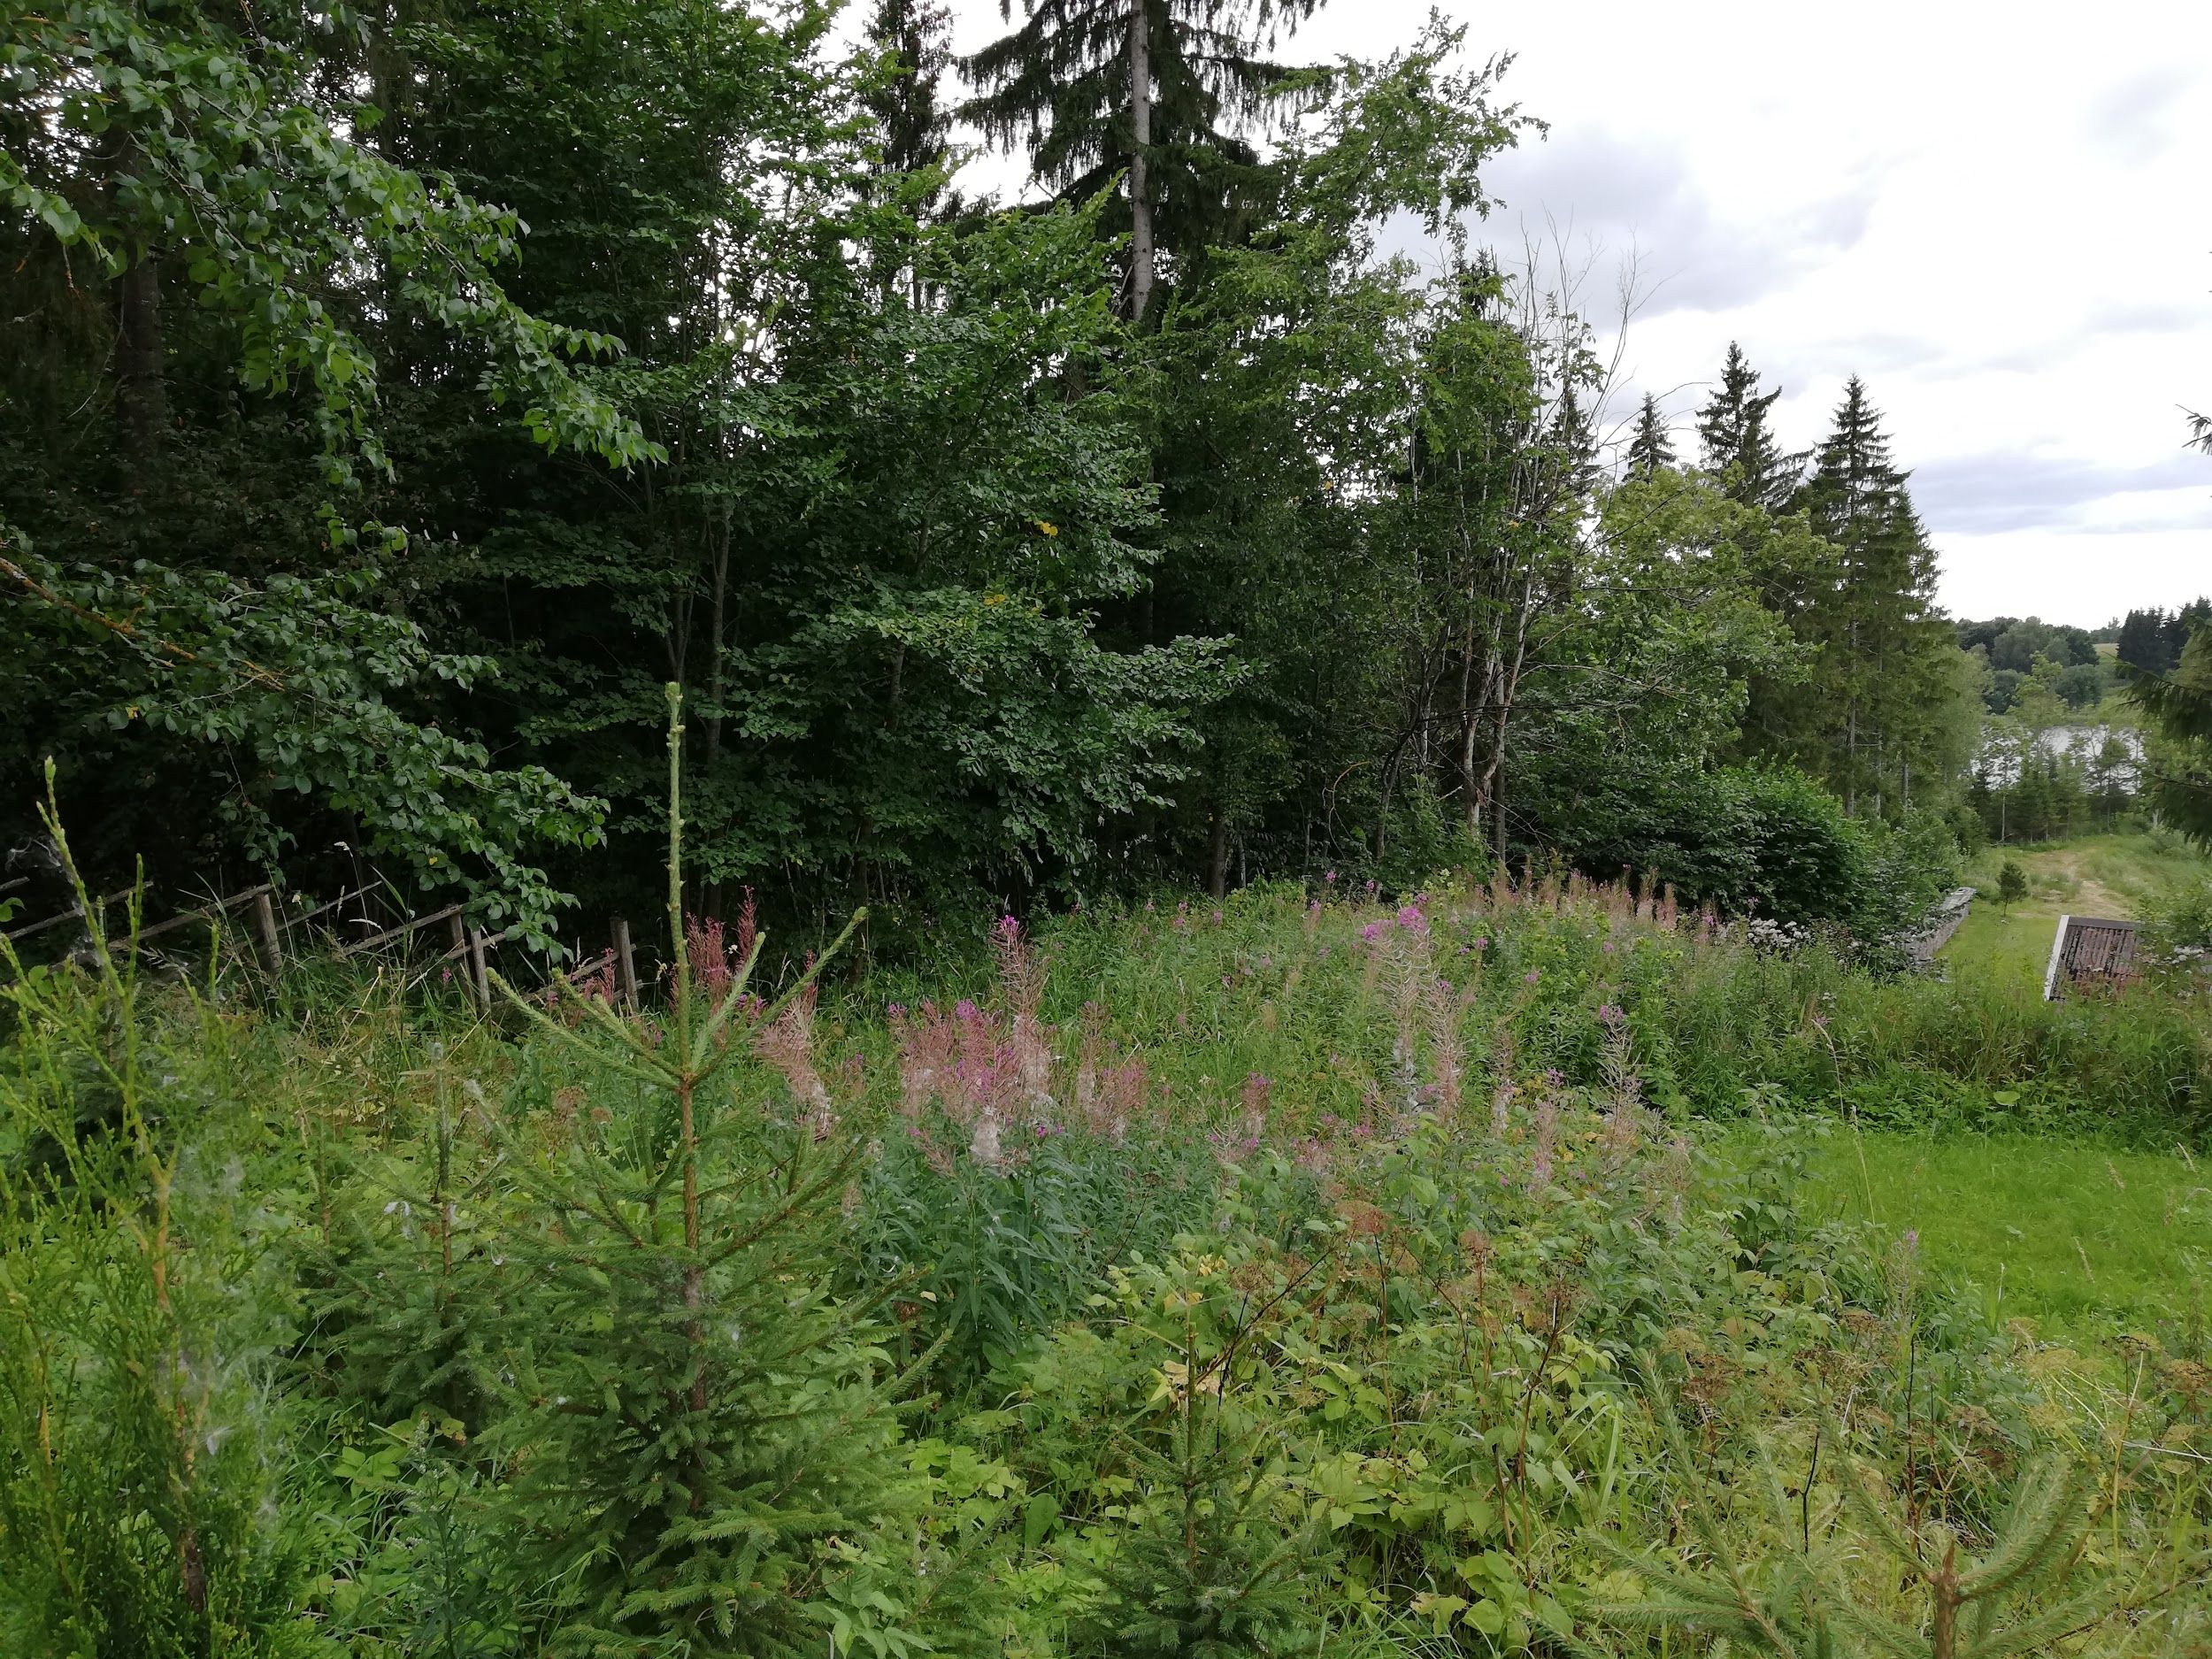
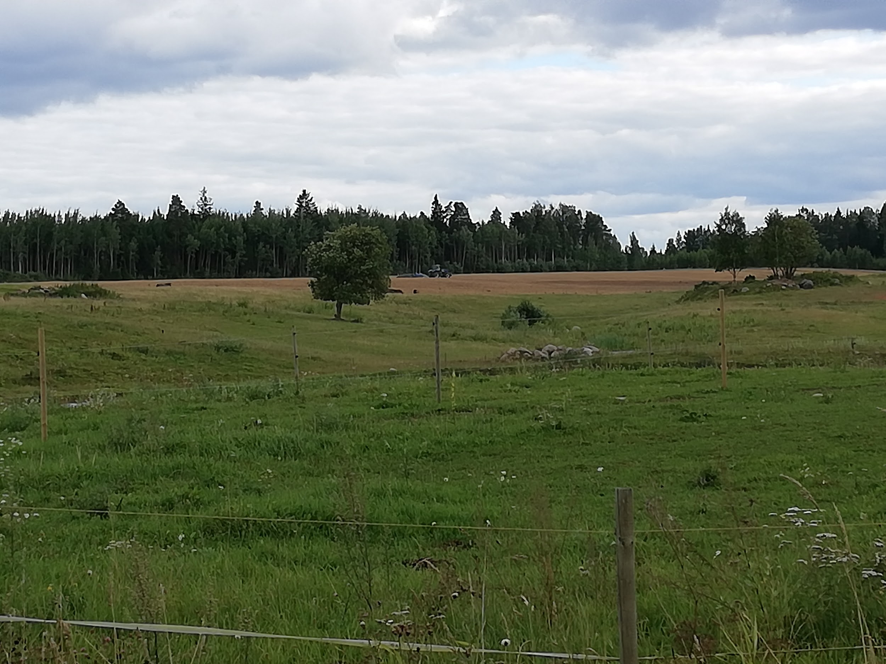
Introduction
Estonian this year´s soil is eroded soil, we saw that in the neighborhood.
The camp is located in the primal valley of Viljandi.

Slide 3
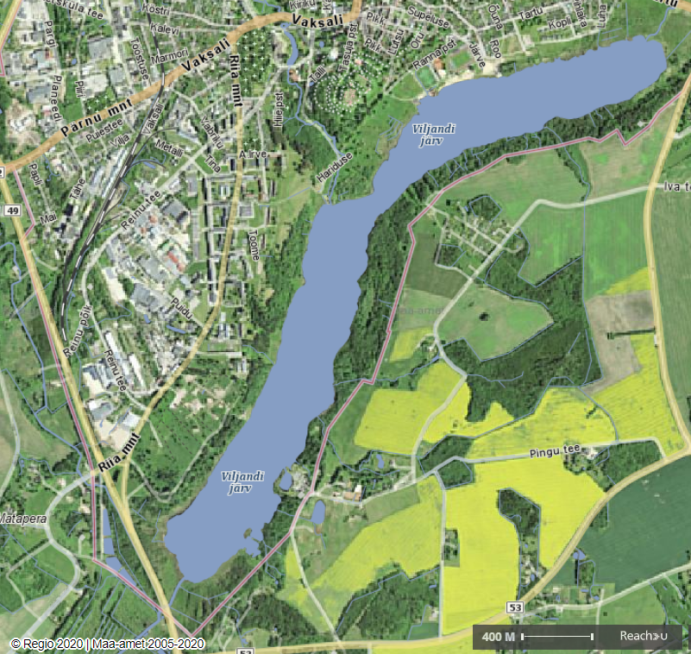
Lake Viljandi
The largest width of Lake Viljandi is 450 m. The length of the lake is 4 km. Maximum depth at 11m
Viljandi Lake is a valley lake with glacial formation
Lake Viljandi formed continental ice erosion
The water level of the lake is 43m above sea level
Investigation area

Slide 4
Research questions and hypothesis
Research question:
How does the location on the slope of the primal valley affect the soil erosion?
Hypothesis:
Slope has thinner layer of soil then the valley upper side.
Slopes upper side has less horizons then the bottom of the valley.
Vegetation reduces erosion.

Slide 5
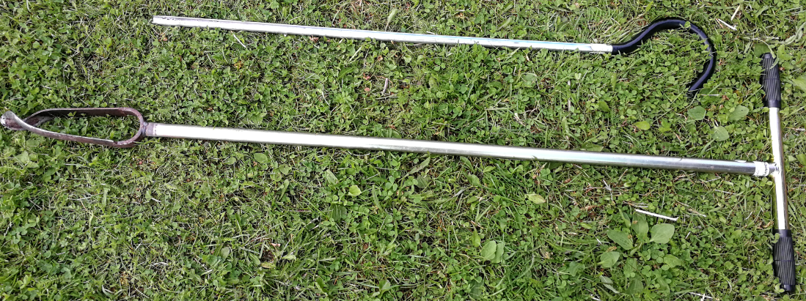
Required materials
70 cm
20 cm
● Shovels
● Measure tape
● Soil drill
● Cups for soil
● pH-meter
● Thermometers
● Soil colour book
● MUC Field Guide
● Phone microscope
● Clinometer
● Worksheets
● Camera
● Compass
● Sprayer
● Computers
● Water and distilled water
● Vinegar
● LabQuest

Slide 6
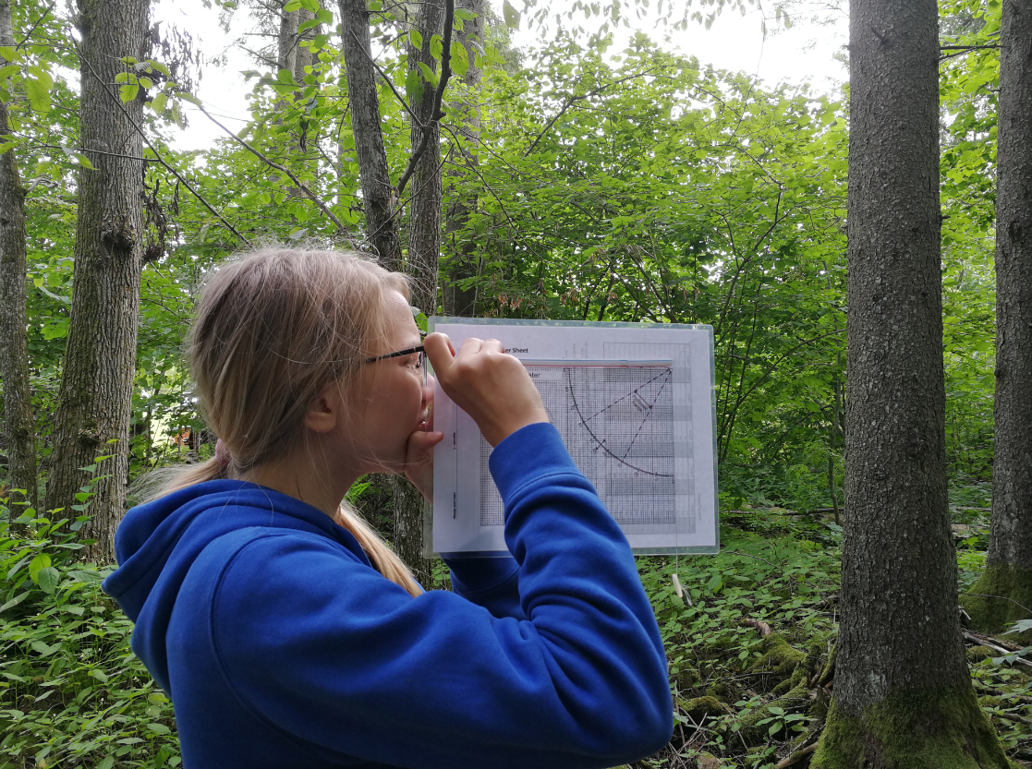
Methods
🠶Soil excavations (2)
🠶Auger holes (6)
🠶Description of the soil profile
🠶Measurements of soil temperature
🠶Soil analysis:
🠶Soil texture and structure
🠶Soil pH
🠶Soil colours
🠶Carbonates in the soil
🠶Measurements of altitudes

Slide 7
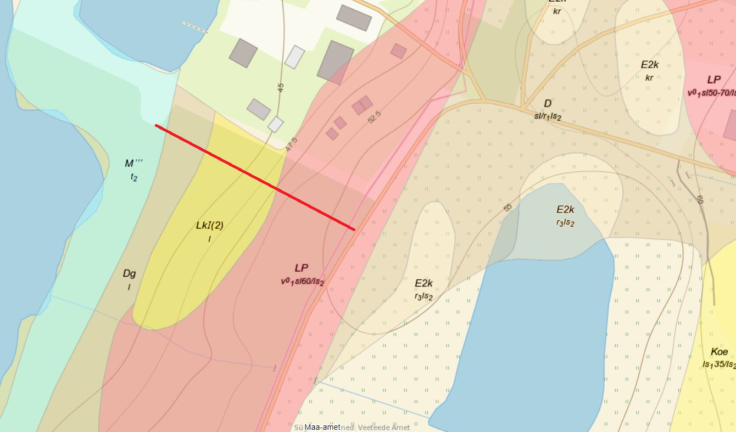
Investigation sites on 100 m line
0
100

Slide 8
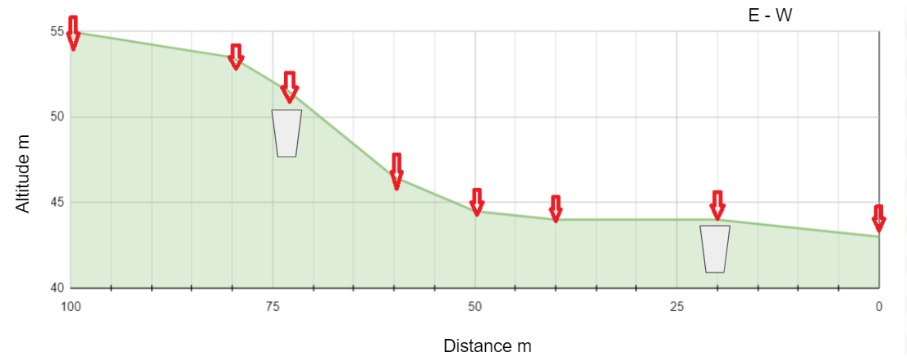
Profile of investigation area
Caves Auger holes

Slide 9
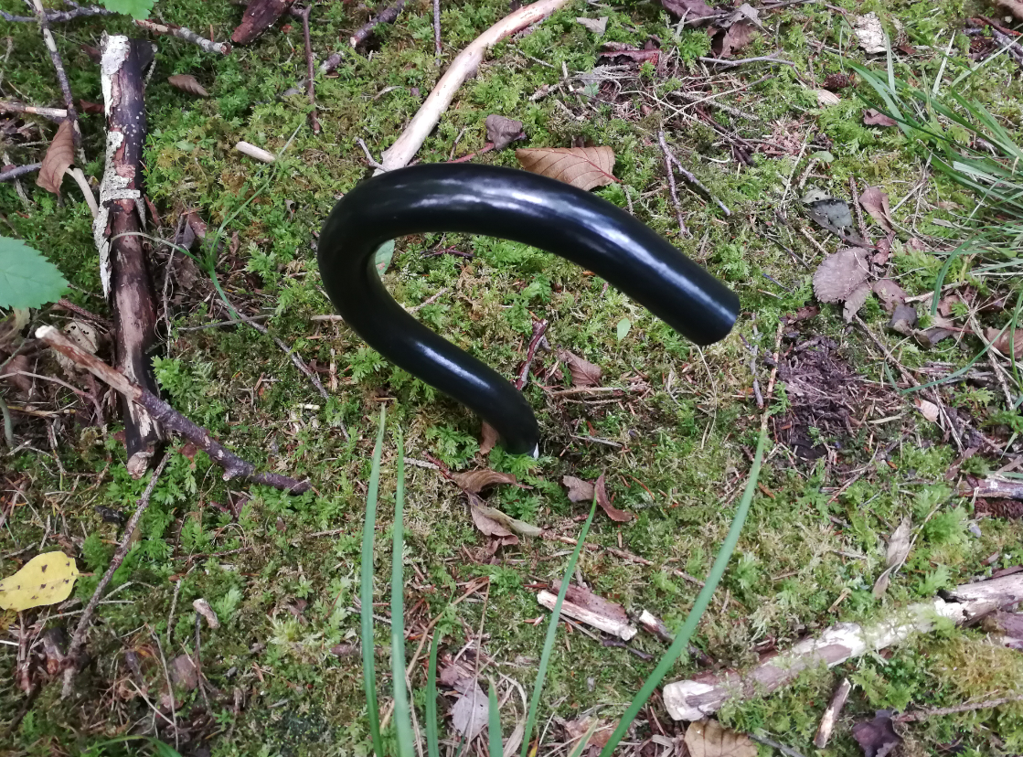
Auger hole
This was at 0 meters.
There is a 70 cm layer of Eutric Histol (lowland peat).
Altitude: 43 m.

Slide 10
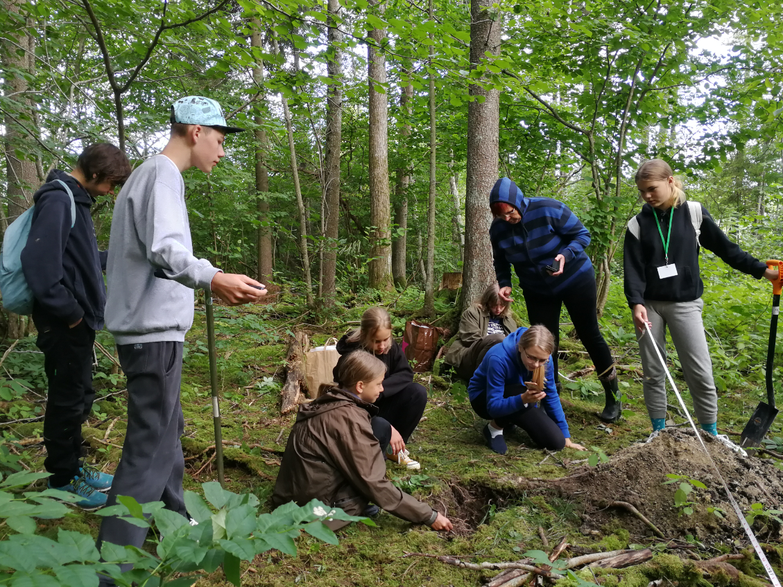
MUC 1221

Slide 11
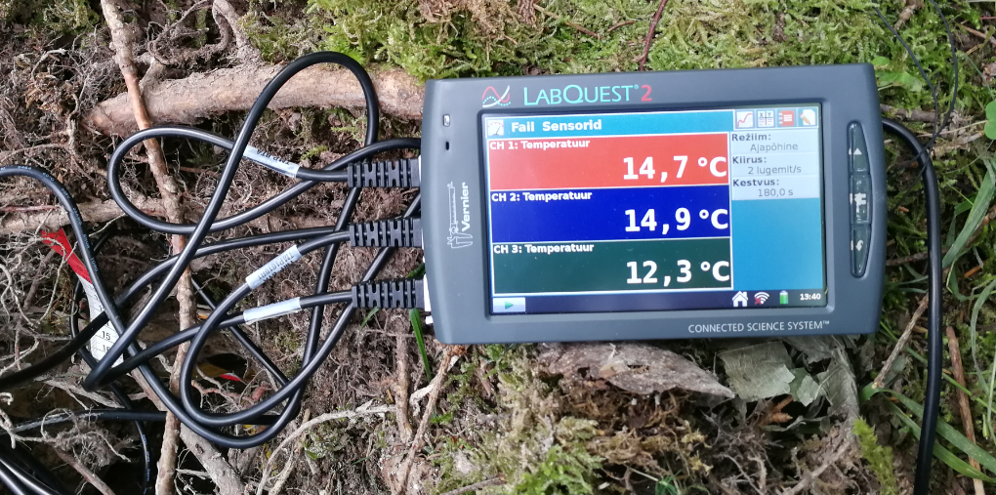
Layers temperature
5 cm
10 cm
100 cm

Slide 12
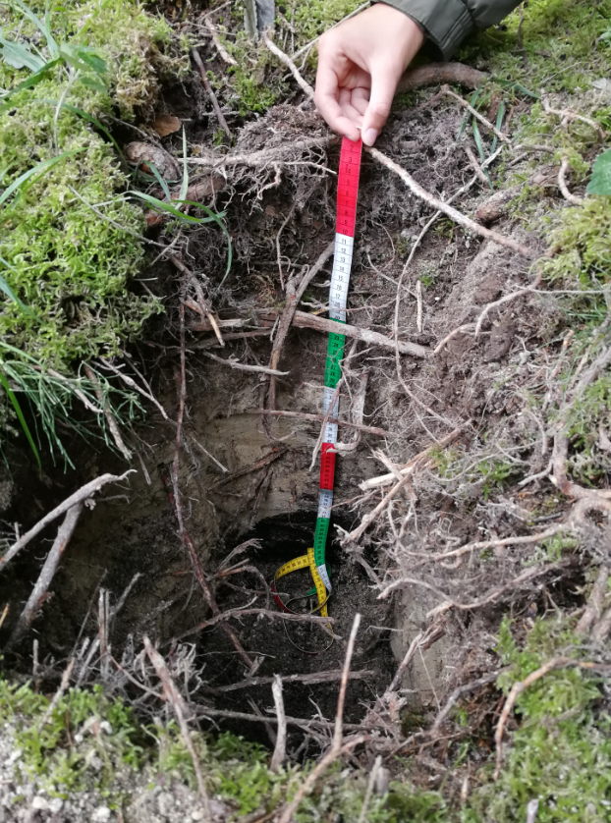
2. Soil excavation
This was at 20 meters.
Horizons: Decay, Humus, Lakelime, Peat
Layer thickness (cm): 3 - 19 - 43 - 28+
Rocks: none
Roots: many
Texture of humus: sandy-loam
Structure of humus: granular
Carbonates in 3rd horizon (lakelime)

Slide 13
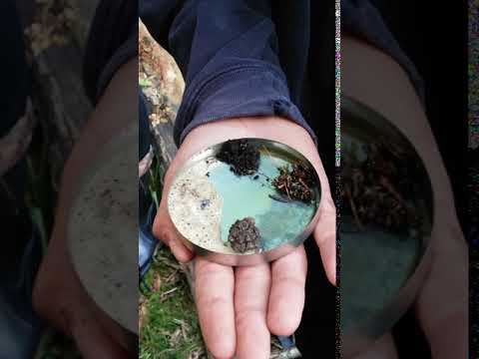
Determination of carbonates with vinegar

Slide 14
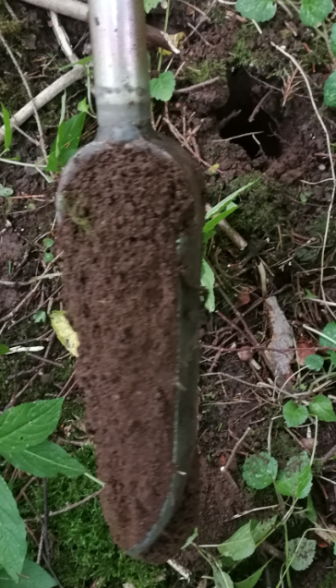
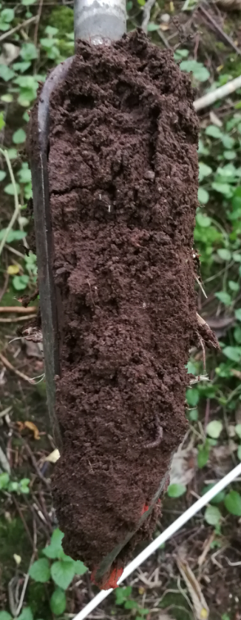
3. Auger hole
0-20cm
This was at 40 meters.
There was a 40 cm layer of humus.
We could not go any further because there was too many rocks.
20-40cm

Slide 15
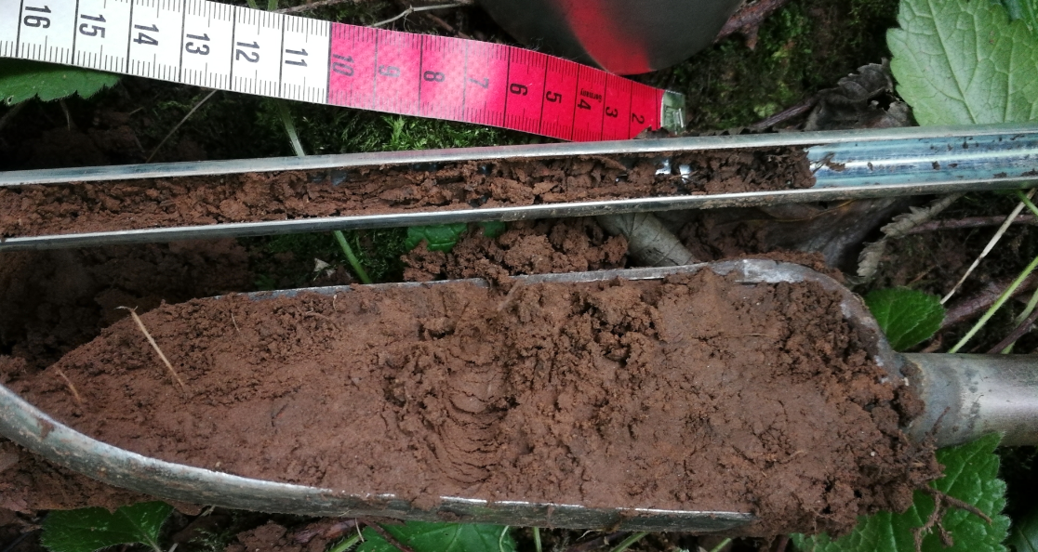
4. Auger hole
This was at 50 meters.
There was a 10 cm layer of humus.
It was a little bit redish.
It went smoothly lighter.

Slide 16
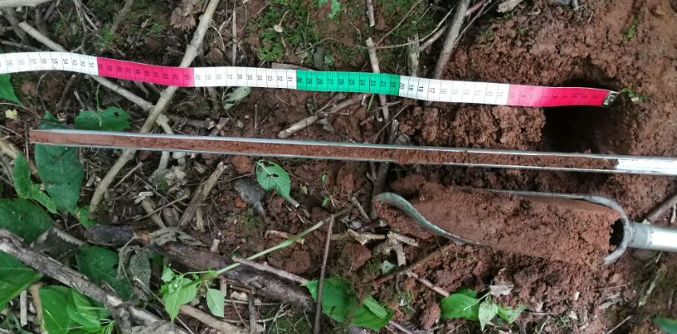
5. Auger hole
This was at 60 meters.
There was no humus.
Red horizon (B ?)

Slide 17
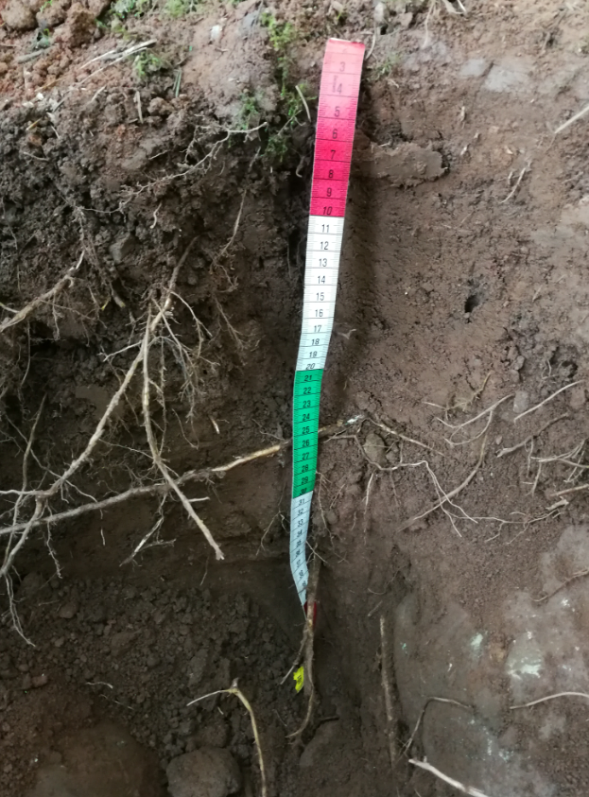
6. Soil excavation
This was at 73 meters.
There was a 7 cm layer of humus.
You can`t really see but the soil was actually pretty red.
Rocks: There was very many big rocks.
The first layer had 7 cm of humus.
The second layer had 38 cm of subsoil.
The third layer had 37+ cm C-horizon.
Roots: many

Slide 18
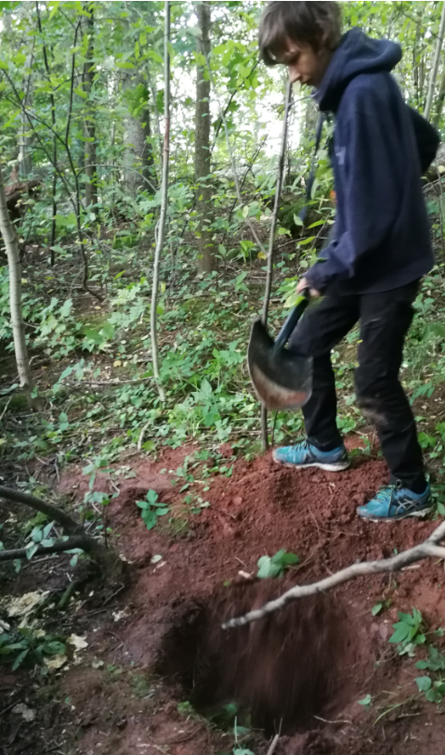
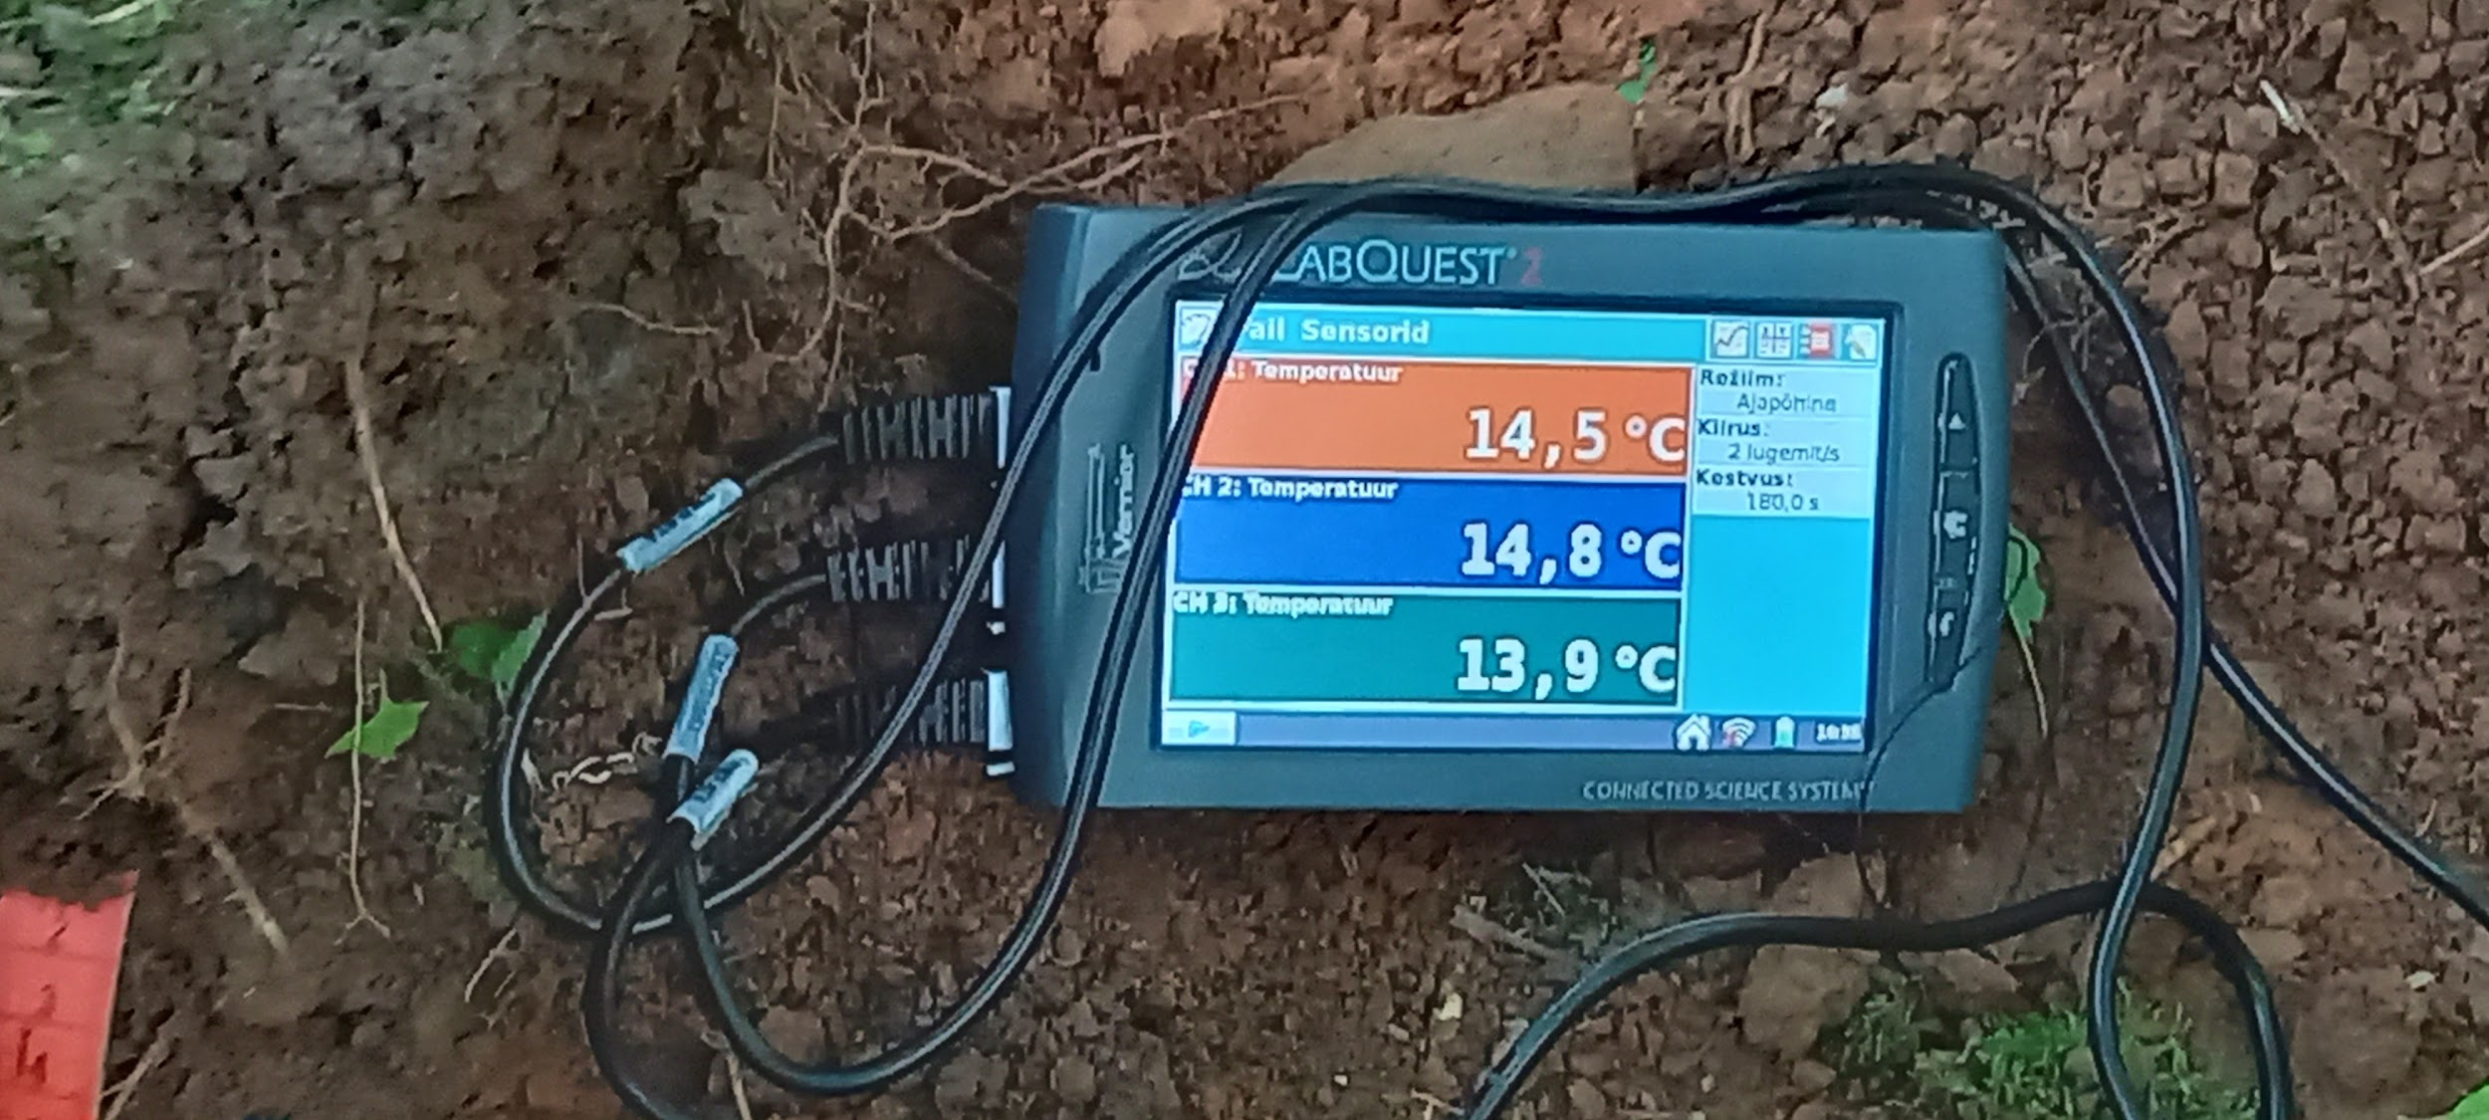
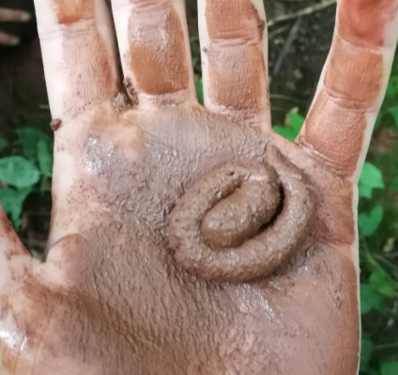
Temperature measuring
new MUC 1222
clayloam
soil texture

Slide 19
7. Auger hole
This was at 80 meters.
There was a 10 cm layer of humus.
It went from dark humus to light humus.
There was no redness.

Slide 20
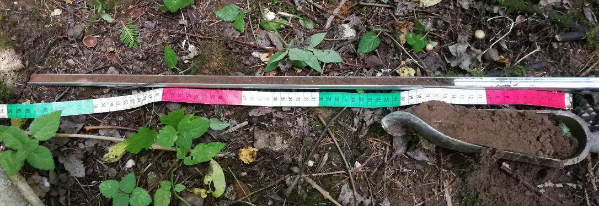
8. Auger hole
This was at 100 meters.
There was a 35 cm layer of humus.

Slide 21
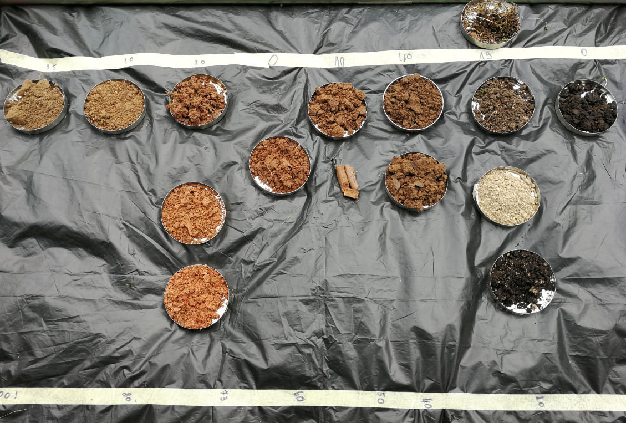
Conclusions
thickness of humus horizon
end
start

Slide 22
Conclusions
The research question was: How does the location on the slope of the primal valley affect the soil erosion?
The slope has a thinner layer of soil.
Hypothesis:
´´Slope has thinner layer of soil then the valley upper side.,, Is true.
´´Slopes upper side has less horizons than the bottom of the valley.,, Is partially true.
´´Vegetation reduces erosion.,, Is not true.

Slide 23
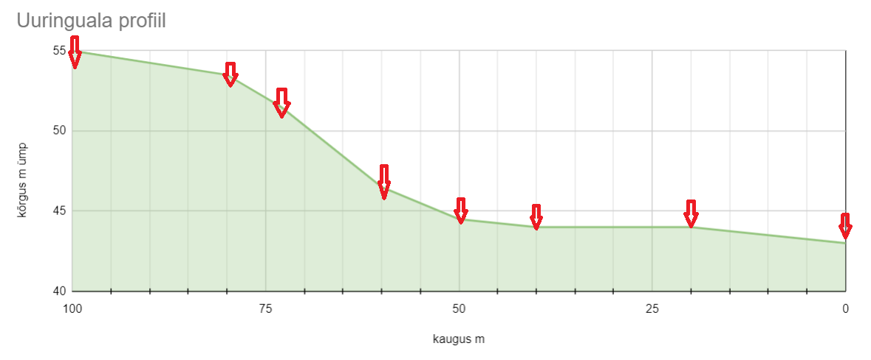
Effect of ground slope on erosion
Profile of investigation area
E - W
Altitude m
Distance m
35 10 7 0 10 40 19 0
Humus horizon thickness cm

Slide 24
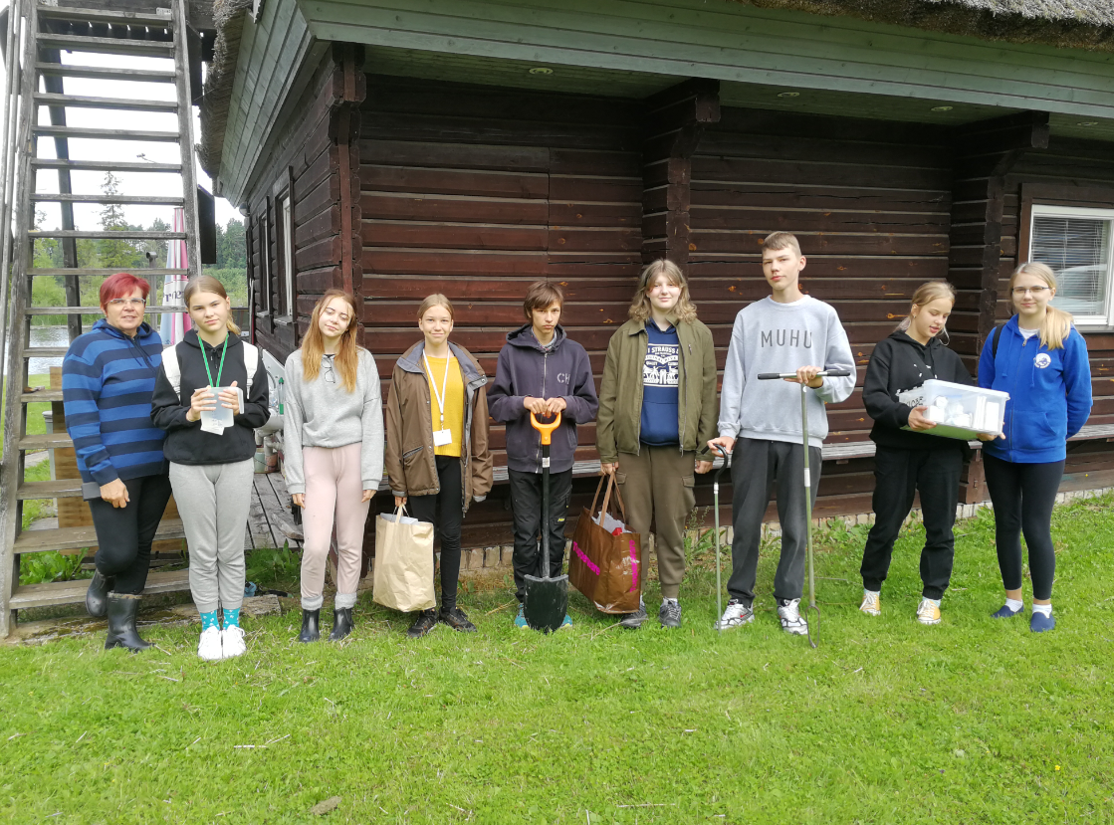
Authors
Berta Varik Tuuli Hommik
Liisa Loreena Värton teacher: Ülle Anier
Kristel-Elis Siidra instructor: Vaike Rootsmaa
Eliise Juur
Roosi Pehlak
Henry Härm
Lauri Pehlak

Slide 25
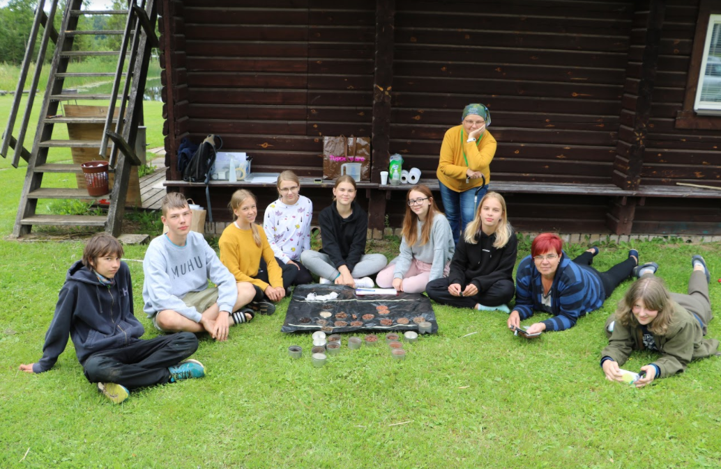
Thank you for listening!

