Slide 1
Welcome to the 2024 IVSS Judging Webinar

Slide 2
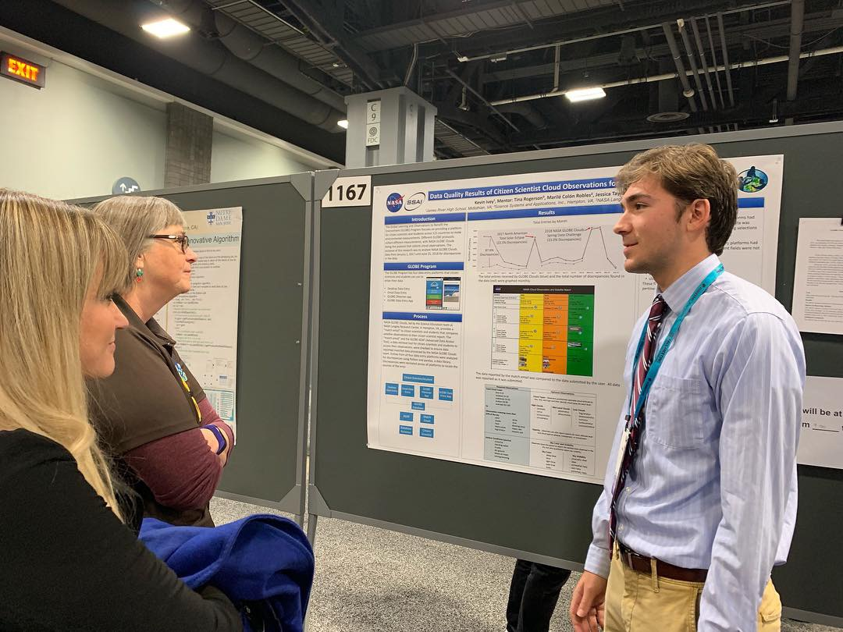
International Virtual Science Symposium (IVSS) Summary
The IVSS provides an opportunity for primary through undergraduate students from all GLOBE countries to showcase their GLOBE research projects. By participating in the IVSS, students have the opportunity to receive valuable feedback from STEM professionals, earn virtual badges, and engage in the scientific process.
Projects include:
Research Report
Presentation
Optional badges

Slide 3
2024 IVSS Theme
“Climate Investigations:
Understanding Earth as a System”
This theme has connections to GLOBE’s “Year of Climate and Carbon Campaign” and encourages students to explore how they can be part of possible solutions to the environmental problems they are investigating.

Slide 4
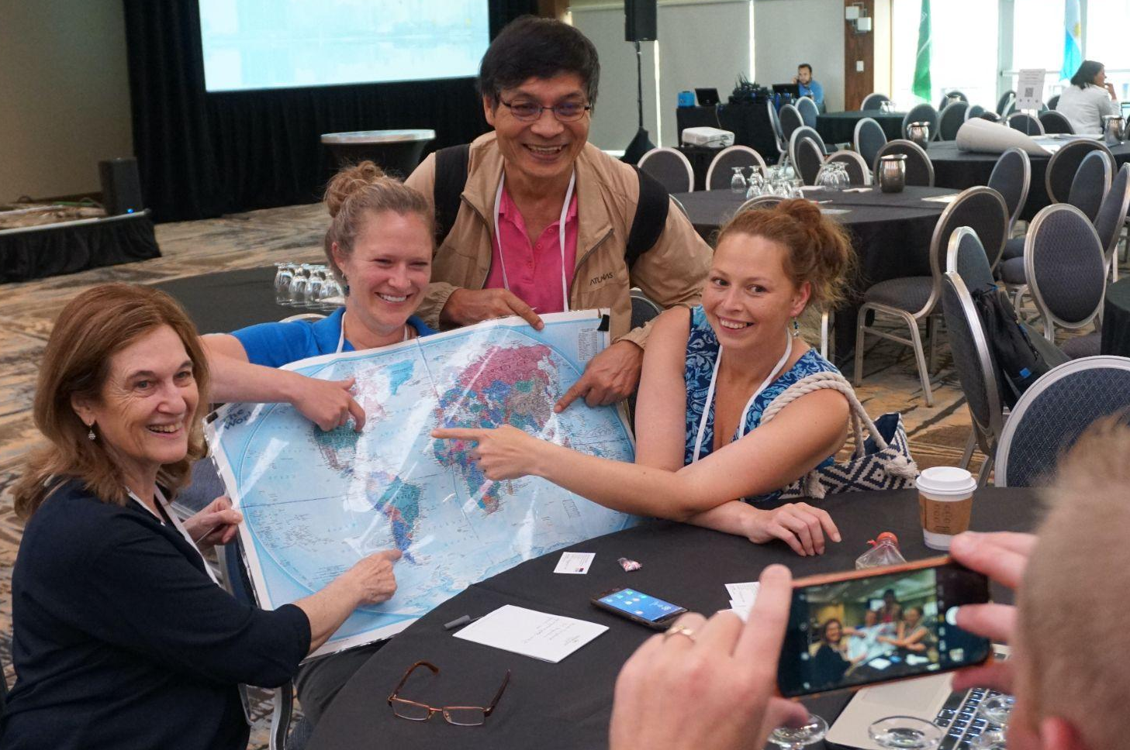
IVSS Volunteer Judges
We rely on scientists, teachers, and community members from all over the world who volunteer their time to judge student research projects.
We aim to have at least 3 judges per student project.
Volunteer judges are instrumental to the success of the IVSS - Thank you!

Slide 5
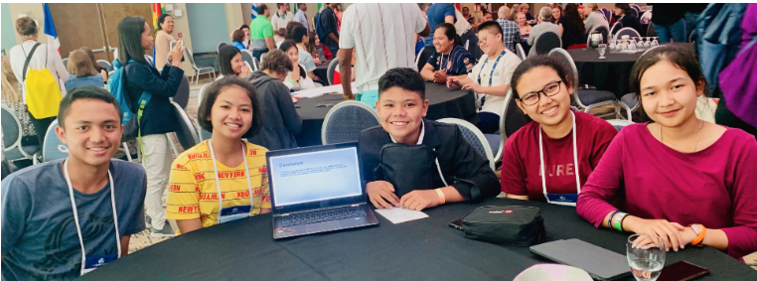
2024 IVSS Judging Timeline
20 March: Projects and scoring information emailed to judges
20 March- 3 April: Judging Period
3 April: All scoring forms due
22 April: Feedback sent to teachers and badges posted on GLOBE.gov school pages
22 April: GLOBE Earth Day Broadcast and celebration of all IVSS projects; stipend drawing

Slide 6
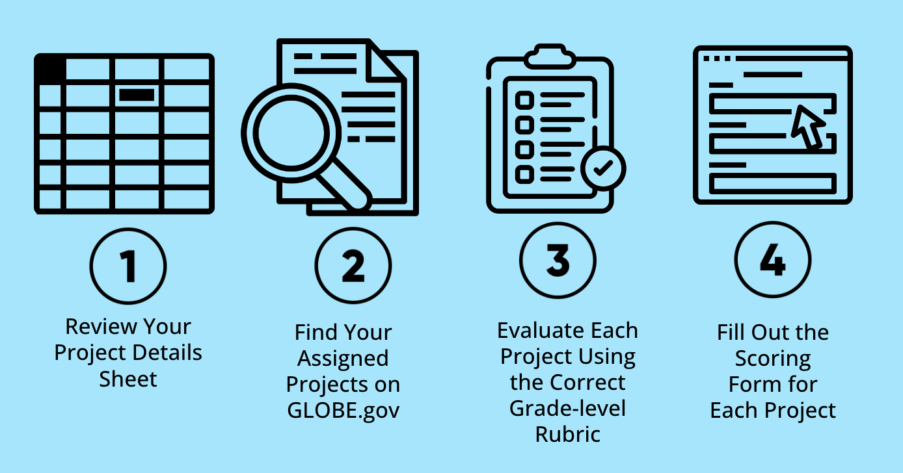
The Four Steps of Judging

Slide 7
Judges are assigned specific projects
You will receive a “Judge Project Details Sheet” with information about your assigned projects.

Slide 8
Judge Project Details Sheet
You will be emailed a spreadsheet with details about projects you have been assigned to score.

Slide 9
2. Accessing student projects
Use the link provided on the Project Details Sheet in Column Q or search for the report on the Student Research Reports page using the Article ID.

Slide 10
Judge Project Details Sheet
Links provided:
1: Direct link to each project
2: Scoring rubrics by grade-level
3: Google scoring and feedback submission form
4: Student Reports database
2
1
4
3

Slide 11
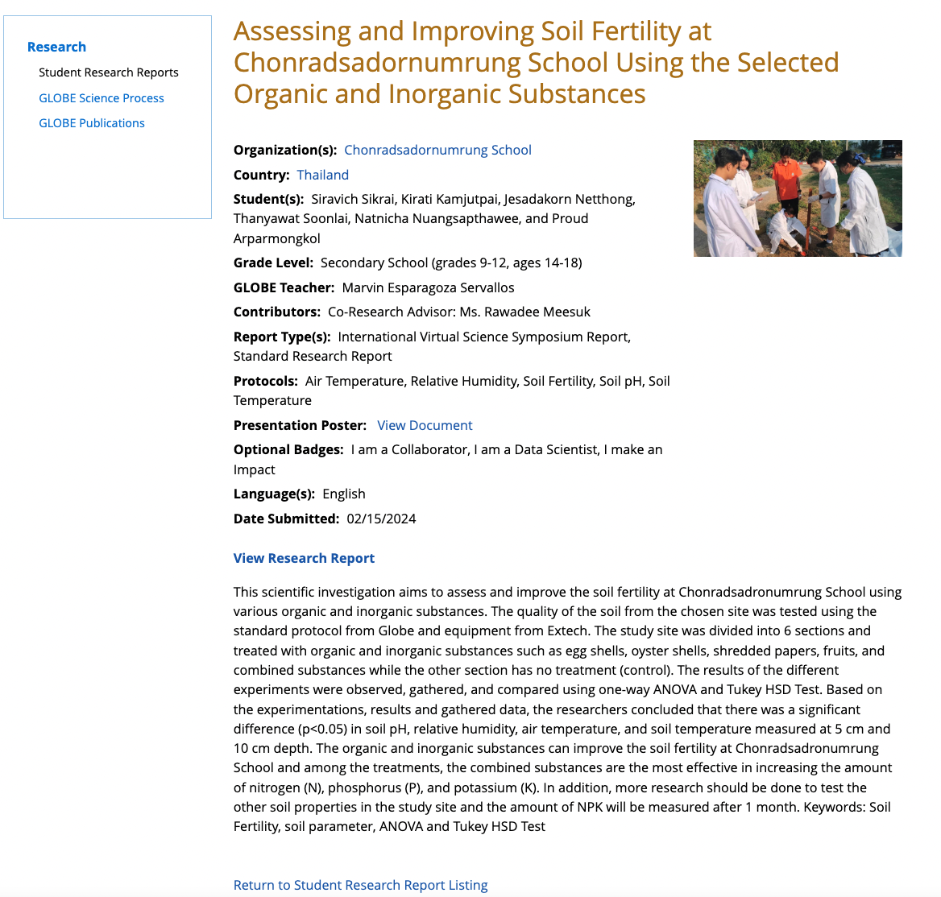
Student Report Page
Make sure you evaluate both the report and presentation on your scoring form.
Presentation may be a poster, PowerPoint, Prezi, Storymap, or video. Video URLs are also found on Judge Project Details Sheet.

Slide 12
3. Using rubrics to score projects
Projects elements, criteria, and content should be assessed according to students’ age.

Slide 13
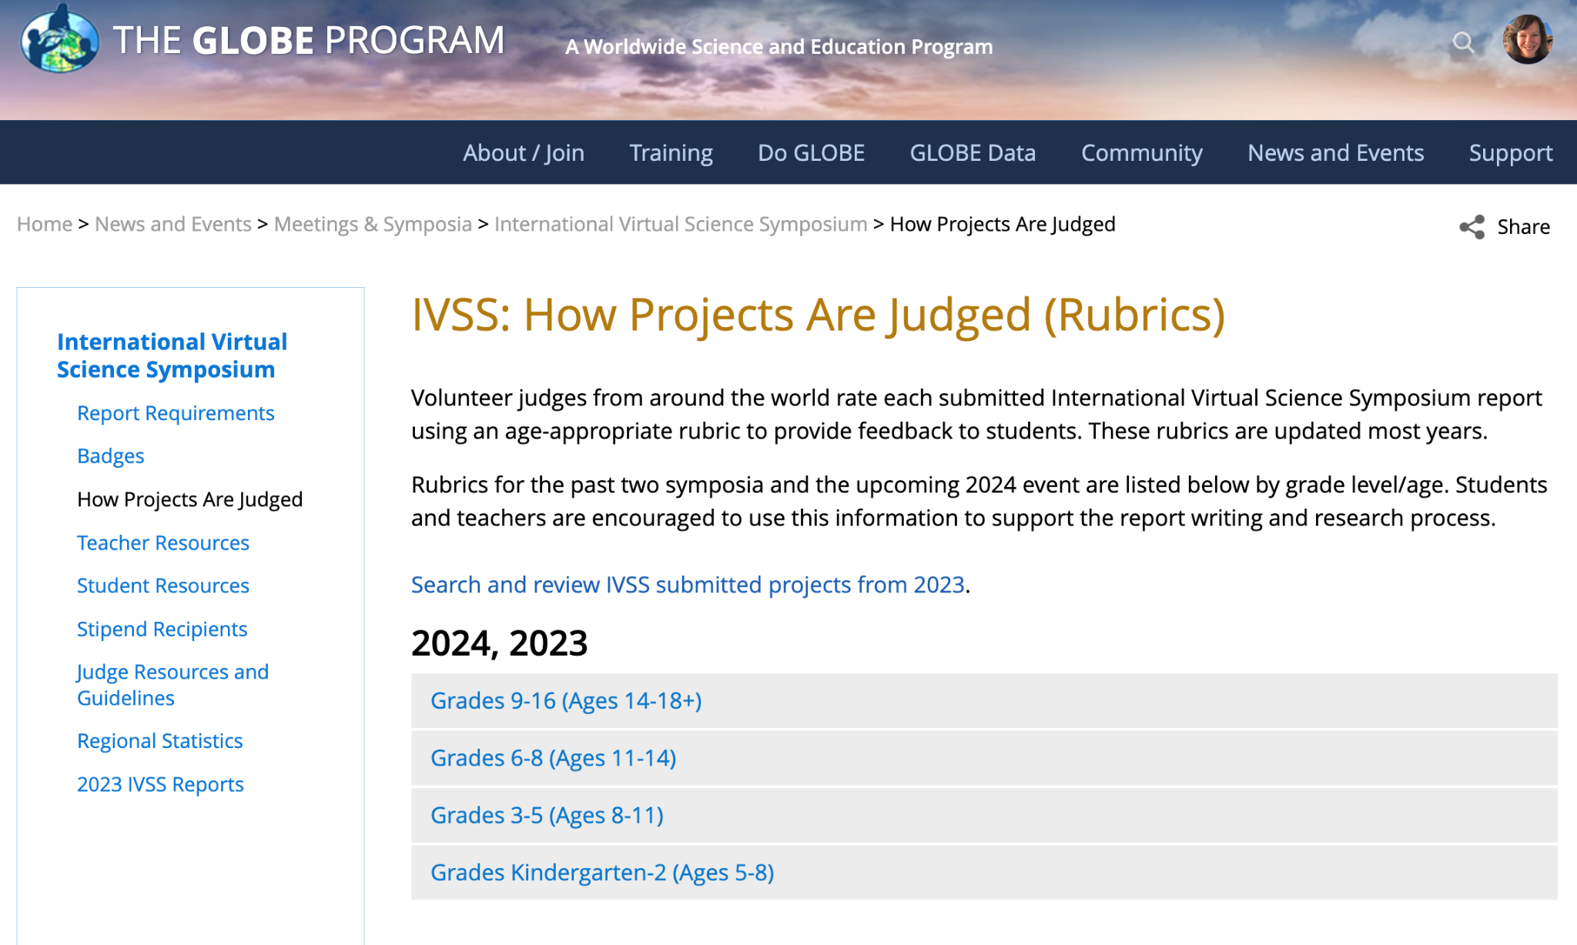
Rubrics by Grade-level
www.globe.gov/science-symposium

Slide 14
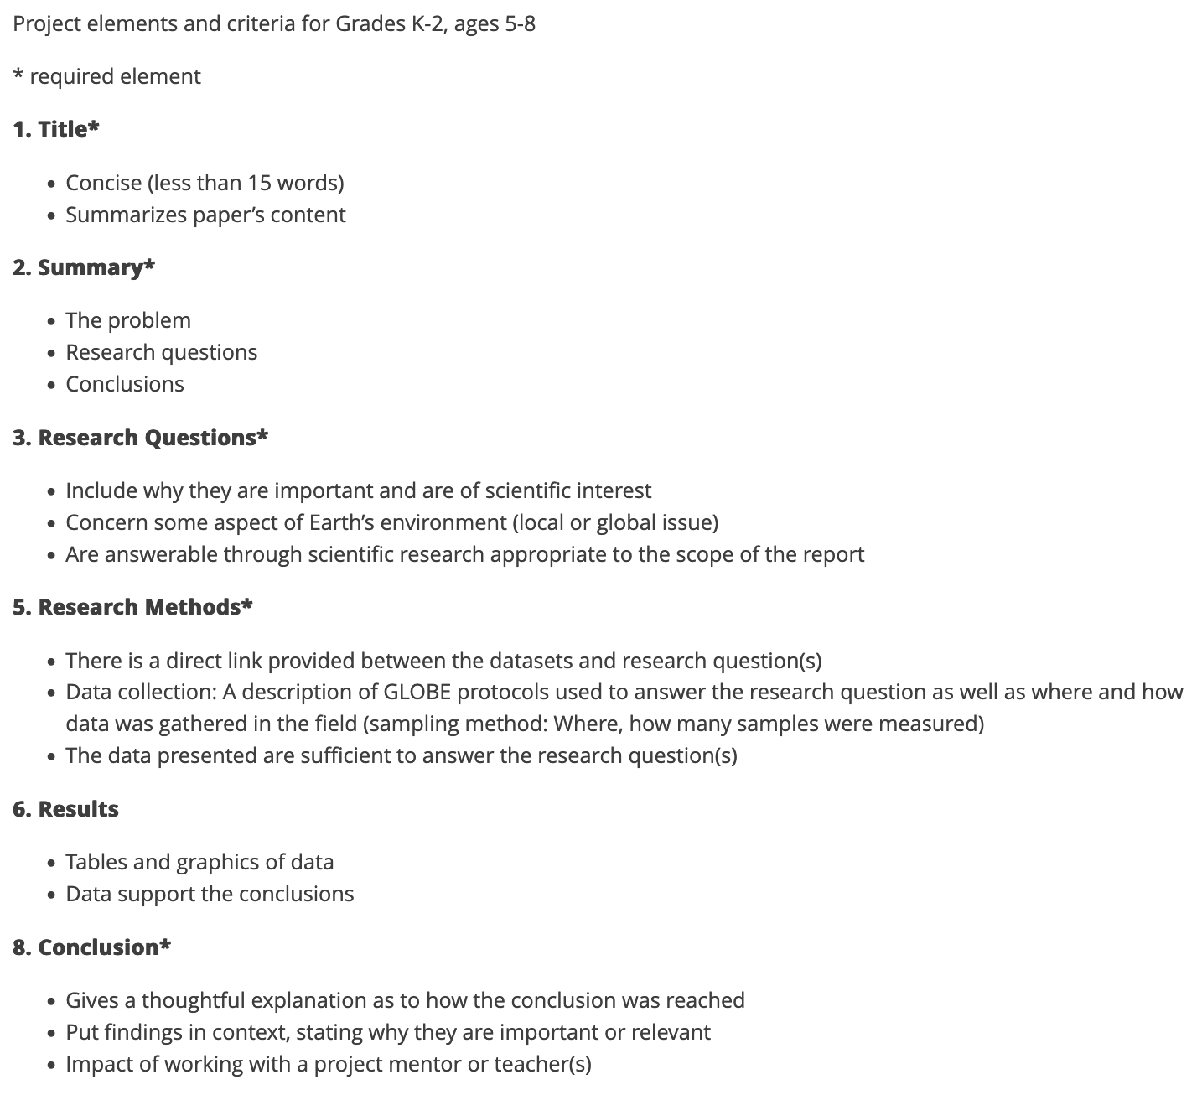
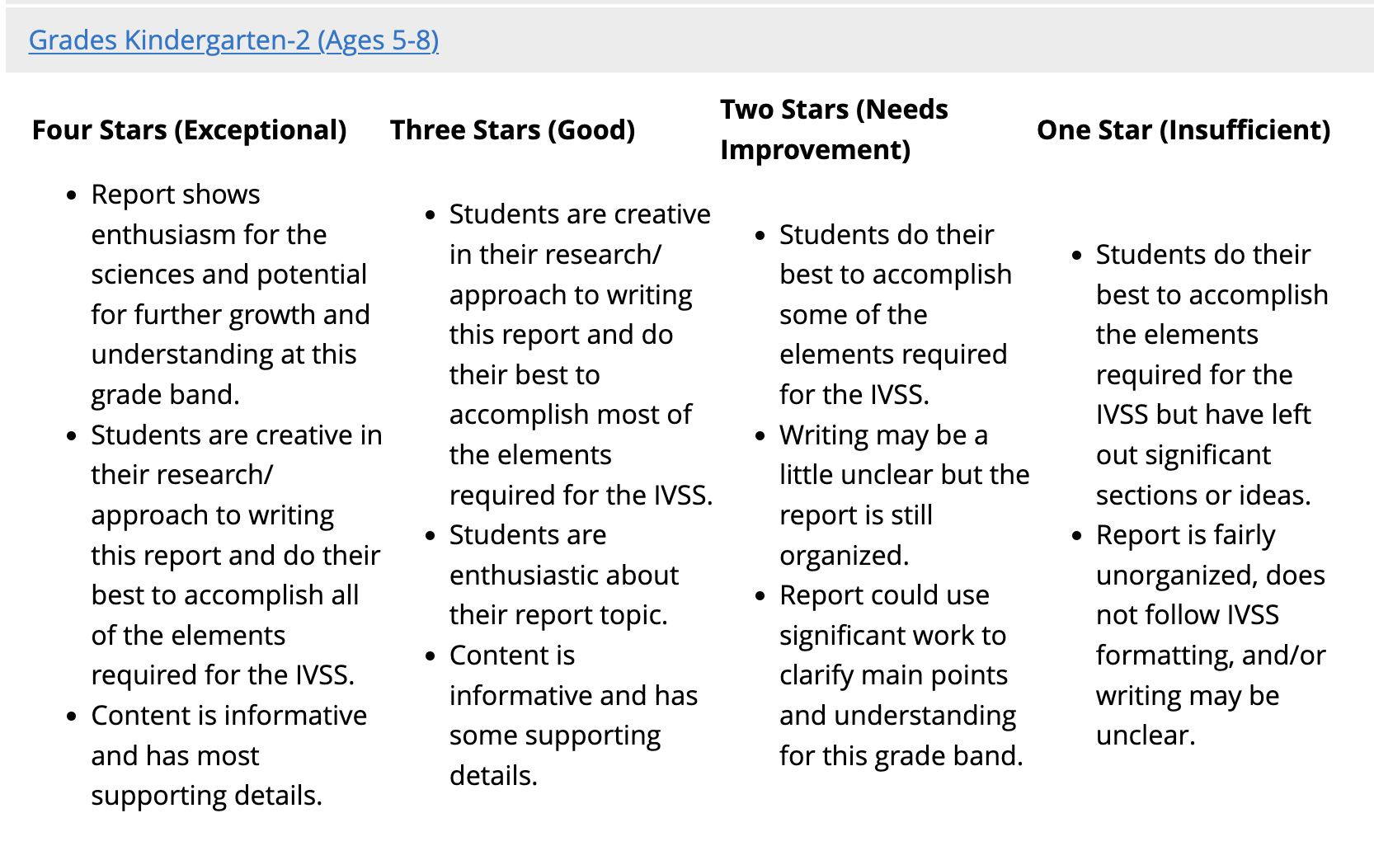
Rubrics by Grade-level
(Grades Kindergarten - 2nd, Ages 5-8)

Slide 15
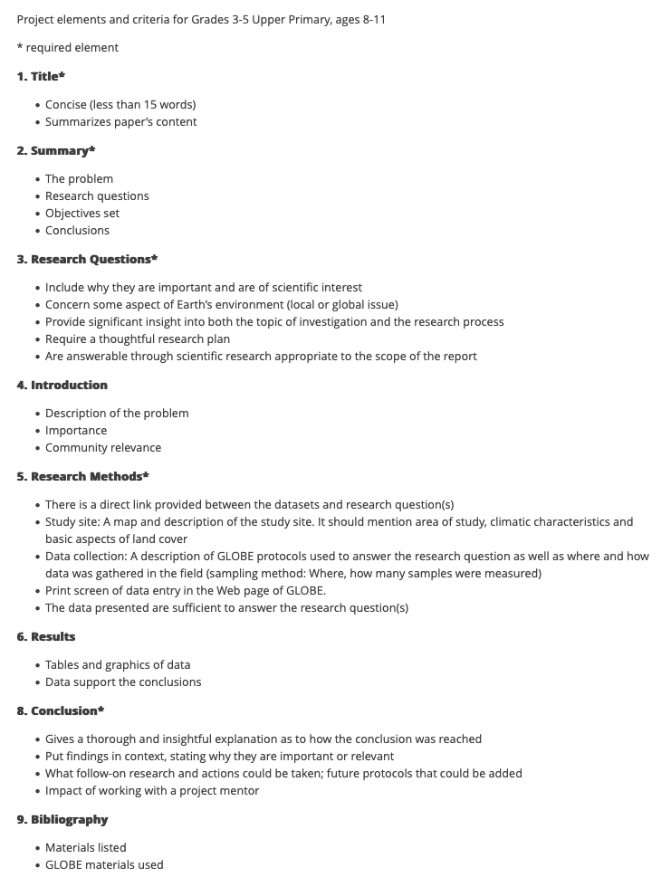
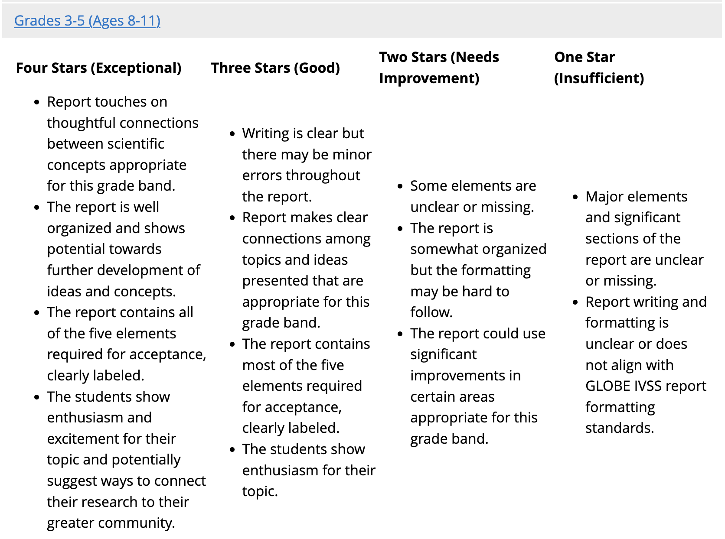
Rubrics by Grade-level
(Grades 3rd-5th, Ages 8-11)
Note: Expectations are different for each grade-level

Slide 16
4. Filling out the Feedback Submission Form
Also known as the Scoring Form or Judging Form. Responses are anonymous.

Slide 17
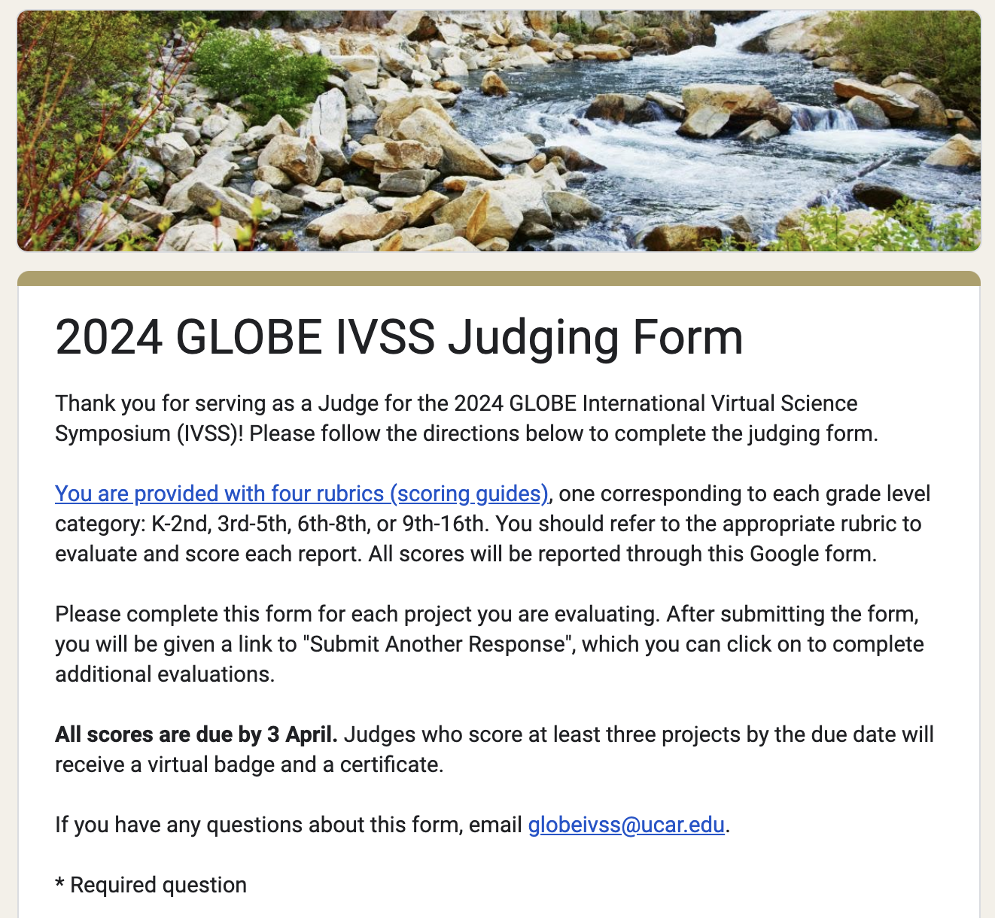
Feedback Submission Form
- Use this Google form for entering scores and feedback – link will be sent via email and is also linked on your Project Details Sheet
- The feedback form should be filled out once you are completely done reviewing a project (report and presentation)
Fill out one form for each project

Slide 18
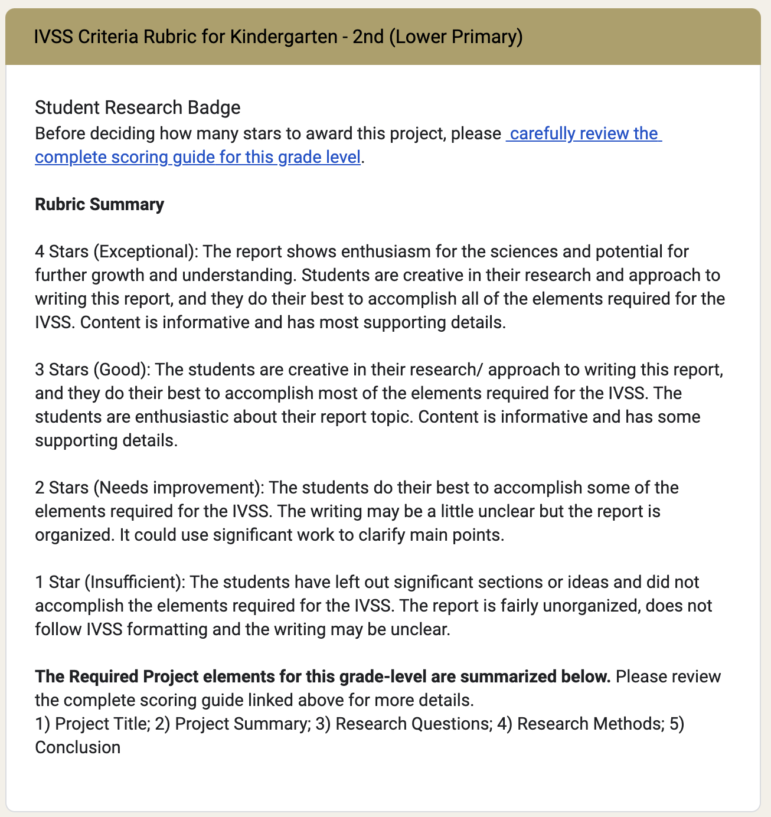
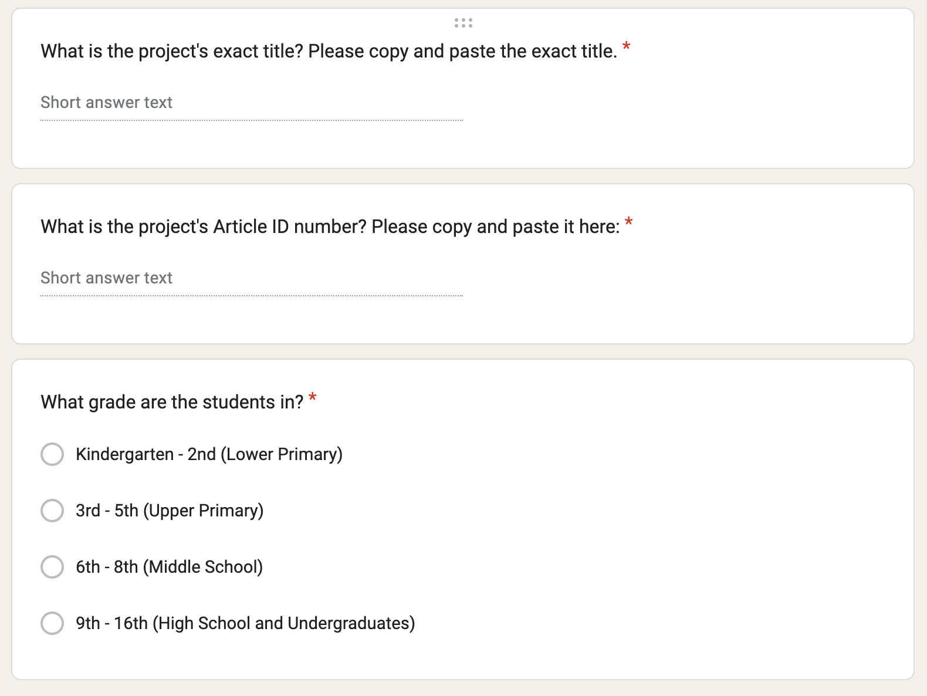
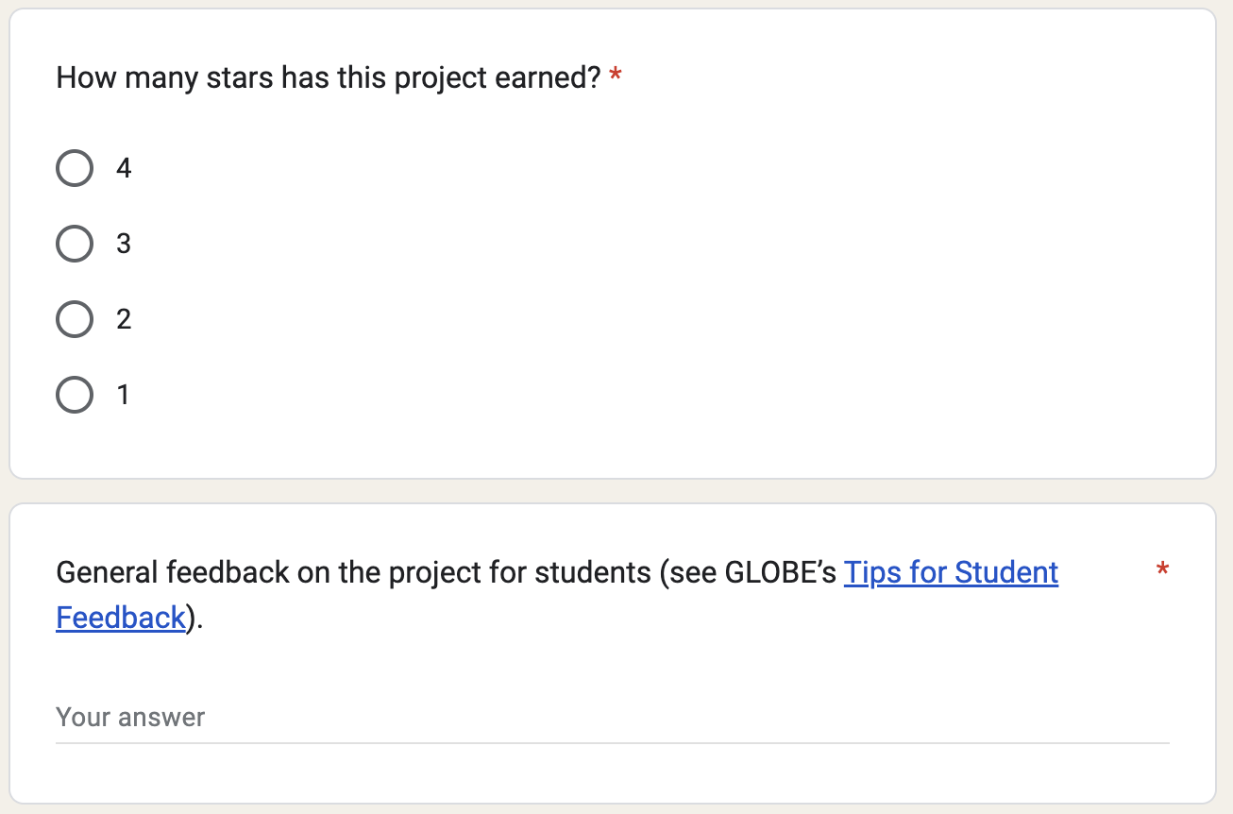
Scoring Projects
Enter information from Project Details Sheet or Student Report page.

Slide 19
Merit Based Student Research Badge
Make sure you score reflects both the report and presentation!
1 Star Project - Insufficient
The report is missing significant information or does not contain all five required elements.
2 Star Project - Needs Improvement
Report may be incomplete and need additional clarification or be missing one or more of the required elements.
3 Star Project - Good
Report contains all required elements and is written clearly, but could need a bit more information or explanation.
4 Star Project - Exceptional
The report goes above and beyond the expectations of this project and is clear and concise.
Notes:
Five required elements:
Abstract/Summary
Research Report
Explanation for each additional badge
Presentation
Photo Release Form

Slide 20
Providing Constructive Feedback
The best and most important part of the IVSS! Feedback will help students become better scientists.

Slide 21
Tips for Giving Feedback
- These are student projects ☺
- Consider grade-level/age when providing feedback
- Be considerate of language differences – students may not understand what you are saying and you should score on content rather than grammar
- Check for content in the presentation AND the report
- Please keep in mind that these projects come from all over the world

Slide 22
Tips for Giving Feedback
Be positive – provide constructive feedback
Highlight strengths
Think of areas you can focus on:
Project structure and complexity: Are the research question(s) and objectives clear? Do they demonstrate a deeper understanding of the content/context?
Data: Is there enough data? Did they do any analysis or visualization? Are interpretations supported by data?
Broader impacts: Do they consider broader impacts, such as ecological impacts?
Resources used: Did they use appropriate tools/methods? Did they use GLOBE resources, such as the data visualization system?

Slide 23
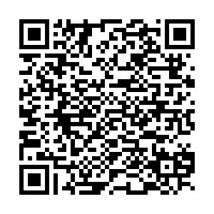
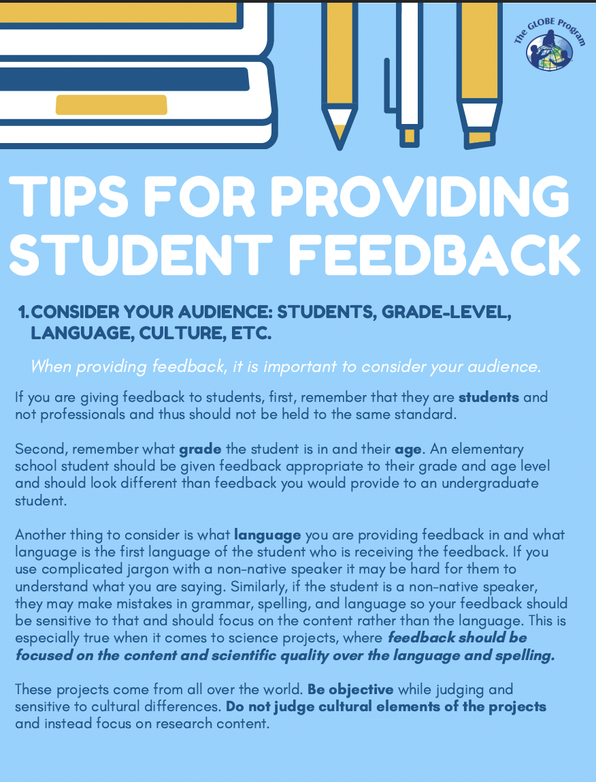
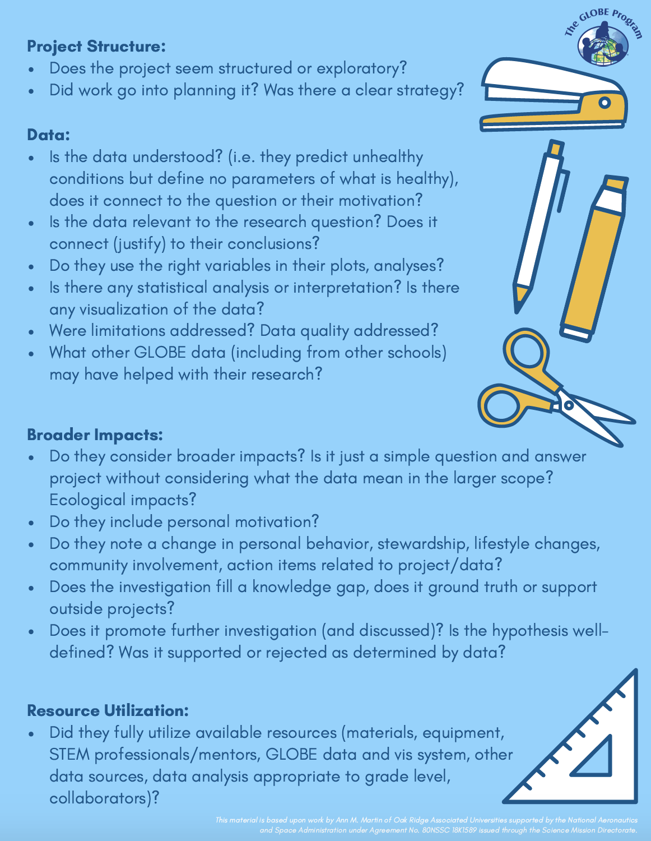
Providing Constructive Feedback

Slide 24
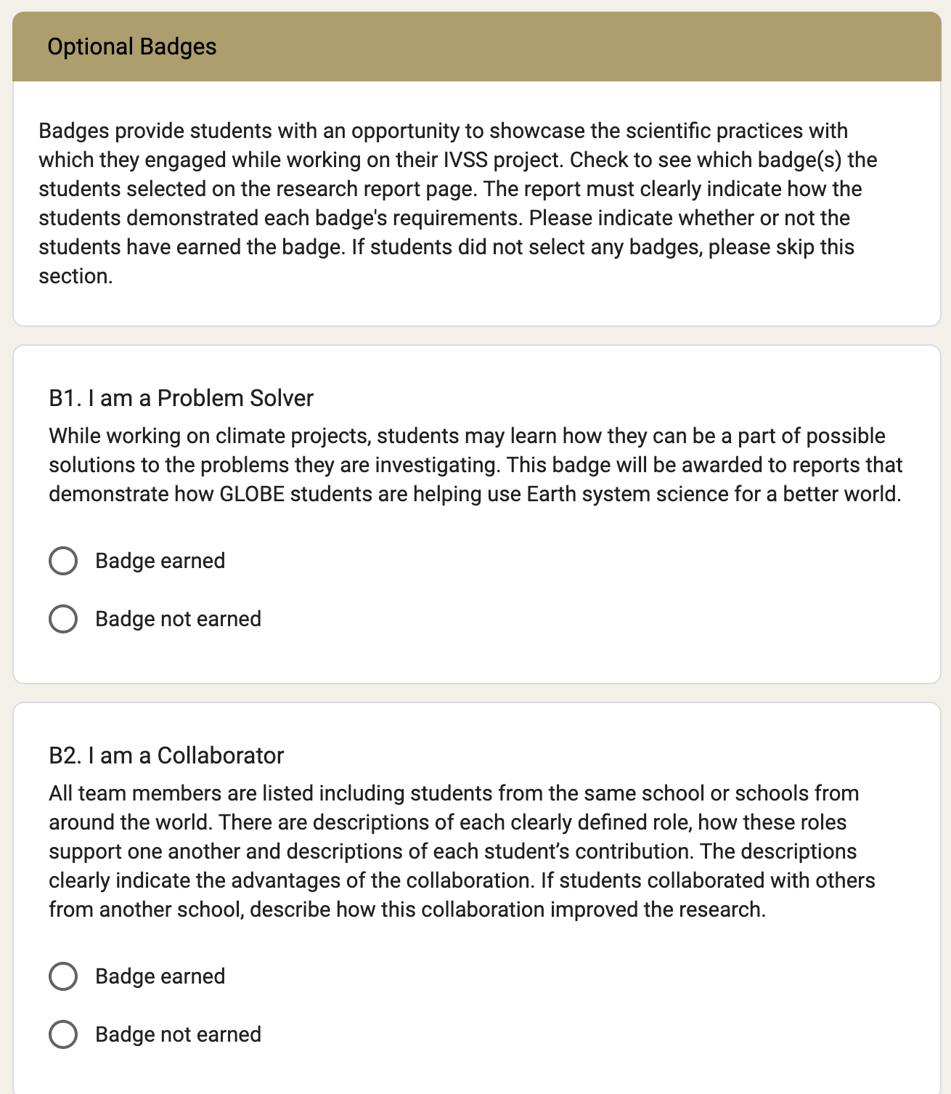
Optional Badges
Optional badges for each project will be shown on the following:
Project Details Sheet
Student Report page on GLOBE.gov
Students should describe how badges were earned in their report.

Slide 25
Optional Badges: Project Details Sheet
“TRUE” = students applied for the badge
“FALSE” = students did not apply for the badge

Slide 26
Optional Badges: Student Report Page
Students should describe how badges were earned in their report.

Slide 27
Badge Descriptions
I AM A PROBLEM SOLVER - BADGE FOR THIS YEAR’S THEME
While working on climate projects, students may learn how they can be part of possible solutions to the problems they are investigating. This badge will be awarded to reports that demonstrate how GLOBE students are helping use Earth system science for a better world.

Slide 28
Badge Descriptions
I MAKE AN IMPACT
The report clearly describes how a local issue led to the research questions or makes connections between local and global impacts. The students need to clearly describe or show how the research contributed to a positive impact on their community through making recommendations or taking action based on findings.
I AM A STEM STORYTELLER
The report describes or shows how the students shared the story of their research in a creative way. This could be via a dramatic interpretation, a blog, Instagram post, artist rendering, or any other way to creatively share what the students learned.

Slide 29
Badge Descriptions
I WORK WITH A STEM PROFESSIONAL
The report clearly describes collaboration with a STEM professional that enhanced the research methods, contributed to improved precision, and supported more sophisticated analyses and interpretations of results.
I AM A DATA SCIENTIST
The report includes in-depth analysis of students' own data as well as other data sources. Students discuss limitations of these data, make inferences about past, present, or future events, or use data to answer questions or solve problems in the represented system. Consider data from other schools or data available from other databases.

Slide 30
Badge Descriptions
I AM AN ENGINEER
The report uses student-generated sources of evidence to describe an engineering problem, looks at solutions through engineering, or optimizes a design to address a real-world problem, and describes the potential impact of the engineering principles on the environment.
I AM A COLLABORATOR
All team members are listed including students from the same school or schools from around the world, along with clearly defined roles, how these roles support one another, and descriptions of each student's contribution. The descriptions clearly indicate the advantages of the collaboration. If the students collaborated with students from another school, describe how working with other schools improved the research.

Slide 31
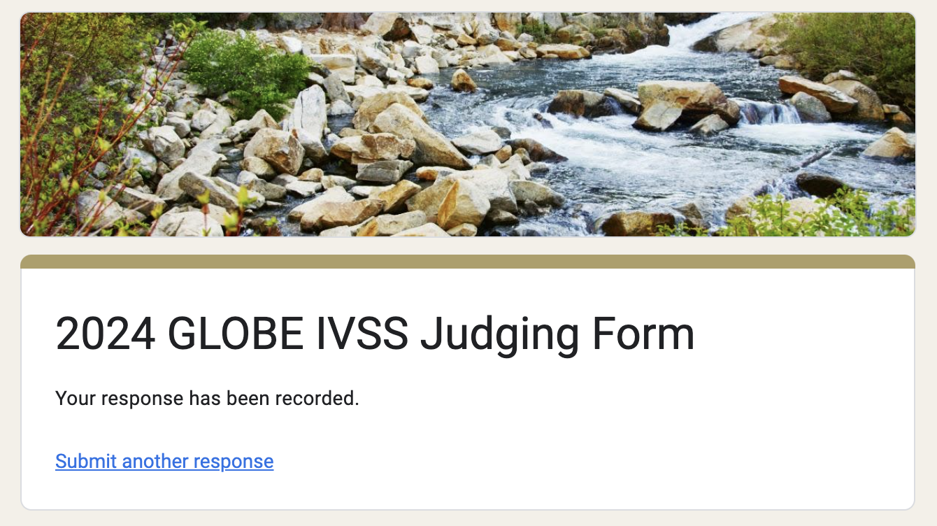
Fill out the form completely for each project

Slide 32
As a thanks…
Judges who score at least 3 projects by the April 3 deadline will receive a virtual badge and certificate.

Slide 33
Questions or Issues with Your Assigned Projects?
- If you are not able to complete the judging for your projects, email globeivss@ucar.edu as soon as possible to notify the IVSS team.
- If you can score more projects, let us know!
- If you can’t find a project or think something is not correct, let us know right away.
- If you have a conflict of interest with a project, let us know and we will change your assigned projects.
- Any questions or concerns, email globeivss@ucar.edu.

Slide 34
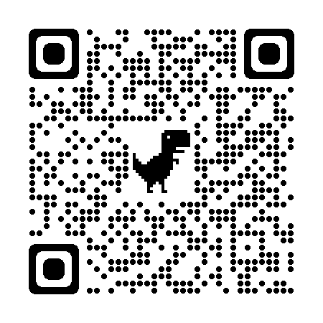
More Information
https://www.globe.gov/news-events/meetings_symposia/virtual-conferences
> www.GLOBE.gov
> News & Events
> Meetings & Symposia
> International Virtual Science Symposium
globeivss@ucar.edu

Slide 35
2024 IVSS Judging Timeline
20 March: Projects and scoring information emailed to judges
20 March- 3 April: Judging Period
3 April: All scoring forms due
22 April: Feedback sent to teachers and badges posted on GLOBE.gov school pages
22 April: GLOBE Earth Day Broadcast and celebration of all IVSS projects; stipend drawing

Slide 36
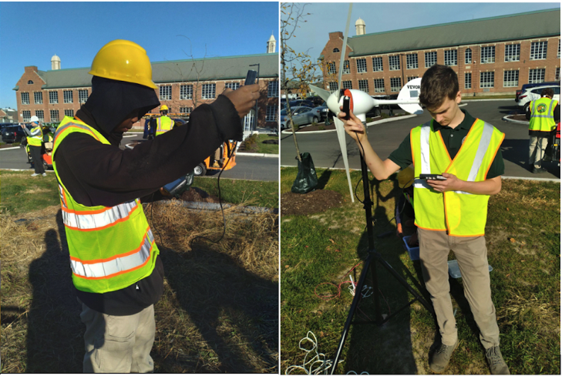
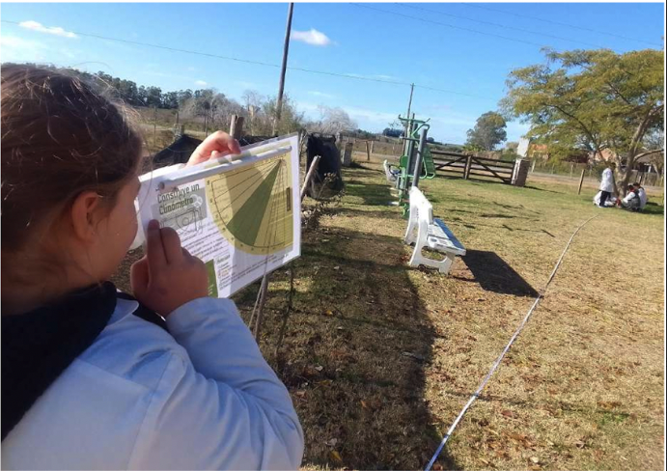
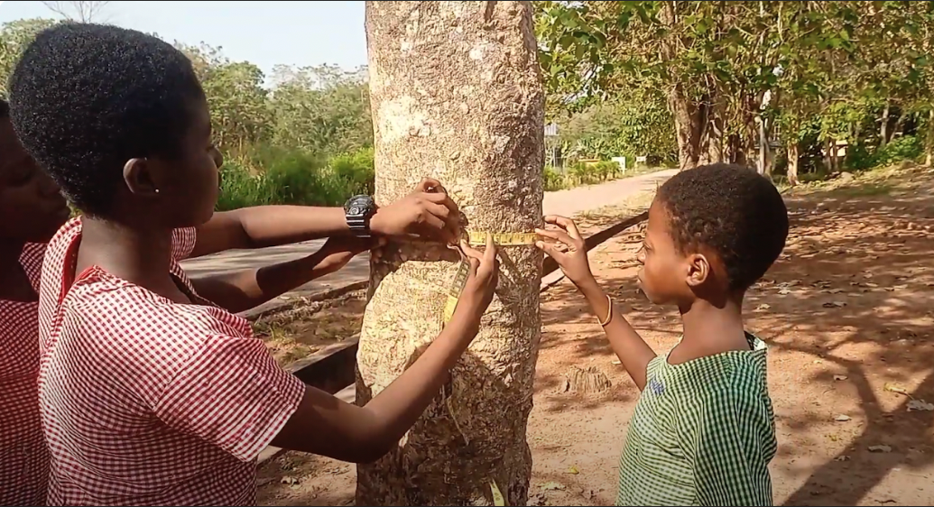
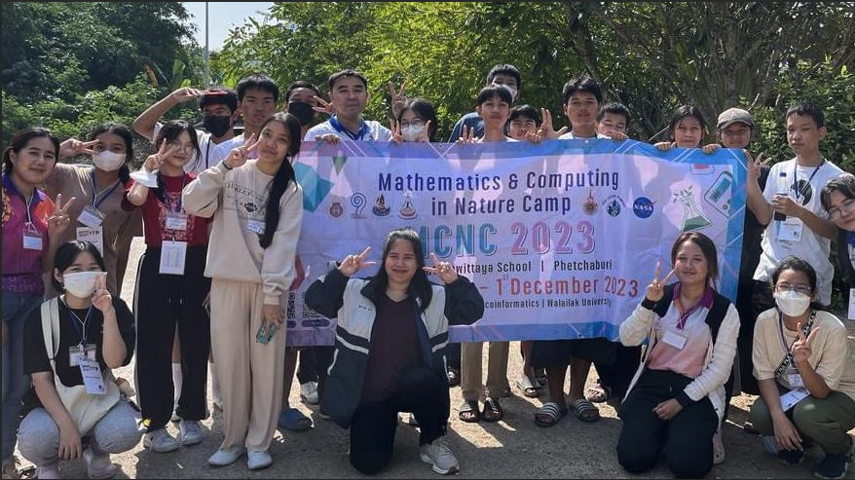
Thank you!
Questions?

