Slide 1
Microplastics Awareness

Slide 2
Hello!
You can contact me at iesindia@gmail.com

Slide 3
Agenda
What is it?
What is at Risk?
What are the significant source of these plastic
What can be done

Slide 4
1.
What is Microplastic
Let’s start by learning what is microplactic

Slide 5
Microplastics are small plastic pieces less than five millimeters long which can be harmful to our ocean and aquatic life.

Slide 6
What is it?
Straightforward – they are tiny plastic particles.
Some marine researchers define them as being anywhere from smaller than 1mm to 5mm – They are too small to be filtered
There are two types of microplastics – “primary” and “secondary”
Primary starts out small, secondary break down into smaller bits

Slide 7
The Environmental Risk
They will accumulate in the water (accounting for 10% of litter on beaches) and reside there for a long time.
Fish mistake them for plankton – leading them to die of undernourishment or constipation.
Many other animals on the marine food chain ingest them as well
Half of plastic in the marine environment is buoyant but other plastics can sink to the sea floor, affecting sediment dwelling species
Plastic debris serves to transport different organisms outside of their natural habitats.
Exacerbates the problem of invasive species and loss of biodiversity

Slide 8
The Chemical Risk
When plastic is exposed to UV rays in water, it releases harmful chemical compounds not found in nature
BPA – A common component of food containers, has negative affects on both fetal development and adult hormone levels.
Carcinogen – An agent directly involved in causing cancer
POPs (Persistent organic pollutants)-organic compounds resistant to environmental degradation – they are pollutants that don’t deteriorate, and they then biomagnify and bioaccumulate – (mercury build up in big fish by eating smaller fish and the subsequent effect on humans)
Harmful chemicals may also attach to the plastics in the water.
Chemicals can leach into the organisms that ingest the plastics

Slide 9
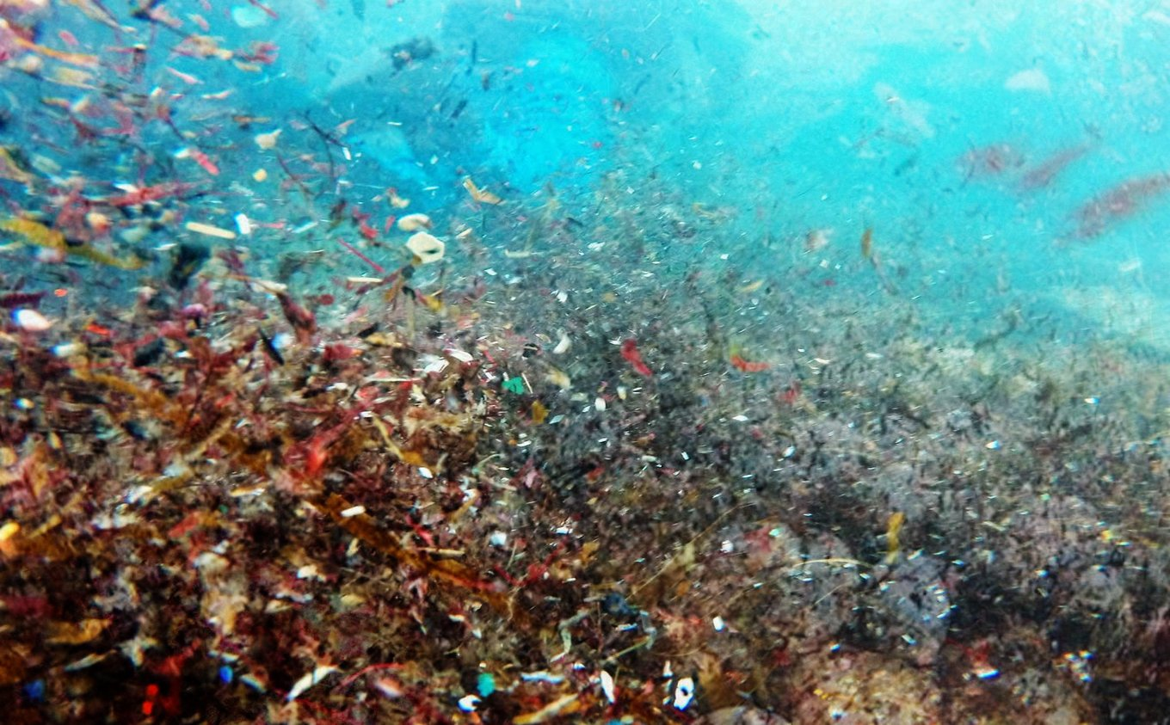
Ever wondered how much plastic is in our oceans?
Oceans are bearing the brunt of our obsession with plastic. The numbers tell us just how bad things have gotten.
8
million pieces of plastic pollution find their way into our oceans every day.
12
million tonnes of plastic are poured into the ocean every year.
5.25
trillion macro and microplastic pieces are floating in the open ocean.

Slide 10
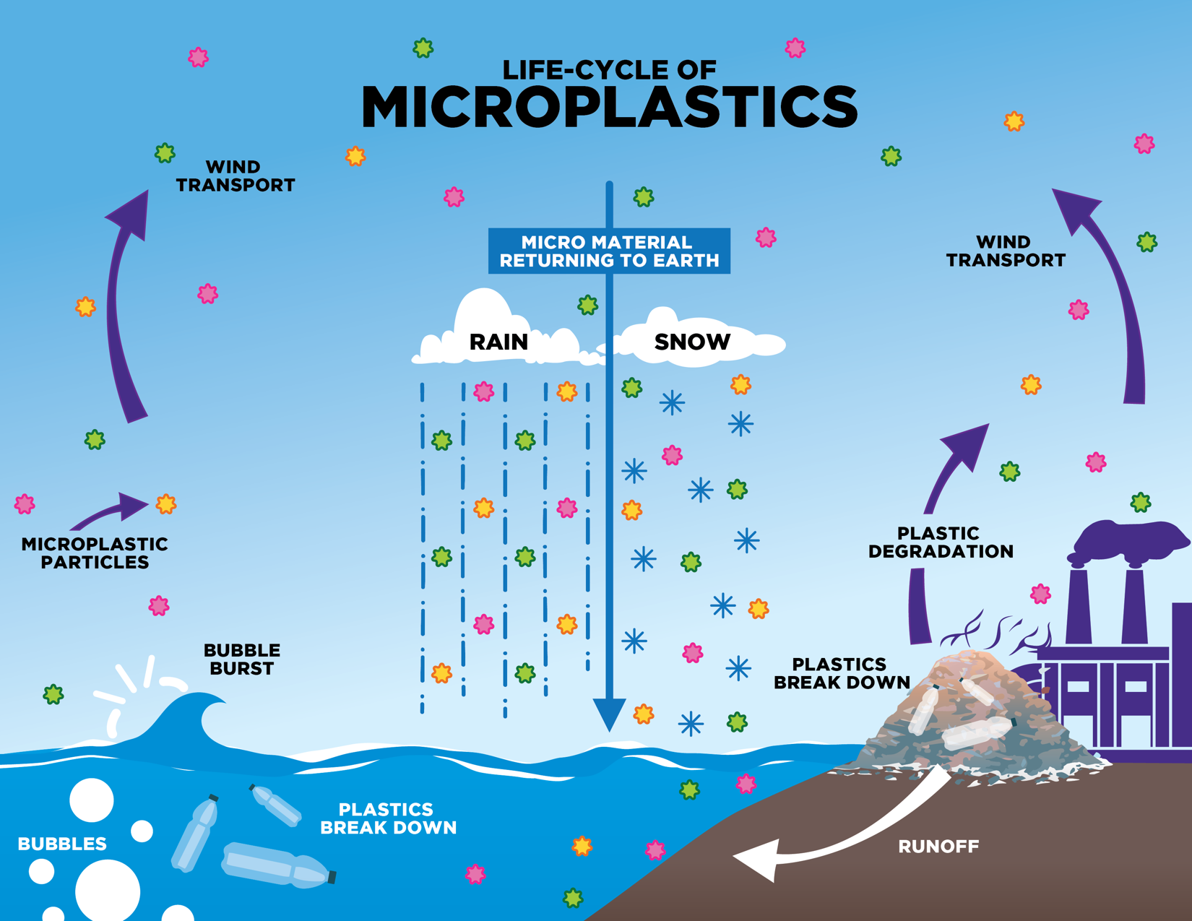

Slide 11
2.
How You Can Help Solve The Problem

Slide 12
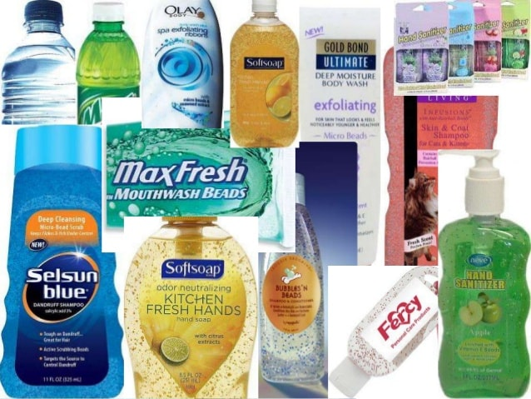
What are some significant sources of these plastics?
Notes:
They are found in toothpastes, body washes, shampoos, etc.

Slide 13
Domestic use of Microplastic
They are found in toothpastes, body washes, shampoos, etc. known as “Micro Beads”.
“Primary Microplastics” in toothpaste or bodywash eventually wash from the drain to a body of water.
Carcinogen – An agent directly involved in causing cancer.
“Secondary Microplastics” would be plastic bottles or containers…anything that can be broken down into smaller bits
Harmful chemicals may also attach to the plastics in the water.
Chemicals can leach into the organisms that ingest the plastics

Slide 14
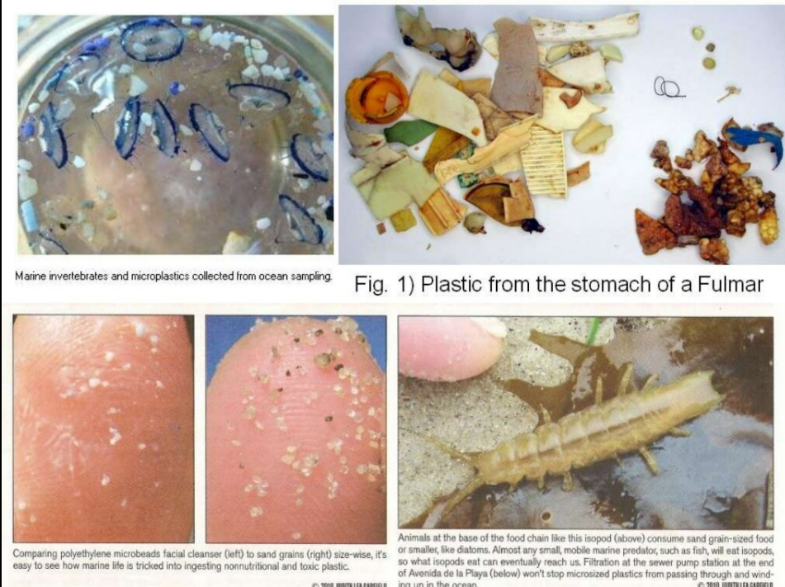

Slide 15
Microplastic pollution in Asia & Pacific Region
Asia is the most populous continent in the world, and most Asian countries are under rapid development while facing serious environmental problems.
According to the data from Plastics Europe, world production of plastics reached 311 million metric tons in 2014, an increase of 38% from 2004. China and Japan are the two leading countries with the highest plastic production in Asia accounting for 26% and 4% of the world’s total production in 2014, respectively.
Plastic production in the rest of Asia accounted for 16% of the world production. All together Asia produced nearly a half of the world’s plastic materials in 2014.

Slide 16
Microplastic pollution in Asia & Pacific Region
Among the top 20 countries ranked by the mass of mismanaged plastic waste, all of them are developing countries except the USA which has the highest waste generation rate but the lowest percentage of mismanaged plastic waste.
Twelve Asian countries were on the list with China, Indonesia, and the Philippines ranked top three. The percentage of mismanaged plastic waste among these Asian countries varied from 1.0 to 27.7%. As a result the environmental release of plastic wastes is more likely in these Asian countries.
The Maldives has the highest levels of microplastic pollution on the planet, according to recent research published in the Journal Science of the Total Environment.

Slide 17
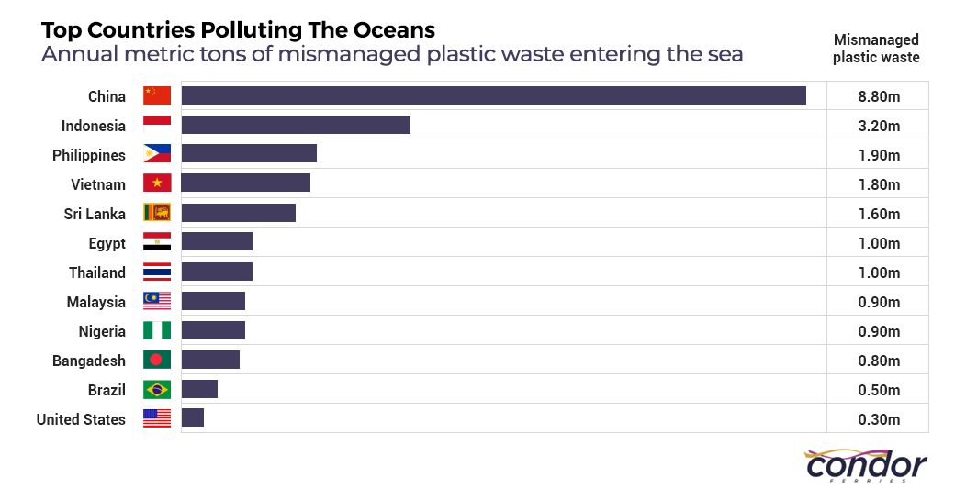

Slide 18
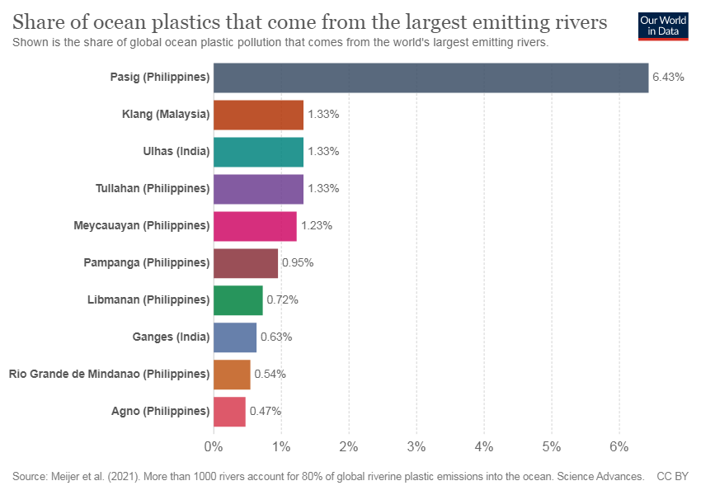

Slide 19
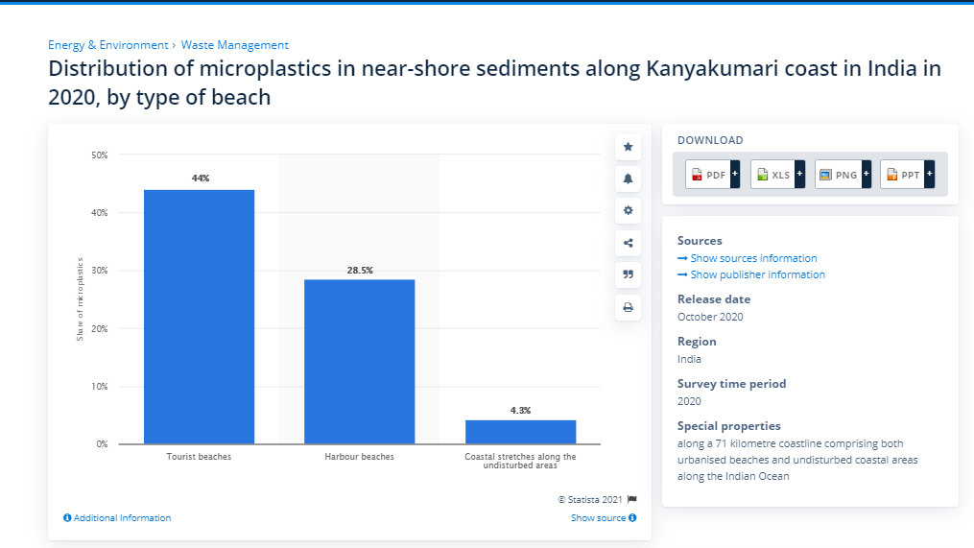

Slide 20
Distribituaion of Microplastic
No. of microplastic 250 mL⁻¹ Sediment
1 – 10
11 -20
21 -30
31 -40
Distribution of Microplastics Sediment samples were collected from 18 shores across 6 continents. All 18 shores has microplastics present

Slide 21
How are we consuming microplastics?
The most common sources of plastic ingestion are our drinking water, seafood, sea salt, and beer.
It’s estimated that we consume between 74 000 to 121 000 microplastic particles per year and drinking bottled water could add an extra 90 000 particles to that number.
The second largest source of microplastics is shellfish. Microplastics are now found in a wide range of sea animals, which can often mistake plastic for food, or simply ingest it through the water, but shellfish contain particularly high levels because they are consumed whole.
Research shows that our land and agriculture are receiving a significant dose of microplastics from improper composting. Due mainly to lazy composting at the individual level, plastics are ending up in our compost, which goes on to become fertilizer for our food supply. These plastics then breakdown and we’re left with microplastics throughout our fields.
Notes:
Today, microplastics are just about everywhere, so it’s not exactly surprising that they are making their way into our bodies.
Tap water is a huge source, but if you regularly consume bottled water, you could actually be doubling the amount of microplastics you ingest.
Microplastics aren’t just found in our water sources, however.

Slide 22
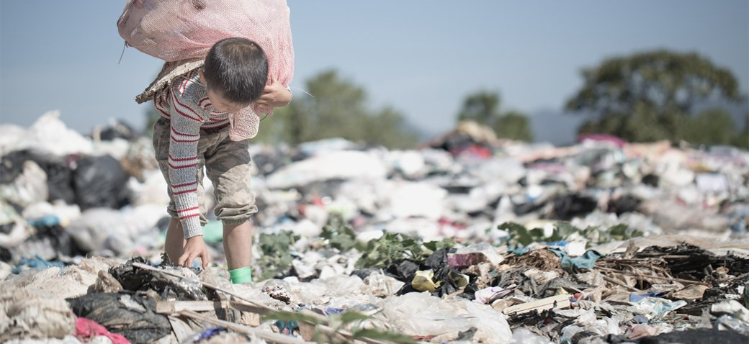
How much plastic are we consuming?
Research is still in its early days and while the recent study placed consumption at approximately 5g per week (i.e. the amount of plastic in a credit card), it only looked at items that make up approximately 15% of our caloric intake (fish, shellfish, salt, sugars, alcohol, water, and air).
The other 85% of our diets weren’t looked at it in the study.
Notes:
Currently, we don’t know exactly.

Slide 23
What can you do?
While there is no doubt that large scale change and advancements are necessary to properly tackle our global plastic crisis, there are still many individual changes we can make.
When it comes to your personal consumption, a logical first step is to reduce intake of the top microplastic culprits. This means reducing (or ideally, eliminating) your consumption of bottled water and shellfish.
We can also take steps to reduce the amount of plastic we consume.
One unexpected culprit of microplastics is synthetic clothing, which releases microplastics into the water during production and when you wash them in the laundry. switching to natural materials like organic cotton and linen is a great way to minimize your plastic use and carbon footprint.
We’re in the early days of understanding the effects of microplastics on our health and our environment, and there is still a lot of work to be done before we have a clear idea of the true impact.
However, AP RCO is taking it as a positive that this important issue is beginning to get the awareness and research it deserves and hope the upcoming training webinar on Microplastic in water bodies will become a catalyst for greater change.
Notes:
What does this mean for us?
Again, we don’t really know yet. The study looked specifically at what we are consuming, rather than the effect that this has on our health, so more research needs to be done before conclusions can be made. Some studies have shown signs that microplastics can lead to health complications. the buildup of plastics in our body could be toxic and could impact our immune systems in the long run.

Slide 24
Thanks!
Any questions?
You can find me at @deshbandhu & iesindia@gmail.com

