Slide 1
2024 GLOBE International Virtual Science Symposium (IVSS) Webinar #4, 18 January 2024
www.globe.gov/news-events/meetings_symposia/virtual-conferences

Slide 3
2024 IVSS Timeline & Webinars
11 October 2023: General IVSS Informational Webinar (recorded)
25 October 2023: Climate Resources Webinar (recorded)
6 December 2023: Badges Webinar (recorded)
15 December 2023 - 06 March 2024: Reports Accepted
December 2023 - February 2024: Judge Recruitment
18 January 2024: Submitting Student Projects Webinar
20 March 2024: Judging Webinar
20 March - 03 April 2024: Judging Period
22 April 2024: Feedback to Students
Notes:
We will have an additional joint webinar witht the Year of Climate and Carbon Campaign (YCC) later in October.
Then starting in January and ending March 1st 2024, we will be accepting projects
March 22nd 2023 will be the judging webinar, which informs judges on expectations and how to judge IVSS projects.
March 22nd will be the start of the judging period which will end April 5th 2024.
Finally April 5th 2024 we will have our Earth day celebration and the drawing for the stipends.

Slide 4
Project Requirements
Most important: you have to use GLOBE data!
Title
Abstract/Summary
Research Report
Explanation for Each Badge
Presentation
Photo Releases
This is what you will need in order to be considered in the IVSS judging process.

Slide 5
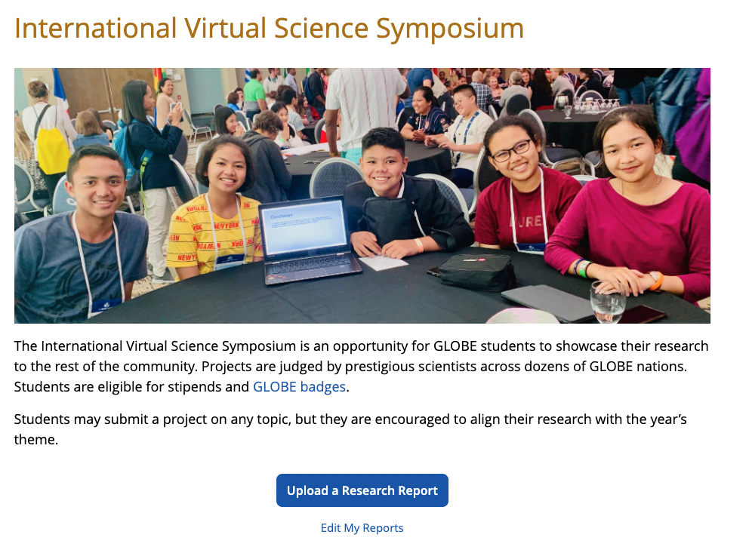
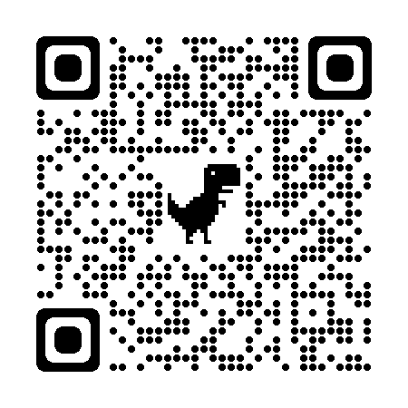
Submitting Your 2024 IVSS Project
Visit the IVSS webpage to access the IVSS Project Upload Tool:
Notes:
Screenshare to show the upload tool?

Slide 6
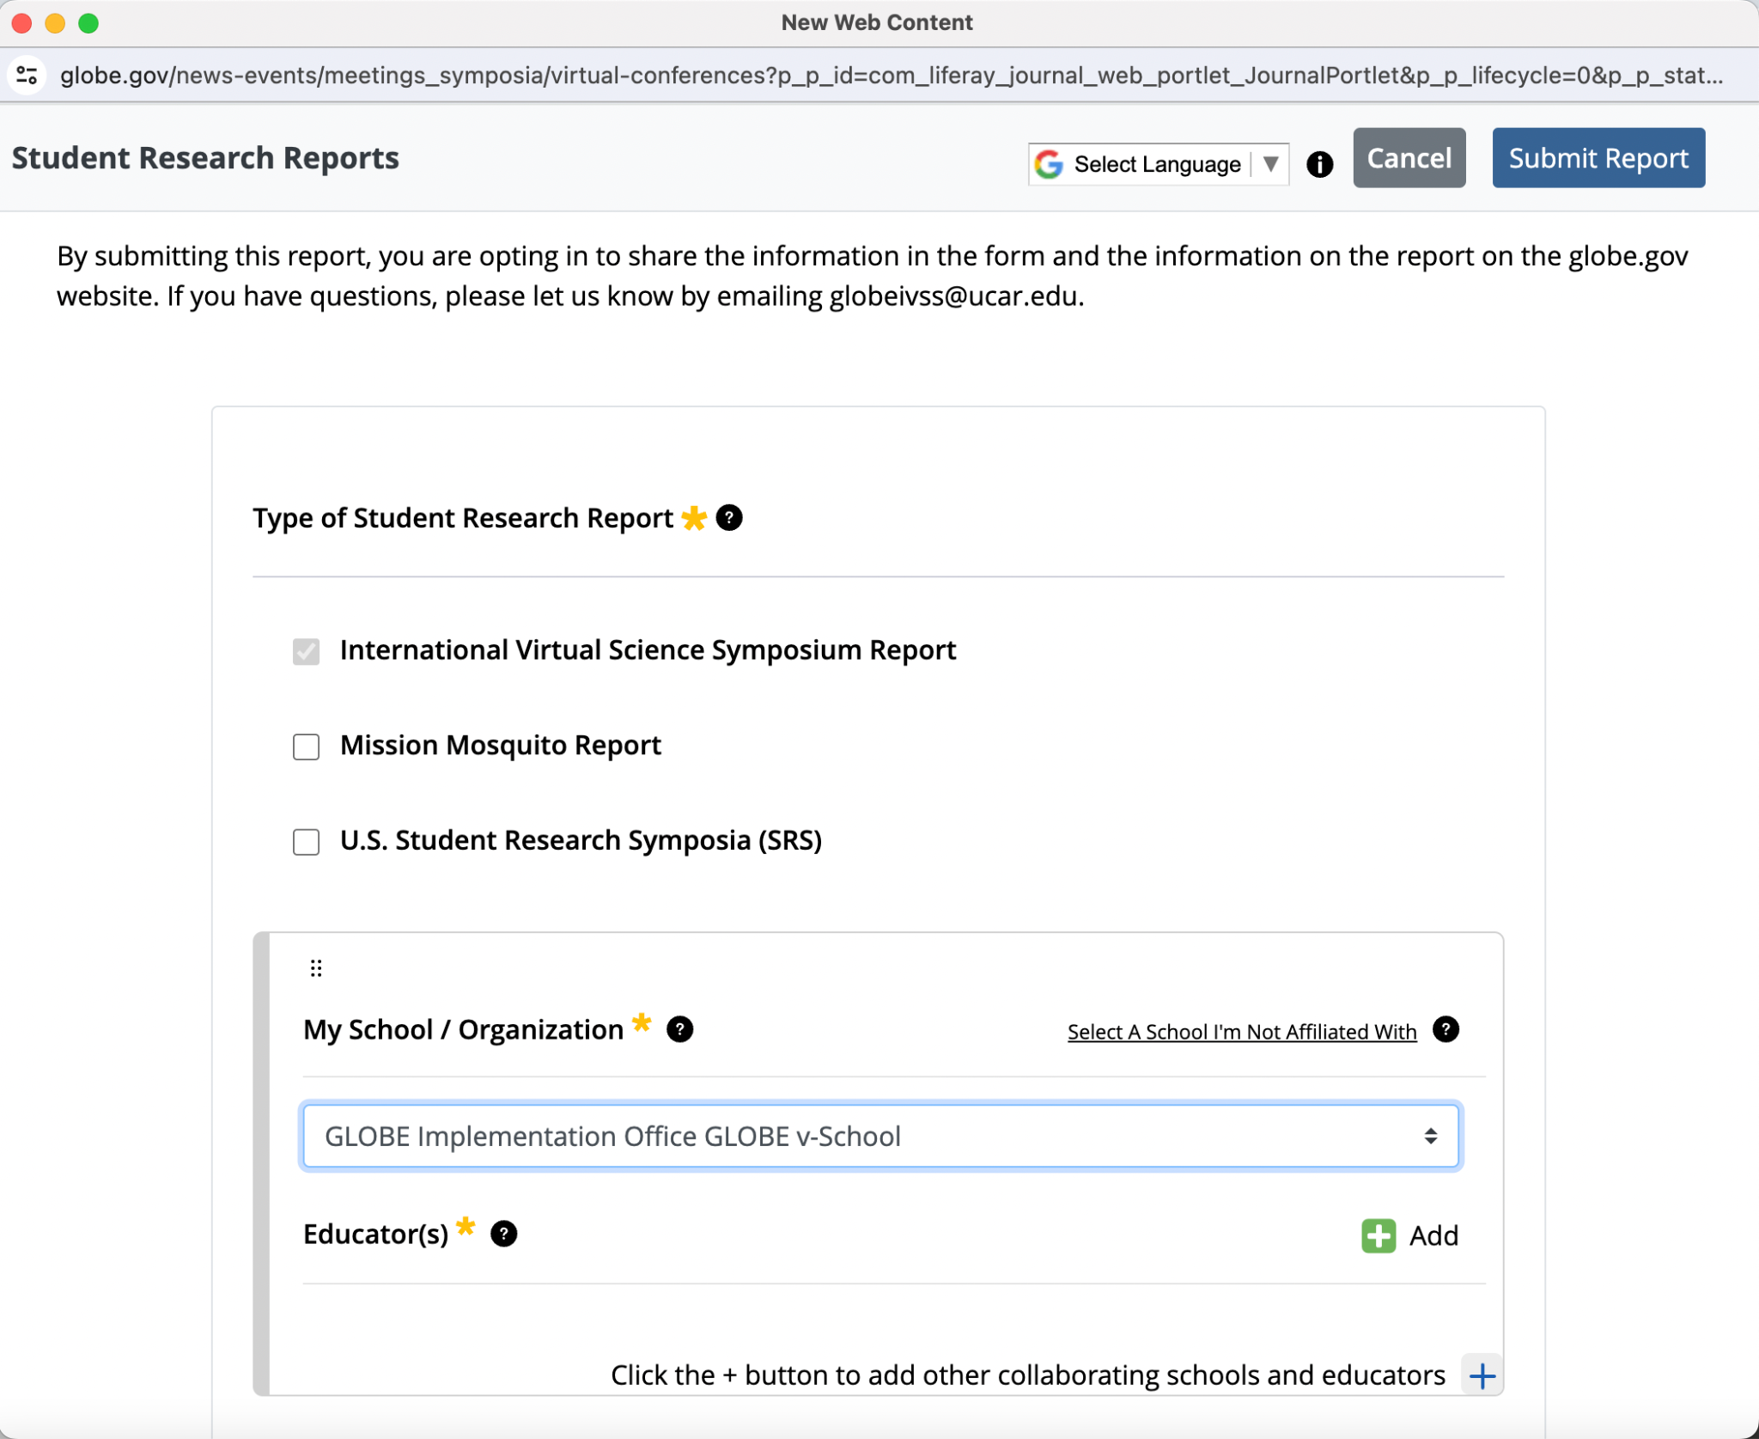
IVSS Research Report Upload Tool
IVSS Report
Select School & Teacher(s)
Notes:
Remind teachers to include email addresses; Click the + button to add educators from other schools

Slide 7
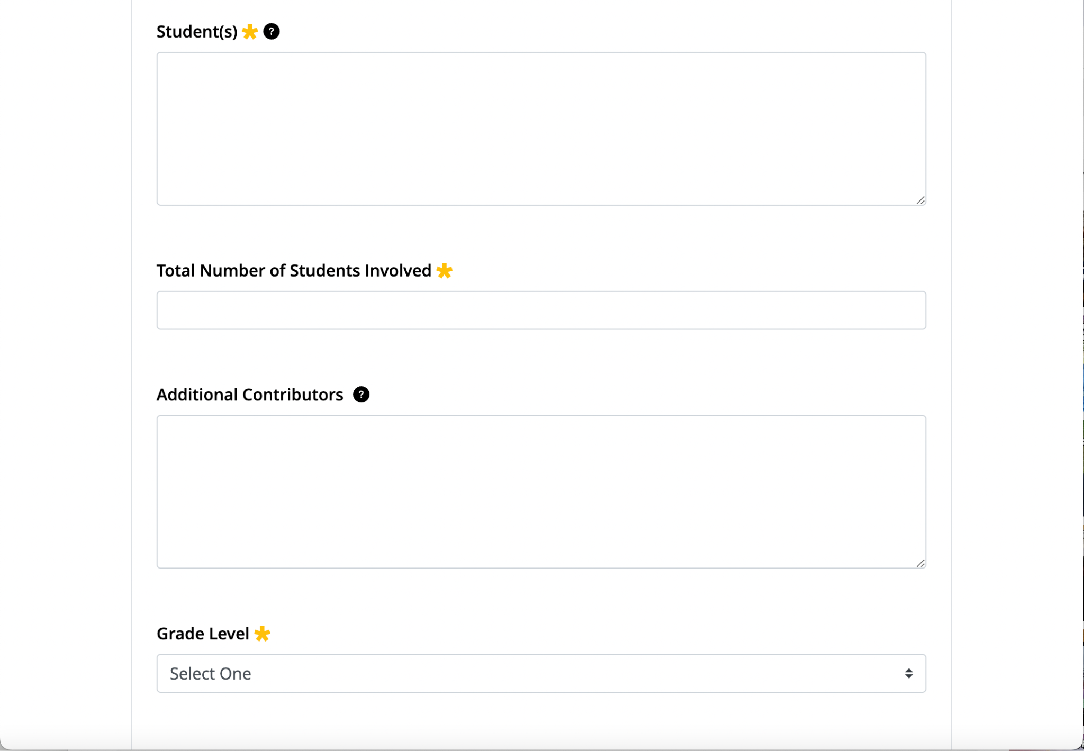
IVSS Research Report Upload Tool: Student Information
Include names of all students who contributed to the project
Names & organizations of collaborators
Ex: GISN Professionals, Scientists, etc.
Notes:
Include student collaborators from other schools

Slide 8
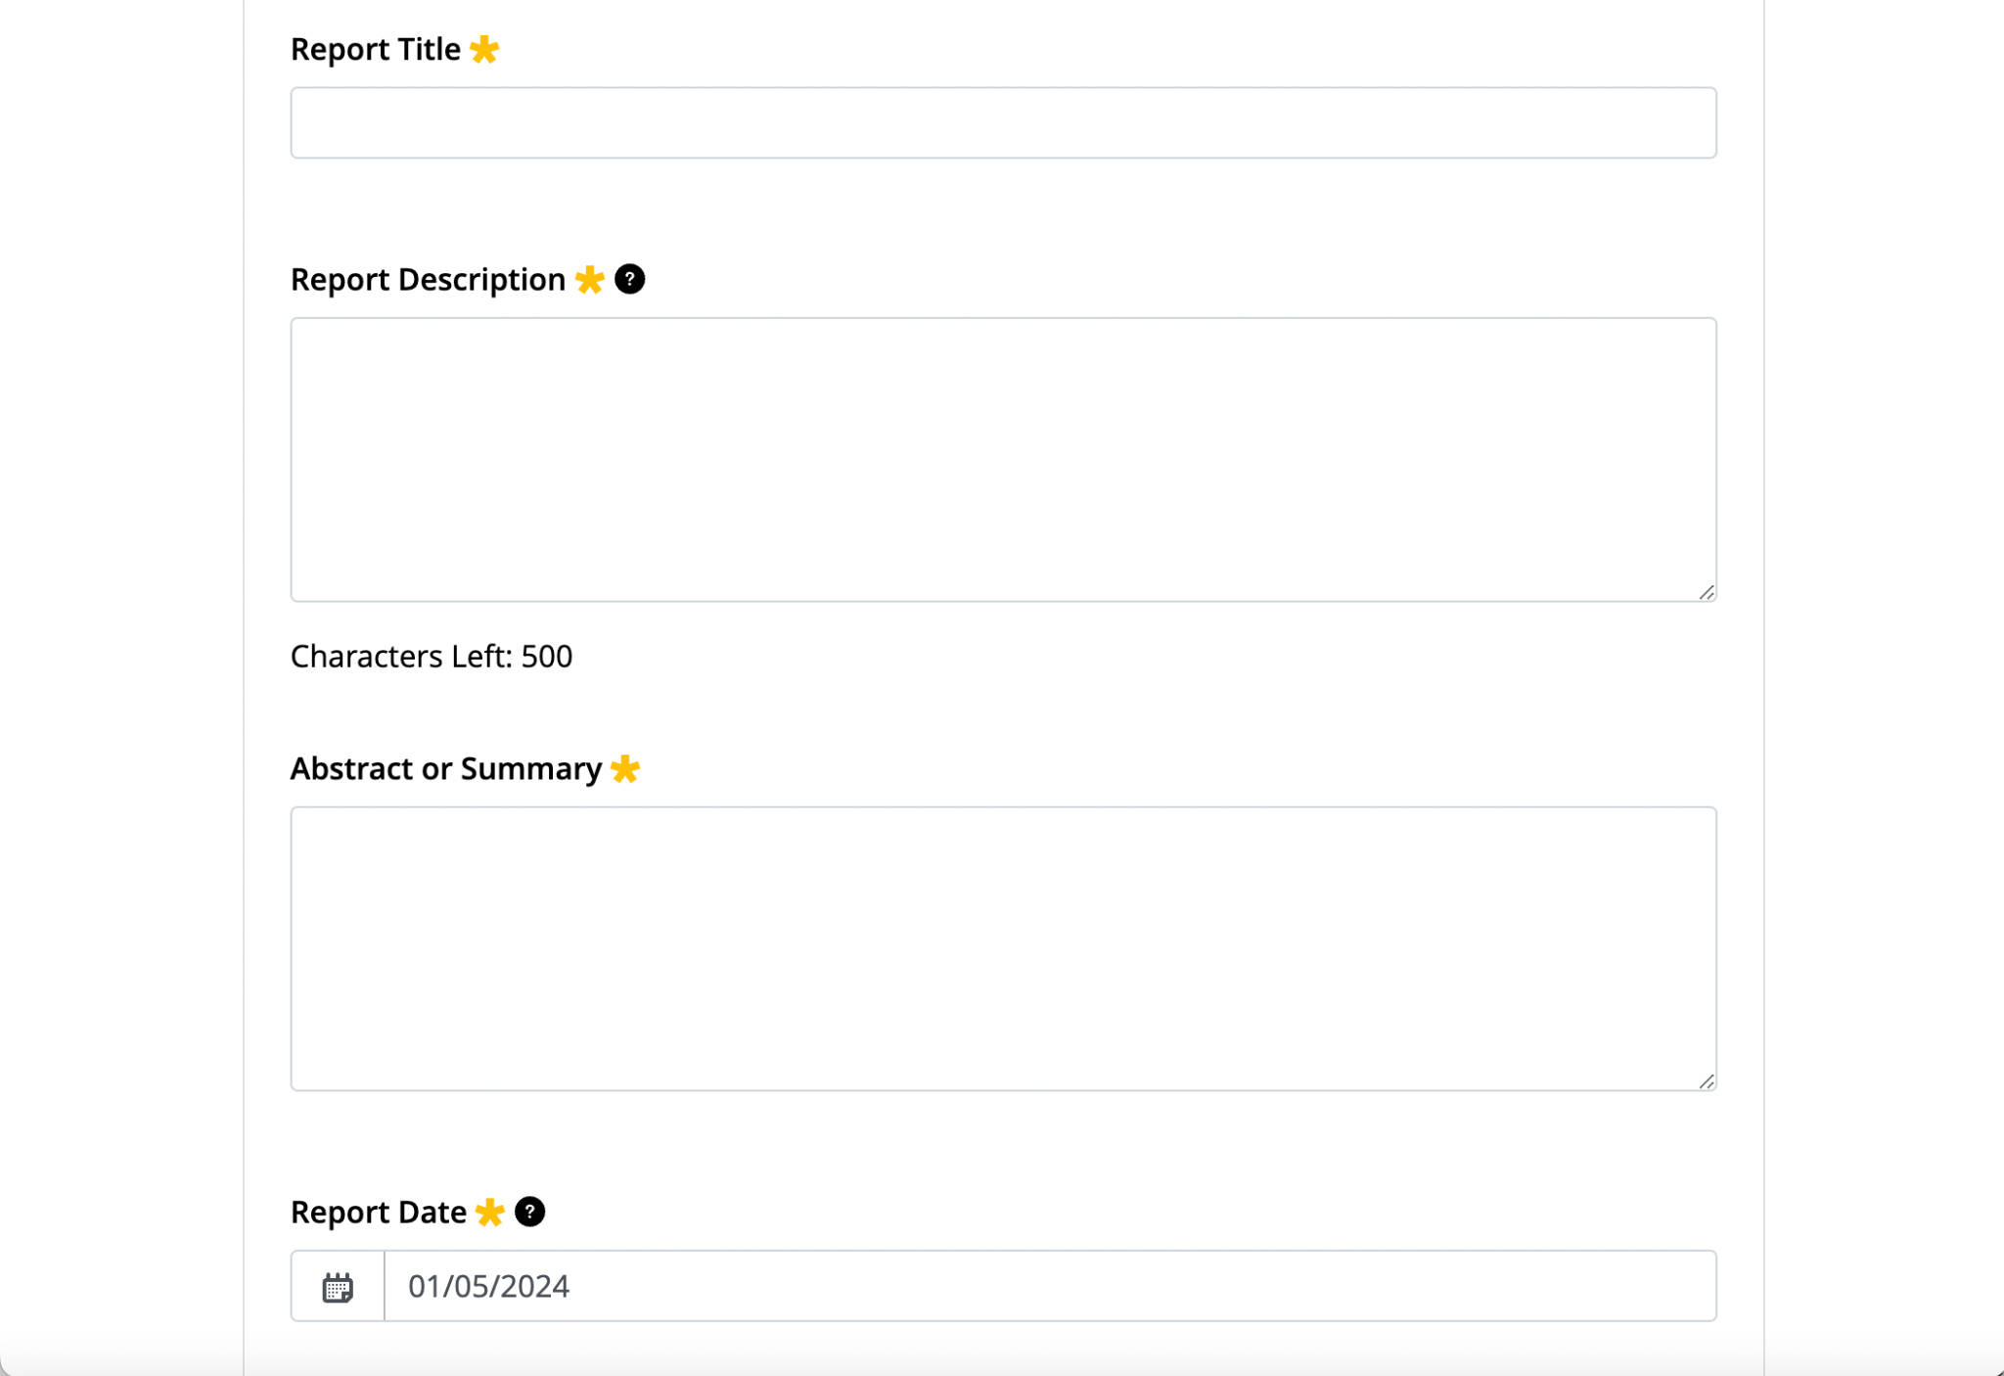
IVSS Research Report Upload Tool: Report Information
Describe your project in 500 characters or less
Abstract or Summary from research report
Notes:
Description is a quick overview of the project; Abstract can come directly from report

Slide 9
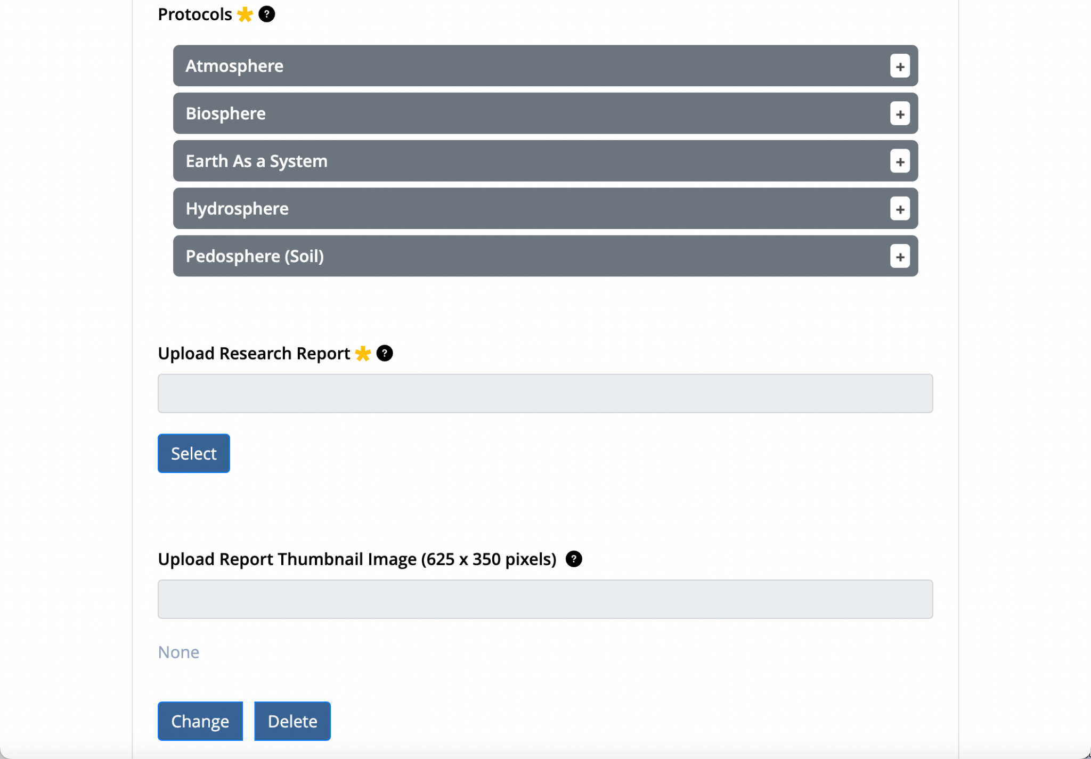
IVSS Research Report Upload Tool: Report Information
Select all GLOBE protocols you used
Upload a PDF, DOC, or TXT file
JPG or PNG image to display with your report

Slide 10
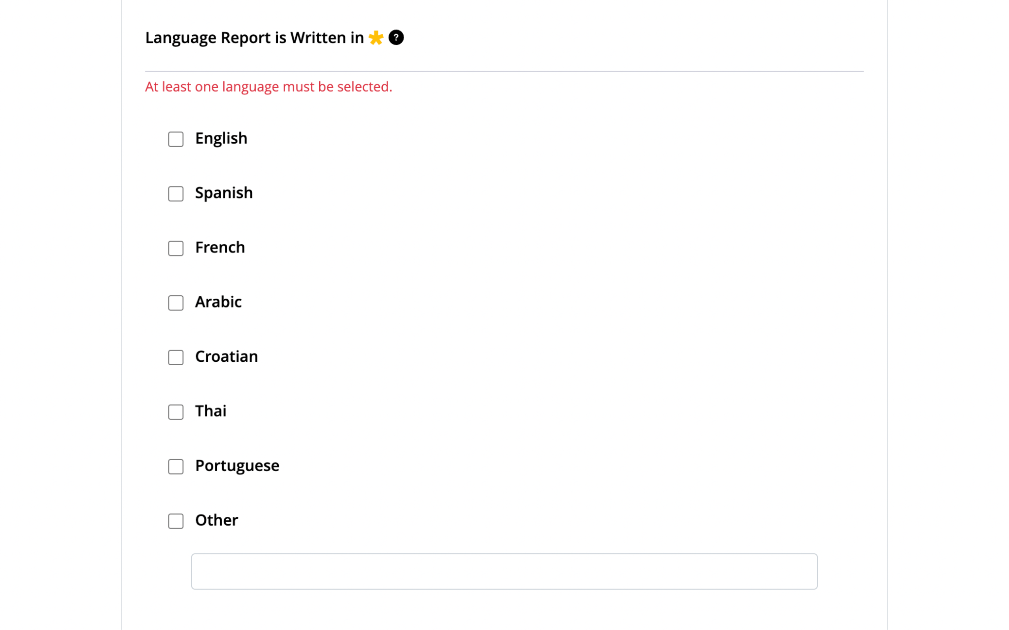
IVSS Research Report Upload Tool: Report Language

Slide 11
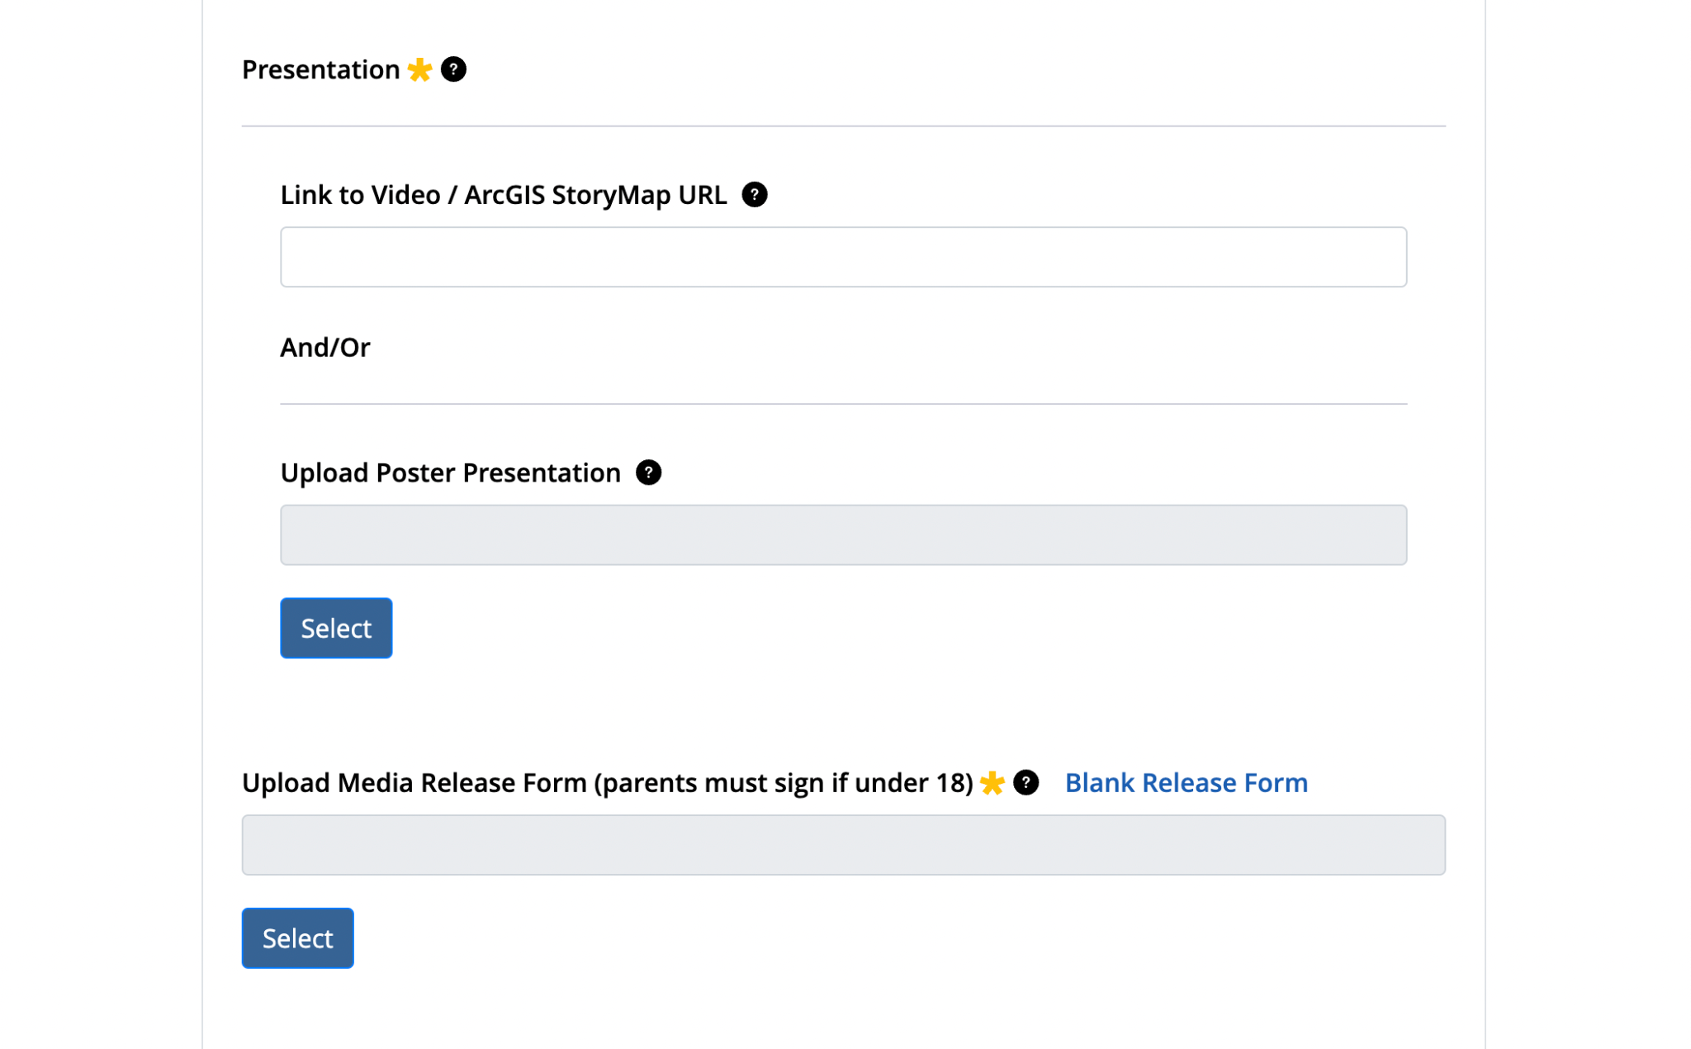
IVSS Research Report Upload Tool: Presentation
Web link (URL)
Upload a PDF or PPT file
Needed for anyone whose image is in the report!

Slide 12
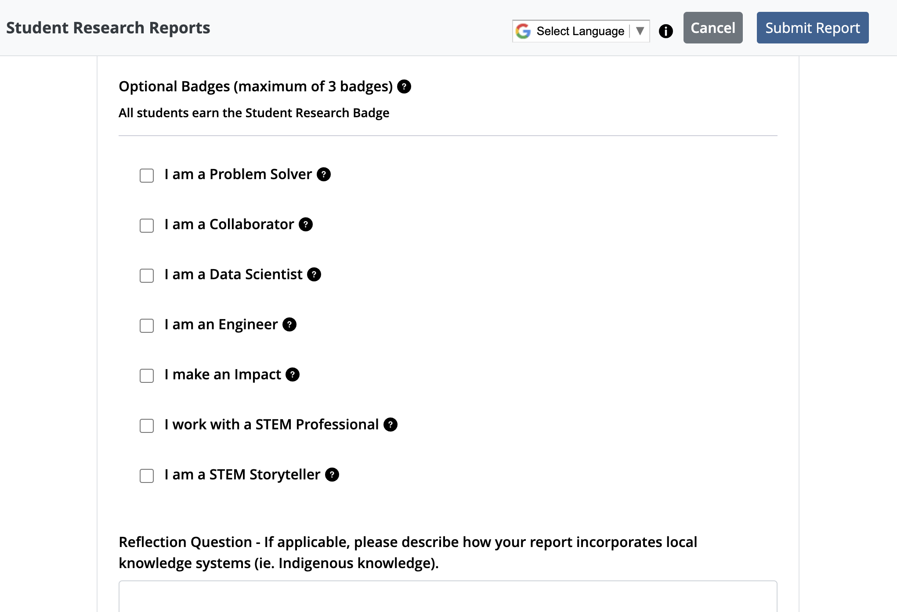
IVSS Research Report Upload Tool: Badges
Select up to 3 badges
Notes:
As you are writing your report, be sure to explain how you worked toward the badges in your report.

Slide 13
Edit Your Report (time is limited!)
Notes:
Teams have a few days to edit their reports after they submit. Please edit rather than re-submit. If students miss the edit window and have to resubmit, please email the IVSS team to let us know so we can avoid duplicate project submissions.

Slide 14
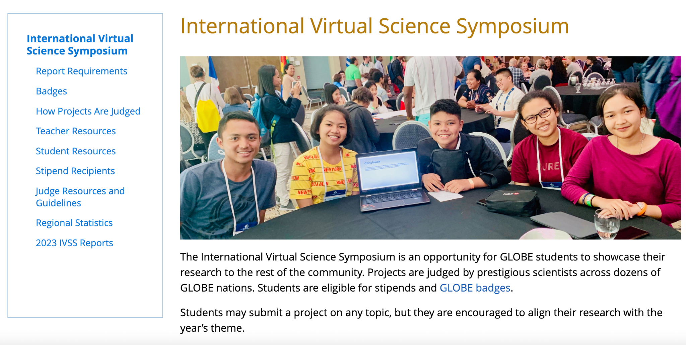
Additional Project Resources
Notes:
An example of a project from the 2023 IVSS is showcased above. Student researches from Kenya, Africa investigated the impact of mulching on soils. Research questions included how mulching affects soil pH, whether mulching is a suitable substitute for chemical fertilizers and herbicides, and whether mulching is an effective agricultural practice.
Read more about this student research project by visiting the 2023 IVSS Stipend recipient page: https://www.globe.gov/news-events/meetings_symposia/virtual-conferences/ivss-stipend-recipients

Slide 15
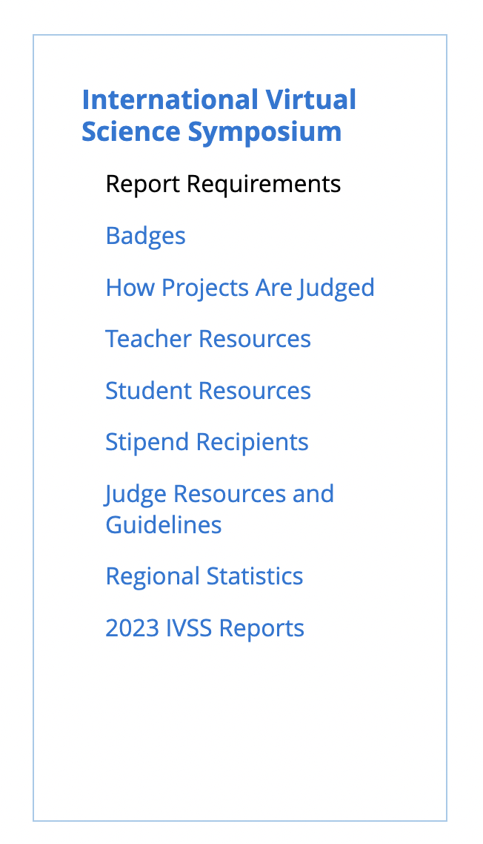
Additional Project Resources: Report Requirements
Written Report
Title & Abstract or summary
Five (5) Sections: Introduction, Methods and materials, Results and data, Discussion, Conclusion
Citations
Badge Descriptions
At least two (2) additional badges and a four-star report are required to be eligible for stipend drawing.
Presentation
Link to Video or ArcGIS StoryMap OR
Presentation poster (PPT, PDF, or image file)
Thumbnail image
Image to be displayed with the report
Photo Release Form
Notes:
Report requirements vary by grade level.

Slide 16
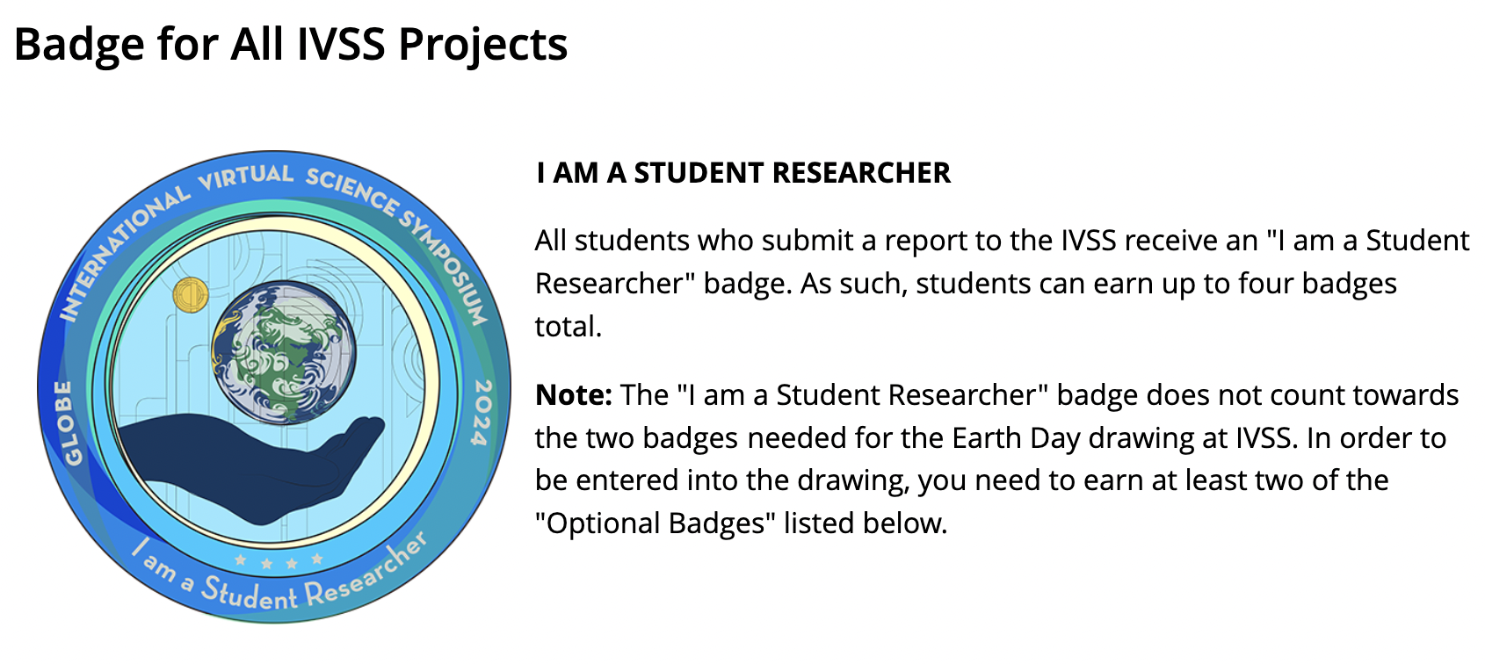
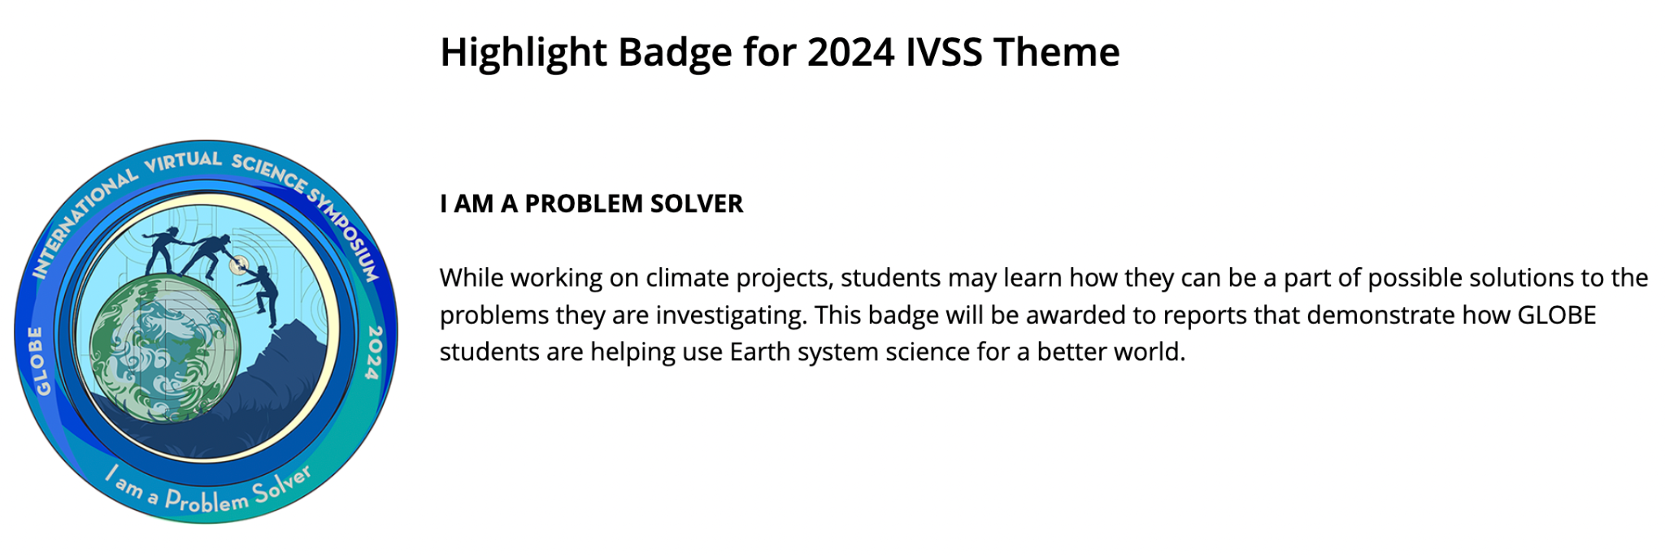
Additional Project Resources: Badges
Students can earn up to 3 additional badges
Report should describe how each badge was earned
Notes:
Students can earn up to 3 additional badges (out of 7) and report should explain how each badge was earned. A minimum of two additional badges is required to be part of the stipend drawing.

Slide 17
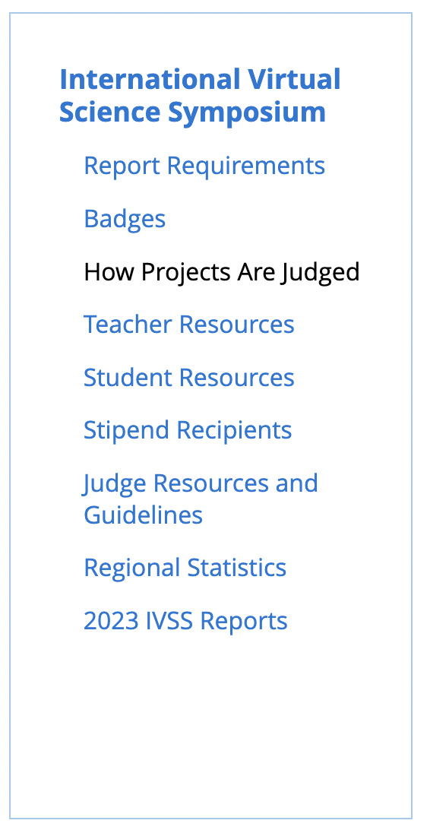
Additional Project Resources: How Projects are Judged
Rubrics by grade level/age
Includes details on what each project element should include
Students are encouraged to review the rubric information to support the writing and research process.

Slide 18
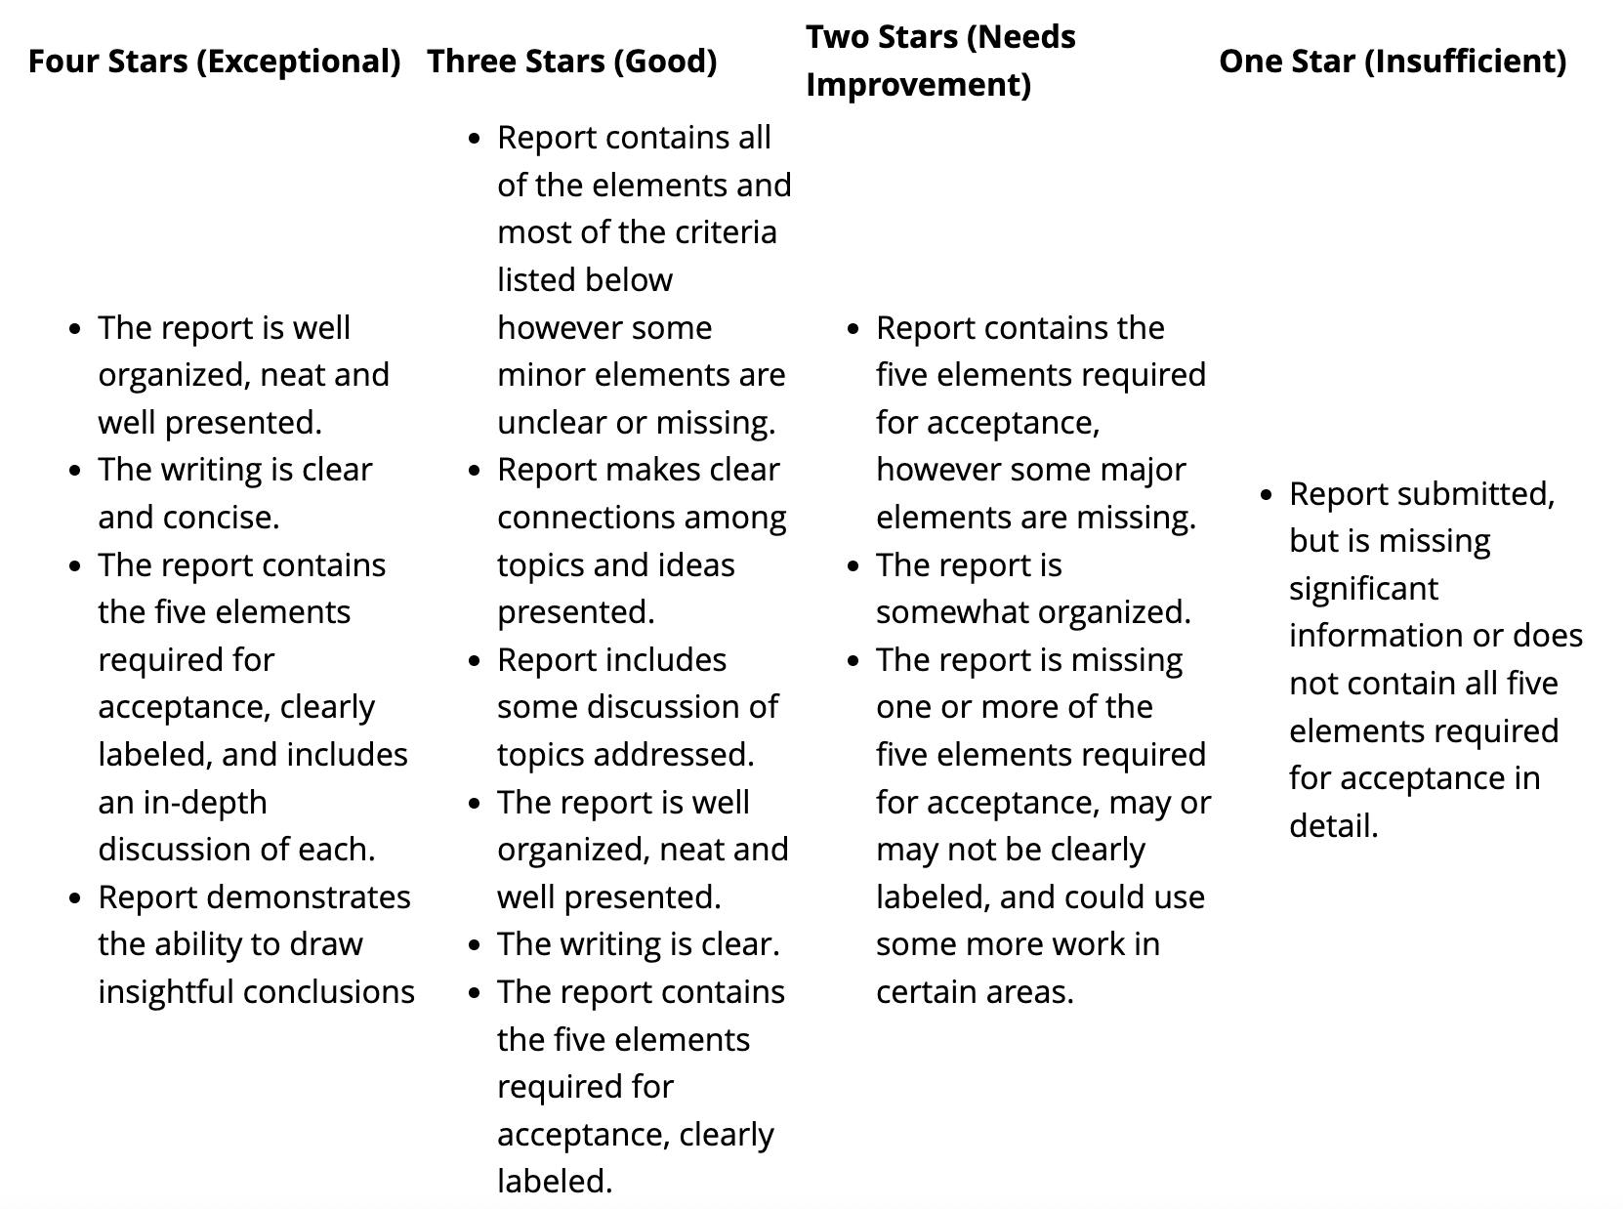
Additional Project Resources: How Projects are Judged
Rubric Example, Grades 9-16 (Ages 14-18+)
Notes:
Insightful conclusions - next steps

Slide 19
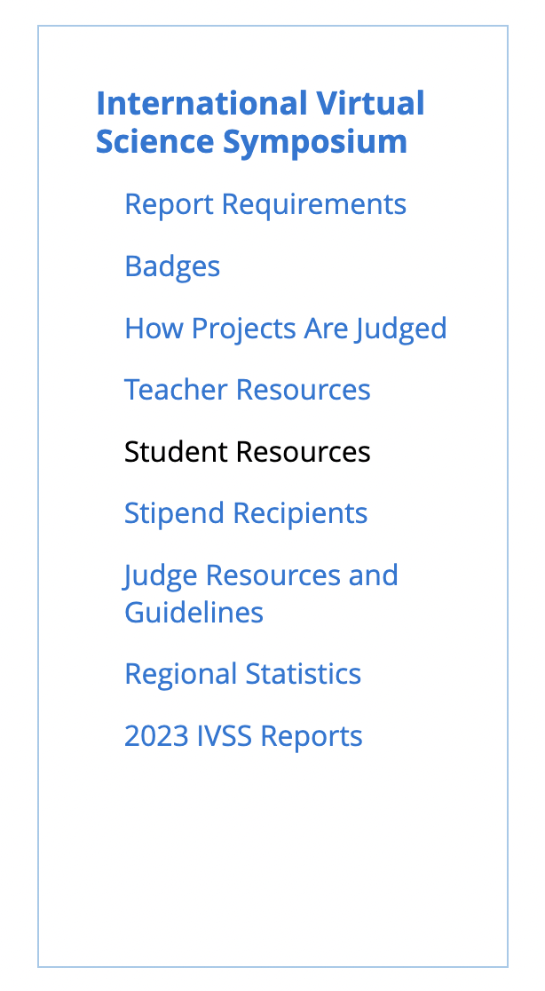
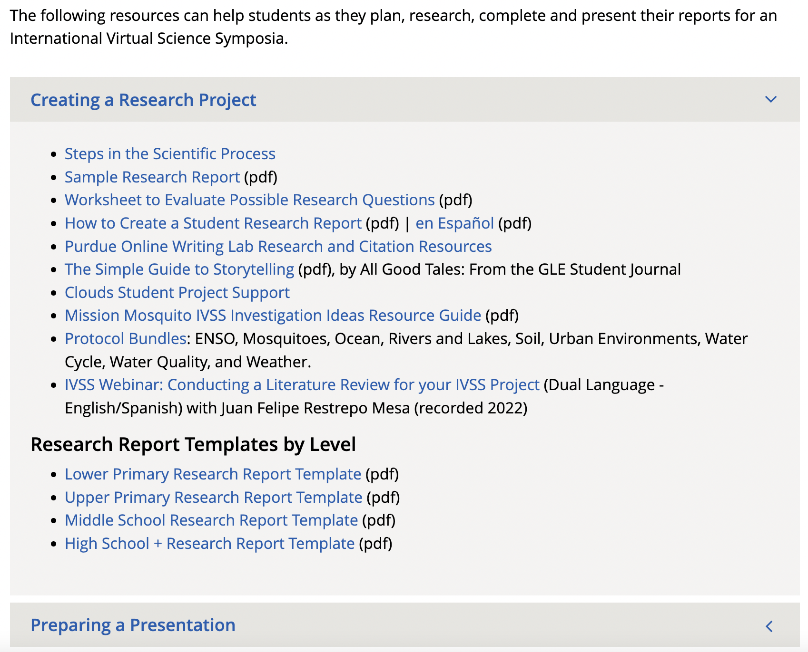
Additional Project Resources: Student Resources
Notes:
Student resource topics: Creating a Research Report, Preparing a Presentation, Data Resources, and Webinars.
Highlight student resources to create a research report, including report examples and templates by grade level

Slide 20
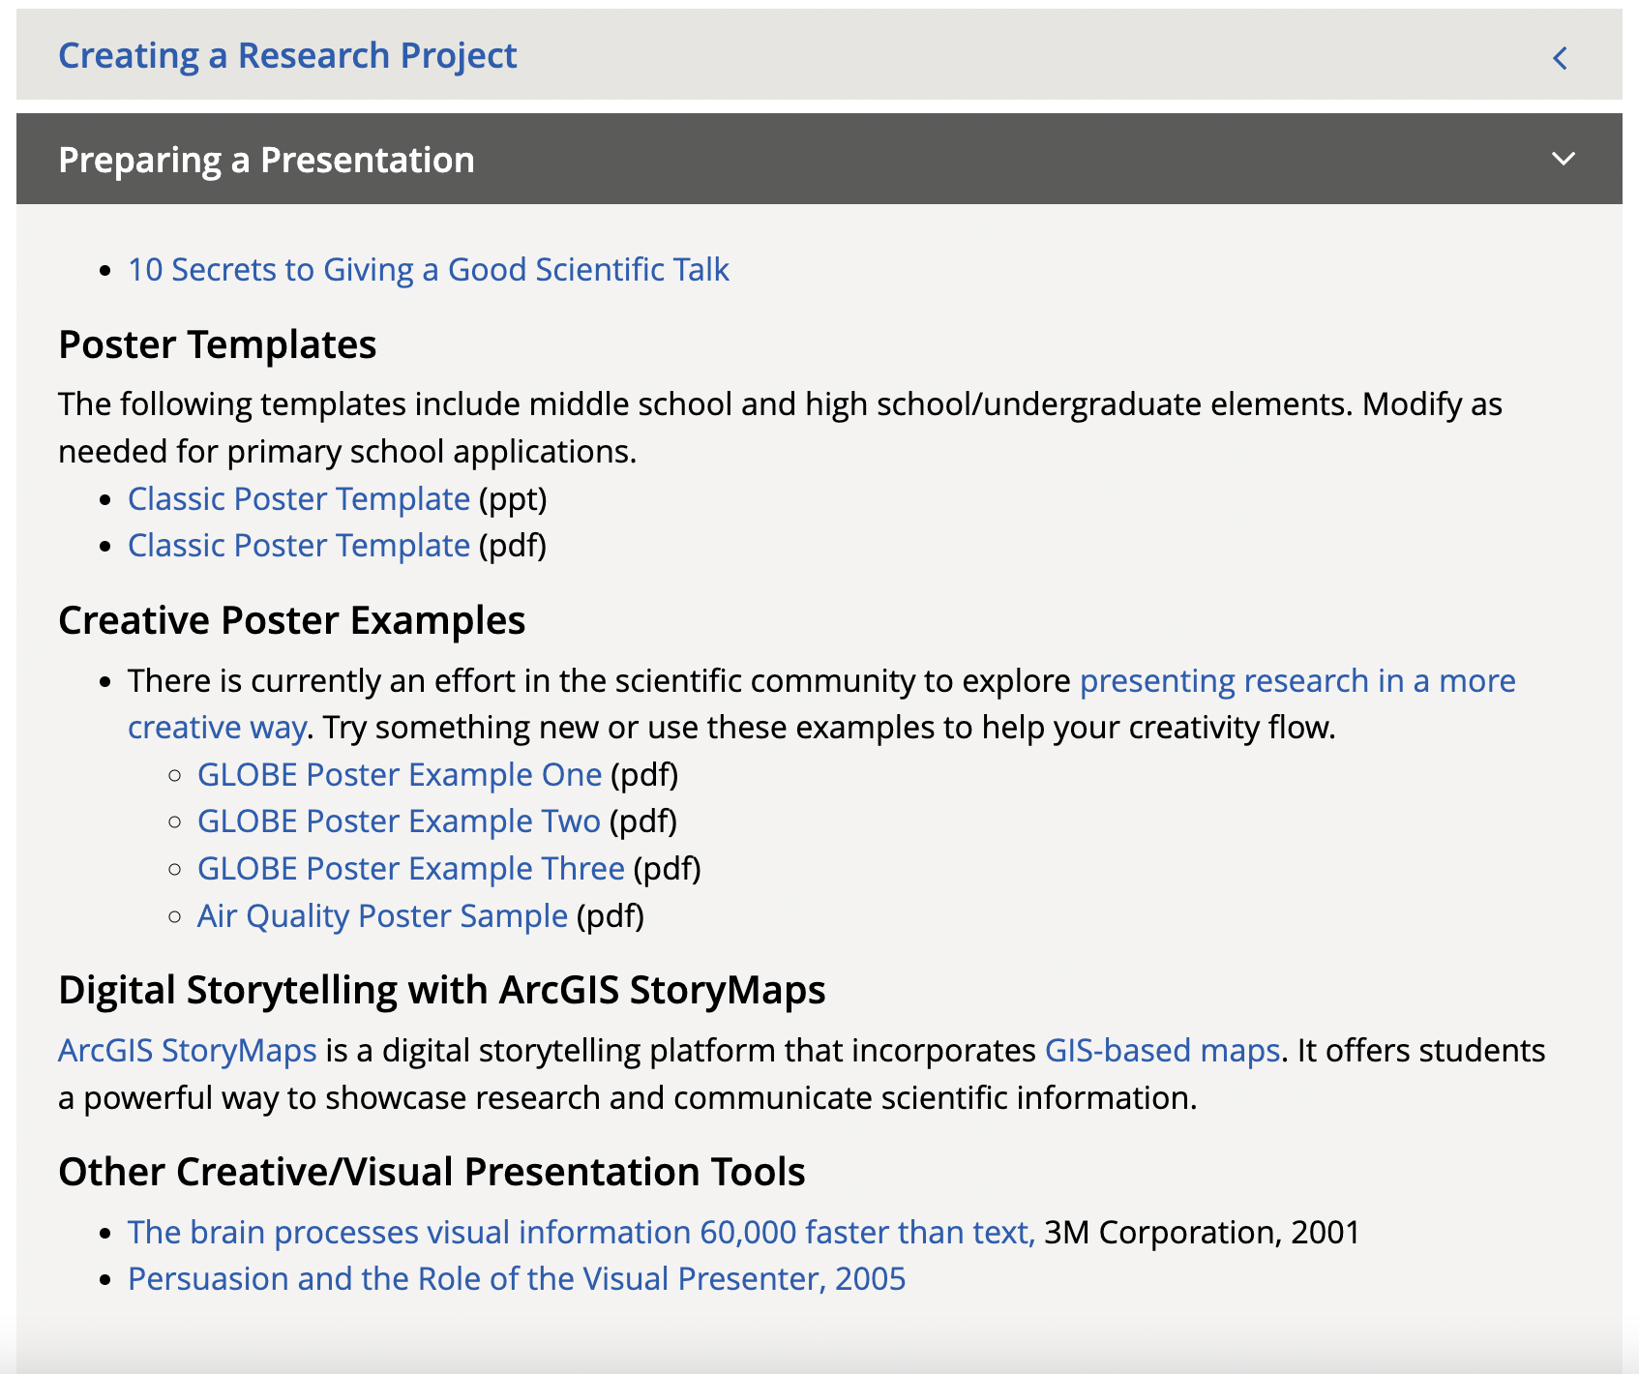
Additional Project Resources: Student Resources
Notes:
Highlight resources for preparing a presentation, including examples and templates

Slide 21
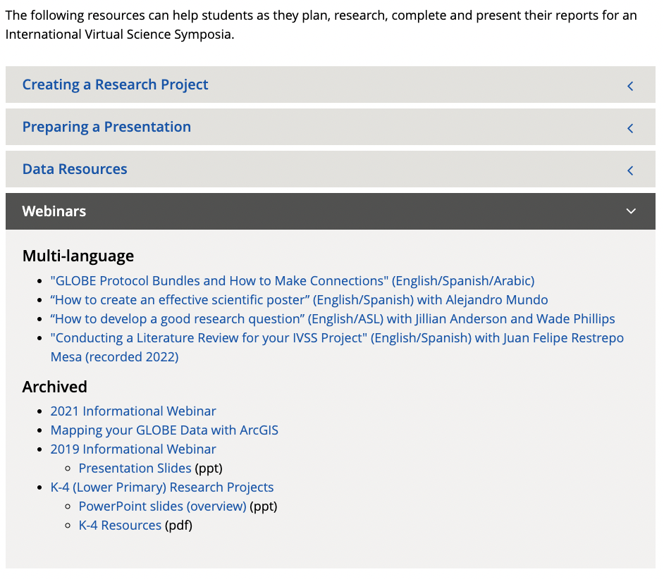
Additional Project Resources: Student Resources
Notes:
Highlight recorded webinars: resources to help students get started with a project, visualize data, and more

Slide 22
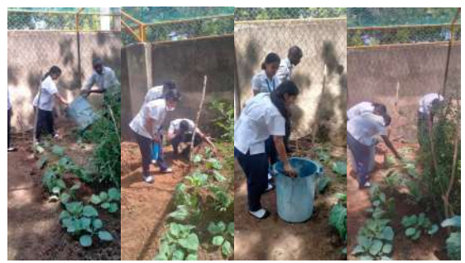
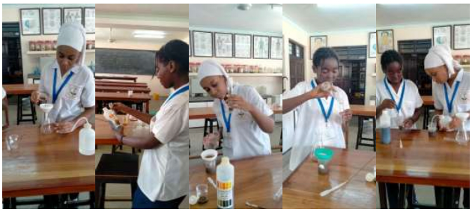
Important Reminders
Photo Release Forms
Required for everyone who appears in a photo or video!
Projects are due on March 6!
Stipend drawing in April
Qualified projects: 4-star rubric rating and at least two optional badges
Stipend recipients will be invited to the 2024 GLOBE Annual Meeting Student Experience
Stipend can be used toward attending the Annual Meeting
Above images: Students from Shree Swaminarayan Academy in Kenya investigating the impact of mulching on soils.

Slide 23
2023 IVSS Stipend Recipients
Latin America and Caribbean
Title: Relación entre el avistamiento de mariposas, las variables ambientales y la vegetación del patio escolar
Teacher: Darío Greni
School: Escuela No. 88 Alfredo B. Nobel
Location: Uruguay
Near East and North Africa
Title: Soil (Pedosphere) Investigations
Teacher: Wejdan Melhem
School: King Abdullah The Second School for Excellence Irbid
Location: Jordan
North America
Title: Comparing Select Atmospheric Parameters Between Disparate Geographic Locations Using Collaboration Between Two GLOBE Schools
Teacher: Diana Rae Johns
School: Crestwood High School
Location: USA
Title: Predicting Volume of Mosquito Borne Diseases Using A.M.E.A Sensor/Radio Network
Teacher: Cassie Soeffing
School: Institute for Global Environmental Strategies (IGES)
Location: USA
Africa
Title: Investigating the Impact of Mulching on Soils
Teacher: Henry Moseti
School: Shree Swaminnarayan Academy
Location: Kenya
Asia and Pacific
Title: Investigating a Comprehensive Study on the Factors Influencing Color Change in Caladium bicolor for Enhanced Cultivation and Economic Benefits in Horticulture
Teacher: Pornpawit Tabchum
School: Paphayomphittayakom School
Location: Thailand
Europe and Eurasia
Title: Connection Between Peat and Plants
Teacher: Jaan Pärn
School: Estonian Learning Expedition
Location: Estonia
Visit the IVSS Stipend Recipients page to explore these projects!

Slide 24
2024 IVSS Timeline & Webinars
11 October 2023: General IVSS Informational Webinar (recorded)
25 October 2023: Climate Resources Webinar (recorded)
6 December 2023: Badges Webinar (recorded)
15 December 2023 - 06 March 2024: Reports Accepted
December 2023 - February 2024: Judge Recruitment
18 January 2024: Submitting Student Projects Webinar
20 March 2024: Judging Webinar
20 March - 03 April 2024: Judging Period
22 April 2024: Feedback to Students
Notes:
We will have an additional joint webinar witht the Year of Climate and Carbon Campaign (YCC) later in October.
Then starting in January and ending March 1st 2024, we will be accepting projects
March 22nd 2023 will be the judging webinar, which informs judges on expectations and how to judge IVSS projects.
March 22nd will be the start of the judging period which will end April 5th 2024.
Finally April 5th 2024 we will have our Earth day celebration and the drawing for the stipends.

Slide 25
Get in touch with us:
globeivss@ucar.edu
https://www.globe.gov/news-events/meetings_symposia/virtual-conferences

Slide 26
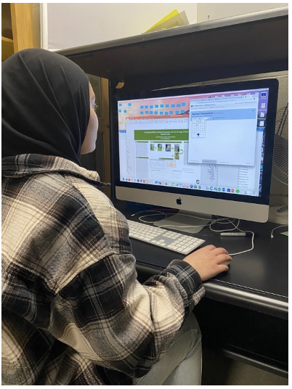
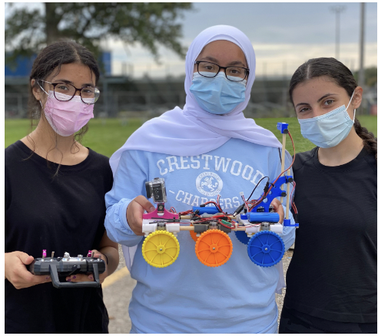
Thank you! Questions?

