Slide 1


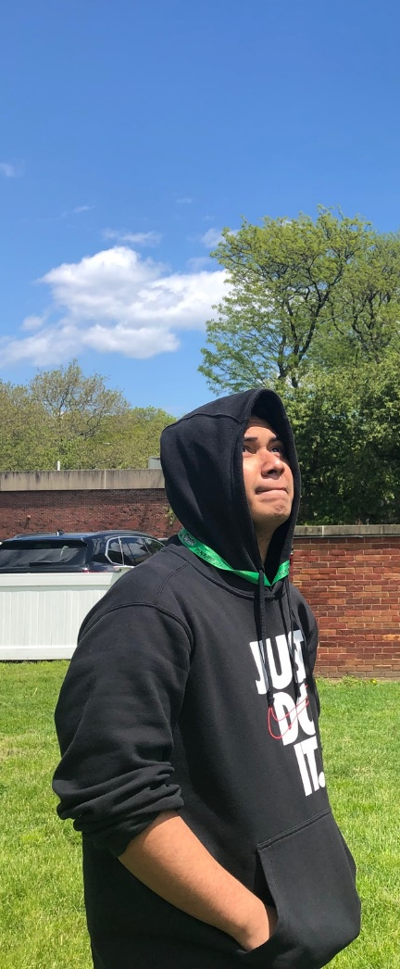
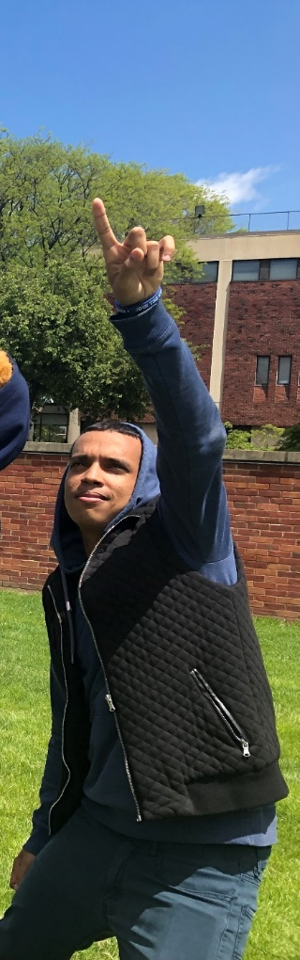
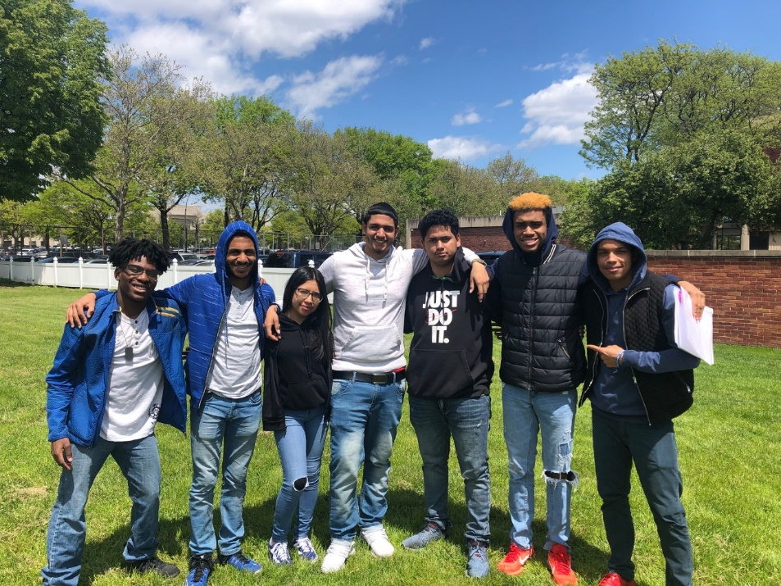

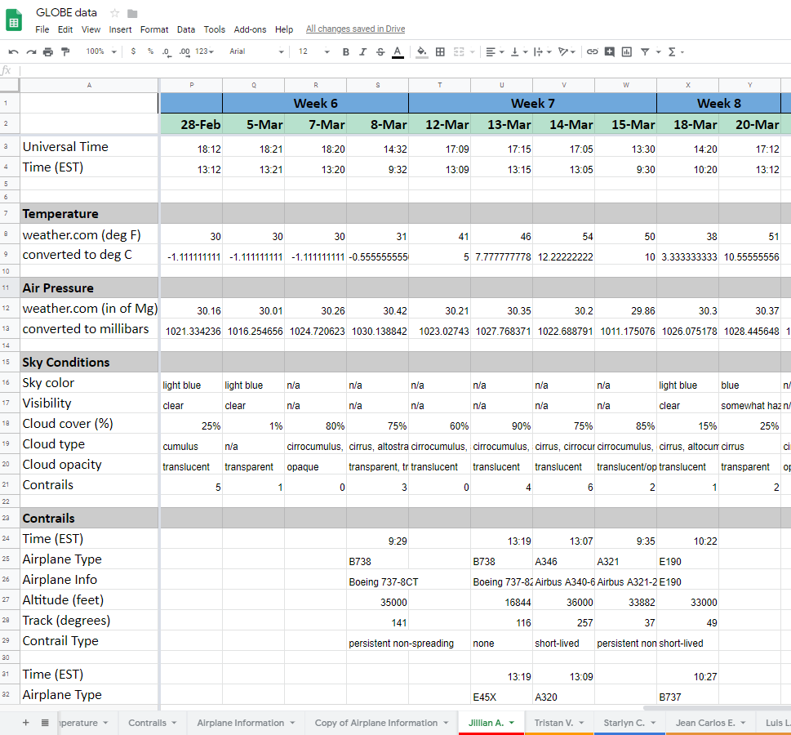

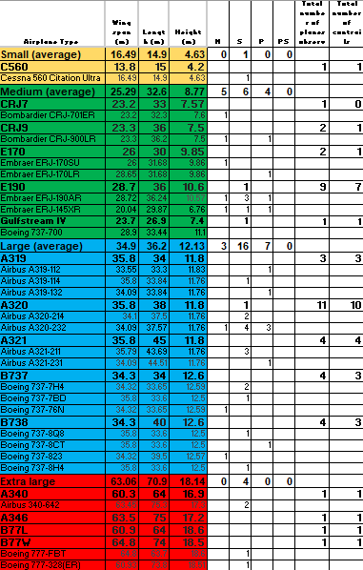
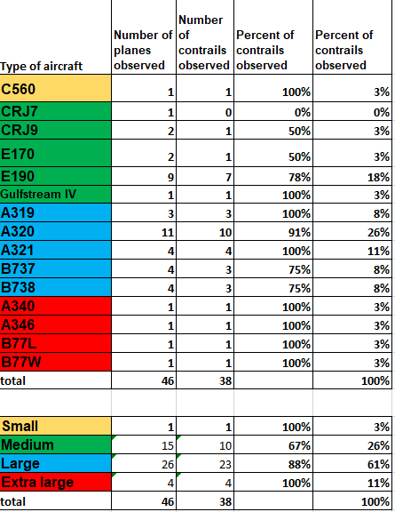
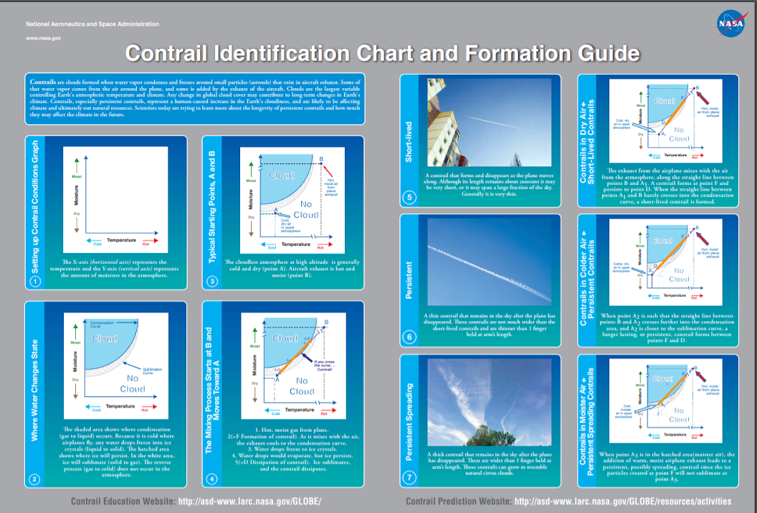
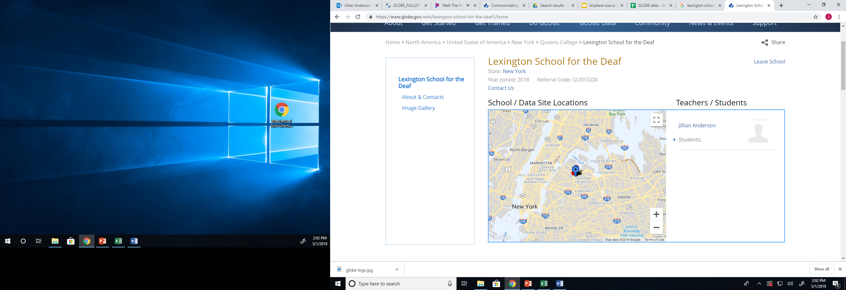
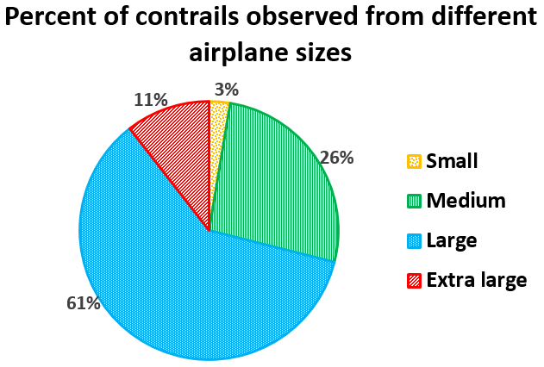


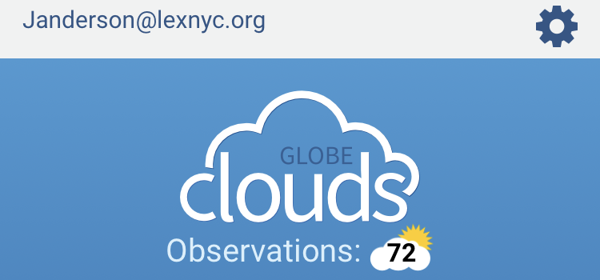

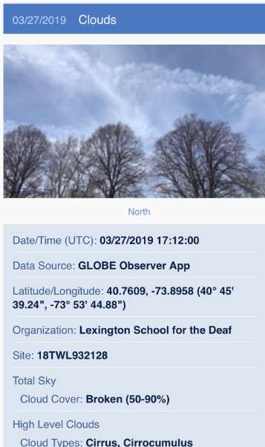
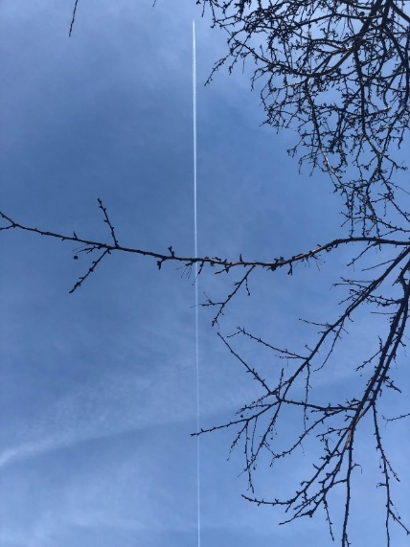
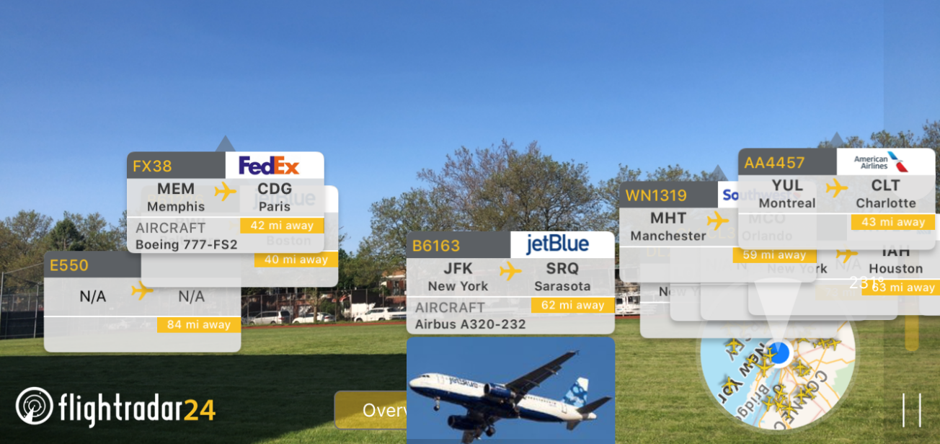
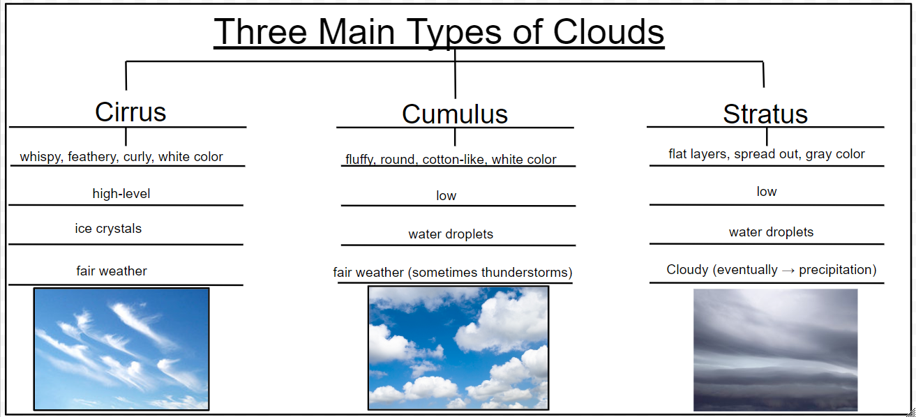
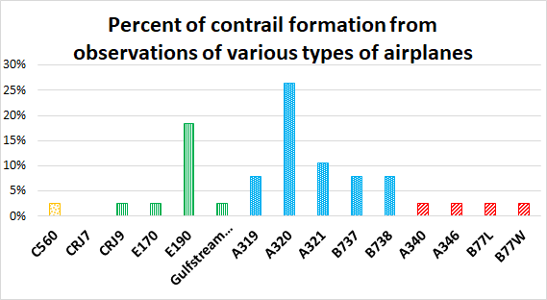
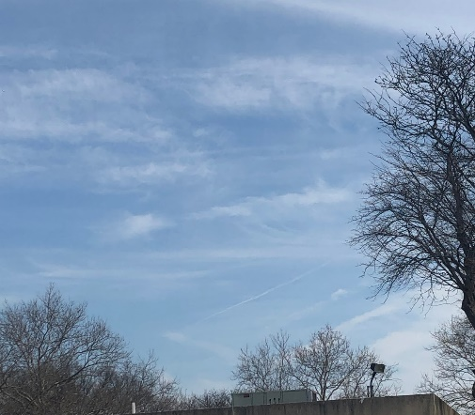
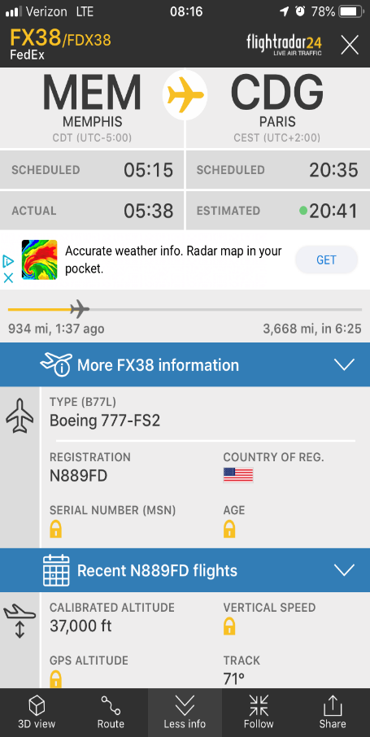
Does Airplane Size Affect the Number of Contrails Produced?
Luis L., Tristan V., and Jean Carlos E.
Lexington School for the Deaf
Queens, NY
Abstract
Research Methods
Results
Field Photos
  The intent of this research project was to compare the number of contrails observed by a set of students at Lexington School for the Deaf to the size of the airplane observed producing the contrail. The hypothesis that bigger airplanes will make more contrails compared to smaller airplanes seems to be supported by the data collected and analysis completed.
  Our Investigation Site
Lexington School for the Deaf is located in Queens, New York.
This is an urban area that is a borough of New York City.
The school is located in an area that is characterized by typical climate patterns following the four seasons of the northeastern region of the United States of America.
There are a few trees and buildings that block the view of a small portion of the sky for daily observations while on the school grounds. However, more area of the sky is visible than would typically be possible at an urban school location.
Lexington School for the Deaf is located approximately 2 miles from LaGuardia Airport.
Observations were collected in accordance with GLOBE’s Cloud Protocols, including the use of: GLOBE S’Cool Cloud Identification Chart, GLOBE Contrail Chart, GLOBE Field Guides, and the GLOBE Observer app; to record information about airplanes in the area, the Flightradar24 app was used.
Data were organized into a class-wide Google Sheet.
Data were collected as often as possible (weather permitting) during weekdays that school was in session. On Mondays and Fridays, data were collected between 9:30am-11am EST and Tuesday-Thursday data were collected between 1pm-2pm.
Figure #1 and 2: Field Observations
Class Google Sheet Data of Clouds and Atmosphere
Contrail Observations
Research Question
Discussion and Conclusions
  Problem
Do bigger airplanes make more contrails compared to smaller airplanes?
  Hypothesis
We think bigger airplane will make more contrails because bigger airplanes have a lot of exhaust gas.
Analysis of Results
We see a trend that suggests larger airplanes typically make more contrails.
  Discussion
Our hypothesis was supported by our data. We typically saw larger airplanes produce more contrails.
Figure #3 and 4: Contrails and Airplane Size
Introduction
Map of Study Site
Experimental Plan
Go outside with GLOBE Contrail Chart & Cloud Identification Chart.
Make observations about clouds (kind of clouds, percent of sky covered by clouds, cloud opacity, sky visibility, color of sky, contrails) and record time (Eastern Standard Time).
Record data in Google Sheet. Find the temperature and air pressure from Weather.com; also note in Google Sheet.
After organizing our information about airplanes and contrails we researched to find information about the planes’ sizes.
We grouped the planes by size in four classes: small, medium, large and extra large based on sizes.
Using that information, we made a graph to represent the relationship between airplane sizes and number of contrails observed.
  Error Analysis and Next Steps
One problem is that we did not see many “small” airplanes compared to other airplanes.
It would be helpful to collect more data from more planes.
We are all human so we will make mistakes.
If possible we would need to find a time during days that will be the same everyday for observations.
Our system for organizing planes into categories of sizes was created by our teacher. There may be a better way of representing this data that we do not know about yet.
Figure #5 and 6: Graph Analysis
GLOBE Badges, Collaborations, and Credits
This research was completed with the help and support of a number of outside participants. This project would not have been possible without our collaborators. We would like to give special thanks to NASA’s Langley Research Center, including but not limited to Rosalba Giarratano, Marilé Colón Robles, Dr. Margaret Pippin, William Wood, Christina York, Tina Harte, and Jessica Taylor. We had the great privilege of having a video conference via Zoom with this amazing group of scientists in the spring of 2018 regarding our research and future interests and they have continued to provide support and encouragement.
We would also like to thank our family at the Lexington School for the Deaf for their continued support and interest in our endeavors. Special thanks to our administrators and staff who have continued to encourage our projects and goals, including but not limited to Don Galloway, Jane Moran, Frank Dattolo, Cindy Casson, Amanda Heinbaugh, Dolly Dominguez, and Bill Moran.
Last but not least, we would like to thank Jennifer Bourgeault and Haley Wicklein of the GLOBE Program for helping us obtain funding and make travel arrangements for our trip to be possible!
Study Site Key:
Lexington School for the Deaf
LaGuardia Airport
Airplanes need to be 25,000 feet or higher in the atmosphere to produce a contrail.
Scan this QR Code to see our ASL signs for contrails!
GLOBE Observer App
Flightradar24 App
Bibliography
  References
  GLOBE Cloud Protocols; GLOBE.gov; GLOBE Observer app
  GLOBE Clouds Contrail Investigation - https://www.globe.gov/web/s-cool/home/contrail-investigation
  Flightradar24.com; Flightradar24 app
  Skybrary.com
  Weather.com

