Slide 1
Humus acid

Slide 2
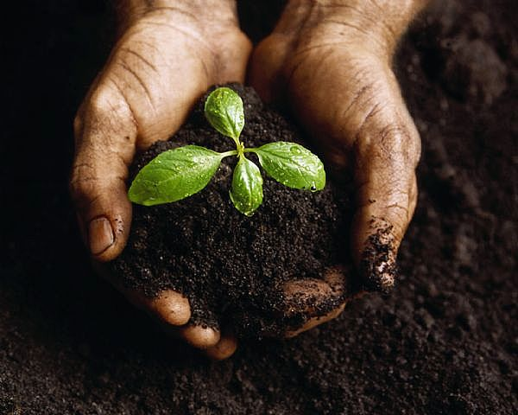
Properties of the Different Kinds of Soil
by Marlen Isakov, Baktyiar Abdyvaliev, Kenzhebek uulu Nurdoolot.

Slide 3
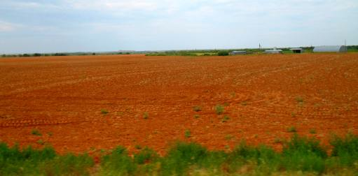
Soil Color
The most obvious property when looking at soil is its color.
Geologist officially recognize over 170 different soil colors.
But the most common color of soils are shades of black, brown, red and gray.
Red soil

Slide 4
Generally speaking, the darker a soil, the more nutrients it contains.
The darker color often indicates an increase in decomposed organic matter known as humus.
Gray soil often indicate poor drainage, while
red soil may indicate a lack of nutrients.

Slide 5
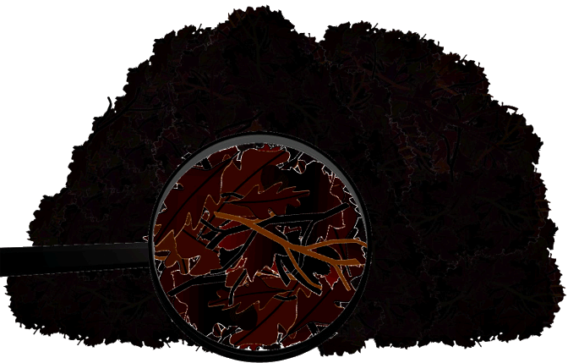
Now what about the properties of humus-- the soil formed when dead plants and animals decay.
http://www.edupic.net/sci_gr.htm
Free clip are for educational use
It is a dark brown or black (color).
It feels crumbly and loose when dry and spongy when wet (texture).

Slide 6
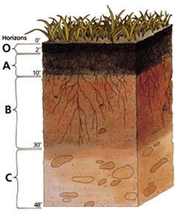
When dead plants and animals decay leaving behind the humus, it accumulates in the second layer of soil (A).
Humus holds more water than sand or silt but less than clay.
Water does drain through humus quickly.

Slide 7
Humus contains the minerals that were part of the bodies of the dead plants and animals.
It contains nutrients (minerals such as, nitrates, phosphates, potassium, copper, zinc dissolved in water) that plants need to be healthy. Without these nutrients plants will not flourish.
In short, humus brings soil to life.

Slide 8
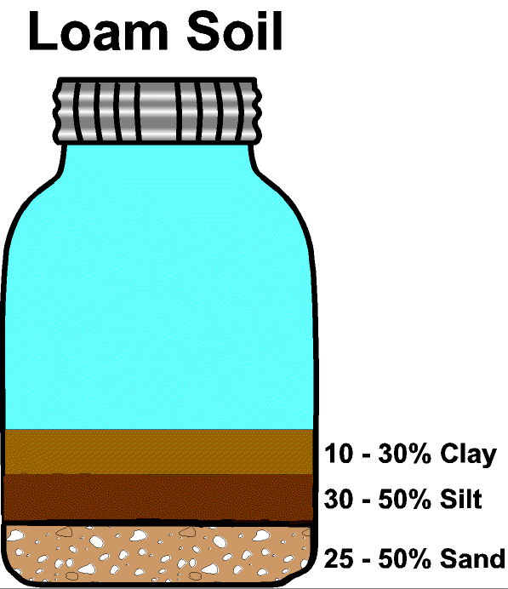
Loam is a mixture of clay, silt, sand and humus and is the best soil for growing plants.
Because loam is a mixture of four kinds of soil, it holds the proper amount of water and provides all the nutrients plants need.
Loam is formed in nature when the dead plants and animals are left to rot and mix in clay, sand or silt.
Also needs humus

Slide 9
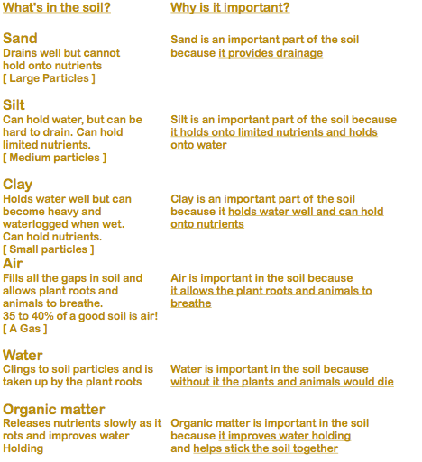

Slide 10
Soils
Soil is the function of climate (water and temperature), organisms (bacteria, insects, plants etc.), parent material (rock under the soil), relief (steepness) and time.
Factors affecting soil formation
Relief
Climate
Vegetation
Soil Formation
Drainage
Soil Biota
Parent Material

Slide 11
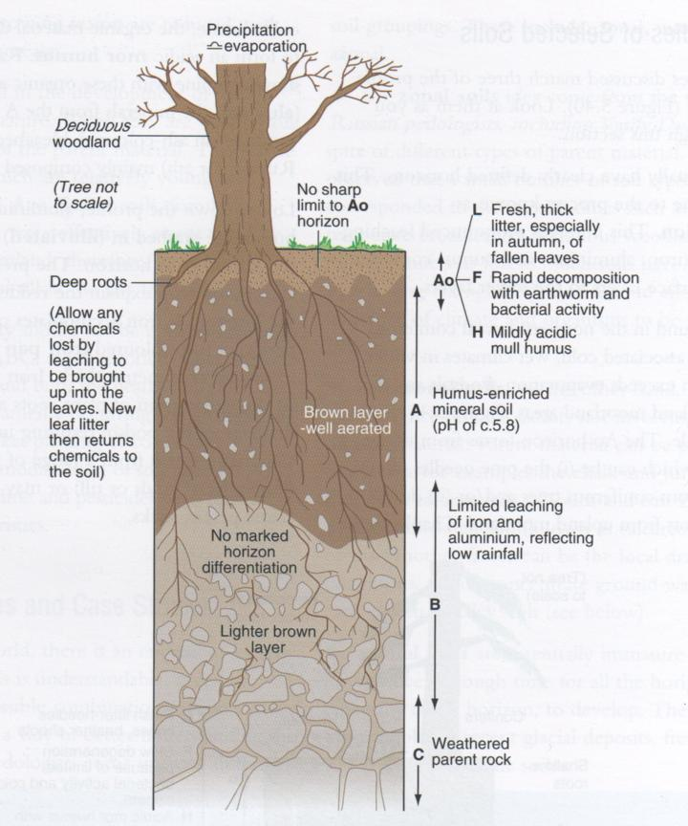
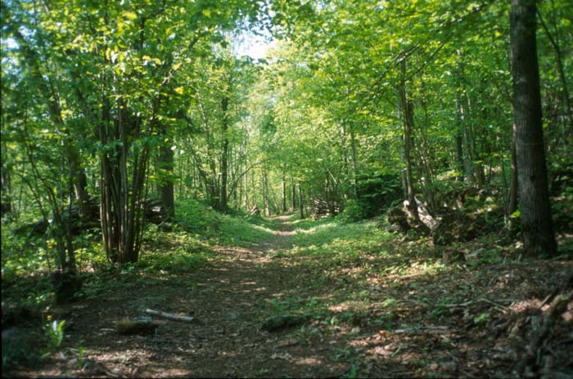
Brown Earth Profile
Slide 6

Slide 12
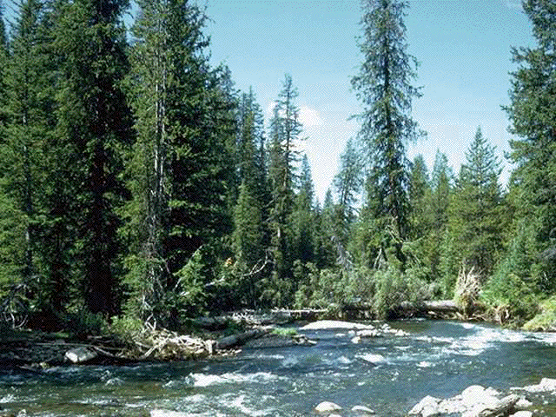
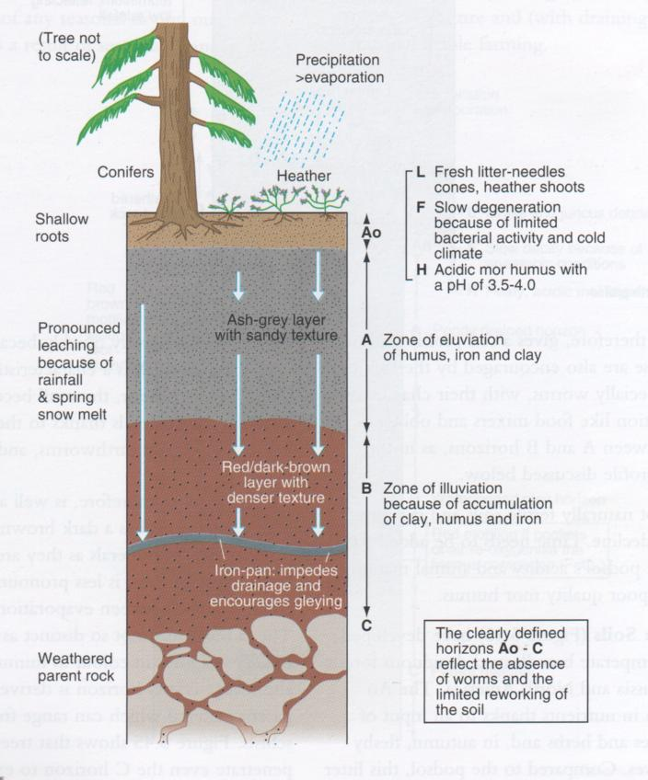
Slide 7
Podzol Profile

Slide 13
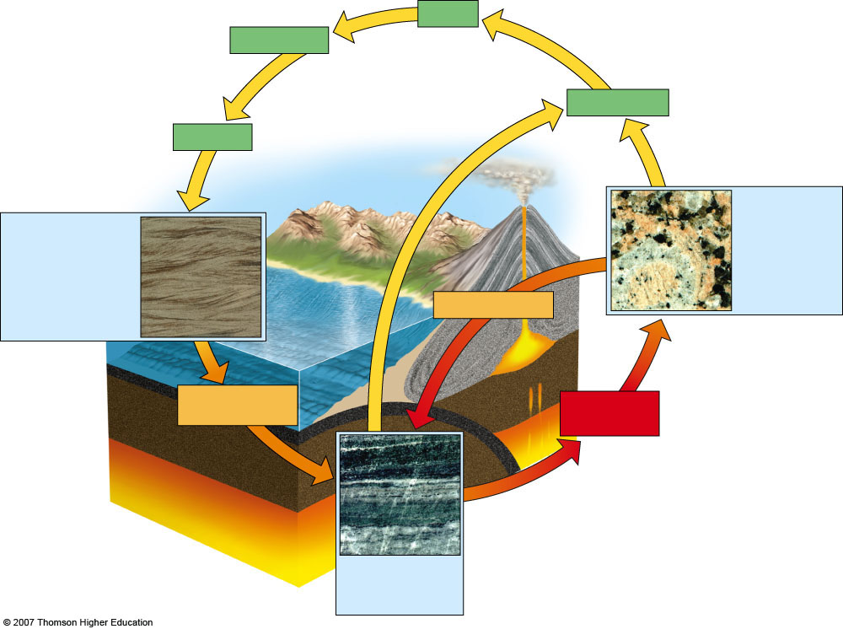
Erosion
Transportation
Weathering
Deposition
Igneous rock Granite, pumice, basalt
Sedimentary rock Sandstone, limestone
Heat, pressure
Cooling
Heat, pressure, stress
Magma (molten rock)
Melting
Metamorphic rock Slate, marble, gneiss, quartzite
Fig. 15-8, p. 343

Slide 14
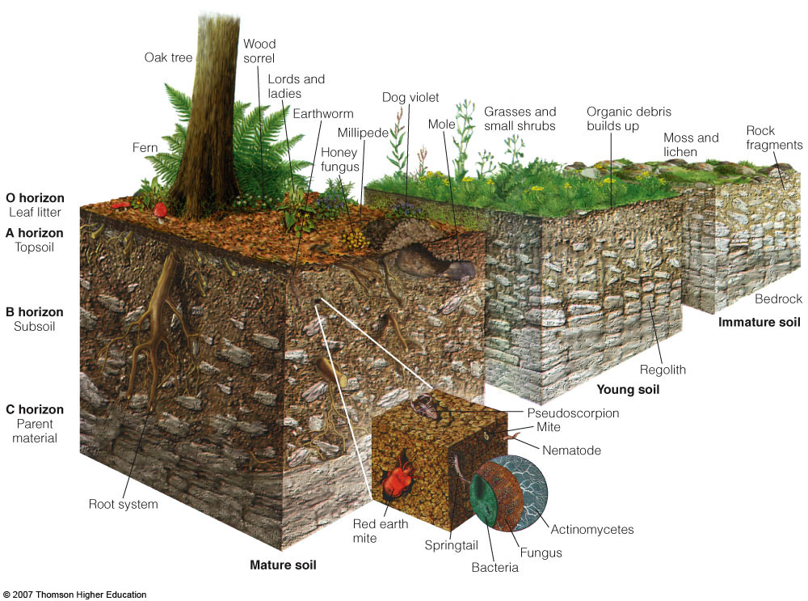
SOIL: Horizons

Slide 15
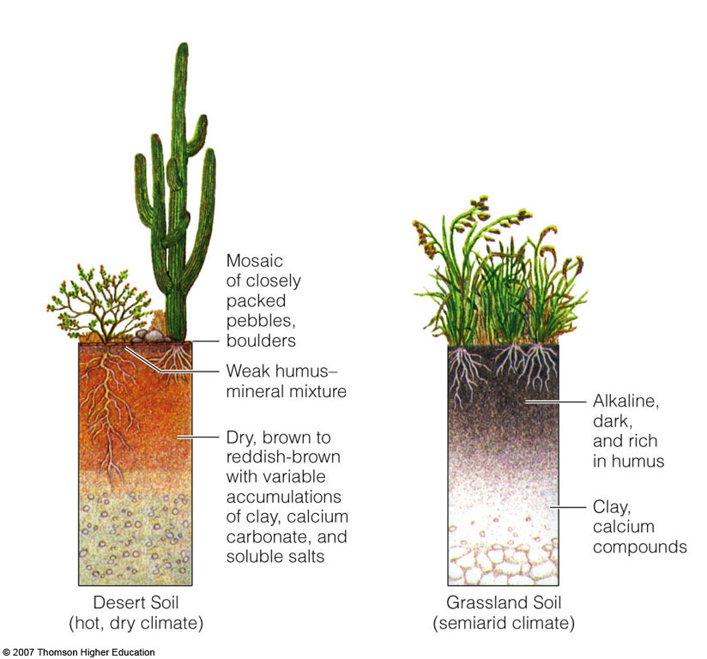
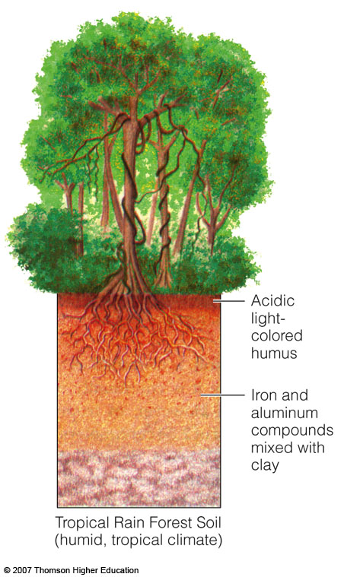
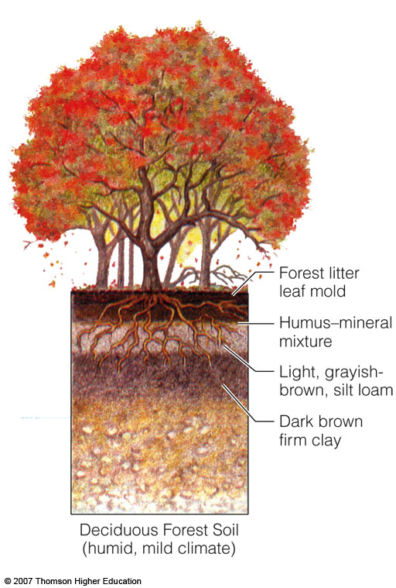
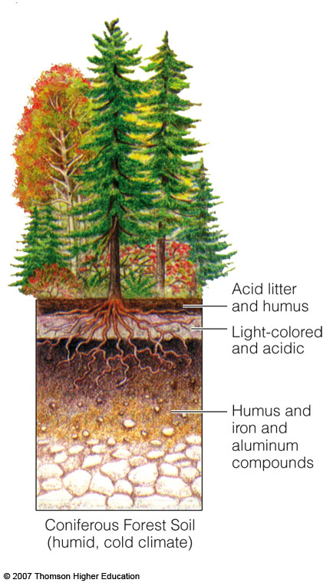
Soil Profiles of the Principal Terrestrial Soil Types

Slide 16
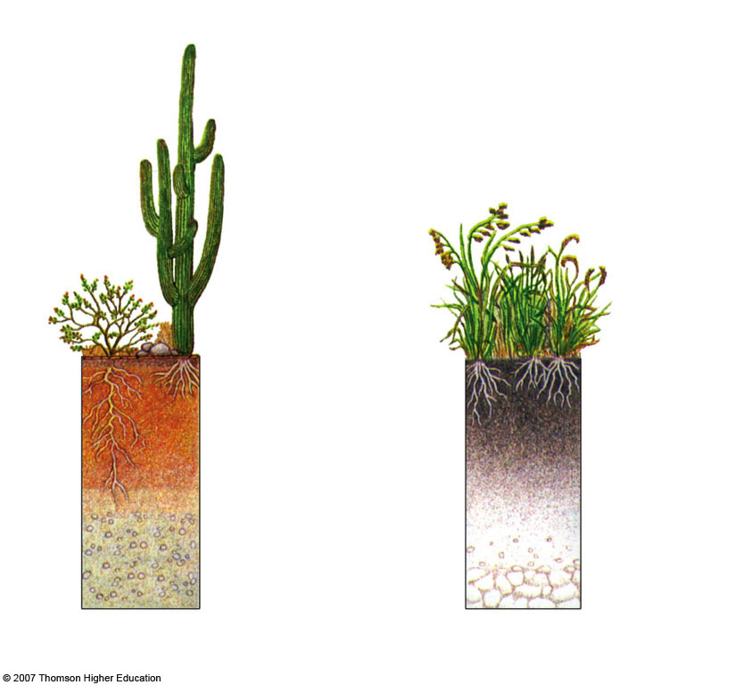
Mosaic of closely packed pebbles, boulders
Weak humus-mineral mixture
Dry, brown to reddish-brown with variable accumulations of clay, calcium and carbonate, and soluble salts
Alkaline,
dark,
and rich
in humus
Clay, calcium compounds
Desert Soil
(hot, dry climate)
Grassland Soil
semiarid climate)

Slide 17
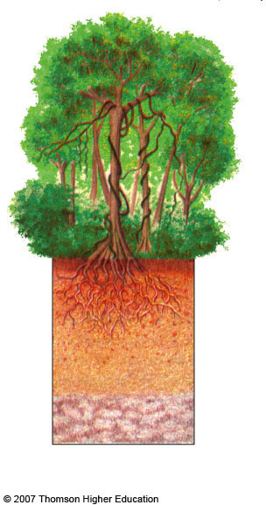
Tropical Rain Forest Soil
(humid, tropical climate)
Acidic
light-colored humus
Iron and aluminum compounds mixed with clay
Fig. 3-24b, p. 69

Slide 18
Nutrients in Soil
Nutrients are chemical elements and compounds found in the environment that plants and animals need to grow and survive.
Nitrate (NO₃-),
nitrite (NO₂-),
ammonia (NH₃),
organic nitrogen (in the form of plant material or other organic compounds), and
phosphates (PO₄³-)(orthophosphate and others)

Slide 19
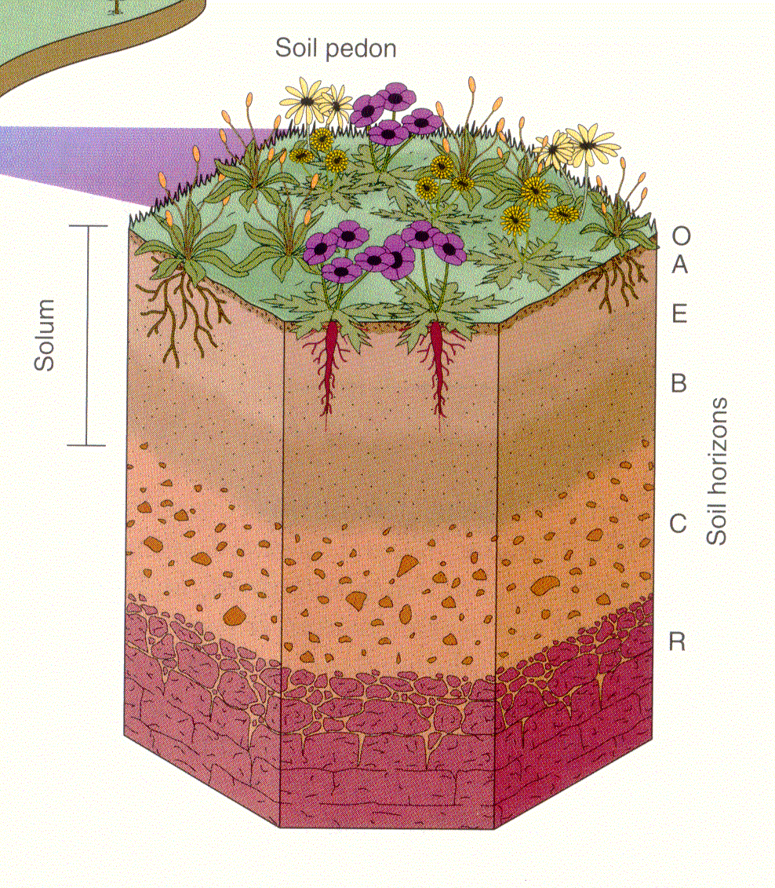
Some of the eluviated material may be deposited further down in the soil i.e. accumulation of clay particles; precipitation of iron and aluminum oxides - these processes are known as ILLUVIATION and result in a lower illuviated horizon.
The effect of the above is the formation of a soil profile:

Slide 20
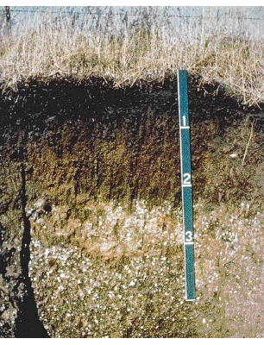
What is meant by a "well-developed" soil? A soil is more than a heap of rock fragments, organics, air and water thrown together; it has INTERNAL ORGANIZATION created by soil-forming processes:
This soil is organized into distinct layers or horizons.

Slide 21
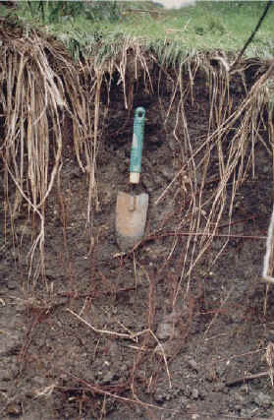
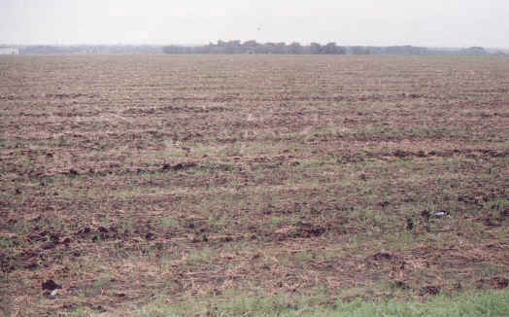
Vegetation and soils in the Blackland Prairie.

Slide 22
Soil: The Final Frontier
Soils not only reflect natural processes but also record human activities both at present and in the past.
They are therefore part of our cultural heritage.
The modification of soils for agriculture and the burial of archaeological remains are good examples of this.

Slide 23
Without it, what would we do?
Soil helps to provide much of the food that humans consume.
Only 25% of the Earth’s surface is made up of soil and only 10% of that soil can be used to grow food.
I.E., without soil, we cannot support primary producers.
By the way, they are the base of the trophic levels!

Slide 24
As in other areas of Kyrgyzstan, in the Chui valley observed altitude change of land cover. three major belts can be distinguished: flat semi-desert-dry steppe, low- and middle-meadow forest-steppe and steppe alpine meadow.

