Slide 1


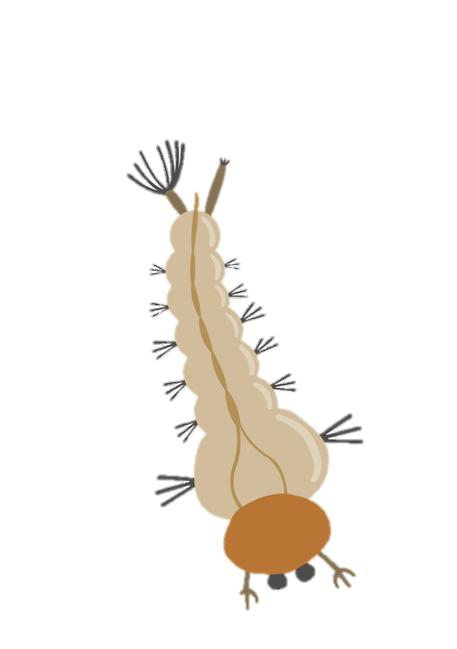
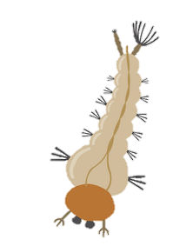
Mosquito Larvae diversity and abundance relation
to land cover in coastal area in Trang Province, Thailand
Students: Miss Piyapat Pethin, Miss Kanyakorn Tongsongsom and Mr.Surayut Kongjun
Teachers: Mrs. Patchara Pongmanawut
Scientists: Dr. Anantanit Chumsri and Dr. Fahmida Wazed Tina
School: Princess ChulabhornScience High School Trang

Slide 2
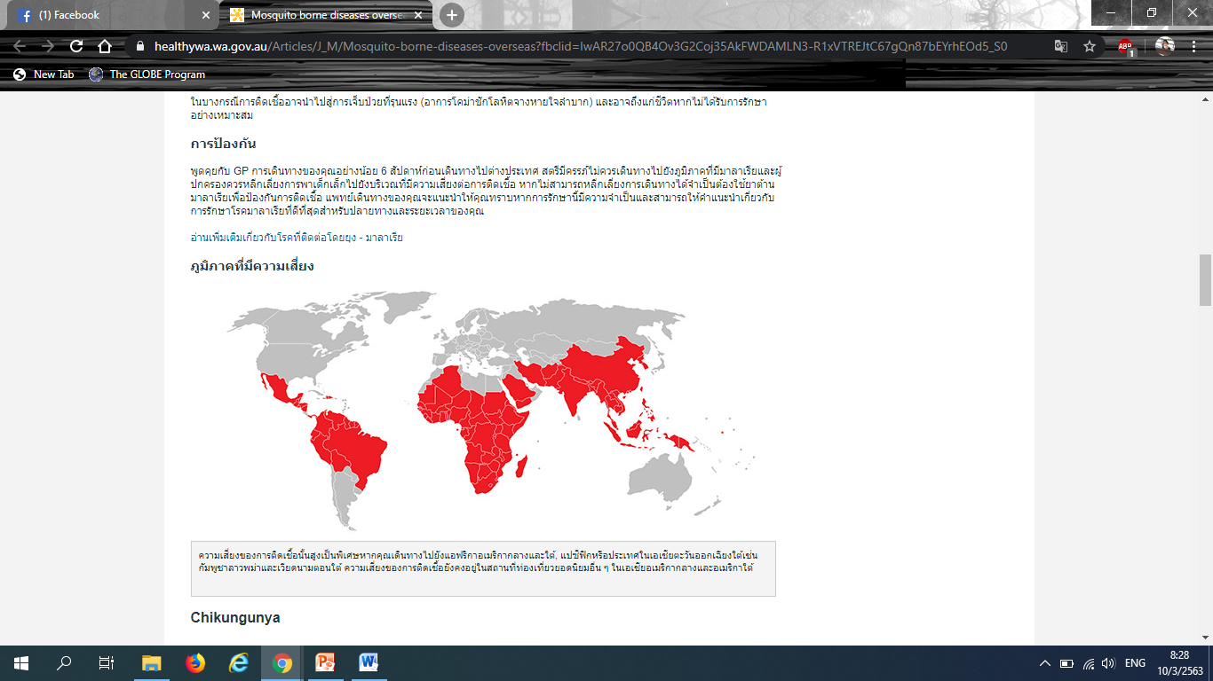
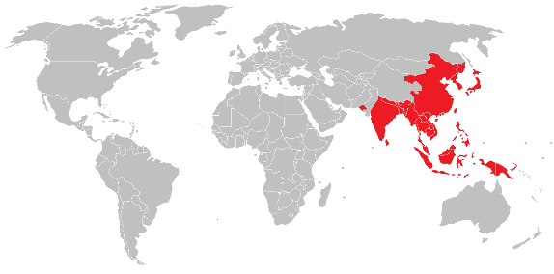
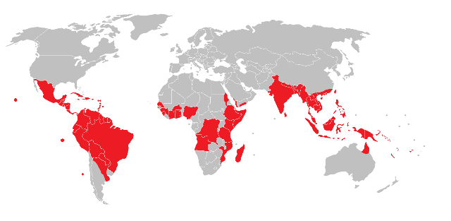
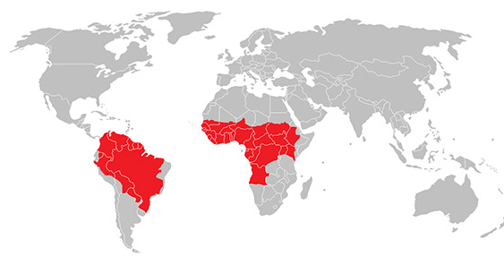
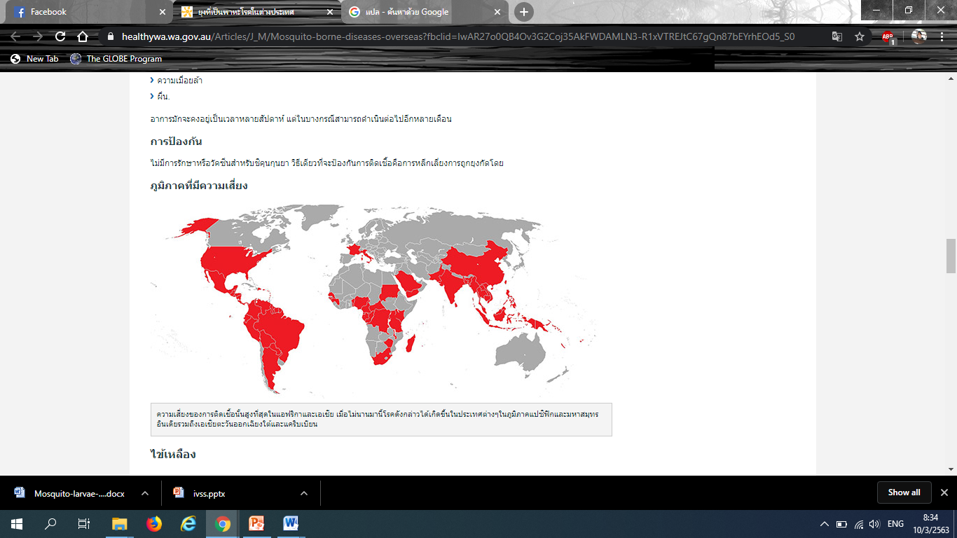
The region is at risk of mosquito-borne disease
The region is at risk of dengue fever.
The region is at risk of Japanese encephalitis .
The region is at risk of malaria.
The region is at risk of elephantiasis.
The region is at risk of chikungunya.

Slide 3
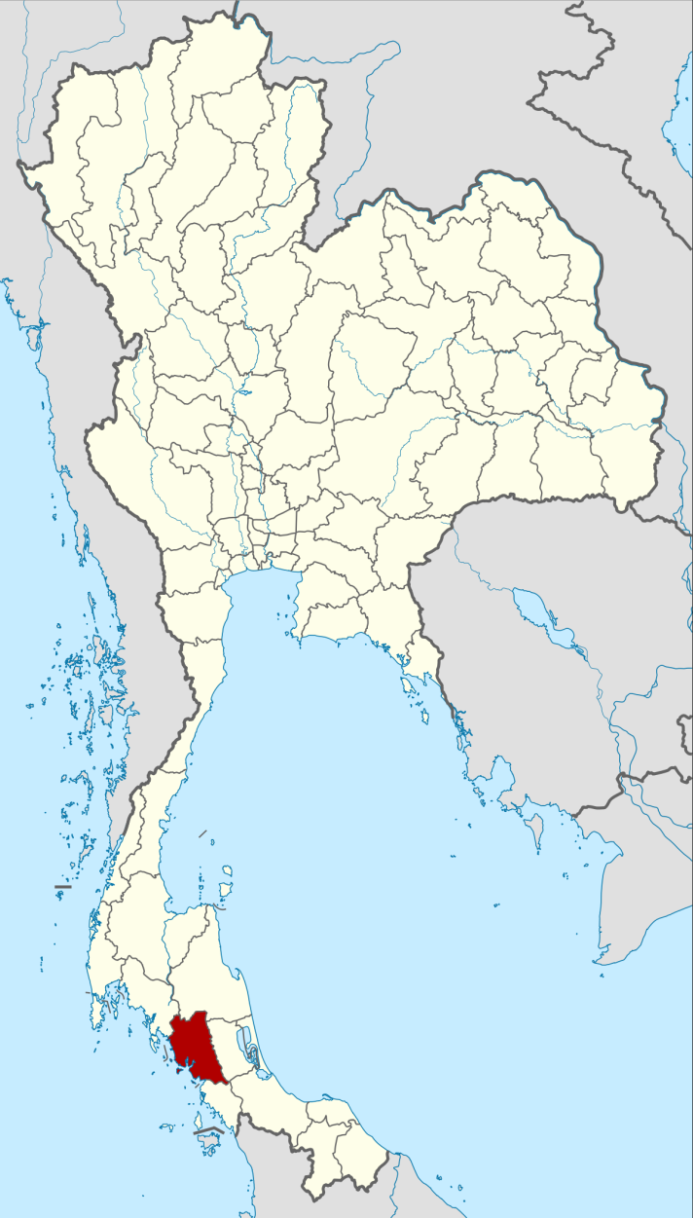
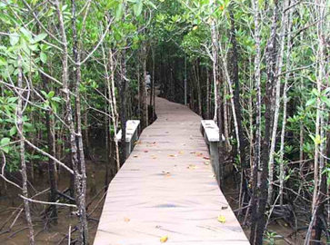
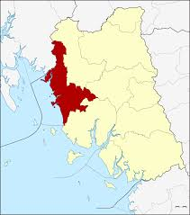
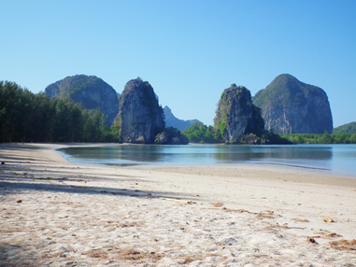
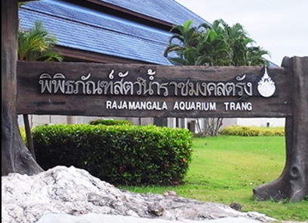
Trang Province
Radchamongkol Beach

Slide 4
Research questions
1.Do the differences of forest in coast areas (beach forest area, Melaleuca forest area, mangrove forest area, forest near residential area) affect the mosquito larvae species and numbers?
2.Do the water quality (surface temperature, water temperature, pH, Electrical conductivity) and volume affect the species and numbers of mosquito larvae?
3.Do the temporal variations (beach forest area, Melaleuca forest area, mangrove forest area, forest near residential area) effect on the coexistence of Aedes aegypti, Aedes albopictus, and Culex spp. larvae?
Notes:
พูดถึงลูกน้ำยุงในแต่ละสัปดาห์

Slide 5
Hypothesis
1.The differences of forest in coast areas (beach forest area, Melaleuca forest area, mangrove forest area, forest near residential area) affect the mosquito larvae species and numbers.
2.The water quality (surface temperature, water temperature, pH, Electrical conductivity) and volume affect the species and numbers of mosquito larvae.
3.The temporal variations (beach forest area, Melaleuca forest area, mangrove forest area, forest near residential area) effect on the coexistence of Aedes aegypti, Aedes albopictus, and Culex spp. larvae.
Notes:
พูดถึงลูกน้ำยุงในแต่ละสัปดาห์

Slide 6
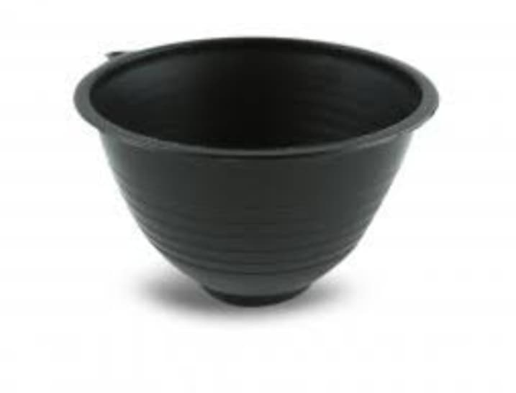
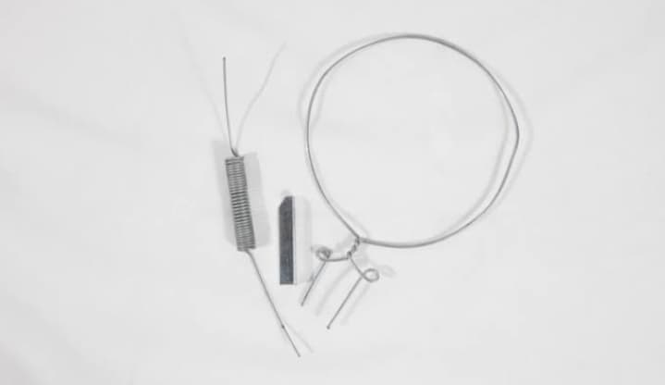
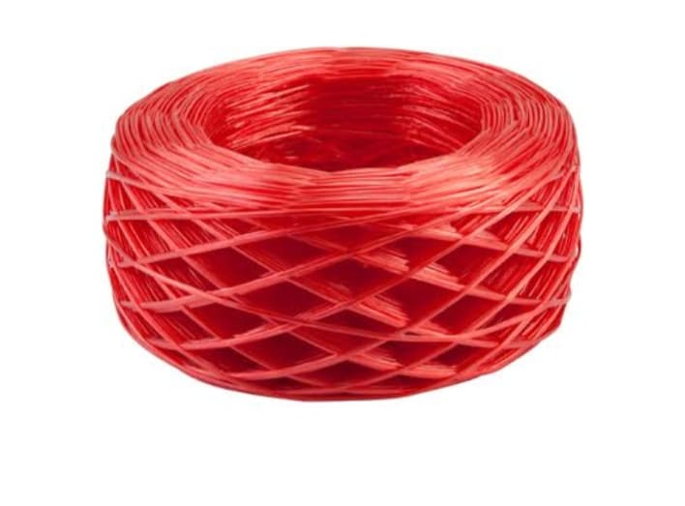
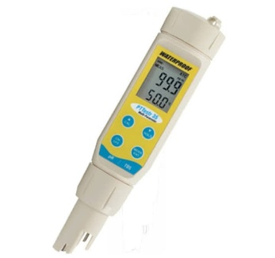
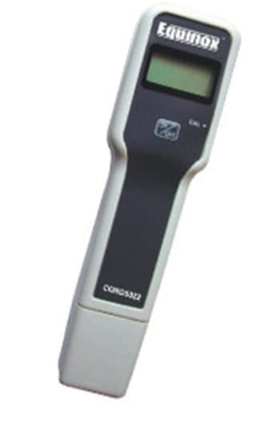
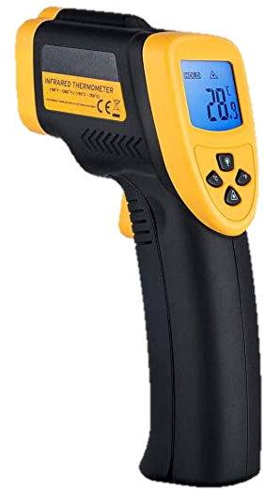
Equipment for setting up Ovitrap
01
Rubber cup
03
02
Wire
Rope
Equipment for measuring water qualities
01
02
Conductivity Meter
Infrared Thermometer
PC Test 35
03

Slide 7
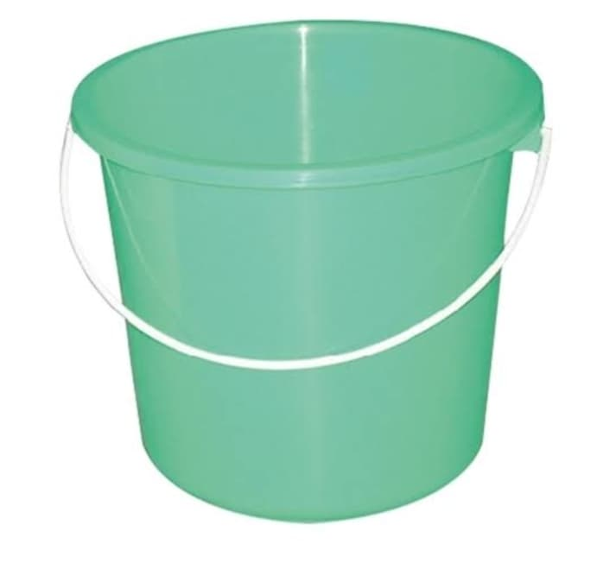
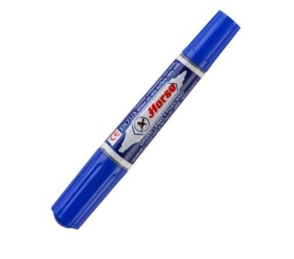
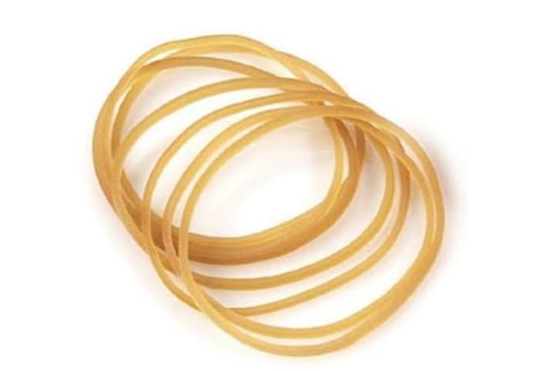
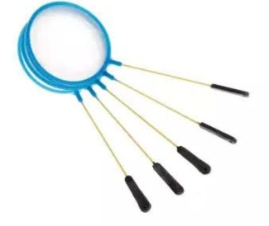
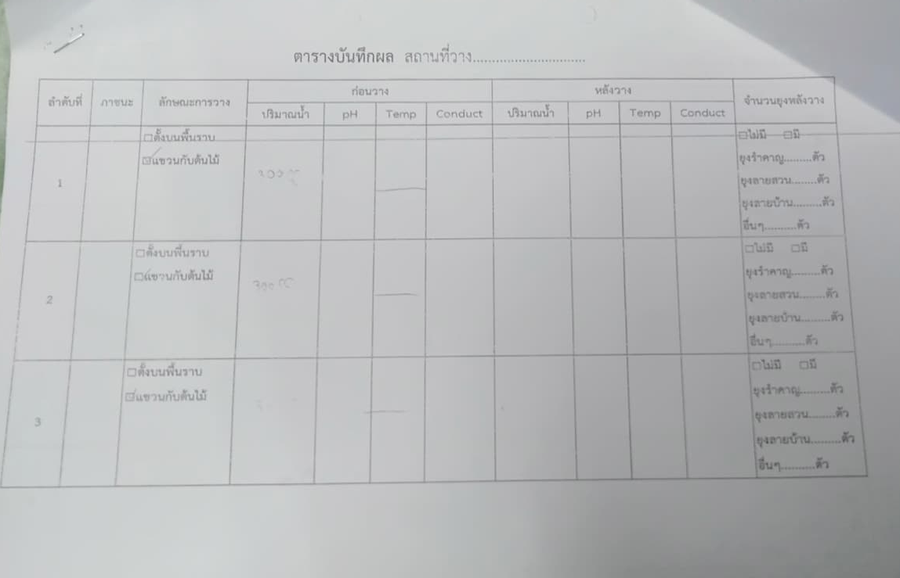
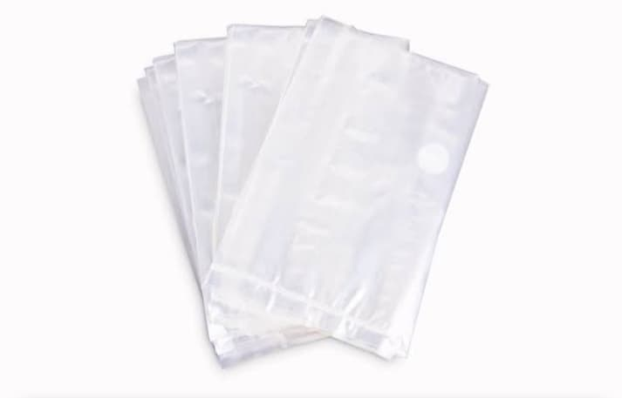
Equipment for collection mosquito larvae
01
Bucket
04
Permanent pen
02
05
Rubber band
Aquarium net
03
06
Data sheet
Plastic bag

Slide 8
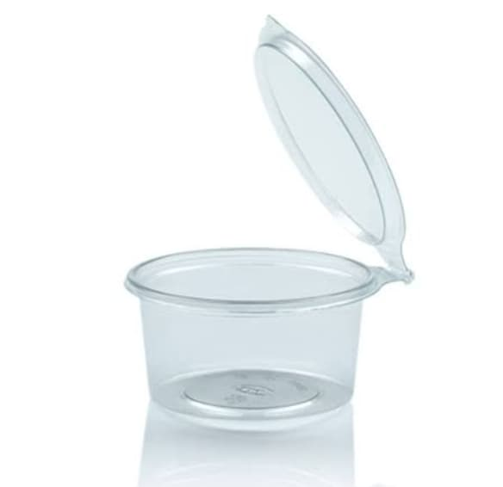
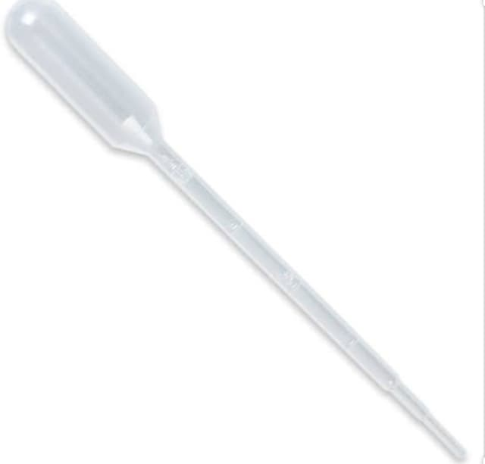
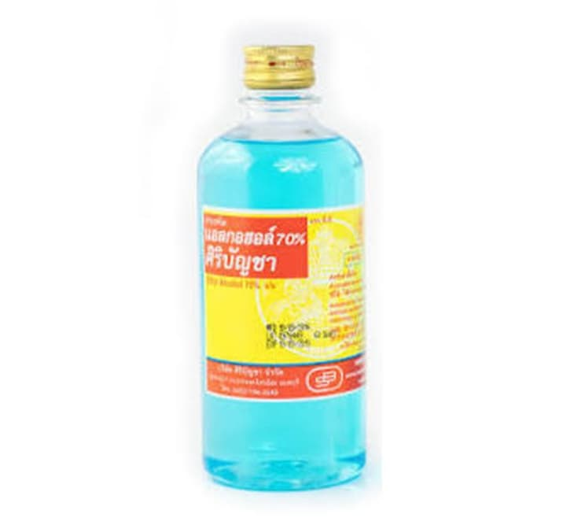
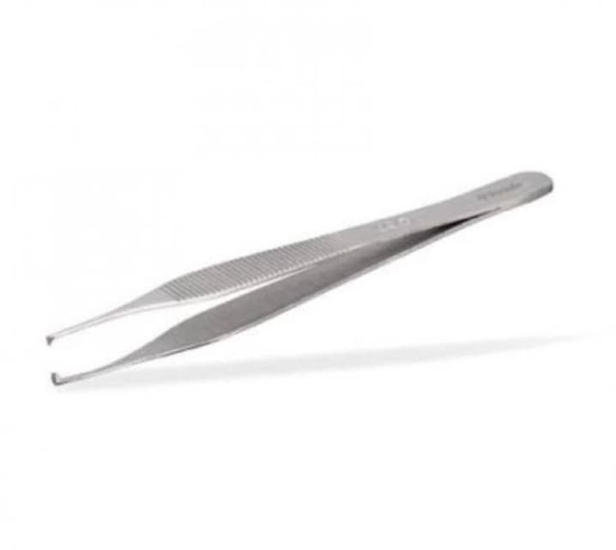
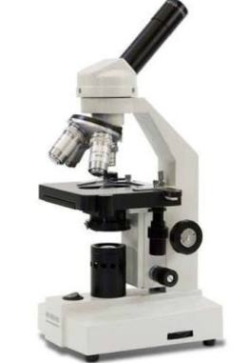
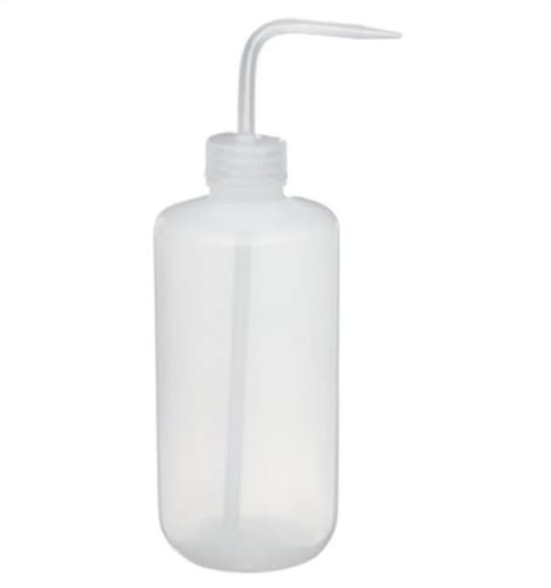
Equipment for preserving and identifying mosquito larvae
01
Small plastic
bowl
04
Dropper
05
02
Alcohol 70%
Forceps
03
06
Distilled water
Microscope

Slide 9
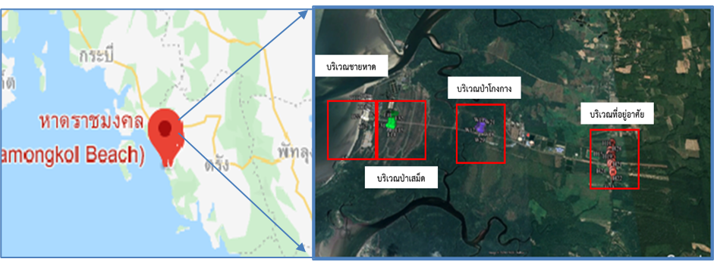
Study site
Study area at Rajamongala beach, Sikao district, Trang province

Slide 10
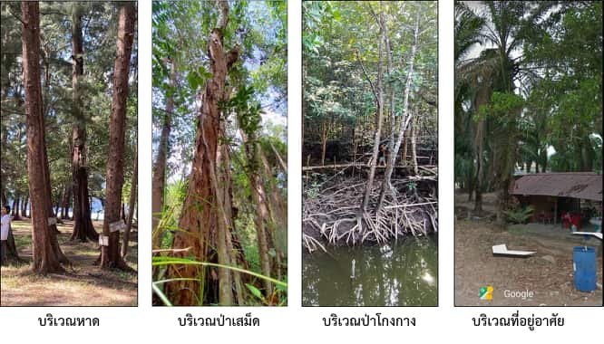
Study sites of Land cover
Beach forest area
Melaleuca forest area
Mangrove forest area
Forest near residential area

Slide 11

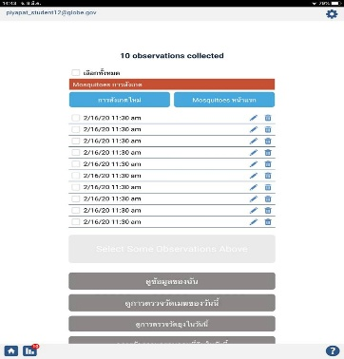
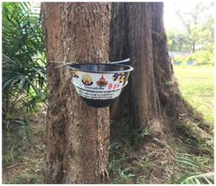
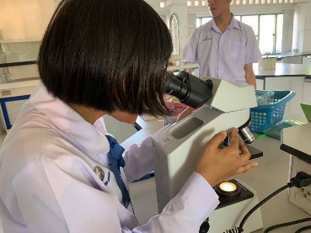
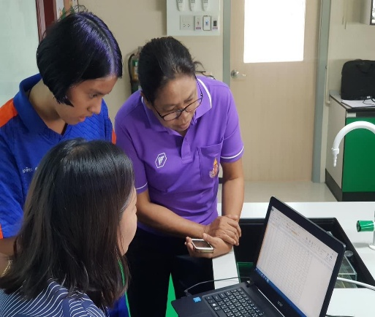
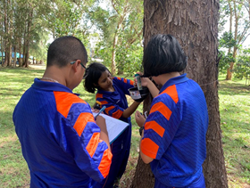
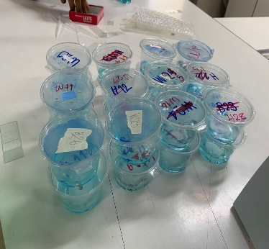
Experimental Design
Experimental Design
Set up ovitraps
Identified
01
02
03
04
Collecting data
Data analysis

Slide 12
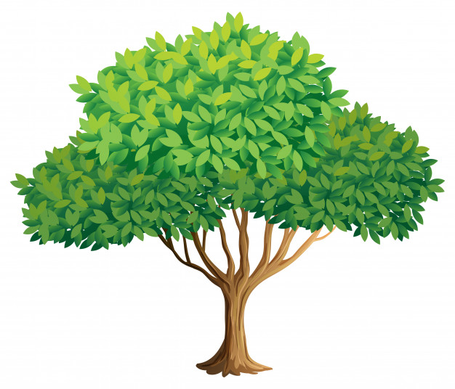
Step 1
Set up ovitraps
At least 1 meter above the ground
Notes:
พูดถึงความชุกชุมของลูกน้ำยุงในแต่ละพื้นที่

Slide 13

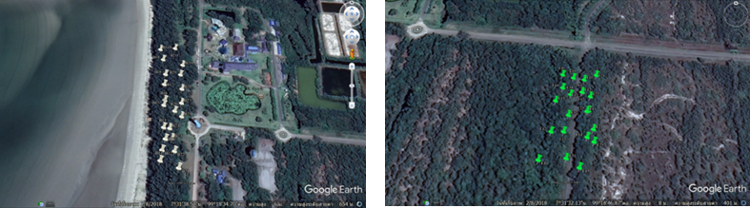
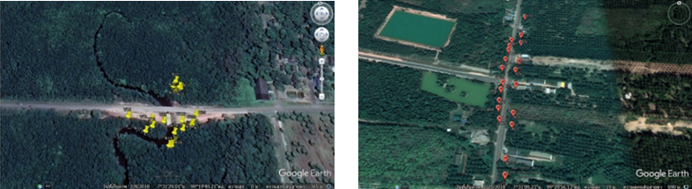
Step 1
Set up ovitraps in 4 types of land cover
Beach forest area
Melalueca forest area
Mangrove forest area
Forest near residential aerea

Slide 14
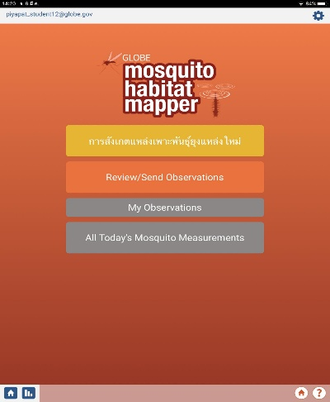

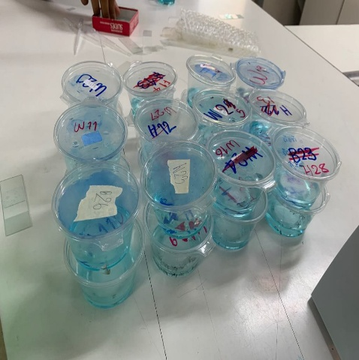
Step 2
Collecting data
Water volume
pH
01
Water qualities
Surface temparature
Water temparature
Eletrical conductivity
02
Mosquito larvae

Slide 15
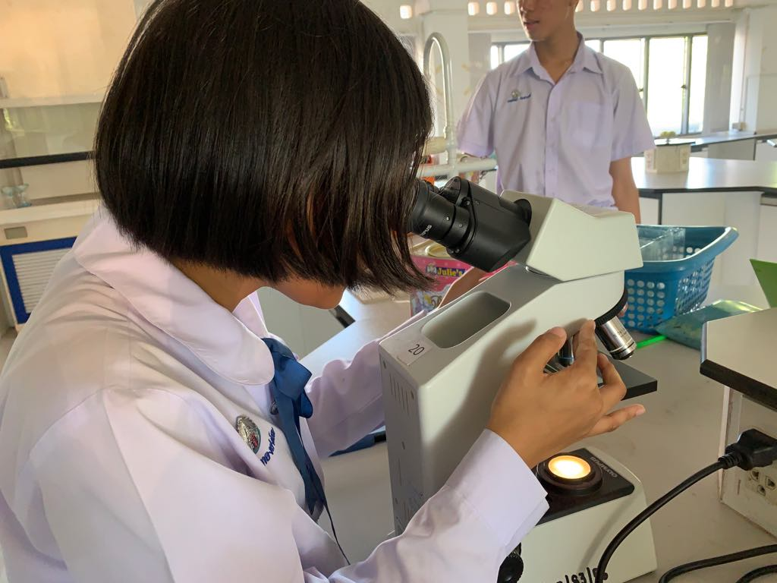
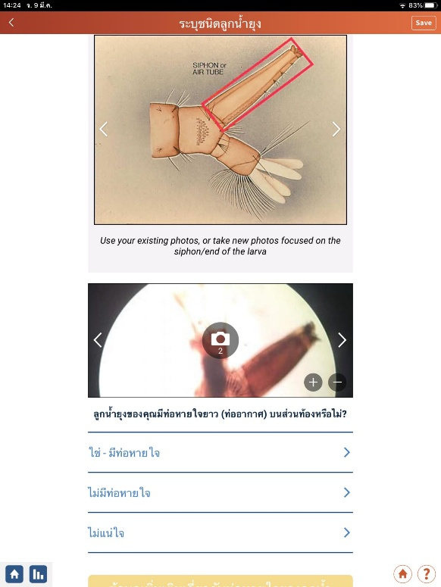
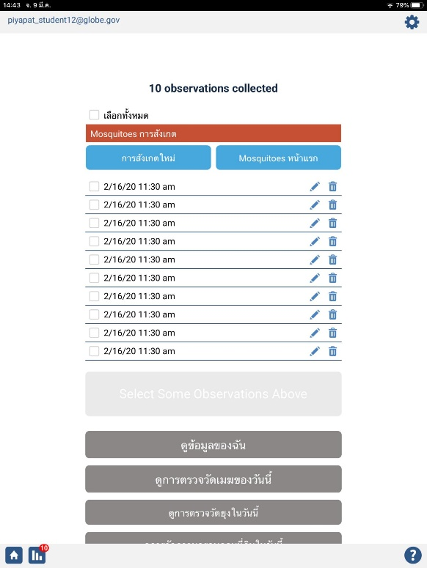
Step 3
Identified
02
Identified mosquito larvae.
sent data to globe

Slide 16
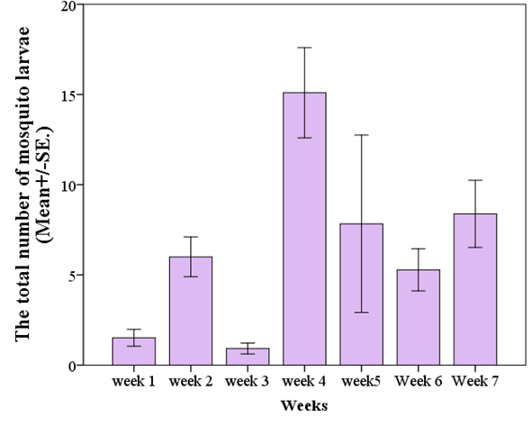
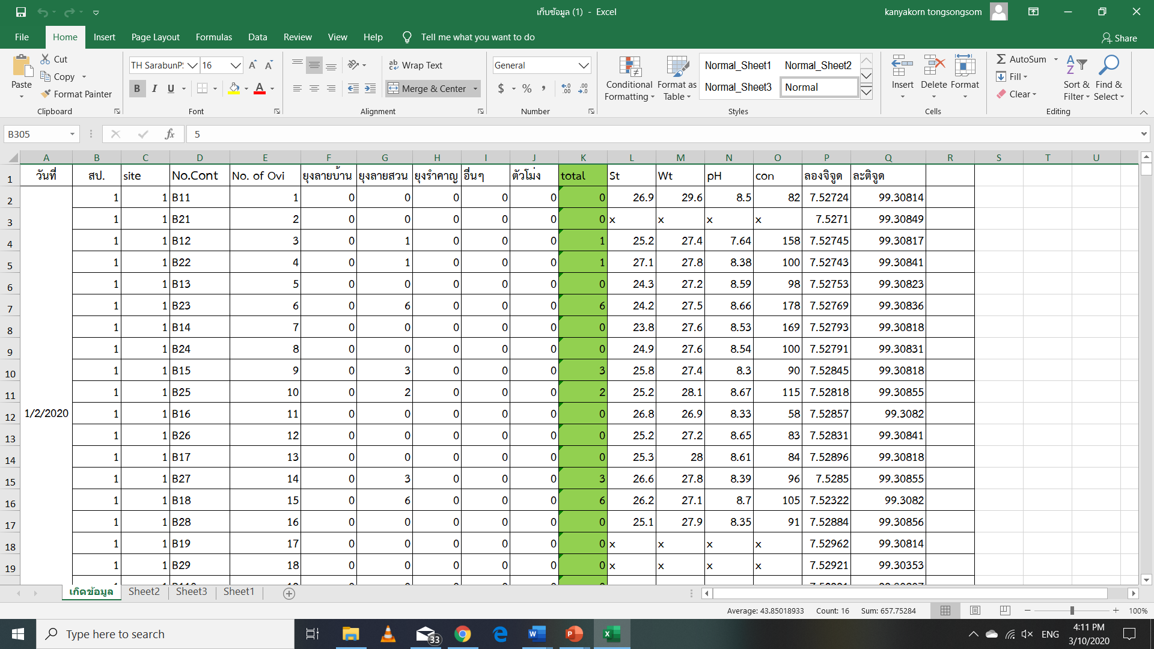
Step 4
Data analysis
02
Input data for analysis in Microsoft Excel
Analysis data with SPSS

Slide 17
Result
Types and numbers of mosquito larvae in coastal area at Trang province.
Types of mosquito larvae | The numbers of mosquito larvae |  |  |  | Total
 | Beach forest area | Melaleuca forest area | Mangrove forest area | Forest near residential area
Ae.aegypti | 0 (0) | 0 (0) | 8 (88.89) | 1 (11.11) | 9 (100)
Ae.albopictus | 185 (11.91) | 140 (9.01) | 673 (43.34) | 555 (35.74) | 1553 (100.00)
Culex spp. | 52 (18.90) | 29 (10.55) | 29 (10.55) | 165 (60.00) | 275 (100.00)
Pupa | 19 (17.76) | 23 (21.50) | 19 (17.76) | 46 (42.99) | 107 (100.00)
Total | 256 (13.17) | 192 (9.88) | 729 (37.50) | 767 (39.40) | 1944 (100.00)
Notes:
พูดถึงลูกน้ำยุงในแต่ละสัปดาห์

Slide 18

Result
The number of mosquito larvae found in week 1-week 7 at Coastal area, Trang province
Notes:
พูดถึงความชุกชุมของลูกน้ำยุงในแต่ละพื้นที่

Slide 19
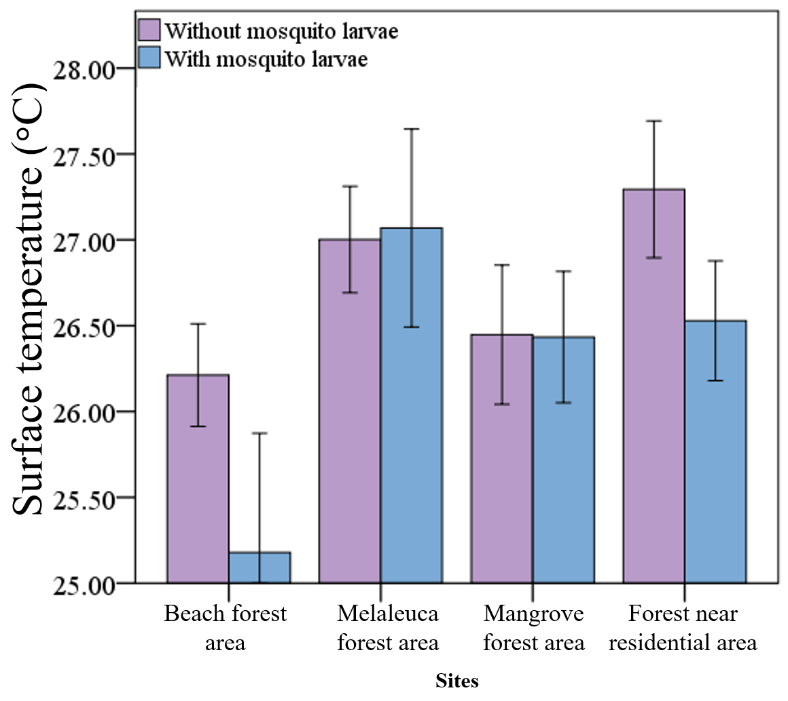
Result
Surface temperature between ovitrap with and without mosquito larvae in Trang province
Notes:
พูดถึงคุณภาพน้ำกับบริเวณที่พบลูกน้ำยุงกับไม่พบลูกน้ำยุงโดยอธิบายว่าในแต่ละบริเวณมีค่าไม่แตกต่างกัน

Slide 20
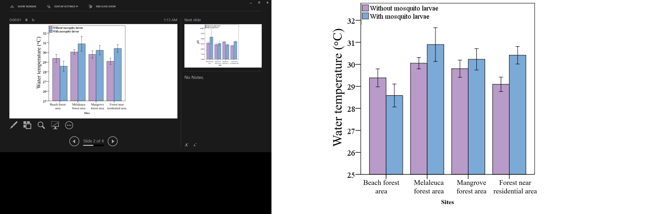
Result
Water temperature between ovitrap with and without mosquito larvae in Trang province
Notes:
พูดถึงคุณภาพน้ำกับบริเวณที่พบลูกน้ำยุงกับไม่พบลูกน้ำยุงโดยอธิบายว่าในแต่ละบริเวณมีค่าไม่แตกต่างกัน

Slide 21

Result
Electrical conductivity between ovitrap with and without mosquito larvae in Trang province
Notes:
อธิบายเรื่องสถิติทดสอบ

Slide 22

Result
pH water bbetween ovitrap with and without mosquito larvae in Trang province
Notes:
อธิบายเรื่องสถิติทดสอบ

Slide 23
Result
Relationship among numbers of mosquito larvae, water quality and Water volume
Types of mosquito larvae | Spearman's rho | Surface Temperature (^{๐}C) | Water Temperature (^{๐}C) | pH water | Electrical Conductivity (µs/cm) | Water volume
Ae.aegypti | Correlation Coefficient | 0.100 | 0.026 | -0.078 | 0.029 | 0.574
 | Sig. (2-tailed) | 0.076 | 0.649 | 0.166 | 0.610 | 0.201
Ae.albopictus | Correlation Coefficient | 0.019 | 0.233* | -0.034 | 0.306*** | 0.238**
 | Sig. (2-tailed) | 0.830 | 0.007 | 0.697 | 0.000 | 0.0045
Culex | Correlation Coefficient | -0.007 | 0.080 | -0.002 | 0.125* | 0.151
 | Sig. (2-tailed) | 0.937 | 0.356 | 0.985 | 0.026 | 0.081
Pupa | Correlation Coefficient | -0.011 | 0.062 | 0.008 | 0.001 | 0.456
 | Sig. (2-tailed) | 0.845 | 0.268 | 0.883 | 0.979 | 0.125
Total mosquito larvae | Correlation Coefficient | 0.016 | 0.247** | -0.032 | 0.282** | 0.172*
 | Sig. (2-tailed) | 0.856 | 0.004 | 0.710 | 0.001 | 0.045
 | N | 316 | 316 | 316 | 316 | 316
Notes:
อธิบายการอยู่ของลูกน้ำยุงแต่ละชนิดในแต่ละคุณภาพน้ำแต่ละอย่าง

Slide 24
Result
Numbers and proportions of positive containers occupied by Ae. aegypti (AEG), Ae. albopictus (ALB), and Culex (CX) in coastal area at Trang province.
Sites | Number of Ovitrap | Positive Ovitrap | AEG only | ALB only | CX only | AEG+ ALB | AEG+ CX | ALB+CX | AEG+ ALB +CX | None | Proportion AEG | Proportion ALB | Proportion CX
Beach forest area | 140 | 29 | 0 | 18 | 1 | 0 | 0 | 6 | 0 | 111 | 0.00 | 0.83 | 0.24
Melaleuca forest area | 140 | 22 | 0 | 13 | 4 | 0 | 0 | 3 | 0 | 118 | 0.00 | 0.73 | 0.32
Mangrove forest area | 140 | 42 | 0 | 35 | 1 | 1 | 0 | 4 | 0 | 98 | 0.02 | 0.95 | 0.12
Forest near residential area | 140 | 56 | 0 | 39 | 4 | 1 | 0 | 8 | 0 | 84 | 0.02 | 0.86 | 0.21
Notes:
อธิบายการอยู่ของลูกน้ำยุงแต่ละชนิดในแต่ละคุณภาพน้ำแต่ละอย่าง

Slide 25
Conclusions
Conclusion
The number of Ae.aegypti and Ae.albopictus were highest in Mangrove forest area. The number of Culex spp. and pupa was highest in Forest near residential area
The number of Ae.albopictus and total mosquito larvae positive correlated with water temperature, Electrical conductivity and water volume but Culex spp. larvae positive correlation with Electrical conductivity.
The highest coexistence rate of Ae. aegypti and Ae. albopictus was found in Mangrove forest area and forest near residential area.
The highest coexistence rate of Ae. albopictus and Culex larvae was found in Forest near residential area (coexistence in 5.34%.
Ae. aegypti and Culex larvae was not found coexistence all area and three types of larvae were not found coexistence all area.
Notes:
อธิบายการอยู่ของลูกน้ำยุงแต่ละชนิดในแต่ละคุณภาพน้ำแต่ละอย่าง

Slide 26



Suggestions based on our study
Suggestions based on our study
To suggest the administration to control the mosquito.
To make people aware about the mosquito situation.
To use the information to make disease control measures.
Notes:
อธิบายการอยู่ของลูกน้ำยุงแต่ละชนิดในแต่ละคุณภาพน้ำแต่ละอย่าง

Slide 27


Acknowledgment
Acknowledgment
Directors and Science teachers, Princess Chulabhorn Science High School Trang
Mrs. Anantanit Chumsri, Rajamangala University of Technology Srivijaya,Trang campus
Notes:
อธิบายการอยู่ของลูกน้ำยุงแต่ละชนิดในแต่ละคุณภาพน้ำแต่ละอย่าง

Slide 28
THANK YOU FOR ATTENTION

