Slide 1
Lake Erie
Western and Eastern Basin Water Quality Comparison
Joanne Michalski
Melody Tsapranis
Amy Lauer
Pamela Patterson
Great Lakes Bwet NOAA

Slide 2
Abstract
This research was about differences in water quality in the eastern and western basins of Lake Erie because water quality affects the quality of life for persons living near the Great Lakes. Algae blooms are more common in the western basin and may be related to water quality as measured in the tributaries. Algae blooms can affect ecosystem and human health. The research question was “Are there differences in water quality measurements in tributaries the eastern and western basins of Lake Erie?” The GLOBE protocols used were dissolved oxygen, pH, water temperature, and water transparency. Results indicated that more data collection is needed in order to make a correlation with algae bloom differences seen in satellite images.

Slide 3
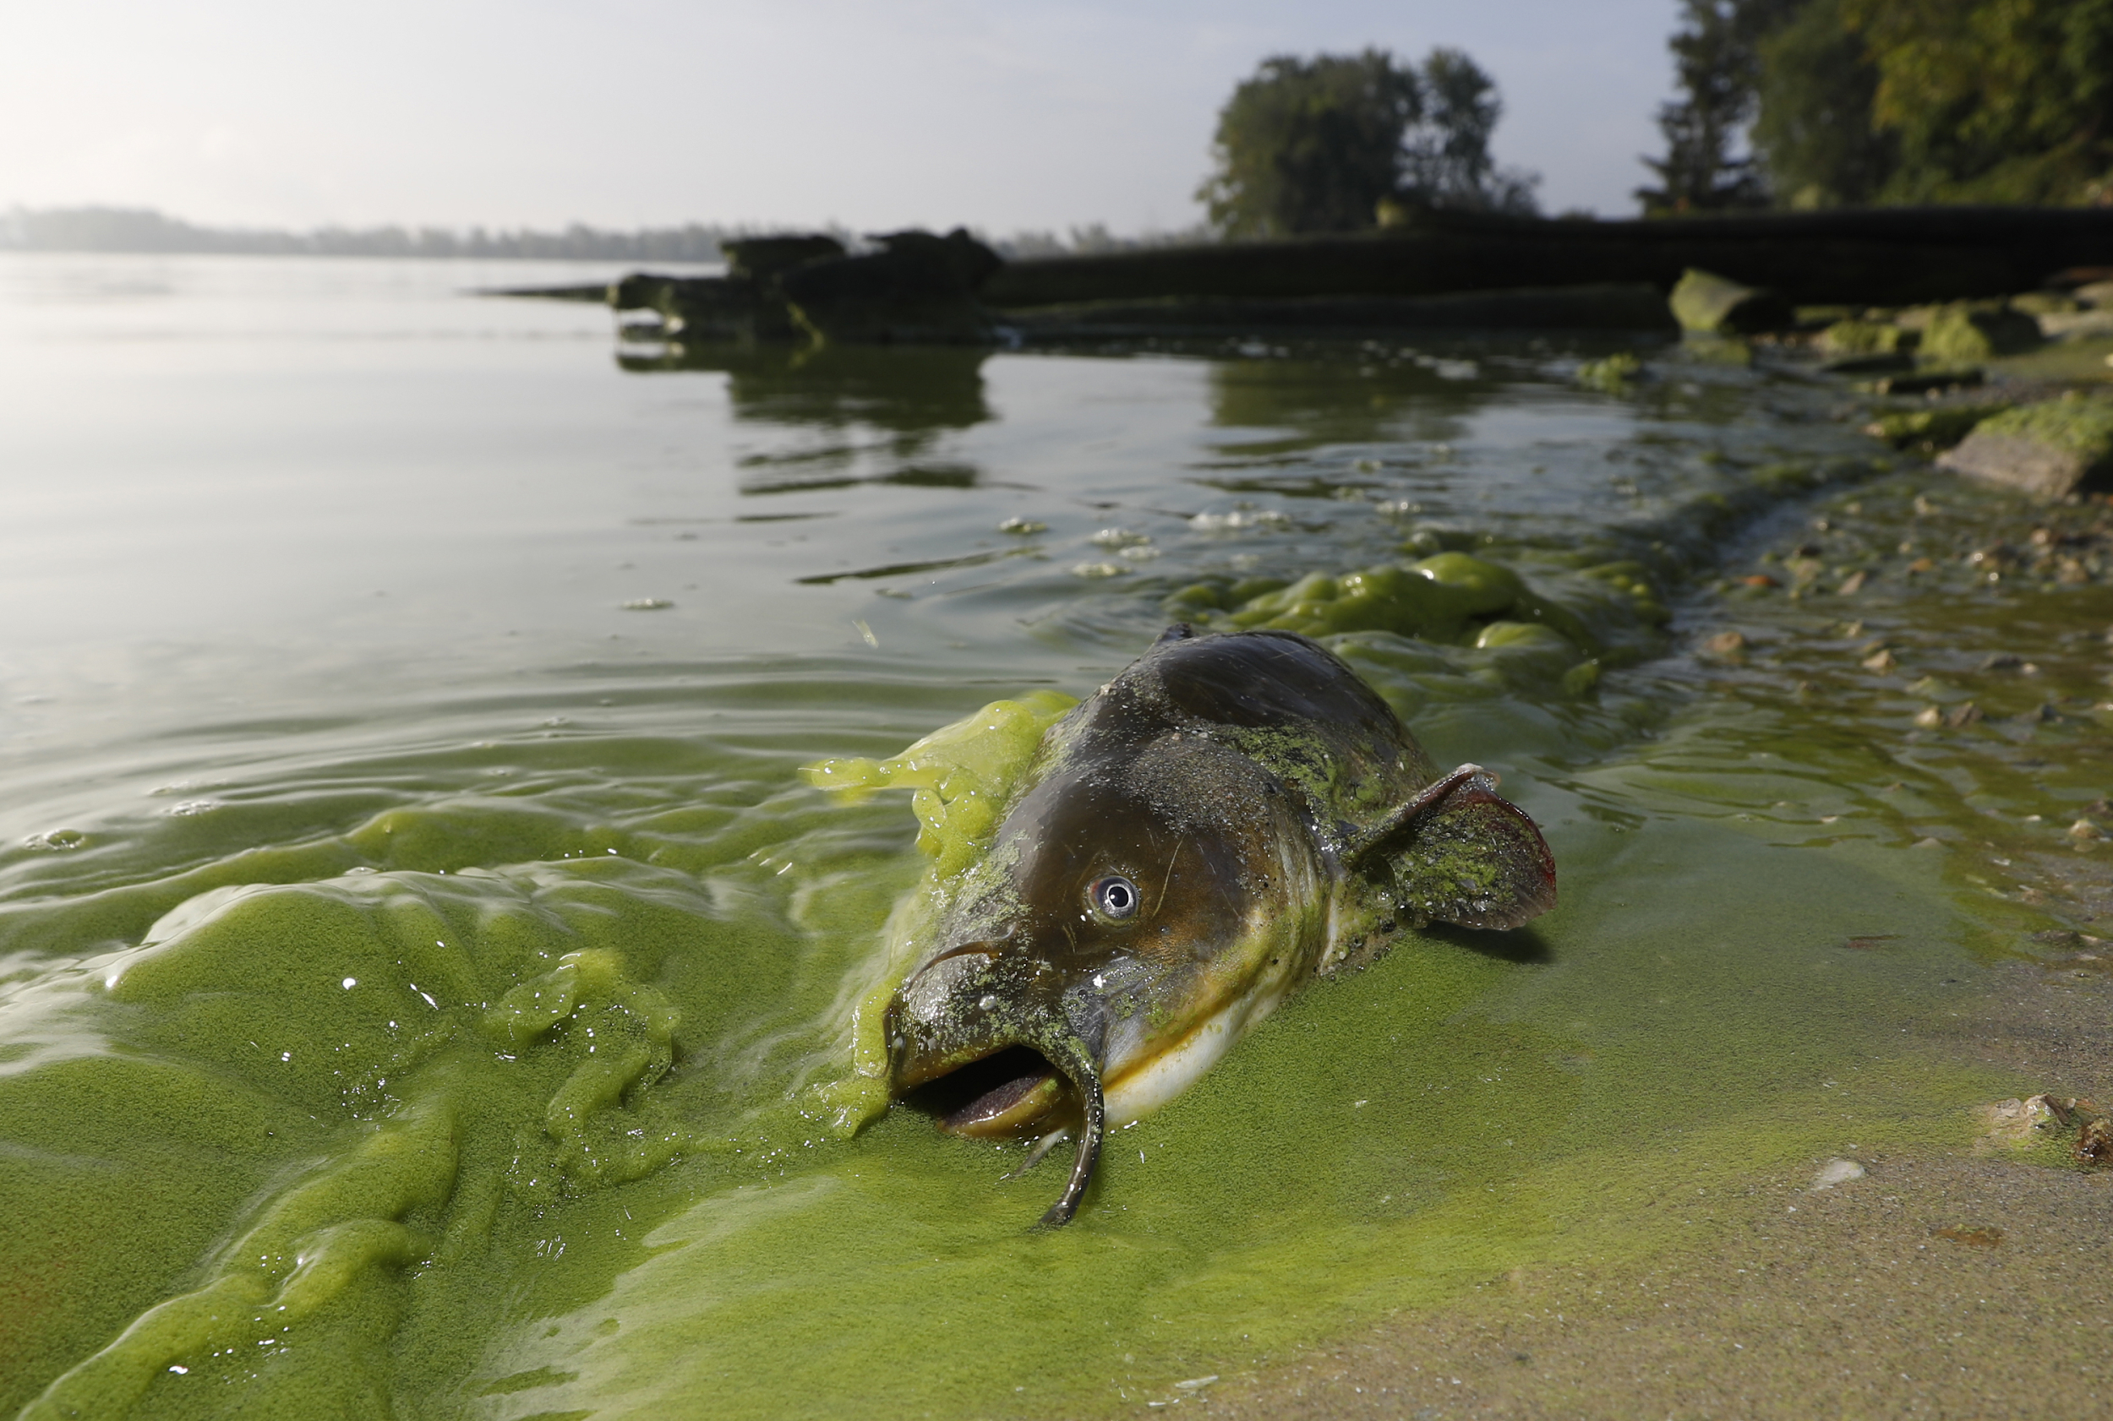
Research Question
Our research question asks if there are differences in water quality measurements in the tributaries of the eastern and western basins of Lake Erie.
If there are differences in water quality measurements then there may be differences in the patterns of algae blooms between the two basins. Which would lead to further research into algae blooms in the two basins.
This topic is of interest because the ecological health of the lake and human health can be impacted by water quality issues and algae blooms.

Slide 4
Introduction
Cyanobacteria blooms (blue-green algae) occur frequently in the Great Lakes. These blooms, while proving to be unsightly and foul-smelling, have adverse effects on the lake ecosystem. (4) In addition, they can affect fish, mammal, and bird health, as well as human health. They can affect the economy by interfering with fishing and tourism. (5) . In addition, there is growing concern about these blooms affecting drinking water supply (1). A recent review of urban river basins found that there are many factors contributing to these blooms, including nutrient runoff from sewage and agriculture, but found that these were not the only drivers (3). Another study found that the combined effects of temperature and nutrient runoff were most important in determining the amount of algae growth (2). By studying runoff water hydrology for three sites, one close to the western end of Lake Erie, and two toward the eastern end, insights into the role of runoff in algae blooms may be obtained, since the incidence of algae blooms is quite different at the two ends of the lake (6).

Slide 5
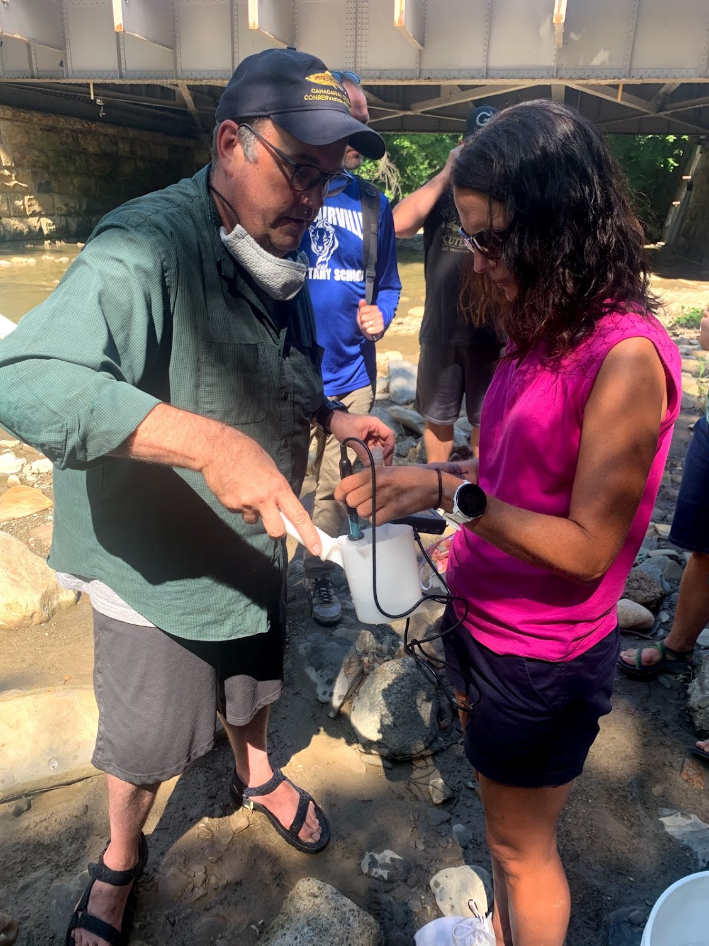
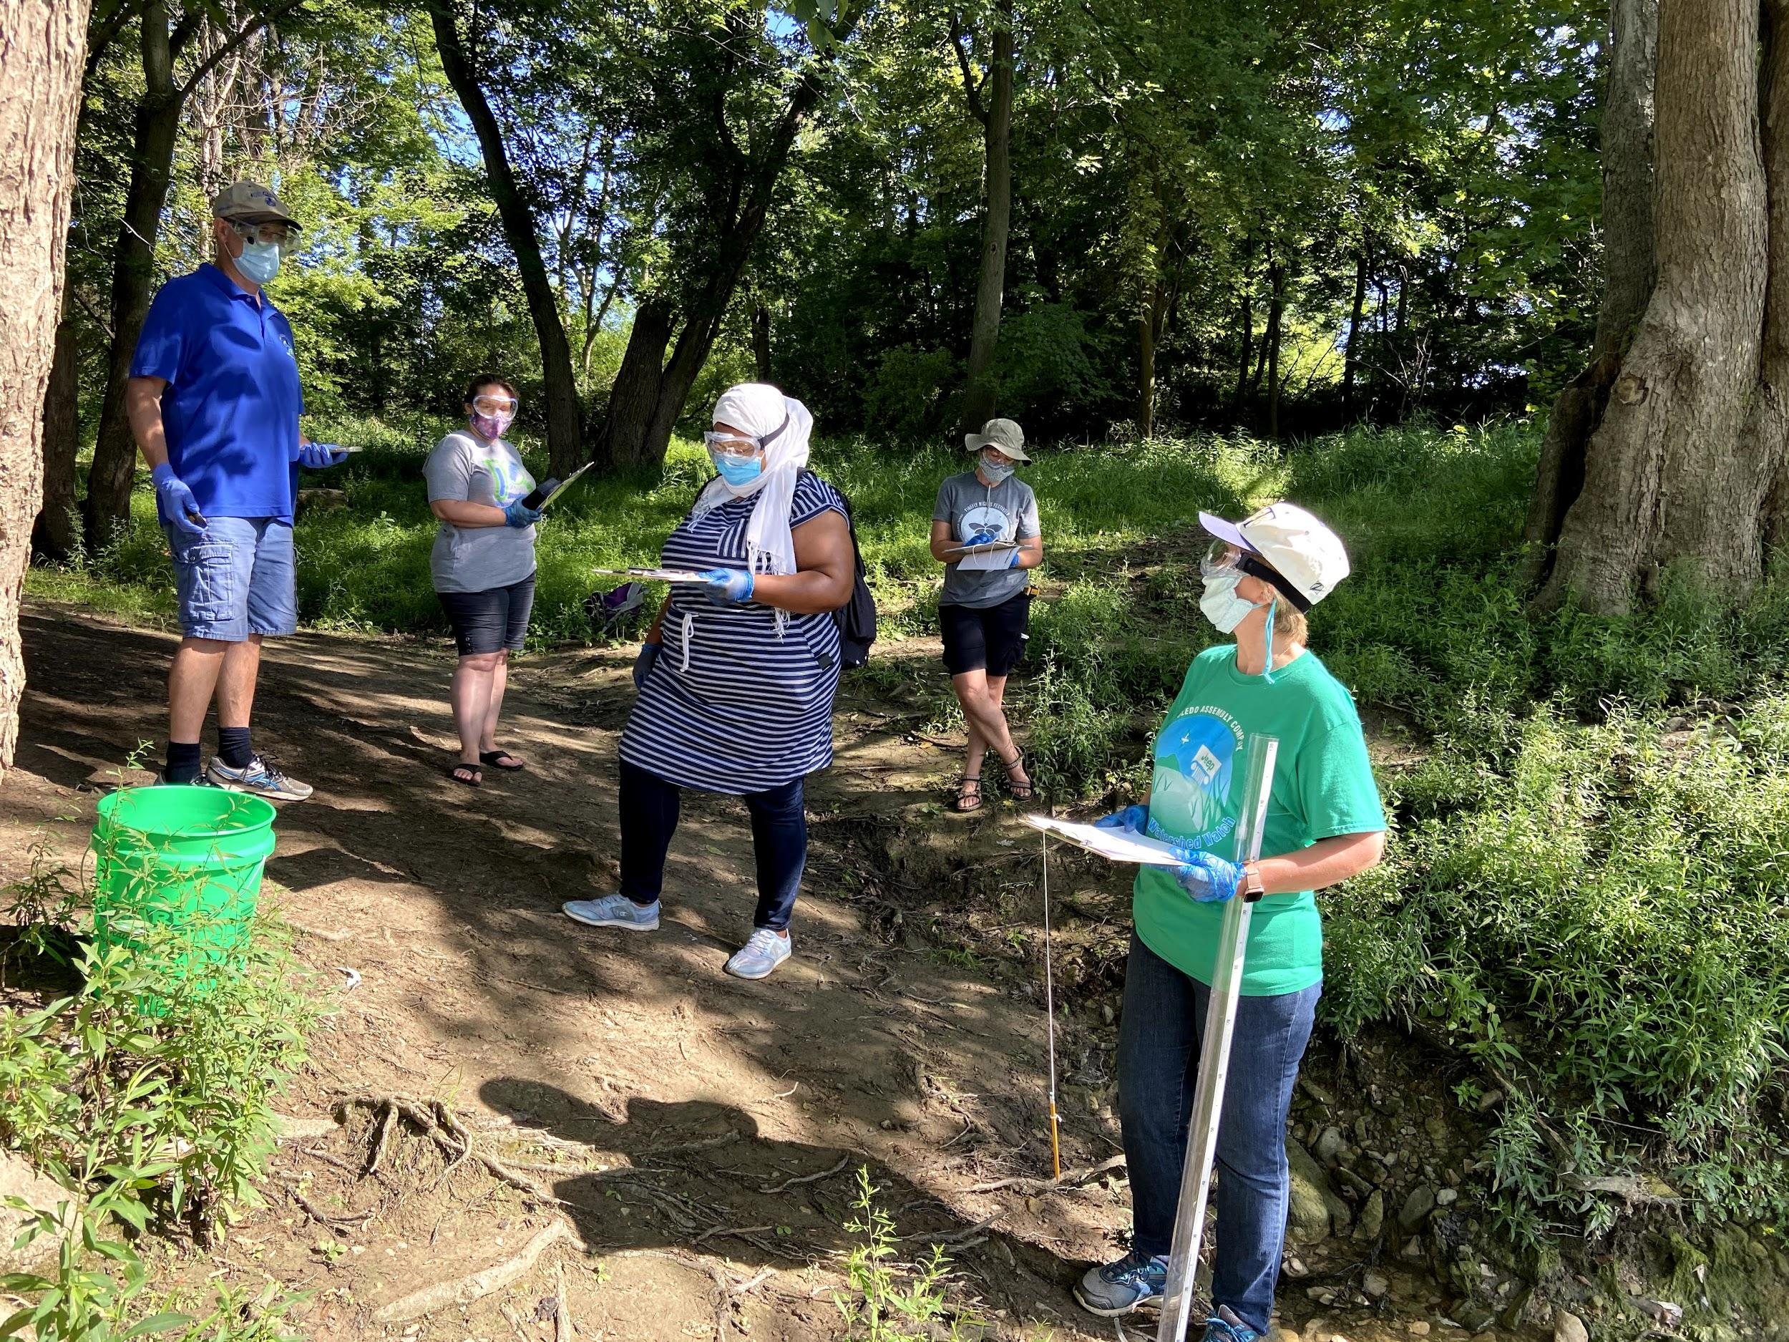
Introduction (continued)
GLOBE protocols were used to study water temperature, conductivity, pH, dissolved oxygen, water transparency, and freshwater macroinvertebrates from three tributaries in the Lake Erie watershed. The Maumee River tributary in Toledo, Ohio, Crooked Brook in Dunkirk, NY, and Canadaway Creek in Fredonia, NY were studied in July of 2020.

Slide 6
Research Methods
Water quality data will be collected from 3 tributaries of the Lake Erie watershed. The Maumee River tributary in Toledo, Ohio, Canadaway Creek in Fredonia, New York and Crooked Brook in Dunkirk, New York. Our plan will produce data to compare water quality from the Western Basin of Lake Erie to the Eastern Basin of the lake.
The following GLOBE Hydrology protocols will be used: Water Transparency, Water Temperature, Dissolved Oxygen and pH.
Data will be collected in the morning for 3 consecutive days.

Slide 7
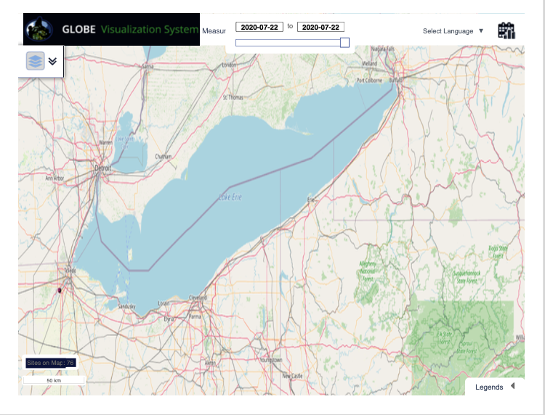
Map of Study Site: Lake Erie
Globe Visualization Tool

Slide 8
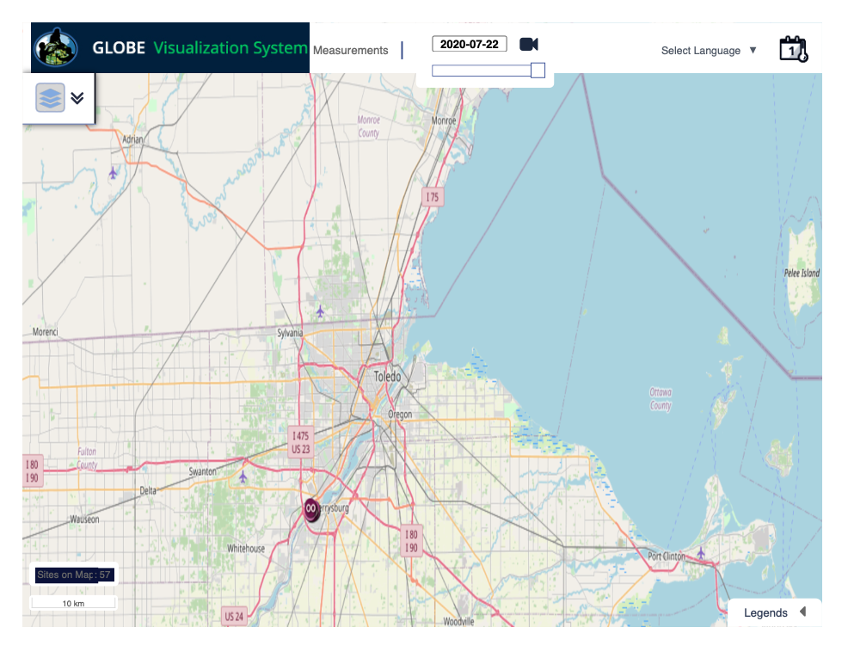
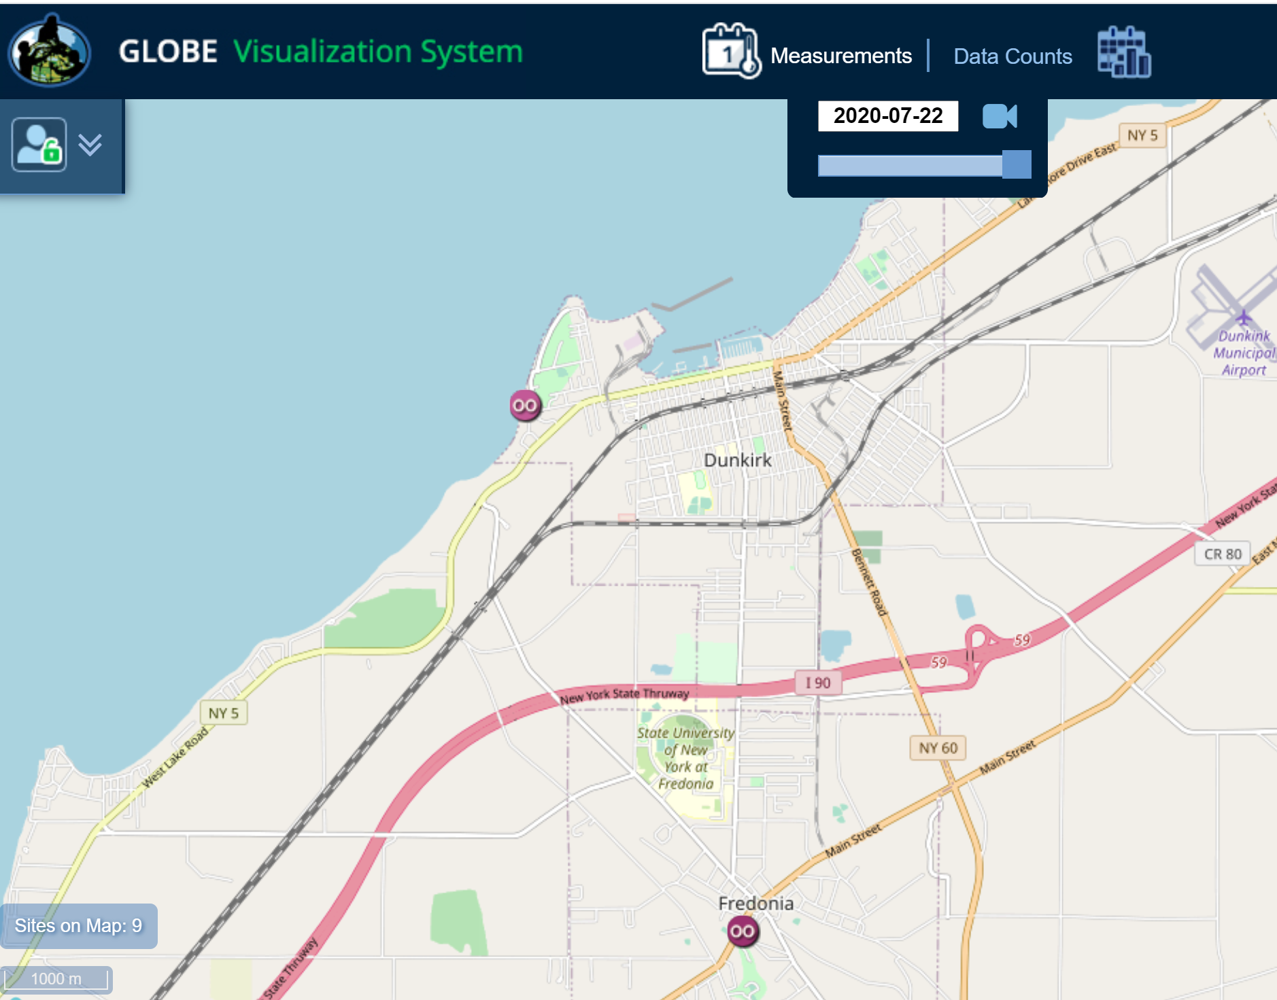
Data Collection Site Locations leading into Lake Erie
Collection from Tributaries 7/20/20 - 7/22/20
[GLOBE VIsualization tool and Google Maps]

Slide 9
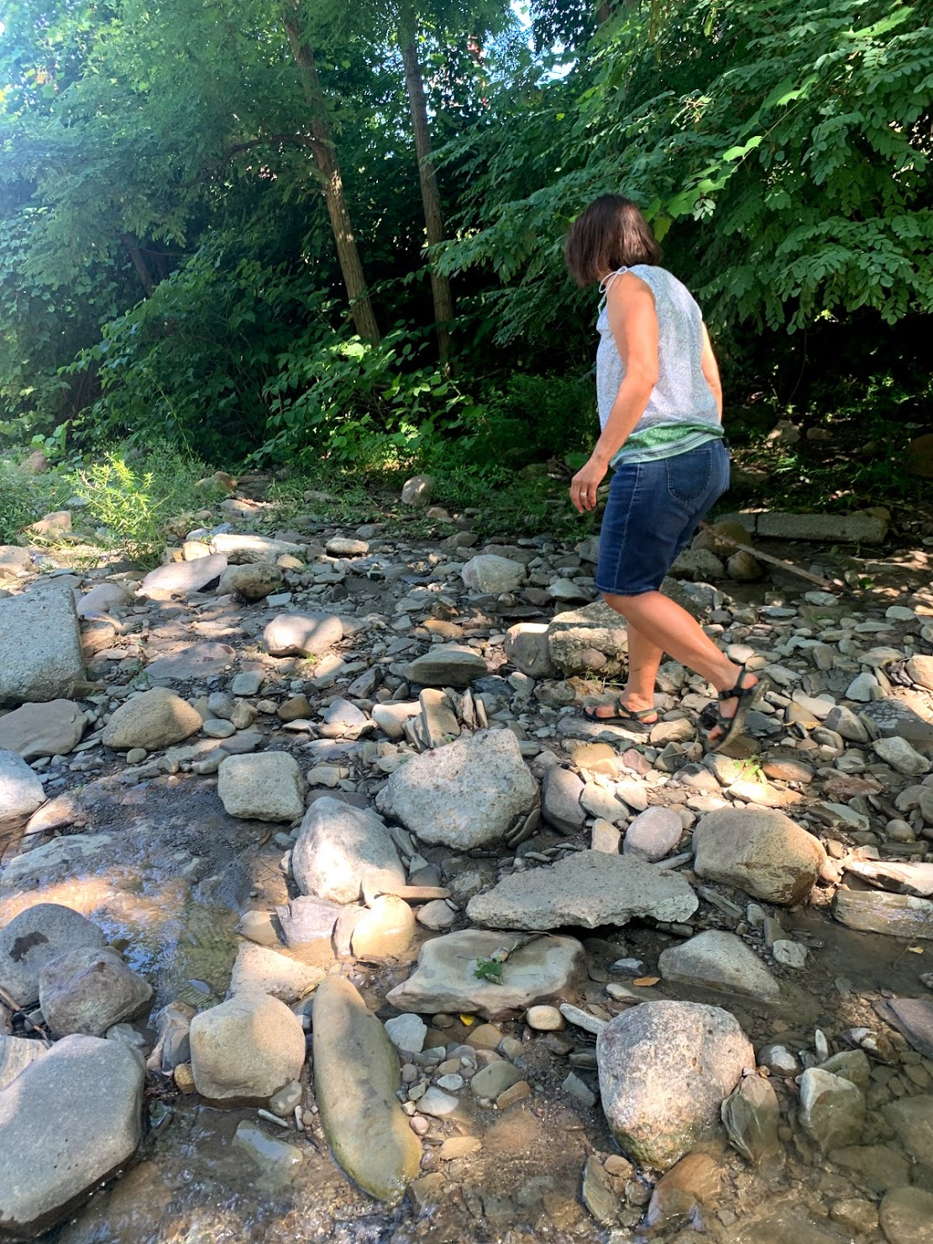
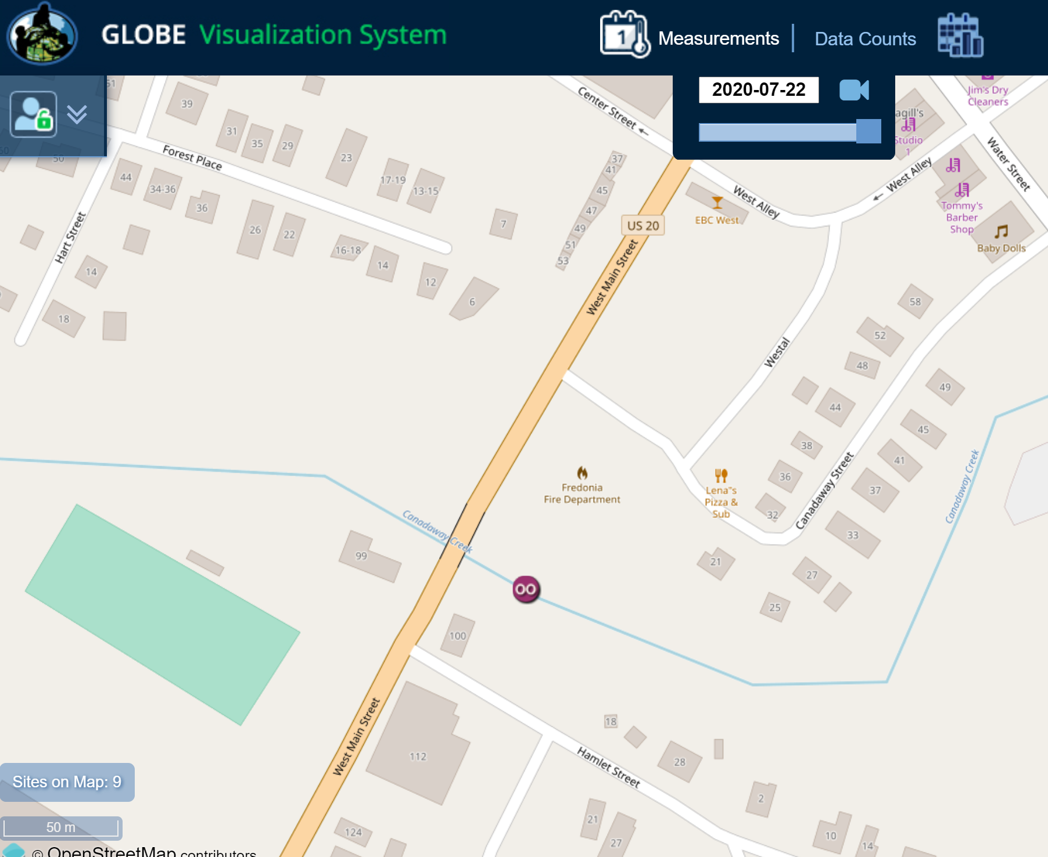
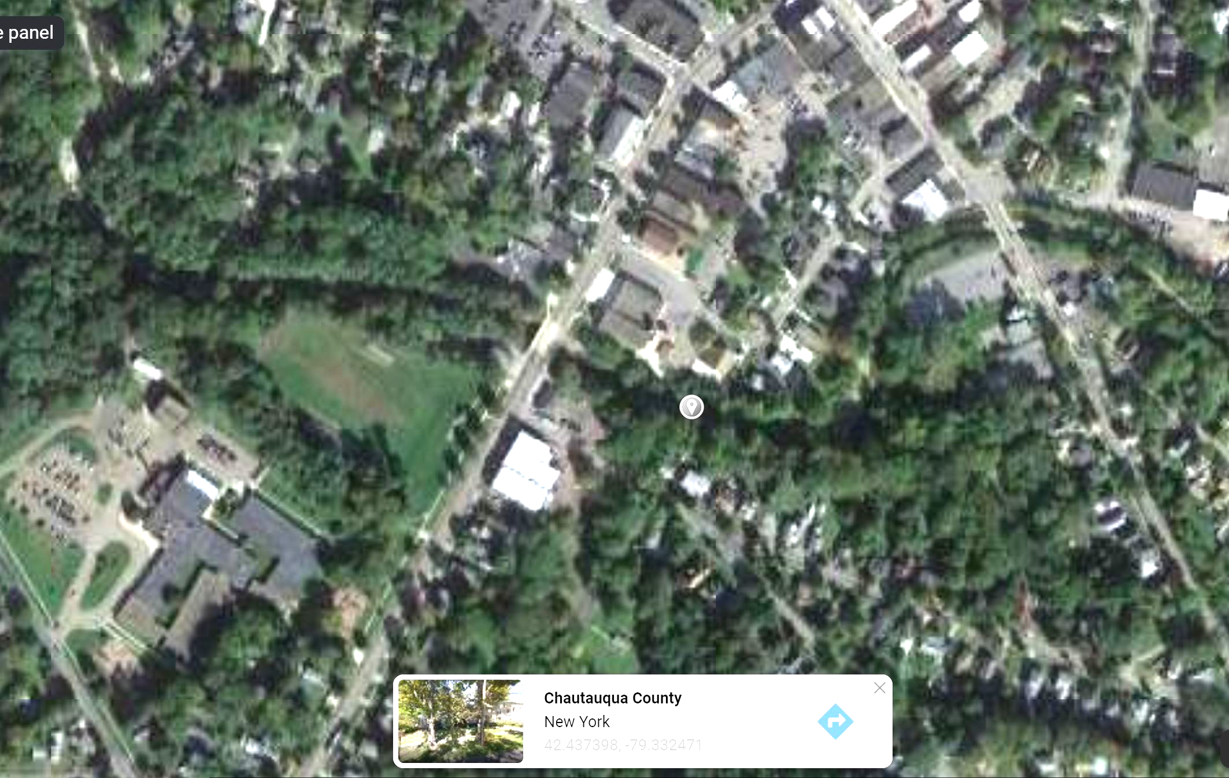
Map of Site #1 Canadaway Creek
Fredonia, NY
Chautauqua County
[GLOBE VIsualization tool and Google Maps]

Slide 10
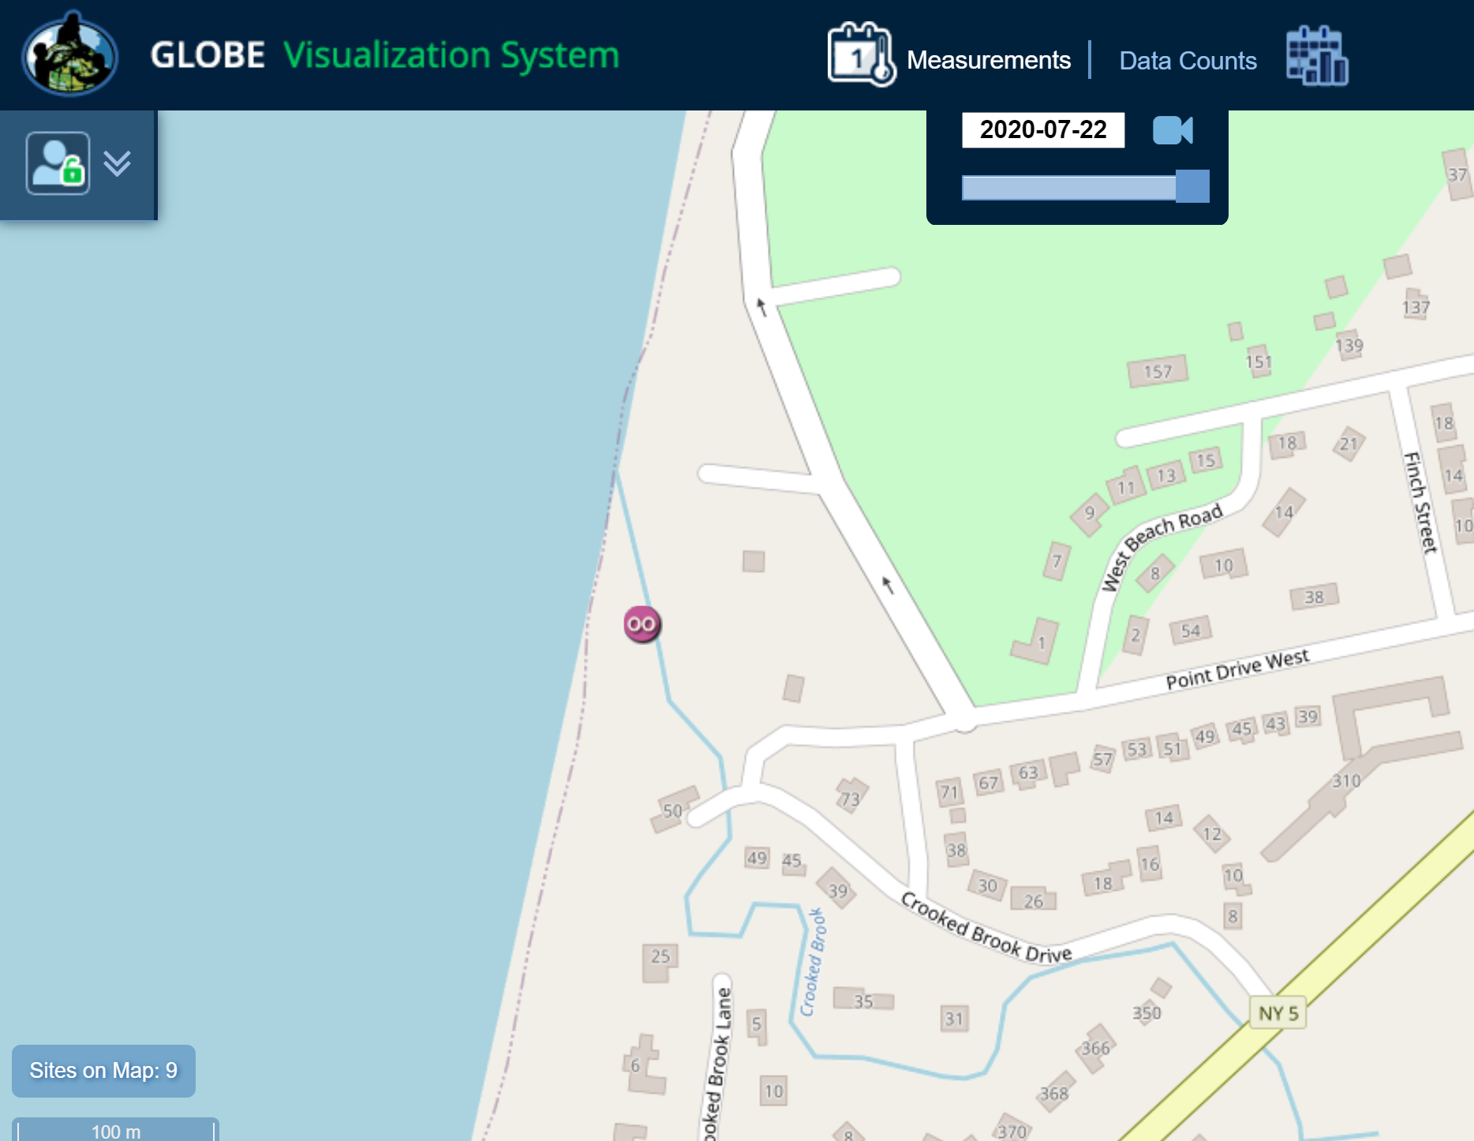
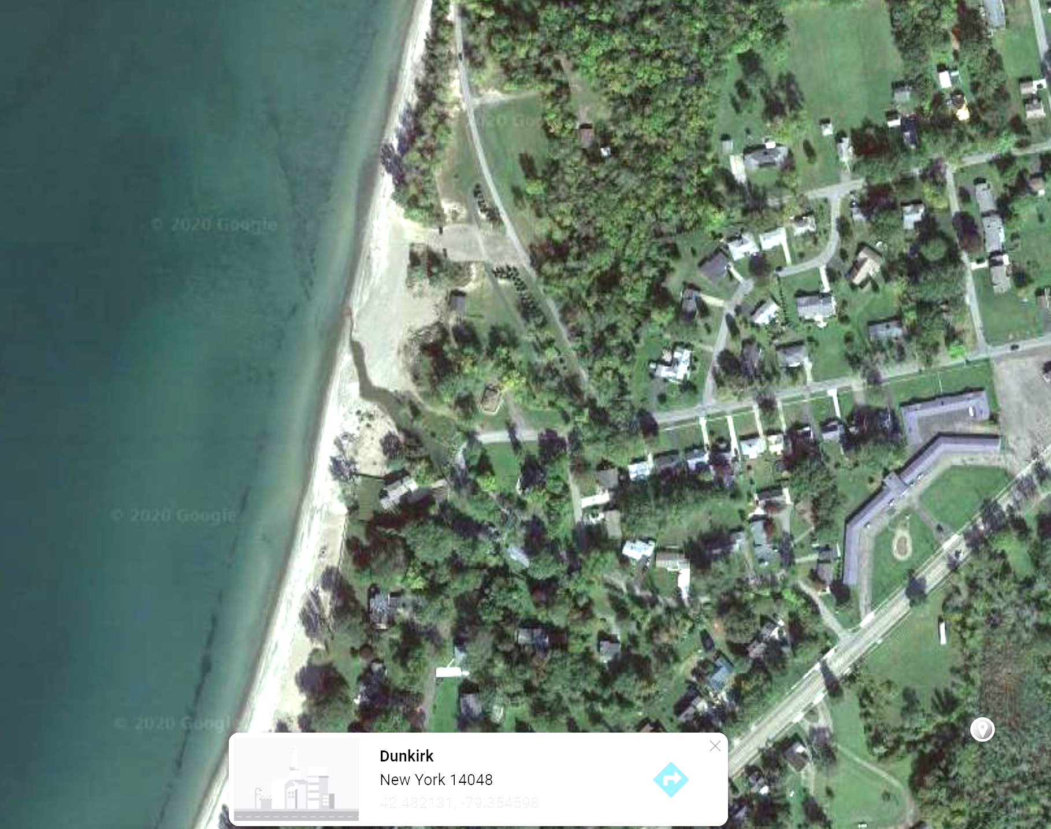
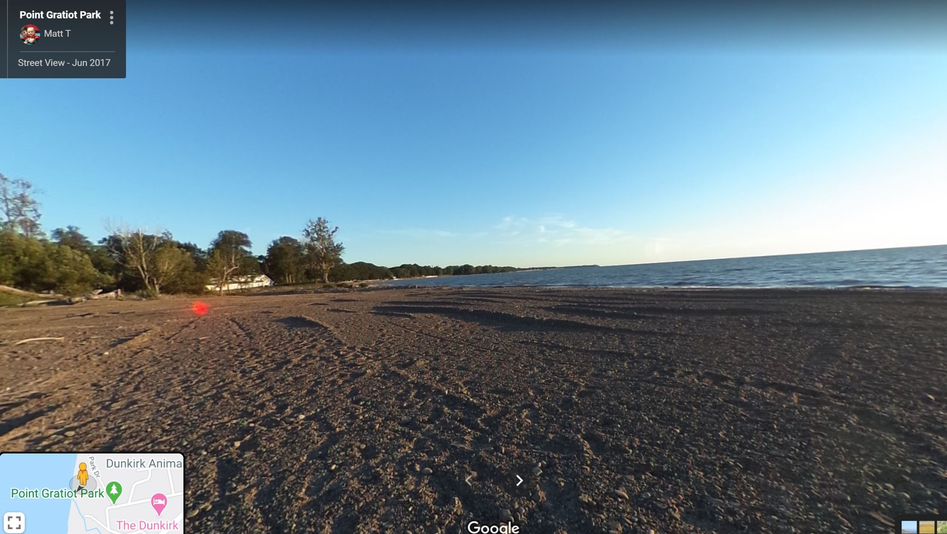
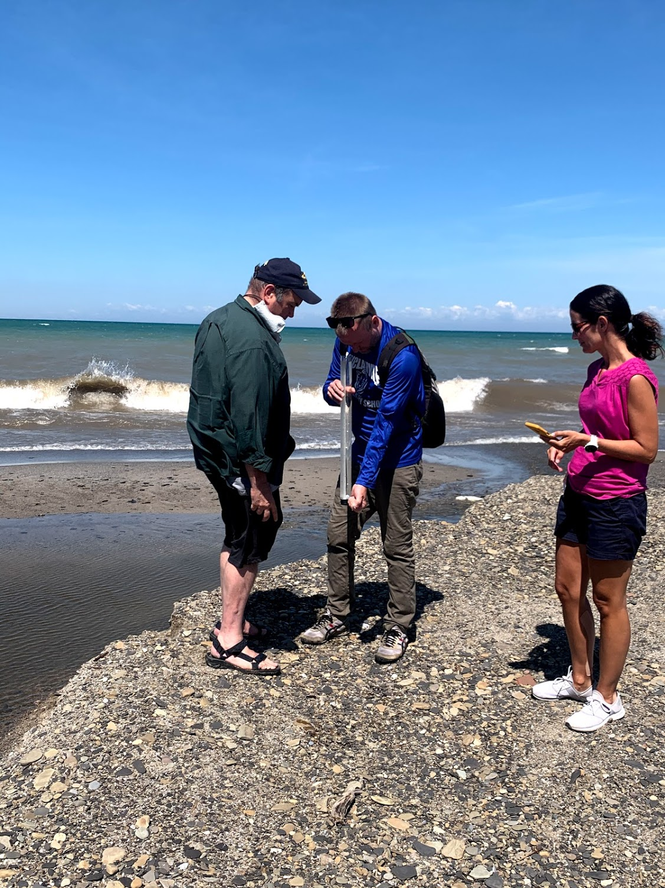
Map of Study Site #2 Crooked Brook: Dunkirk, NY
[GLOBE VIsualization tool and Google Maps]

Slide 11
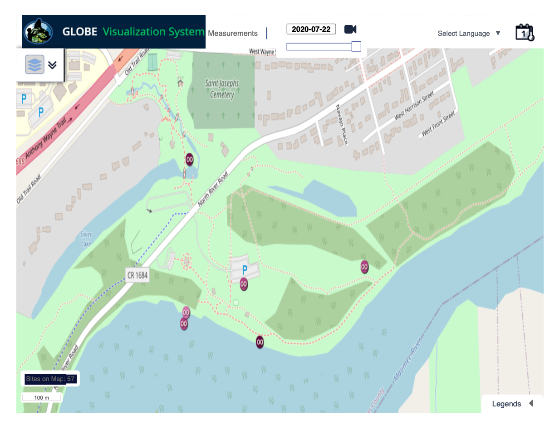
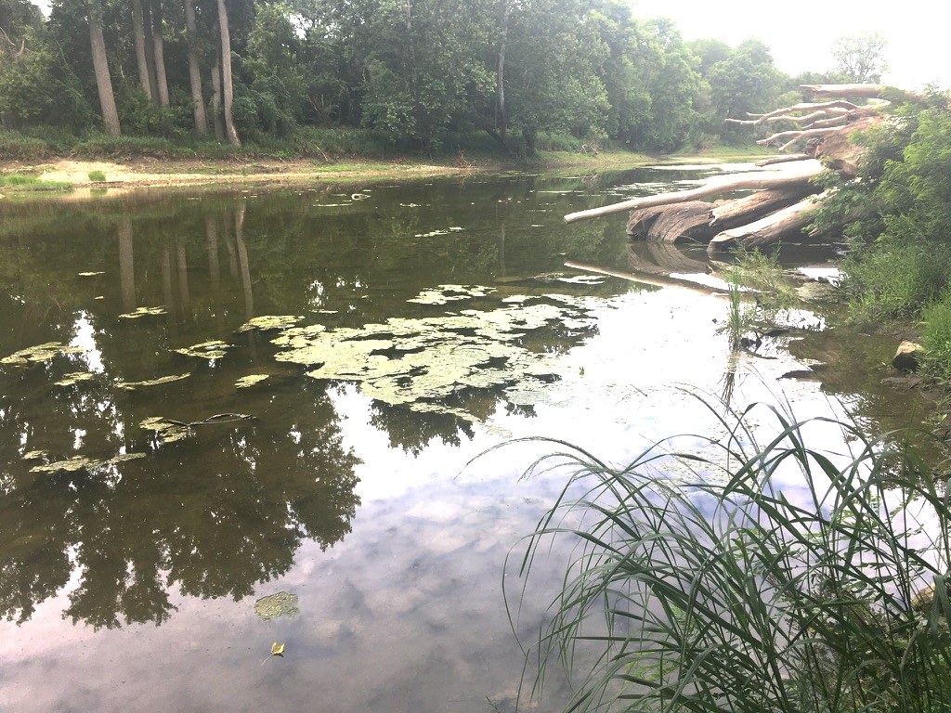
Map of Study Site: Maumee River, Toledo, Ohio

Slide 12
Research Methods
The following GLOBE hydrology protocols were used: Water Temperature, Water Transparency, Dissolved Oxygen, and pH.
Multiple data points for each water quality measure were collected. High air temperatures and a dry July likely influenced the results.
Universal protocols were used that allowed for direct comparison of data between sampling sites.

Slide 13
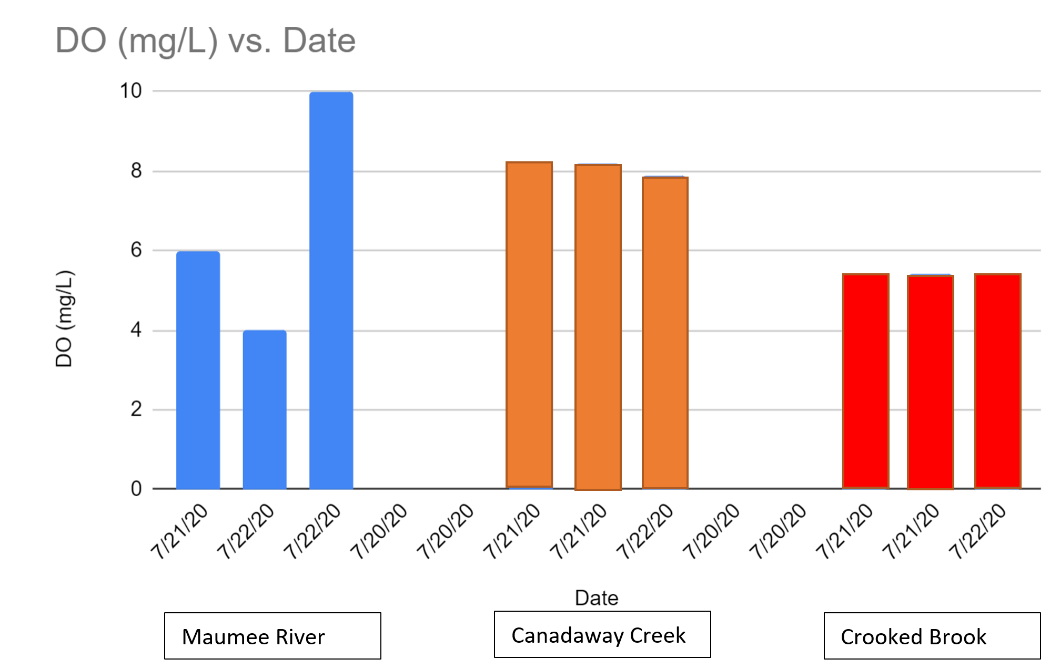
Results Dissolved Oxygen (mg/L)

Slide 14
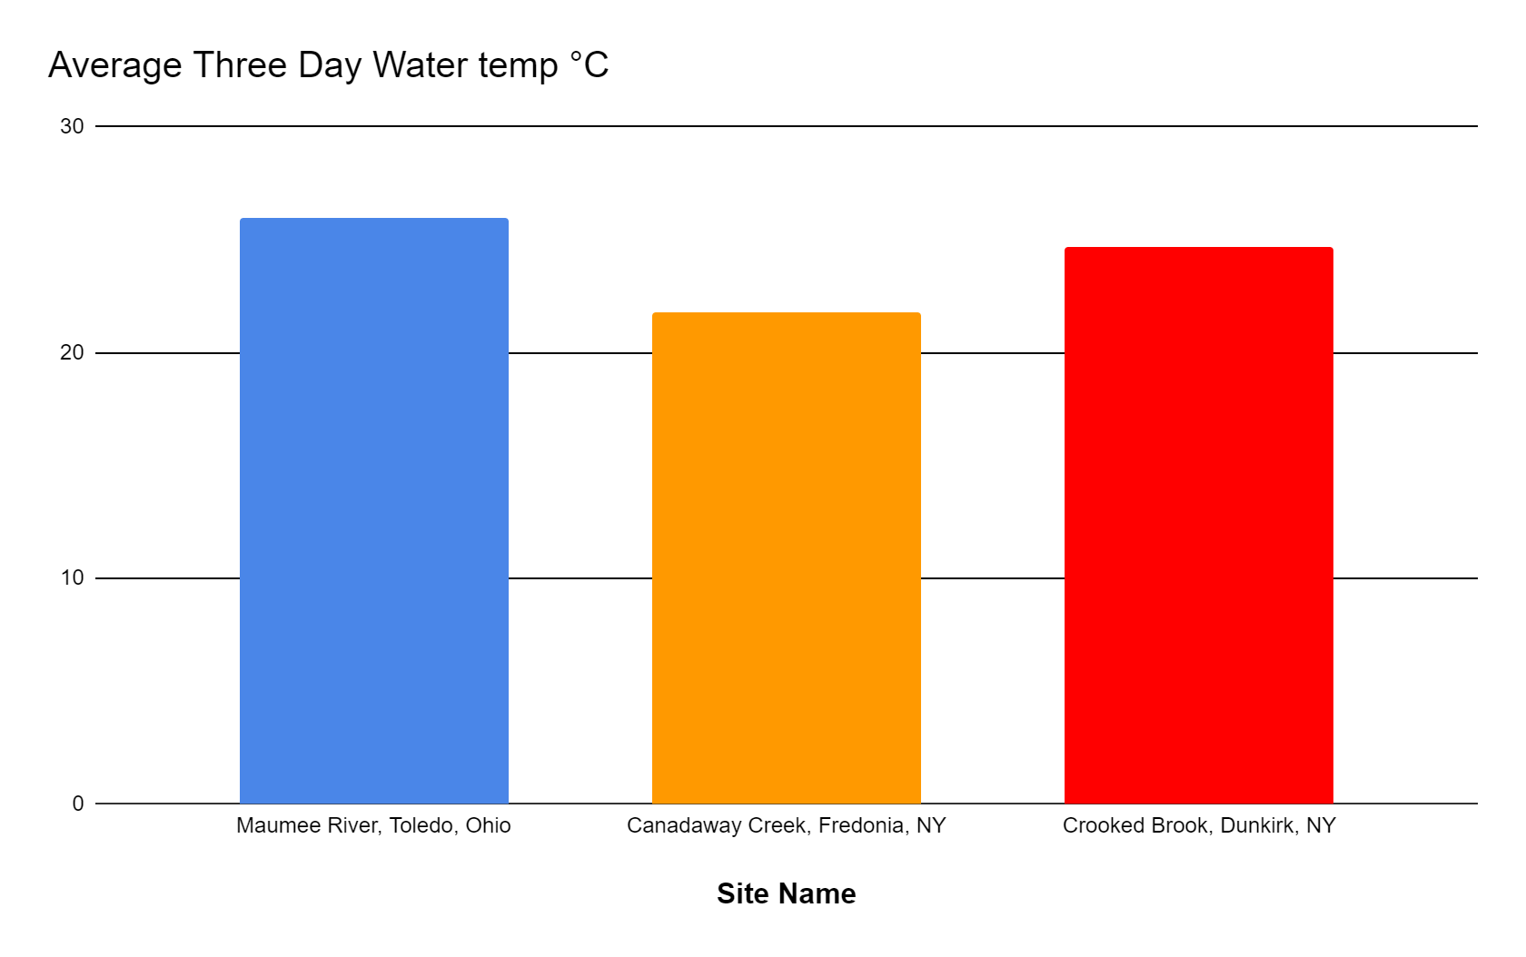
Results: Temperature

Slide 15
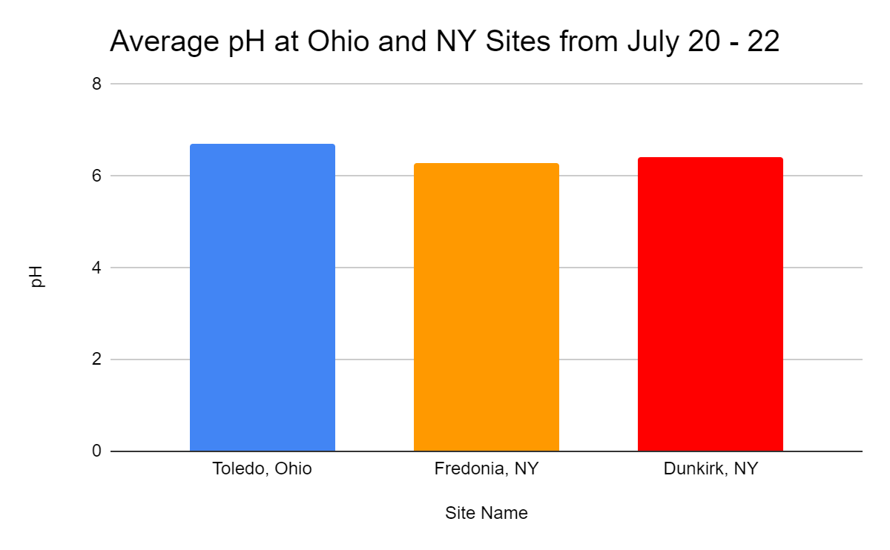
Results: pH

Slide 16
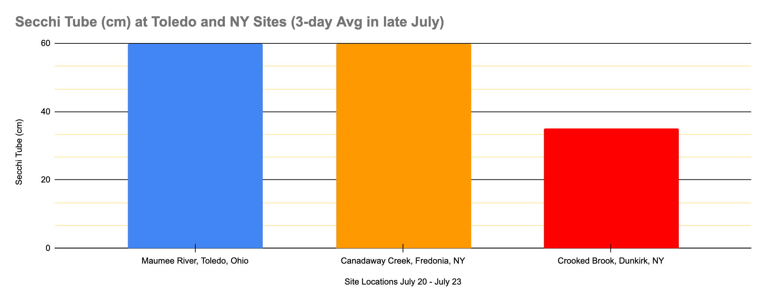
Results Secchi Tube

Slide 17
All Results: July 20 - July 23, 2020

Slide 18
Discussion
According to the data, there is not a significant difference between the two streams and the two ends of the lake.
Average pH was between 6.2 and 6.4, consistent between the two sides of the lake.
Water temperature values were between 22 and 25 degrees. Lower temperatures observed at Canadaway Creek were most likely due to the shaded location with swift moving water. As expected, higher dissolved oxygen levels were consistently found in this location.
The Crooked Creek location turbidity levels were higher (30-35cm) vs. 60 cm at the other locations. This was likely due to inorganic matter. This location was right at the beach where the creek enters Lake Erie.
The results indicate that more data collection is needed in order to make a correlation. with algae bloom differences seen in the satellite images.
The data are important to science and our community because it is a preliminary analysis of the two locations and connections were made for further research.

Slide 19
Conclusions
Improvements to this research include adding additional water quality protocols, recording additional sampling conditions, and additional data points.
We appreciated doing this research for GLOBE and NASA because it helps us bring real science to our classrooms and greatly aids in student motivation and understanding of their surrounding environment.

Slide 20
Bibliography
Chiu, Y., Chen, Y., Wang, T., Yen, H., & Lin, T. (2017, May 20). A qPCR-Based Tool to Diagnose the Presence of Harmful Cyanobacteria and Cyanotoxins in Drinking Water Sources. Retrieved July 23, 2020, from https://www.ncbi.nlm.nih.gov/pmc/articles/PMC5451997/
E;, L.M. (n.d.). Eutrophication and Warming Boost Cyanobacterial Biomass and Microcystins. Retrieved from: https://pubmed.ncbi.nlm.nih.gov/28208670/
H;, O. (n.d.). Challenges Regarding Water Quality of Eutrophic Reservoirs in Urban Landscapes: A Mapping Literature Review. Retrieved July 23, 2020, from https://pubmed.ncbi.nlm.nih.gov/30586945/
US Department of Commerce, N. (2019, April 10). Great Lakes: Harmful Algal Blooms. Retrieved July 23, 2020, from https://oceanservice.noaa.gov/hazards/hab/great-lakes.html
What is a harmful algal bloom?: National Oceanic and Atmospheric Administration. (n.d.). Retrieved July 23, 2020, from https://www.noaa.gov/what-is-harmful-algal-bloom
https://www.glerl.noaa.gov/res/HABs_and_Hypoxia/lakeErieHABArchive/HAB20191031_2019031_LE.pdf
https://www.globe.gov/

