Slide 1
Overview
Downy Mildew is a fungal disease. It damages a large number of plants and crops such including;(Vegetables, Fruit Trees, and Ornamental Plants).

Slide 2
My Experiment
I started to study the types of herbs that contain very strong fungicides, including garlic. The effectiveness of garlic is similar or close to that of expensive fungicides. When researching, I found a video clip that explain how to find a fertilizer that eliminates the disease and that garlic was used by someone else in making a fungicide. Garlic and other chemical materials can be used as a fertilizer that I have turned into a spray by using the garlic extract and its spreading at specific times. We can also make use of the extracted garlic by cultivating them and thus is recycled without any losses. I succeeded in using this fungicide in treating infected tomato. In this, climate factors such as humidity helped me, especially the climate that starts from the end of January to the mid of February. I have been spreading tomatoes with the garlic extract. The results I reached were positive.

Slide 3
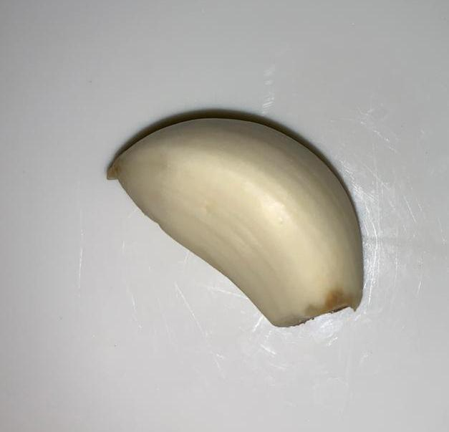
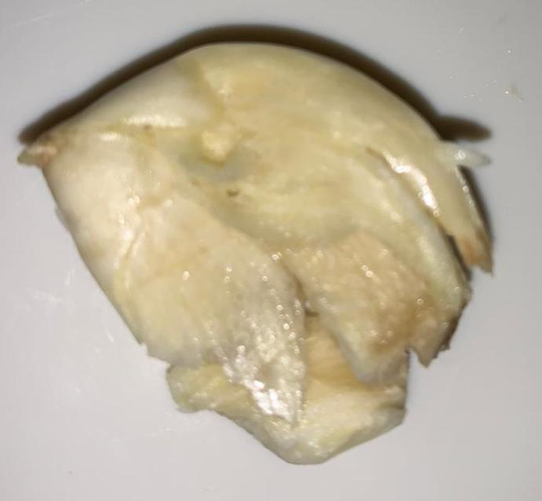
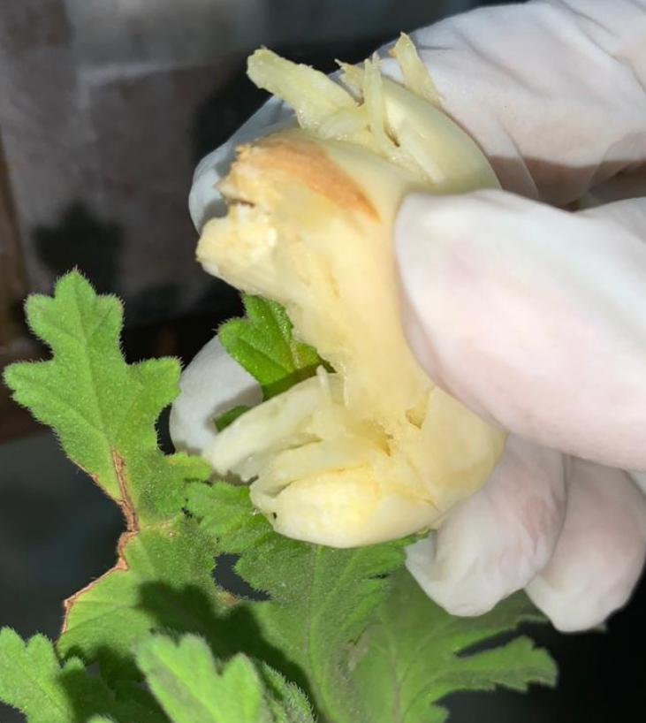
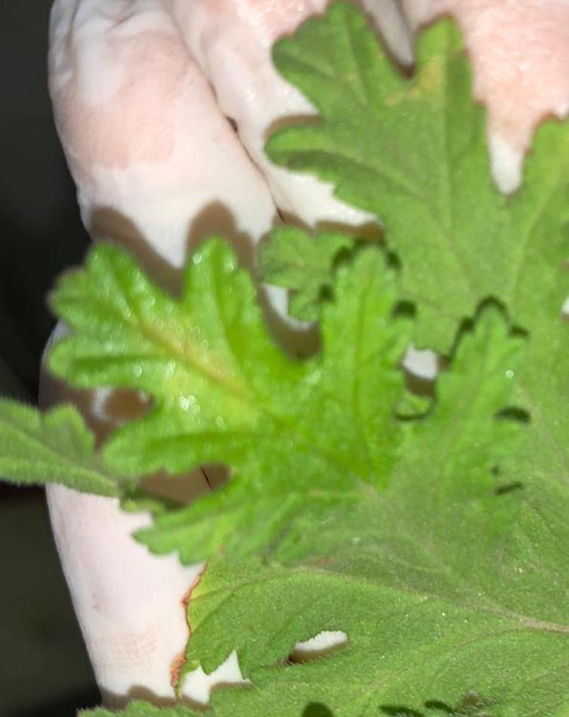
Steps of the Experiment

Slide 4
Results
I concluded that the hypothesis supports the results. Therefore, it is possible. In essence, garlic kills fungi, improves plant growth and is not harmful to living creatures.

