Slide 1


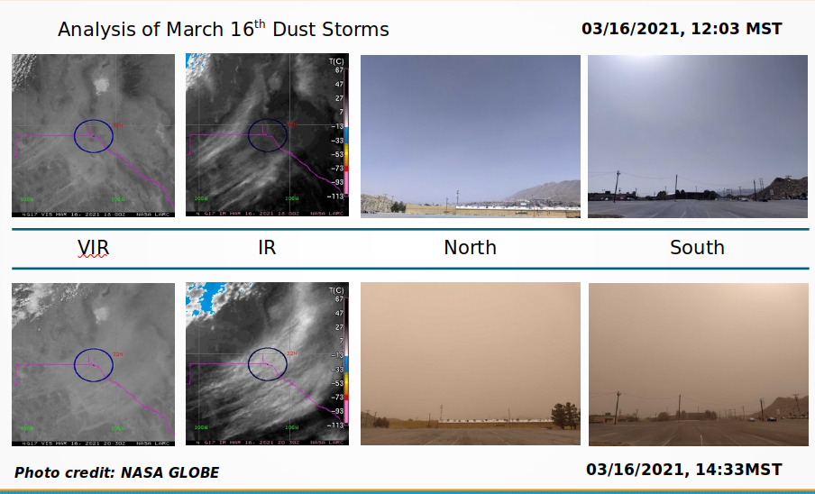
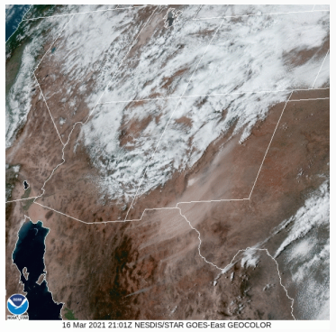
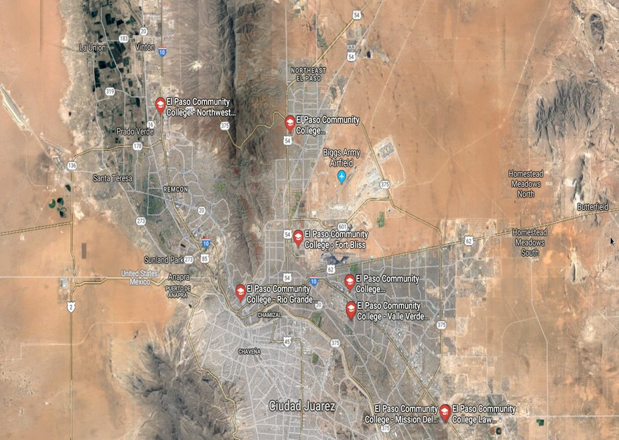
Impacts of Chihuahuan Desert Dust Storms using GLOBE data
J. G. Olgin
El Paso Community College
Abstract
Research Methods
Results
Discussion
Dust storms have impacted the El Paso desert region, peaking the interest of public safety and health professionals. Such storms have transported pathogens from desert soils over long distance, affecting desert inhabitants. These storms have also caused diminished visibility for travelers on US highways. The goal of this project is to determine the frequency and intensity of dust storms in the region using GLOBE and satellite data, and how it can be applied in mitigation efforts in public health and safety arena.
Planning Investigations
Describes the planning process
  Includes a map and description of the study site with mention of: (1) the area of study, (2) climatic characteristics, and (3) basic aspects of land cover
  Describes the GLOBE protocols and NASA assets to be used
  Describes organization for data collection, including instrument calibration, preparation of all materials, and tools and equipment to be used
  Data collection strategy including how the time of day of data collection would be selected, how frequently data would be collected, and the timing and location of sample collection and measurement.
Carrying Out Investigations
Describes what happened
  Describe the GLOBE protocols, NASA assets, or other data sources actually used
  Describes data collection activities including discussions of the specific locations at a site where data sampling occurred
  Describes the specifics about the data (e.g., the kinds of data, amounts of data)
  Describes the steps for data collection (e.g., frequency of sampling or measurement activities; the protocols used, the role of each team member in collecting data, etc.)
Analyzing Data
  Addresses the research question(s)
  Describes the procedures for data analysis including the mathematical calculations used
  Includes a detailed analysis of the data
  Tables and graphics show patterns or trends in the data
  Print screen of GLOBE visualization page
Interpreting Data
  Discusses the meaning of the results
  Discusses how and why the results support the hypothesis or not
  Provides a description explaining the importance, relevance, and impact of the analyses, with regard to the science
  Presents a clear, complete and insightful discussion of the limitations of the methods and the data used
  Compares results with similar studies
  Suggests possible sources of error
Research Question
Figure #1
How can dust storm frequency and intensity vary over seasons?
What type of weather systems and ground conditions are conducive for dust storms?
How can the results of this research tie into public health and safety mitigation efforts?
GLOBE Data Used
  Describe the GLOBE protocols and/or data that you used in your research
  Where did the data come from? Did you collect it using GLOBE protocols (if so, which ones), or download it from the GLOBE website?
  How did you use this data in your research?
Introduction
Content Knowledge
  Brief (300 to 500 words)
  Describes the environmental or societal problem the research question addresses
  States the importance or significance of the research; establishes relevance to a community
  Accurately uses science content and demonstrates understanding of basic scientific concepts and fundamental principles covered in the GLOBE protocols.
  A 1-2 paragraph research review demonstrating what you know already about this topic; includes 3 to 5 citations in text, including at least one primary source in a “peer-reviewed” journal.
Conclusions
Figure #2
Drawing Conclusions & Next Steps
  Conclusions are supported by the results
  Gives a thorough and insightful explanation as to how the conclusion was reached
  Suggests improvements in the methods
  Discusses implications for future research
  Recommends follow-up research or actions to be taken
  Discusses possible future protocols that could be used
  Describes the impact of working with a project mentor
Bibliography
References
  Cites prior literature correctly
  (See owl.english.purdue.edu for guidance and resources)
  Lists GLOBE materials and NASA assets used
  Provides sources beyond those provided by GLOBE
Notes:
<number>

