Slide 1
HOW OUR LIME TREE AFFECTS THE LIVES OF STUDENTS AND TEACHERS IN SCHOOL
Antonela Nikolić, III. primary school Varaždin, Croatia
Square Ivana Perkovca 35, 42000 Varaždin
Mentors: Anica Vragović, Marina Balažinec

Slide 2


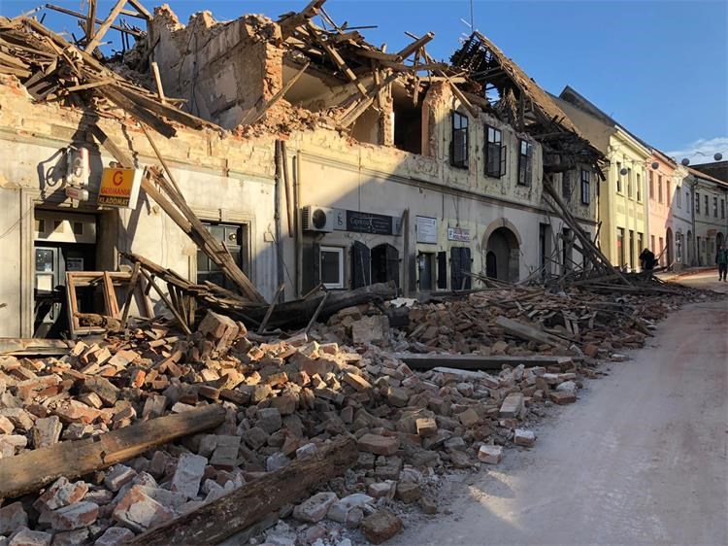

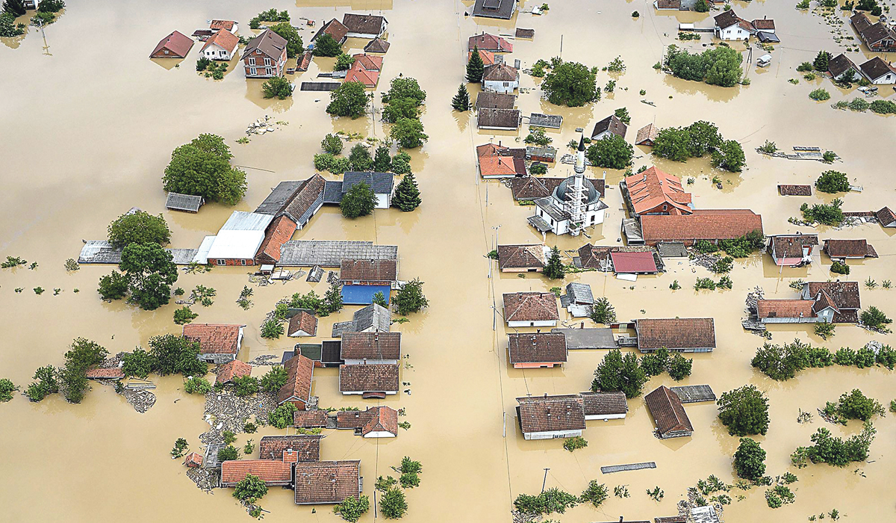
INTRODUCTION
The effects of climate change are being felt worldwide
I wanted to contribute to the protection of our planet and actively participate in environmental observation, GLOBE

Slide 3
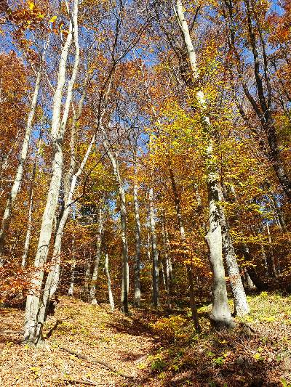
Lime tree budburst is 2 weeks earlier due to climate change
I learned a lot about nature and ecosystems

Slide 4

PROJECT GOAL
Develop awareness of human connection with nature
Encourage students to actively participate in environmental protection and nature protection
Encourage school authorities to plant more trees around the school
Link mathematics to nature

Slide 5
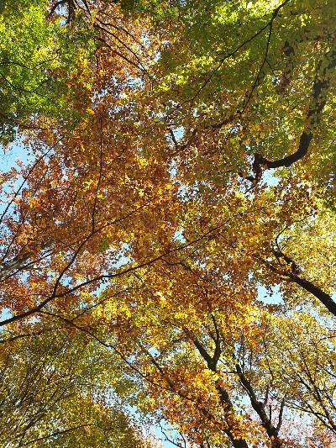

TREES AND MAN
THE FACTS I TAKE INTO ACCOUNT WHEN CALCULATING
Nature - the most effective measure for nature conservation (ETH)
1 $m^{2}$ of leaves prodce 500 ml of oxygen per hour (Hewiston)
The average person breathes 12 times per minute in a standby state and has 500 mL of air in one breath, of which 79% oxygen (Car, 2011)

Slide 6
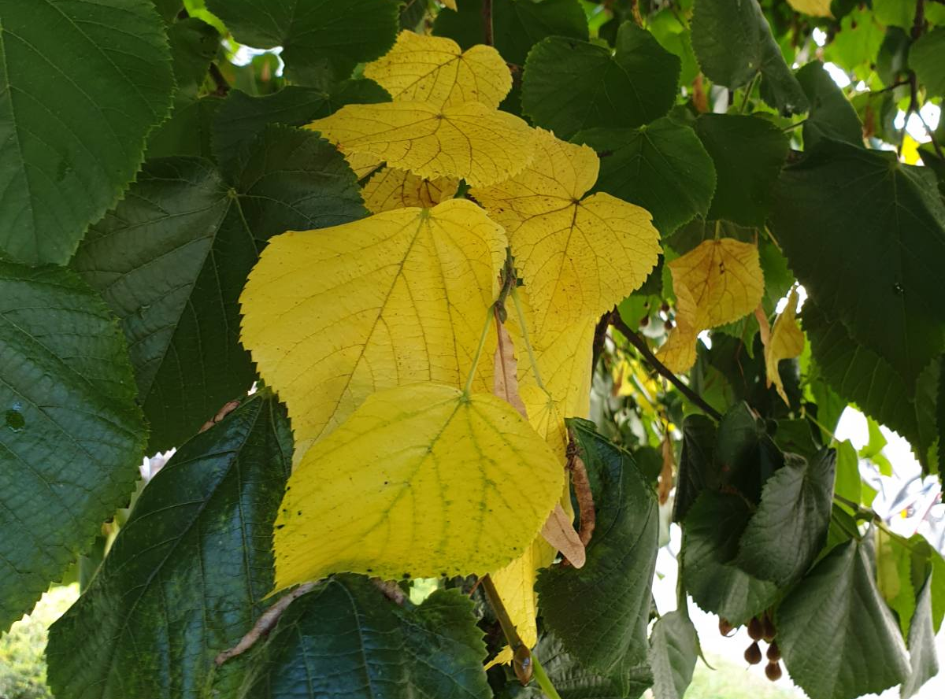
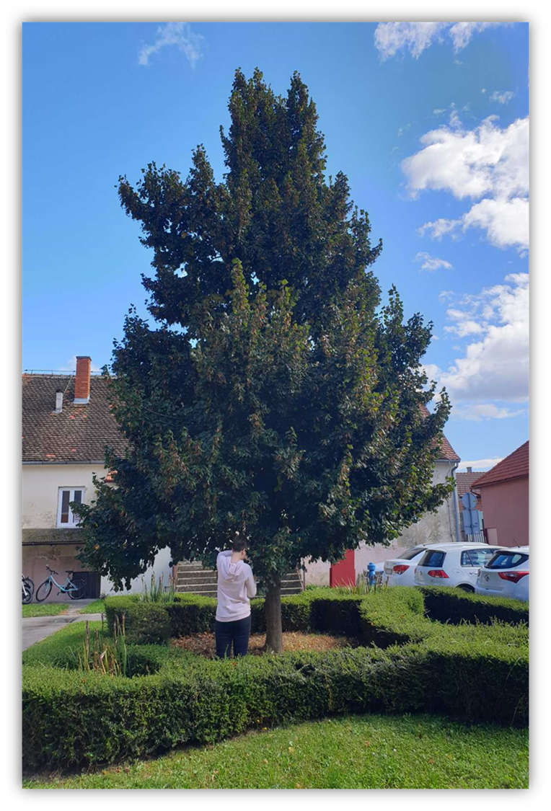
OUR LIME TREE
It belongs to the species of small-leaved lime (lat. Tilia cordata)
Grows to 18 m
Canopy dense, symmetrical youth, half-corner later
Pale yellow leaves
Blooms of June and July
Multi-seeded nutmeg
Thrives on various types of soil
Drijen, 2020

Slide 7

RESEARCH QUESTIONS
How much lime tree produces oxygen in one hour, day and year?
How much oxygen does the average person breathe in one hour, day and year?

Slide 8
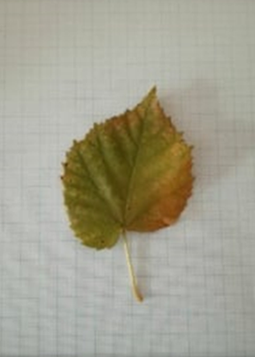
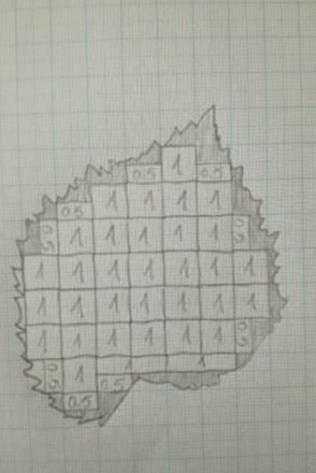

MATERIALS AND METHODS:
I calculated the leaf surface using millimeter paper, 42 ${cm}^{2}$

Slide 9
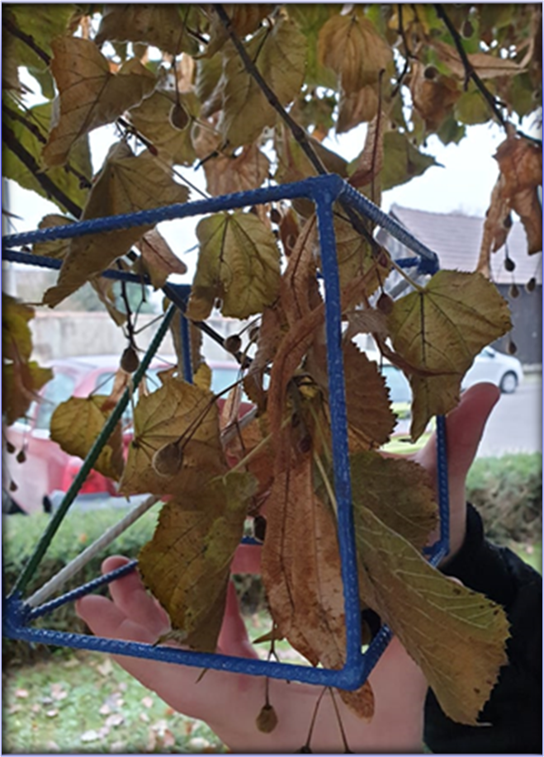
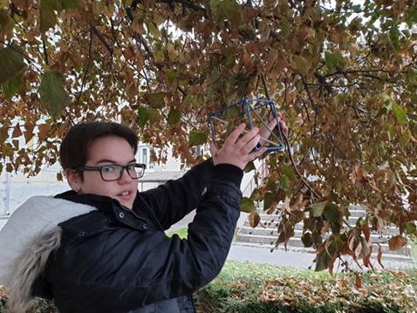

I used wire cube with volume 2.2 ${dm}^{3}$ ,16 leaves
To get an approximate number of leaves on a lime tree, 174,569 leaves

Slide 10
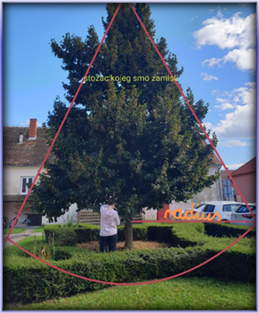

I imagined the lime tree canopy as a cone, 2 400 ${dm}^{3}$

Slide 11

from this data I calculated how much lime produces oxygen:
1 leaf – 2.1 mL oxygen/h
In hour – 367 L/h
In Day – 8808 L
In a year – 3 214 920 L
z

Slide 12
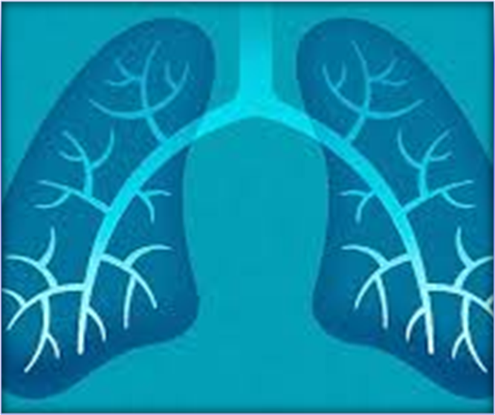

AMOUNT OF OXYGEN INHALED (1 person)
1 breath – 500 mL – 395 mL oxygen/breath
IN THE HOUR
1 min = 12 breaths = 4740 mL of oxygen
1h= 60 min
284 400 mL/h
IN THE DAY
number of minutes per day · amount of oxygen in one minute = 6 825 600 mL oxygen/day
In a YEAR
2.5 · ${10}^{9}$ L

Slide 13
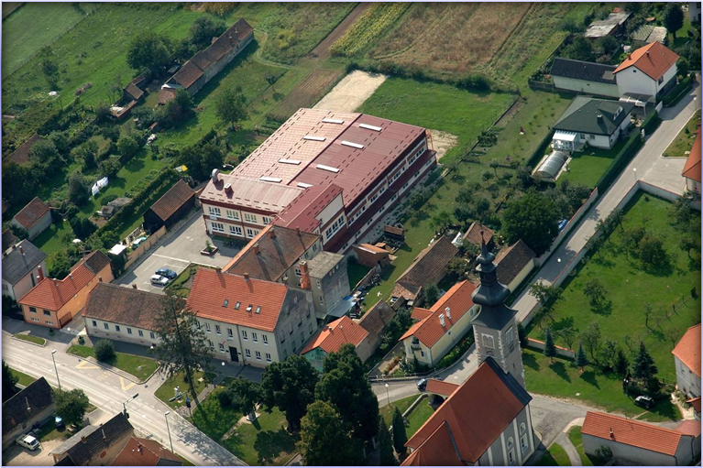

OUR SCHOOL
391 students + 43 employees = 434 people in our school
IN THE HOUR
434 · 284 400 = 123 429 600 mL/h
IN THE DAY
434 · 6 825 600 mL = 2 962 310 L/day
IN THE YAER
434 · 2 962 310 L ≈ 1.08 · ${10}^{9}$L/year

Slide 14
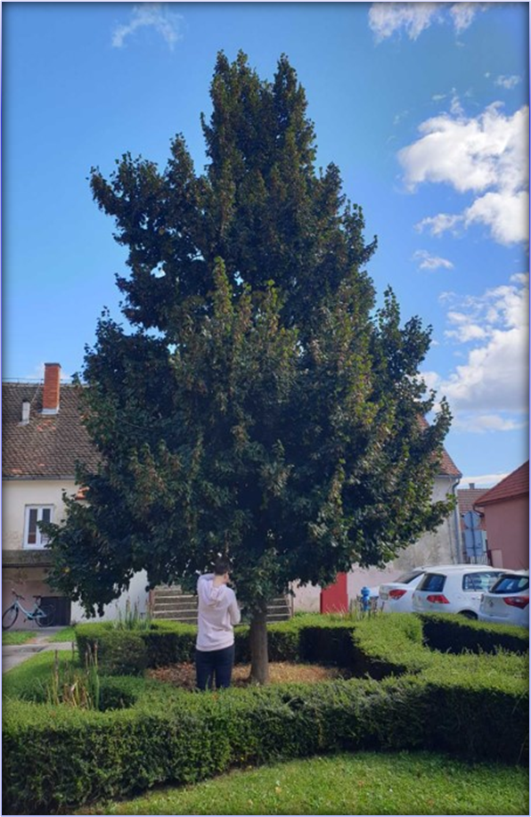
CONCLUSION
In theory it is necessary to plant 336 lime trees in our schoolyard
I hope that we will plant 2-3 trees, so we can be closer to nature
I also hope other schools in Croatia do the same
Mathematics is really all around us and is the foundation of all natural sciences
Thank you for your time

Slide 15
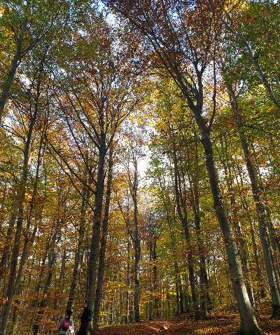
Trees are poems the Earth writes upon the sky – Kahill Gibran

