Slide 1



Investigation of Mosquito Larvae Habitats in The Water Ditch at Hsin Tien Senior High School
Author：LUO, XIN YI HUANG, YU CHIN LIU, YU HSUAN
Teacher：CHEN, CHENG CHANG

Slide 2
Outline
Motivation of research
Environmental introduction
Research method
Data
Discussion
Future work
Reference

Slide 3

Motivation of research
Due to our previous participation in the mosquito seminar , when registering for the science fairs, we thought that if the subject is related, it will be easier when researching, so we decided to study topics related to mosquitos.

Slide 4
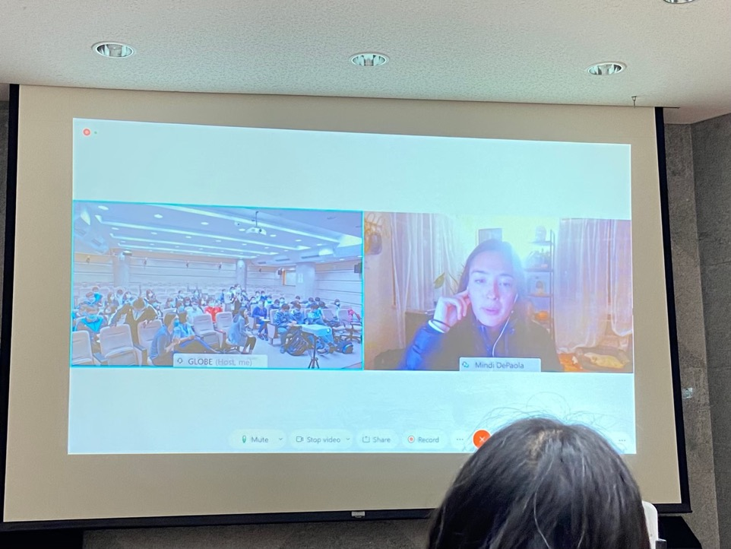

Slide 5
In Taiwan, mosquitoes are everywhere, and they live in humid places, such as mud, tree holes, grass, or ditches.
In Hsin Tien High School, mud and tree holes are not common, and the grass is in the sun, cannot guarantee the growth environment required for larvae, so we only have ditch.
After the observation, we analyzed the data and we wanted to know whether there will be larvae in every ditch, and whether the number of larvae varies in different places.

Slide 6
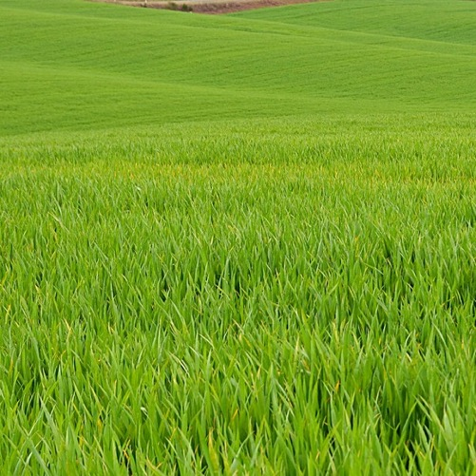
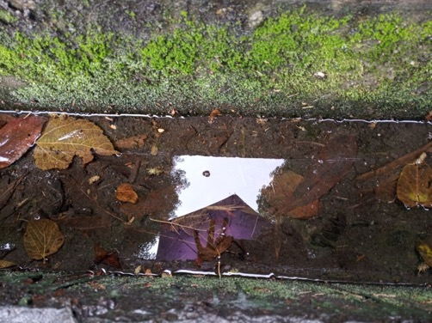
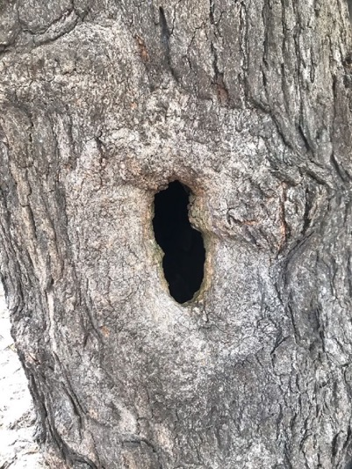
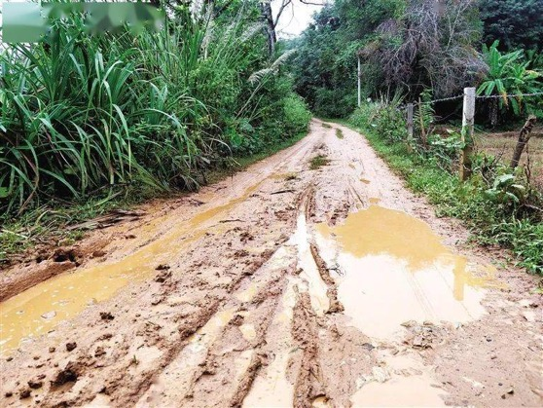

Slide 7
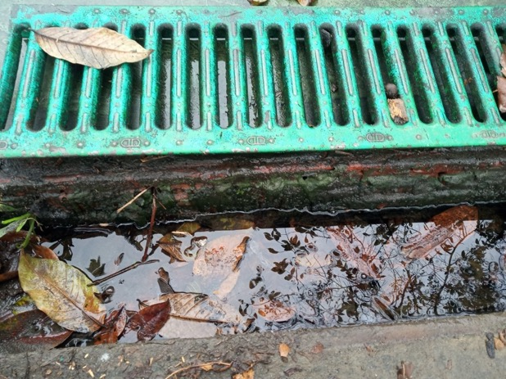
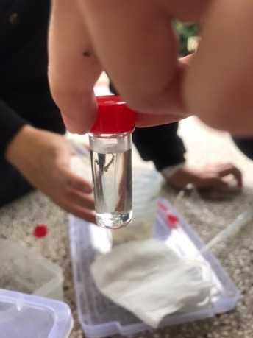
After the observation, we analyzed the data and we wanted to know whether there will be larvae in every ditch, and whether the number of larvae varies in different places.

Slide 8
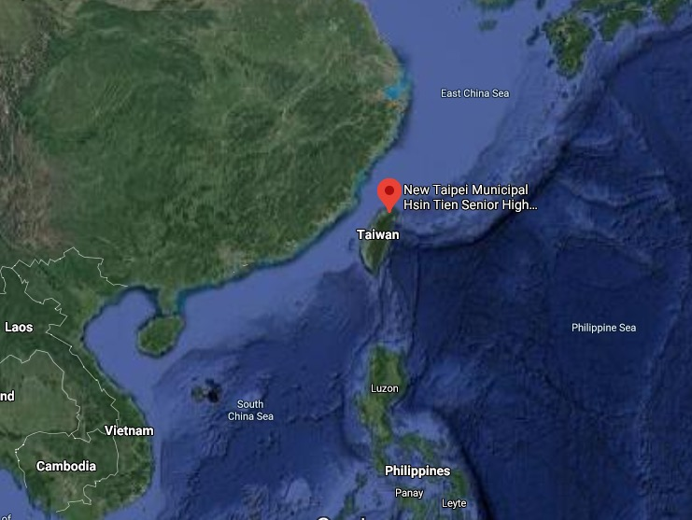
Environment introduction
Location : New Taipei City, Taiwan
Climate : Asia monsoon climate
Coordinate:121.531810,24.975642

Slide 9
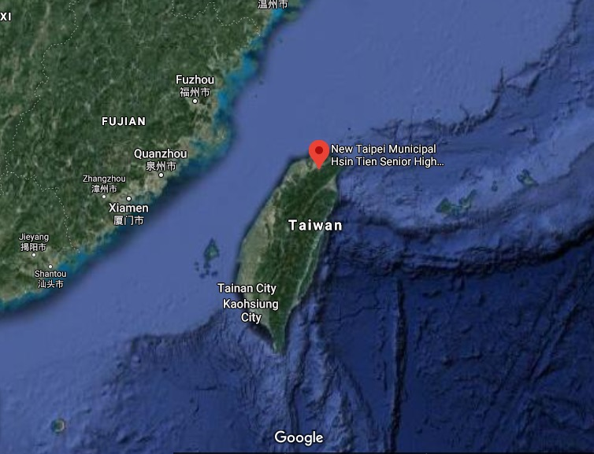
Northern of Taiwan Nearby the capital

Slide 10
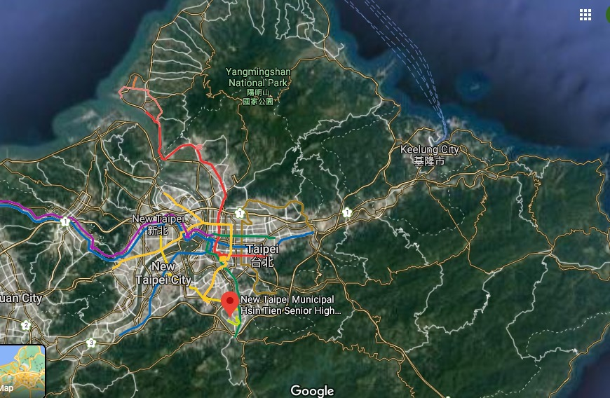

Slide 11
Research method
Record date and time
Remove the drain cover
Observe the ecology of the water ditch and take photos and records
Measure and record water temperature, air temperature and air pressure
(1) Take a water sample with a big dropper and
observe the water quality and small creatures
(2) Take a water sample with a measuring cup to
collect mosquito larvae and small animals
6. Put the collected mosquito larvae and small animals in
vials separately
7. Measure the pH value of water samples in the
laboratory.

Slide 12
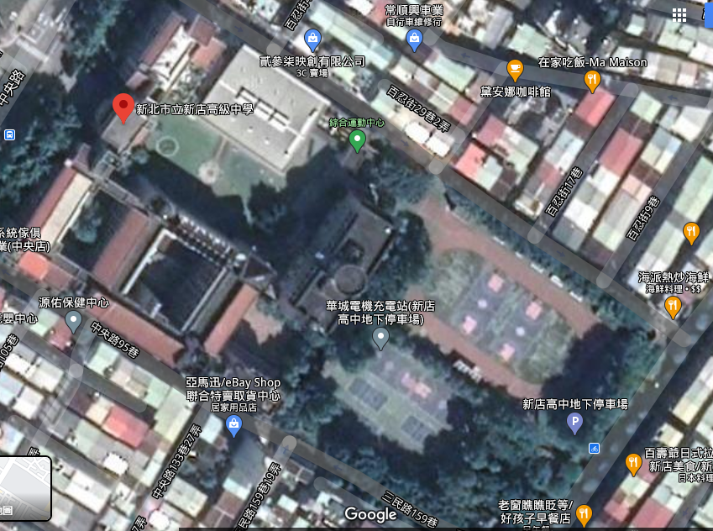
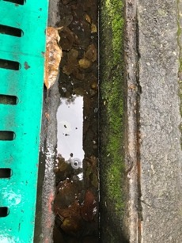

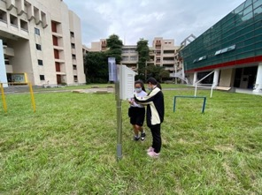
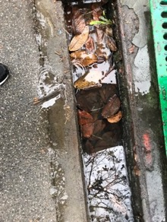
Sampling location
B
A

Slide 13
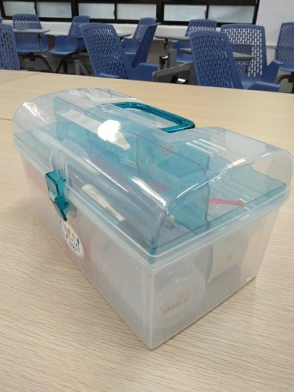
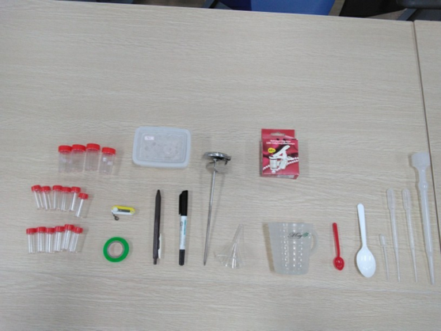
Toolbox
Tools

Slide 14
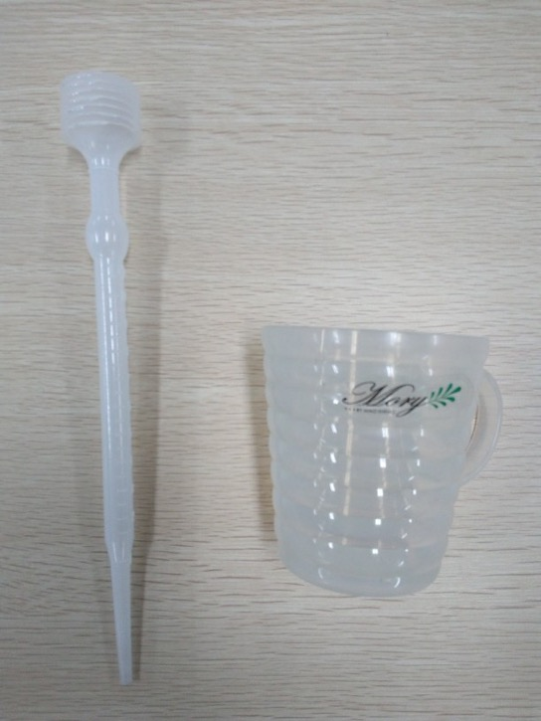
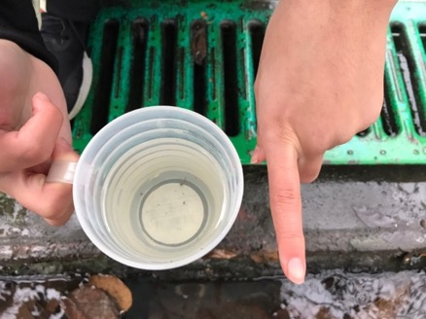
Sampling tool
Big dropper:
water absorption
Water cup:
scoop up water, fishing for larva

Slide 15
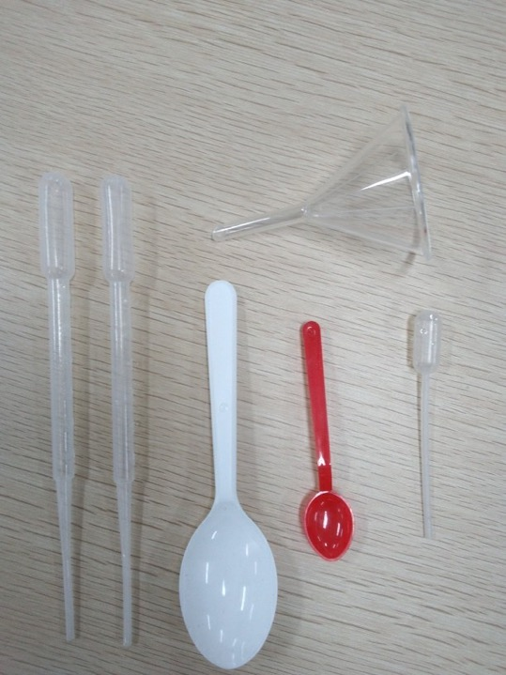
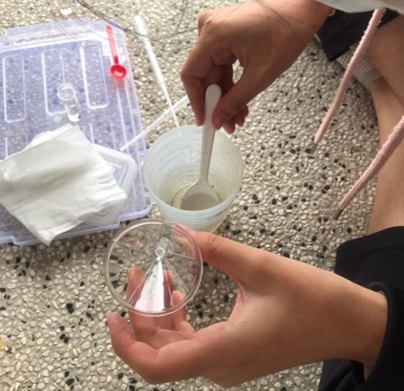
Repacking tool
Pipette: draw up water
with larva
Spoon: scoop up
Funnel: pour water

Slide 16
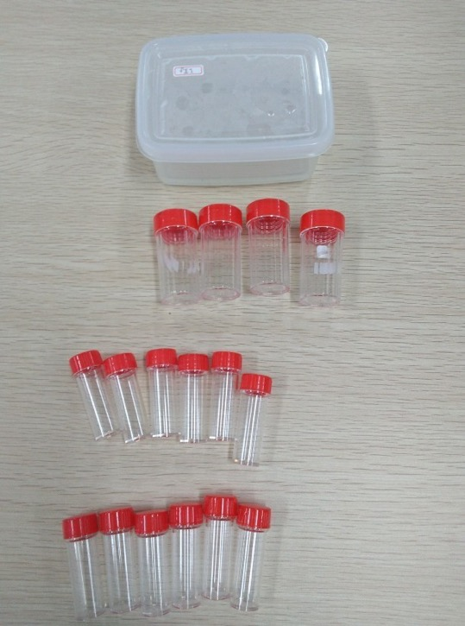
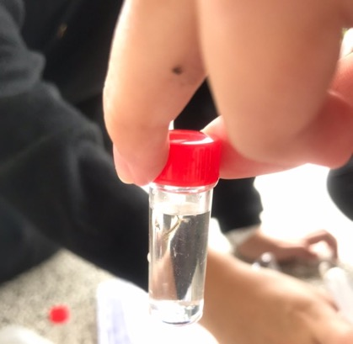
Repacking tool
Box: keep in small bottle
Small bottle: keep in sample

Slide 17
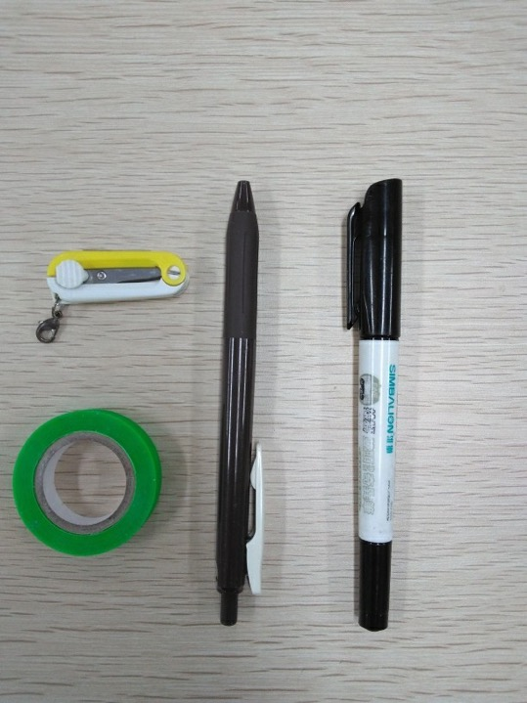
Marking tool
Small scissors: cut tape
Tape: marking, label
Pen: writing, marking

Slide 18
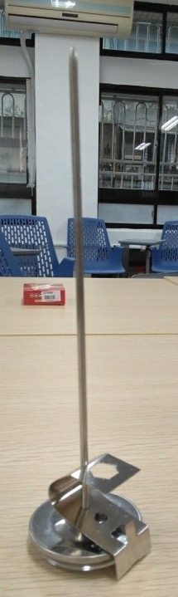
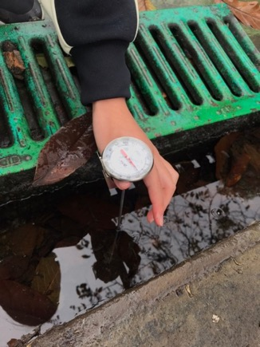
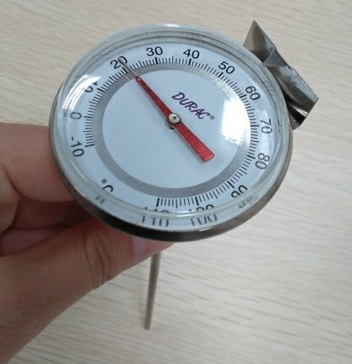
Measuring tool
Thermometer:
measure water temperature

Slide 19
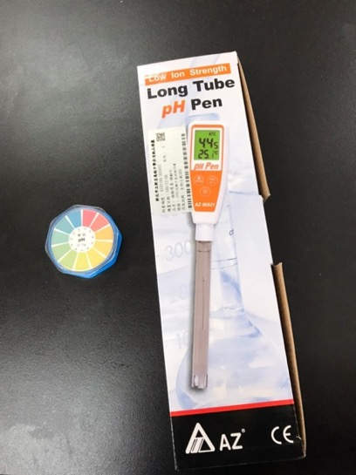
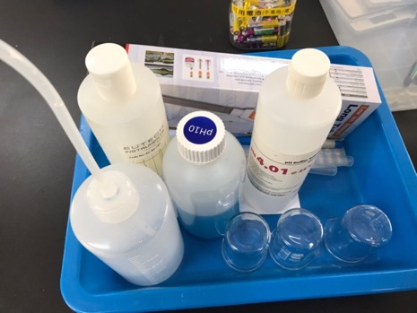
Measuring pH tool
pH meter
Universal test paper

Slide 20
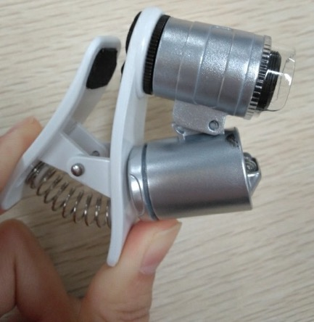
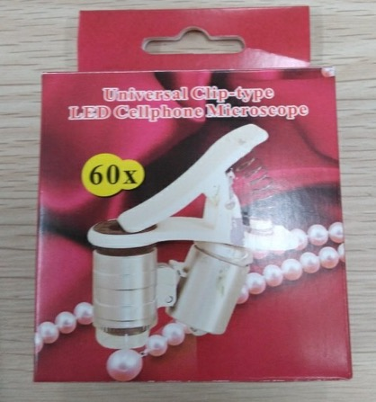
Observation tool
Cell phone microscope: distinguish larva

Slide 21
Data
Date | Air pressure(hpa) | Air temperature (°C) | Place | Water temperature (°C) | pH | Mosquito larva(Culex) | Rainfall (mm)
12/15 | 1021 | 19.1 | A | X | X | 0 | 3.4
 |  |  | B | X | X | 0
12/21 | 1021 | 18.2 | A | 17.0 | instrument:9.65 | 1 | 4.4
 |  |  | B | 17.0 | X | 0
12/25 | 1018 | 17.3 | A | X | X | 0 | 3.2
 |  |  | B | X | X | 0
12/28 | 1015 | 22.0 | A | 21.0 | instrument:6.65 | 1 | 3.2
 |  |  | B | 21.0 | instrument7.0 | 0
1/4 | 1020 | 22.0 | A | 20.0 | instrument:9.94 paper:7 | 4 | 5.6
 |  |  | B | 19.0 | instrument:9.94 paper:7 | 0
1/11 | 1023 | 18.0 | A | 12.0 | instrument:6.7 paper:6 | 0 | 7.8
 |  |  | B | 12.0 | instrument:7.4 paper:6 | 0

Slide 23
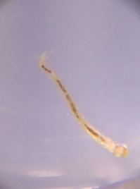
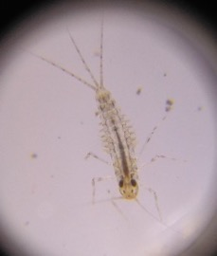
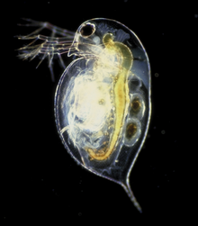
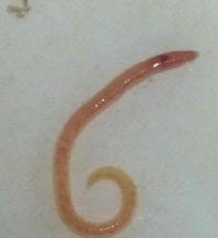
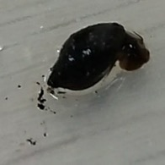
Data | Other
12/15 | Diptera larva Mayfly Larva
12/21 | Red nematode
12/25 | Non-aquatic organisms but like a larva
12/28 | Big mouth snails
1/4 | Red nematode Daphnia
1/11 | White soft creature
Diptera larva
Mayfly Larva
Red nematode
Daphnia
Daphnia
Big mouth snails

Slide 24
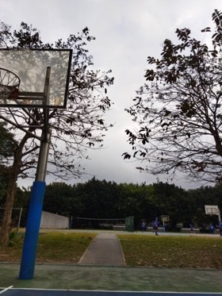
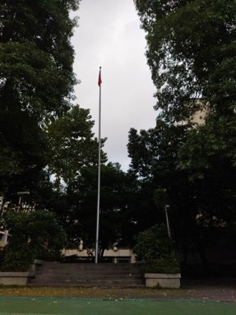
Discussion
1. The difference between Place A and Place B
 | Is there a larva | Water clarity | Is it in the shadow | Amount of water | Number of leaves | Aquatic organisms
Place A | Yes | Mixed | Yes | Less | More | Big mouth snail
Place B | No | Clearer | No | More | Less | Cricket
Place A
Queen`s crape myrtle
Place B
Blackboard tree

Slide 25
2. Is rainfall related to the number of larvae caught?
From the chart, we can see that there is a correlation between the two.
Number of larvae have positive relative with Rainfall.
2020/12/21 2020/12/28 2021/01/04 2021/01/11

Slide 26
3. After the capture, the larvae died one after another
At first we thought that the temperature was too low and the larva died, but after checking the temperature, we found that the reason was not the case.
After that, we checked the observation records and found that the larva had not been ventilated for four consecutive days, and it was speculated that the cause of the larva’s death was hypoxia.

Slide 27
Future work
Continuous observation every Monday
Measure dissolved oxygen
Increase the number of observation days
Increase observation sites

Slide 28
Division of Labor
A：LUO, XIN YI B：LIU, YU HSUAN C：HUANG, YU CHIN
Identify the type of sample | A | Pick up the larva | BC
Measure the pH value | A | Subpackage | BC
Measure the water temperature | A | Observe the larve | ABC
Take a photo | B | Observe the ditch | ABC
Measuring temperature and air pressure | C | Recording | ABC
Fetch water | BC | Check the information | ABC
Water quality | BC | Make report | ABC

Slide 29

Reference
https://www.google.com/maps/@12.9278984,90.3815462,11373190m/data=!3m1!1e3 (2021.01.27)
https://zh.wikipedia.org/wiki/%E6%B0%B4%E8%9A%A4 (2021.02.02)
https://news.ebc.net.tw/news/living/109477 (2021.02.02)

Slide 30
Thank you for listening.

