Slide 1
IVSS 2023
Kyllinga brevifolia surround soil characteristics in school

Slide 2
Motivation
Kyllinga brevifolia is Cyperaceae Kyllinga vegetation,
most of them grow in waterside or moist environment,
one time beside the Stevenson screen observed meteorology，I unexpected found the sod in school have grown the Kyllinga brevifolia,because it like growing in waterside,thus it growing i our school have no waterside sod,let me be surprised，and then start to note it,so I want to use this research to investigate have growing the Kyllinga brevifolia sod,compare the other sod whether the moist be high

Slide 3
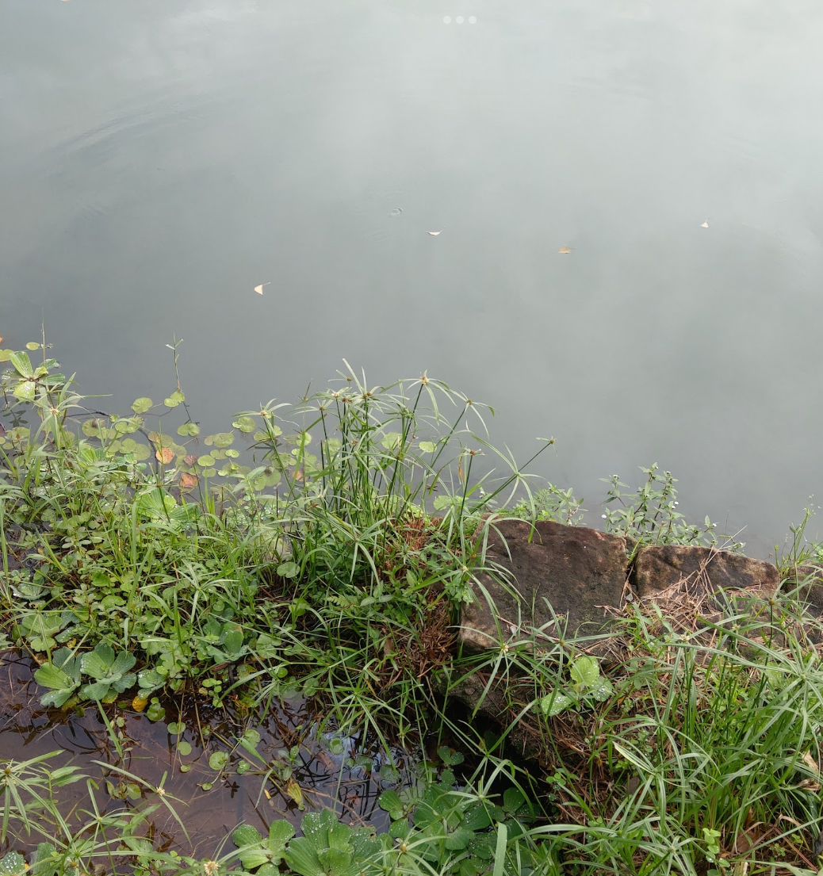
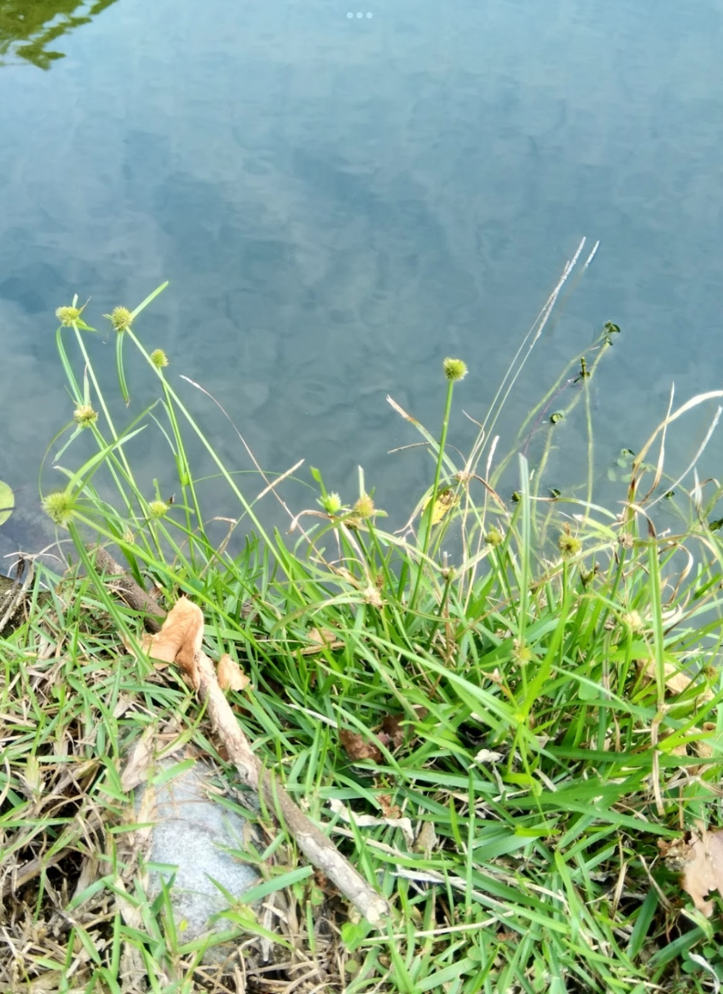
Vegetation introduced

Slide 4
Mode
1.collect the soil probably half of the glassware（ Kyllinga brevifoli soil beside the Stevenson screen sod in school (deep with 5,15,20 add no grass soil) be middle, east west south north each 4km collect no grass soil
Because the soi lnot very difference，so we change the place in process,（Kyllinga brevifotoli have or have not soil beside the Stevenson screen sod in school (deep with 5,15,20 add no grass soil) and the no sod soil in playground
2.after the collection and go to the laboratory to measure the soil with 200g
3.take to the oven to bake
4.wait for next time after collect soil take out,each of them measures how much g (seldom g is moisture)
5.each of cup take 20g soil,add 40g distilled water stir well wait for settle
6.use burette to absorb above water
7.and use pHinstrument and pH test papers to measure pH

Slide 5
Material
1.glassware 8.Plastic box
2.burette 9.oven
3.scoop 10.hoe
4.Electronic scales 11.thermometer
5.distilled water
6.pH instrument and pH test papers
7.Neutral water

Slide 6
Experience and Found
before:
Centered on the Kyllinga brevifolia by the Stevenson screen in school to collect in surfaces 5-10cm,10-15cm,15-20cm soil,and to around east west south north each to extend 4km ,each collect in surfaces 10-15cm area soil,and measure 200g soil put in oven ,final measure the evaporation water.
after we delete east west south north,the other choose no grow Kyllinga brevifolia to measure ,see two sod moisture,temperature,pH deference.

Slide 7
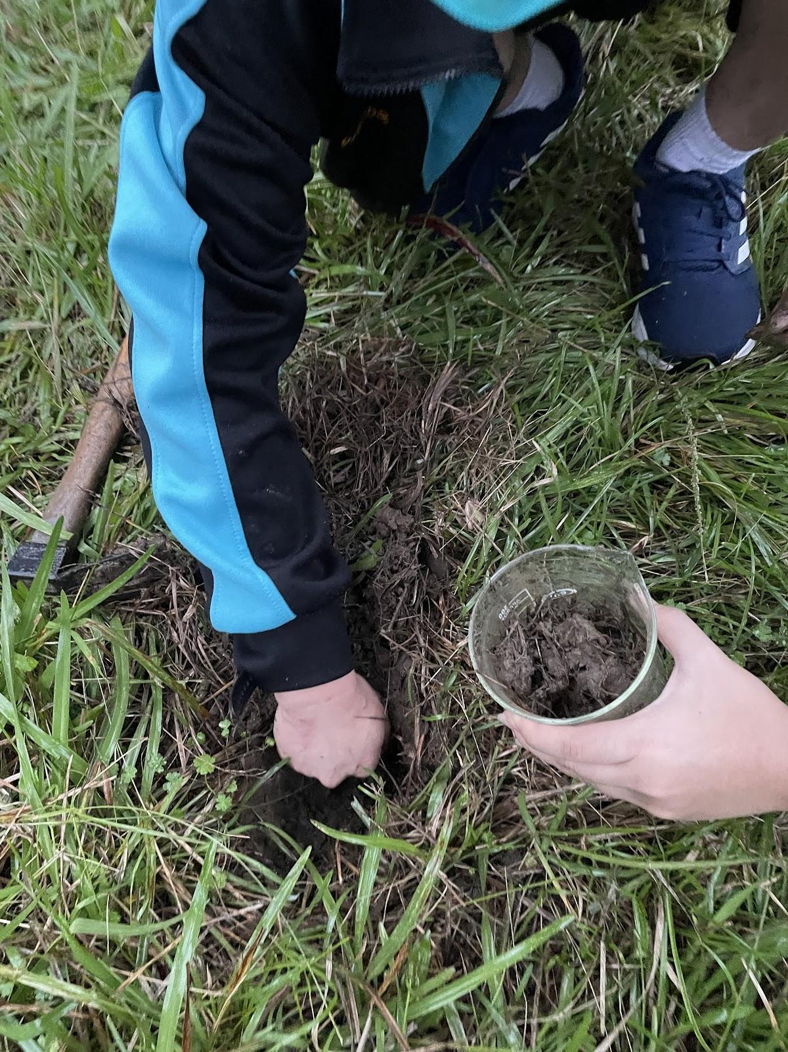
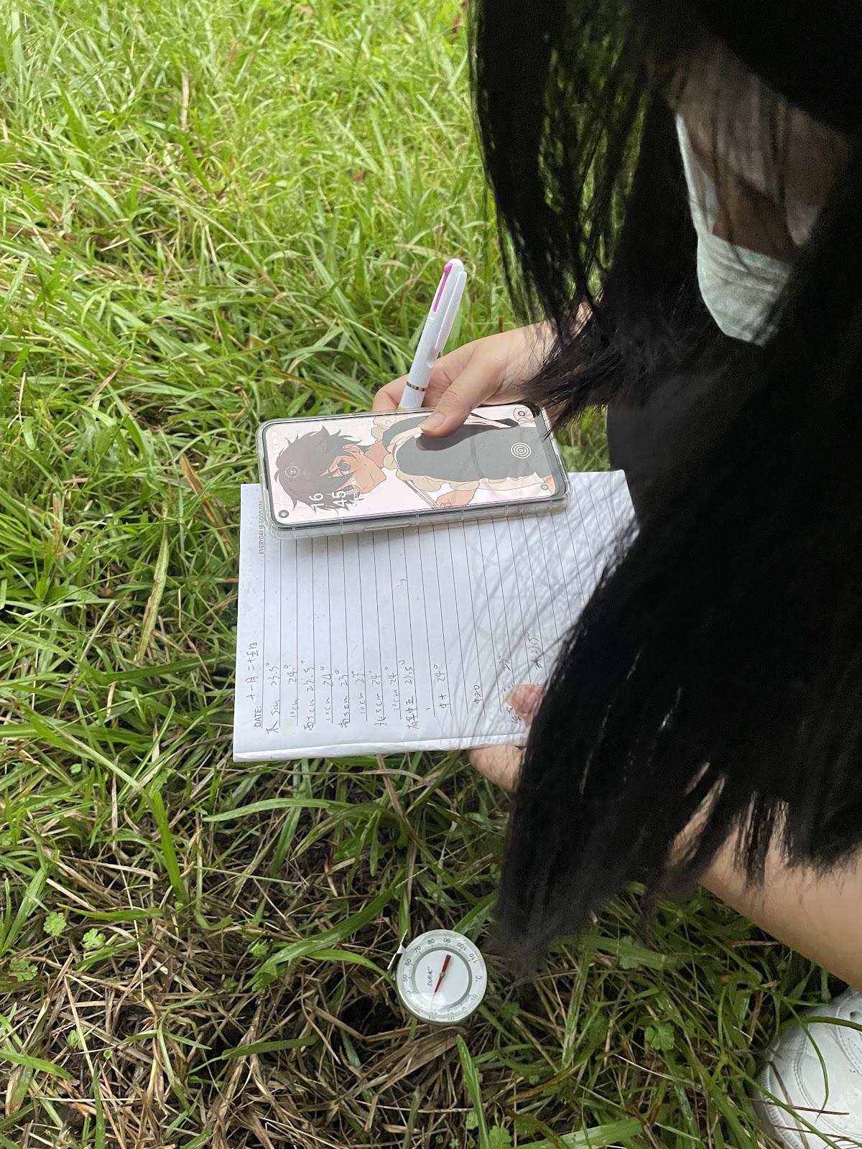
process（1）
The two picture is we collect soil and measure soil temperature

Slide 8
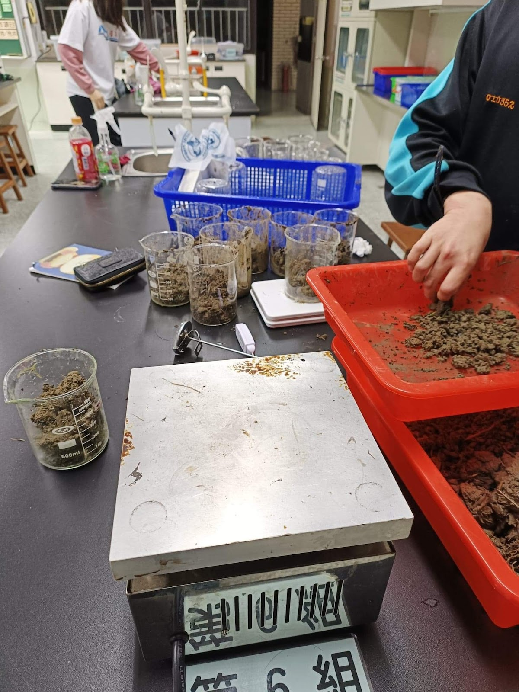
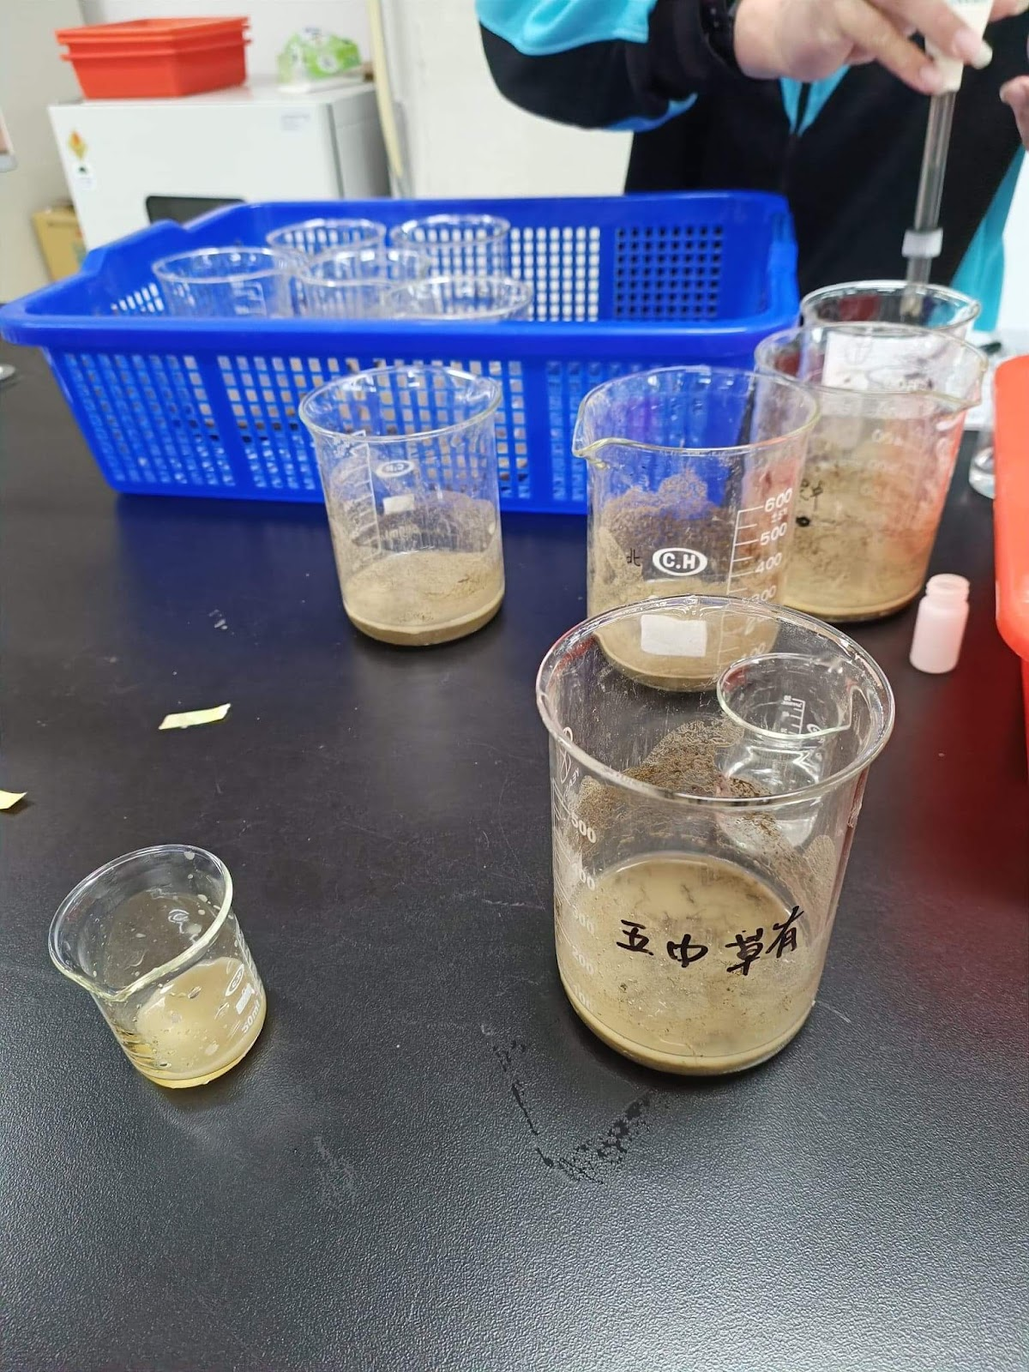
Process（2）
The step is take bake soil 20g and add 40g distilled water,mix together,and use pH instrument and pH test papers to inspect

Slide 9
Introduce for sheet
a- Without Kyllinga brevifolia around the shutter at a depth of 5 centimeters
b- Without Kyllinga brevifolia around the shutter at a depth of 10 centimeters
c- Without Kyllinga brevifolia around the shutter at a depth of 15 centimeters
d- Have Kyllinga brevifolia around the shutter at a depth of 5 centimeters
e- Have Kyllinga brevifolia around the shutter at a depth of 10 centimeters
f- Have Kyllinga brevifolia around the shutter at a depth of 15 centimeters
g- Without Kyllinga brevifolia around the sports ground at a depth of 15 centimeters
h- Without Kyllinga brevifolia around the sports ground at a depth of 15 centimeters
i- Without Kyllinga brevifolia around the sports ground at a depth of 15 centimeters

Slide 10
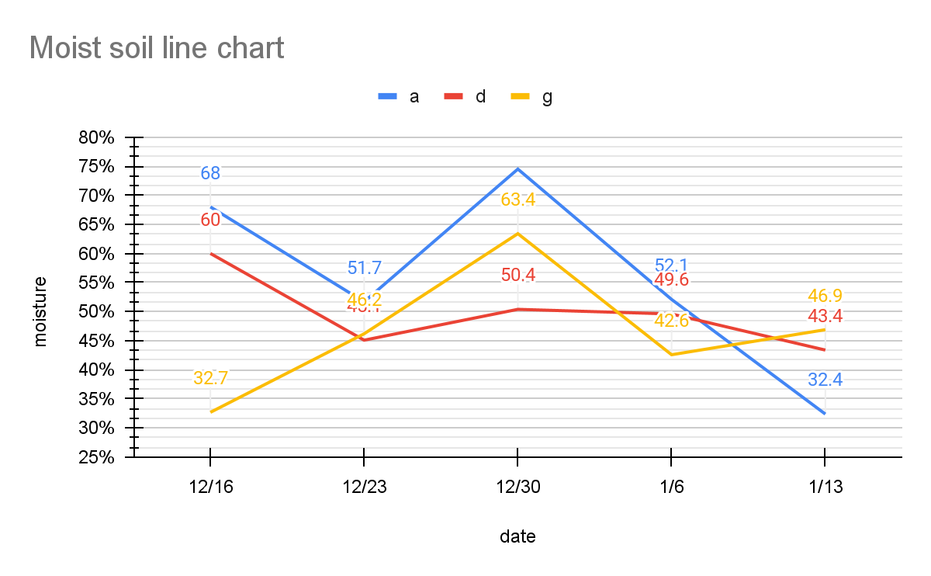

Slide 11
Discuss
From this chart we can see the difference in soil moisture at different locations at the same depth. The fluctuation of the humidity in the playground is very obvious, and the second largest fluctuation is the soil next to the shutter box, but without the Kyllinga brevifolia. Although the soil with the growth of Kyllinga brevifolia is not the highest humidity, but the humidity is more average. Surprisingly, however, the average soil moisture was higher without the brevifolia than with the brevifolia.

Slide 12
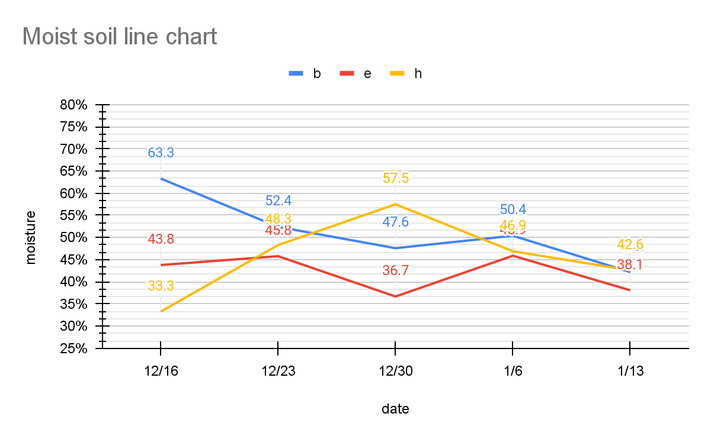

Slide 13
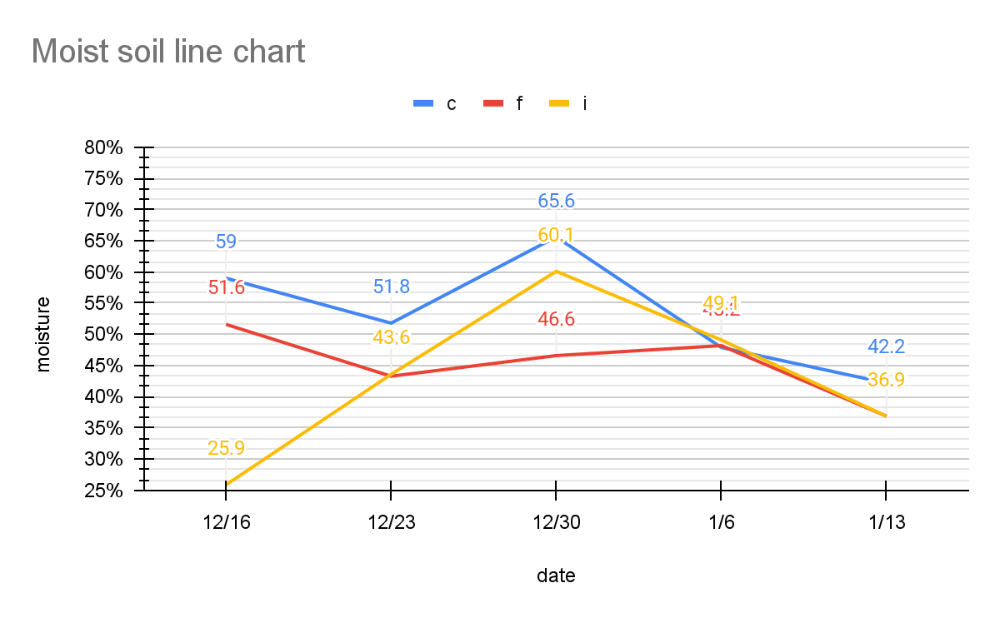

Slide 14
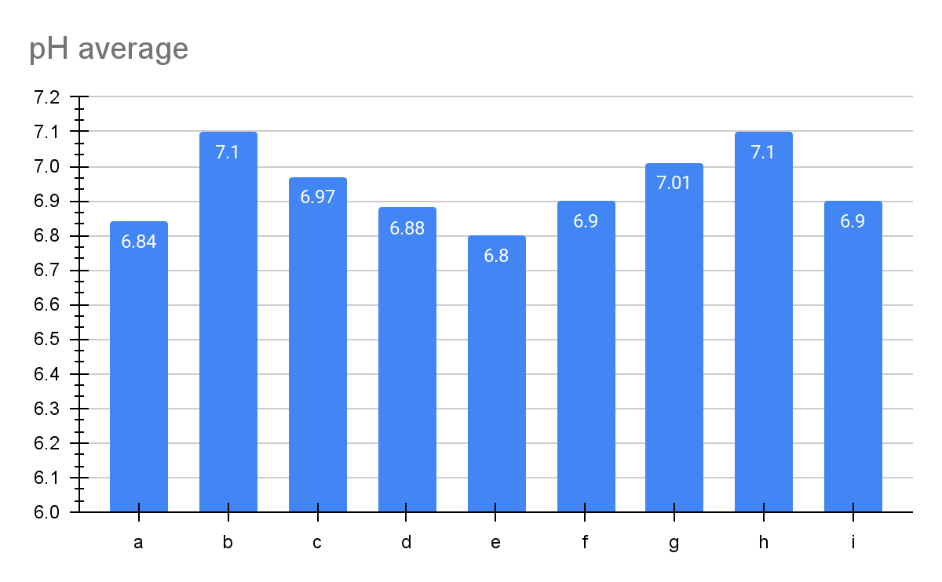

Slide 15
Discuss
The pH of the soil where Kyllinga brevifolia grows is maintained below 7, but the difference in pH is not too big

Slide 16
Conclusion
According to the experimental results, the growth of the Kyllinga brevifolia may not only require a sudden high humidity, but also a roughly stable soil humidity. In Taiwan, there is rain all year round in the northern region, so the soil with better water holding capacity near the shutter box is suitable for the growth conditions of the Kyllinga brevifolia. As for the pH part, due to the lack of data and the small difference between the pH of the school soil, it cannot be used as a basis for judgment.

