Slide 1
Soil PH observation at the campus
Student: Zi-Yu Li/Chia-En Tsai
Teacher: Cheng-Chang Chen
School: Hsin Tien Senior High school
Country: Taiwan Partnership
Date : 2021/3/7

Slide 2
Research Questions and Hypothesis
Materials and Method
Analysis and Results
Conclusions
Discussion
References/Bibliography

Slide 3
Research Questions
Will rain affect the pH value of the soil?
Will the pH value of soil in the same place but at different depths be the same?
Will the pH of the soil affect the growth of plants?
Is it possible that exotic plant species will be eliminated by changing the pH of the soil?

Slide 4
Hypothesis
The acidity and alkalinity of rainwater will affect soil pH.
Soils at different depths have different pH values.
The pH of the soil affects the growth of plants.
By changing the pH of the soil, exotic plants can be eliminated.

Slide 5
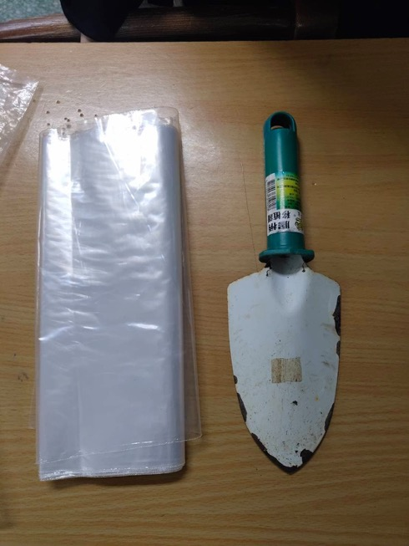
(1)Soil acquisition
Materials :
Zipper bag
Marker
shovel

Slide 6
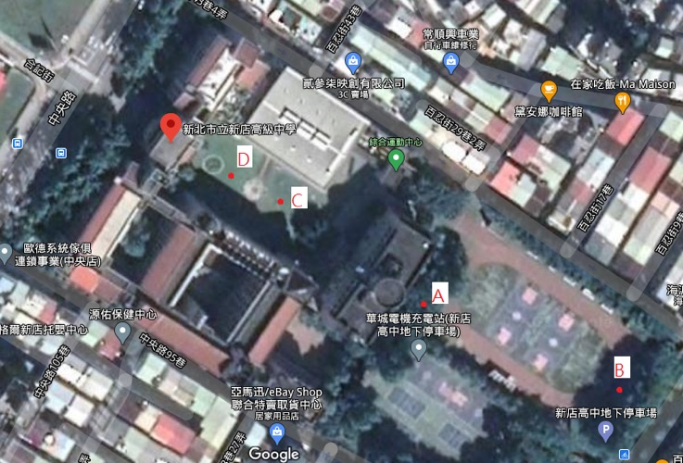
Method :
We sampled four locations.(A/B/C/D)

Slide 7
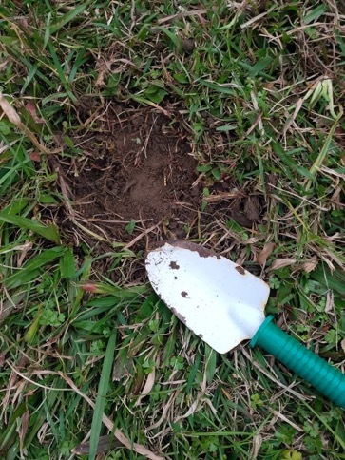
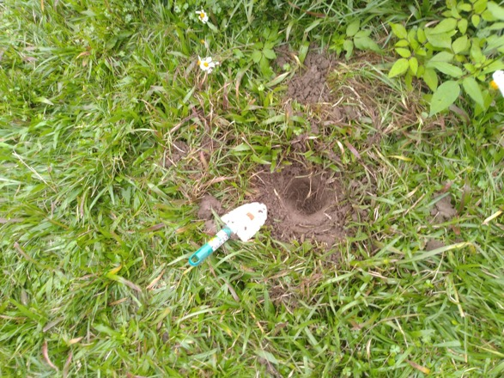
2) Sampling the soil on the surface and the soil 10 cm below the surface at each location.Avoid collecting anything other than soil.(Take samples after removing weeds from the ground)

Slide 8
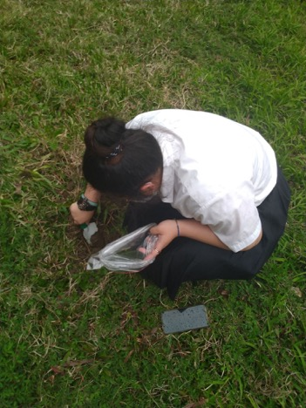
3) Mark the location, time and depth after putting it in the zipper bag.
4) Collecting on rainy and non-rainy days.

Slide 9
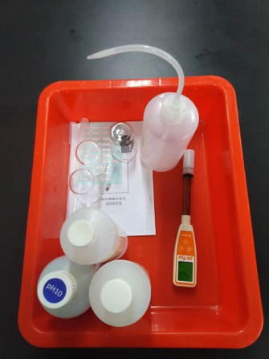
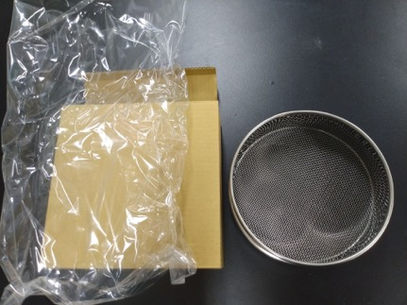
(2)Soil pH measurement
Materials :
pH tester
Beaker
Stirring rod
Pure water
Pen
paper
Balance
Soil
No. 10 Sieve
Dryer
Label
GLOBE Data(Rainfall / pH value of rainwater)

Slide 10
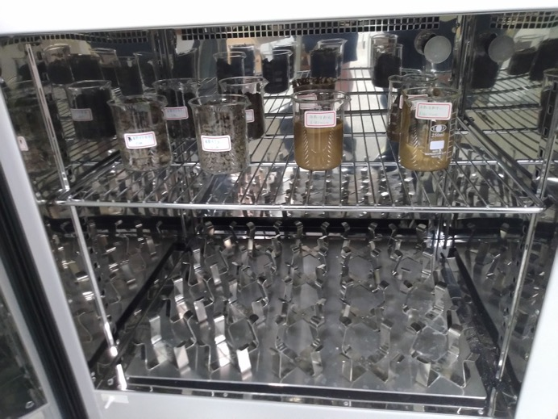
Method :
Dry the soil.

Slide 11
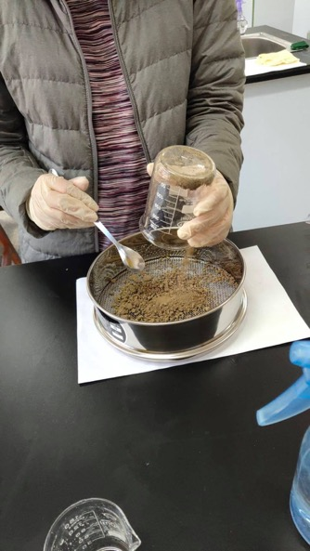
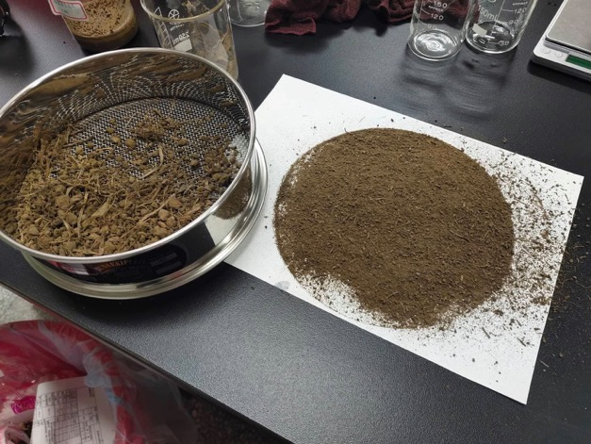
2) Sieved soil.(Put the soil in different places in different beakers and label them)

Slide 12
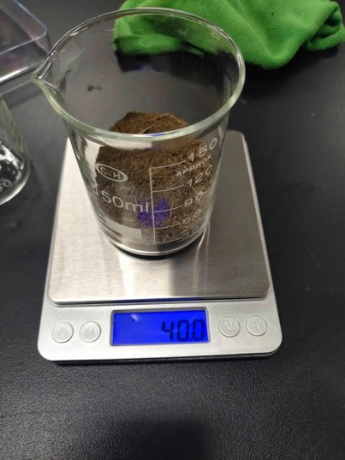
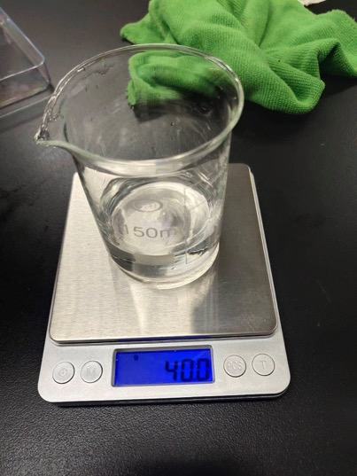
3) Put it in a beaker and mix with pure water, And mark the number.(Ratio 1:1)

Slide 13
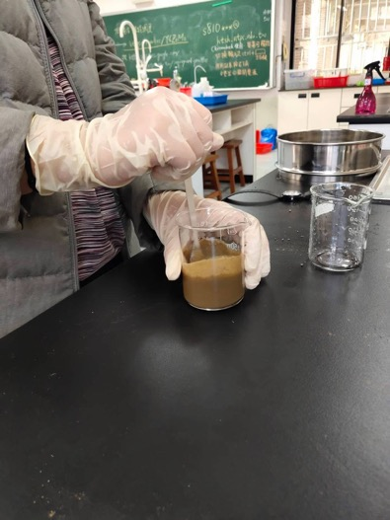
4) Stir for 30 seconds and then let stand for 3 minutes, repeat three times and then let stand for 5 minutes.

Slide 14
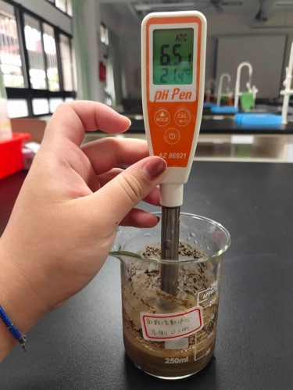
5) Measure with pH tester.(Just measure the upper liquid, do not insert the instrument into the sediment!)

Slide 15
(3) Bidens alba planting
Materials :
Potted plants
pH tester
Soil (From the same place,with the same pH)
Pure water
Shovel
Seed
Vinegar
Lemon juice

Slide 16
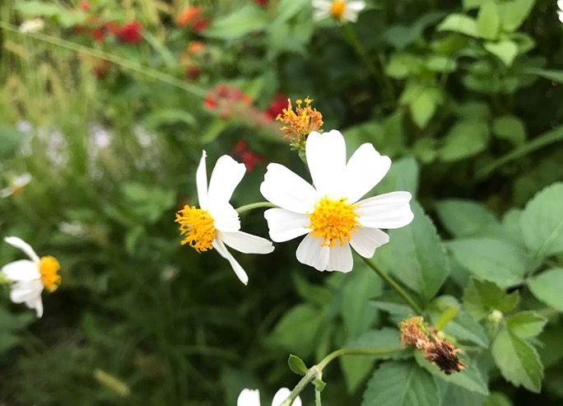
Method :
Collect the seeds of Bidens alba.

Slide 17
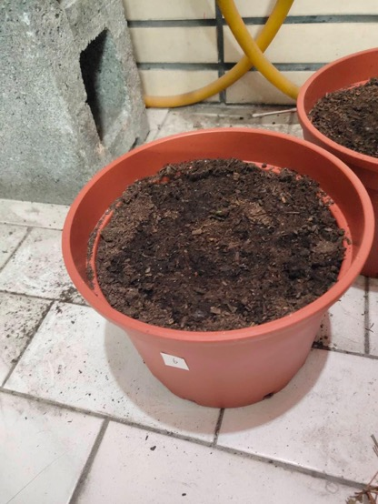
2) Put the seeds in the soil.

Slide 18
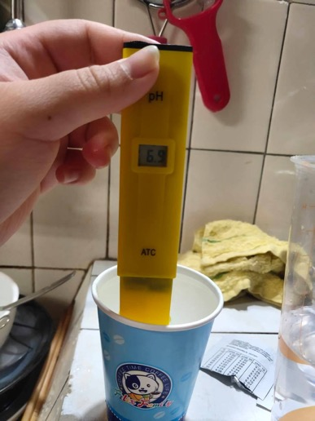
3) Use vinegar and lemon juice to change the pH of vinegar.
4) Divide into five pots and pour water with different pH values ​​respectively.(pH : 6 / 6.5 / 7 / 7.5 / 8 )

Slide 19
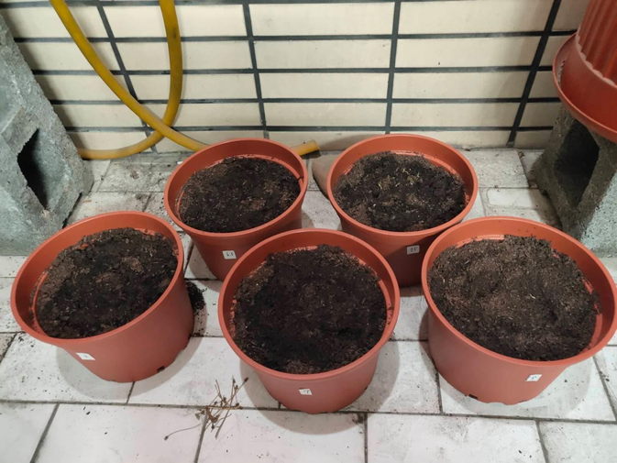
4) Observe the growth.

Slide 20
Results
Soil pH measurement
Location number | date | depth | pH value | Rainfall | PH value of rainwater
A | 2021/1/20 | 0cm | 6.63 | 0 | -
A | 2021/1/20 | 10cm | 6.58 | 0 | -
B | 2021/1/20 | 0cm | 7.25 | 0 | -
B | 2021/1/20 | 10cm | 7.40 | 0 | -
C | 2021/1/6 | 0cm | 6.69 | 25.1 | 5
C | 2021/1/6 | 10cm | 6.62 | 25.1 | 5
D | 2020/12/25 | 0cm | 6.12 | 3.2 | Too little to measure
D | 2020/12/25 | 10cm | 6.06 | 3.2 | Too little to measure

Slide 21
Location number | date | depth | pH value | Rainfall | PH value of rainwater
A | 2021/3/2 | 0cm | 6.66 | 10 | 6
A | 2021/3/2 | 10cm | 6.53 | 10 | 6
B | 2021/3/2 | 0cm | 7.02 | 10 | 6
B | 2021/3/2 | 10cm | 7.15 | 10 | 6
C | 2021/2/26 | 0cm | 6.55 | 0 | -
C | 2021/2/26 | 10cm | 6.84 | 0 | -
D | 2021/2/26 | 0cm | 6.51 | 0 | -
D | 2021/2/26 | 10cm | 6.86 | 0 | -

Slide 22
The pH of 0 cm at location A slightly rises after rainfall(Increase by 0.03), The PH value is slightly lower at 10 cm above the ground.(Decrease by 0.05)
The pH value of location B 0 cm and 10 cm away from the ground will be slightly lower.(Decrease by 0.23 and 0.25 respectively)
The place c is 0 cm above the ground, the pH value has increased by 0.14 after rainfall, 10 cm above the ground, it’s reduced by 0.22.
After the rain, the pH value of location D has reduce. (The surface soil is reduced by 0.39; The soil 10 cm above the ground is reduced by 0.80)

Slide 23
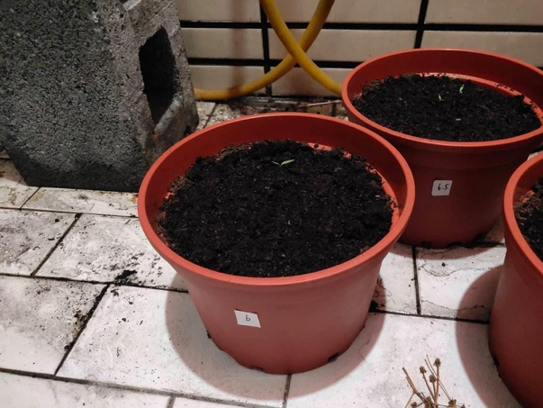
Bidens alba planting
As of 3/6 :
Potted plants using water with a pH of 6, A total of one seedling grew.

Slide 24
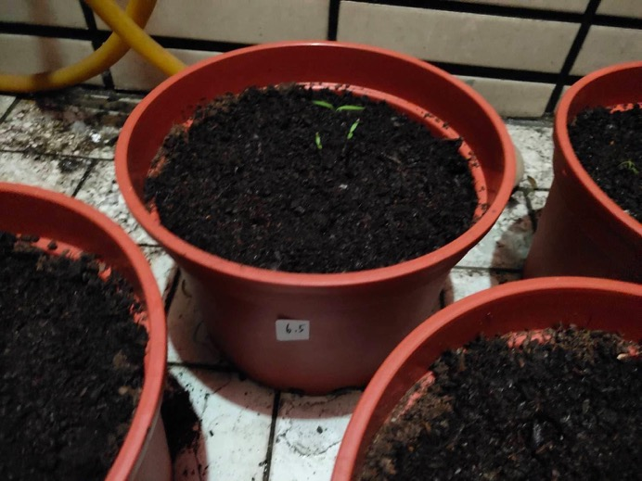
2. Potted plants using water with a pH of 6.5, A total of three seedling grew.

Slide 25
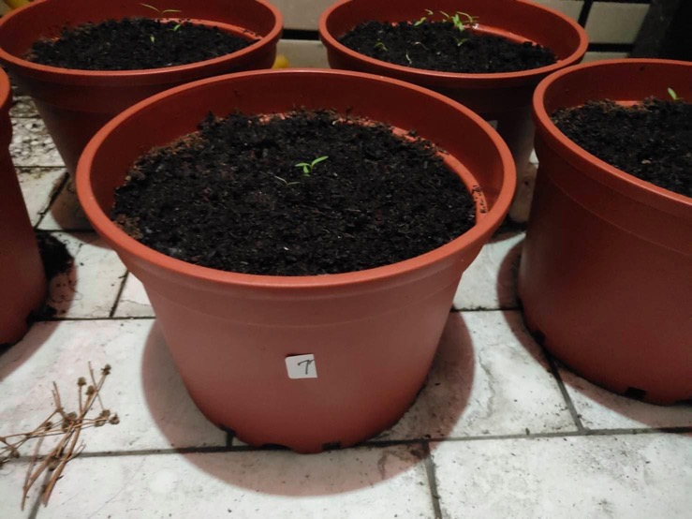
3. Potted plants using water with a pH of 7, A total of three seedling grew.

Slide 26
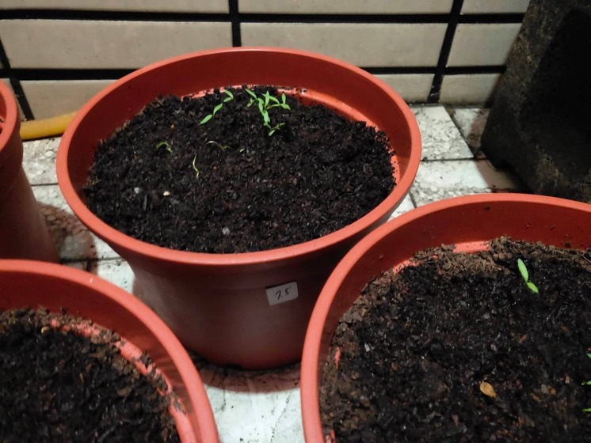
4. Potted plants using water with a pH of 7.5, A total of fourteen seedling grew.

Slide 27
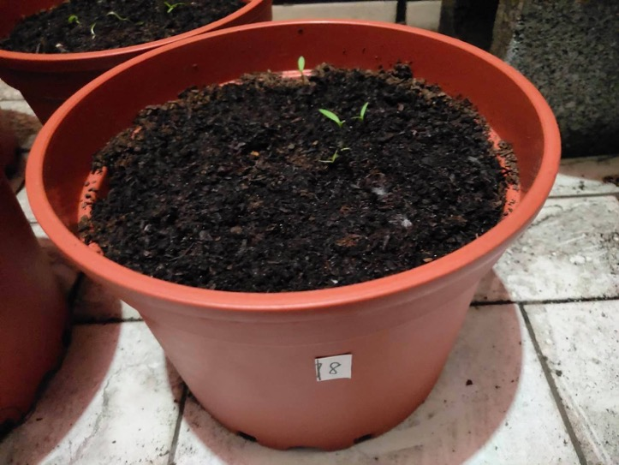
5. Potted plants using water with a pH of 8, A total of four seedling grew.

Slide 28
Analysis
In the first experiment, we used a pH meter to measure the pH of the soil before the rain and what changes happened after the rain.
In the second experiment, we observed the growth process of Bidens alba to find out the unsuitable environment for its growth. In this case, we can reduce the growth of Bidens alba by changing the pH of the soil.

Slide 29
Discussion
After rainfall, the pH value of all soils has changed, So rainfall has an impact on the pH of the soil.
The pH value of the soil in the same place will not increase or decrease at the same time due to rainfall, It may be due to the fact that the surface soil is drenched in more rain.
Bidens alba is the best in soil with a pH of 7.5, this may be the most suitable environment for its growth.

Slide 30
Conclusions
The pH of the soil will be affected by rain.
The pH value of soil at different depths in the same place will be different.
The pH of the soil affects the growth of plants.
The growth of exotic plants can be reduced by changing the pH of the soil.

Slide 31
References/Bibliography
https://www.globe.gov/do-globe/globe-teachers-guide/soil-pedosphere
https://www.globe.gov/documents/352961/353769/Soil+pH+protocol/782a668b-cecb-4801-ad80-db32a701eb58
http://nrch.culture.tw/twpedia.aspx?id=21557
http://www.rhythmsmonthly.com/?p=10410

