Slide 1
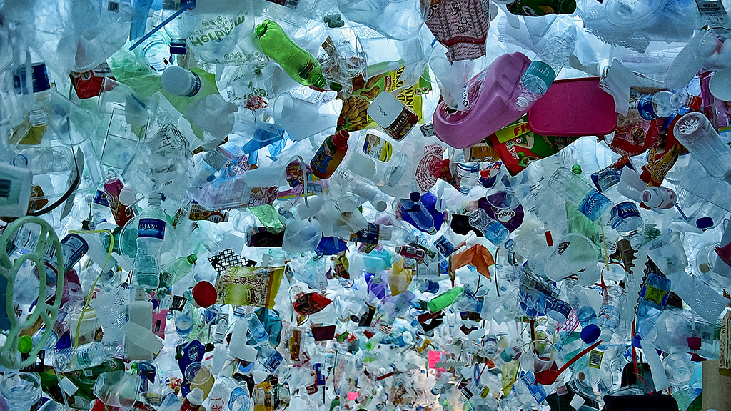

The impact of Mediterranean mussels (Mytilus galloprovincialis, LMK.) on the amount of microplastic in the sea
Karla Lea Čerkuć,
Mentor: Mihaela Marceljak Ilić
XV. gimnazija, Jordanovac 8, Zagreb
Autor : Choo Yut Shing

Slide 2
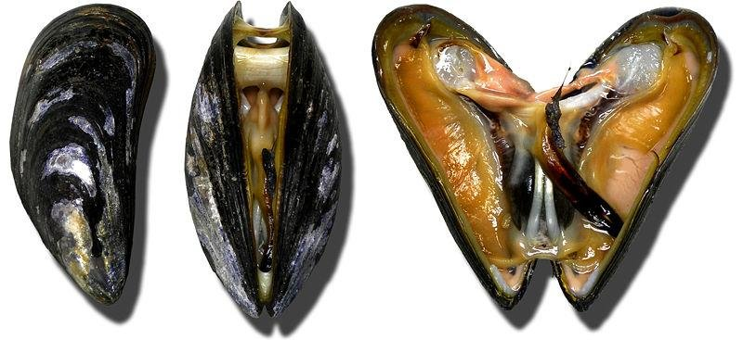
Mediterranean mussels
an edible sea mollusk
dark blue shells
5 to 8 cm long (15 cm)
It feeds on plankton and organic matter
filtering seawater
6 liters of water per hour.
By Lamiot, 4 november 2006 from wikimedia commons.

Slide 3
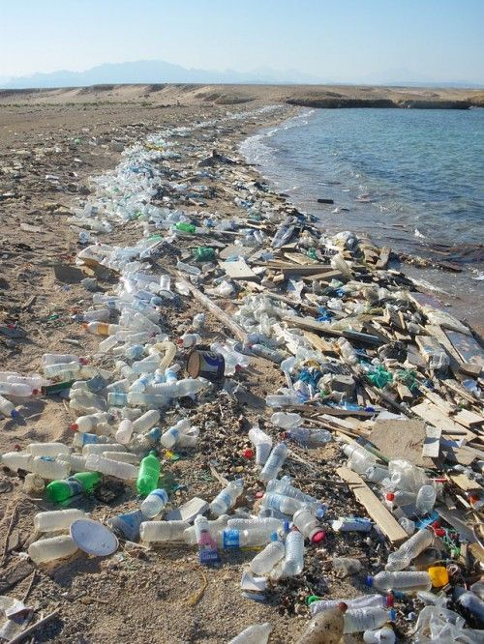
Plastic
synthetic and semi-synthetic polymers
different characteristics
fossil resources (coal, crude oil, natural gas)
organic products (cellulose, sugar beet, corn, seaweed, etc.)
Fragmentation
Autor Athanasios Valavanidis, 2014.

Slide 4
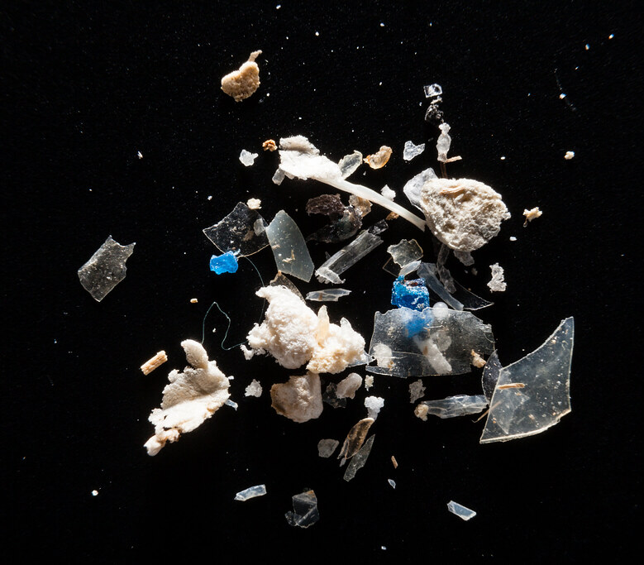
MICROPLASTIC
synthetic solid particle
polymer matrix
regular or irregular shape
1 μm to 5 mm
primary or secondary manufacturing origin
which is insoluble in water.
bioaccumulation occurs within each trophic level
biomagnification through the food chain.
By Will Parson, Chesapeake Bay Program

Slide 5
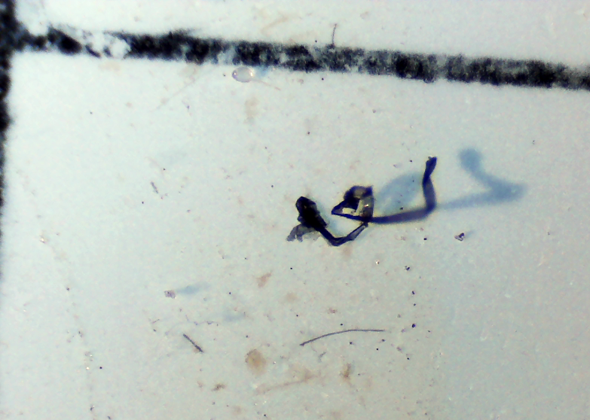
Research aim
determine whether Mediterranean mussels reduce the amount of microplastics from the sea
biopurifiers of microplastics in the areas of mariculture

Slide 6
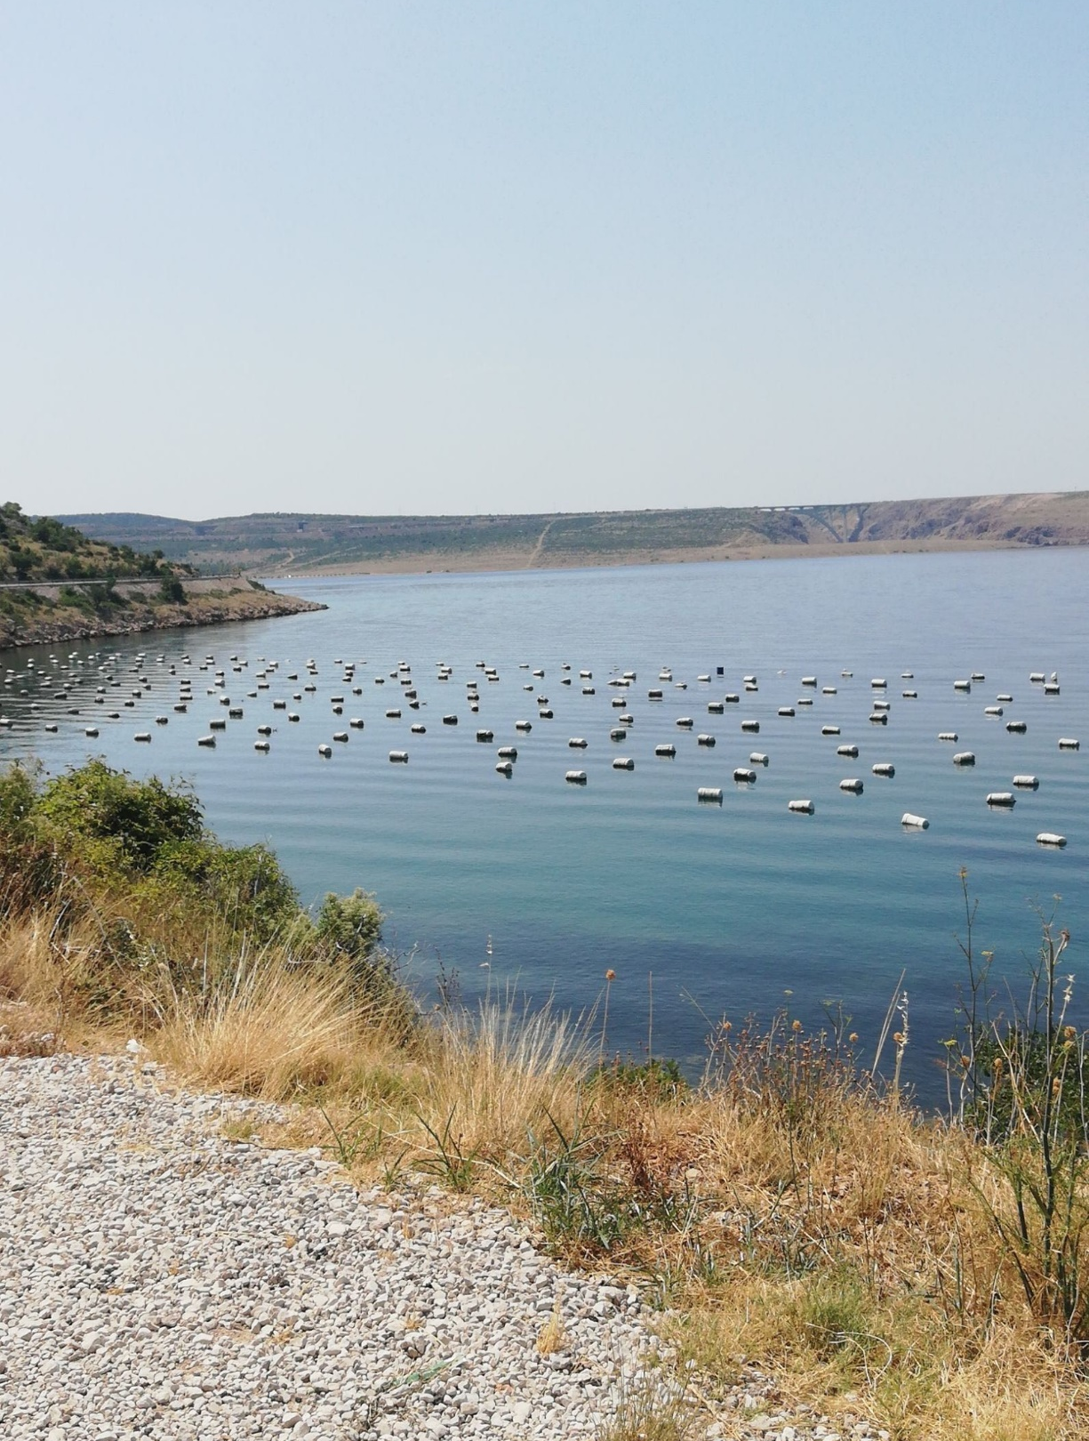
Research methods
Mussel farms
Natural mussels’ habitats
Mussel- free habitats
3 x 0.5 L
GLOBE hydrology protocols for water pH and water temperature
Vacuum filtering
Microscoping (400x)
Shape, size, color

Slide 7
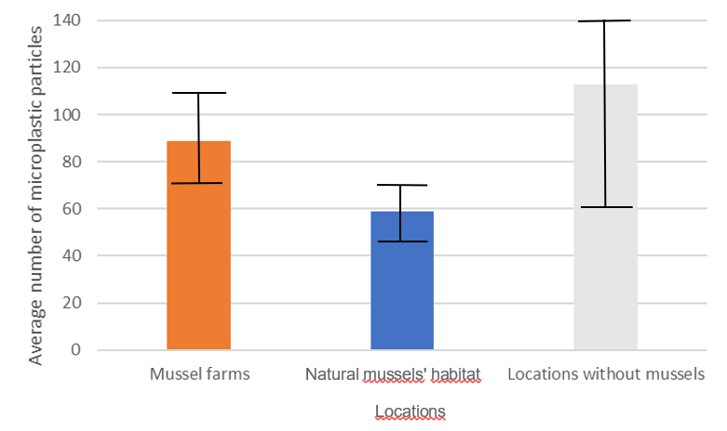
Results
The area with the highest amount of microplastic is the area without mussels.

Slide 8
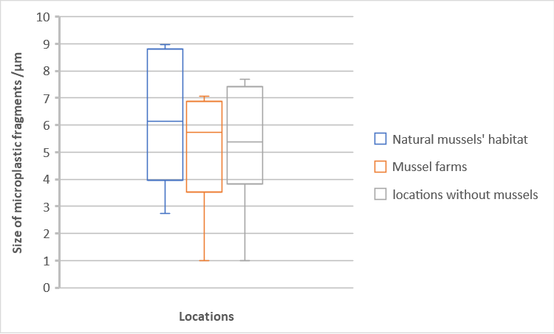
natural mussels’ habitats have the largest MP fragments,
locations without mussels have the smallest fragments of MP
difference in the size of the MP fragments is statistically confirmed.

Slide 9
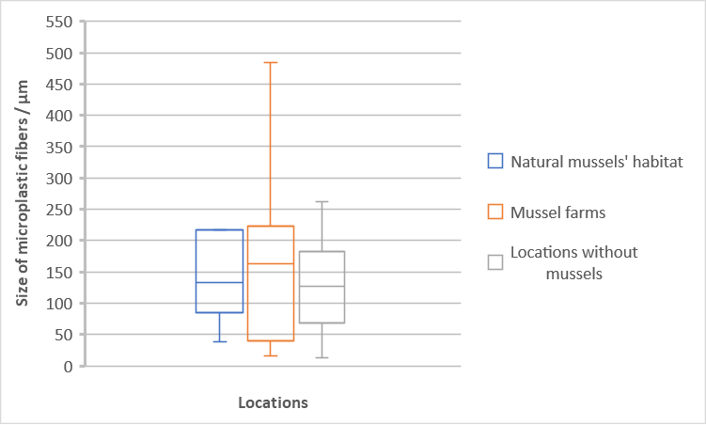
No significant differences between fiber sizes from different locations.

Slide 10
Conclusions
lesser amount of microplastics found near the habitats of mussels
human pollution of the sea is very visible and concerning
undetermined source of dark blue plastic
The main form of microplastic in a fragment shape,
The largest fragments of microplastic are found in the natural habitats of mussels
Mussel farms have the greatest deviations when it comes to the average size of microplastic fibers

Slide 11
Bibliography
Bonham V. (2017). Mytilus galloprovincialis (Mediterranean mussel). Cabi
https://www.cabi.org/isc/datasheet/73756. Accessed 15. 7.2022
Šarlija D. 2021. Pers. comm.
Sutti A., 2020. MICROPLASTICS-Protocol Proposal. DeakinUni. pristupljeno 30.1.2023.
https://video.deakin.edu.au/media/t/1_ewulcwtx
Frias J. P. G. L., Nash R. (2019). Microplastics: Finding a consensus on the definition. Marine
Pollution Bulletin, 138, 145-147.
Miller M.E., Hamman M., Kroon F.J. (2020). Bioaccumulation and biomagnification of
microplastics in marine organisms. Areview and meta-analysis of current dana.
PLoSone https://journals.plos.org/plosone/article?id=10.1371/journal.pone.0240792 .
Accessed 8.1.2023.

