Slide 1
GLOBE
Adding Measurement Data into Your Site
How to Enter Data
How to Edit or Delete Data

Slide 2
Introduction
You should have completed Part 1 for Teachers – Creating a Data Entry Site
We will continue from Part 1 using the site created to learn how to enter your data.
This presentation is available online as well as a video which walks you through the steps.
http://www.globe.gov/get-trained/using-the-globe-website
There is a section for you to try things for yourself after the demonstration and a section to test your knowledge at the end.
Questions – contact help@globe.gov

Slide 3
Adding a Measurement
If you aren’t there already, select “Enter Data” from the GLOBE home page, and then “Enter Training Data”.
Select your school name and the site name we created in Part 1.
You will see the list of all data entry forms which are available for the type of site you’ve created – ie an atmosphere site will have different forms than a soils site.

Slide 4
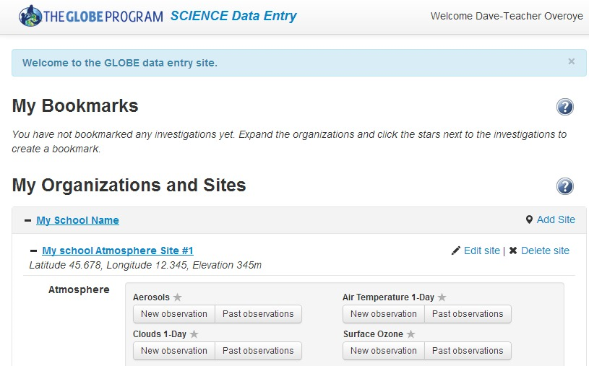
List of data entry forms available for an atmosphere site

Slide 5
Enter Data
Select Air Temperature 1 day -> New Observation
Forms start with date and time…then follow with the information associated with the protocol data sheet
Choose Today’s date and use the solar noon time provided
  In the real system your measurements should be entered with the real time of measurement
Enter 100 degrees for the current temperature and “send data”
  Your error will be flagged and you can try again.
Enter 20 degrees and “send data”
  The observation is recorded with the green happy face
Return to the Data Entry Home page by clicking on “Data Entry Home” in the breadcrumbs on the top

Slide 6
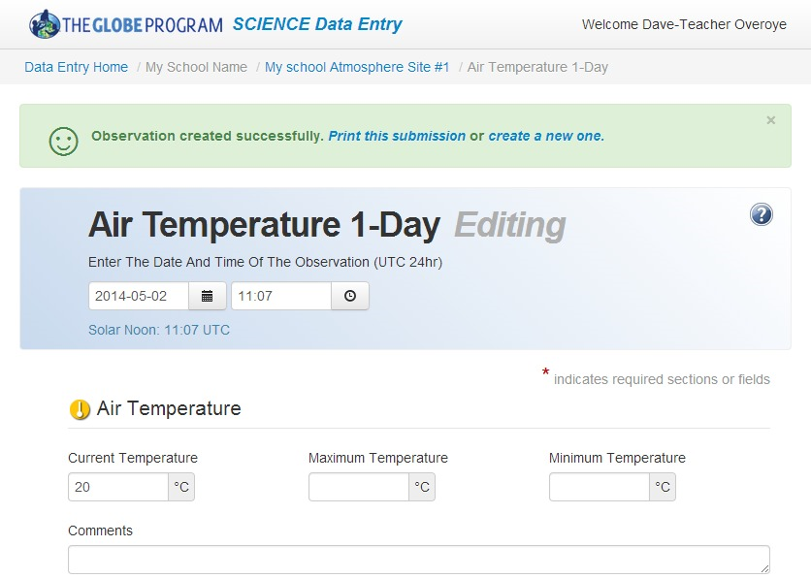
Adding and editing air temperature measurements

Slide 7
Bookmarking and Editing
From the Data Entry Home page (in the breadcrumb) find the Air Temperature 1 day form.
  Click on the little star next to the title to “bookmark” the form
  This will put the form on the top so you and your students can get to it quickly and easily
Click on “Past Observations” under the Air Temperature 1 day
  Your data entry is listed. You may delete it, or click on it to change. Click on the date/time and enter 17 and “send data”
  Your Observation is updated

Slide 8
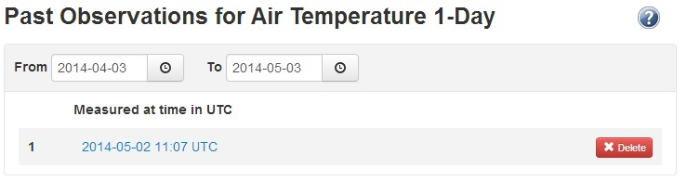
Editing Past Observations

Slide 9
Your Turn – Add a Measurement
Find the site you created in Part 1 of this training
Bookmark the Air Temperature 1 day form
Use the form to enter data
  Try using 100 degrees, and save….then a more realistic number and save
After submitting the data, return to edit the data, change it and save

Slide 10
GLOBE Mobile apps
GLOBE Data Entry app
  All Protocols
  Looks and acts just like the desktop forms
GLOBE Observer
  Clouds and Mosquitoes Only
  Easy to use
  If you login with your GLOBE Teacher account, or your student accounts, the data you enter will be counted with your school.

Slide 11
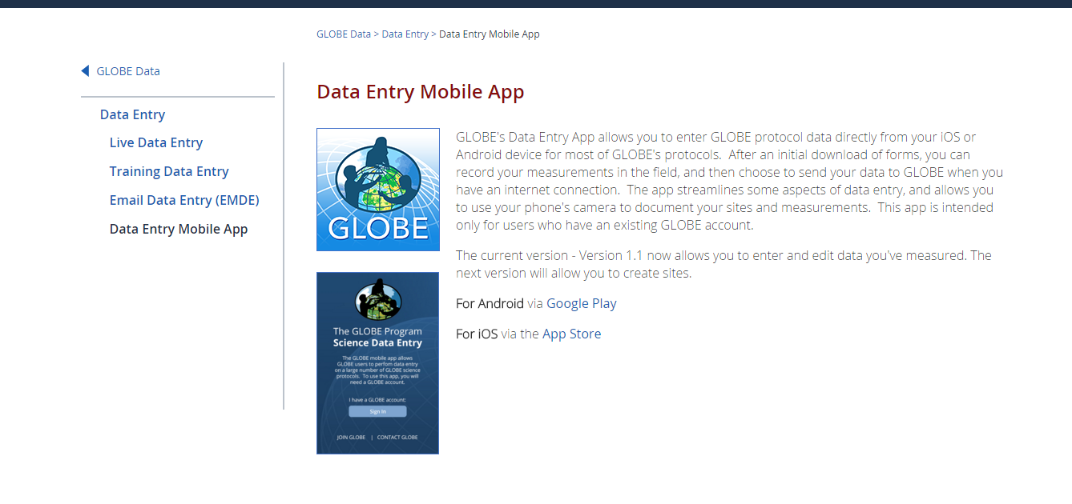
The GLOBE Data Entry App
Go to GLOBE -> Data Entry and click on the link for Mobile App
This gives you a link to download the app from Apple and Google

Slide 12
Data Entry App
All forms are downloaded to your mobile device
All data is stored on your mobile device until you “Send Data to GLOBE”
You can have more than one person on the same mobile device (Switch User)
You need to logon with your GLOBE account, but once you logon once, you won’t have to logon again.
You may need to “Update Forms” if you ever add a site or change site information
You must create the site on your desktop before entering data on mobile (This will change soon with the next release)

Slide 13
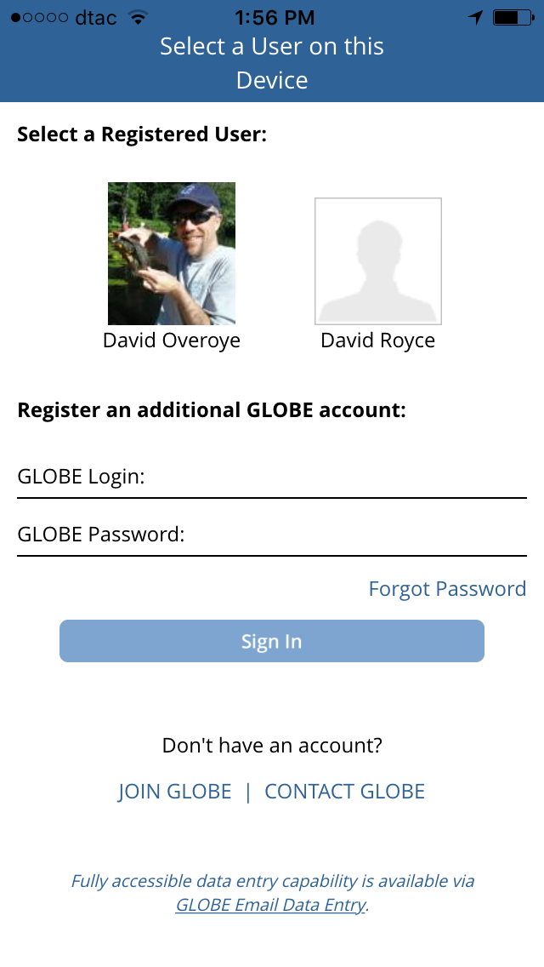
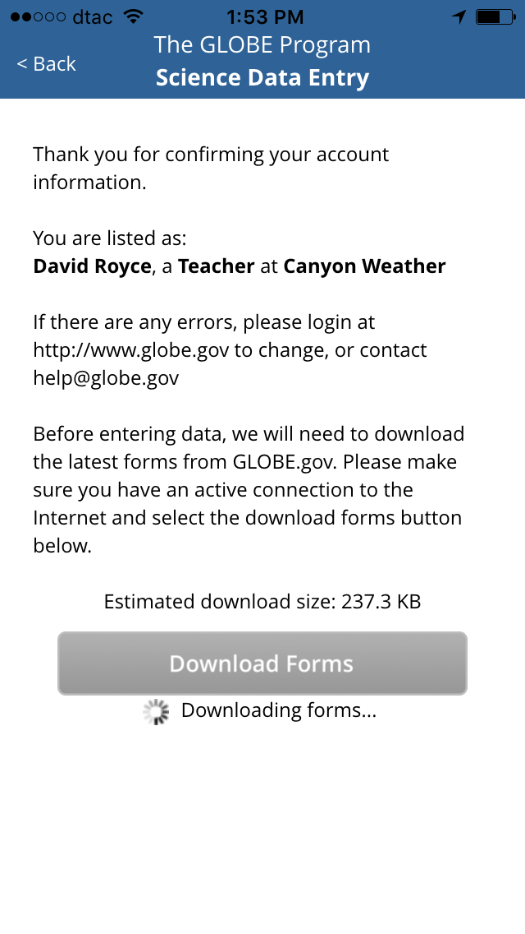
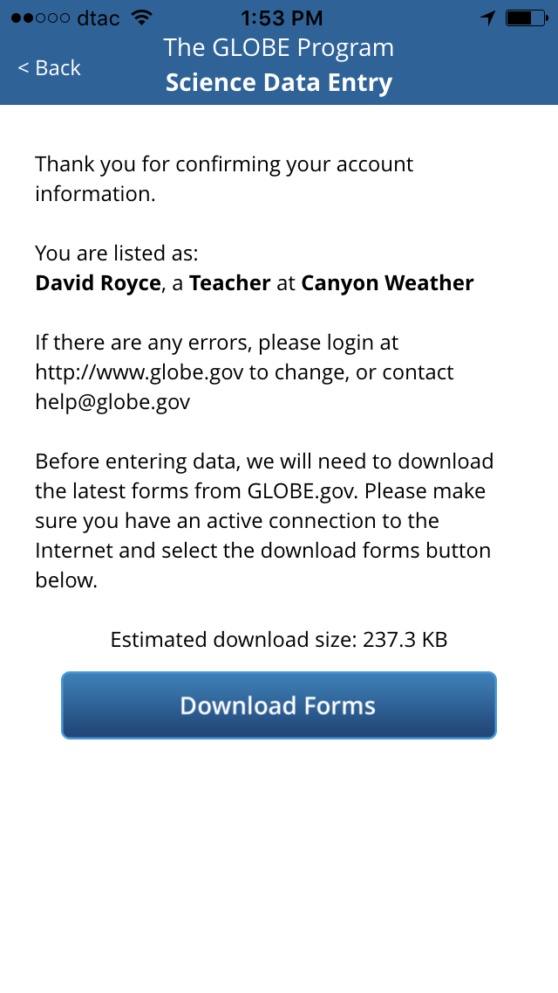

Slide 14
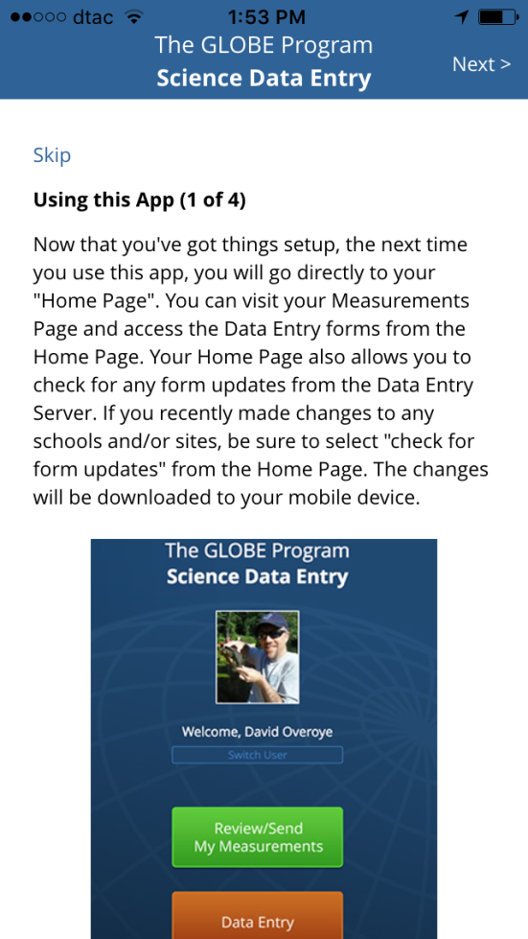
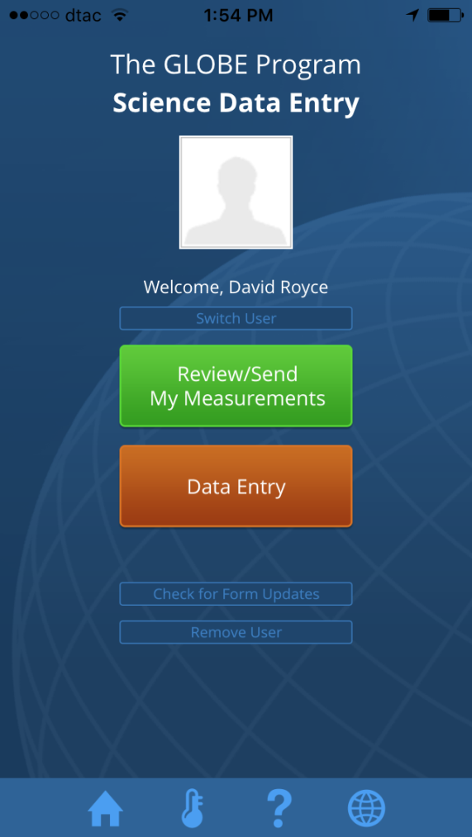

Slide 15
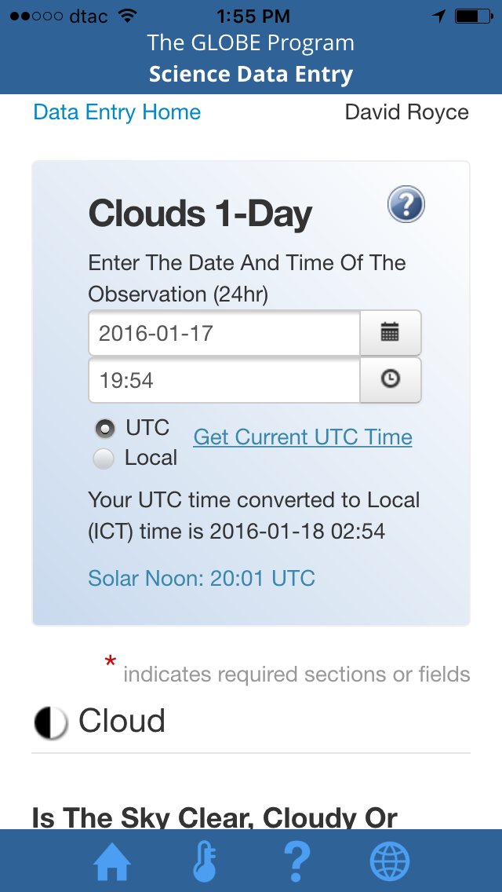
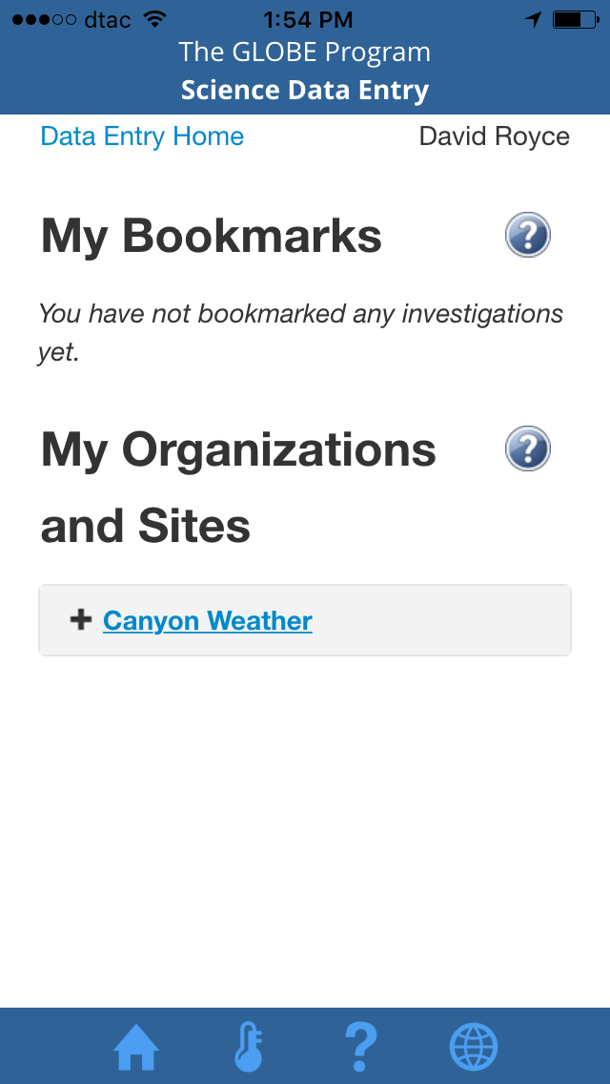
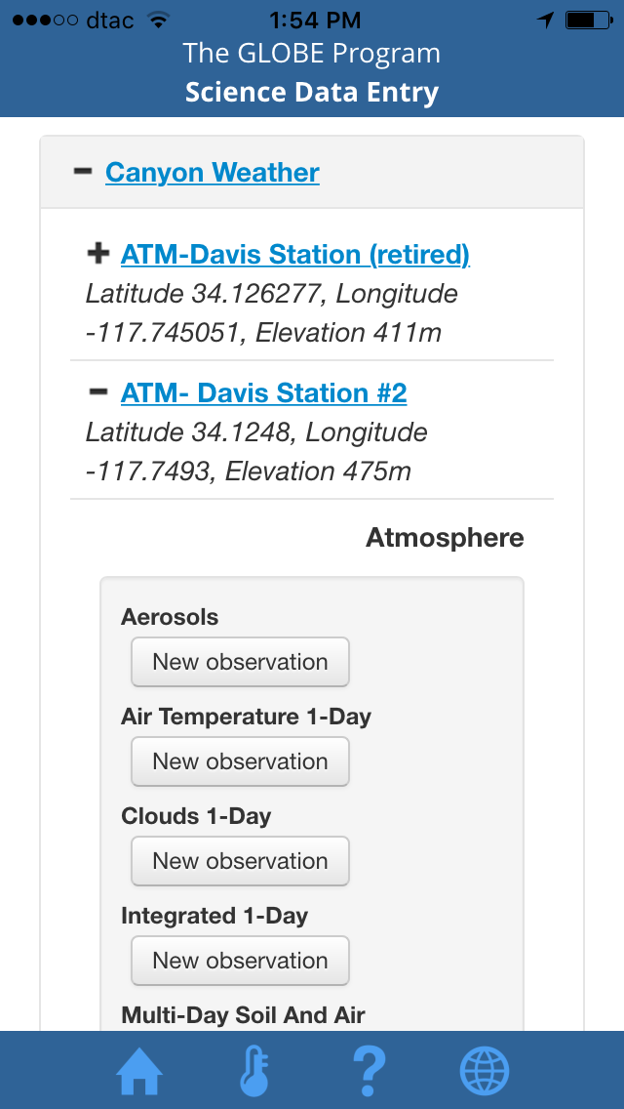
Select Your School, Select Your Site, Select Your Protocol and Enter Data

Slide 16
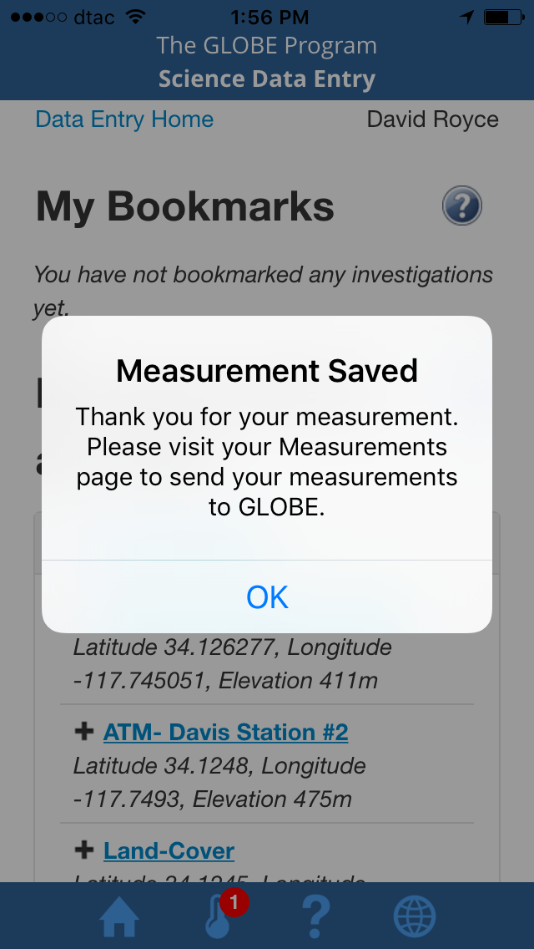
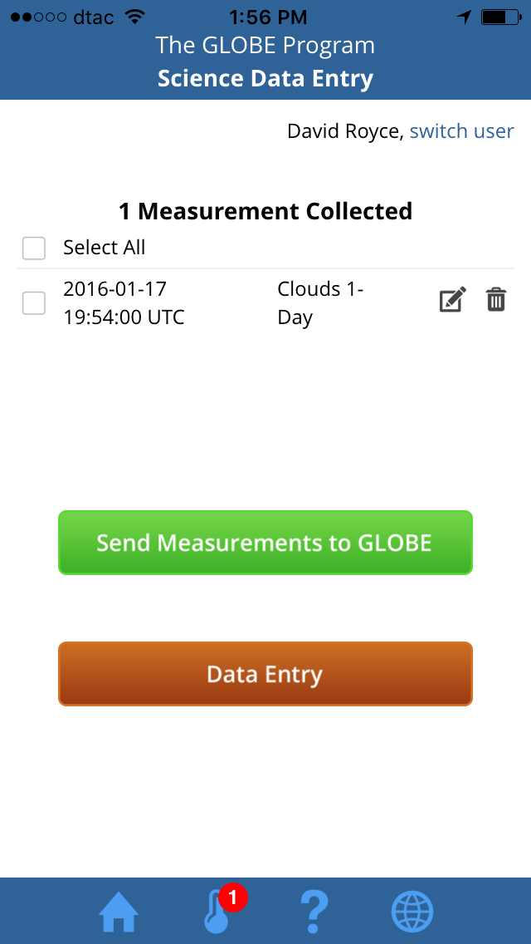
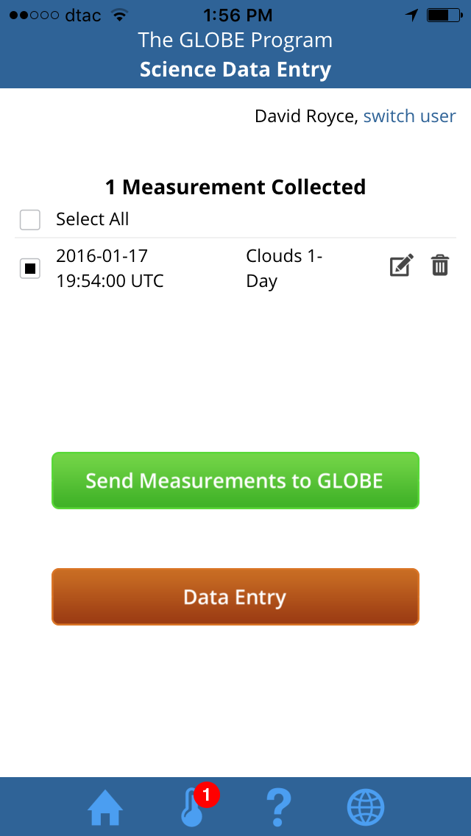
Saved Measurements can be sent to GLOBE

Slide 17
GLOBE Observer
Login with your GLOBE account, or your student accounts
You do not need to setup a site first – it will do it for you
You can only do Clouds and Mosquitoes at this time
  (For GLOBE members Clouds includes air temp, barometric pressure and humidity)

Slide 18
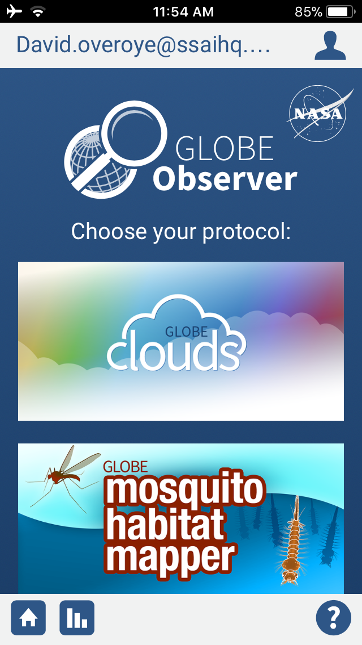
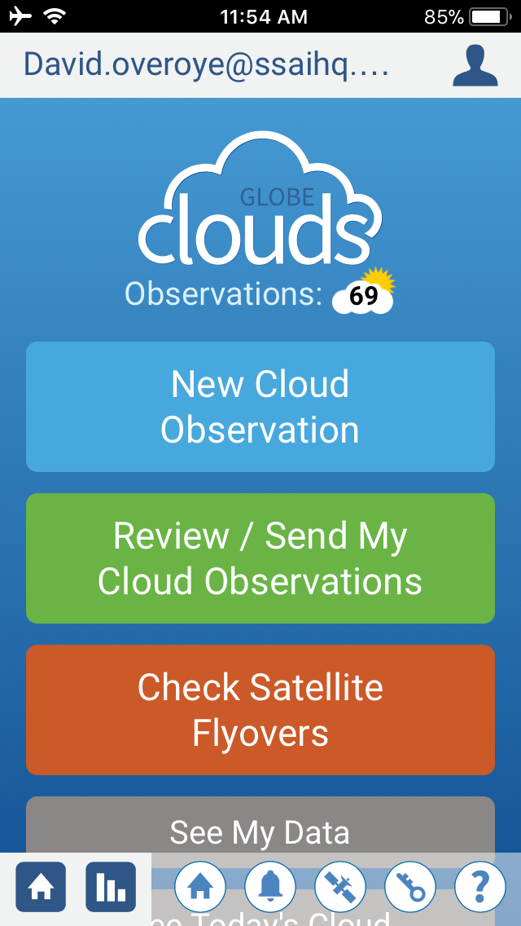

Slide 19
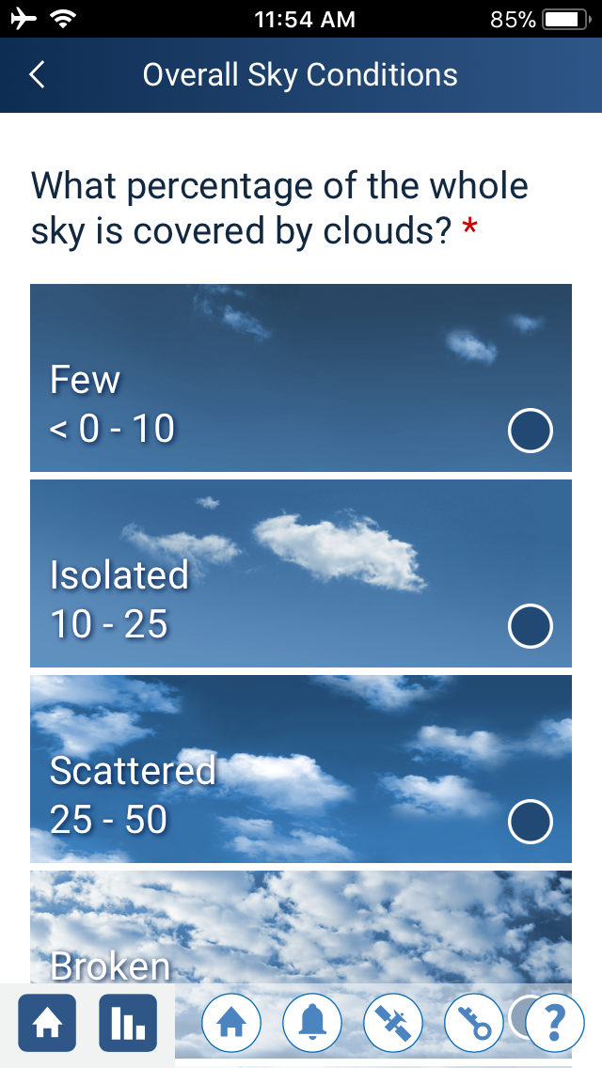
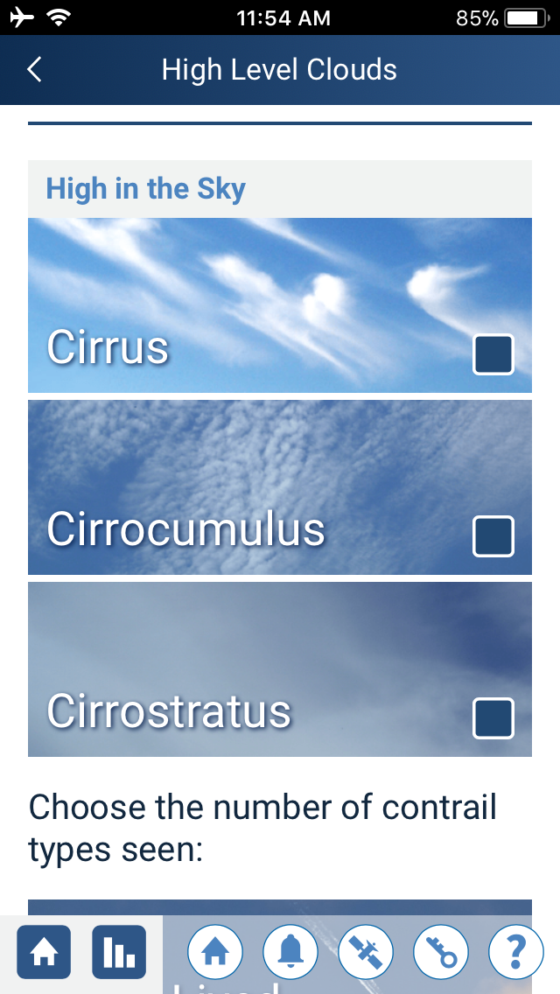

Slide 20
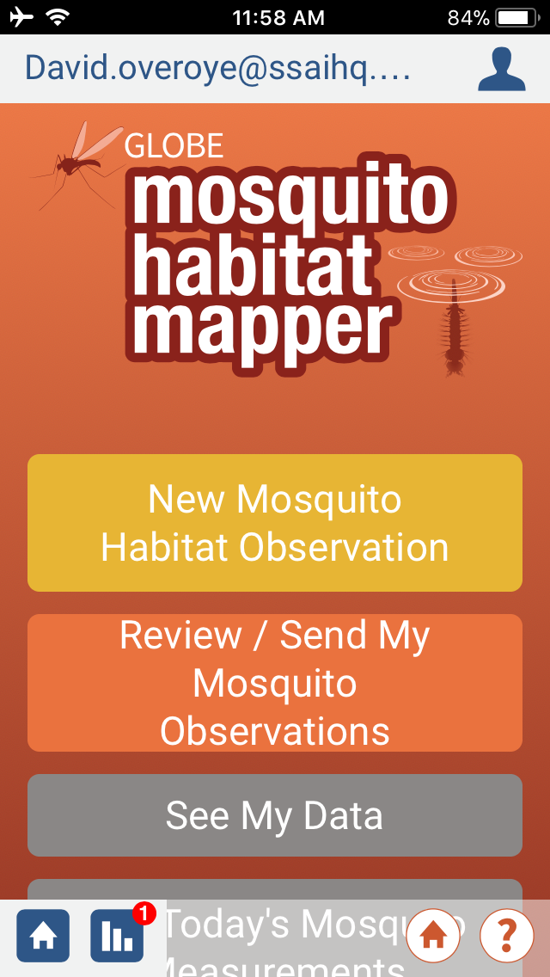
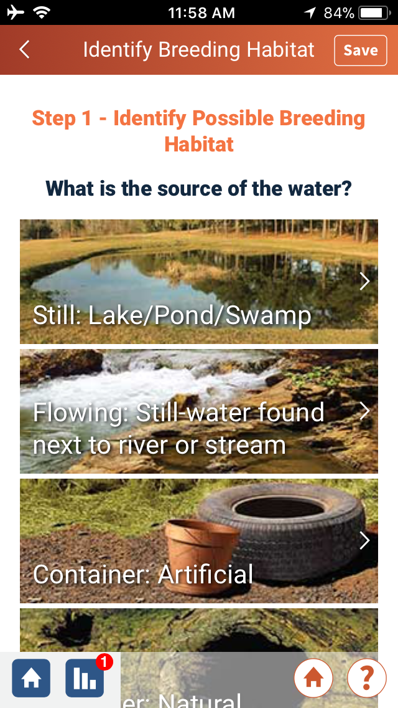

Slide 21
Test
Can I change a measurement I already submitted?
Can I enter phenology measurements with my Atmosphere site?
Can I delete my site?

Slide 22
Test - Answers
Can I change a measurement I already submitted?
Yes – you can edit or delete previous measurements.
Can I enter phenology measurements with my Atmosphere site?
In general, you can only enter measurements for protocols which match the type of site you created.
Can I delete my site?
Only if there is no data associated with the site.

Slide 23
Next Steps
Congratulations – you should have:
  Entered Data
  Edited Data
  Bookmarked a data entry form to make it easier to enter data
You can now
  Continue to Part 3 – Visualizing and Retrieving Data
  Consider beginning to enter data in the real production system
Questions – contact the GLOBE Helpdesk – help@globe.gov

