Slide 1
GLOBE Setting up your GLOBE account and MyPage
Checking and Updating your GLOBE information
Changing your MyPage

Slide 2
Introduction
How to find and change your account information – email, password, address etc
What is a “MyPage?
How do I change my “MyPage”?
This presentation is available online as well as a video which walks you through the steps
There is a section for you to try things for yourself after the demonstration and a section to test your knowledge at the end.
Questions – contact globehelp@ucar.edu

Slide 3
Review your account information
Login and click on the circle on the top right to access your
“account settings”
Details – name, email, picture – upload your picture
Password
Organization – which organization/school you belong to
Communities – which communities you’ve joined
GLOBE User Groups – your roles in GLOBE. Includes Organization Manager and notification preferences. Organization Manager for your school must be checked in order for you to change your school page.
GLOBE Info – preferences and information
GLOBE Training – your training records
Other areas are optional and self explanatory
Review these sections for accuracy. Update if needed.
Remember to click “Save” on the bottom if you make any change

Slide 4
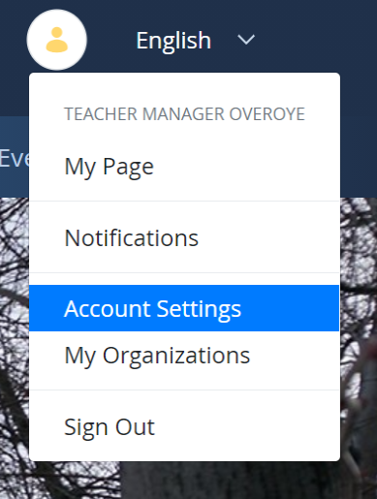
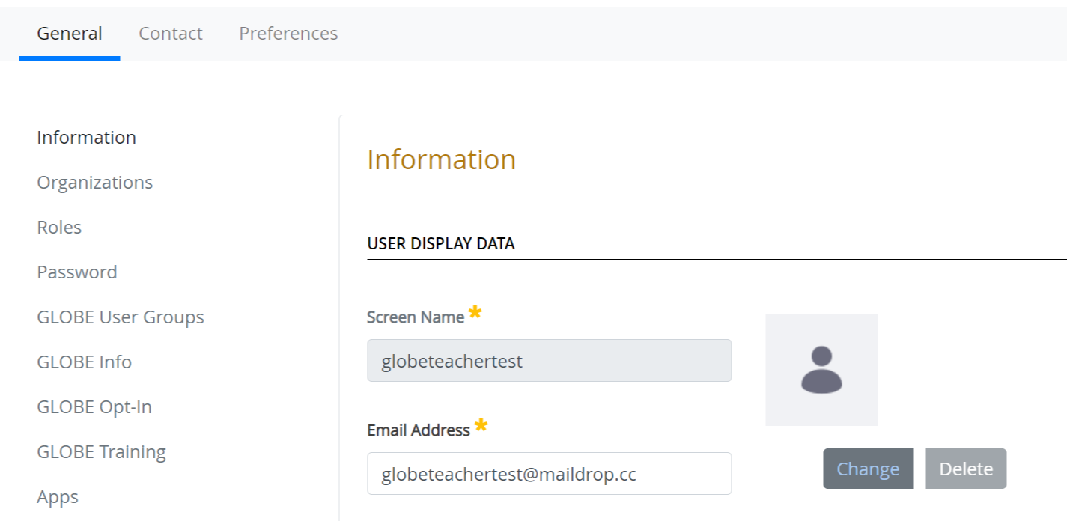
Your Turn
Try this…
Add your picture and check your job title
Look at your GLOBE User groups and make sure your information is correct
Check your GLOBE info is correct.
Check your address and phone number (optional)

Slide 5
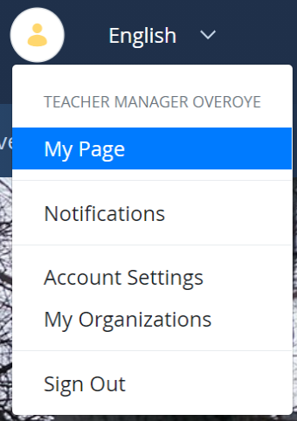
Your “MyPage” – Home Page
Your MyPage contains information about yourself and your role in GLOBE
Select the first option from the drop down on the top right - “My Page”
Update the information on your Home Page
Look for the three dots to “Edit Web Content”
Click “Change” to upload your picture.
Use “Edit” to update the number of students you are involved with under “Metrics”
Try creating a Student Account

Slide 6
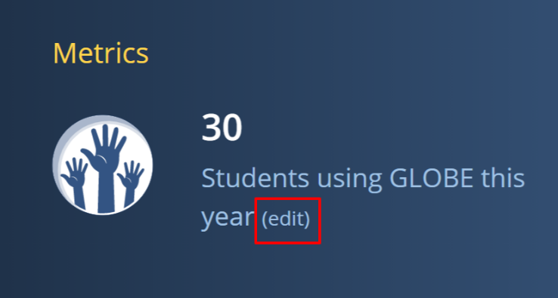
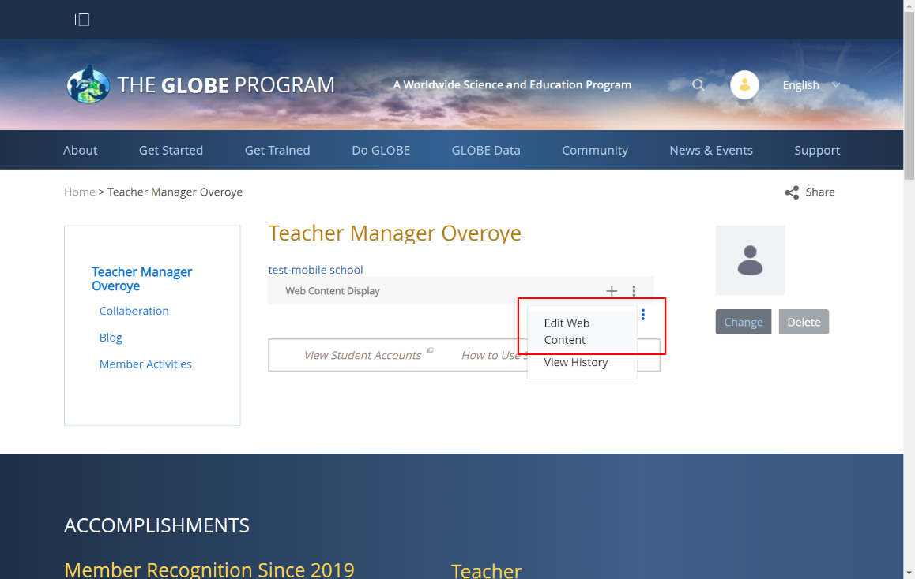
Your Turn – MyPage changes
Try this…
Go to your “Mypage” and add some content. (Look for the 3 dots under your school name).
Click “Change” to upload your picture.
Use “Edit” to update the number of students you are involved with under “Metrics”
Read about student accounts, then create one.

Slide 7
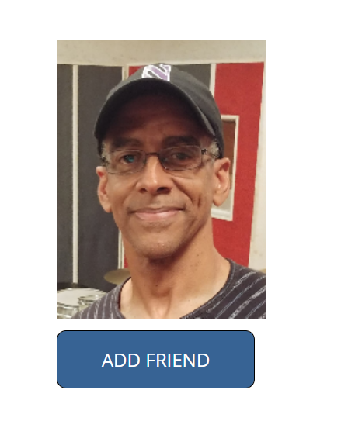
Your MyPage – Collaboration
Collaboration page shows all your GLOBE “Friends” and any activities they are doing on the site.
Add friends by clicking the “Add Friends” button on anybody’s mypage. Once they accept, you’ll be able to email them directly.
You can also accept friend requests that are sent to you
If you accept a friend request, your new friend will have access to your email address
There is another video talking about all the ways you can collaborate in GLOBE

Slide 8
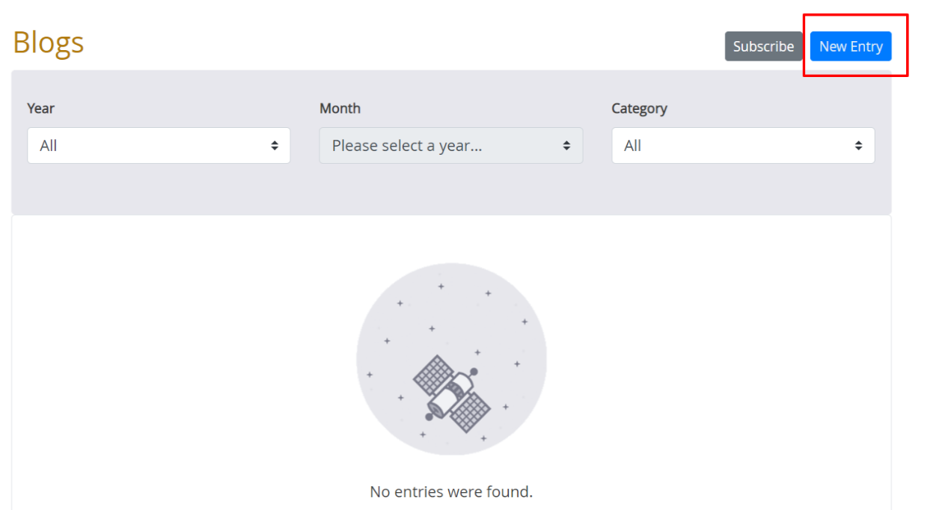
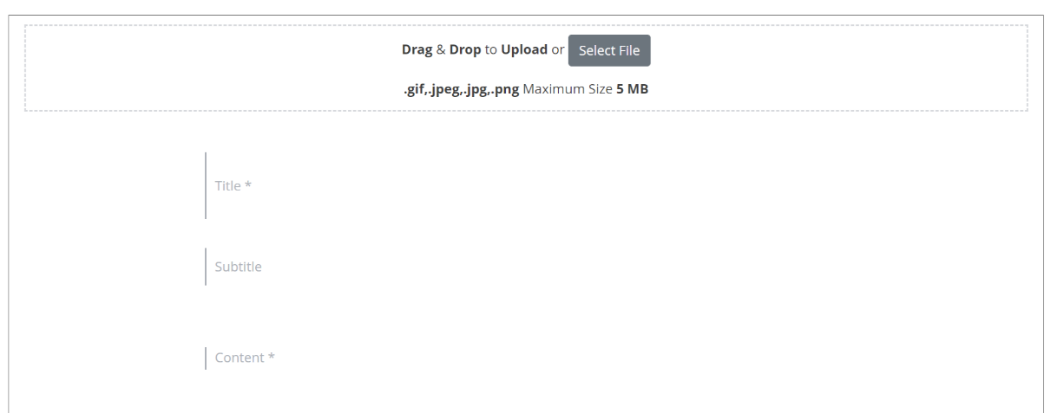
Your MyPage - Blog
You have access to a blog where you can tell everyone about what you are doing in the land of GLOBE
All blogs are aggregated to the “Community Blogs” portion of the website.
Students can comment on blogs as well.

Slide 9
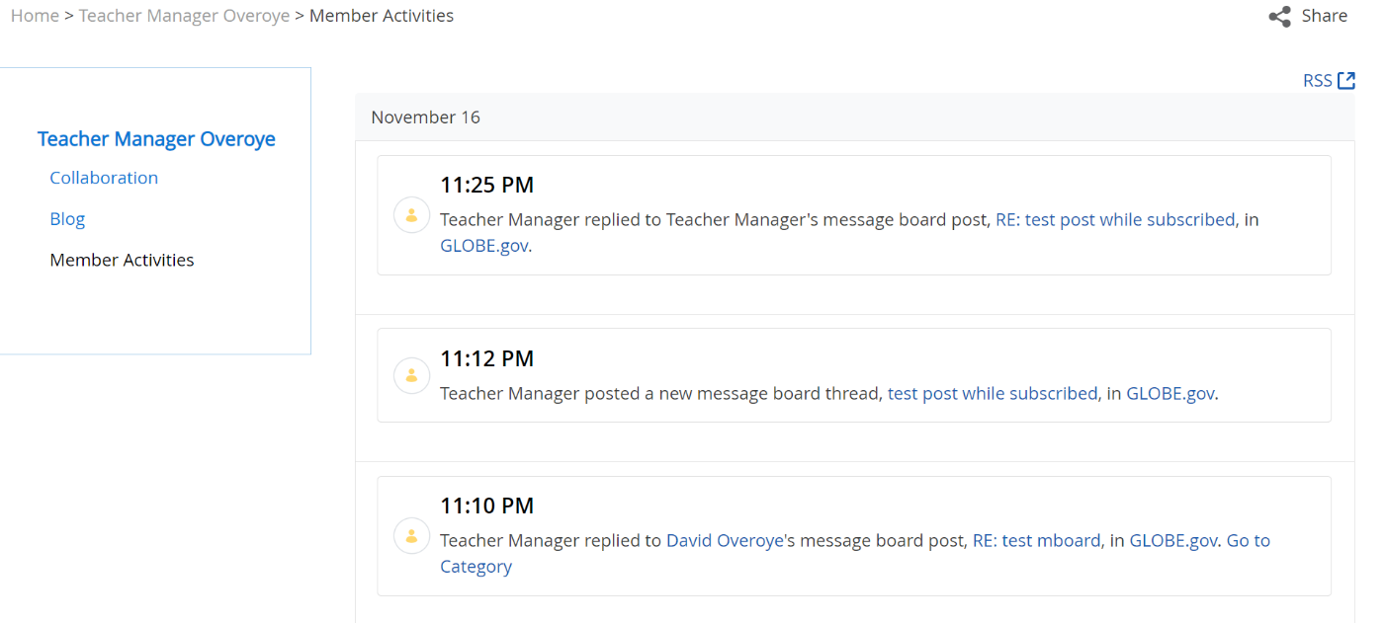
Your MyPage – Member Activities
This page shows all the postings and uploads you or your friends have done in GLOBE
If your students have posted anywhere on the site, it will show up here as well

Slide 10
Test
I want to change my email address or password. Where do I go?
I noticed my school page says there’s a different number of students than there really is..How do I change that?
I don’t have a picture on my “MyPage” how can I get one?
How can I add some information about myself on my MyPage?

Slide 11
Test - Answers
I want to change my email address or password. Where do I go?
Click on your circle icon on the top right and select Account Settings. Your name and email are on the “information” link and password is on the “password link”. You can also click “Forgot Password” from the login screen if needed.
I noticed my school page says there’s a different number of students than there really is..How do I change that?
Your school information sums up all the teacher information. You and other teachers in the school need to edit the total number of students on your MyPage. That will change the totals on the school page.

Slide 12
Test – Answers (2)
I don’t have a picture on my “MyPage” how can I get one?
Click on the circle on the top right and select My Page. On the main page, select “Change” on the picture or icon on the right and upload a picture.
How can I add some information about myself on my MyPage?
Move your mouse under your school name and look for 3 blue dots which appear to the right side of the page. Click “Edit Web Content” and fill in the information you’d like to enter.

Slide 13
Next Steps
Congratulations – you should:
Know how to change your personal information
Know how to change and update your “MyPage”
You can now
Update your information
Next Training – Creating Student Accounts
Questions – contact the GLOBE Helpdesk – globehelp@ucar.edu

