Slide 1
GLOBE
Creating Student Accounts
Setting up my student accounts
What can a Student do with their account?

Slide 2
Introduction
What is a Student Account
How do I setup a student Account
How do I know what a student is doing with their account?
This presentation is available online as well as a video which walks you through the steps
There is a section for you to try things for yourself after the demonstration and a section to test your knowledge at the end.
Questions – contact help@globe.gov

Slide 3
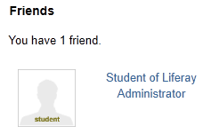
Student Accounts
Any Teacher can create up to 50 student accounts
Students can log in with their student account, and:
  Enter Data on behalf of their teacher
  Post comments and questions to forums
  “Friend” someone and post on their wall
Students can not:
  Change their school page
  Have a Mypage which they can change
  Change their password, username or any other information about themselves
  Send or Receive email from their account
Student Accounts
  Should not include a student’s name
  Are automatically “Friended” to their teacher so the teacher can always see what they are posting
  Are automatically deleted when the teacher account is deleted

Slide 4
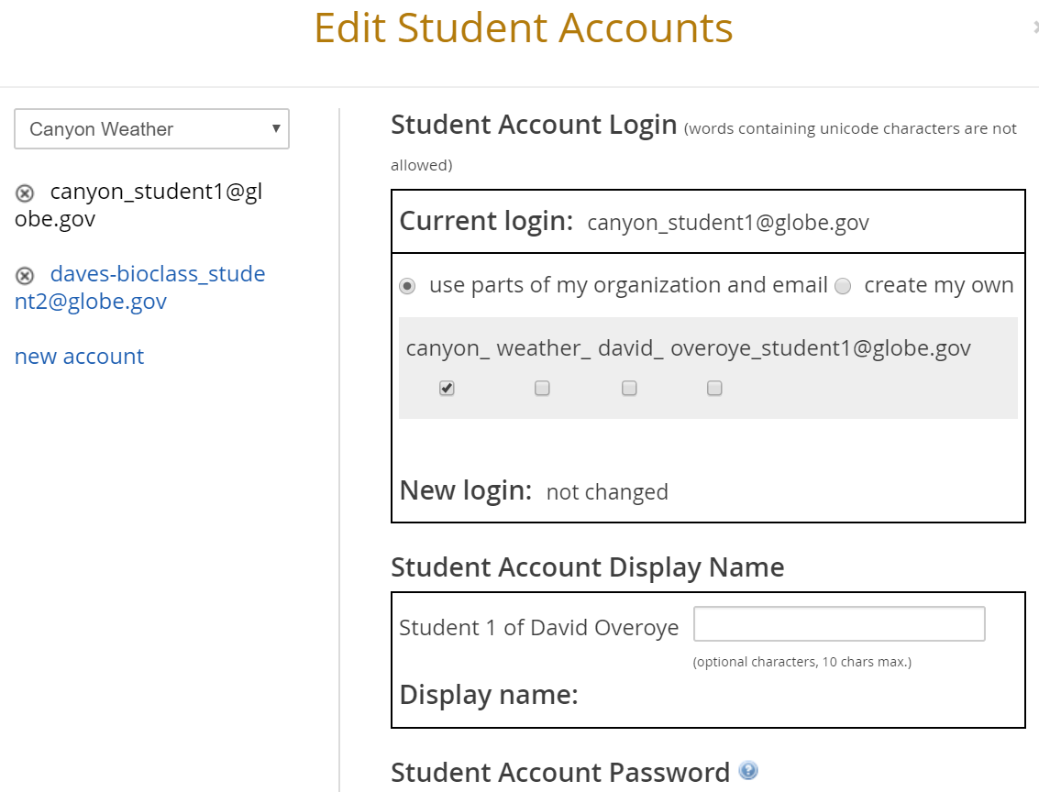
Student Accounts
When a teacher navigates to their Mypage for the first time, and selects View Student Accounts, they will see their schools and any student accounts.
When “new account” is clicked, the “Create Student Account” form is displayed

Slide 5
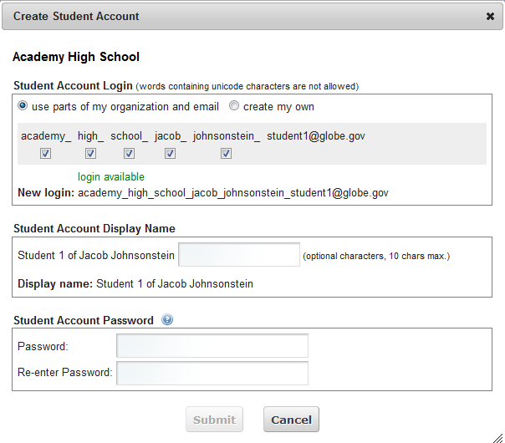
Student Accounts

Slide 6
Student Accounts
Teachers have the ability to customize the student account login before the account is created. Teachers may choose to either create a student login based on tokens of the school name, or may choose to create their own login.
  PLEASE DO NOT USE THE STUDENT NAME
Teachers may optionally add an extra field after the student’s display name, to further identify the nature or purpose of the student account.
  PLEASE DO NOT USE THE STUDENT NAME
A password must be supplied. Current password rules can be viewed by clicking on the help (?) icon.

Slide 7
Student Accounts
After the student account is created, it may be modified by clicking on the link
Student accounts may be manually deleted by clicking on the “x” icon next to the login.
In the “Edit Student Account” form, the login, display name and password may all be edited.

Slide 8
Student Account Permissions
  Enter data (Live and Training), Desktop, Mobile Data Entry App and GLOBE Observer
  Post to forums
  Join Communities
  Automatically friends with their teacher
  Doesn’t show up on community map
  Can upload pictures to their school page

Slide 9
Your Turn
Create a Student account
  After you’ve created the account write down the email and password
Go to your MyPage/Collaboration tab and see if the student is your “Friend”
Logoff from your teacher account and Login as the Student
Go to your student’s MyPage and see the difference between a student’s MyPage and yours

Slide 10
Test
I can’t change my student’s information under the control panel, why not?
Can I give an account to all 35 of my students?
Why shouldn’t I give a student my account information?

Slide 11
Test
I can’t change my student’s information under the control panel, why not?
Student account can only be managed from your “MyPage” and can only have limited information associated with them
Can I give an account to all 100 of my students?
No, teachers are currently limited to 50 student accounts only. These can be shared if desired. We recommend using one account per period
Why shouldn’t I give a student my account information?
Students should only use the student account. Your teacher account has greater capabilities which are not appropriate for students to have. Please only use student accounts for students and do not share your own personal account information

Slide 12
Next Steps
Congratulations – you should:
  Know how to setup and modify a student account
  Know what a student can do with their account
  How to monitor student activities on the GLOBE website
You can now
  Create Student accounts and get your students engaged with entering data and interacting on the GLOBE website
Questions – contact the GLOBE Helpdesk – help@globe.gov

