Slide 1
Collaboration

Slide 2
Topics
How to find someone to collaborate with
How and why to “friend” someone
Joining and using GLOBE communities and forums

Slide 3
Find someone to collaborate with
Know the person’s name?
Use Search
Know the name of the person’s organization?
Use Search
Know which country they are in?
Use the community map, or drill down
What if I want to find someone who is currently doing a protocol?
Find a Collaboration Partner
Allows you to search for people by various parameters including protocol
Use “Most Active” on the GLOBE Home page, or a country page
Use the Vis system
Select the protocol you are interested in and select the data counts tab
Slide the date range to see if their data is current
Find the school associated with the data, and the teacher at the school

Slide 4
How and why to “friend” someone
You can click “request to be a friend” on anyone’s My Page/Collaboration tab, or from the “Find a collaboration partner” page and send them a note.
They will receive an email letting them know that you have asked to be their friend
When they approve, you will be linked.
You will see them in your friends list
You can post on their wall
You can access their email address

Slide 5
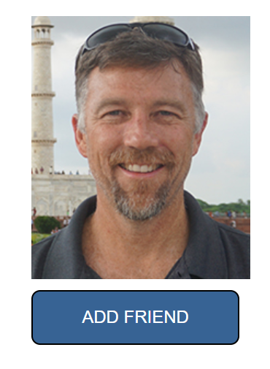
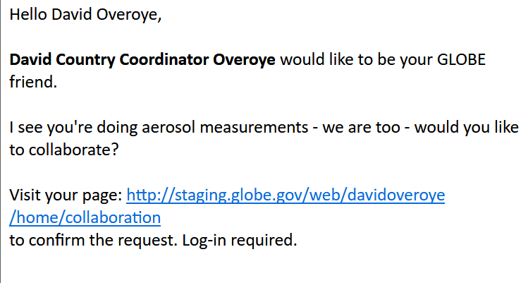
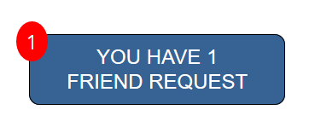
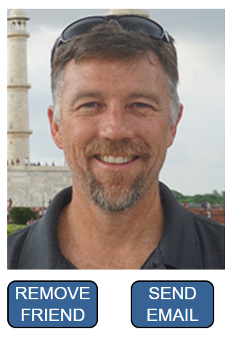
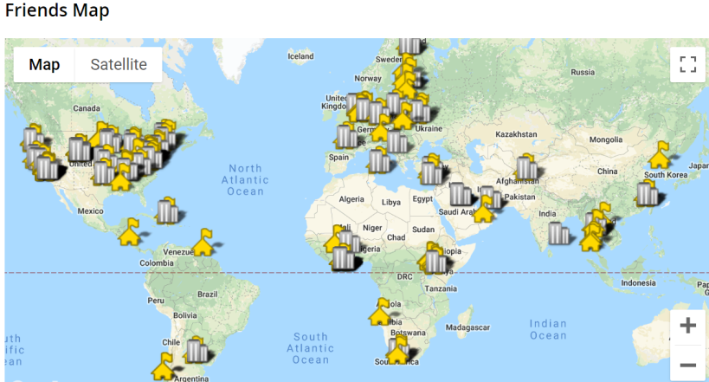
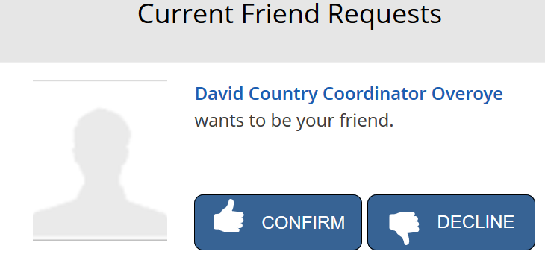

Slide 6
Forums
Nearly every community has a forum
You can post comments and questions to a forum
Everyone is automatically subscribed to the questions and help forum.

Slide 7
Your Turn
Try to find my MyPage and “friend” me – try two different ways to find me (David Overoye/ SSAI) (search by name, organization or collaboration tool for example)
Try to find someone (using the collaboration tool) that is doing the clouds protocol in a different part of the world

