Slide 1
GLOBE Website Challenge

Slide 2
https://pollev.com/davidoveroye433
Do you have your account ready to go

Slide 3
Navigation Challenge
How many GLOBE Schools in South Africa? (Community)
What is the URL a teacher goes to to join GLOBE? (Join)
What is the URL for where I post bugs and questions about the site? (Support)
How many workshops are currently scheduled in Croatia? (Get Trained)
How many Learning Activities are associated with the Aerosol protocol. (Do GLOBE)
Who posted to the scientists blog on 3/8/17? (Community/GISN)
Where is this scientist from?
How many schools received the Atmosphere Science Honor Roll in December, 2016? (GLOBE Data)

Slide 4
Navigation Challenge - Answers
Community Map
123
Join
http://www.globe.gov/join/become-a-globe-teacher or /create-a-globe-teacher-account
Support
http://www.globe.gov/support/feedback-forum
Get Trained
1
Teacher’s Guide
5 – or maybe 6 if you include the introduction
Scientists Network
Olawale Ayodeji Oluwafemi (Femi)
Nigeria
GLOBE Data
91

Slide 5
Collaboration Search (Community)
Find someone in another country who has done a protocol you are interested in within the last year.
Find their MyPage
Request to be their friend

Slide 6
Project Collaborator
Cheat sheet help
Find Someone to Collaborate With | Select Community->Find a Project Collaborator from the top Menu. Use the form to find someone who is in a particular country and using the same protocols as you. Select “Add as Friend” and they will receive an email from you.

Slide 7
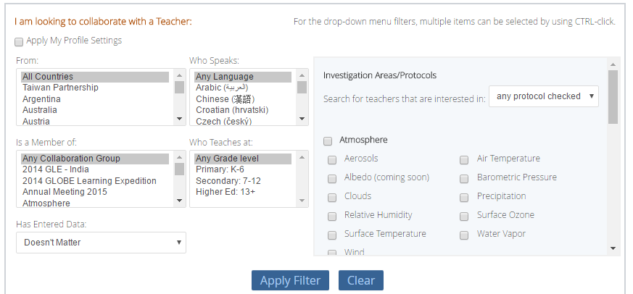
Project Collaborator

Slide 8
Teacher’s Guide Search (Do GLOBE)
Find all protocols, for Middle Grades (6-8), that are one-time measurements and take one period to do. How many results do you see?
(Teacher’s Guide search)

Slide 9
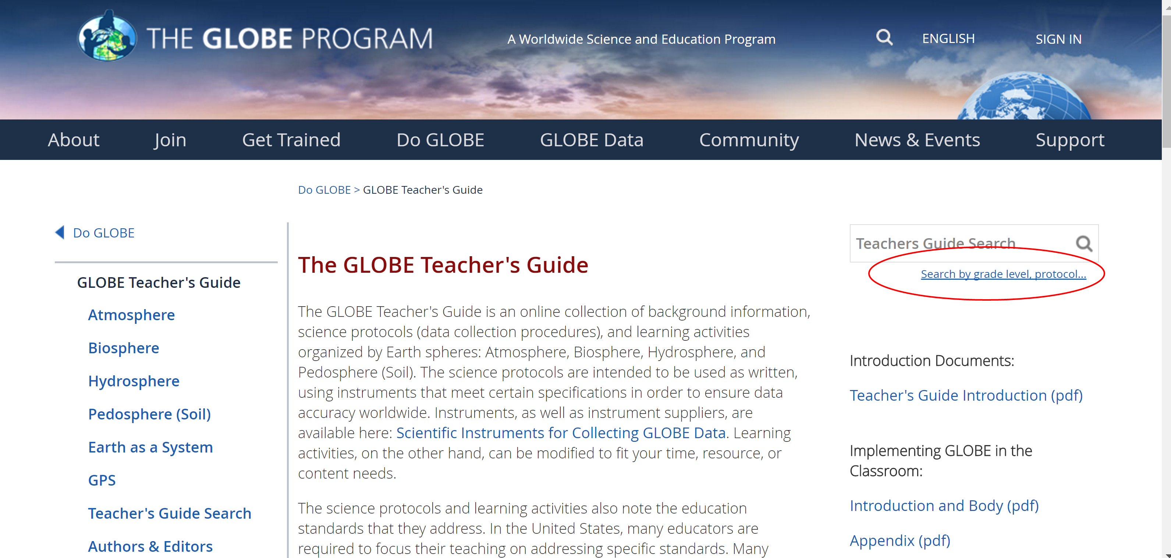

Slide 10
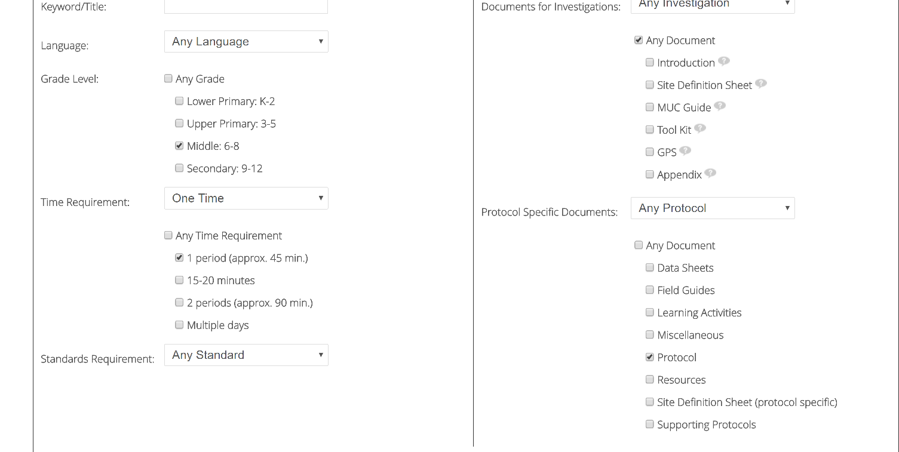
Filter setup

Slide 11
Teacher’s Guide Search
Find all protocols, for Middle Grades (6-8), that are one-time measurements and take one period to do. How many results do you see?
13

Slide 12
eTraining
GLOBE has a full set of online training materials. You can get trained in nearly all GLOBE protocols
What is the URL for the page which has the training for land cover classification (Get Trained)

Slide 14
Update your MyPage
Update information about yourself
Update the number of students you teach
Update which protocols you use
Create a Student Account

Slide 15
Update Your MyPage
Cheat sheet help
Change the content on their MyPage | Click on the first link on the drop down arrow on the top right of the page (Goto->MyPage). Look for and click on the small pencil icon in the middle column of the page. You will see a form which you can input information into.
Input the number of students they directly support (for GLOBE metrics) | Click on “Go to” and select “MyPage”. On the right side of the page, select the “Edit” button next to “Number of my students using GLOBE this year”.
Input which protocols and learning activities they use (for GLOBE metrics, and to let other teachers know what is useful) | Click on Your Name and select “MPage”. On the right side of the page, select the Tab “Protocols and Activities Used”. Click on “Edit” to select which you use.

Slide 16
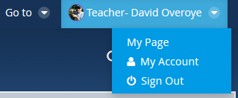
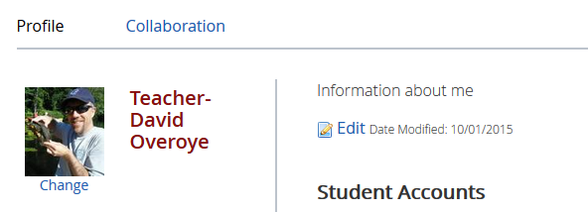
Updating your MyPage

Slide 17
Update your MyPage – your turn
Update information about yourself
Update the number of students you teach
Update which protocols you use
Create a Student Account

Slide 18
Questions

Slide 19
Posting to a Forum
Go to the Atmosphere forum, join the community and post a comment about doing one of the protocols (clouds, aerosol, ozone etc)

Slide 20
Posting to a Forum
Cheat sheet help
Post to a Forum | Go to the forum you are interested in and click “Post a new Thread”, or click “Reply” to an existing thread. You can also “subscribe” to the forum to receive email anytime someone posts to the forum. . Communities are listed under Community->GLOBE Communities

Slide 21
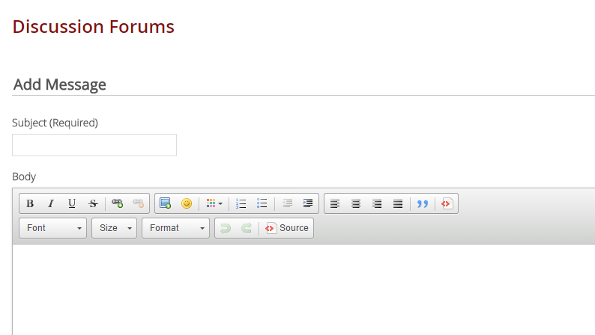
Posting to a Forum

Slide 22
Posting to a Forum – your turn
Go to the Atmosphere forum, join the community and post a comment about doing one of the protocols (clouds, aerosol, ozone etc)

Slide 23
Uploading a Document
Go to the Atmosphere community, join the community and upload a document to the Member Documents folder

Slide 24
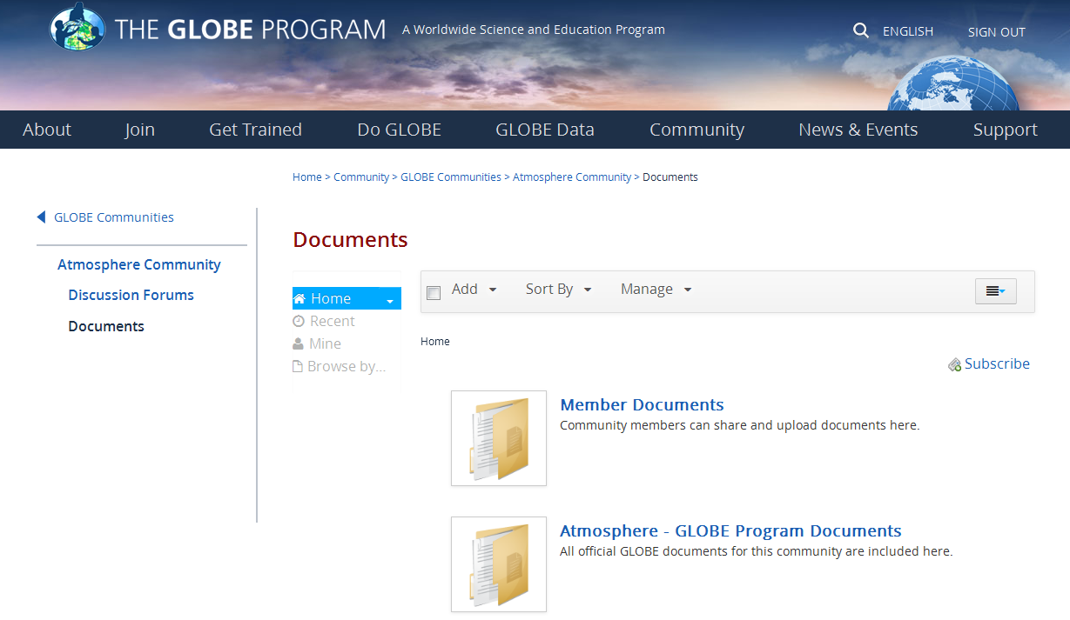
Uploading a Document

Slide 25
Uploading a Document
Cheat sheet help
Upload a Document to a community | Go to the community you’d like to upload the document to. (Community->GLOBE Communities lists all communities). Most Communities have a Documents page – click on it in the left hand nav. Most communities have a “Member Documents” Folder – click on it. Select “Add” from the menu and create a folder, or add a document. Select Browse to find the document, add meta data an “Publish”. There is a document link created which you can link to if desired.
Upload a Document to your MyPage | Select Your Name->MyPage. Select Manage->Content. Select Documents and Media from the left side menu. This is your personal library. Click Add to add documents/images. Once you upload the document, select Details and Get URL to find the URL to the image you just uploaded.

Slide 26
Uploading a Document – your turn
Go to the Atmosphere community, join the community and upload a document to the Member Documents folder

