Slide 1


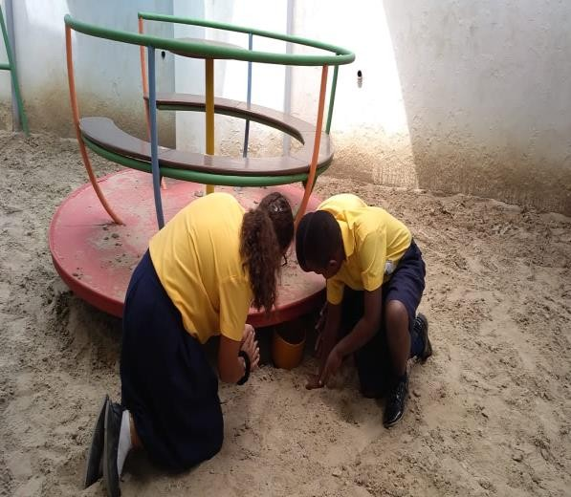
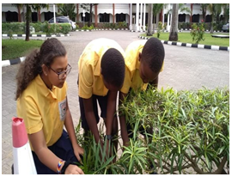
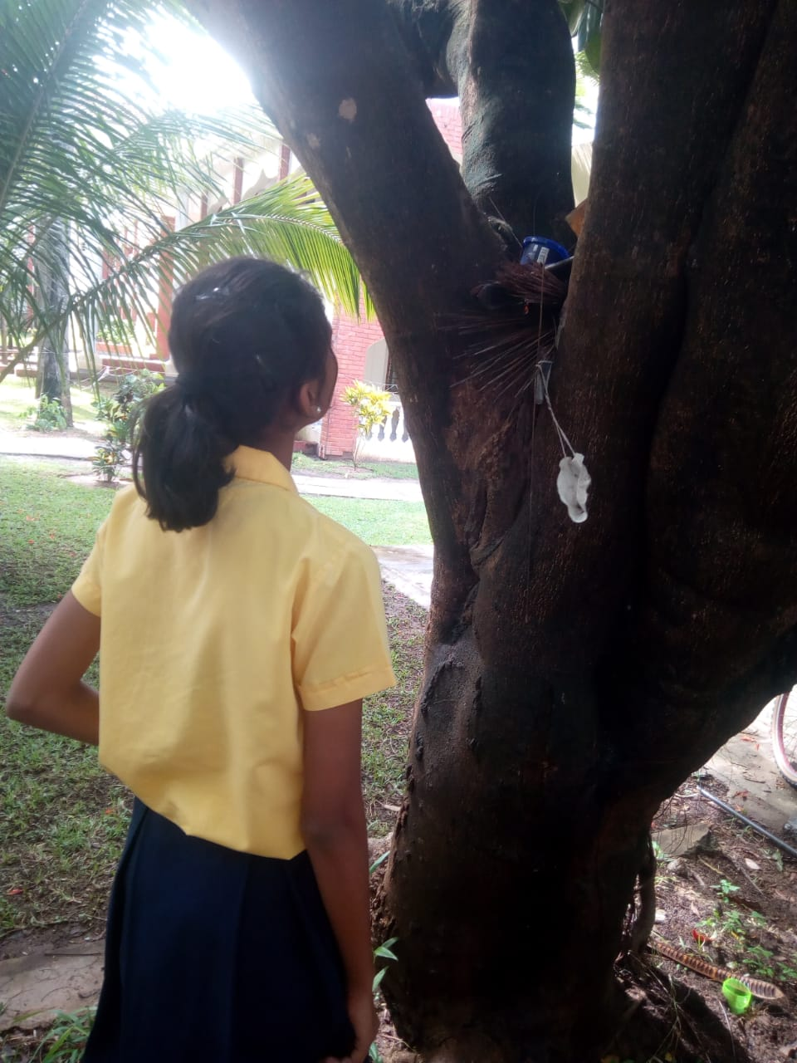
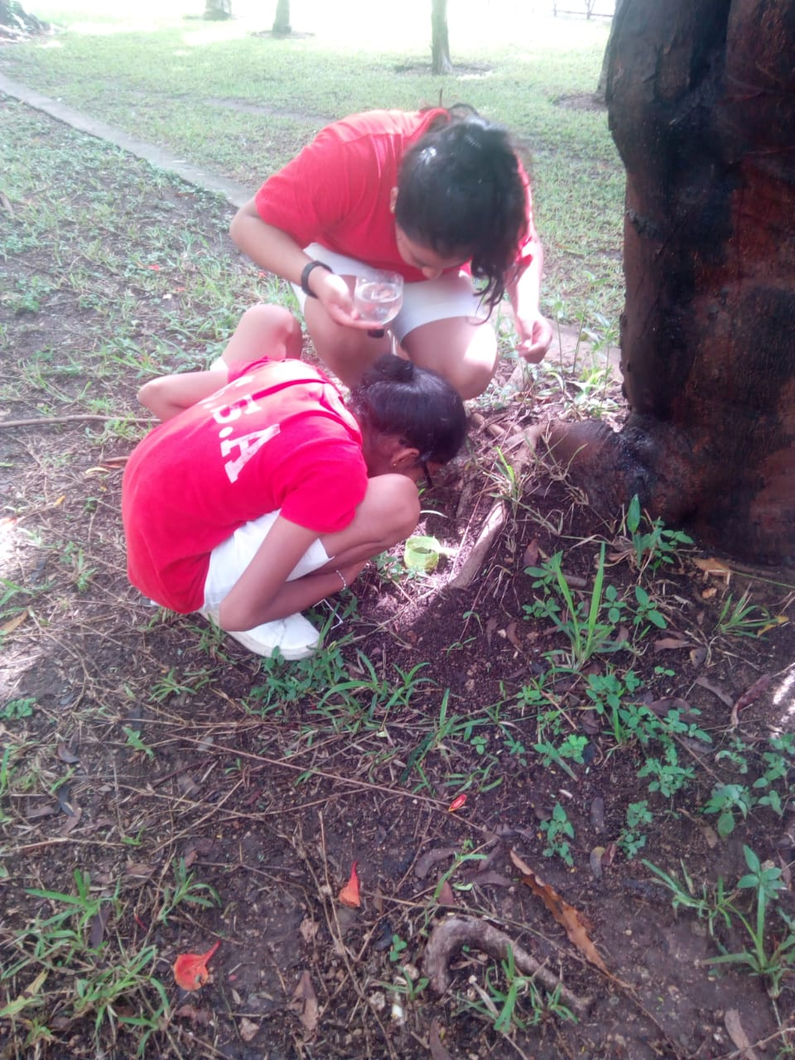
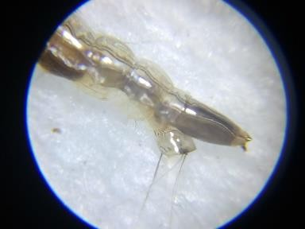
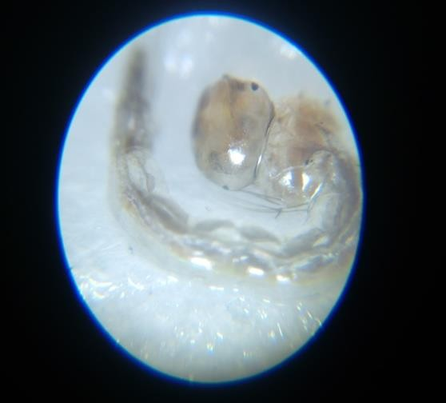
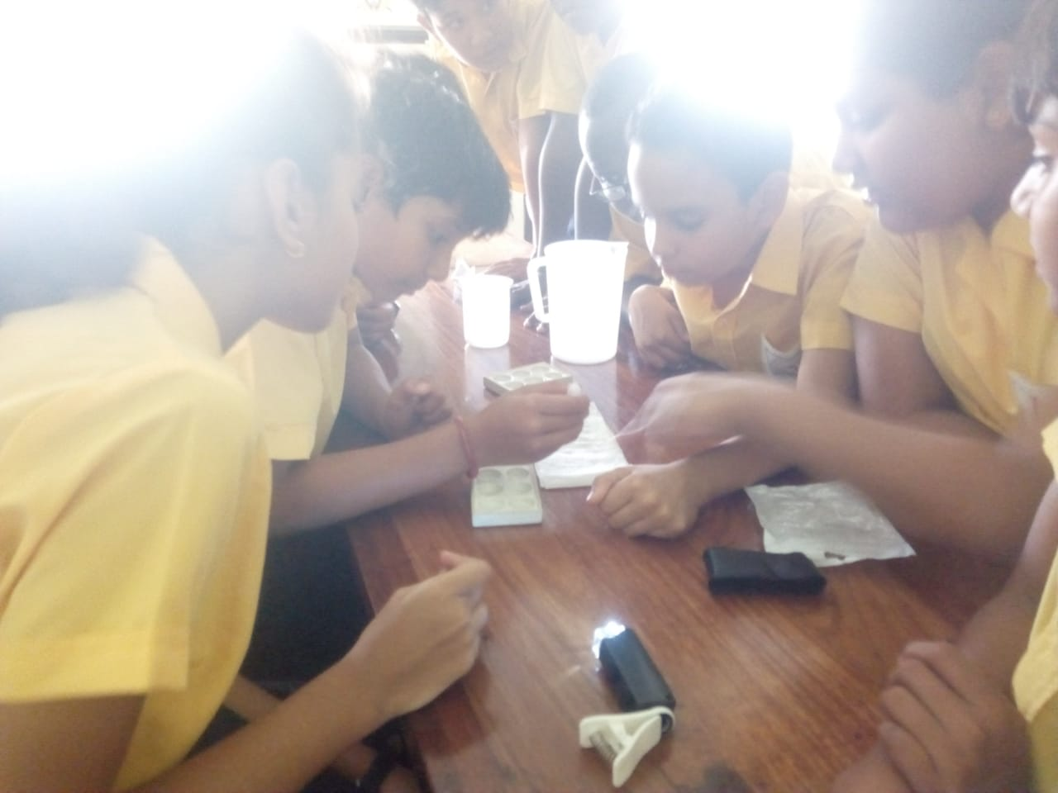
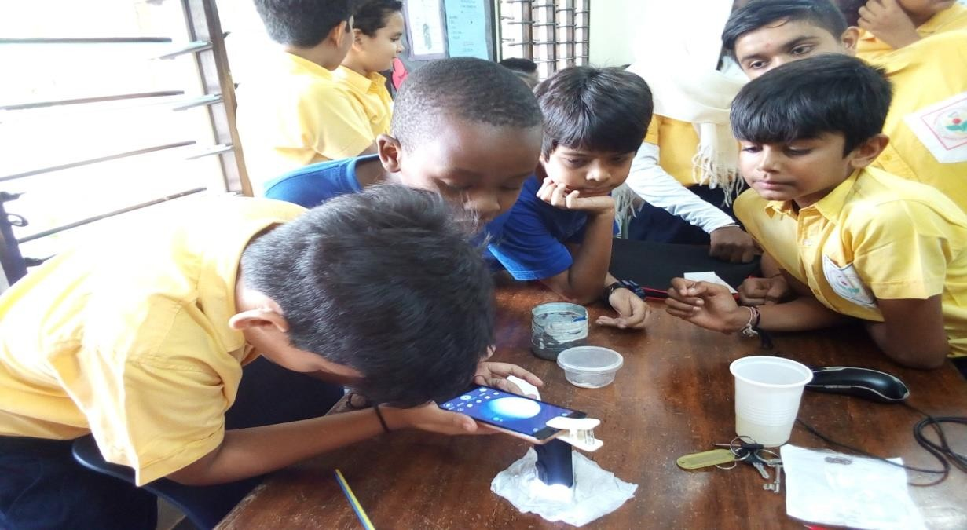
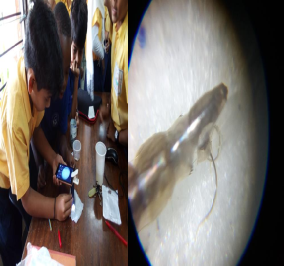
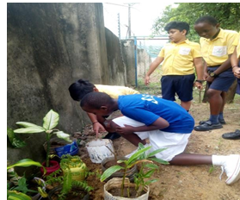
IDENTIFICATION OF MOSQUITO LARVAL SPECIES AT SSA MOMBASA, KENYA
Daren Amore, Eric Wambugu & Jade Omwenga
SHREE SWAMINARAYAN ACADEMY
Abstract
Research Methods
Results
Discussion
There have been reports of mosquito bites at our school’s kindergarten section. The children are bitten by mosquitoes while playing outside and in the classrooms. Fifteen cases of chikungunya were reported between February and March, 2018. Despite spraying with insecticide, the problem still persists.
The aim of this project was to identify the mosquito larval species in artificial breeding places within our school’s kindergarten section.
Equipment and material
  Artificial breeding site
  Dropper
  250ml Beaker
  Magnifier lens – X60 and X100/
  Macro lens
  Petri Dish
  Paper towel
  Globe Observer Application- MHM protocol
  Smart phone
Step 1 : Artificial breeding sites were identified and set up.
Step 2: Mosquito breeding sites were observed regularly.
Step 3: Mosquito larvae were identified using their physical features.
Step 4: Breeding sites were eliminated by pouring the water out
From the larvae identification protocol followed using the mosquito mapper identification, we concluded that the type of mosquitoes that breed in the school’s Kindergarten section is the Aedes mosquito.
From the larvae identification protocol followed using the mosquito mapper identification, we concluded that the type of mosquitoes that breed in the school’s Kindergarten section is Aedes mosquito. This explains the prevalence occurrence of dengue fever and chikungunya in the area.
Aedes species lay their eggs in artificial containers but, in addition, will use natural containers such as a tree hole or a coconut shell. Other species of Aedes mosquitoes breed in floodplains after rain events, in irrigation ditches, in woodland pools, brackish swamps and salt marshes.
Physical feature | Observation | Shape description | Aedes genus
Siphon | Presemt | Cylindrical
Pecten | Present
Siphon hair | Present | Single tuft, single hair
Saddle | Present | Partially covers the anal segment
Comb scale and shape | Present | pitchfork
Tufts | Absent | No tuffs between pecten | Aedes aegypti species
Anal brush | Present | Next to the saddle
Hooks on the Thorax | Present | Dark hooks seen
Research Question
Are different species of mosquitoes in the Kindergarten section at Shree Swaminarayan Academy?
Is Aedes mosquito species the most common in our school due to cases of dengue fever and chikungunya recorded in the school?
Introduction
Conclusions
The aim of our group was to identify the types of mosquitoes which breed in the Kindergarten section in our school. The playing field consists of tunnels, old tyres and many shady trees surrounding the area. There are eight class rooms, a music room, kitchen and the offices. Right in front of the classroom we have a nursery picnic area which is surrounded by large trees and flower gardens. We also have garden seats made of cement under which we collected a huge number of samples.
According to the Kindergarten head teacher there has been an outcry by the parents on the mosquito bites during play. A few cases have also been noted in the classrooms which are frequently sprayed with insecticides. According to her records 15 cases of chikungunya were reported in February and March, 2018.
Although the school spends a lot of money termly to spray insecticides all over the compound, we have not managed to completely eradicate the mosquitoes.
It was a challenge collecting samples in the play area since the place was constantly used for play. Even so a total of 30 larvae were sampled from the area.
Our research findings ruled out our first hypothesis in that only one species, Aedes, was identified in our school compound.
However, our findings were in agreement with our second hypothesis that Aedes species would be commonly found at our school due to the reported cases of occurrence of dengue fever and chikungunya at the Kindergarten. We did not find any Anopheles larvae during the study.
The type of mosquito that breeds in Nyali area is Aedes mosquito. This may explain the low incidence of malaria within the Nyali sub-county as malaria is caused by the Anopheles mosquito.
It is therefore important to educate the community on the importance of destroying breeding sites.
Morphological features of lower abdomen of larvae as seen on Macro lens attached to smart phone.
Map of Study Site
Bibliography
Interviewmania, 2018. https://interviewmania.com/discussion/48705-biology-biology- miscellaneoushttps://interviewmania.com/discussion/48705-biology-biology-miscellaneous
Tian de Jager and Taneshka Kruger, 2019. Killing mosquito larvae can contribute towards malaria elimination. The Conversation, May 29, 2019. http://theconversation.com/killing- mosquito-larvae-can-contribute-towards-malaria-elimination-115998
Teams members observing morphological features using Macro lens attached to smart phone

