Slide 1

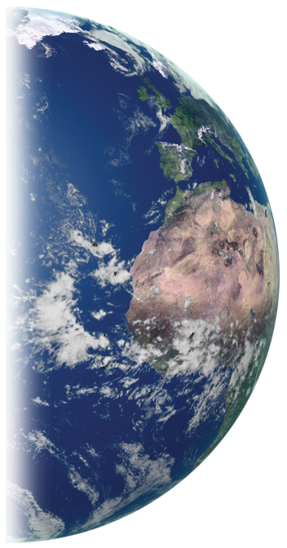
The Globe Program in Brazil
Mosquito Challenge Community Campaign - MCCC
Jean Robert Batana Pires Ferreira
Brazilian Deputy Globe Country Coordinator

Slide 2
The Globe Program in Brazil
2015 - Nasa and Brazilian Space Agency (AEB) signed the Agreement for the GLOBE Program
2016 – AEB started the Globe activities in Brazil
2016-2017:
  Brasilia
  Sao Jose dos Campos
  Rio de Janeiro
  Littoral area of Parana State.

Slide 3
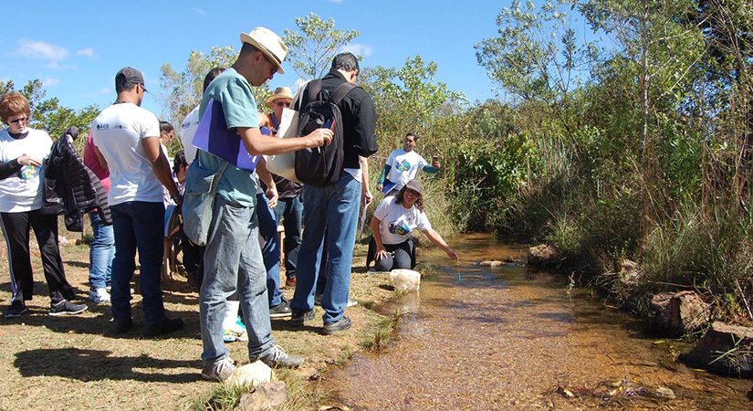
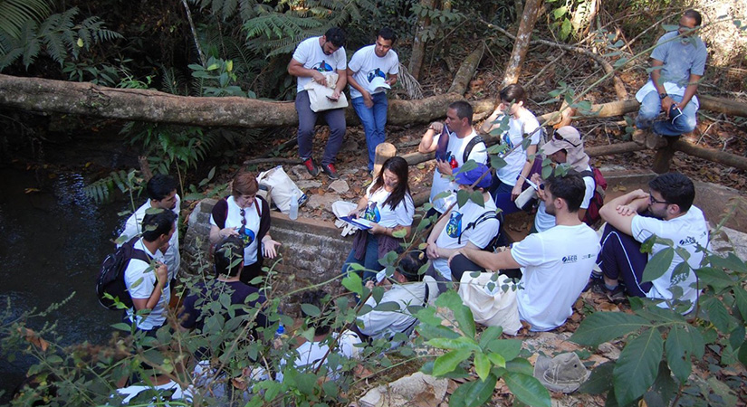
1st Globe-Brazil Workshop
Brasilia: 27 – 29 of June 2016
Atmosphere and Hydrosphere Protocols.
37 Participants: Public school teachers and AEB staff.
Master Trainers: Marta Kingland and Claudia Caro
Field activities in Brasilia National Park

Slide 4
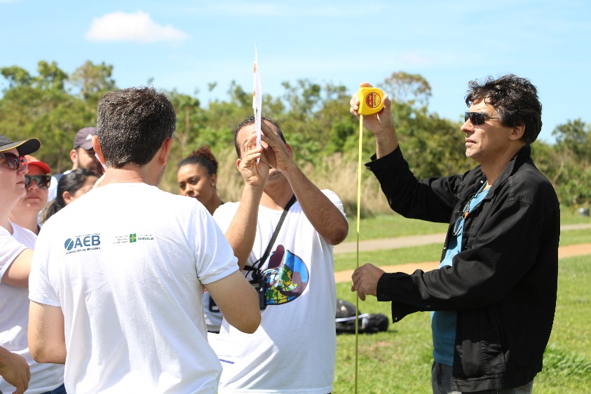
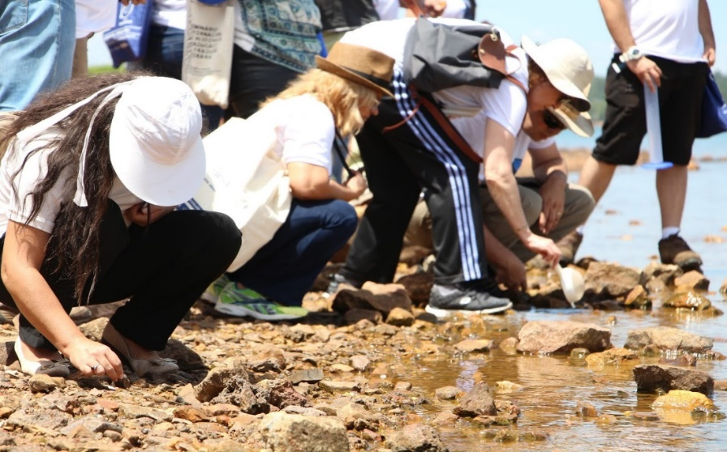
2nd Globe-Brazil Workshop
Brasília: 7 – 8 of November 2016
Atmosphere and Hydrosphere Protocols.
31 Participants: public and private school teachers and AEB staff.
Master Trainers: Marta Kingland and Claudia Caro
Field activities in Dom Bosco Park

Slide 5
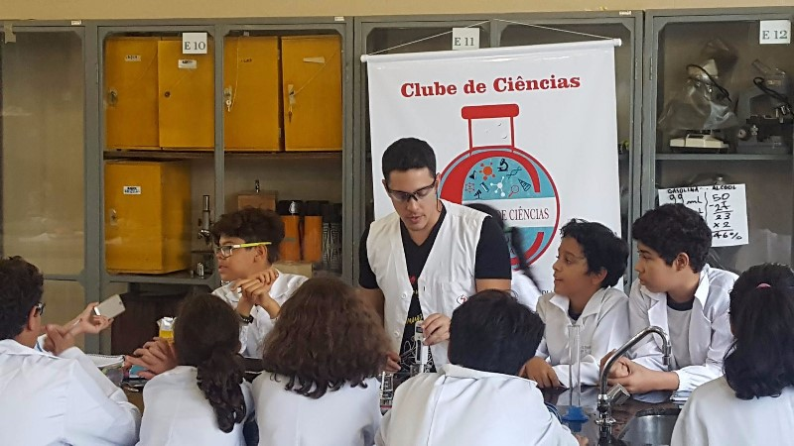
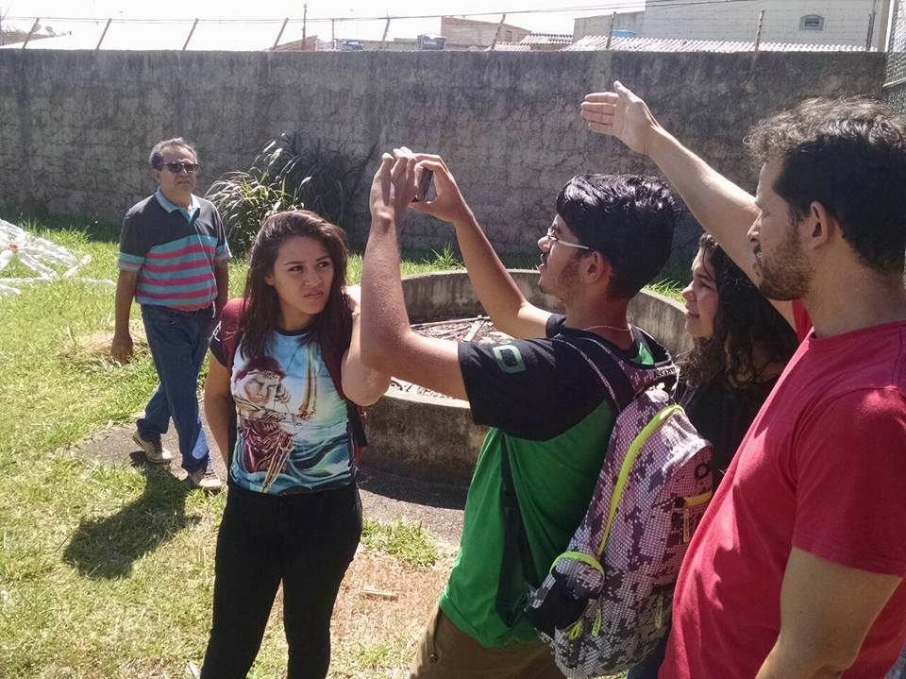
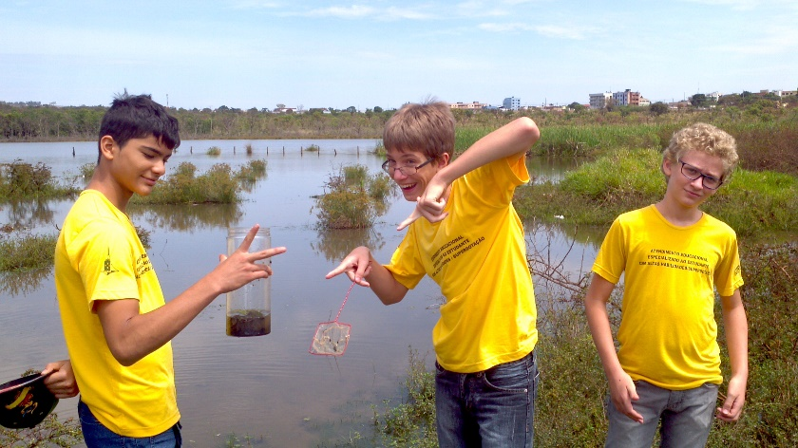
Celebration of Earth Day
22 – 29 of Abril 2017
The Brasilia Globe Schools made a special week to celebrate the Earth Day and the 22nd Globe Anniversary
Students of CEMA, DF.
Students of CEM 111 do Recanto das Ema, DF.
Students of CEF 8 de Sobradinho, DF

Slide 6
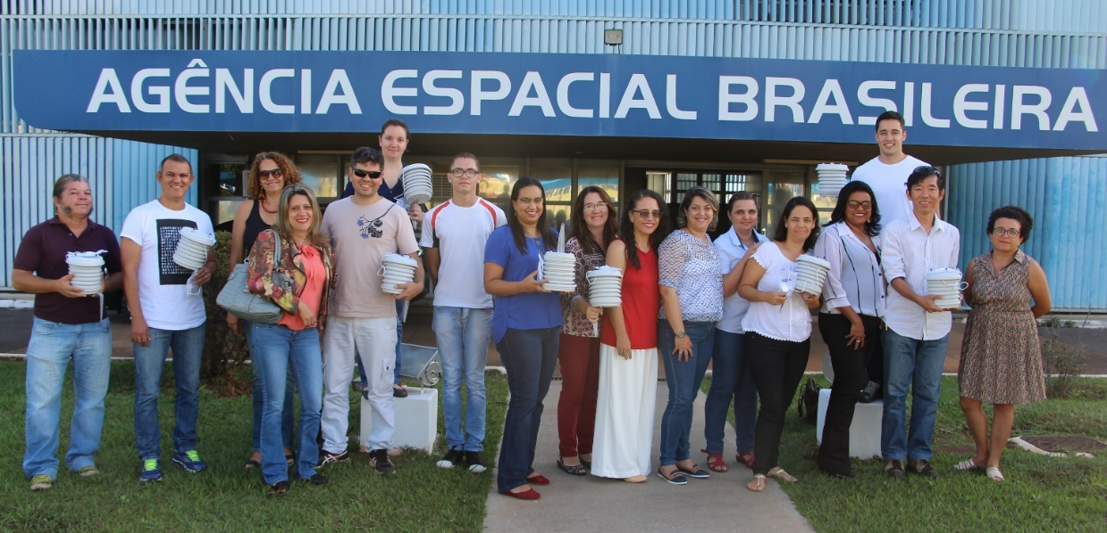
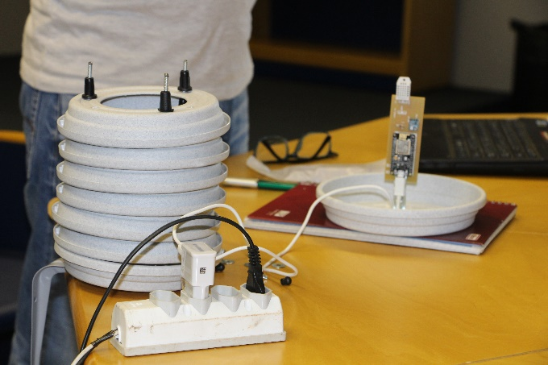
Weather Station
May 2017
12 schools received weather stations that measure current temperature, air humidity, barometric pressure.
AWS designed by Technical School of Brasilia
Teachers in Brasilia receiving Weather Stations

Slide 7
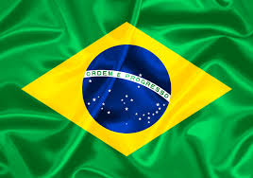
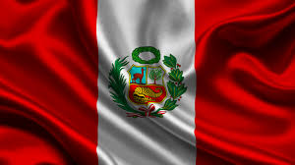
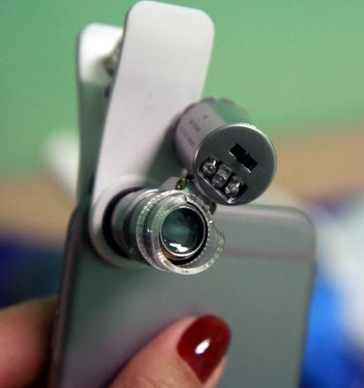
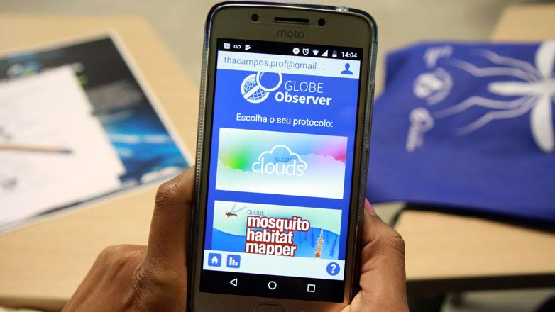
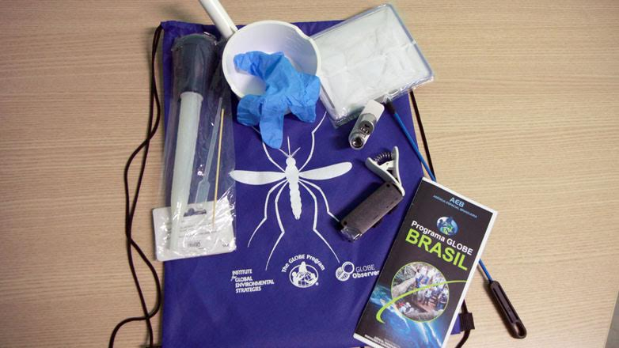

Mosquito Challenge Community Campaign June to November 2017
3 Brazilian cities and 3 Peruvian cities
    Sao Jose dos Campos/SP
    Rio de Janeiro/RJ
    Matinhos/PR
25 schools in each city
83 Brazilian profissionals
About 3500 students
Mosquito Habitat Mapper App

Slide 8
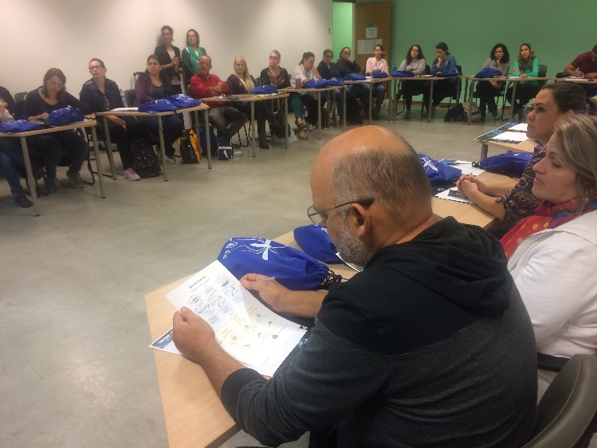
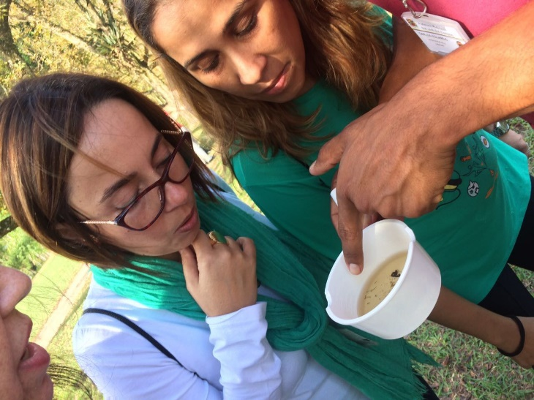
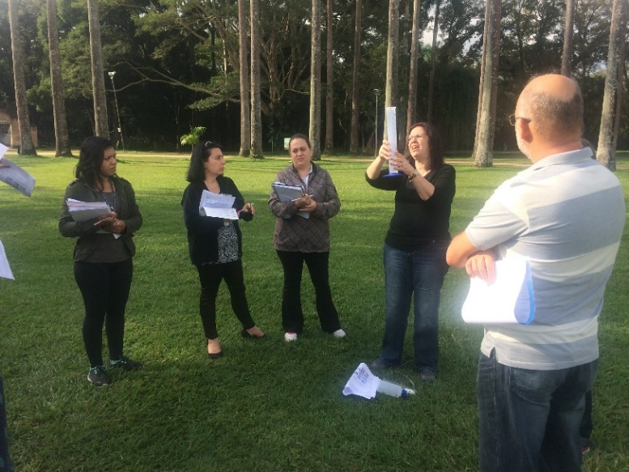
Mosquito Challenge Community Campaign
São José dos Campos/SP: 29 – 30 of May 2017
Atmosphere and Mosquito Larvae Protocols.
Master Trainers: Russane Low and Renee Codsi
Trainers: Aline Veloso and Ines Mauad
3rd Globe-Brazil Workshop – São Jose dos Campos

Slide 9
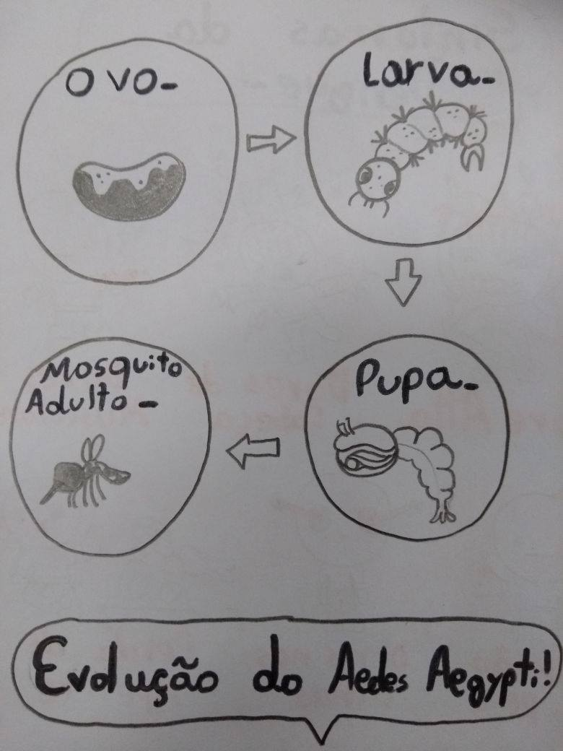
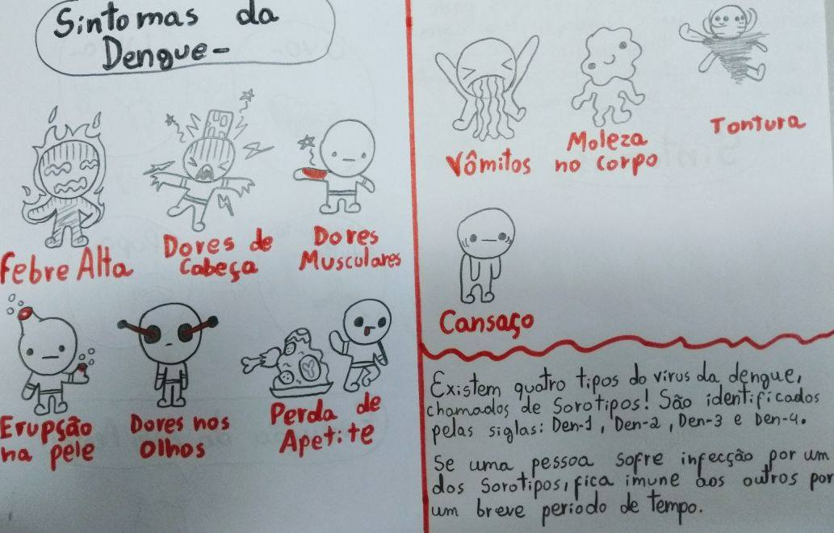
Mosquito Challenge Community Campaign
São José dos Campos/SP: 29 – 30 of May 2017
27 Teachers
03 Representatives of Education Department
02 Reps of Health Department

Slide 10
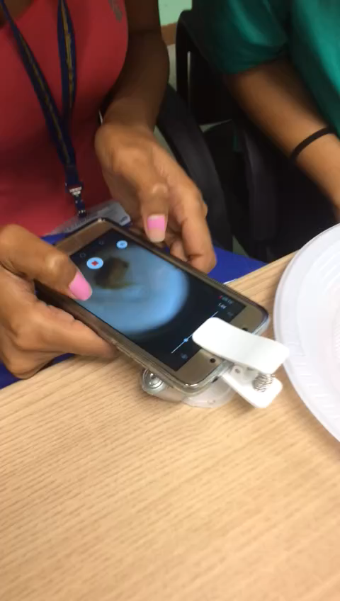
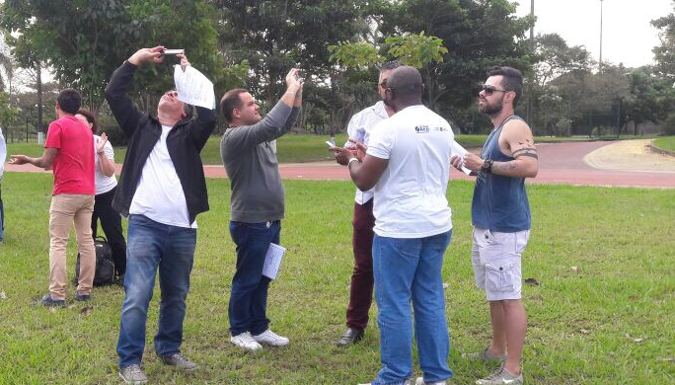
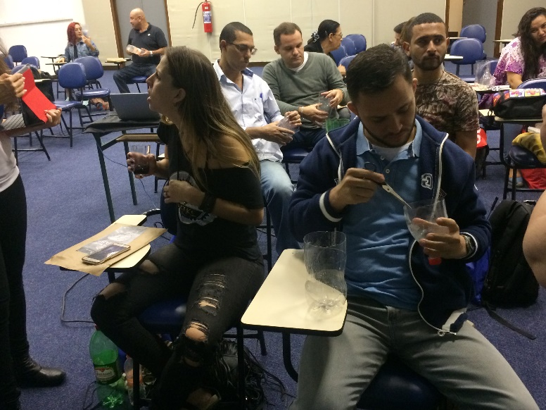
Mosquito Challenge Community Campaign
Rio de Janeiro/RJ: 1 – 2 of June 2017
Atmosphere and Mosquito Larvae Protocols.
Master Trainers: Russane Low and Renee Codsi
Trainers: Aline Veloso and Ines Mauad
4rd Globe-Brazil Workshop – Rio de Janeiro
Vídeo: Pulpa

Slide 11
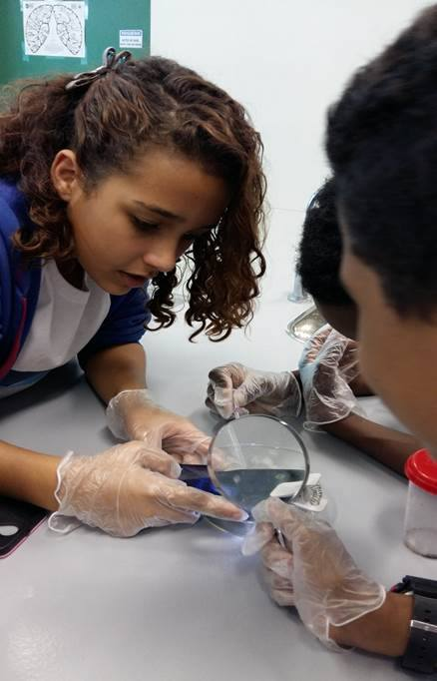
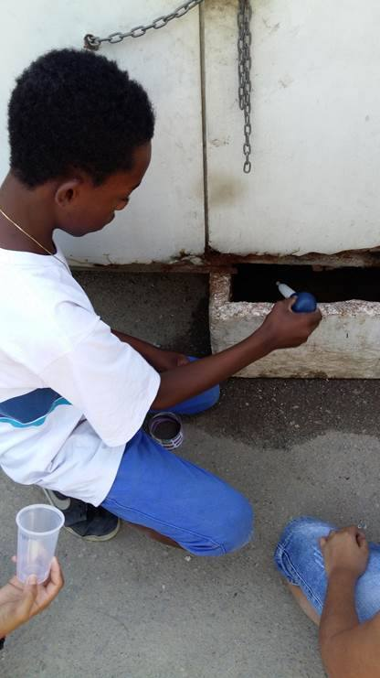
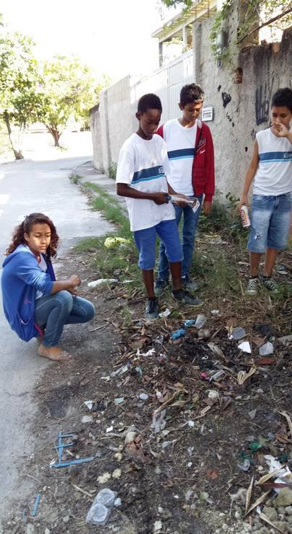
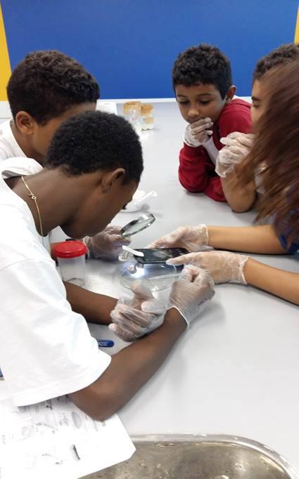
Mosquito Challenge Community Campaign
Rio de Janeiro/RJ: 1 – 2 of June 2017
24 Teachers.
03 Representatives of Education department

Slide 12
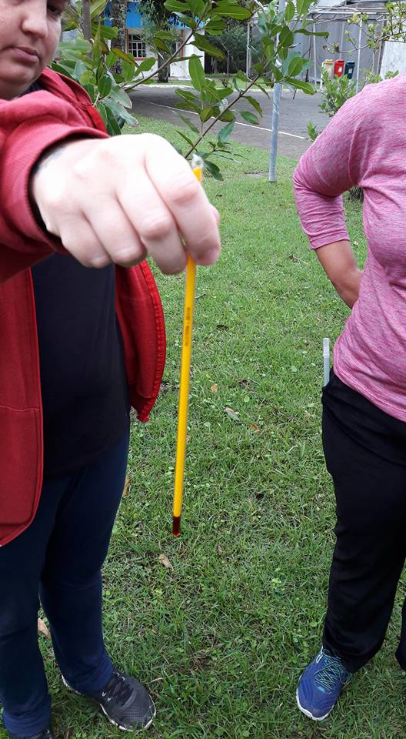
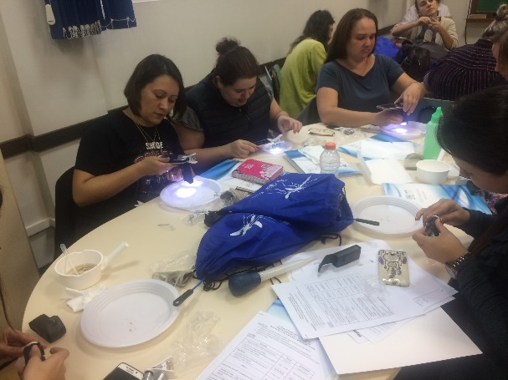
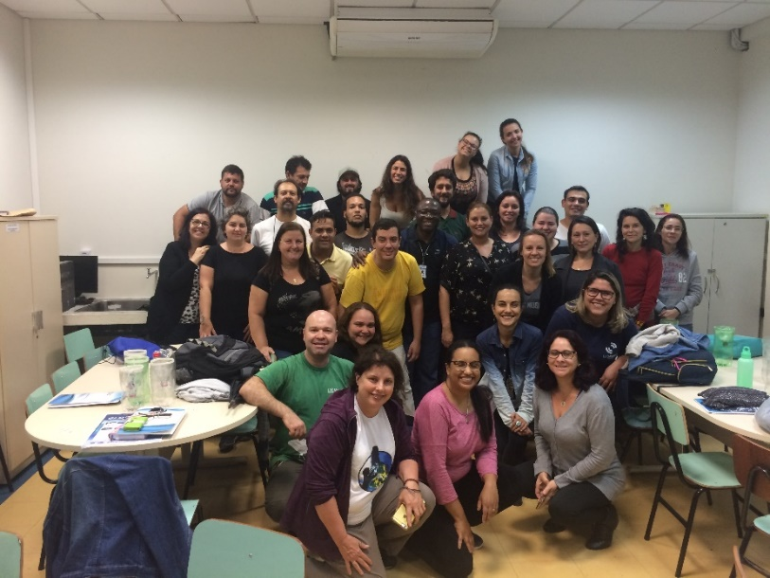
Mosquito Challenge Community Campaign
Matinhos/PR: 5 – 6 of June 2017
Atmosphere and Mosquito Larvae Protocols.
Master Trainers: Russane Low and Renee Codsi
Trainers: Aline Veloso and Ines Mauad
5th Globe-Brazil Workshop – Matinhos

Slide 13
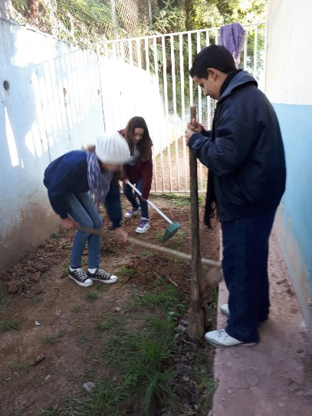
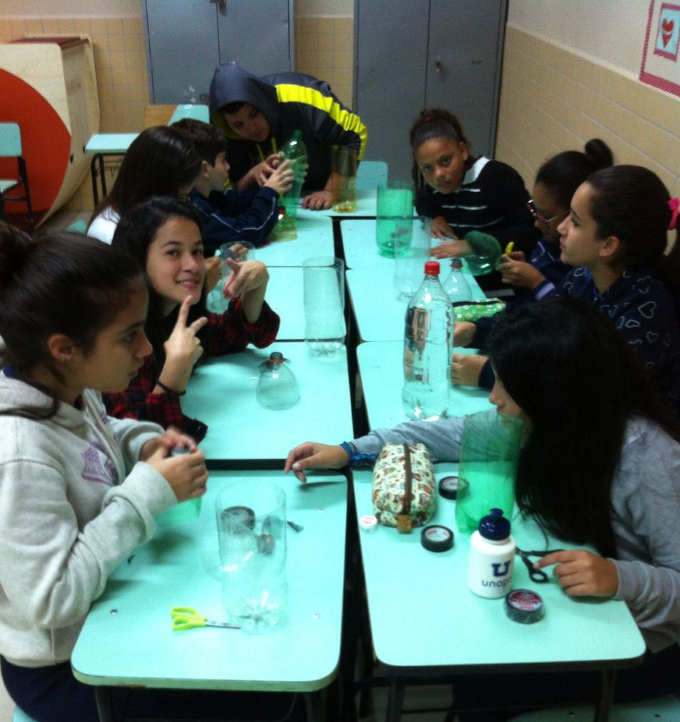
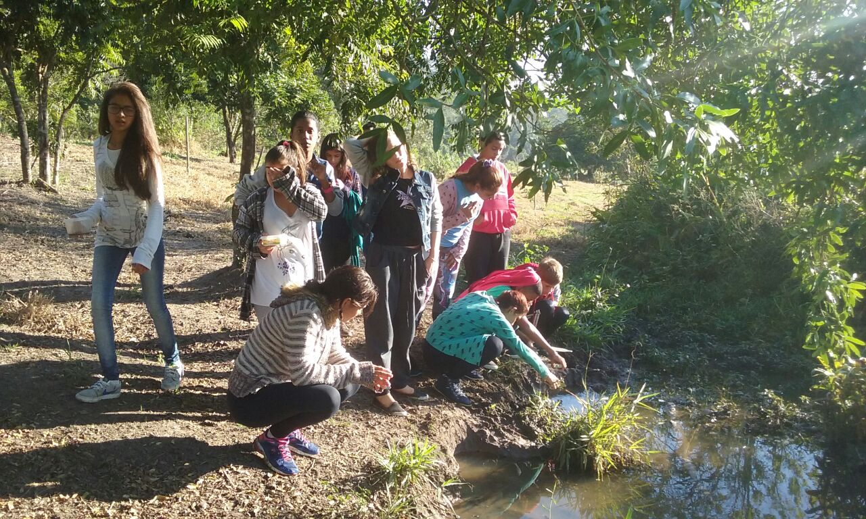
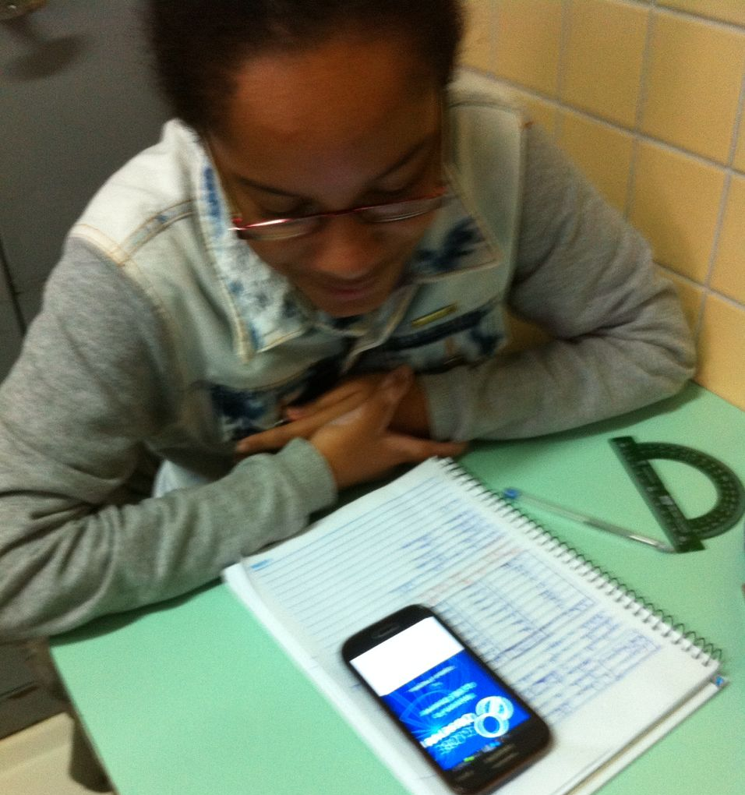
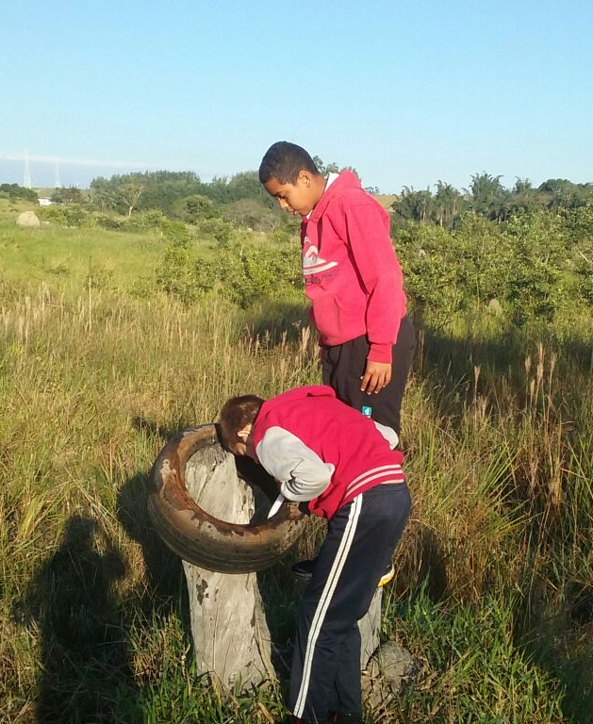
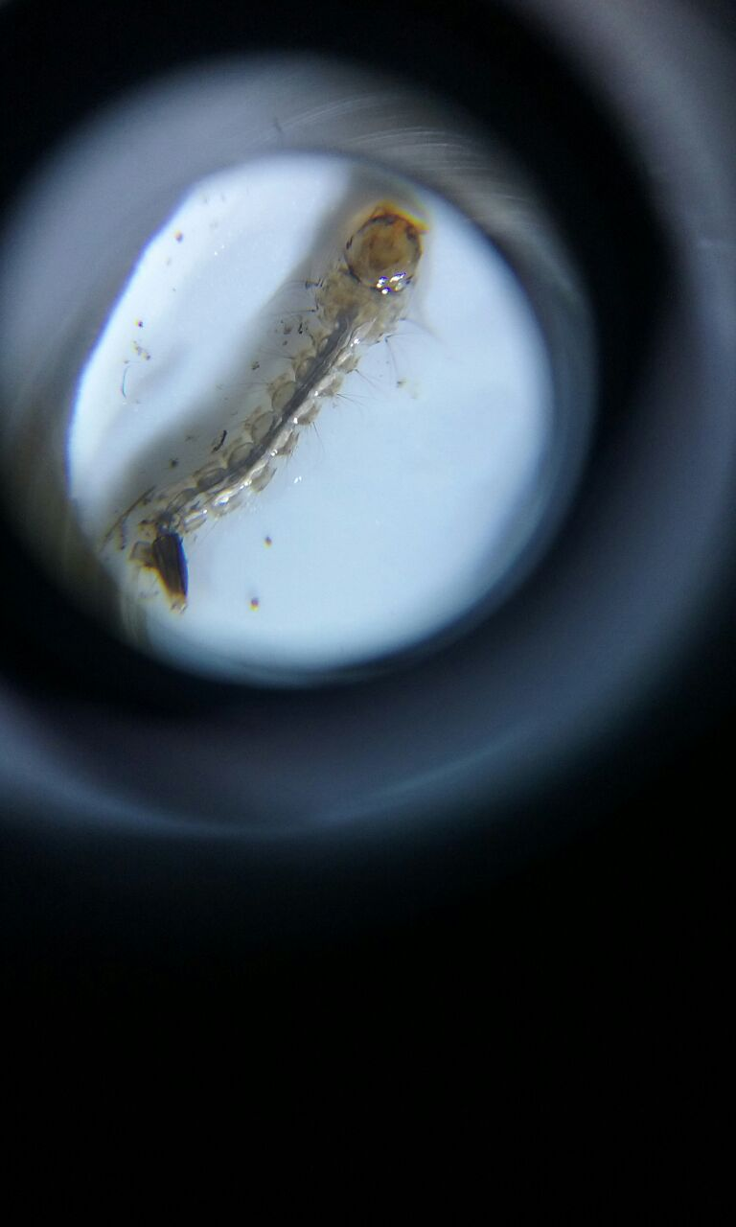
Mosquito Challenge Community Campaign
Matinhos/PR: 5 – 6 of June 2017
Students activities for the MCCC

Slide 14
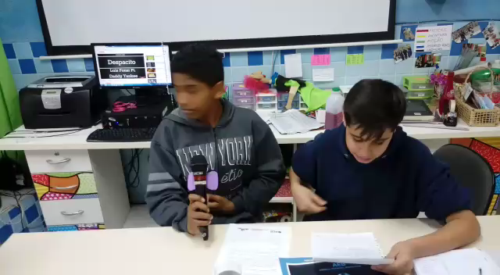
THANK YOU!
OBRIGADO!
MERCI!
DANKE!
.
.
.
Videos: Students from Sao Jose dos Campos composing music for the MCCC

