Slide 1
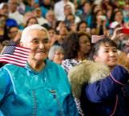
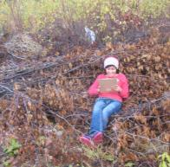
Project Partners:
University of Alaska Fairbanks; Association of Interior Native Educators; GLOBE Implementation Office; NASA Langley Research Center Office of Education; NASA Goddard Space Flight Center Cryosphere Branch; North Slope Borough School District and other school districts; Kenaitze Indian Tribe; Aleutians Pribilof Islands Asso-
Ciation, 4-H Alaska; Santa Ana Community College MESA; Goldstream Group; NASA Science Mission Directorate Education Collective
Elena Sparrow, ebsparrow@alaska.edu
Katie Spellman, klspellman@alaska.edu
Exploring impacts & feedbacks of a warming Arctic,
Engaging learners in STEM using GLOBE & NASA Assets

Slide 2
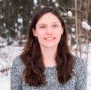
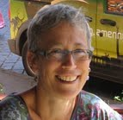
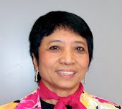
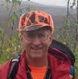
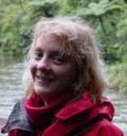
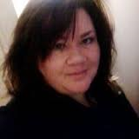
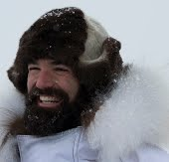
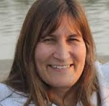
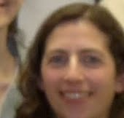
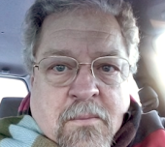
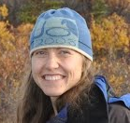
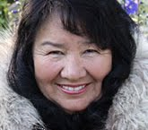
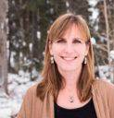
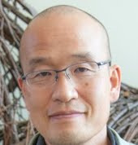
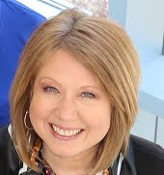
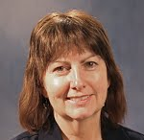
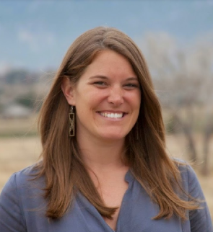
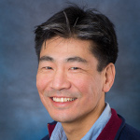
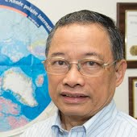
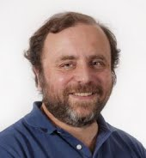
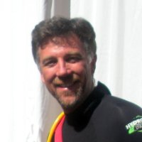
Project Collaborators

Slide 3
Citizen Science Spectrum
Theoretical or generalizable needs
Local community needs
Question | Researcher |  | Citizens
Methods Design | Researcher |  | Citizens with researcher assist.
Data collection | Citizens |  | Citizens
Data Analysis | Researcher |  | Researcher with citizen assist.
Use of findings | Researcher & Citizens |  | Citizens & Researcher
Notes:
The left hand side of the spectrum is citizens as data collectors, and the right hand side of the spectrum is citizens as scientists.
We have examples of both ends of the spectrum going on here at the Bonanza Creek LTER. On the left hand side is my research, where we have a specific question that we need lots of help over a large geographic area to answer. An example of the right hand side is the Rural Alaska Self-Sufficiency Network that Dr. Terry Chapin is working on establishing, where villages approach the network with questions about the way climate change is affecting their community, then he matches the community with a researcher that can help use science as a tool to answer their own questions.

Slide 4
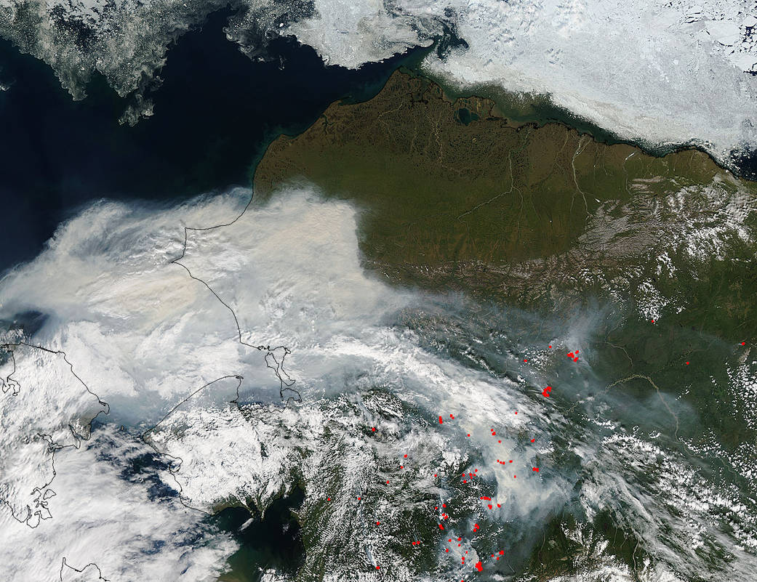
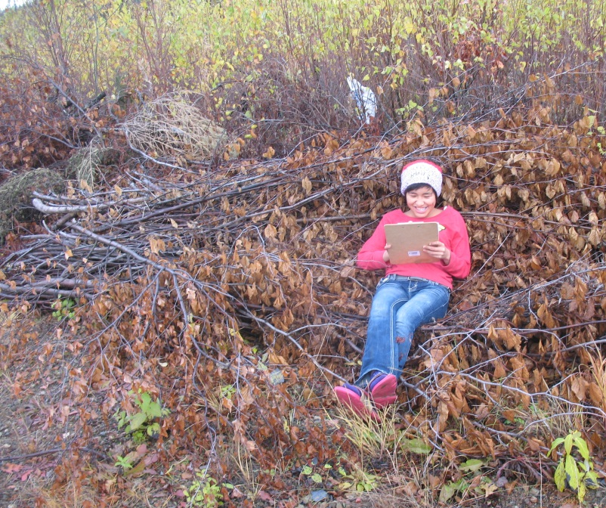
Assets
NASA and GLOBE data provide opportunity for climate change learning from local to global scales.
Shageluk village 8th grader organizes data in a brush pile near the school’s GLOBE post-fire succession monitoring site.
Background- Jeff Schmaltz, MODIS Rapid Response Team; Inset- Katie Spellman, UAF
MODIS image taken by the Aqua Satellite captures smoke filled skies throughout Alaska in July 2015.

Slide 5
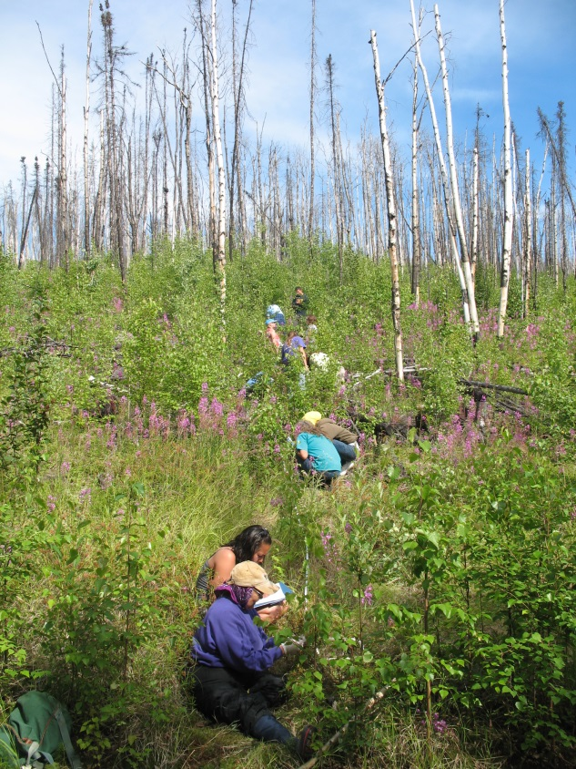
Arctic and Earth SIGNs Objectives
1: Develop a high quality climate change education program that includes NASA assets (resources and experts), citizen science, and mobile technology for formal and informal science education settings
2: Engage educators and community members in learning experiences to model best practice for inquiry-based, culturally responsive climate change science teaching
3: Engage youth, community members and educators in locally and globally important science where they produce and apply new information on the impacts of a changing global climate.

Slide 6
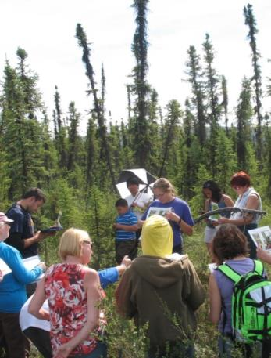
Project Overview
Target Audiences
Primary audience- Educators in rural and indigenous communities and the youth they serve, including:
- Pre- and in-service teachers and K-12
youth
- Informal STEM educators (4-H
leaders/others and youth
- Community leaders (elders, tribal or
town council members, etc.)
Secondary audience- educators and students in other communities underserved in STEM

Slide 7
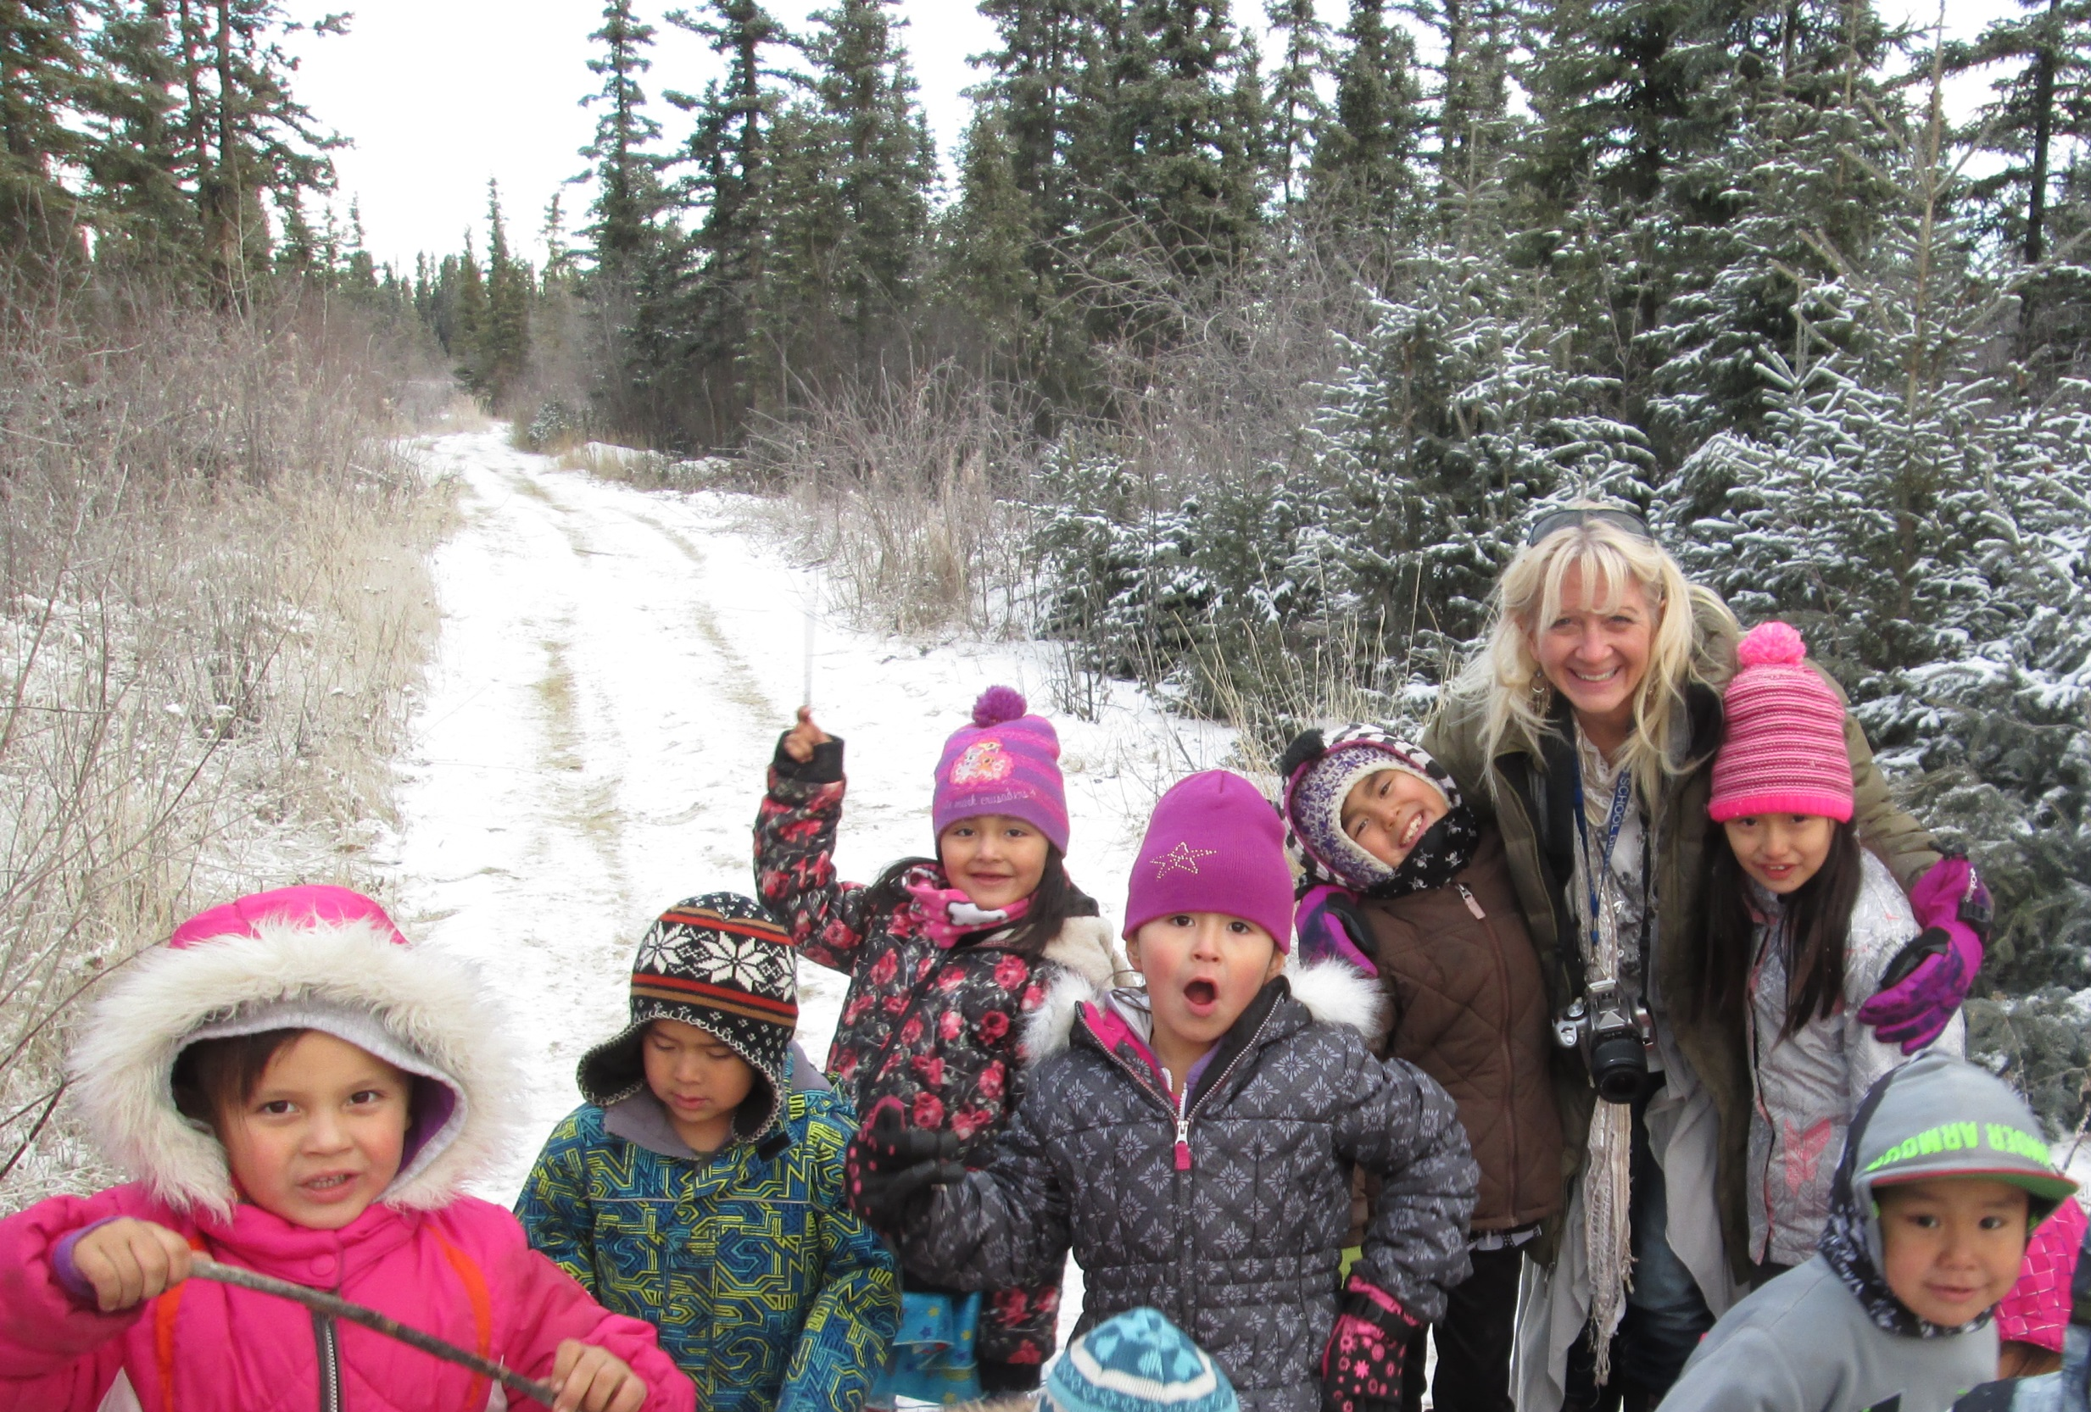
Arctic and Earth SIGNs Big Idea:
We can make a difference on climate change issues by listening, inquiring, observing, and then acting.
Enduring Understandings:
Climate change influences our lives.
Climate change influences earth systems at multiple scales, and we need information at different scales to understand it.
Everyone can DO science.
We can use local and traditional knowledges and STEM to help our community adapt to climate change.

Slide 8
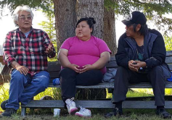
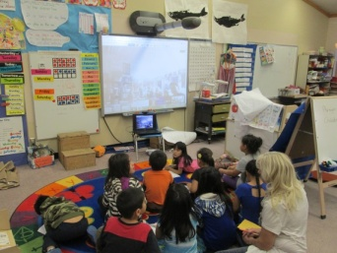
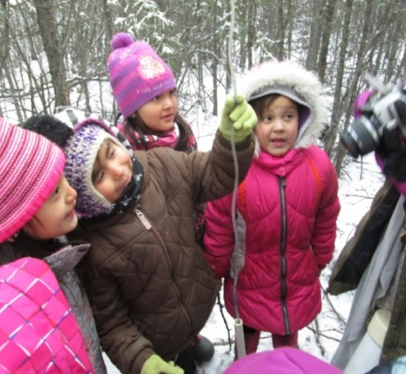
The Arctic and Earth SIGNs inquiry model Using GLOBE, NASA, and local knowledge to make
STEM learning locally relevant and have an impact
Discover what youth and adults know
Identify key climate change issue for community
Brainstorm investigation and stewardship ideas
EXPLORE
SHARE
SHARE
Learn from elders, long-term residents, and scientists about signs and impacts of climate change.
Design and implement stewardship project to help community address the climate change issue
Do culturally responsive activities to establish knowledge base on the topic
Talk with a NASA scientist
Select inquiry question
Make sense of research by analyzing data and reviewing information from local experts, NASA data, and existing research
APPLY
EXPLAIN
Collaborate with a scientist & community to develop and implement GLOBE investigation
EXPERIMENT

Slide 9
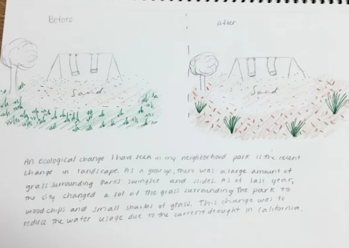
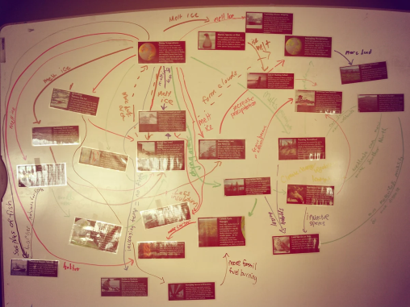
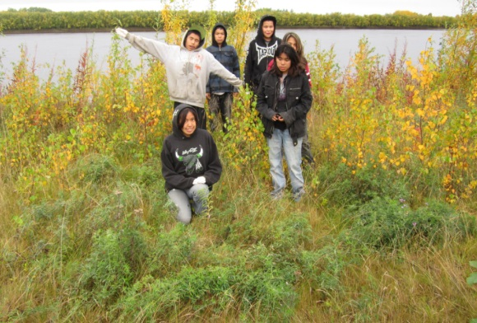
Climate Change and My Community Course
1. What is my personal connection with climate change?
2. How does climate change influence the Earth system?
4. What can I do about a climate change issue in my community?
3. How does climate change affect my community?

Slide 10
Culturally Responsive Learning Units
Association of Interior Native Educators curriculum update and development
Salmon
Fish
Berries
Birds
Medicinal Plants

Slide 11
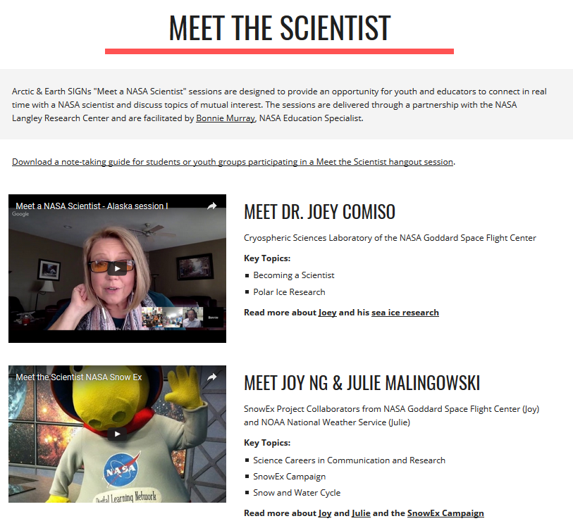

Slide 12
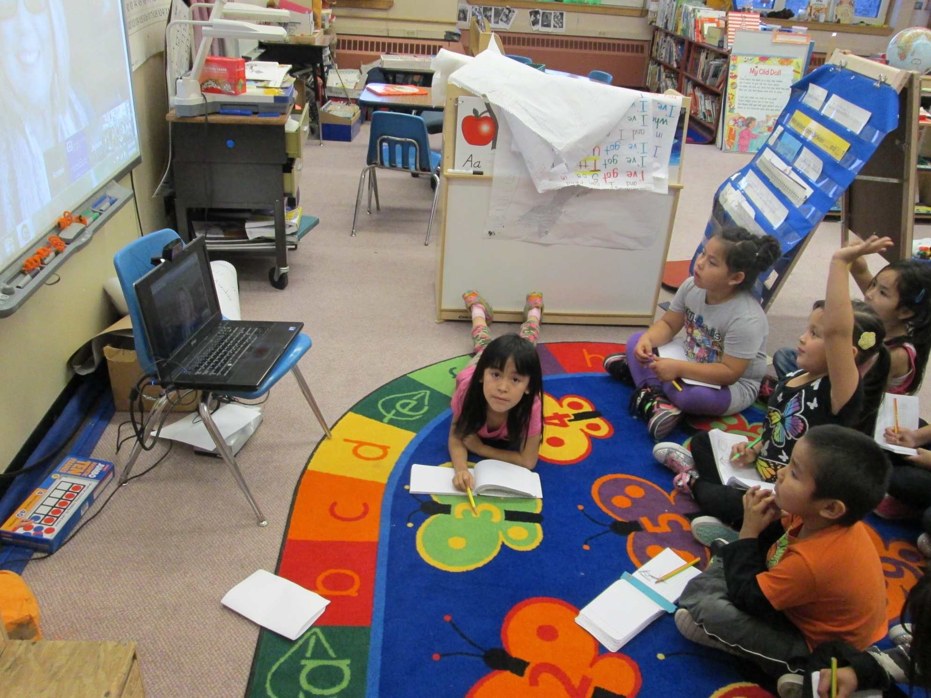

Slide 16
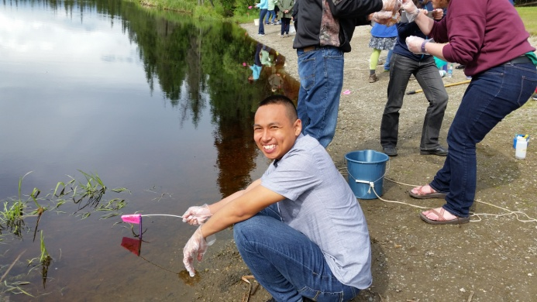
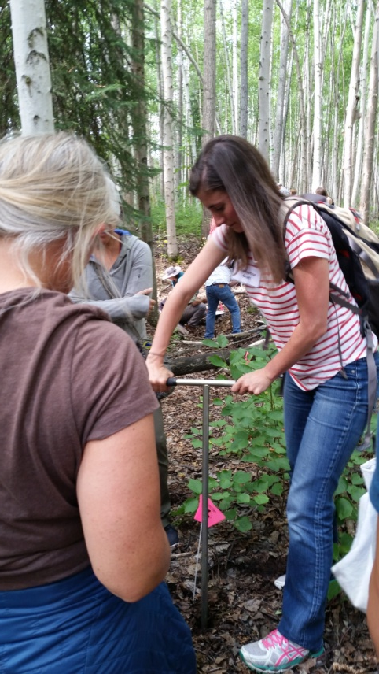
Arctic and Earth SIGNs Activities
Curriculum Development- Modules for Climate Change Education Course for Educators
Culturally Responsive Curriculum
GLOBE Frost Tube Protocol
Professional Development Workshops/Courses
Meet a Scientist
Presentations at National and International Meetings
GLOBE Northwest Regional Science Student Research Symposium
School Visits
Outreach Events

Slide 17
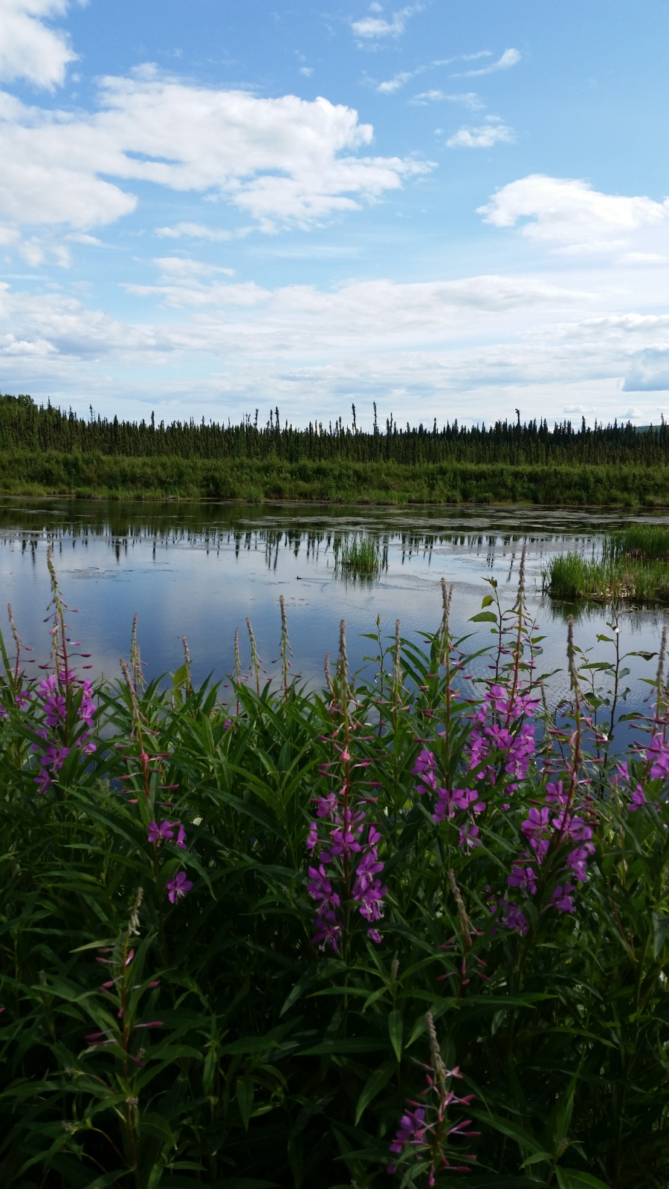
Thank You for your
Attention!

