Slide 1


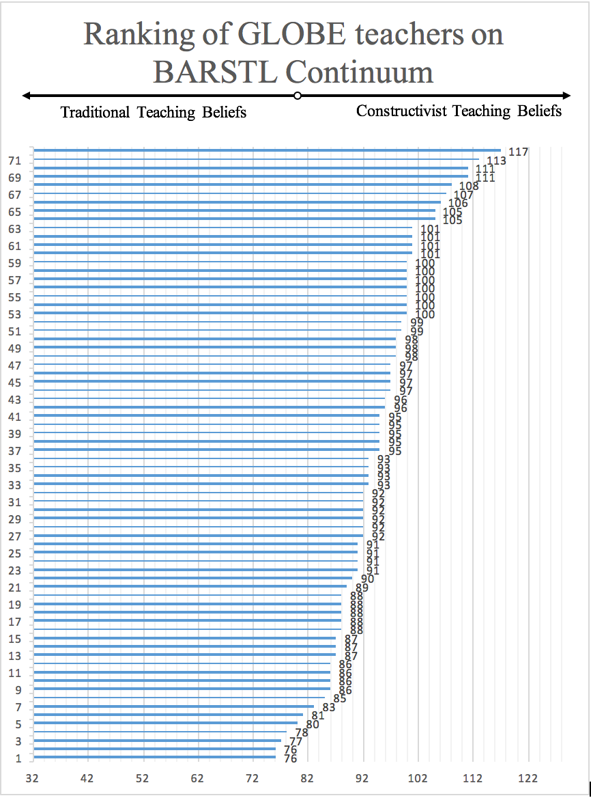
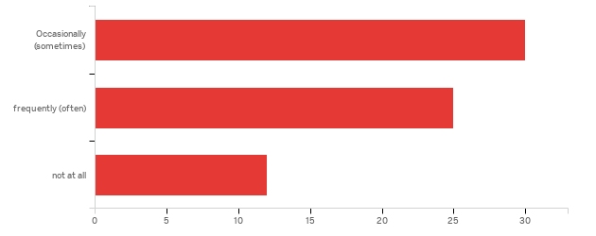
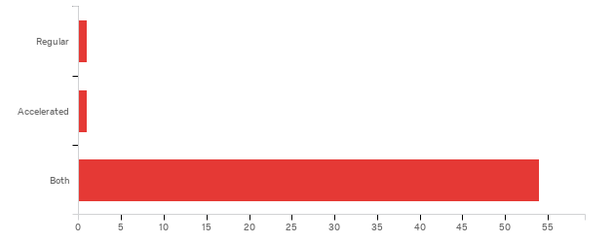
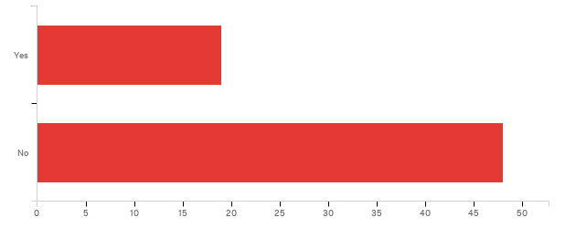
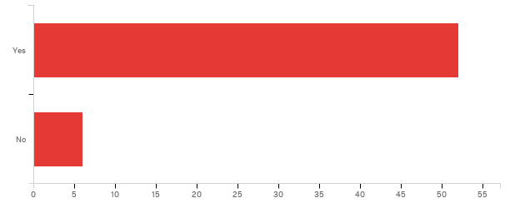
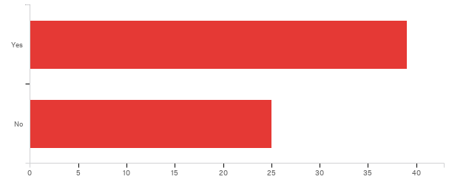
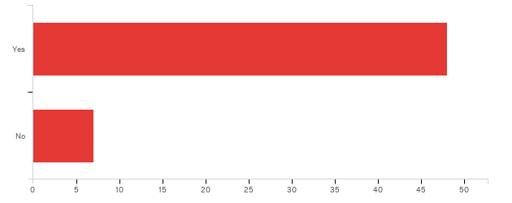
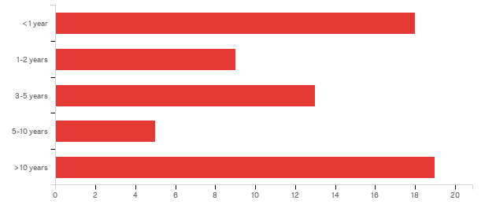
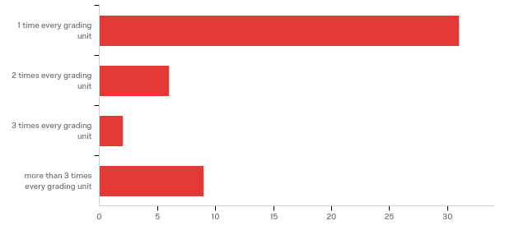
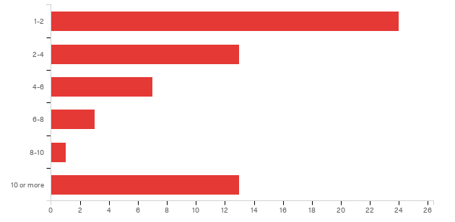

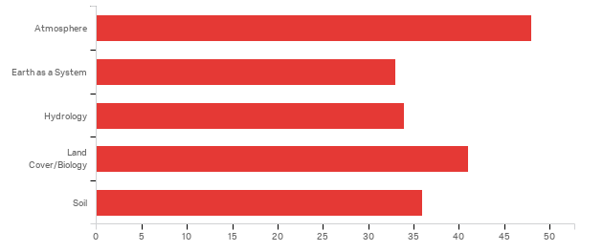
A STUDY OF THE TEACHING BELIEFS OF GLOBE TEACHERS
Laila Ali and Sherry Herron, Ph.D.
The Center for Science & Mathematics Education
College of Science & Technology
ABSTRACT
TGTQ OPEN-ENDED RESPONSES
We investigated the teaching beliefs of teachers trained in GLOBE protocols using the instrument ‘Belief about the Reformed Science Teaching and Learning’ (BARSTL) consisting of 32 items, and their teaching practices using a survey (TGTQ) consisting of 7 demographic items and 18 items with both forced choice and open-ended questions. 72 GLOBE-trained teachers from all regions across the U.S. participated. 93% of the teachers were found to hold constructivist rather than traditional teaching beliefs, and 90% believed that teaching with GLOBE had impacted their students’ learning.
Question | Responses
1. How do GLOBE teachers integrate GLOBE protocols and investigations into their classroom practices? | -incorporate GLOBE investigations in lesson plans. -demonstrate protocols in classroom -organize field trips for data collection -arrange group projects and discussions in class -conduct science fair and workshops
 | “I integrate hydrology, atmosphere, and soil protocols into those topics. I have the same kids all year for 5th grade general science. Our GLOBE investigations are ongoing with projects shared at conferences or virtual conferences at the end of the year.” “We set up study sites around school and take field trips to use our GLOBE protocols in different areas”. “We use GLOBE data collected by students or downloaded from GLOBE website for project-based curriculum teaching.”
2. Why do teachers integrate GLOBE activities in their teaching? | -to enhance classroom instruction and provide deeper understanding of scientific concepts. -to engage students in conducting scientific investigations and data collection. -to motivate science learning, problem-solving and critical thinking skills in students.
 | “Data collection motivates students and students seem to be better problem solvers after using GLOBE…Students develop a better understand of the world around them. In addition, they can use their own data to learn math skills and communicate with others around the world.” “GLOBE activities and protocols are more hands-on than our textbook curriculum and my district does not follow a science curriculum. We have standards but not an official curriculum, the textbook is over 20 years old.” “I like working with real data and so do the students. It has real meaning for them.”
3. How do teachers implement GLOBE activities to enrich STEM education in class? | -by incorporating GLOBE activities within weekly lessons. -by developing inquiry research projects and case studies that utilize GLOBE data. -by conducting actual field work and investigations with students using GLOBE protocols, following discussions with people in government agencies and scientists.
 | “We also bring in wildlife biologists and city officials.” “GLOBE activities have been featured in our school science fair for the last two years. Students have developed their own projects related to activities they have been involved with in class.”
4. What types of challenges do teachers report in implementing GLOBE investigations into classroom practices? | -More than 50% participants reported time constraints. -Others: lack of equipment, limited resources, fitting with curriculum, lack of administrative support, lack of GLOBE training, poor internet connectivity. -need to incorporate GLOBE program at university level due to lack of administrative support and unfamiliarity with other teachers.
 | “Limits on the time it takes to travel to collection sites, set up equipment, and conduct the procedures. Optimal teaching opportunities present themselves many times during field laboratories, especially with the younger students. The struggles with older students usually comes through equipment malfunction or its proper maintenance.” “The website does not always work. Sometimes very slow and can't find our data. Can't analyze what you can't find. Takes time which we don't always have. Tend to need more time to review and analyze data than to collect. There were few struggles with this beyond converting downloaded CSV files to Excel files that can be analyzed.” “I have been frequenting changing my teaching location and assignment; it has been a struggle to remain active in GLOBE.” “It is difficult to find other schools to actually connect the students. The students would love to do projects with others students, but as a teacher, it is hard to develop a project that students can work together.”
5. What kind of successes do teachers experience while implementing GLOBE activities? | -the importance of data collection and scientific investigations -the ability to download, analyze, compare, interpret, share and predict data. -the capability to discuss, collaborate and present their data. -a better understanding of problem-solving and reasoning skills -a sense of accomplishment and responsibility.
 | “I have had a great deal of success with implementing GLOBE activities into my classroom. My administrators over the years have seen the awesome projects that the students have done, celebrated with the students when they have won GLOBE prizes for earth day videos, virtual research conferences, and allowed students to travel to two separate annual meetings to share their work with GLOBE. Students have learned to think about science deeper using GLOBE. The kids utilize technology as they connect with other schools, making videos, taking photographs, using satellite images, producing their project posters.”
6. In what way has GLOBE training influenced teachers’ scientific knowledge? | -it improved their science content knowledge. -it provided them with a better understanding of scientific concepts and resources.
7. How do GLOBE teachers believe GLOBE involvement in the classroom influences their students’ learning? | -students become more independent active learners -they feel like real scientists
 | “Globe gives the opportunity to conduct scientific investigations by developing the accuracy of observation and clarifying good data archiving. GLOBE develops a sense of confidence toward any argumentative inquiry and investigation.” “Part of the scientific method includes data collection. Any hands-on investigations are going to help with retention of scientific concepts. There's something about "doing" science that helps students feel they, too, can be part of the scientific community.” “Students react favorably to the GLOBE activities because they can manipulate equipment, gather relevant data, etc. They learn to observe and think for themselves.”
8. How do teachers change their teaching strategies after learning GLOBE? | -by incorporating more hands-on inquiry-based activities in their teaching. -by adopting more student-centered and group activities using GLOBE data and website.
 | “The training got me out of the classroom to do more experiments and data collection with the students. It was extremely thought-provoking after 30 years in the classroom.” “Students are directing their own study; I am simply their coach and definitely not the content expert. This is not a new approach to my teaching style, but I lacked the tools to do it well in science before GLOBE.” “It enhanced my science teaching skills in an organized way and improved my pedagogy.”
9. Why have you stopped using GLOBE? | -Change of teaching assignment -Not relevant to the teaching assignment -Time Limitations -Need more GLOBE training -Cost Issue -No funds to attend GLOBE workshops.
 | “I feel I need more training and exposure using the GLOBE program. Also, I am just so overwhelmed trying to get the state curriculum addressed.”
METHODS
Data was collected from trained GLOBE teachers across the U.S. using Qualtrics.com. The link to the instruments was emailed to GLOBE partners who then distributed it to the teachers in their regions.
RESPONSE FREQUENCIES OF TGTQ
After being trained in GLOBE, estimate
your level of use in your classroom:
Do you think that accelerated or regular students
learn better with GLOBE investigations?
Have you stopped using GLOBE?
Do you believe that teaching with GLOBE
has influenced your students' learning?
Did you change your teaching strategies
after learning GLOBE protocols or activities?
Do you plan to continue to use GLOBE?
How long have you been using GLOBE
activities/protocols in class?
How often do you or your students enter data?
In approximately how many lessons do you
incorporate GLOBE during a course?
Would you like to implement more indoor
or outdoor GLOBE activities?
DISCUSSION
The purpose of this study was to understand teachers’ beliefs about incorporating GLOBE investigations in their classrooms. Using the TGTQ and BARSTL together provided a complete picture of the teaching beliefs and practices of GLOBE teachers. The BARSTL scores from this study reveal that most of the GLOBE teachers are inclined towards constructivist teaching beliefs. Results from the TGTQ highlighted the struggles and challenges teachers face during classroom practices.
61% of the teachers had changed their teaching strategies after learning GLOBE protocols and incorporated more hands-on inquiry-based activities in their teaching. 82% of the teachers planned to continue teaching with GLOBE activities and protocols. 90% of the teachers believed that teaching with GLOBE had influenced their students’ learning. 96% of the teachers indicated that both accelerated and regular students learn better with GLOBE investigations. One teacher said, “I believe that hands-on experience helps students develop a deeper understanding of scientific concepts”. 71% of the teachers would like to implement more outdoor GLOBE . The results from this study revealed to us that GLOBE teachers believe that GLOBE has influenced their teaching skills and improved their scientific concepts. Thus, we may conclude that GLOBE training provides teachers confidence in teaching science and classroom practices.
Globe investigations trained in:
REFERENCES
Enders, J. (2001) Measuring community awareness and preparedness for emergencies, Australian Journal of Emergency Management, 16, 52–58.
Sampson, V., Enderle, P., & Grooms, J. (2013). Development and initial validation of the Beliefs About Reformed Science Teaching and Learning (BARSTL) Questionnaire. School Science and Mathematics, 113(1), 3-15.
Shulman, L. S. (1986). Those who understand: Knowledge growth in teaching. Educational Researcher, 15(2) 4-14.
Shulman, L. S. (1987). Knowledge and teaching: foundation of the new reform. Harvard Educational Review, 57, 1-22.
Pajares, M. F. (1992). Teachers' beliefs and educational research: Cleaning up a messy construct. Review of Educational Research, 62(3), 307-332.
Park, S., & Oliver, J. S. (2008). Revisiting the conceptualization of pedagogical content knowledge (PCK): PCK as a conceptual tool to understand teachers as professionals. Research in Science Education, 38(3), 261-284.
ACKNOWLEDGEMENTS
I would like to express a heartfelt thanks to my committee chairman, Dr. Sherry Herron, for helping develop the TGTQ and reaching out to the GLOBE community. I offer sincere thanks to the GLOBE partners who sent the survey to their teachers, Dorian Jenny for sending survey to teachers, Augustine Frkuska for sending surveys to the teachers at OLLU partnership and cadre of NASA/GLOBE, Teri Eastburn & Julie Malmberg from UCAR & NOAA climate stewards team for sending surveys.

