Slide 1
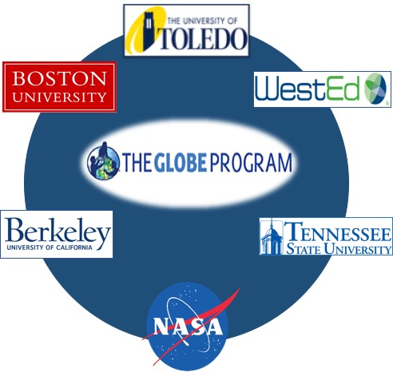

Mission Earth:
Fusing GLOBE with NASA Assets to Build Systemic Innovation in STEM Education
Kevin Czajkowski
The University of Toledo

Slide 2
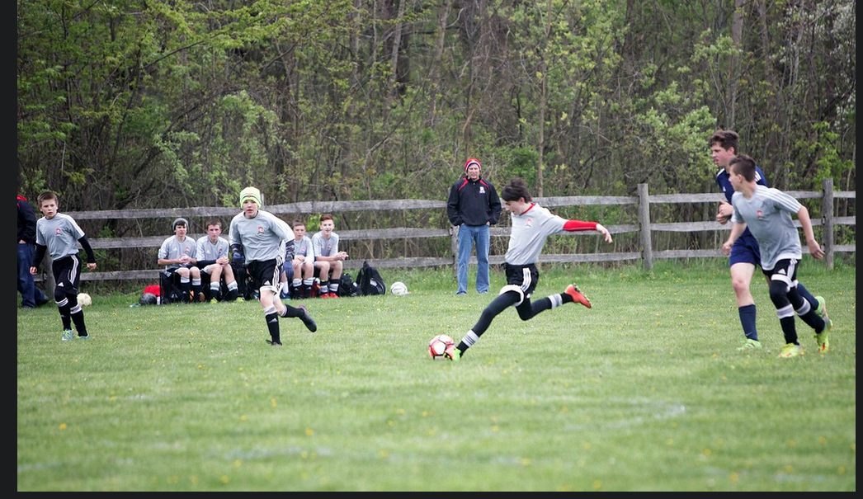
Play the Game: Do Science

Slide 3
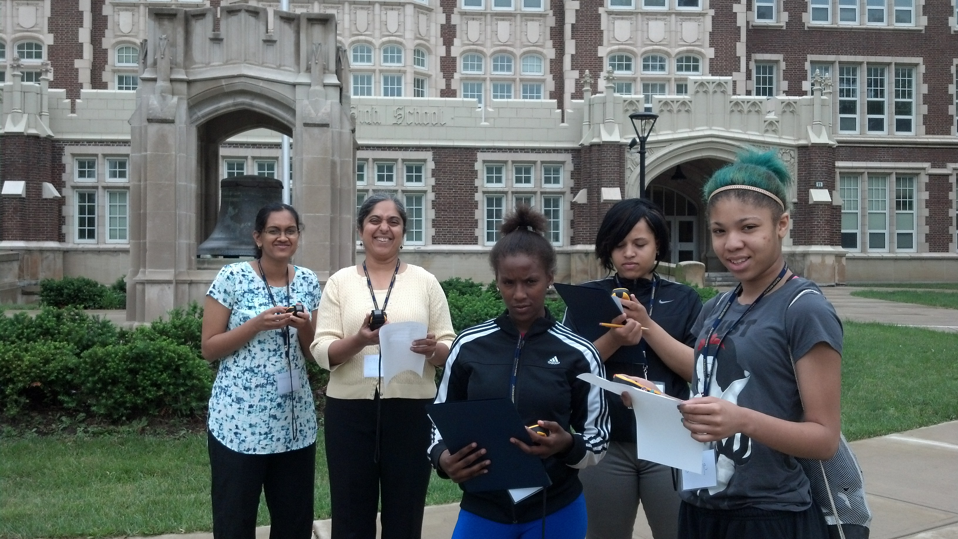
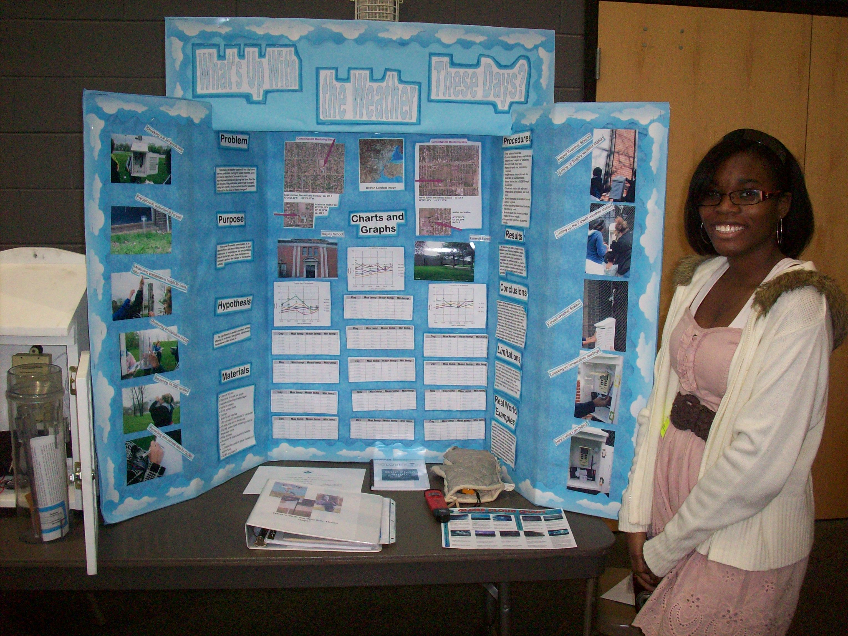
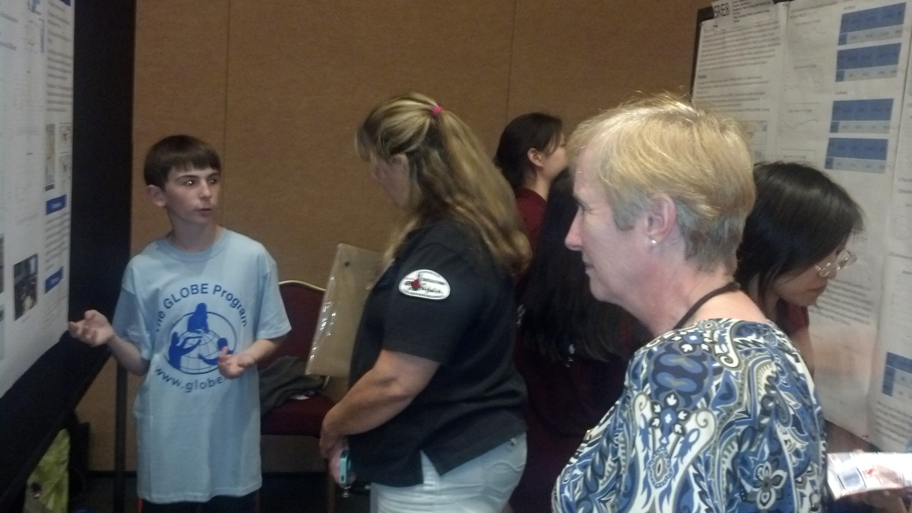

Do GLOBE
Notes:
Improve STEM Instruction by creating developmentally appropriate vertically-integrated K-12 materials and activities which link NASA and GLOBE learning materials, supported by high quality professional development and ongoing support, engaging teachers from all grades (elementary, middle and high school) to work together in both program implementation and continuous improvement.
Increase and Sustain Youth and Public Engagement in STEM through project activities and engagement of citizen scientists through GLOBE’s new citizen science initiative.
Enhance STEM Experience for Undergraduate Students, through service learning for pre-service teachers and engineering challenges.
Better Serve Groups Historically Underrepresented in STEM through serving high-need school districts (Providence, RI, Toledo, OH, Nashville, TN, Oakland, CA) and engagement of Historically Black Colleges and Universities, Tennessee State University.

Slide 4
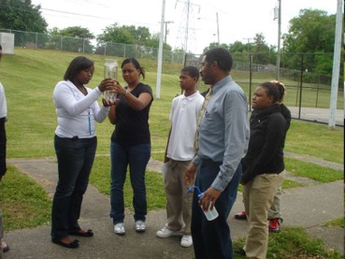
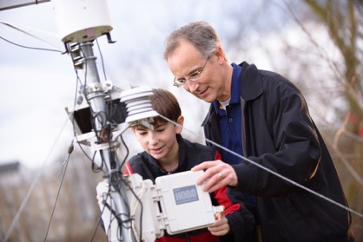
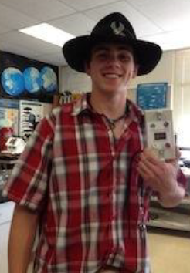
MISSION EARTH:
Students working as scientists
Kevin Czajkowski
Janet Struble
The University of Toledo
Tracy Ostrom
WestED/UC Berkley
David Padgett
Tennessee State University
www.globe.gov/web/mission-earth

Slide 5
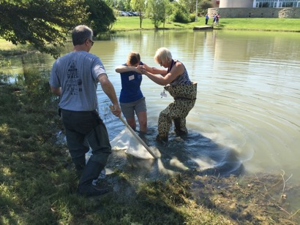
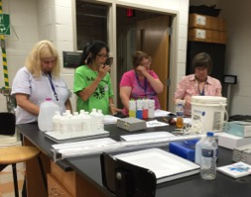
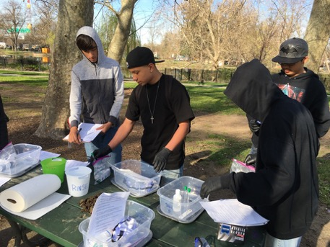
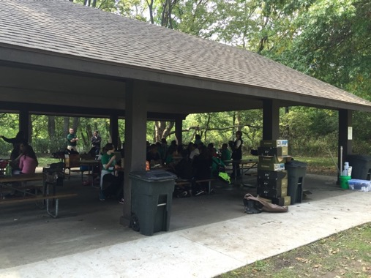
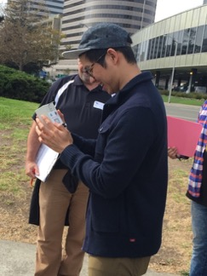
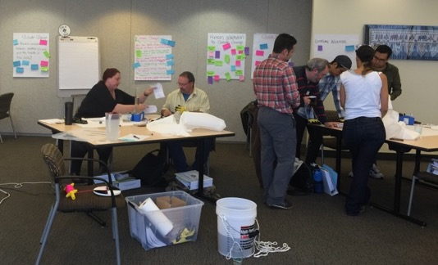
Connecting Teachers and Students to GLOBE and NASA
High School Students doing soil tests at MetSacramento
High School
Navarre Elementary testing the water from the Maumee River at Sidecut Metropark

Slide 6
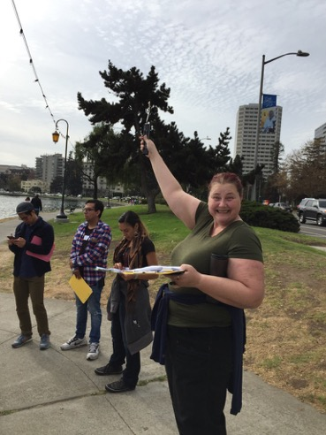
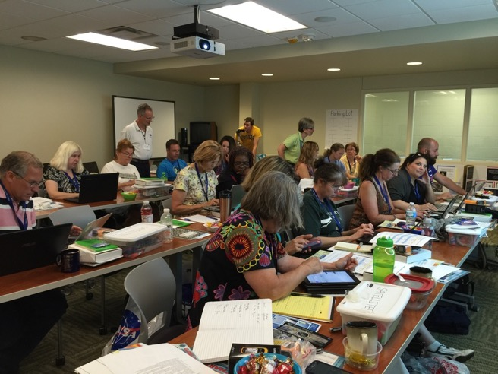
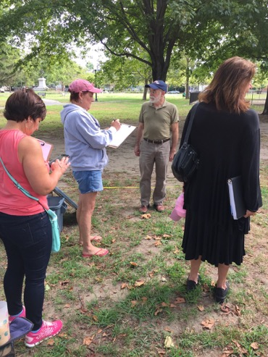
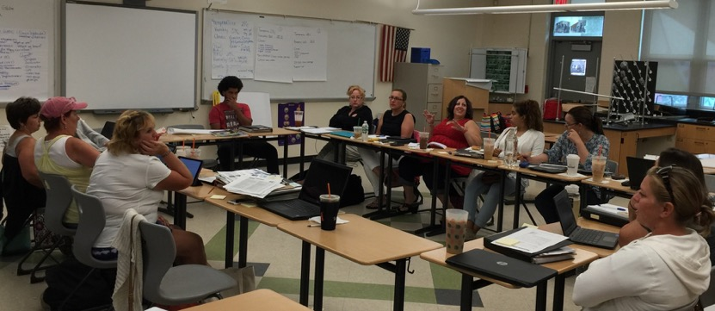
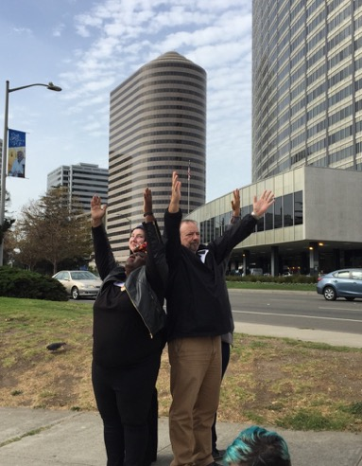
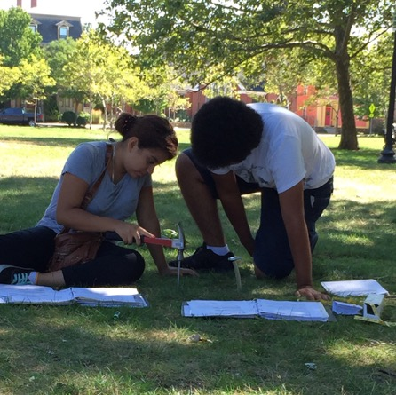
Face to Face Teacher Training

Slide 7
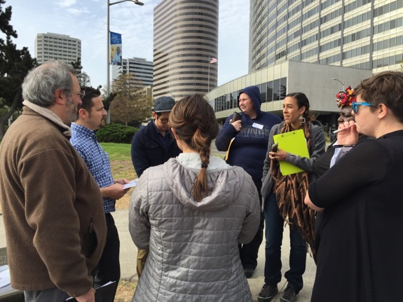
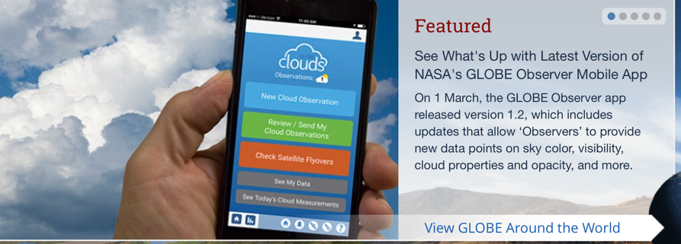
Observing Clouds-Collecting Data
Notes:
Data entry App

Slide 8
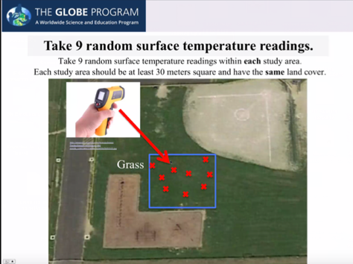
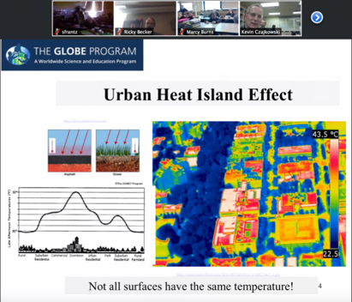
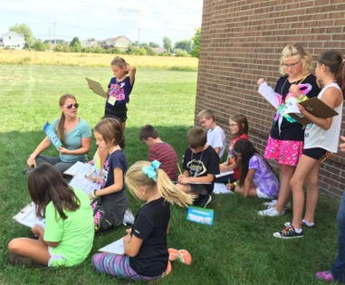
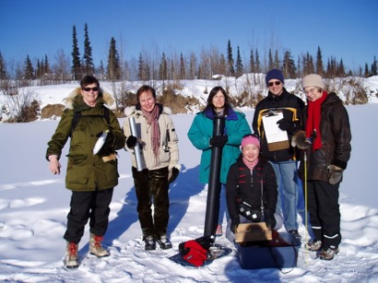
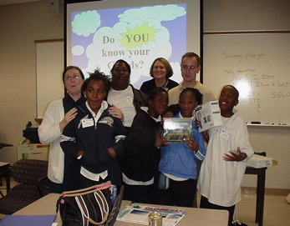
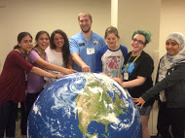
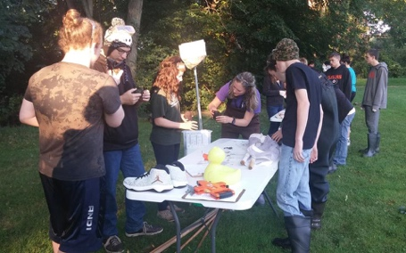
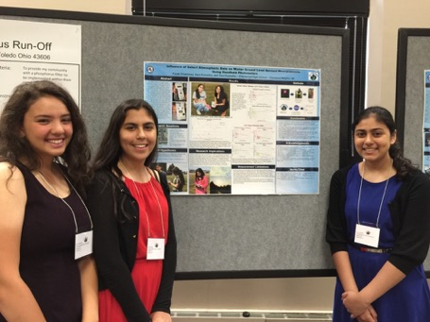
WE DO SCIENCE!

Slide 9
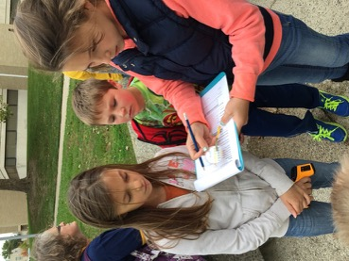
Vertical Integration

Slide 10
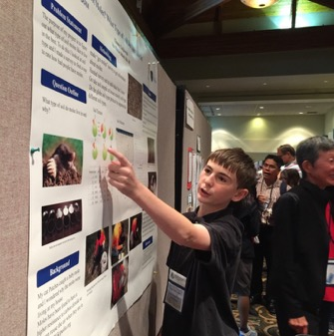
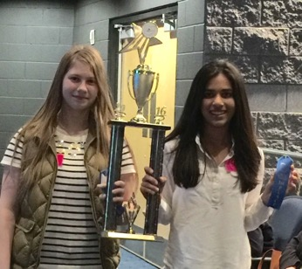
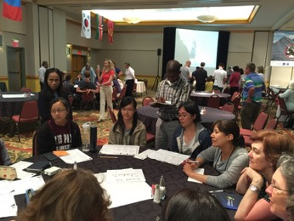
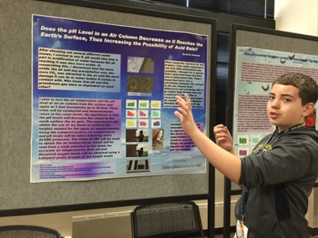
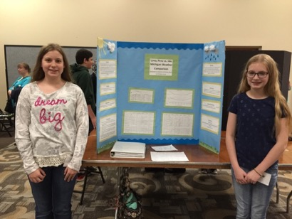
Keep the End in Mind
Students presenting their answers to their research questions
Local Science Fairs (SATELLITES Student Conference at UT)
State Science Fairs
GLOBE
Virtual Science Symposium
http://www.globe.gov/news-events/globe-events/virtual-conferences
Face to Face
Regional GLOBE Science Symposia
https://www.globe.gov/news-events/globe-events
Annual GLOBE Meeting-July 30-Aug. 4 in New Haven, CT
SATELLITES
GLOBE Annual Meeting
GLOBE Midwest Regional Symposium

Slide 11
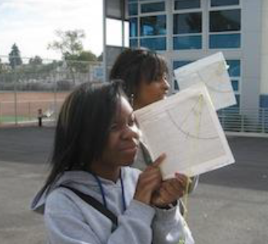
Connecting GLOBE to Engineering Practices
Using Math & Computation Thinking
Planning & Carrying out Investigations
Obtaining, Evaluating & Communicating Information
Students using a clinometer

Slide 12
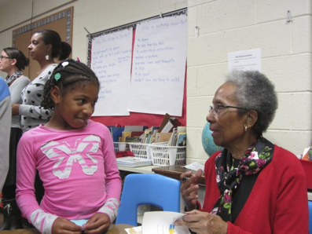
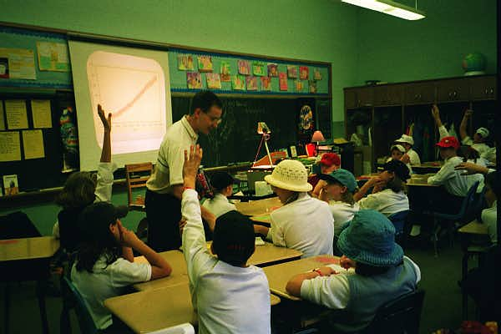
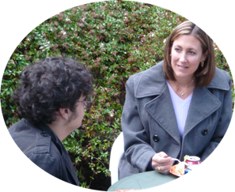
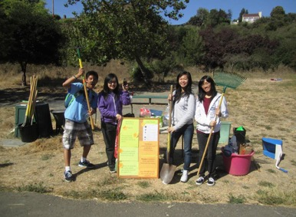
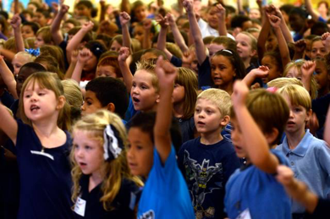
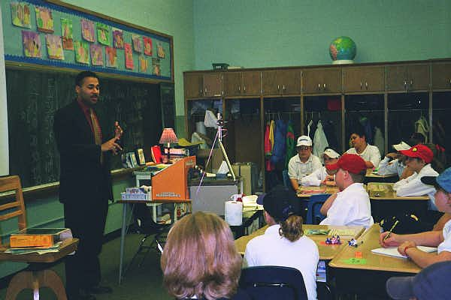
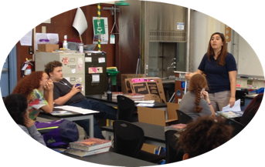
Connecting GLOBE to Careers
Grades preK-5
Grades 6-8
Grades 9-12
Conduct Informational
Interviews with
STEM
Professionals
GLOBE SCIENTIST
Kevin Czajkowski
Story Time
Internships
Create Professional Networks with Air Quality Representatives
Assemblies
METEOROLOGIST
Andrew Humphrey
Notes:
Kevin’s presentation for NASA CAN

Slide 13
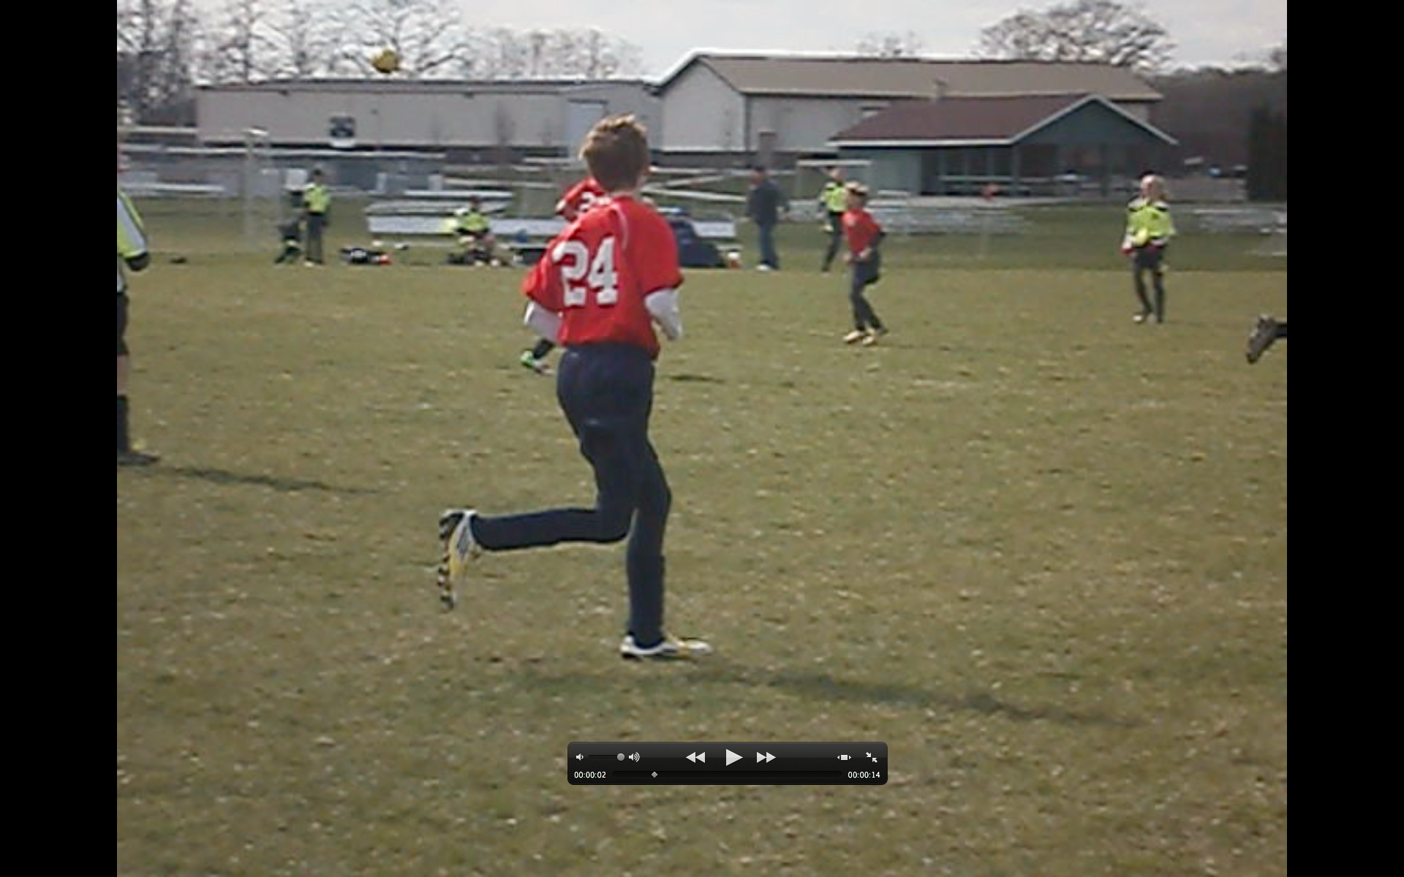
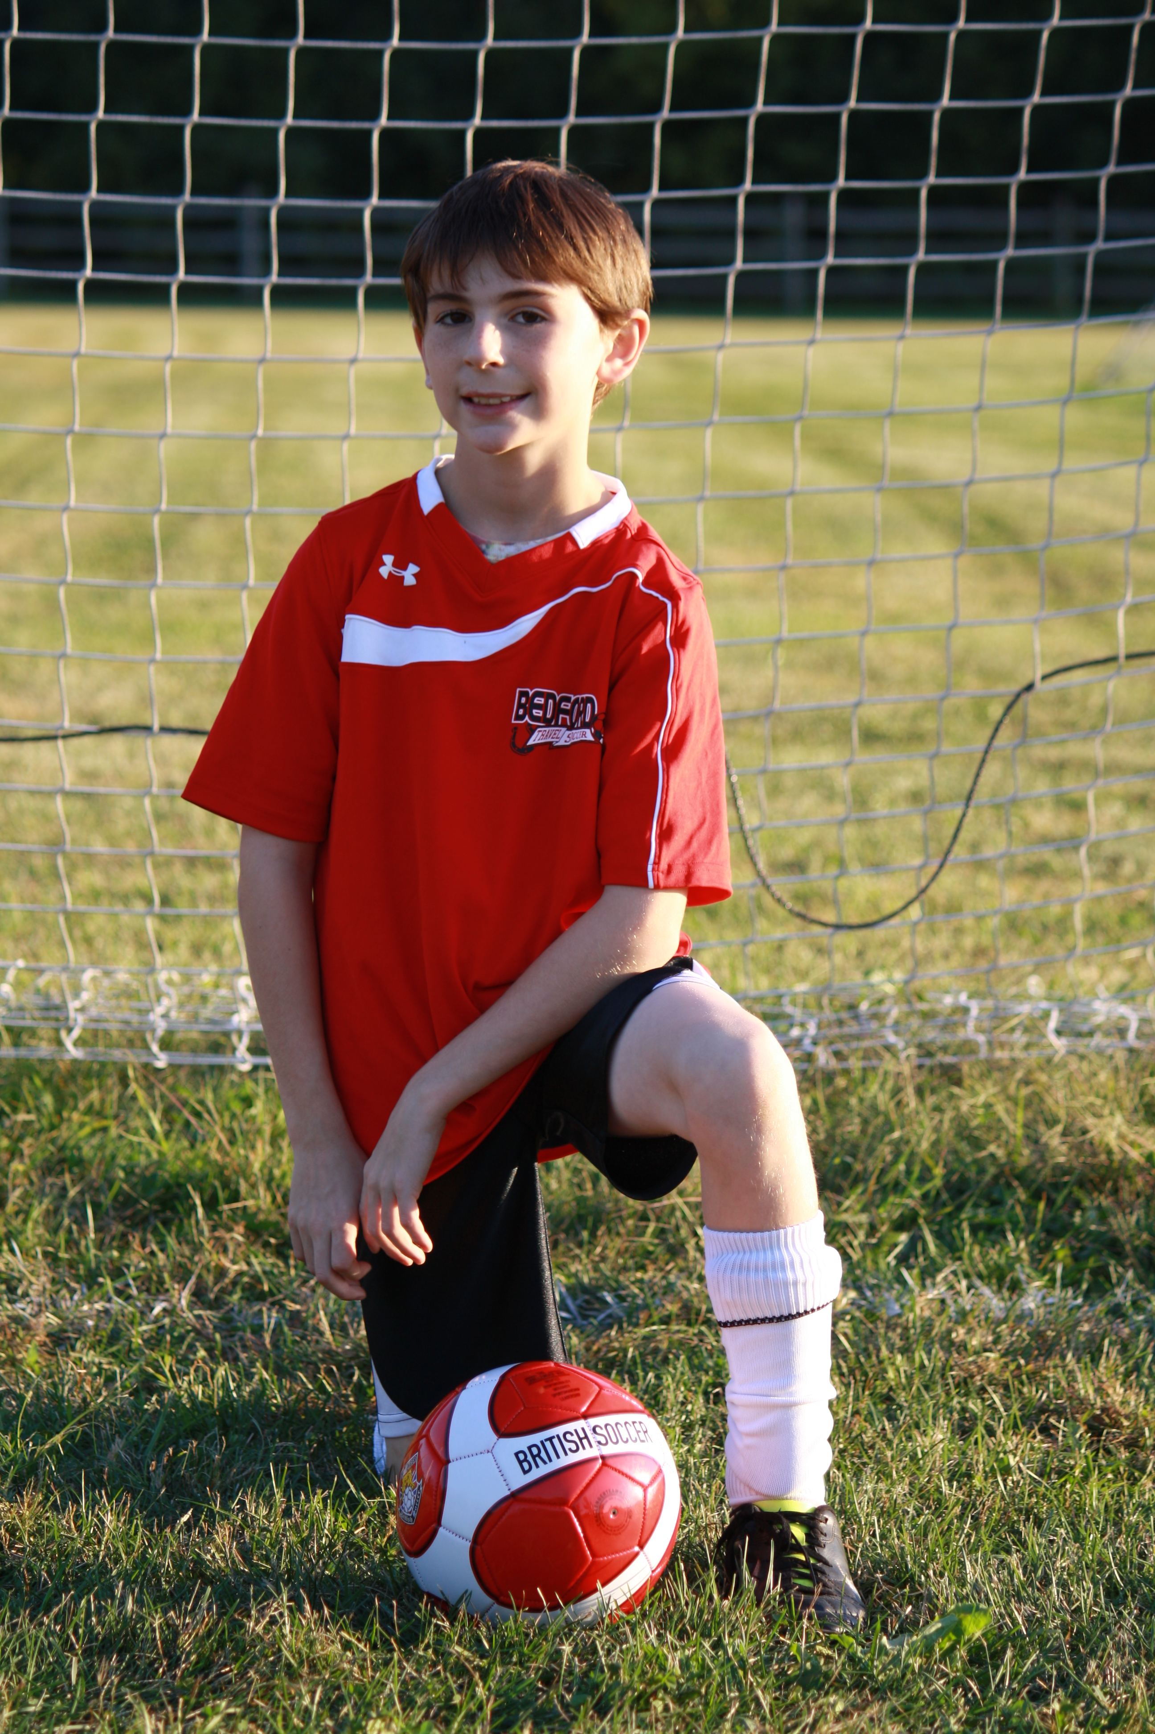
Thank you!
Kevin Czajkowski
GLOBE Scientist
The University of Toledo
Kevin.czajkowski@utoledo.edu

