Slide 1
21st GLOBE Annual Meeting
Thursday, August 3, 2017
Lisa Gardiner¹, Becca Hatheway¹, Jessica Taylor² , Tina Harte³
¹University Corporation for Atmospheric Research, Boulder, CO
²NASA Langley Research Center, Hampton, VA
³Science Systems Applications, Inc for NASA Langley Research Center, Hampton, VA
Notes:
I think the date is August 3rd ?

Slide 2
Session Agenda
What’s New with Elementary GLOBE
eBook Example (What in the World is Happening to our Climate?)
Hands-on Practice with Teacher Implementation Guide
Vocabulary Development: Instructional Read-aloud
Vocabulary Development: Word Wall Activity
3D EG Science Literacy
Learning Activity Example (All Year Long)
Wrap-up

Slide 3
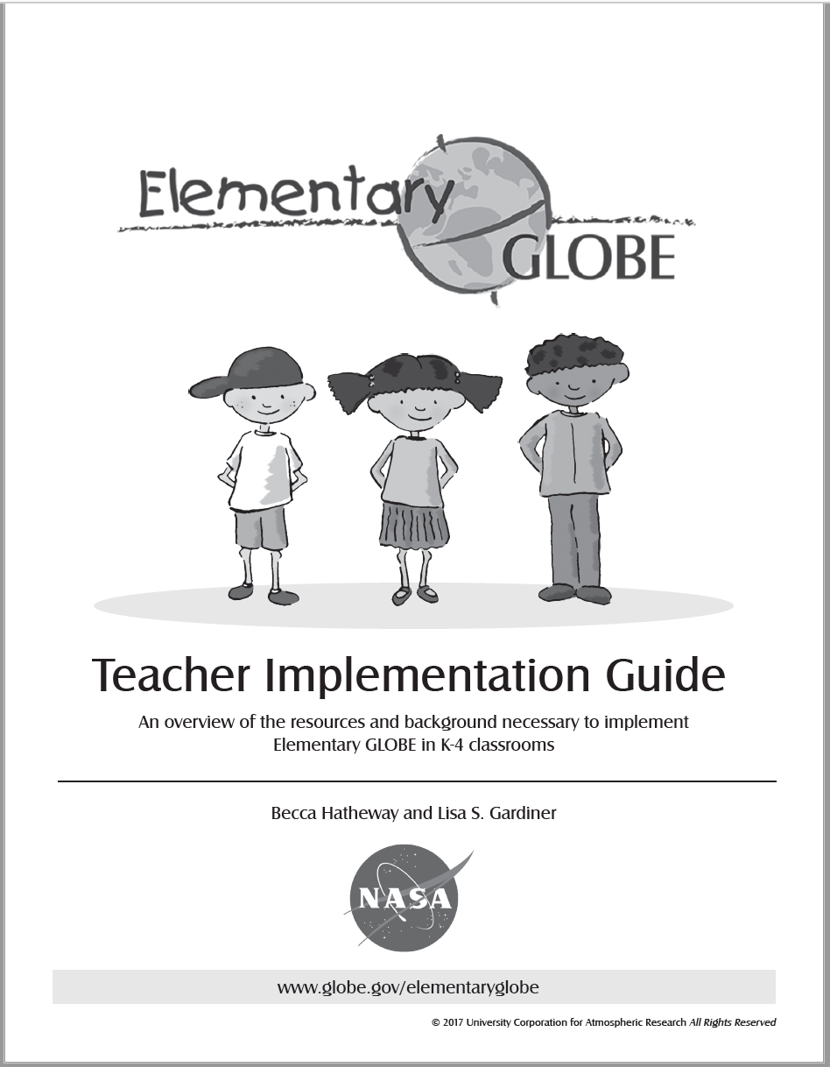
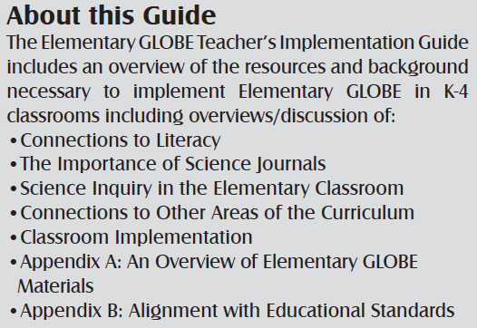
What’s New with Elementary GLOBE
Teacher Implementation Guide
eBooks
Minor updates to original five books
Notes:
BECCA
After developing 2 new storybooks over the last couple years - we’ve shifted focus to implementation resources for Elementary GLOBE
Process of development: input from GLOBE partners, worked with literacy specialists

Slide 4
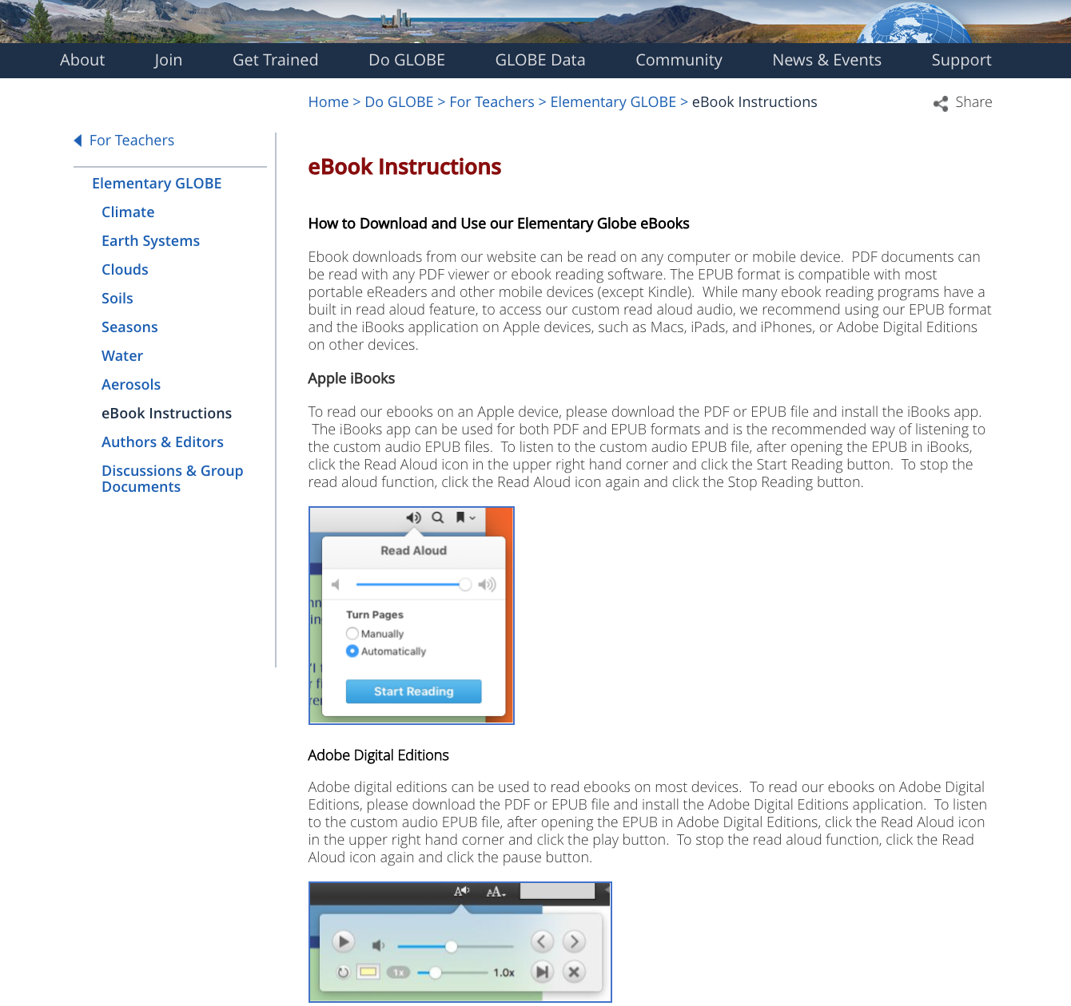
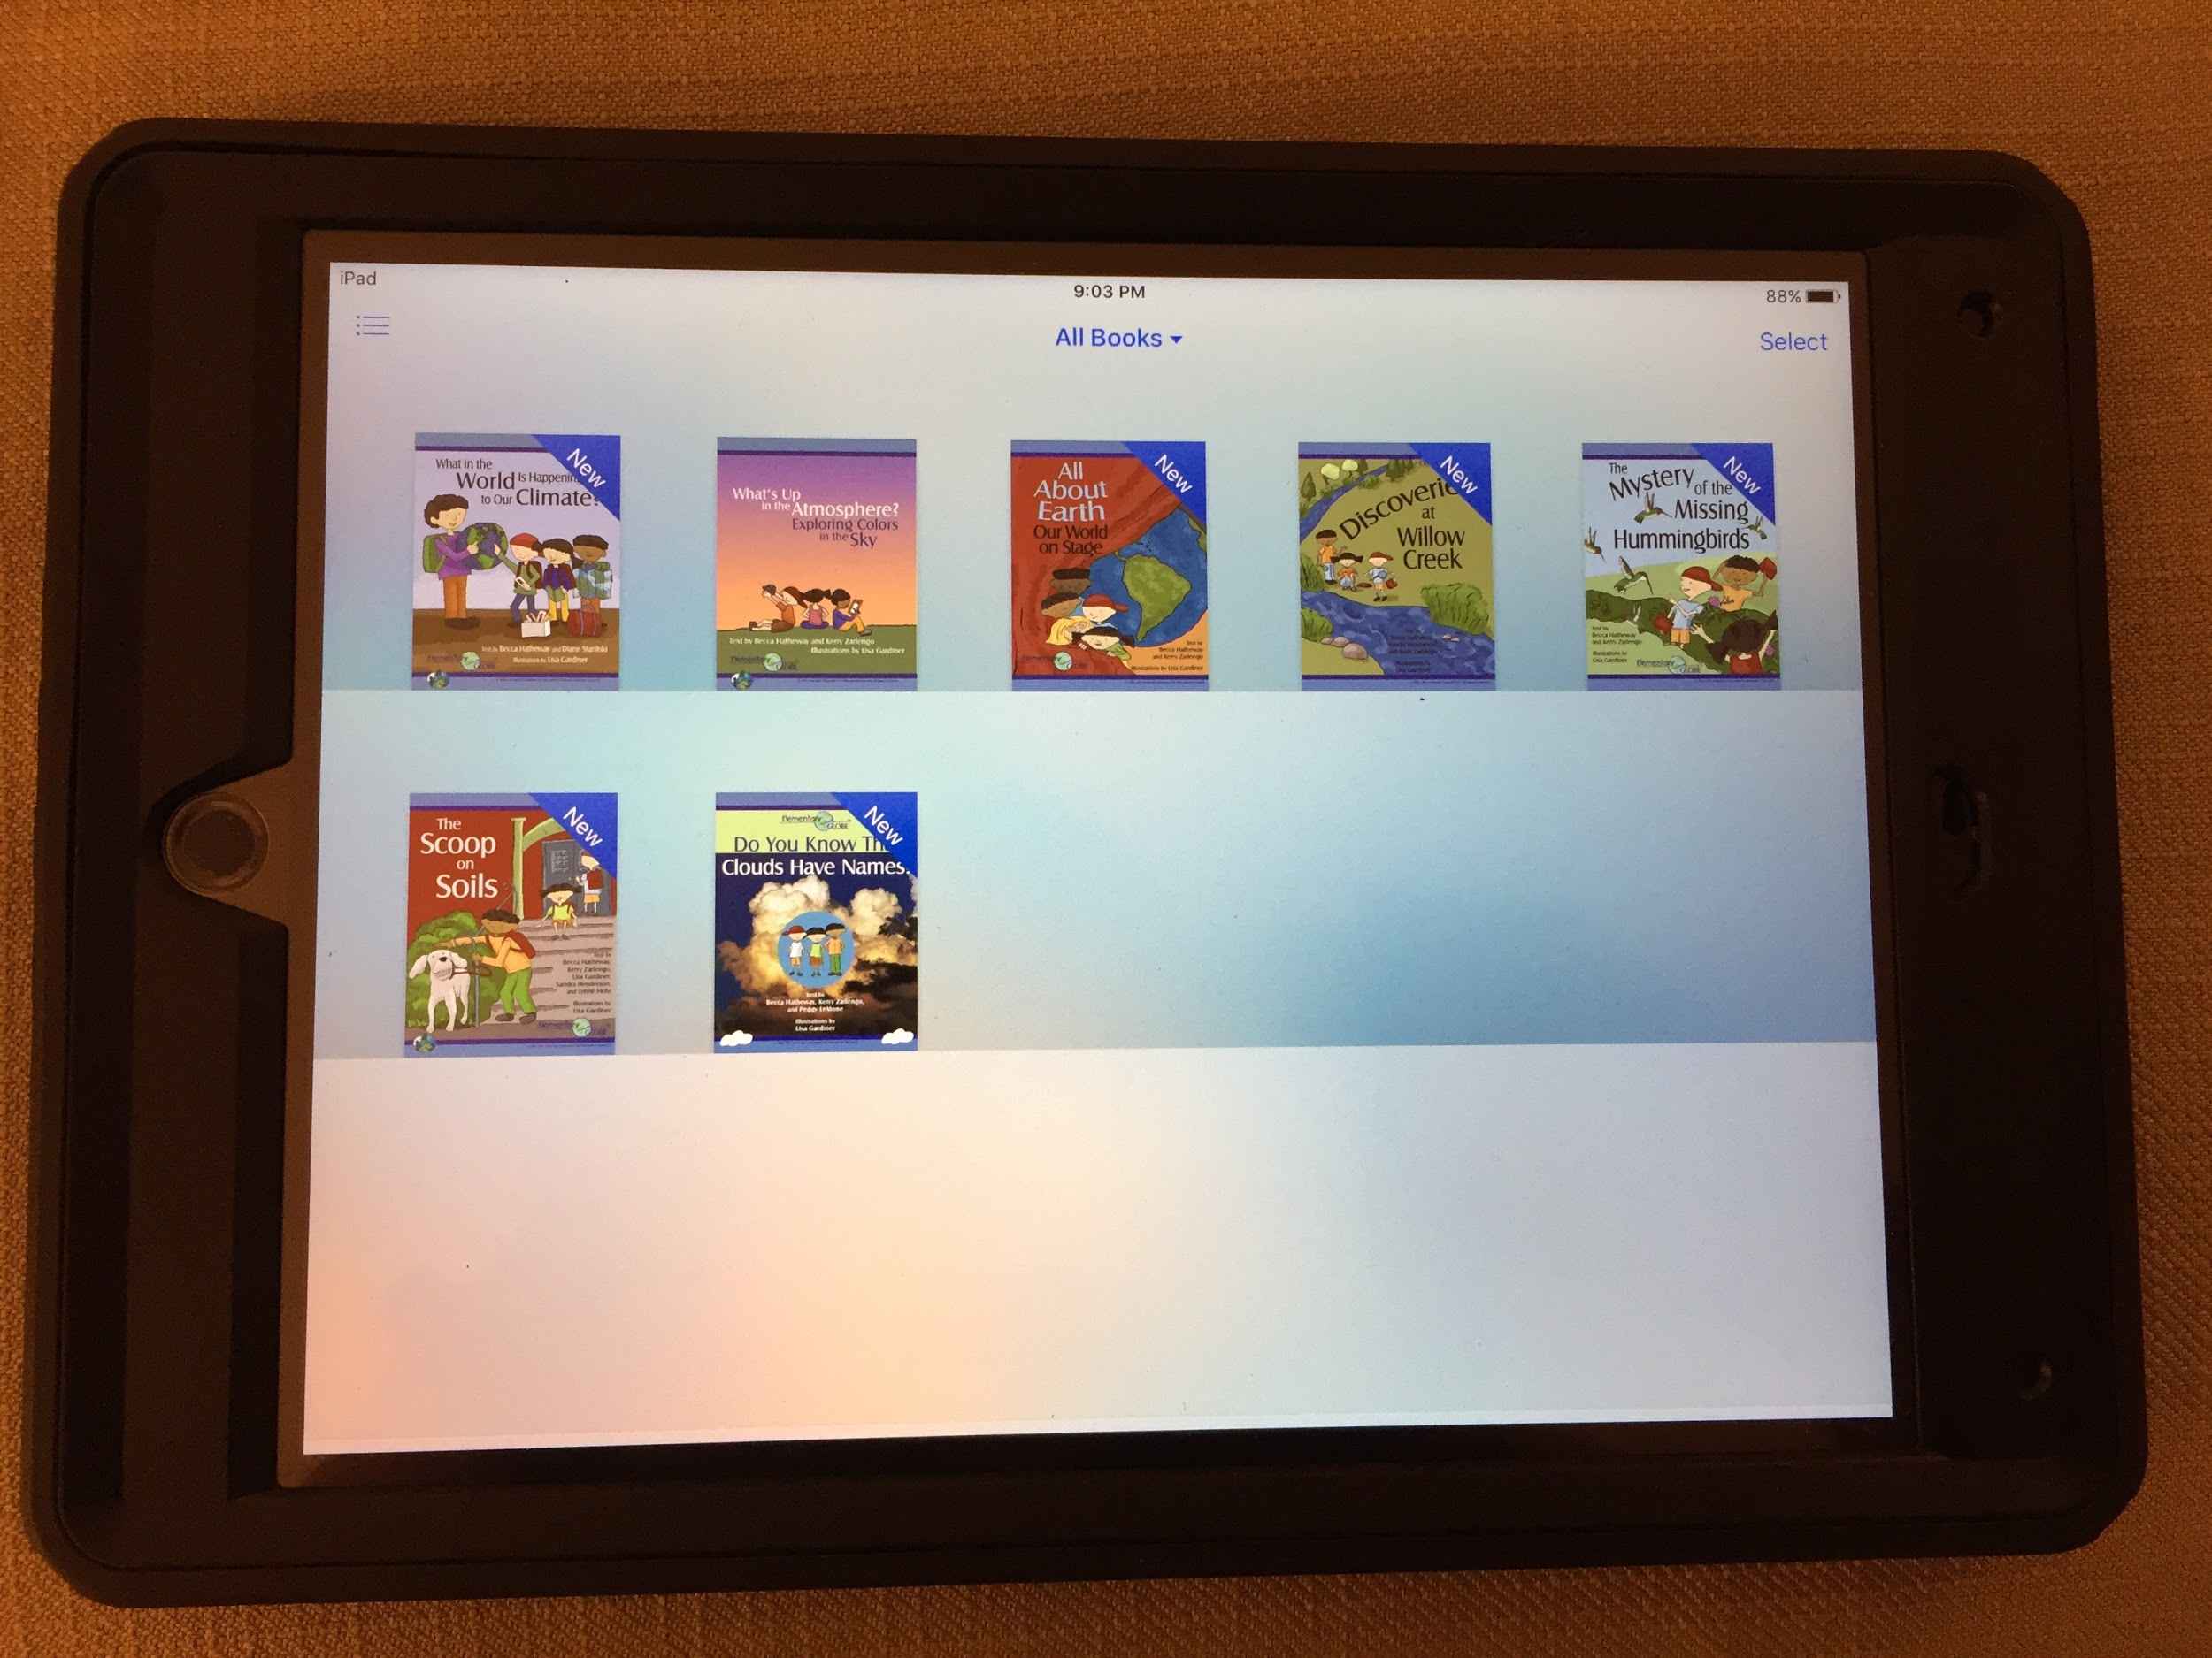
Elementary GLOBE eBooks
Notes:
BECCA
What platforms available for ebooks? (add to chart or tell)
Photo of the ipad

Slide 5
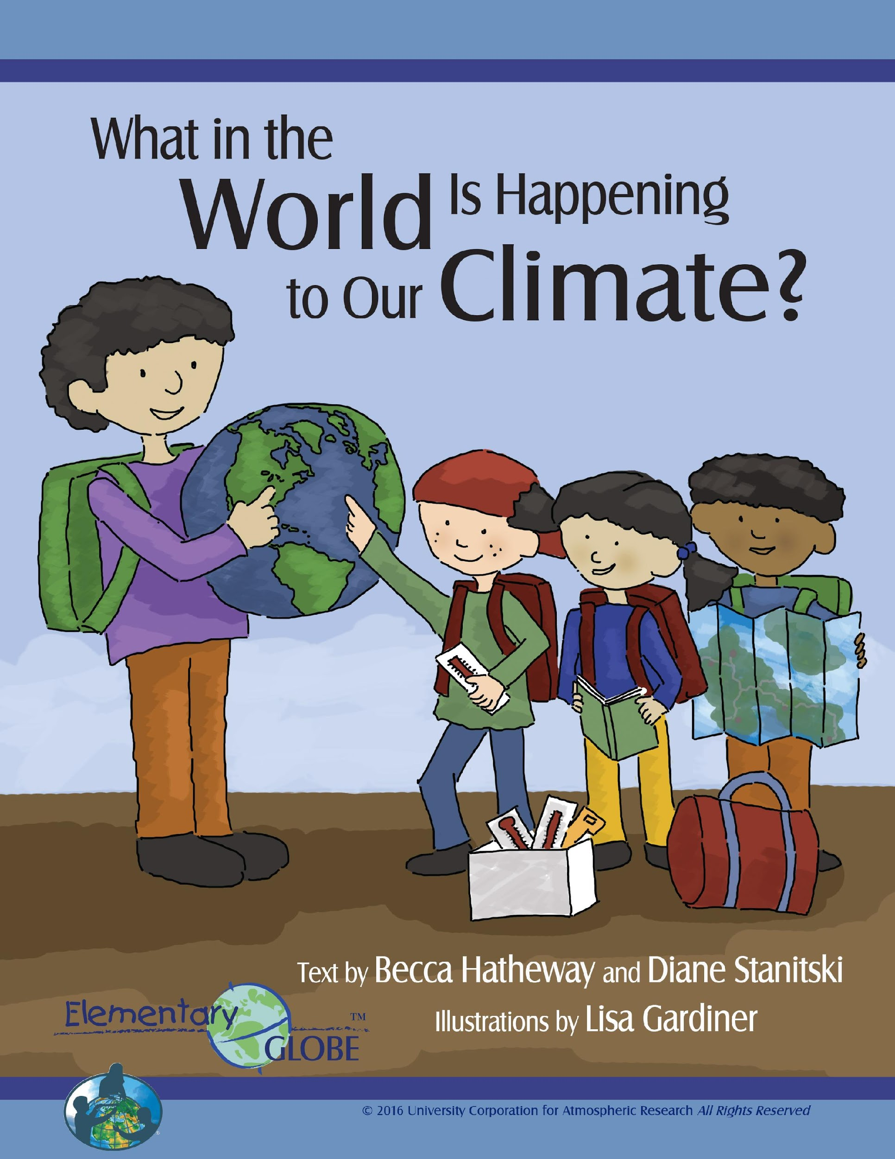
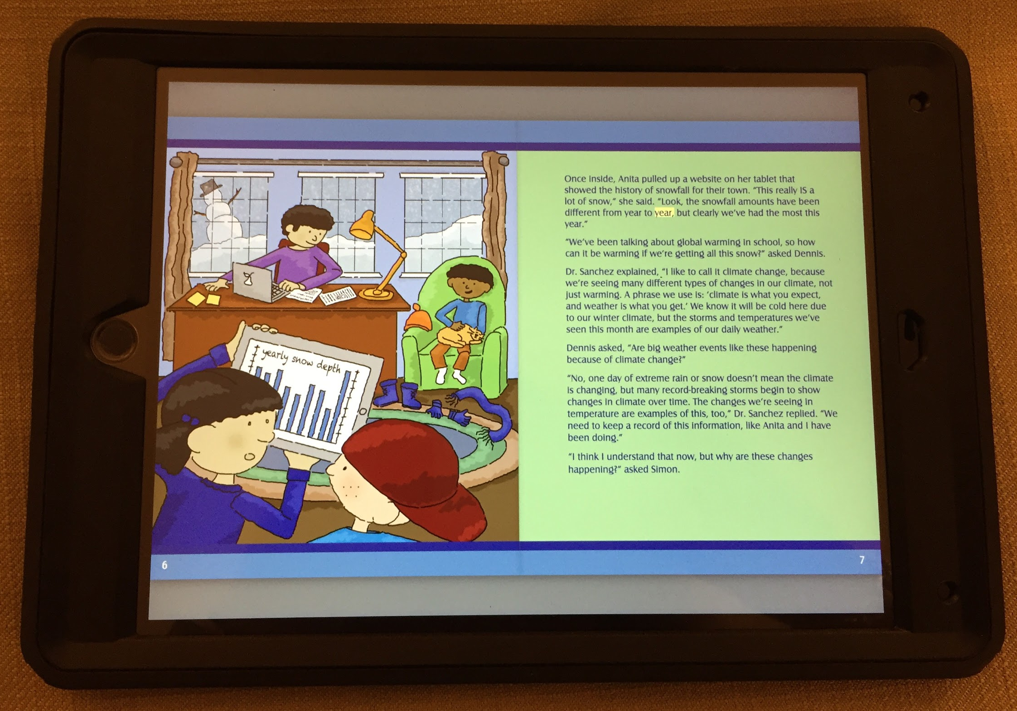
Elementary GLOBE eBooks
Notes:
BECCA
Let’s take 15 minutes to review one of the storybooks. The Climate storybook is the newest in the series and was just released last year.

Slide 6
Vocabulary Development: Instructional Read Aloud
Pre-read the book and note vocabulary chosen for instruction.
Determine the big idea(s) to emphasize for deeper meaning.
Select illustrations for more observation time to enhance the understanding.
Develop open-ended questions that will support the big ideas.
Decide when to engage students in “turn and talks” to support discussion.
Model your thoughts. For example, using sentences that begin: “This part reminds me of when…” “I noticed that….” “I was wondering...”
After reading the story, support deeper understanding of the big ideas by doing the learning activities.
Notes:
LISA
The Elementary GLOBE storybooks and learning activities can help students develop both receptive vocabulary (words that they can understand when read or heard) and expressive vocabulary (words that they can use themselves). At the primary level it is appropriate to read the books out loud to students, taking the time to discuss the new vocabulary words in a context that makes them understandable. Based on recommendations from Elementary GLOBE field testers, certain higher-level vocabulary words were included to stretch the vocabulary provided, helping students learn the meaning of words that enrich their scientific knowledge. The illustrations in Elementary GLOBE storybooks help students visualize new information being presented through colorful depictions of the GLOBE Kids doing science.

Slide 7
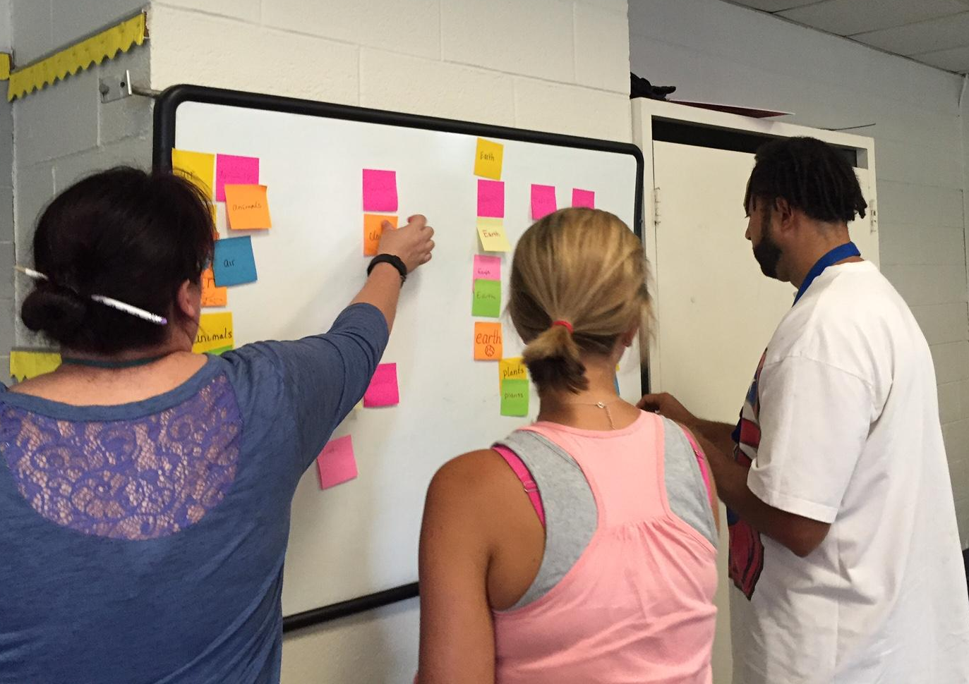
Vocabulary Development: Word Walls
List key vocabulary words from the climate book on sticky notes (one word per note).
Add a picture that describes each word.
Add a student-friendly definition.
Put your sticky notes on the chart paper.
Notes:
LISA
Ask - will anyone share an example of how they have used a word wall (or anchor wall) with students?
Ok - let’s practice. Think about the Climate storybook you just read. Go ahead and put those words on post its and develop a word wall with your group.
After sharing examples discuss:
with post-it notes, after reading portion of a book
Adding pictures to the word wall

Slide 8
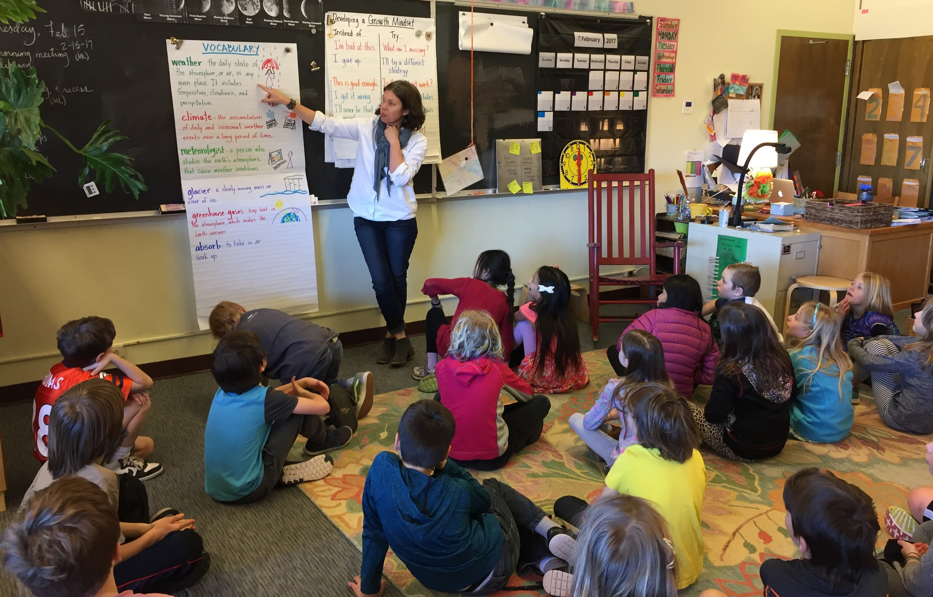
Vocabulary Development: Word Walls
Third grade teacher Erin Koenig introduces a word wall to her students.
Notes:
LISA
Review the words on the chart, provide a description, explanation, or example of each terms and have students use their science journal to describe the meaning of the terms in their own words and pictures. Encourage students to refer to this word wall when they read the storybooks.

Slide 9
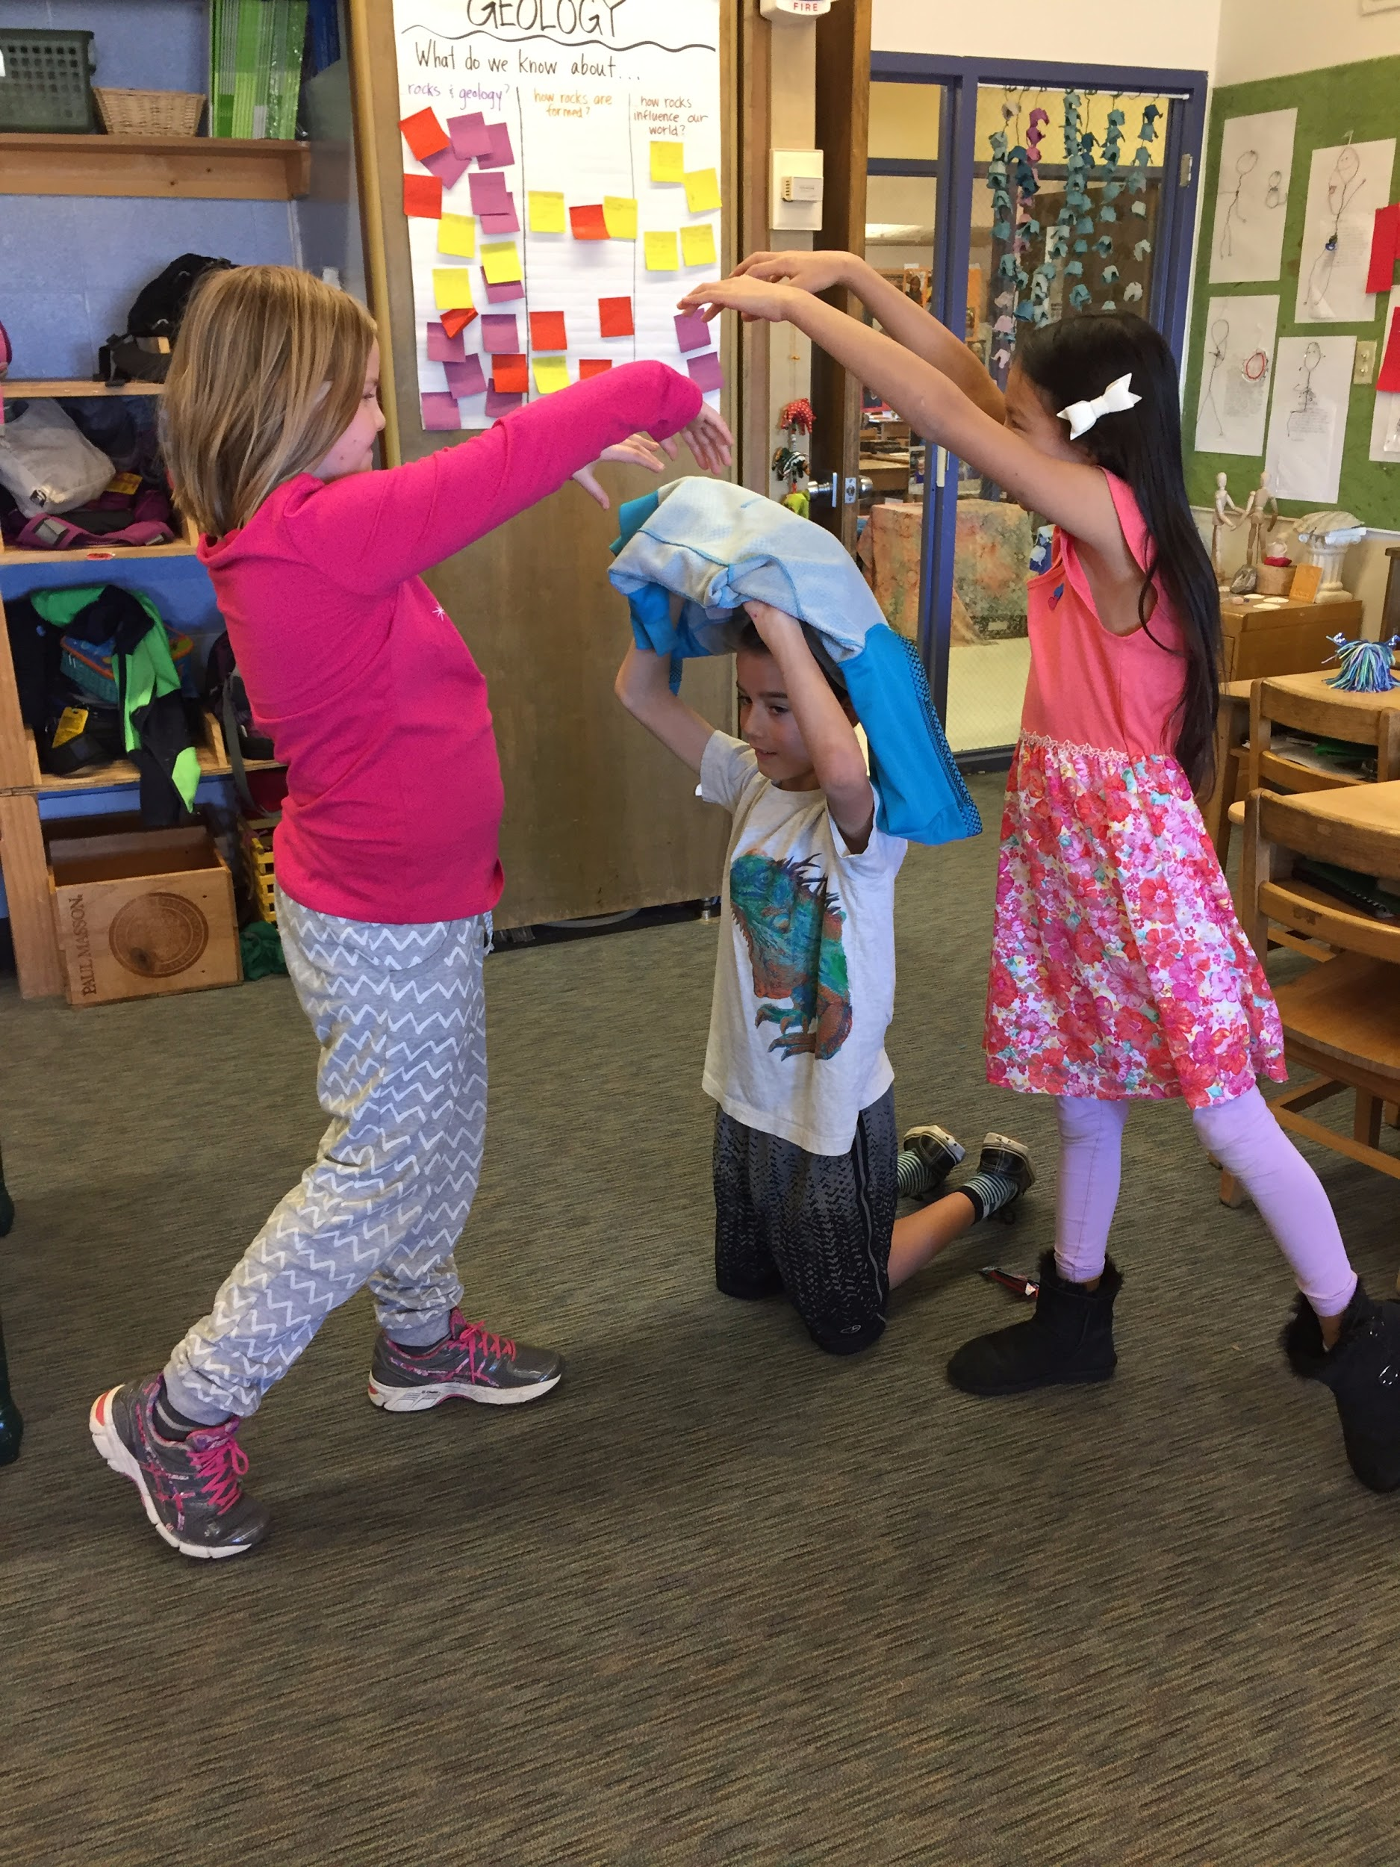
Vocabulary Development: Acting Freeze (Tableau)
Have students create a freeze (also called a tableau) to act out a vocabulary term.
This helps students create a mental image of the word.
For example, the students in the picture at the right are in a freeze to acts out the term greenhouse effect.
Notes:
LISA
Tableau is the theatrical technique in which actors freeze in poses that create a picture of one important moment in the play. The same idea is used in education to help students create a mental image of a vocabulary word.

Slide 10
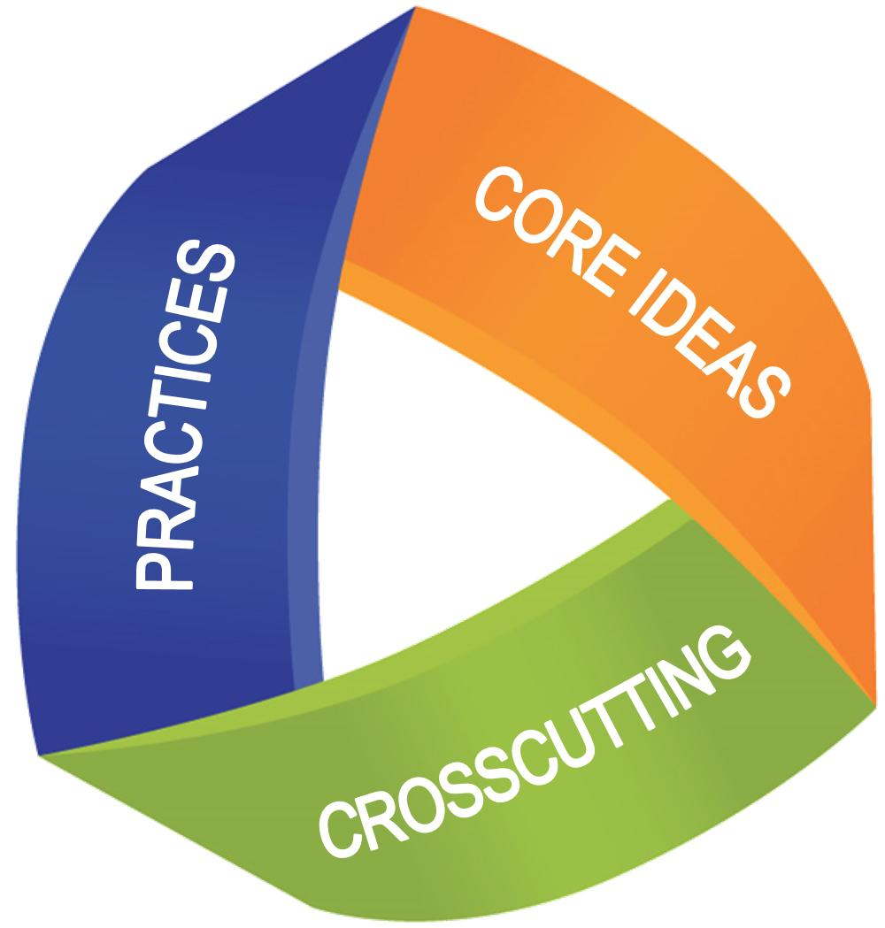
A Three Dimensional Learning Experience:
To be proficient in science students must engage in learning experiences that foster the development of three dimensional learning.
This can be accomplished by providing them with the “practice” of doing science, the opportunity to make “connections” by linking concepts across the sciences, and providing them with experiences through which they can make “applications” of what they are learning whereby increasing the depth of their scientific understanding.
The framework for “Scientific Literacy”: Dimension 1-Science Practices, Dimension 2-Crosscutting Concepts, and Dimension 3-Disciplinary Core Ideas.
Notes:
TINA

Slide 11
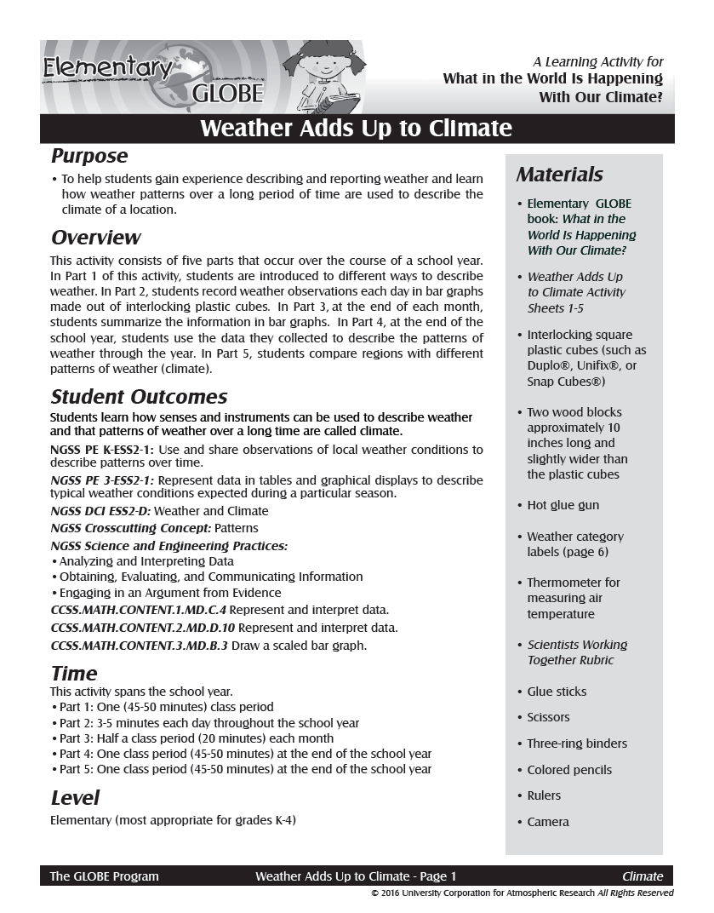
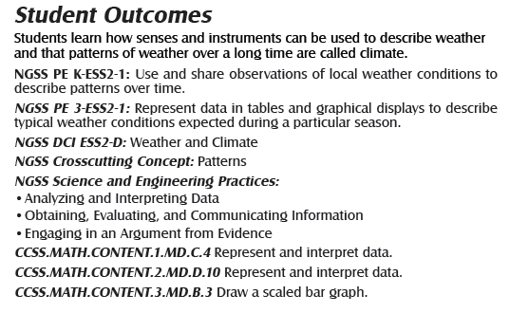
Weather Adds Up to Climate Activity from the 3D Perspective
Notes:
TINA

Slide 12
NGSS and Science Inquiry
NGSS Science Practices: Examples from Elementary GLOBE Storybooks
Asking questions
In What’s Up in the Atmosphere: Exploring Colors in the Sky, the kids discover that sometimes a cloudless sky looks white and other times it looks blue. Anita gushes to Ms. Patel, “Now we have a scientific question and we need your help!”
Developing and using models
In What in the World is Happening to Our Climate?, the kids refer to a model that they made in class to explore how ice melting in water (like sea ice) doesn’t raise sea level while ice melting above the water does raise sea level.
Planning and carrying out investigations
In Discoveries at Willow Creek, the kids notice that the creek looks much different during their spring field trip than it did in the fall. They investigate, comparing their observations from the fall with observations from the spring.
Analyzing and interpreting data
In The Scoop on Soils, Simon makes a chart to compare observations of the soil (such as color, structure, roots and critters) from the three holes that Scoop the dog dug in different environments.
Using mathematics and computational thinking
In Discoveries at Willow Creek, the kids make quantitative measurements to describe the creek. They take the water temperature and measure the time it takes a stick to travel downstream in a segment of the creek.
Constructing explanations
In The Mystery of the Missing Hummingbirds, the kids look at charts of their observations and explain that the hummingbirds could stay in their location only at times of the year when they had enough food and shelter.
Engaging in argument from evidence
In All About Earth: Our World on Stage, during the class play the kids each make a case for why their part of the Earth is most important and how it’s connected in the Earth system.
Obtaining, evaluating, and communicating information
In What in the World is Happening to Our Climate?, kids attending the virtual science fair where they present what they’ve learned about climate change and how to stop it and obtain information from other students about climate solutions.
Notes:
TINA

Slide 13
Hands-On Learning Activities
Each storybook typically has three companion learning activities that further explore the science content while helping students develop science and engineering practices.
The materials necessary to conduct these learning activities are inexpensive and easy to find.
All of the learning activities have been field tested in classrooms across the United States.
Notes:
LISA
Each storybook typically has three companion learning activities that further explore the science content while helping students develop science and engineering practices. The materials necessary to conduct these learning activities are inexpensive and easy to find. All of the learning activities have been field tested in classrooms across the United States.

Slide 14
Alignment of Hands-on Learning Activities to Education Standards
The revised Teacher Implementation Guide has updated NGSS, Common Core, and Geography standards and information about science inquiry and examples of interdisciplinary connections.
Notes:
LISA

Slide 15
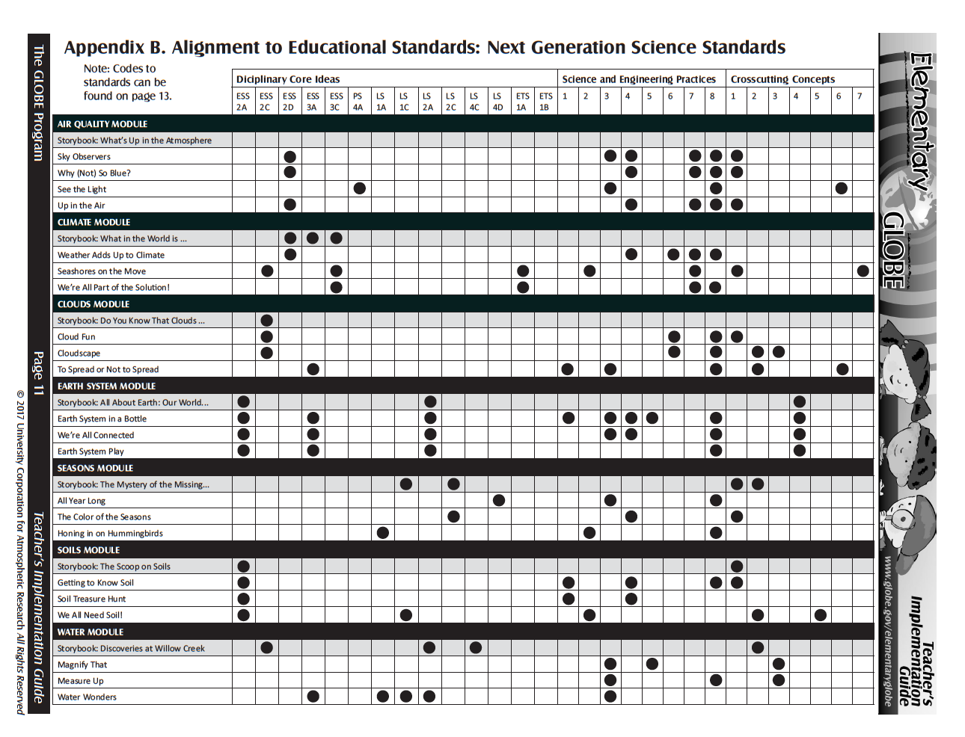
Notes:
LISA

Slide 16
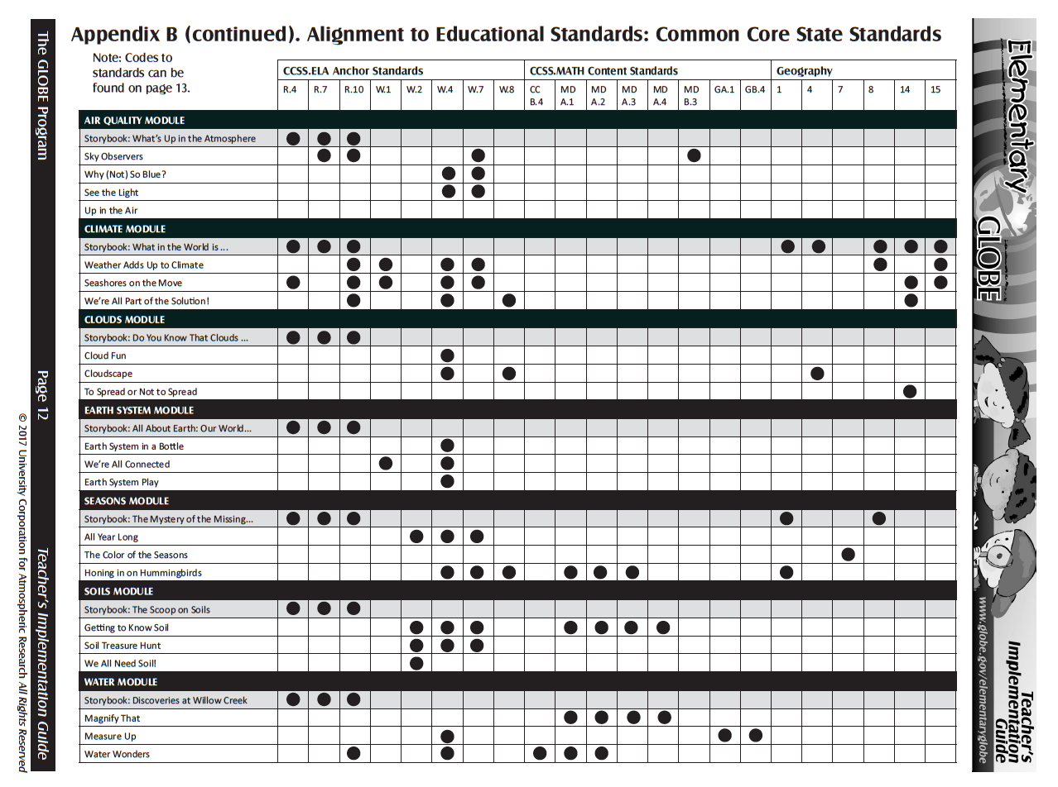
Notes:
LISA

Slide 17
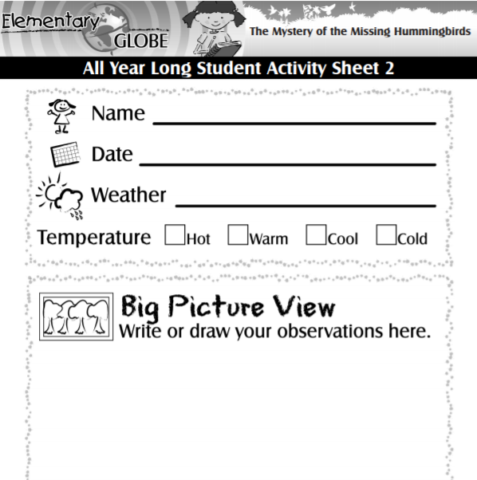
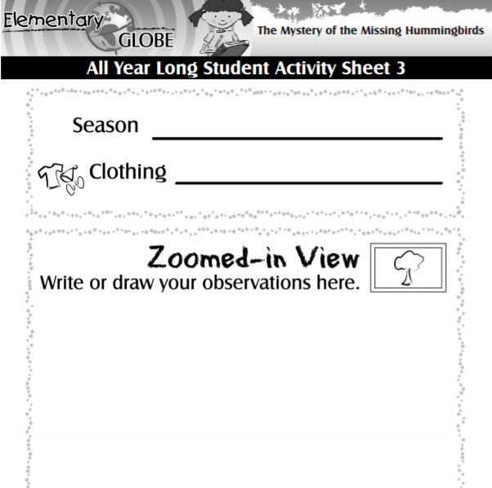
Notes:
BECCA
Pass out sheets.
Go outside and practice making observations.
Return and ask participants to share. Talking points:
Discussion of journaling/observations
Go outside for big picture and zoomed in worksheets
Sharing work
Summary discussion (refer back to science inquiry, NGSS, cross curricular connections)

Slide 18
Summary and next steps
In Progress:
Updates to activities from original five modules
Spanish translations of eBooks, Teacher Implementation Guide, climate module, air quality module, and updates to original books/activities
Coloring sheets
Discussion question:
What should we consider working on next? This could include new products, training, supporting resources, etc.
Notes:
Next steps
Q&A
What do participants think we should do for next steps? (products, training, other)

