Slide 1

GLOBE – Environment and Future
1
Notes:
1

Slide 2
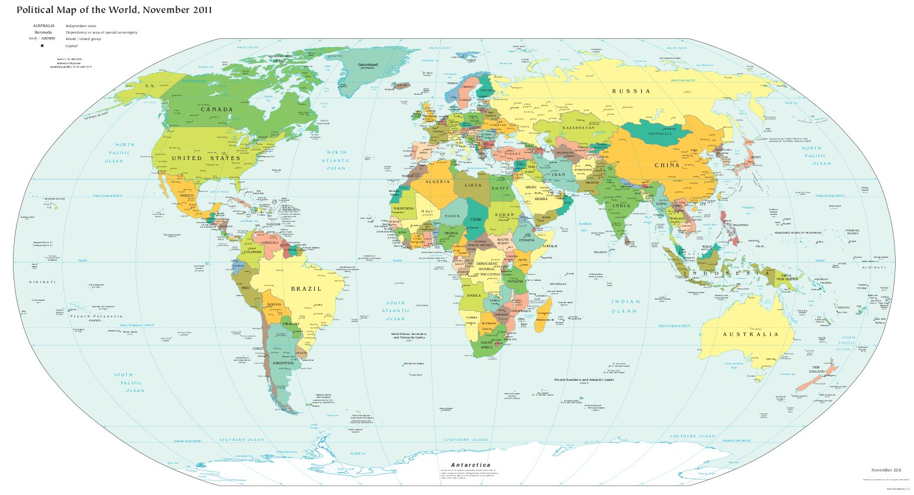
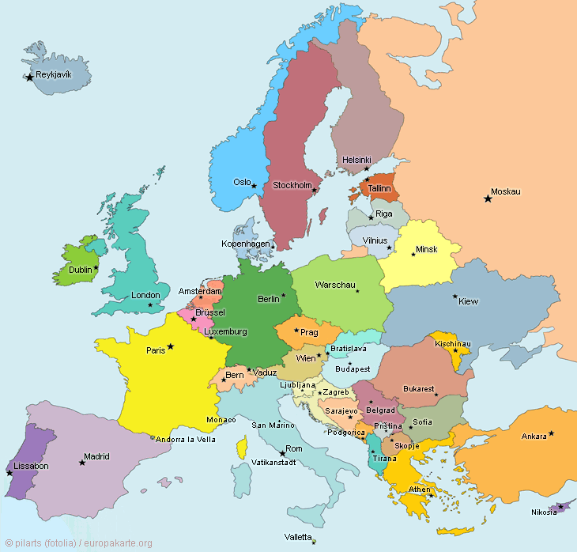
GLOBE – Environment and Future

Slide 3
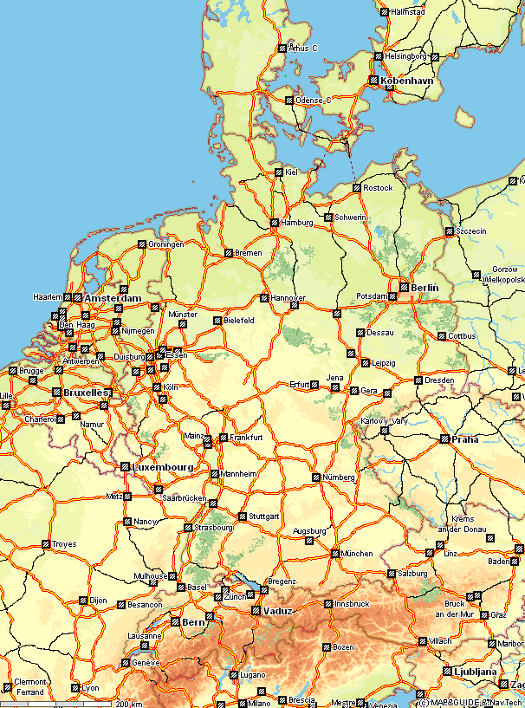

Slide 4
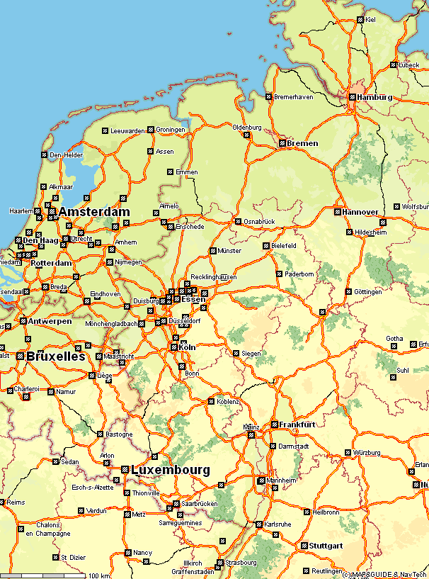

Slide 5
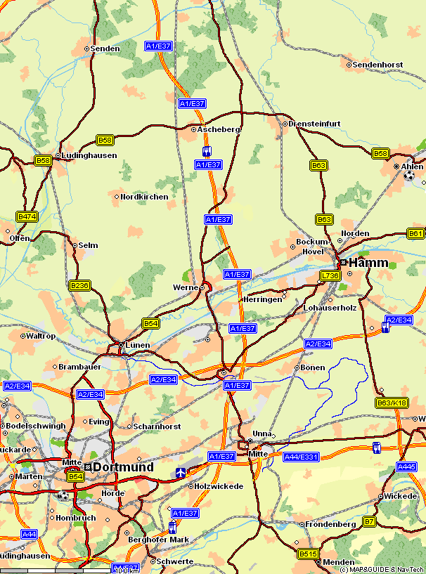

Slide 6
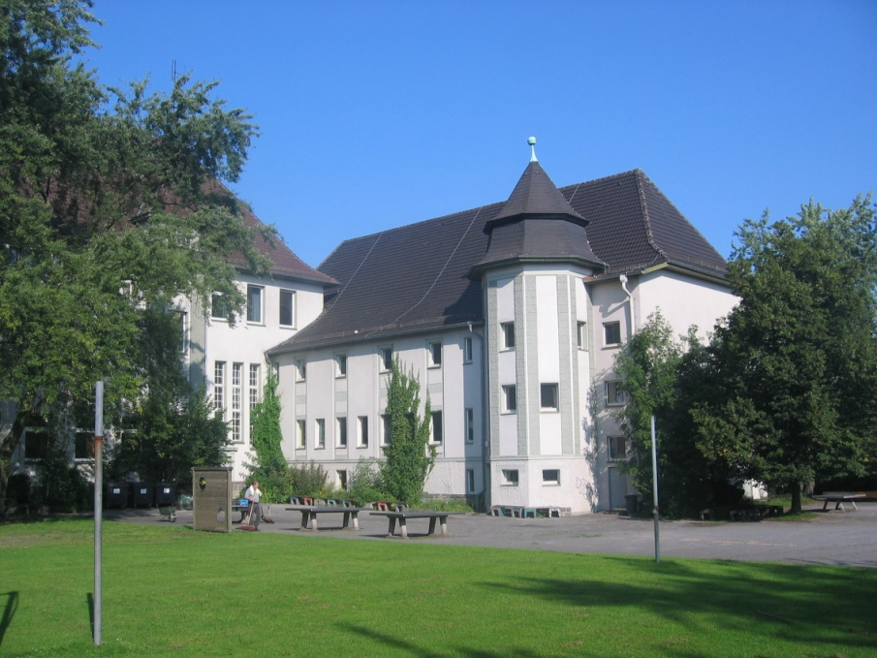
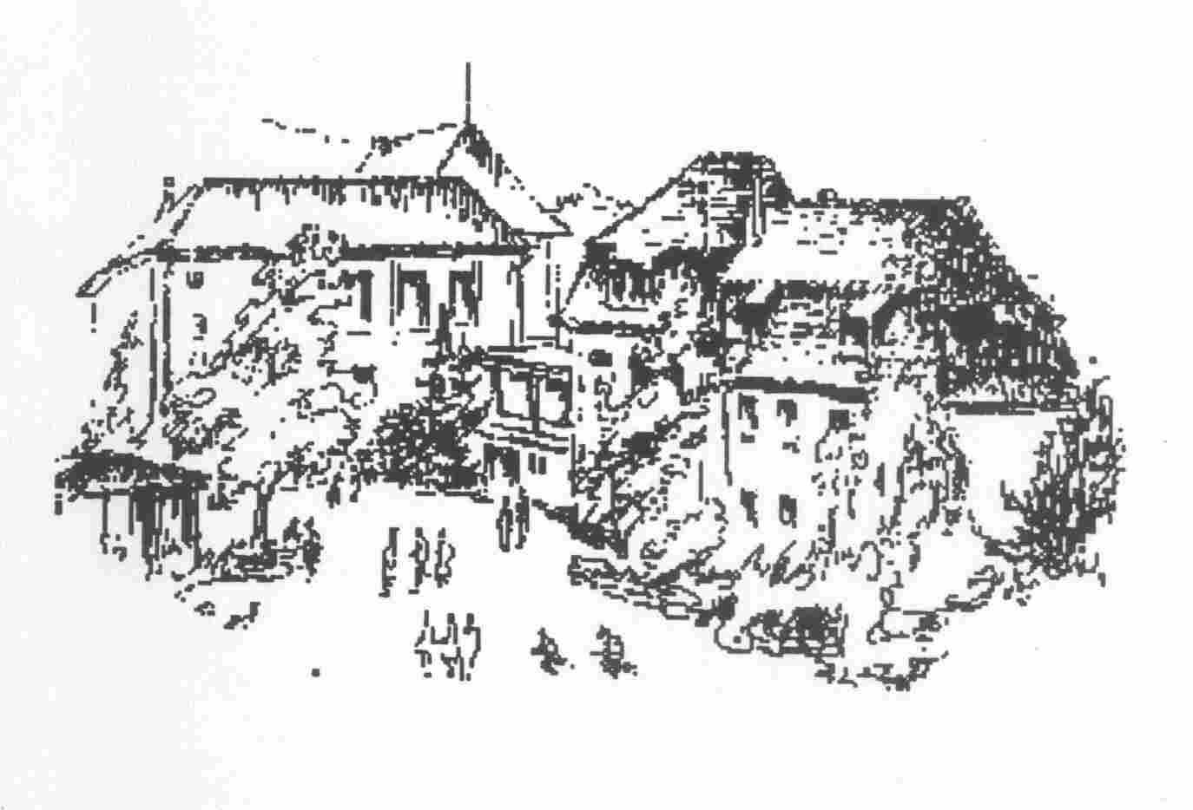
GLOBE – Environment and Future
Coordinates:
Longitude: 7° 41 E
Latitude: 51° 38 N
Height: 115 m

Slide 7
GLOBE – Environment and Future
GLOBE Start at the EBG
- Historical overview since 11/2000
- It began as a voluntary student working group (AG)
GLOBE as a subject
- „GLOBE – Environment and Future“ in elective subjects II in the school year 2008/2009
C. Teaching projects
- Birch-phenology project
- water surveys
- BIO-SOS

Slide 8
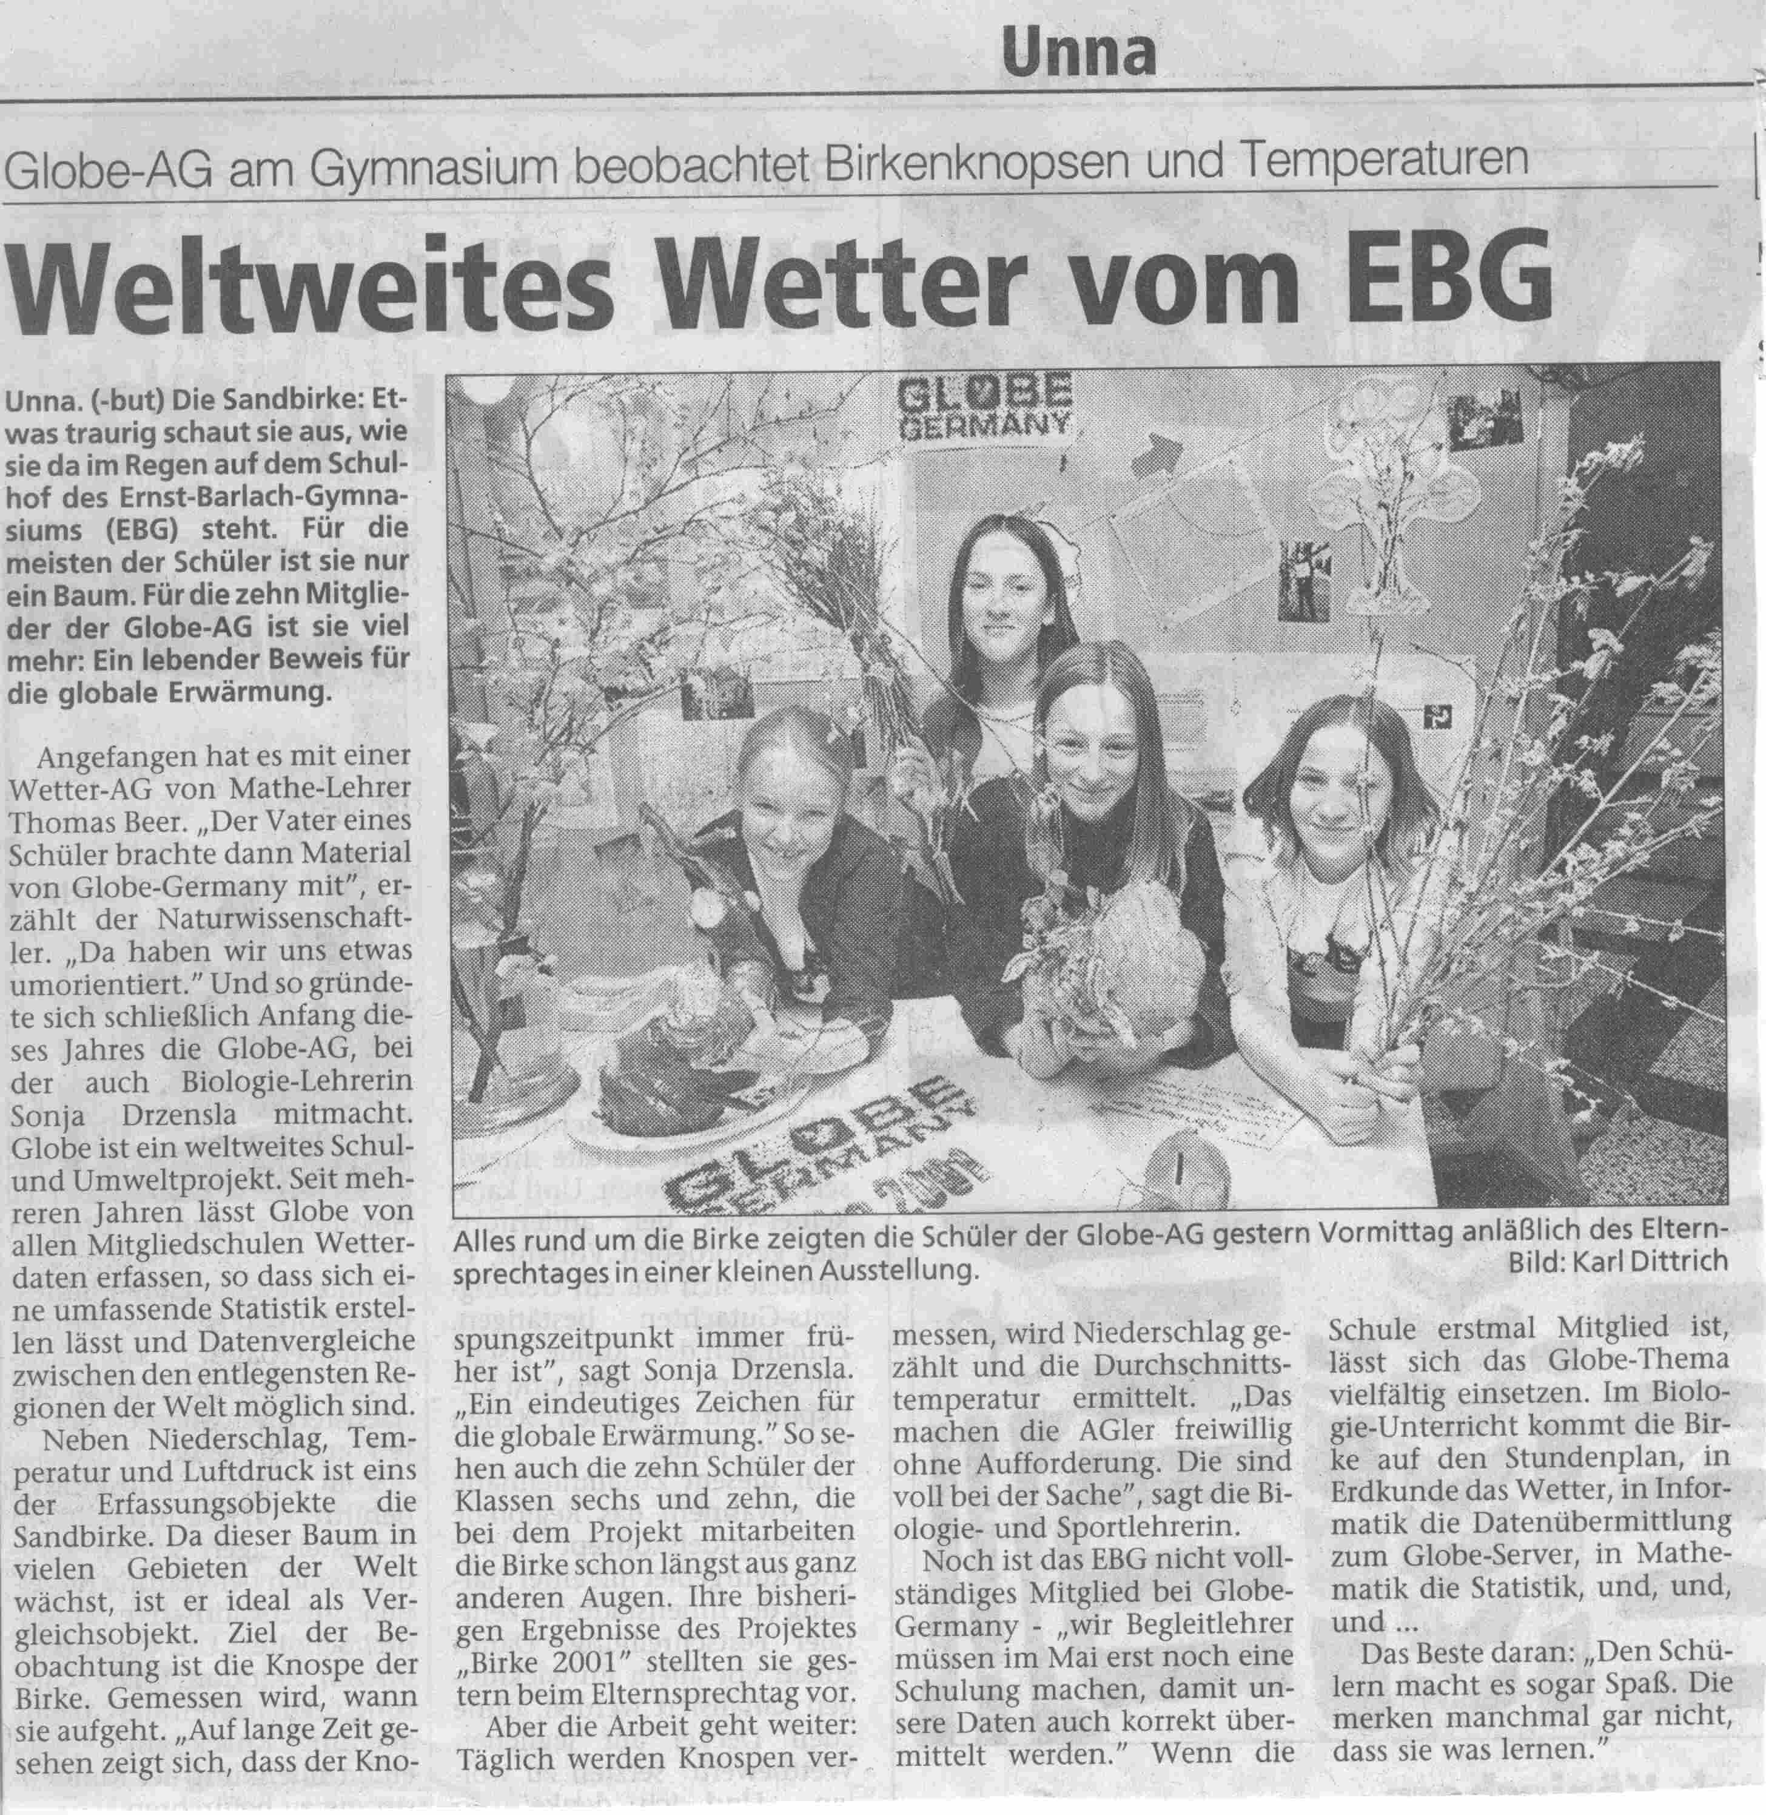
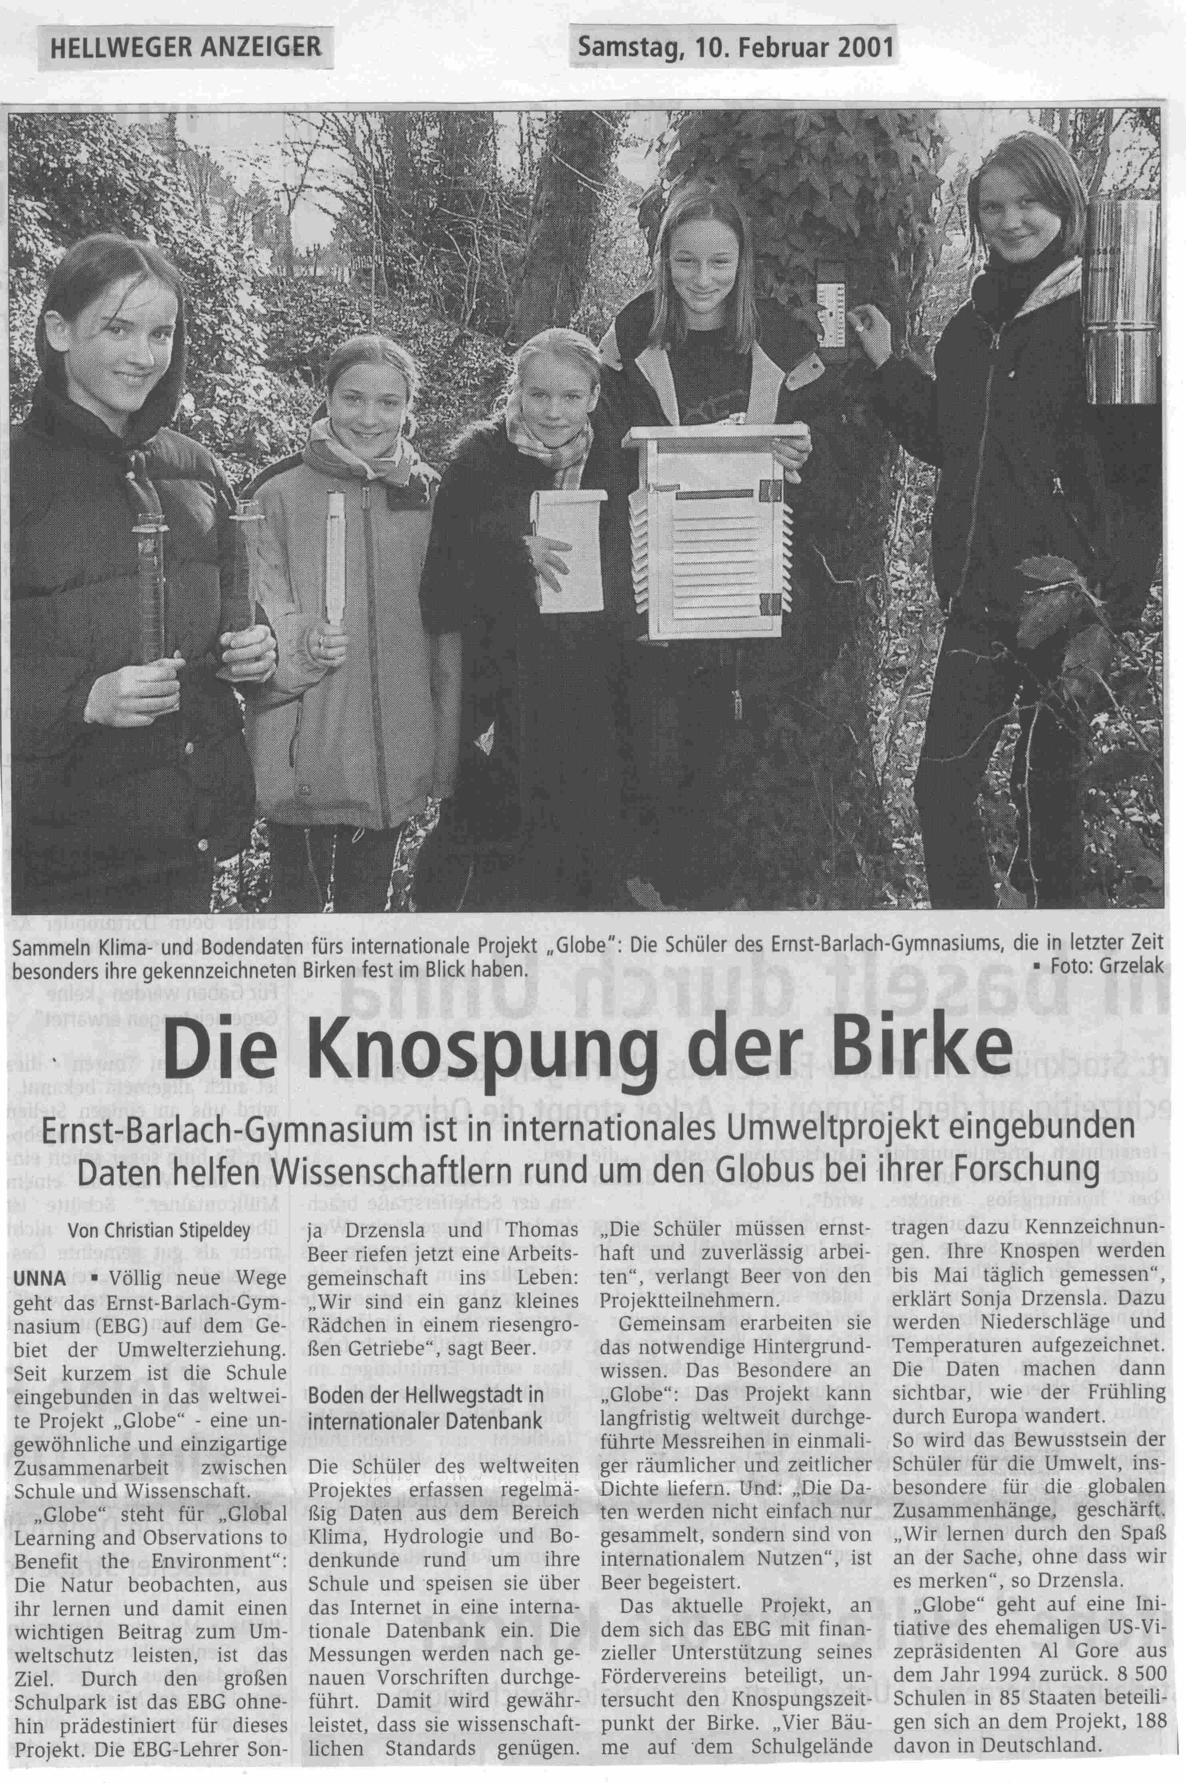
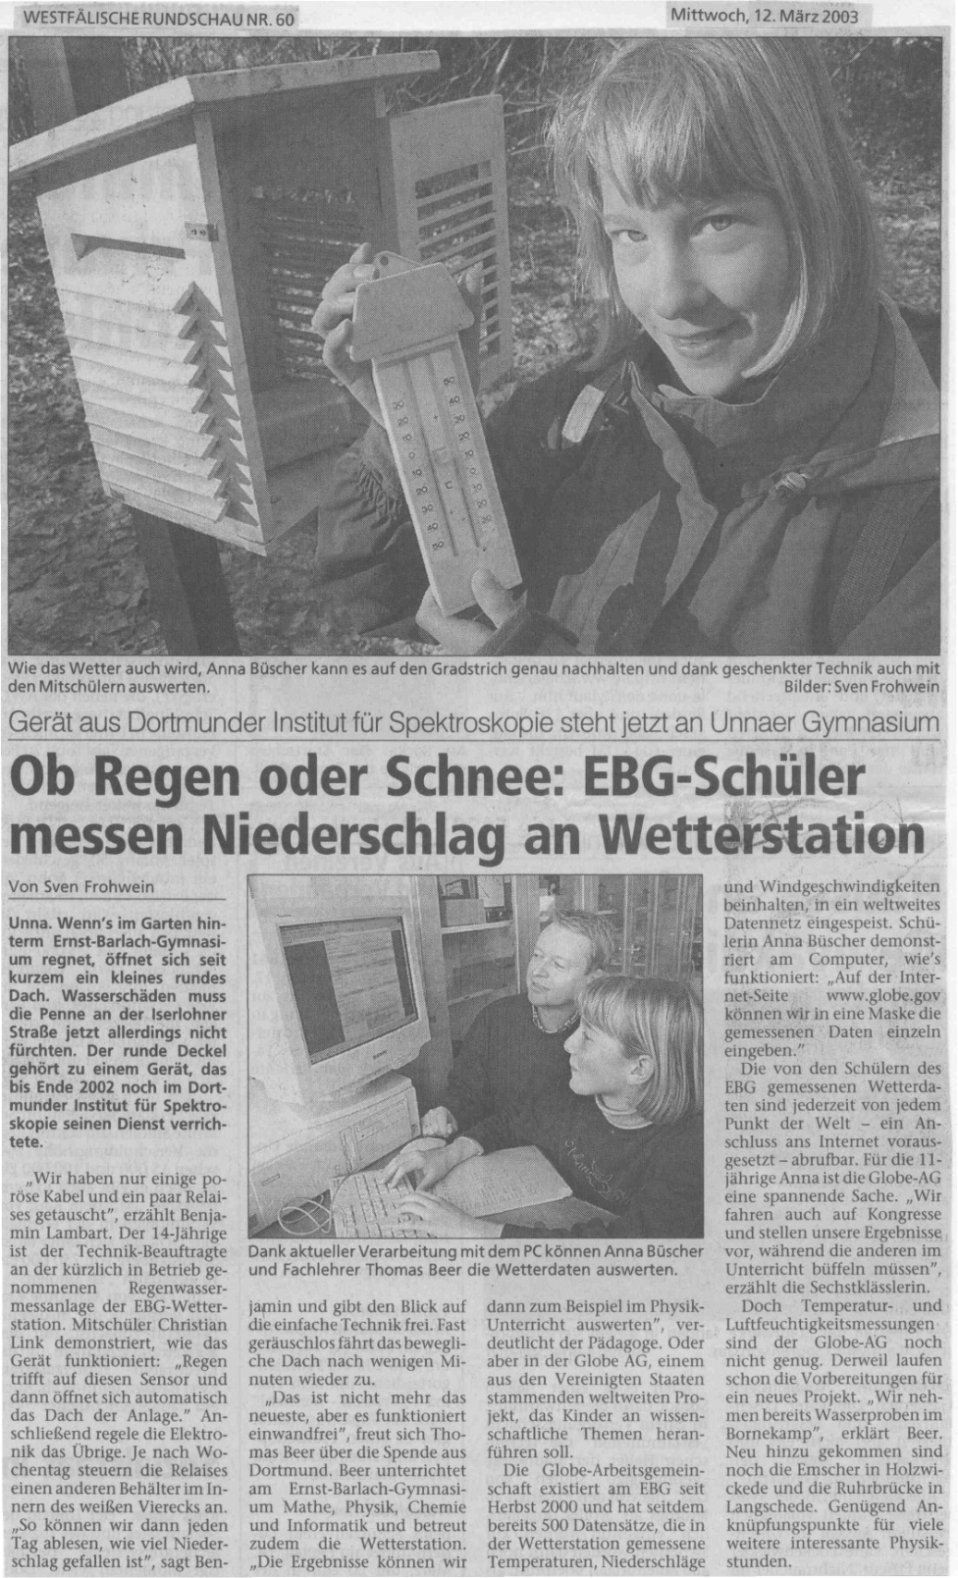
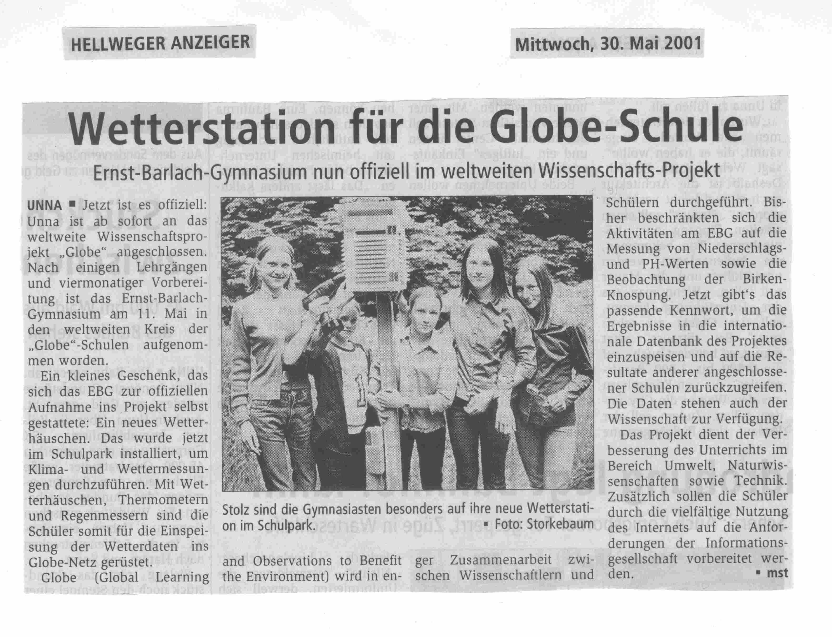
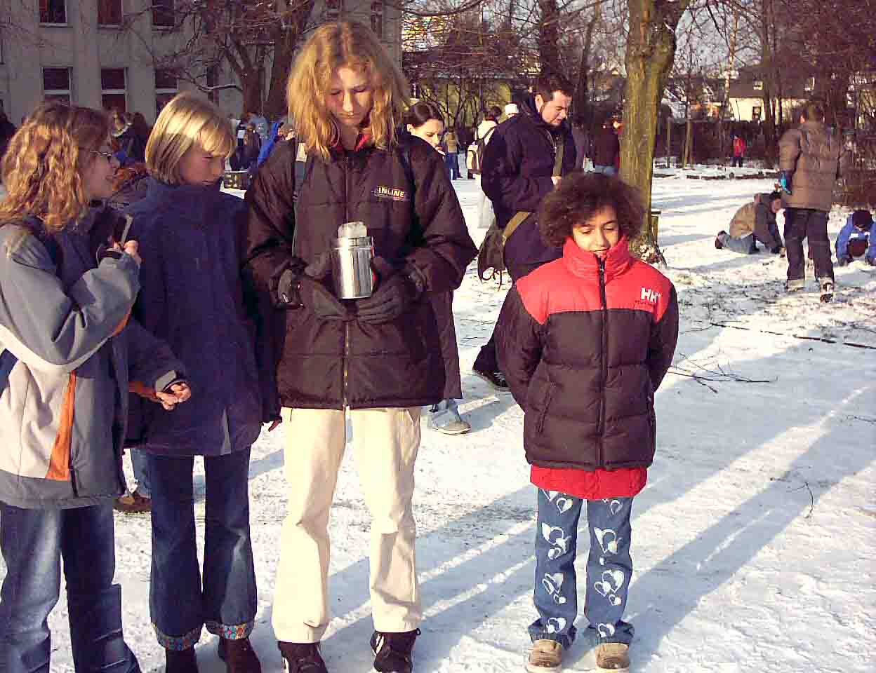
GLOBE – Environment and Future
Our Messteam is astonished about the frozen rain gauge!

Slide 9
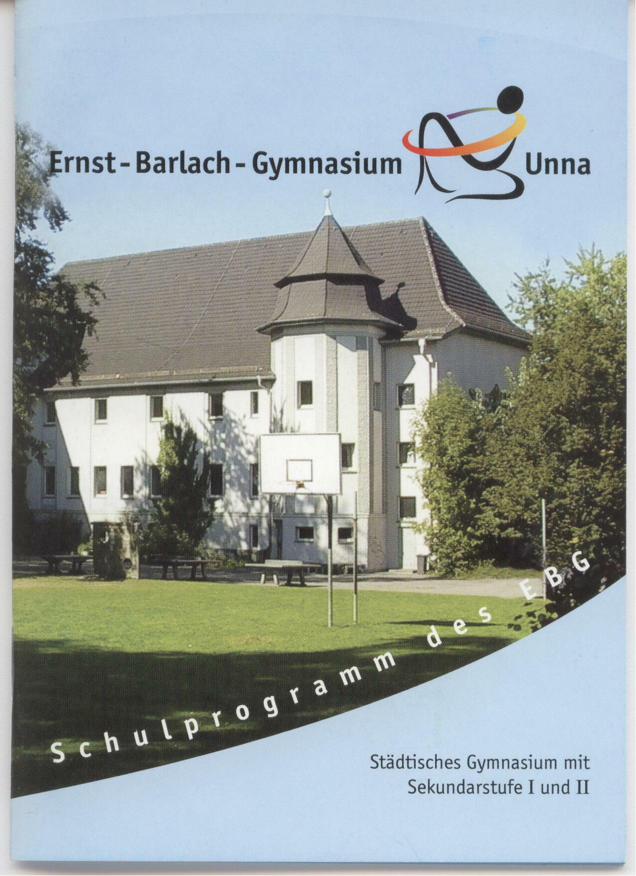
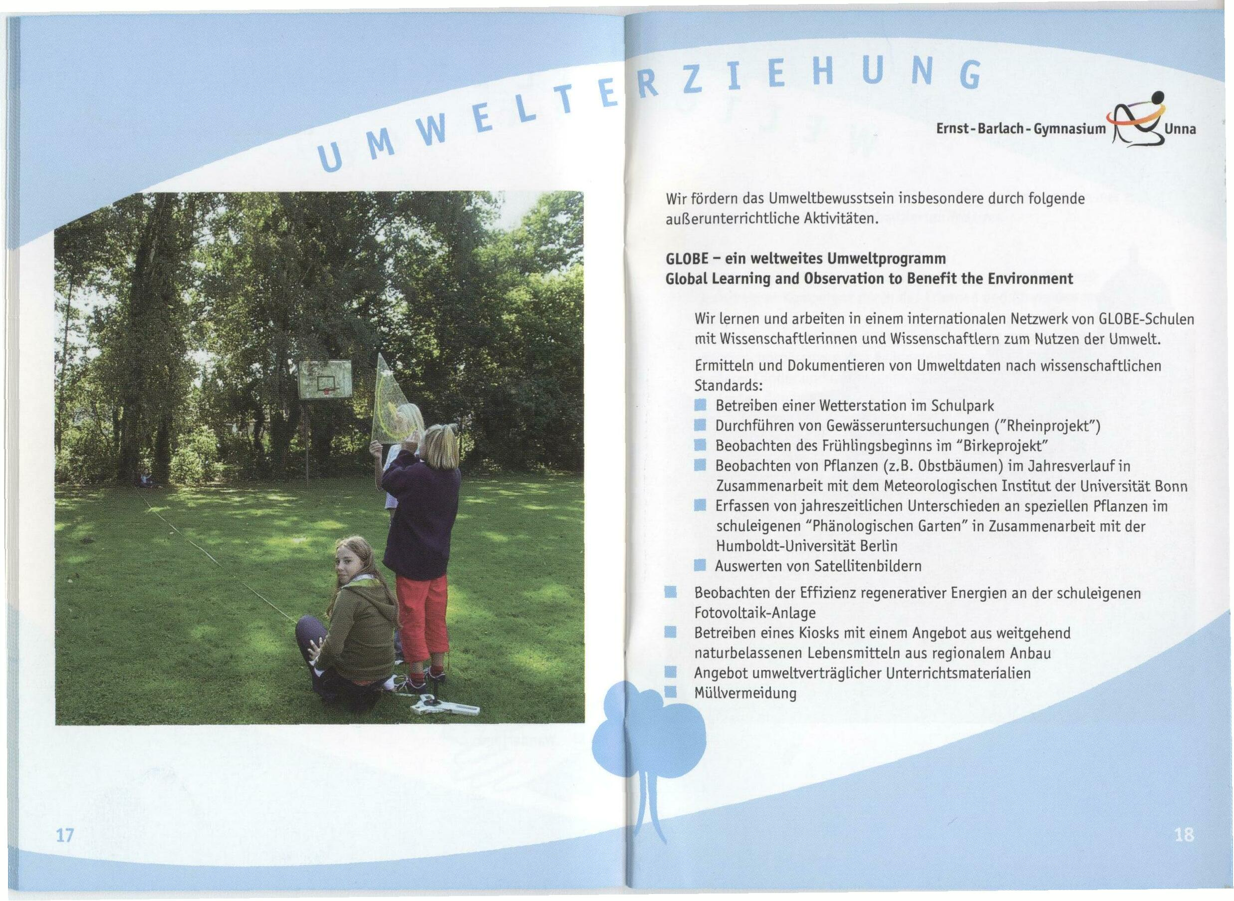
GLOBE – Environment and Future
School Flyer
Environmental education

Slide 10
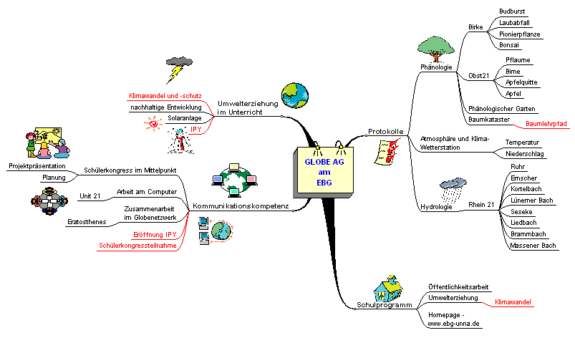
GLOBE – Environment and Future
Mind map about the working group at our school since beginning

Slide 11
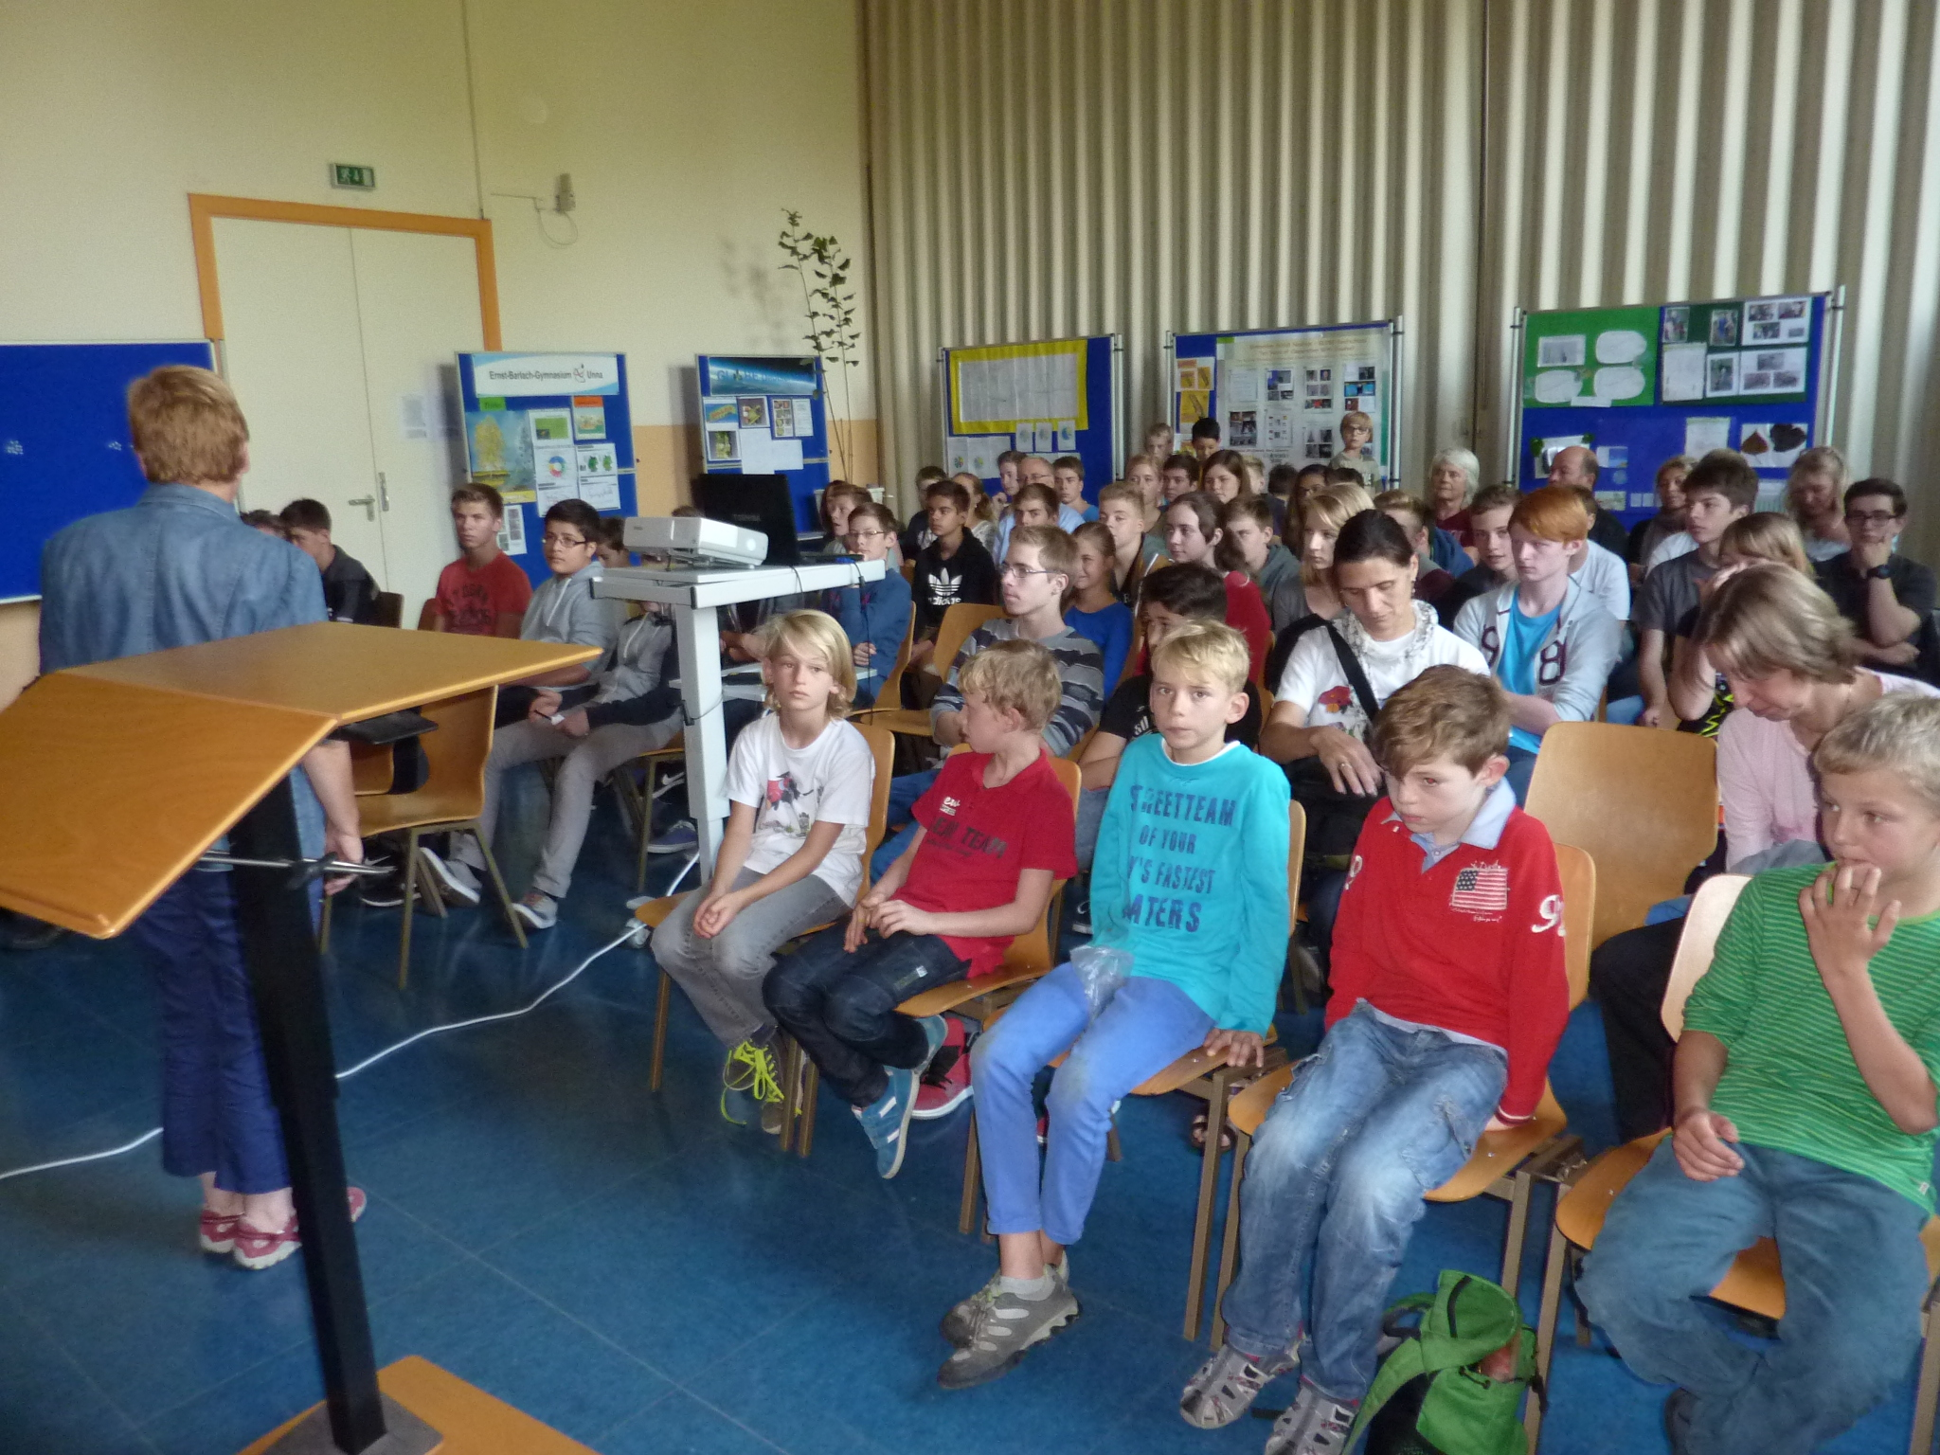
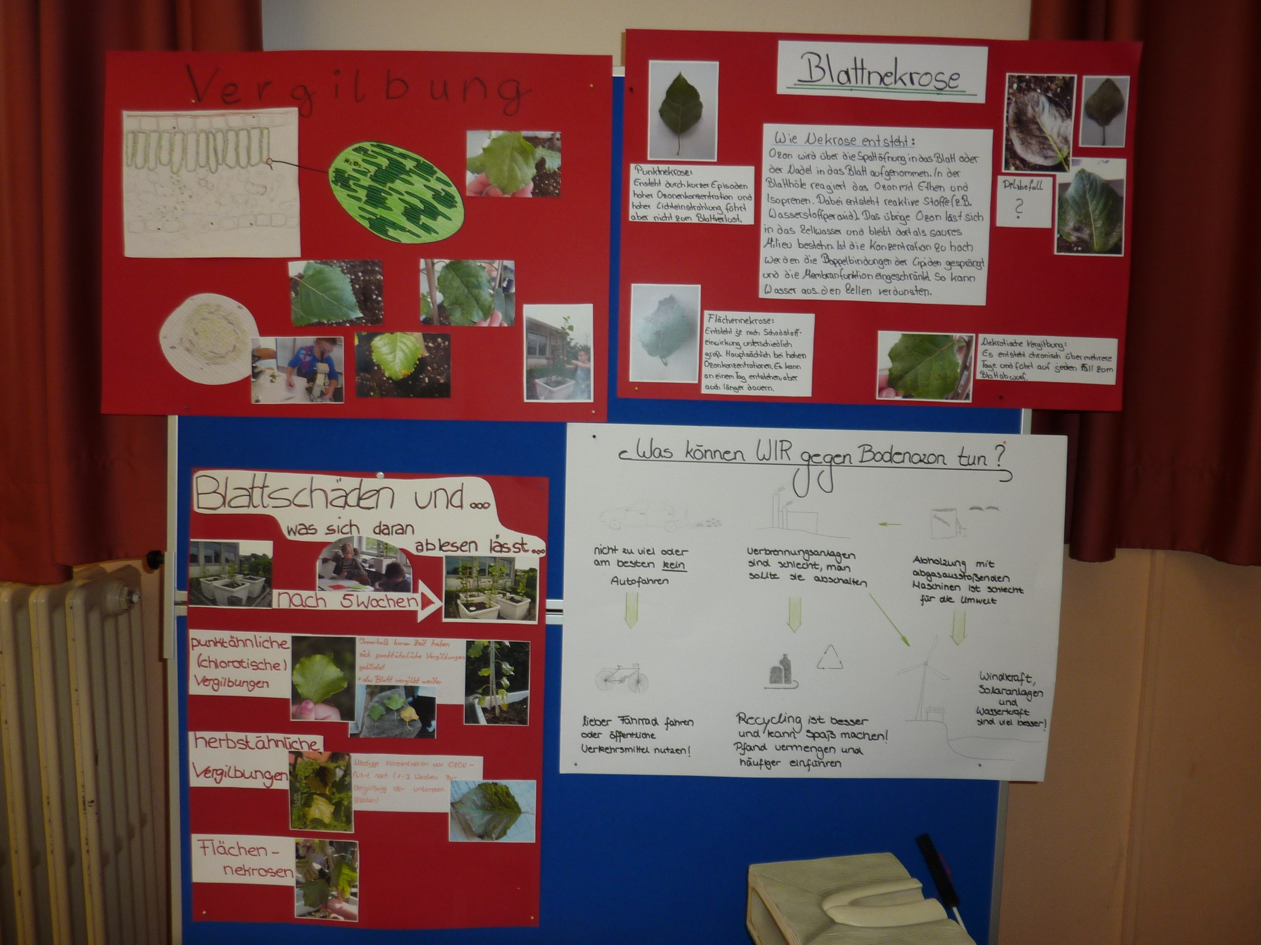
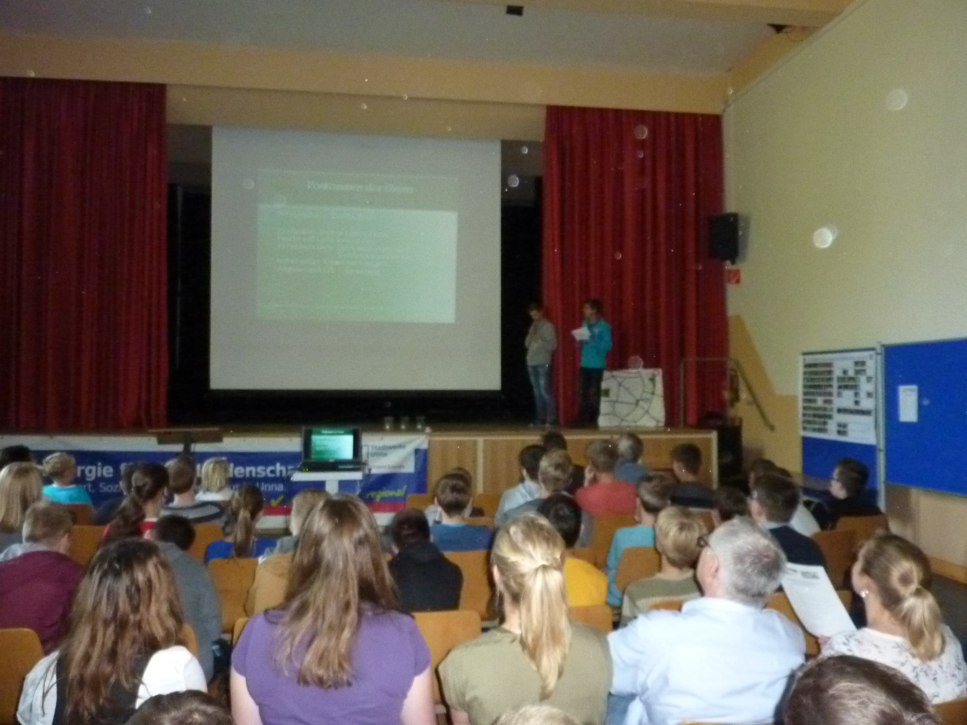
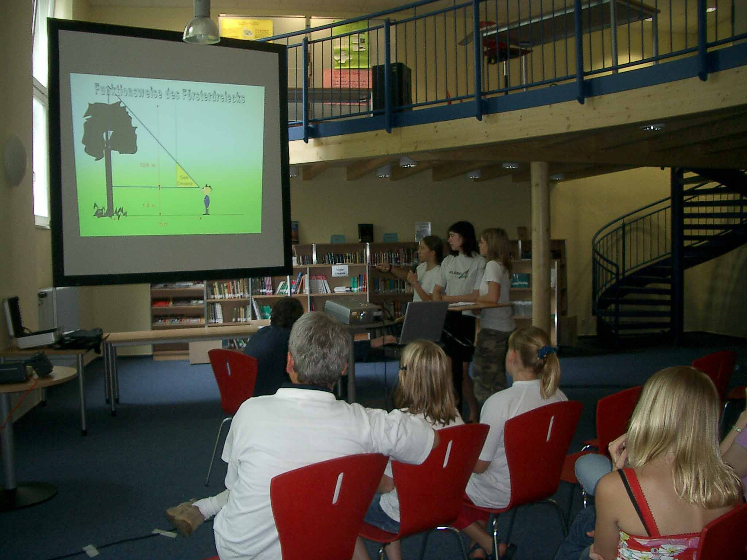
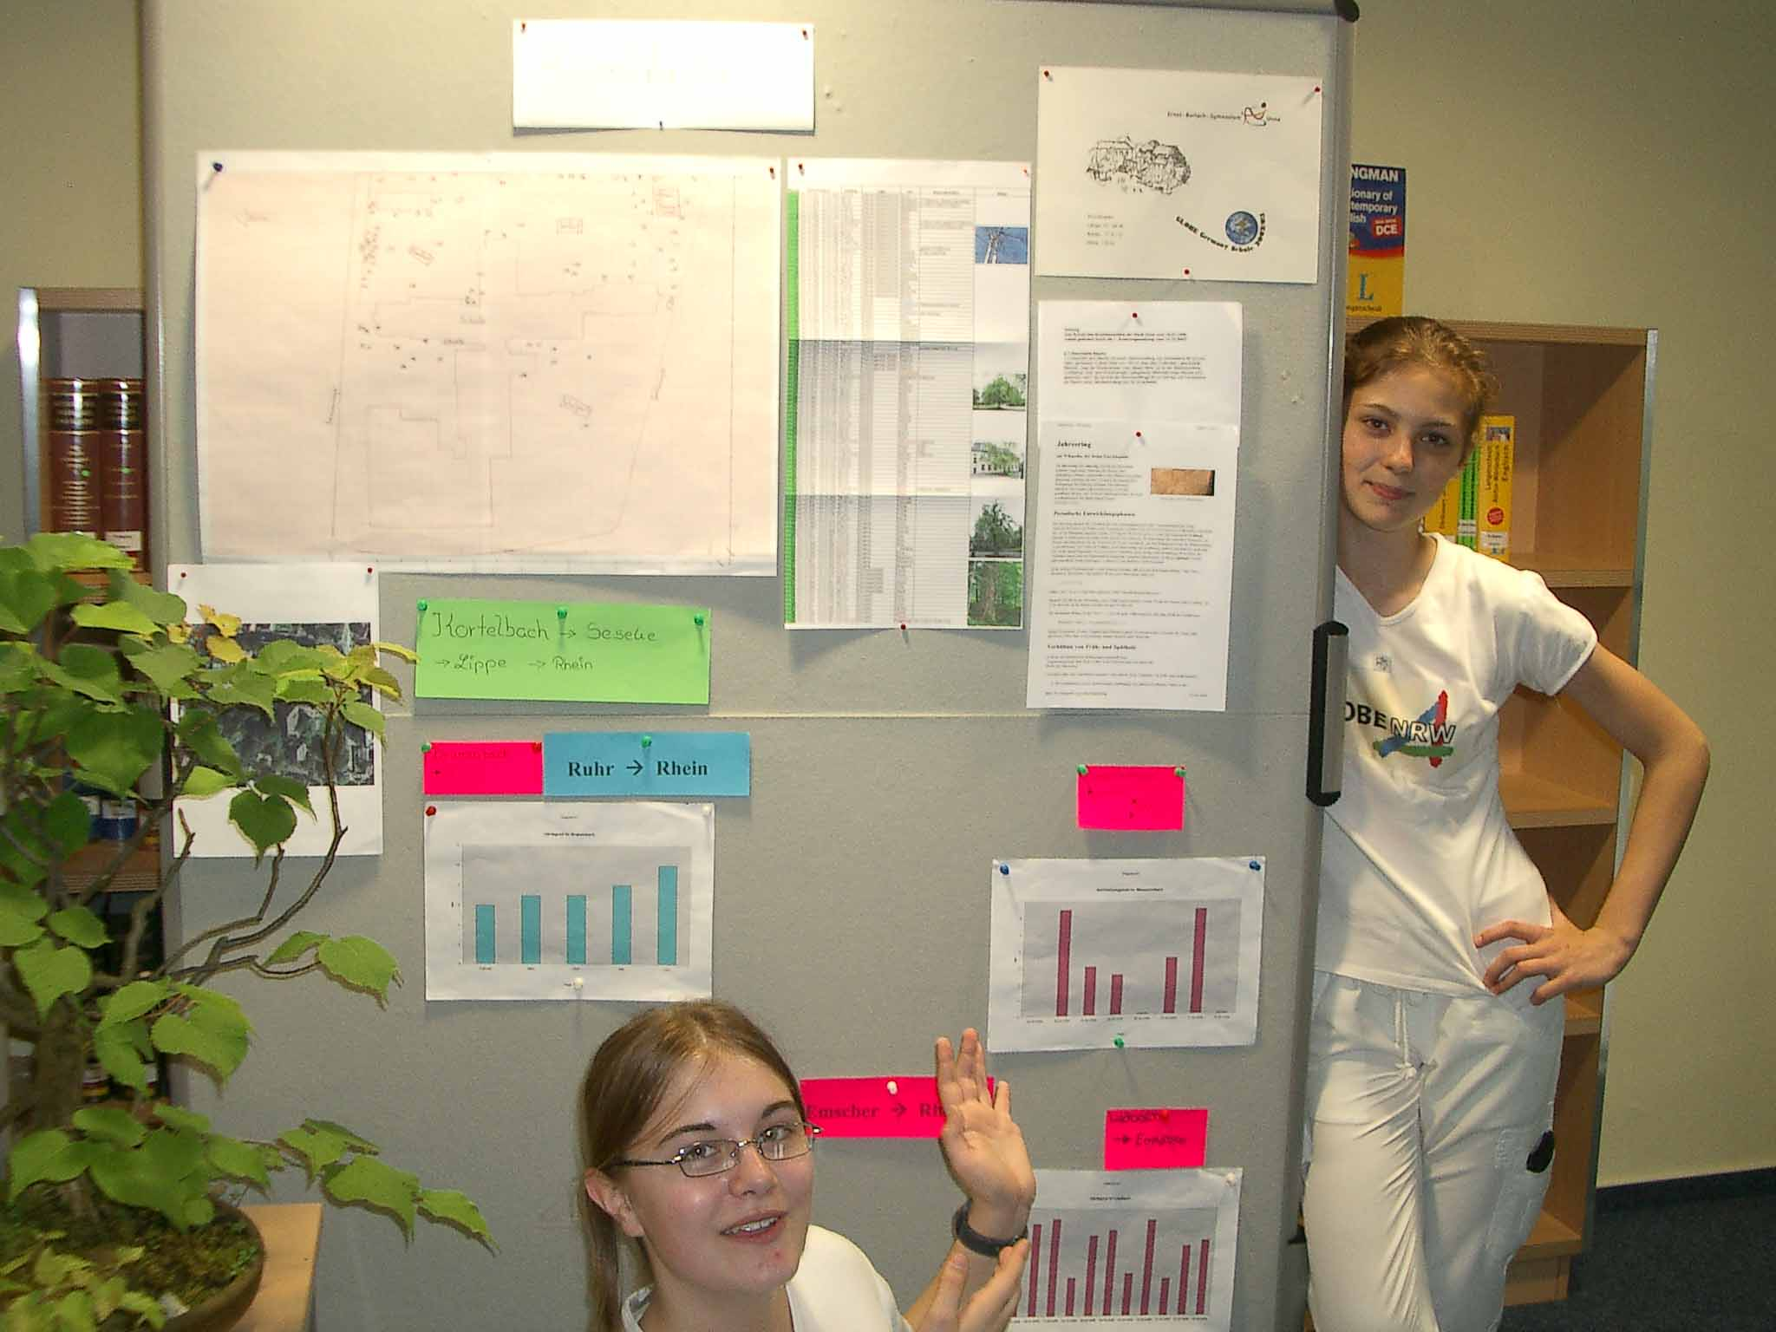
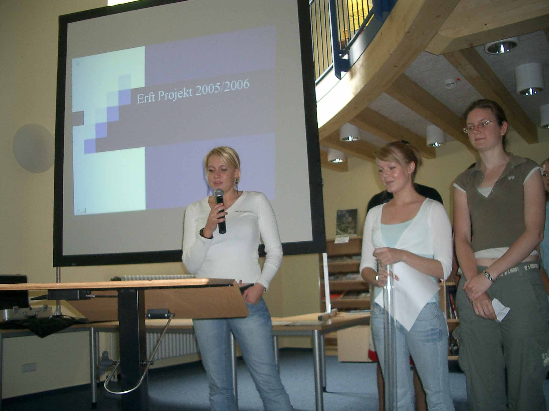
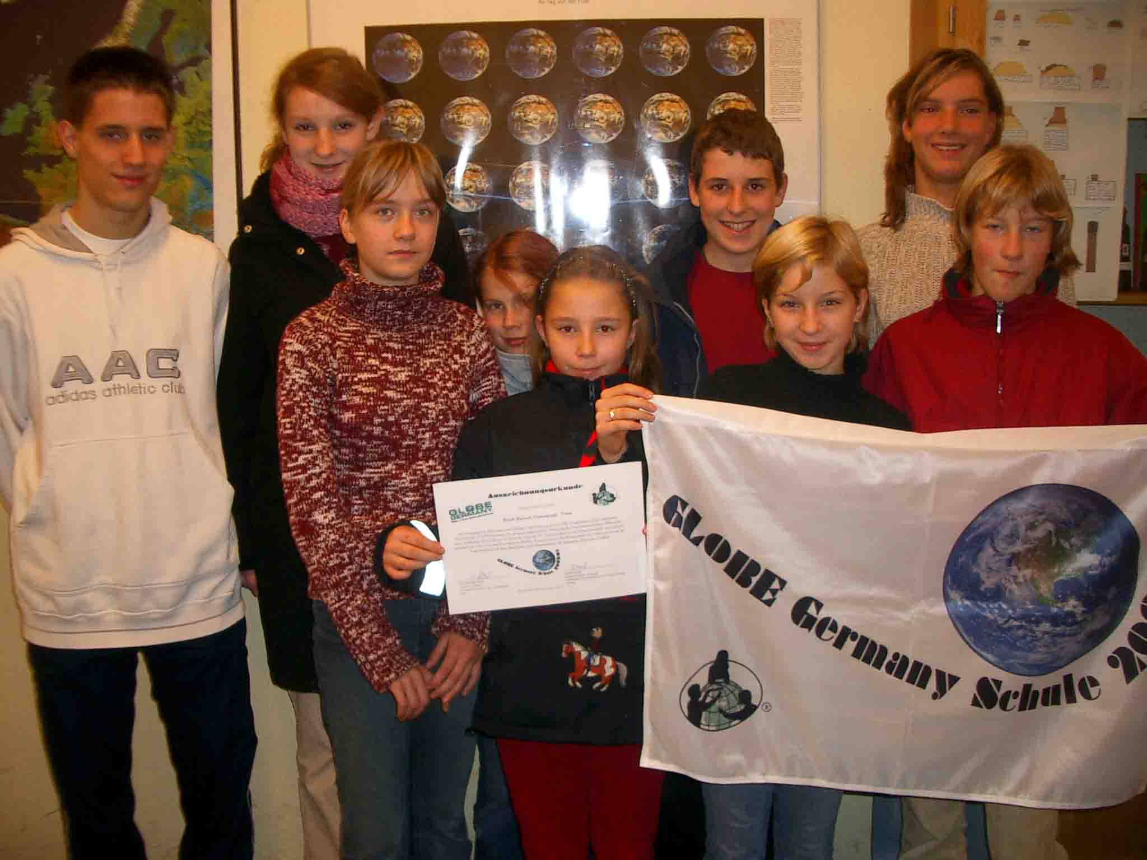

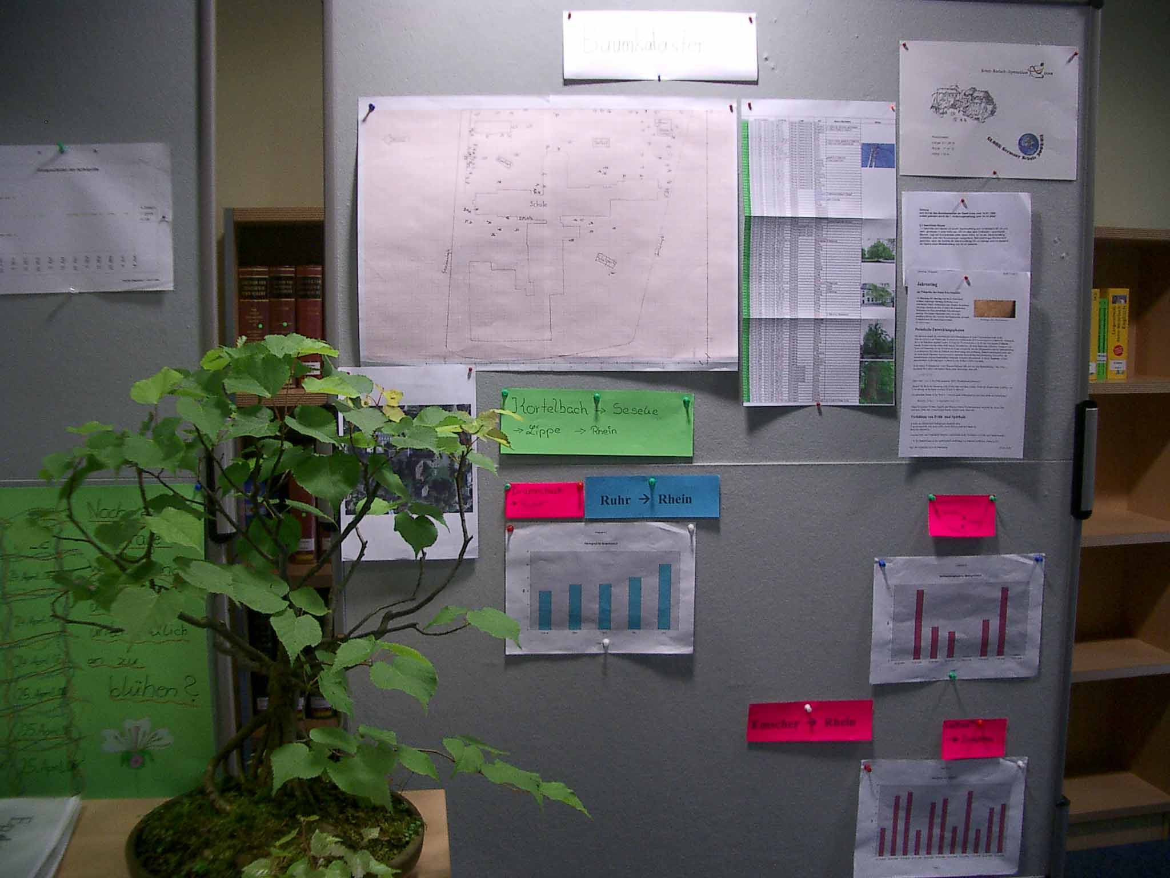
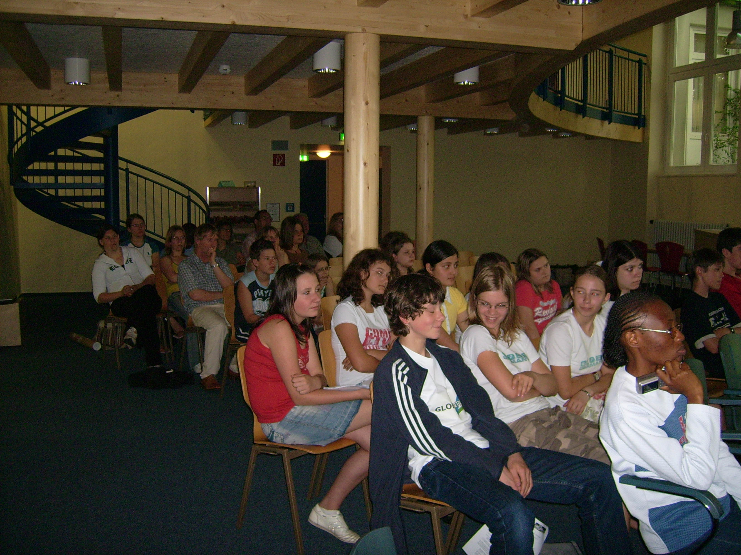
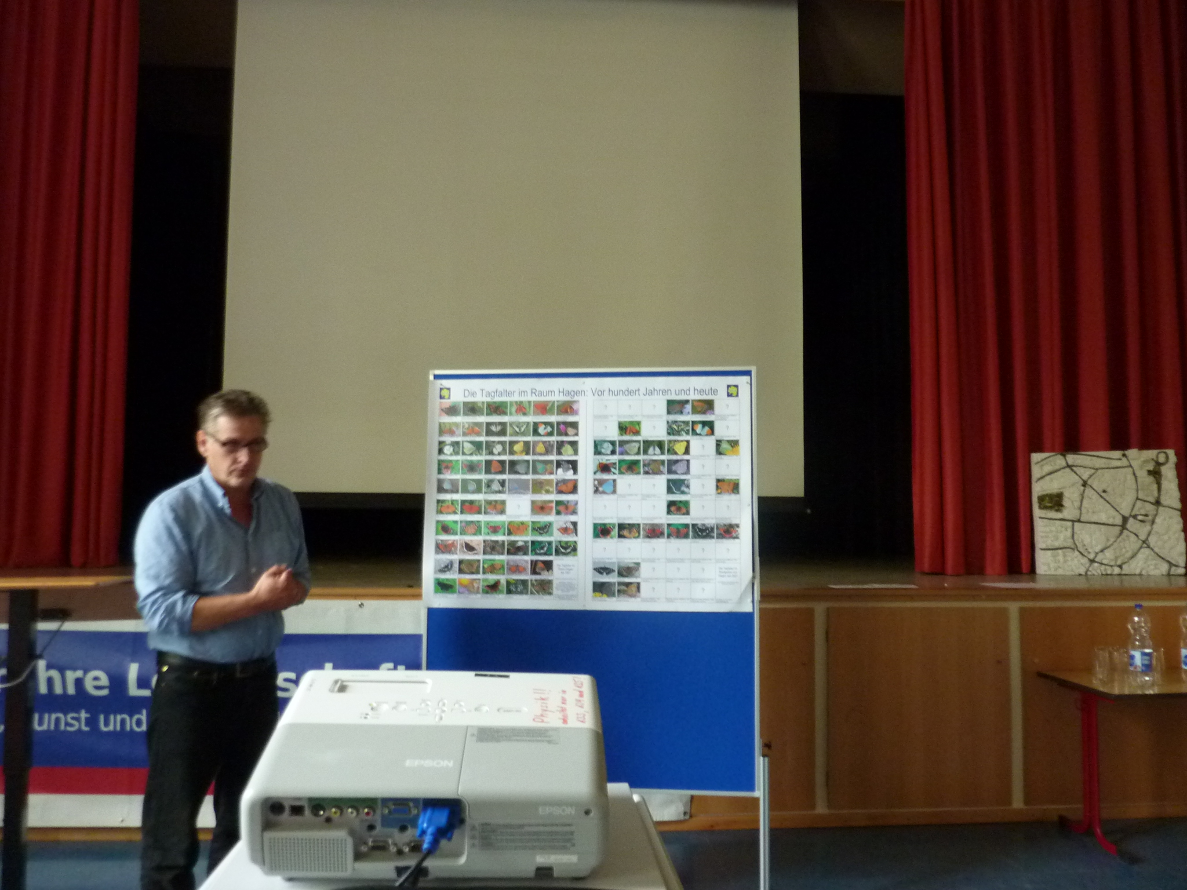
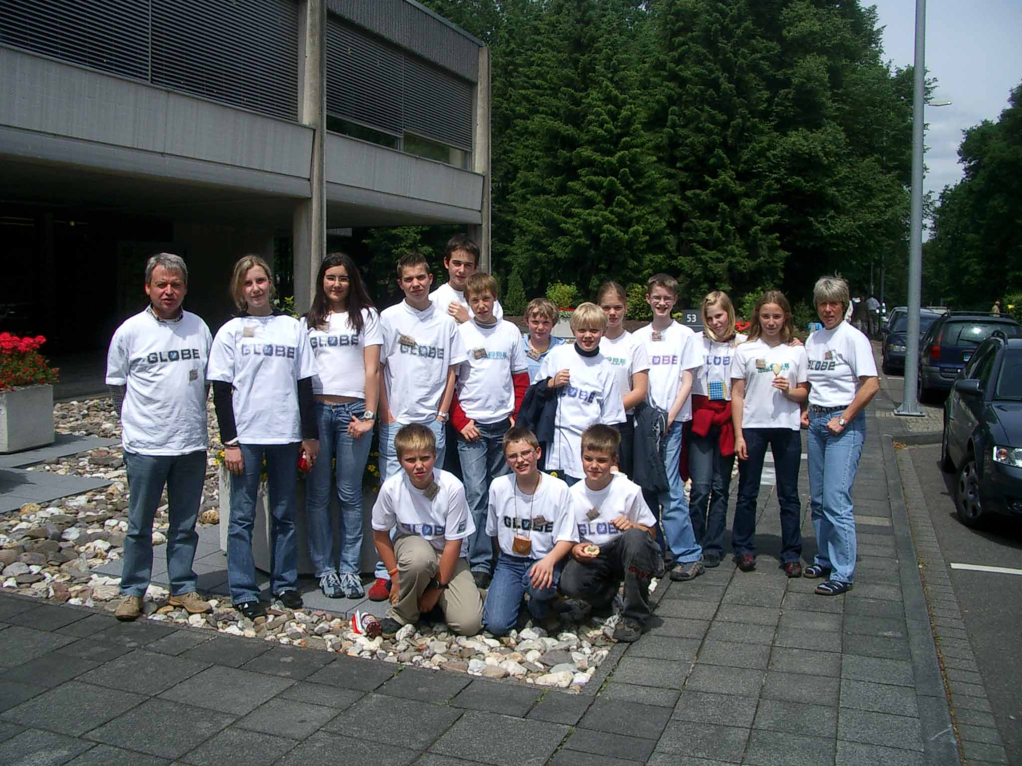
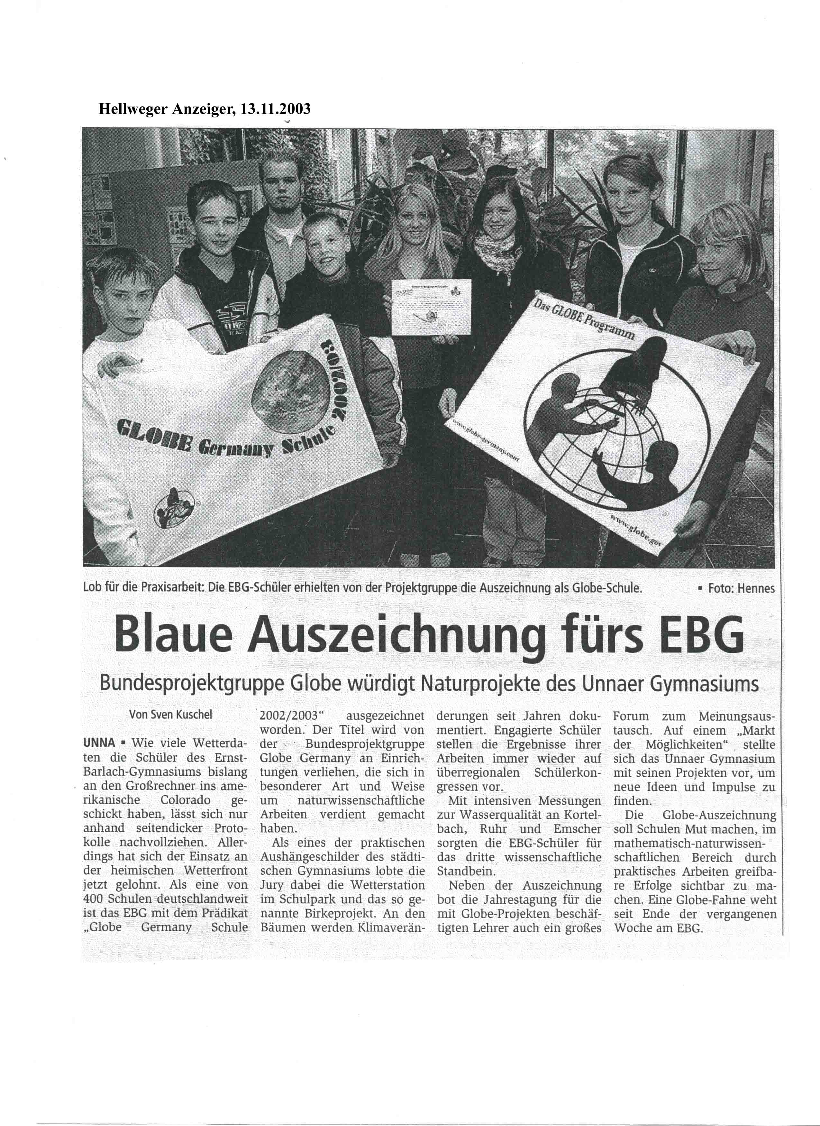
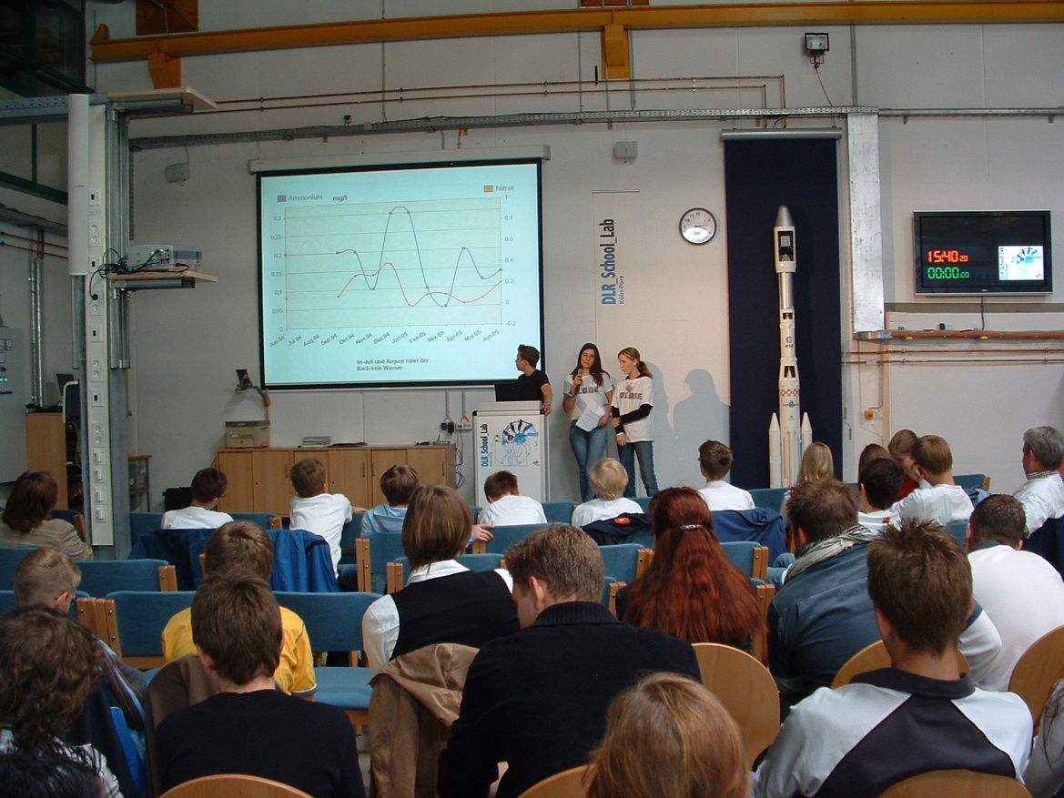
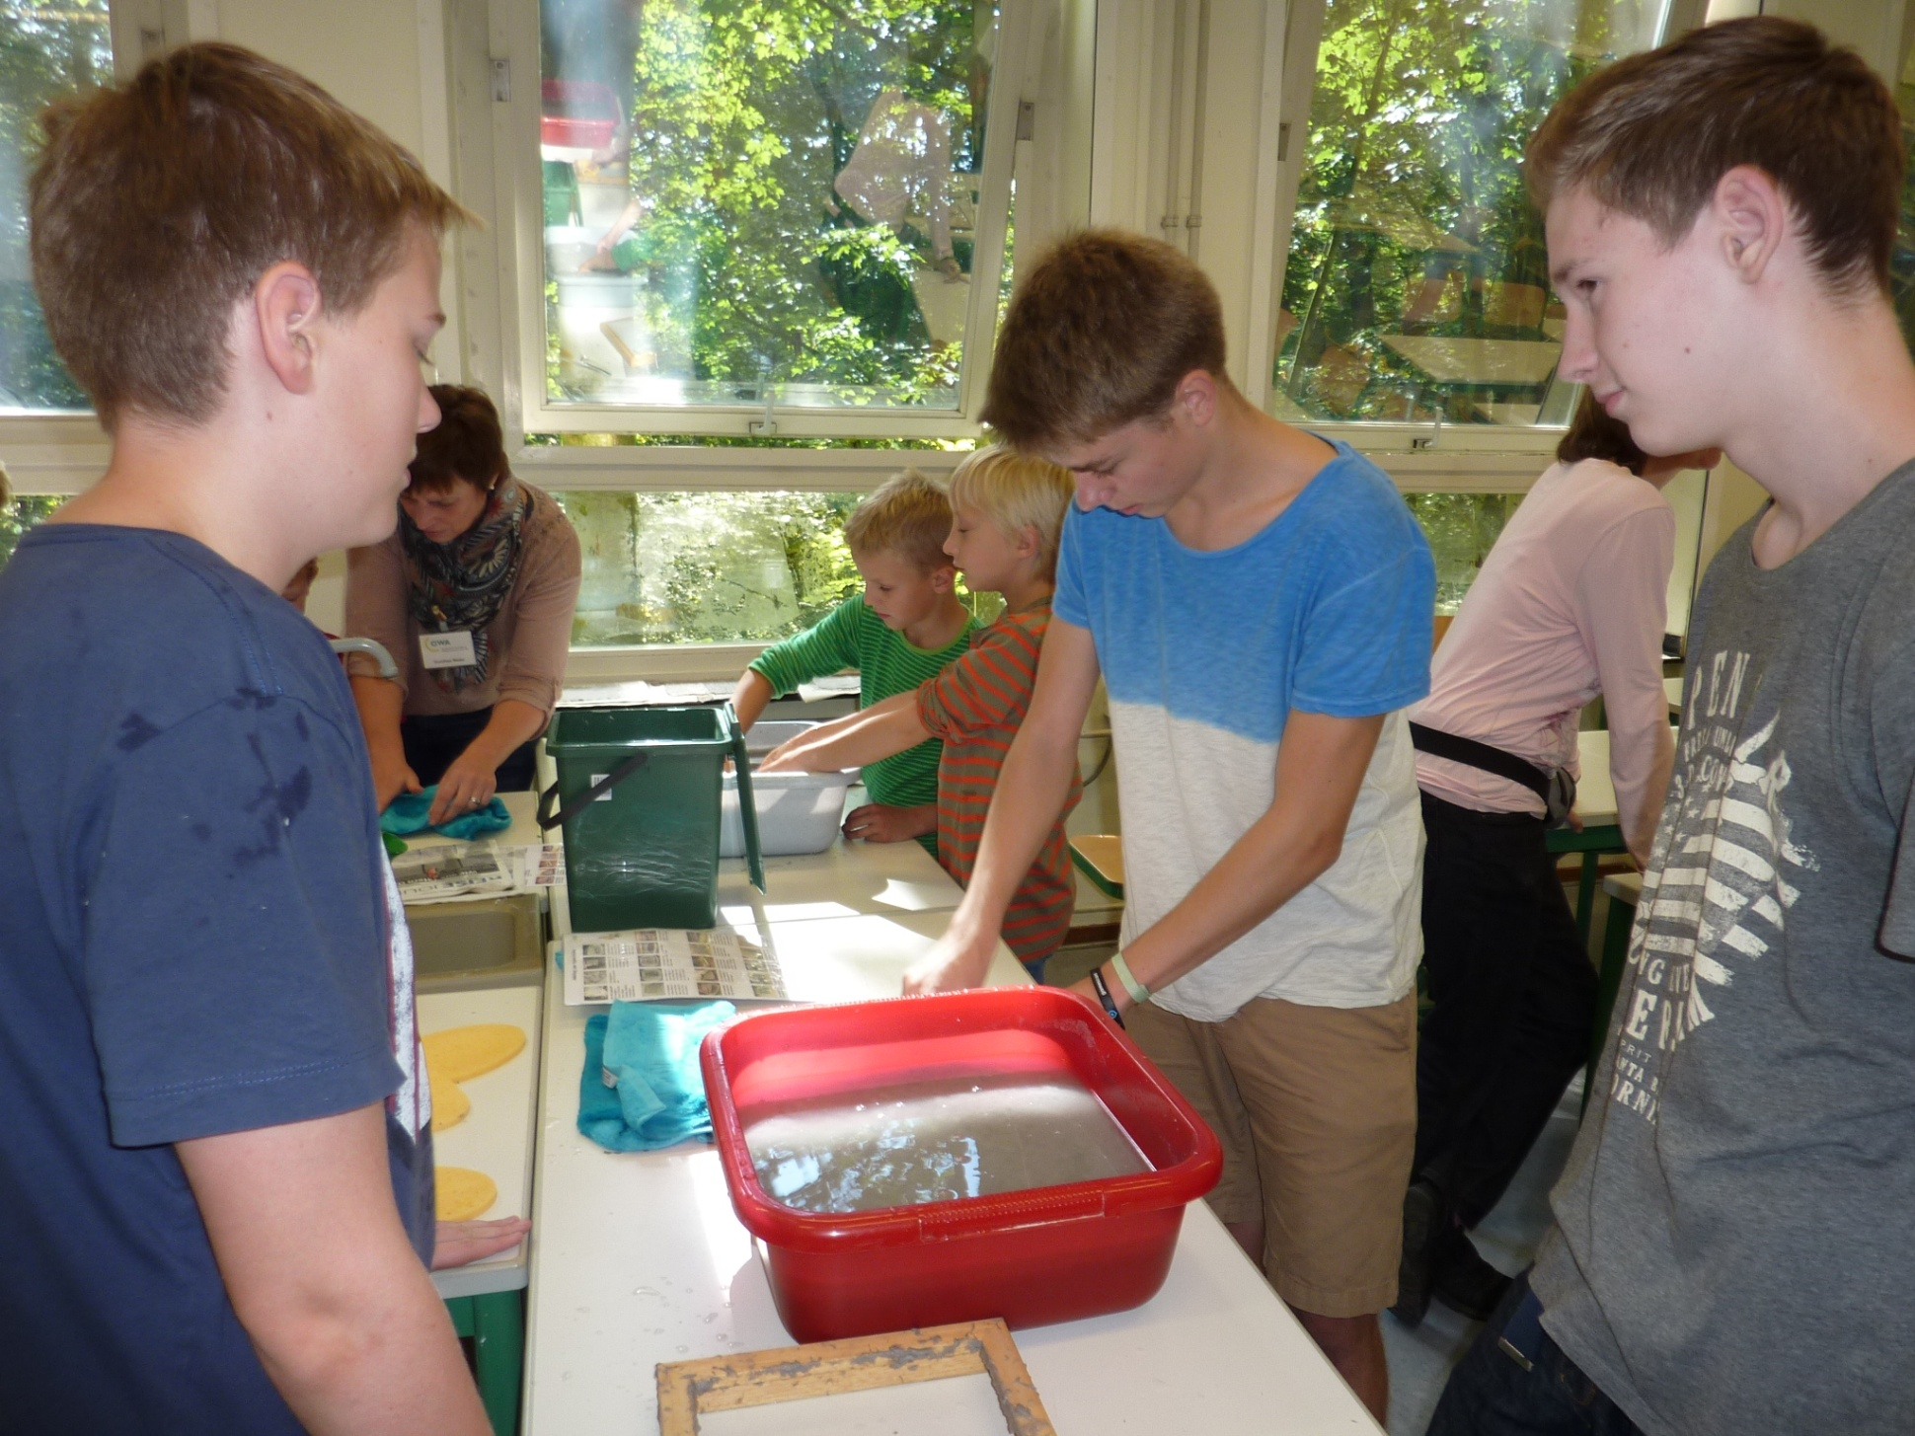
GLOBE – Environment and Future

Slide 12
2007
27 GPM Schools in Germany
Unna

Slide 13
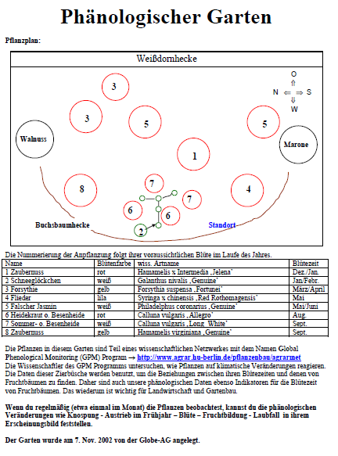
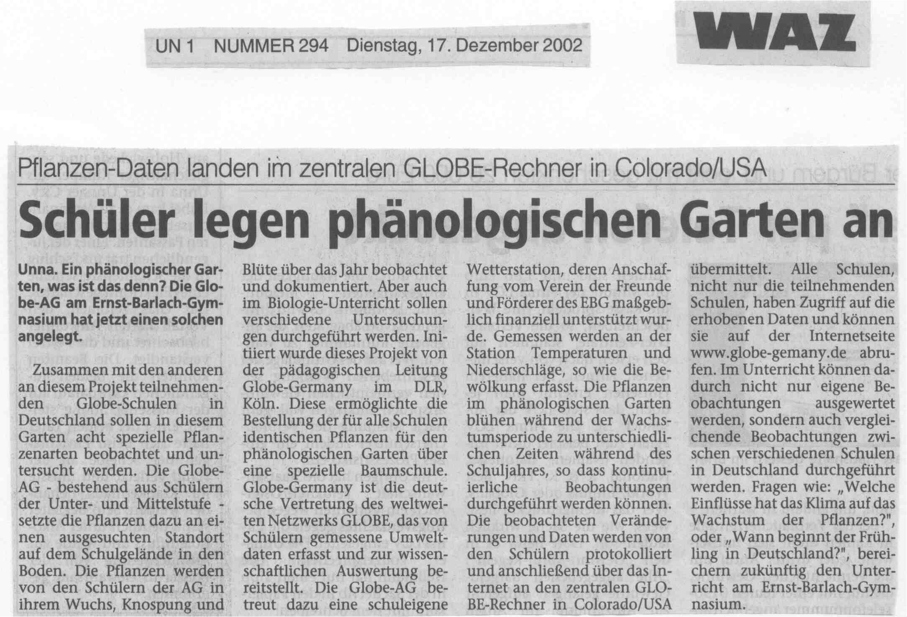
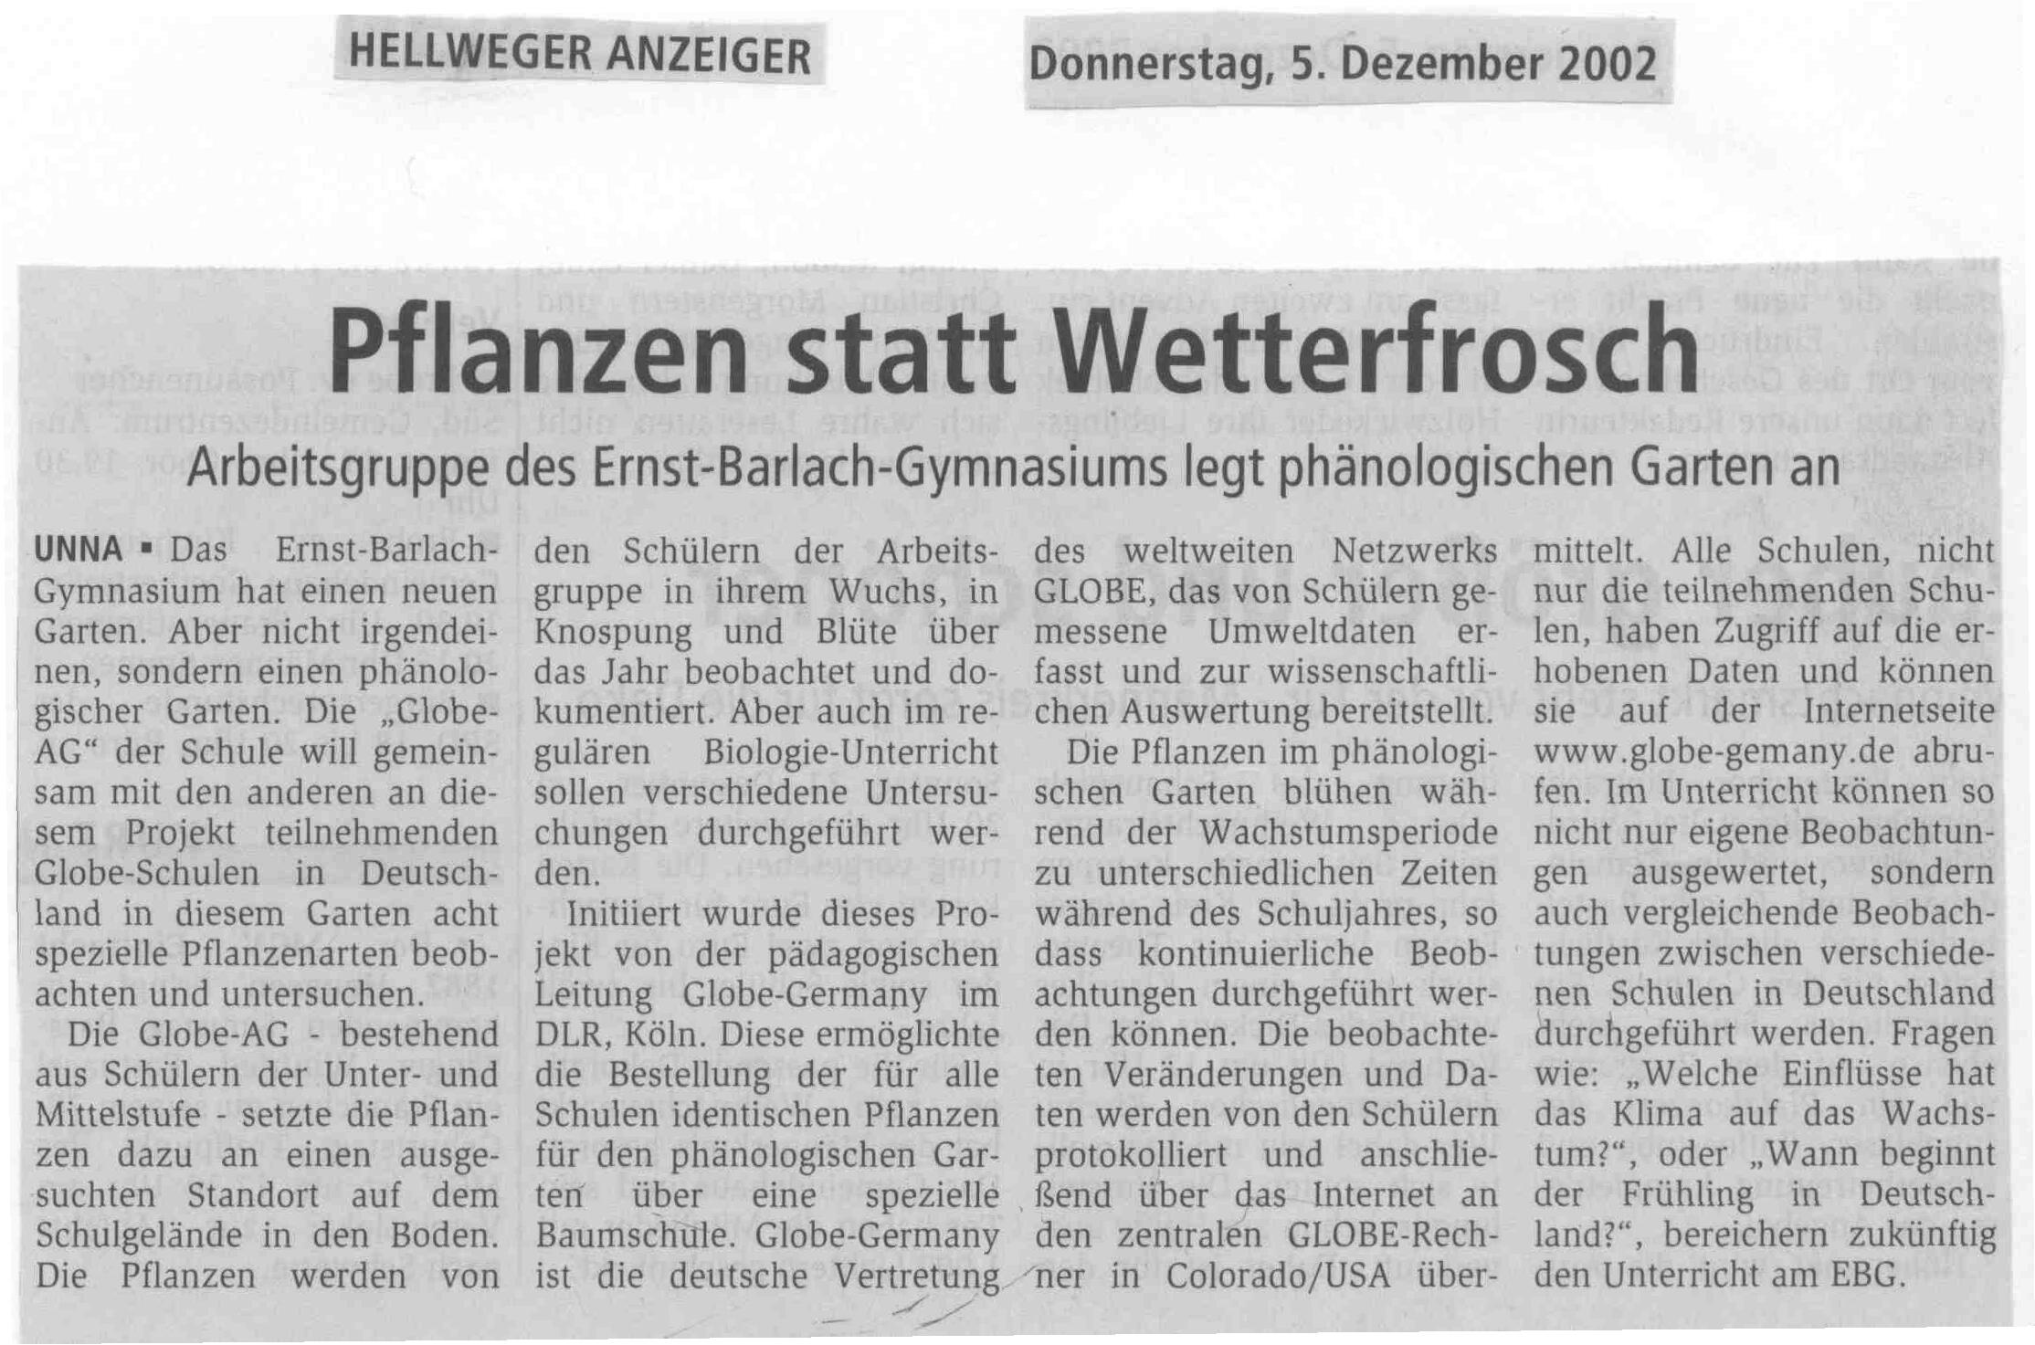

Slide 14
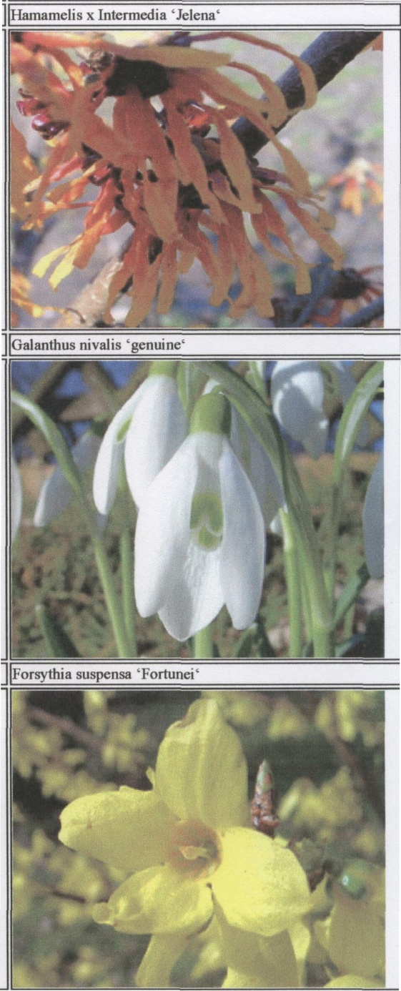
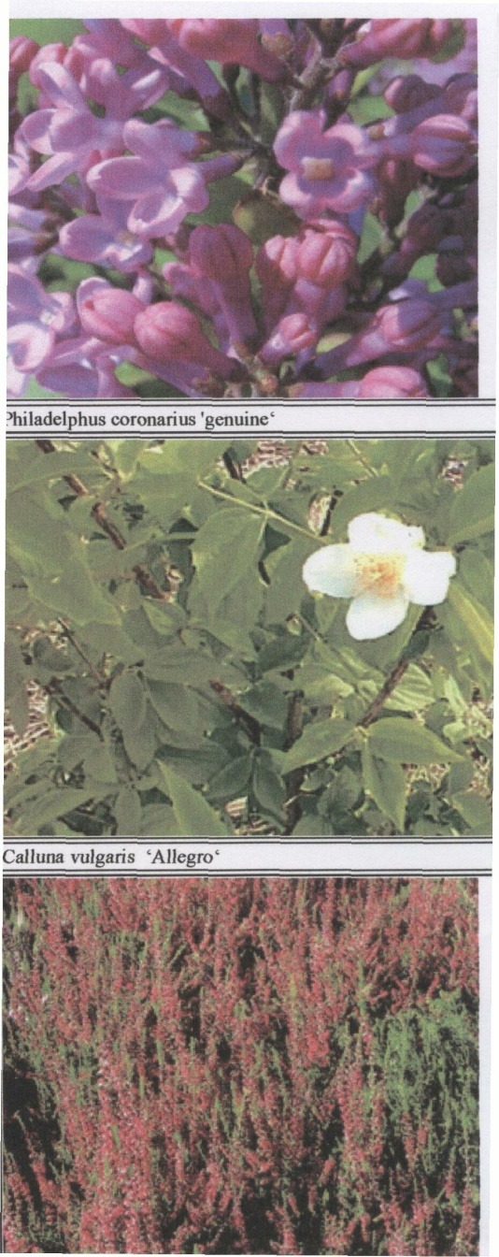
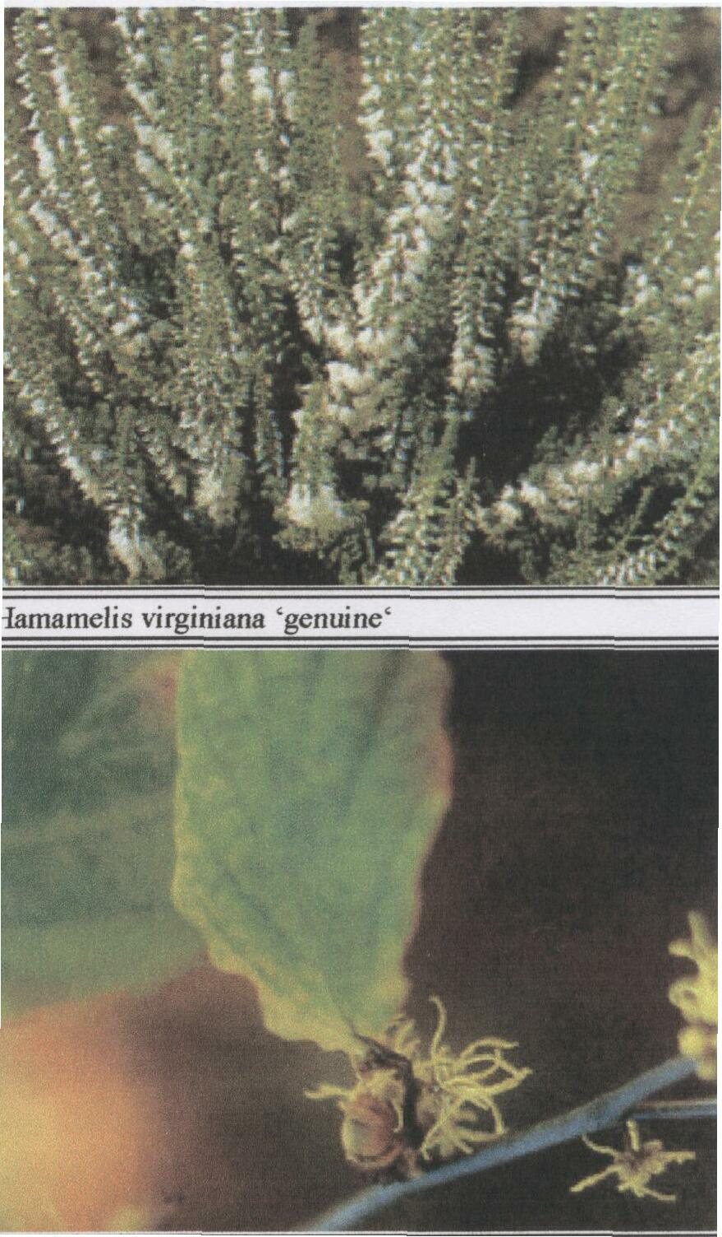
GLOBE – Environment and Future
The 8 plants of the Phenological Garden

Slide 15
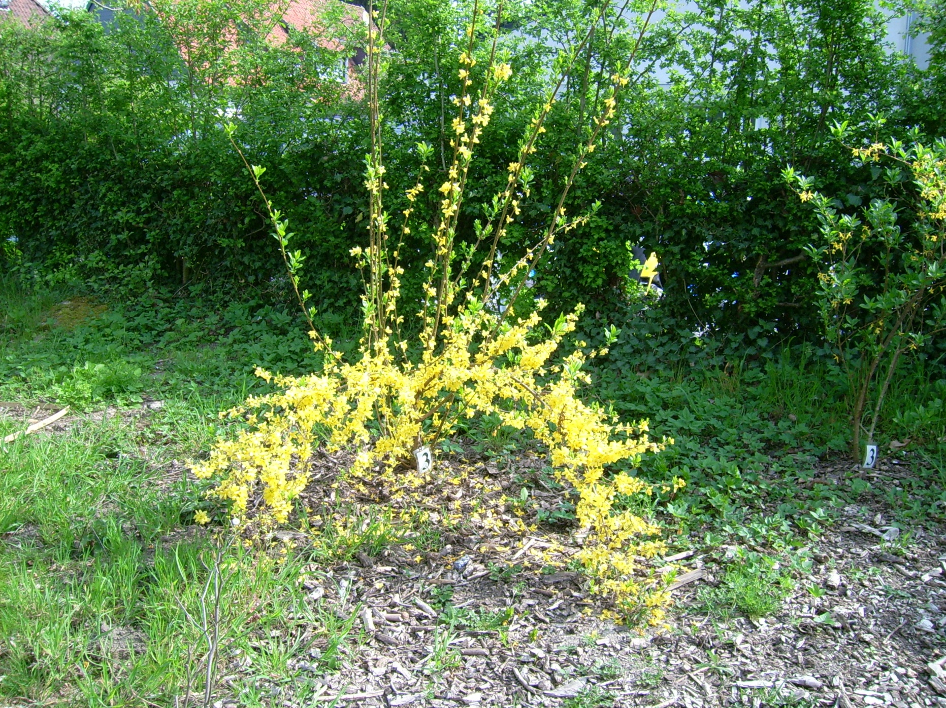
GLOBE – Environment and Future
Forsythie in March

Slide 16
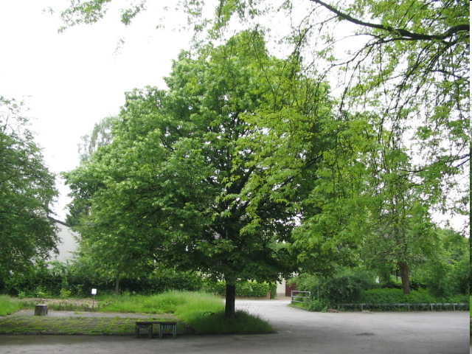
GLOBE – Environment and Future
Survey and map of tree register

Slide 17
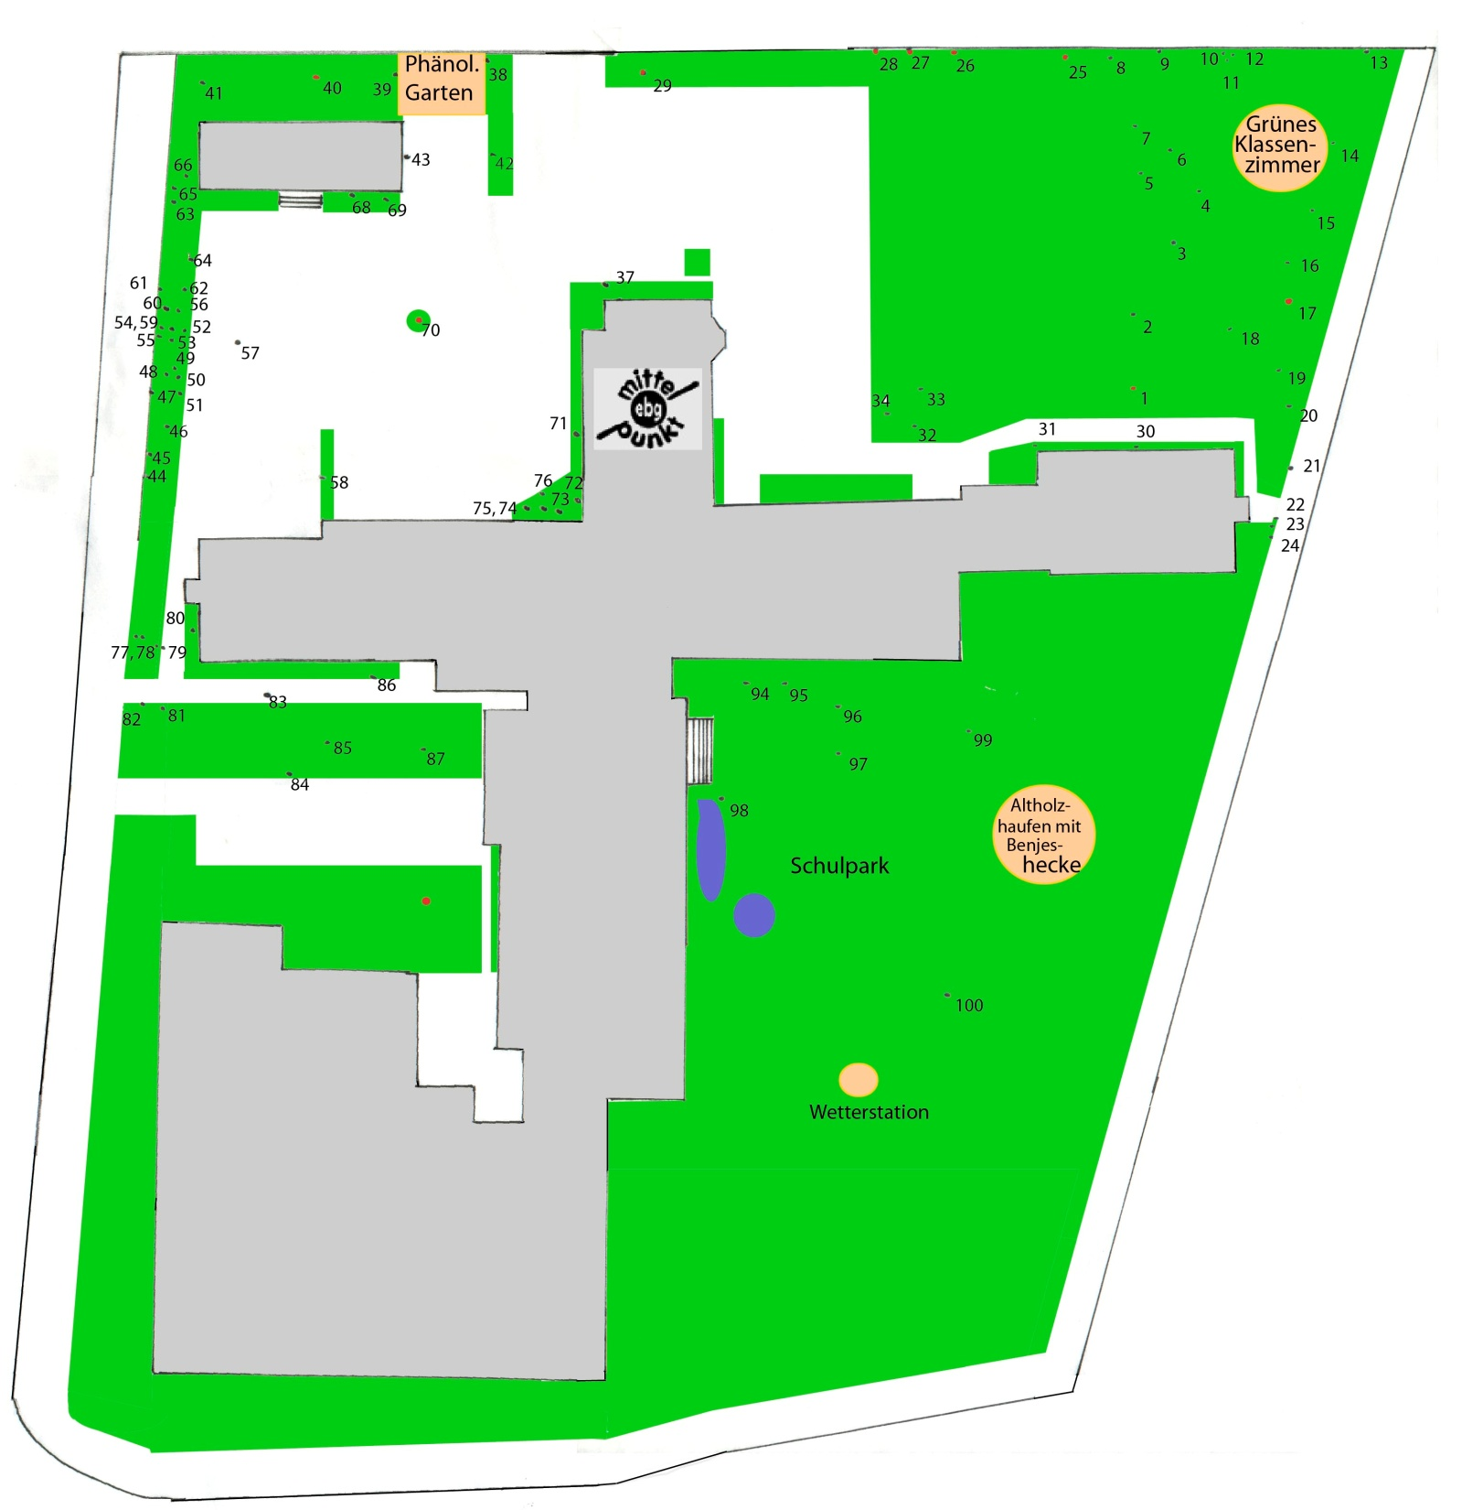

Südhof
Nordhof
Eingang
Turnhallen

Slide 18
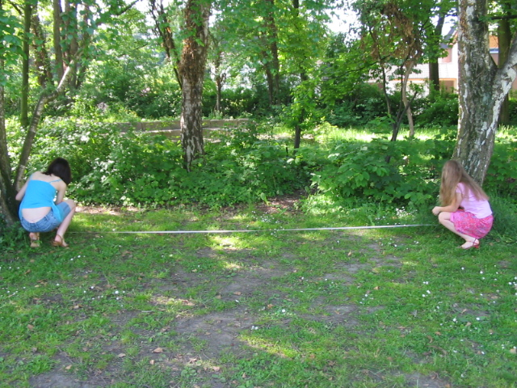
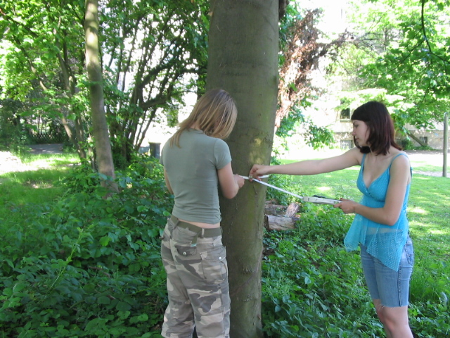
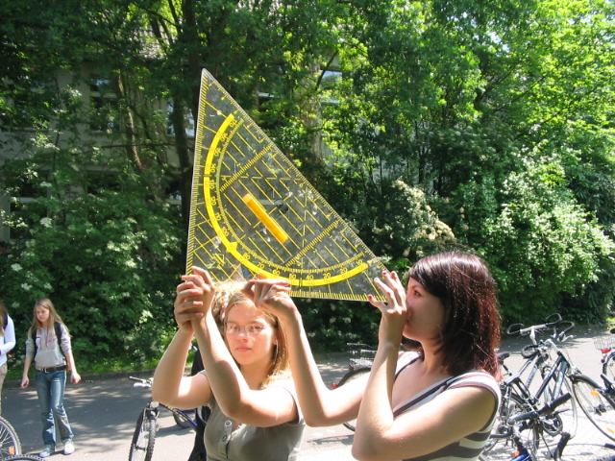
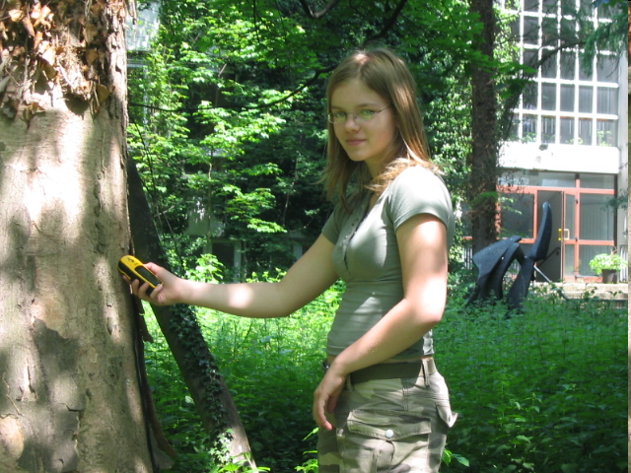
tape measure for
location determining
tape measure for
size measurement
geotriangle for
height determining
GPS-equipment for
position determining

Slide 19
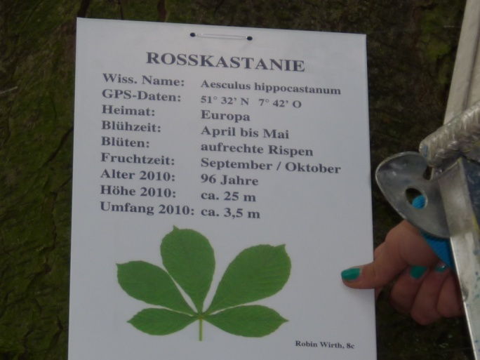
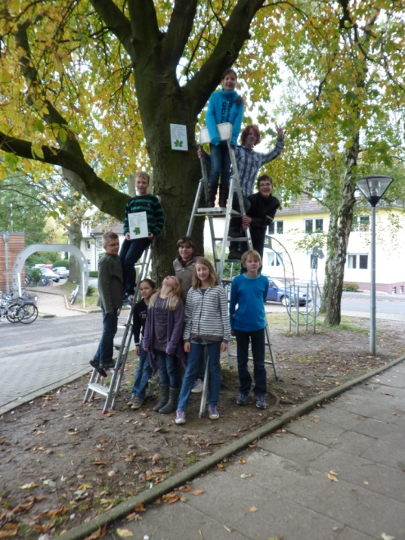
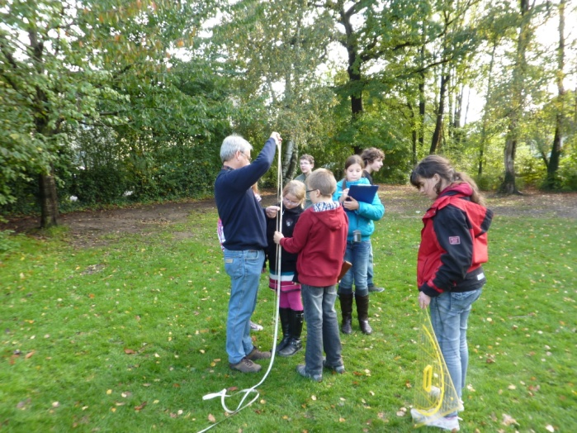
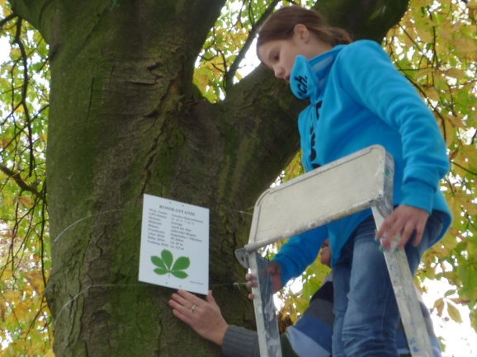
GLOBE – Environment and Future

Slide 20
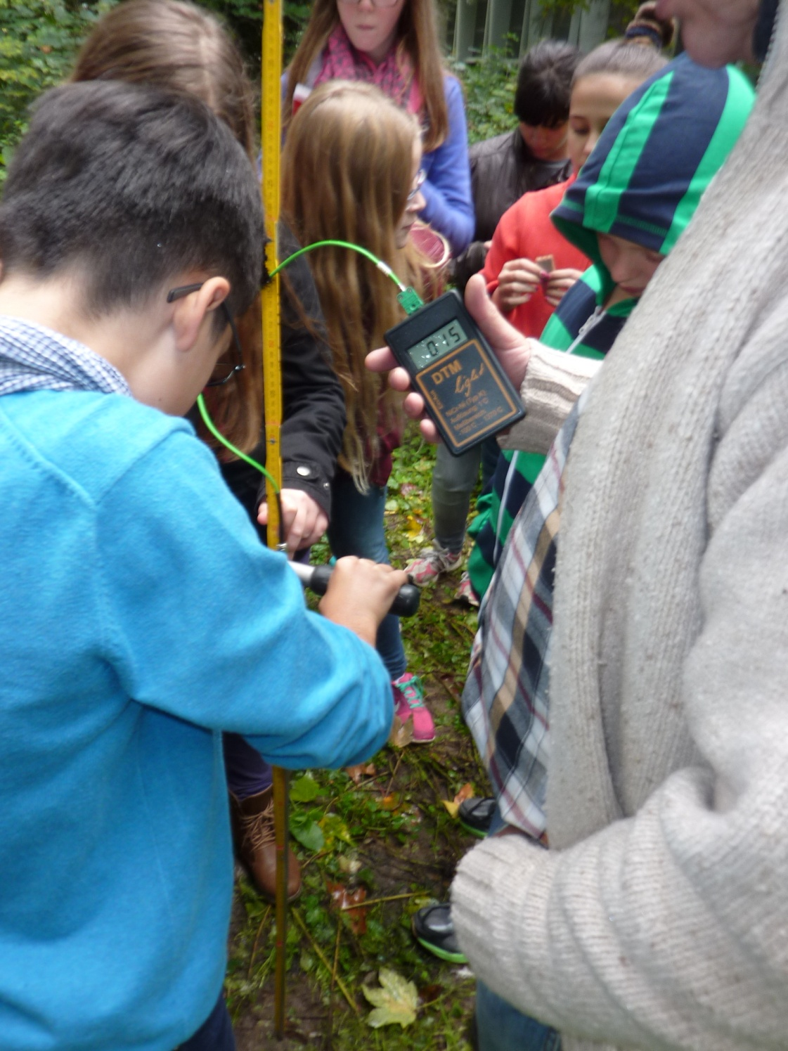
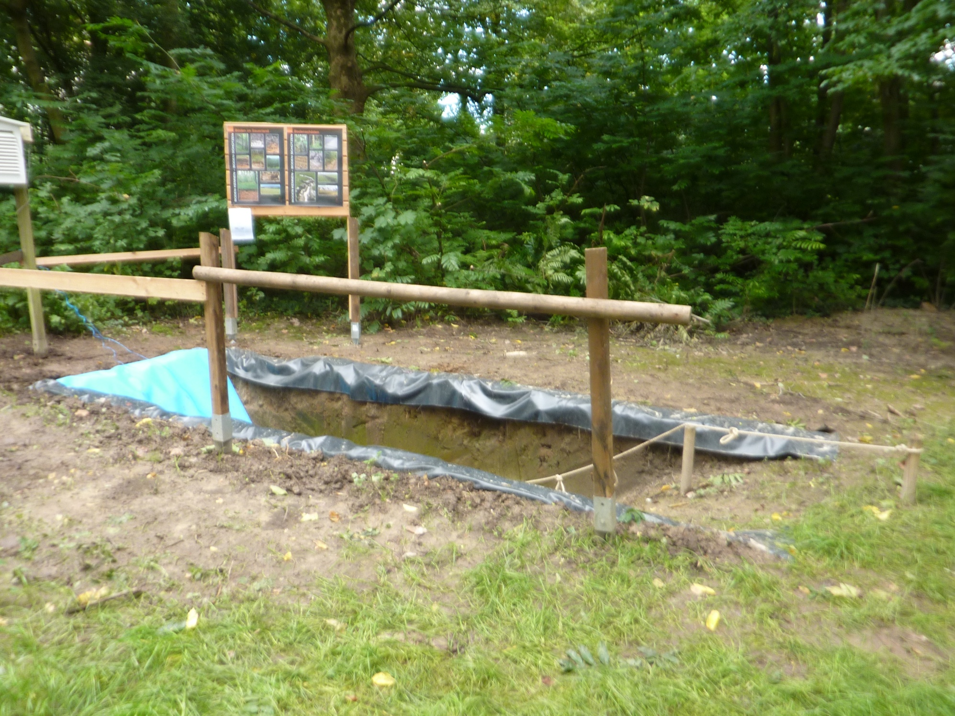
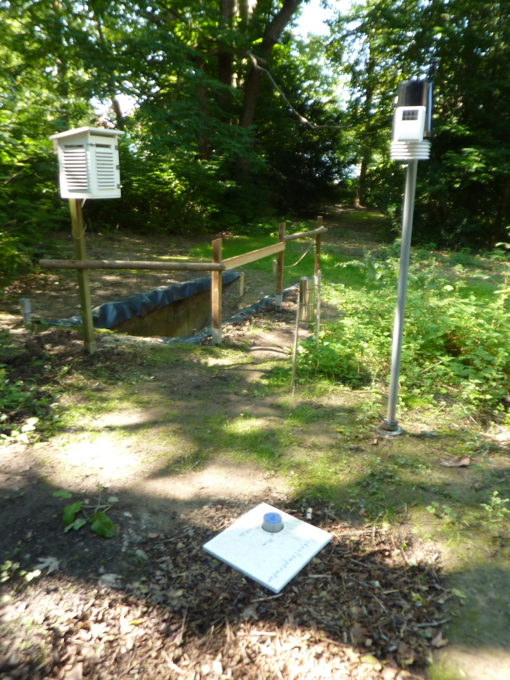
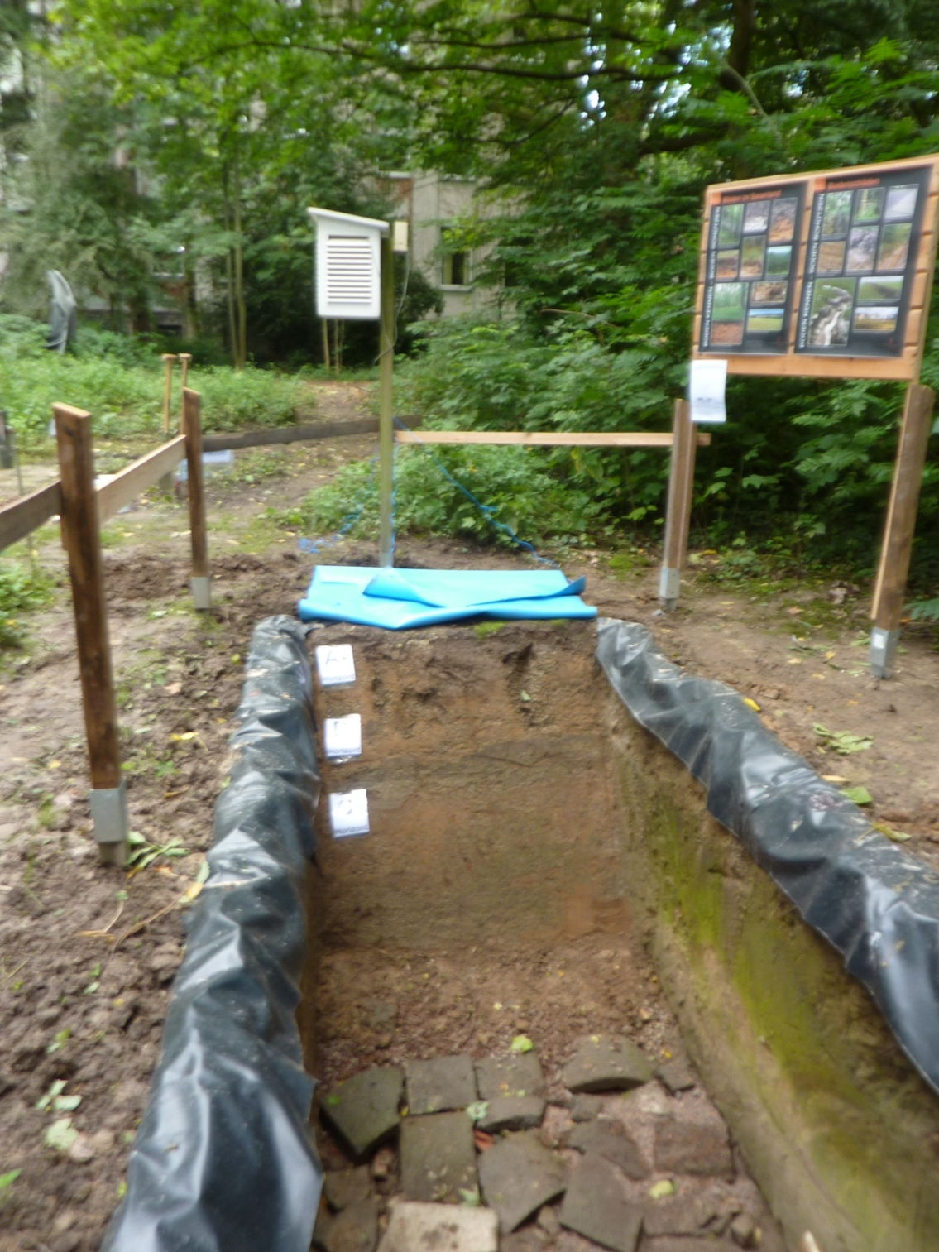

Slide 21
GLOBE – Environment and Future
Atmos-phere
Hydros-phäre
Biosphere
Lithosphere
21

Slide 22



GLOBE – Environment and Future
planning and developing – analysing and experimenting –
identifying solutions and presenting
Exkursions und Laboratorytests
22

Slide 23

EBG
Emscher
Kortelbach
Liedbach
Ruhr

Slide 24







GLOBE – Environment and Future

Slide 25






GLOBE – Environment and Future

Slide 26

GLOBE – Environment and Future

Slide 27

GLOBE – Environment and Future

Slide 28


Slide 29
EBG
Emscher
Kortelbach
Liedbach
Ruhr

Slide 30





GLOBE – Environment and Future
30

Slide 31

GLOBE – Environment and Future
BIO-SOS
Biological standard method for warning of ozone and sulfur dioxide

Slide 32


GLOBE – Environment and Future

Slide 33



Slide 34


GLOBE – Environment and Future

Slide 35

GLOBE – Environment and Future

Slide 36

GLOBE – Environment and Future

Slide 37

GLOBE – Environment and Future

Slide 39









GLOBE – Environment and Future

Slide 40

GLOBE – Environment and Future

Slide 41
GLOBE – Environment and Future
Thank you for your attention!

