Slide 1
Implementing GLOBE in Princess Chulabhorn Science High School NST. (Regional Science School) Thailand.
PCSHS. NST.
GLOBE
GLOBE ANNUAL MEETING 2017, 1st August 2017@Connecticut
STEM-PLC
Kanokrat Singnui
Princess Chulabhorn Science High School Nakhon Si Tammarat

Slide 2
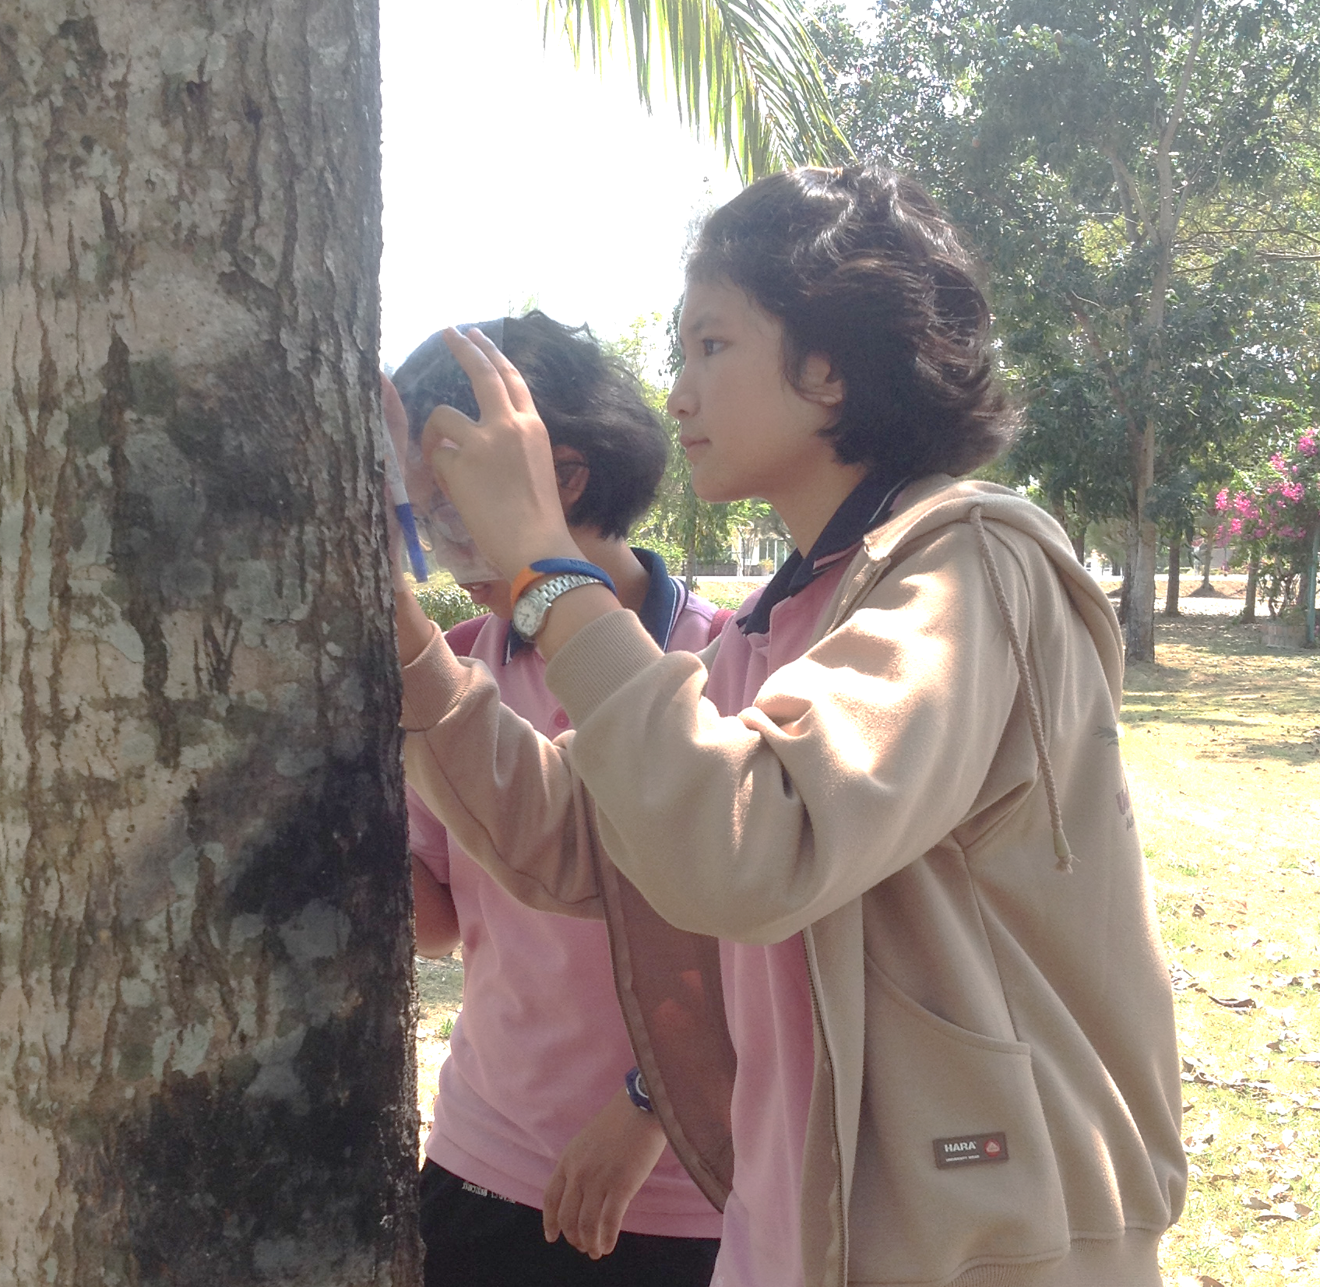
PCSHS. NST.
GLOBE
Implementing GLOBE in PCSHS NST. THAILAND
STEM-PLC
GLOBE Community
GLOBE Experimental
GLOBE Process
GLOBE Training
GLOBE Project in PCSHS.NST

Slide 3
PCSHS. NST.
GLOBE
Implementing GLOBE in PCSHS NST. THAILAND
STEM-PLC
GLOBE Process
GLOBE Project in PCSHS.NST

Slide 4
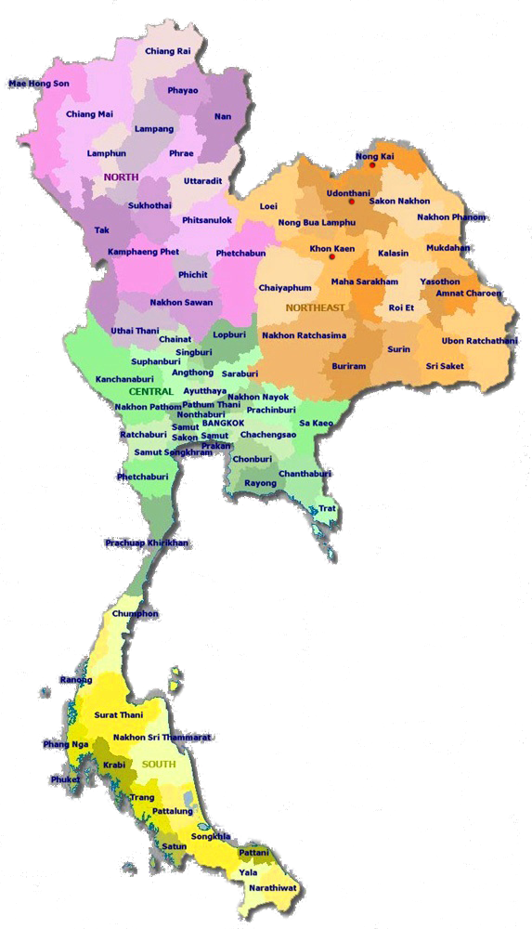
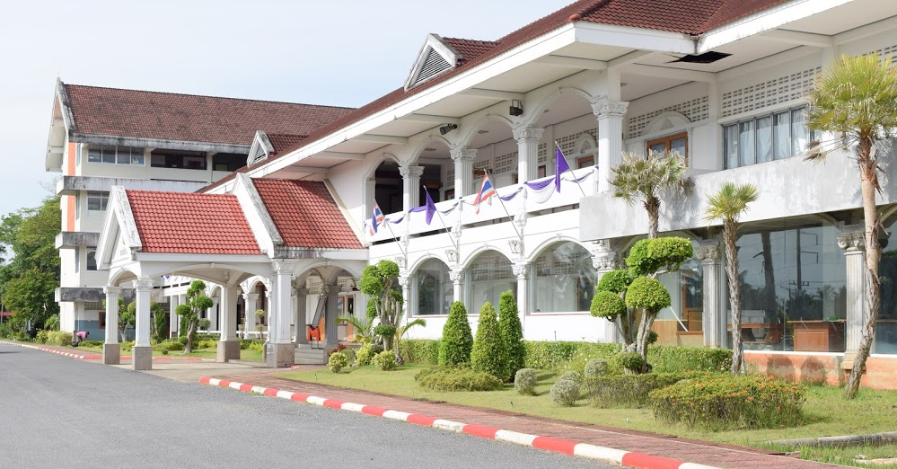
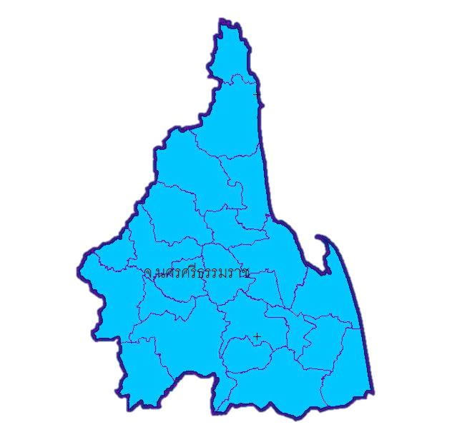
PCSHS. NST.
GLOBE
PCSHS NST Thailand.
STEM-PLC
Princess Chulabhorn Science High School Nakhon Si Tammarat, Thailand.
1 of 12 school of Princess Chulabhorn Science High School (PCSHS) of Thailand.
Regional Science School.
PCSHS. schools established by the Office of the Basic Education Commission to commemorate the
On the occasion of Her Royal Highness Princess Chulabhorn's birthday. His throne is three years round on July 4, 1993.
Curriculum :Regional Science School Program

Slide 5
PCSHS. NST.
GLOBE
PCSHS NST Science Project & GLOBE Project
STEM-PLC
GLOBE Project
PCSHS NST’s Curriculum : Science Project Course
Published/Conference
Supported by the Trainer
Grade 10 : 2stSemester
Data analysis & report
Grade 11 : 1stSemester
Science project experiment
Workshop & Experiment & Data analysis
Grade 10 : 2stSemester
Project proposal & Project pre-study
Grade 10 : 1stSemester
Topic seminar and Project planning
Project is started
5

Slide 6
PCSHS. NST.
GLOBE
PCSHS NST Science Project & GLOBE Project
STEM-PLC
GLOBE Project
PCSHS NST’s Curriculum : Science Project Course
Published/Conference
System Thinking
&
Coaching
Grade 10 : 2stSemester
Data analysis & report
Grade 11 : 1stSemester
Science project experiment
spirituality
Grade 10 : 2stSemester
Project proposal & Project pre-study
Grade 10 : 1stSemester
Topic seminar and Project planning
6

Slide 7
PCSHS. NST.
GLOBE
PCSHS NST Science Project & GLOBE Project
STEM-PLC
Published/Conference
GLOBE Process
Data analysis & report
GLOBE Training
Science project experiment
Project proposal & Project pre-study
Topic seminar and Project planning

Slide 8
PCSHS. NST.
GLOBE
PCSHS NST’s GLOBE Training
STEM-PLC
Training by GLOBE’s Master trainer.
Training
Training by GLOBE’s Teacher trainer.
Training
Training by GLOBE’s Student
Training

Slide 9
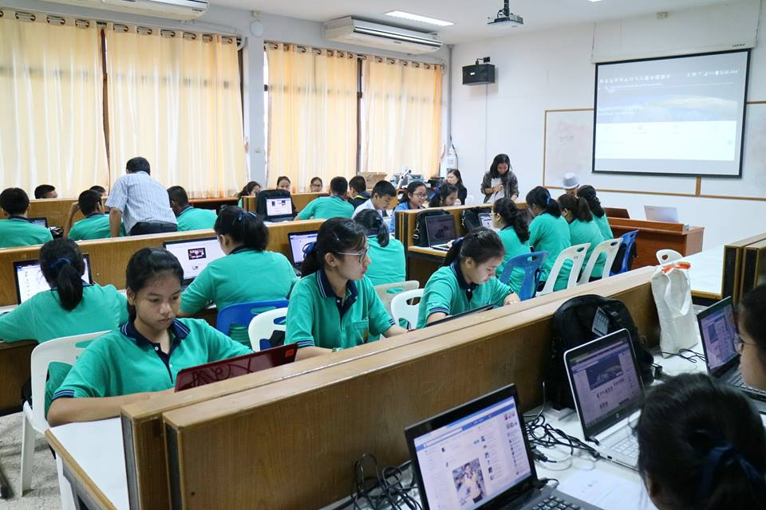
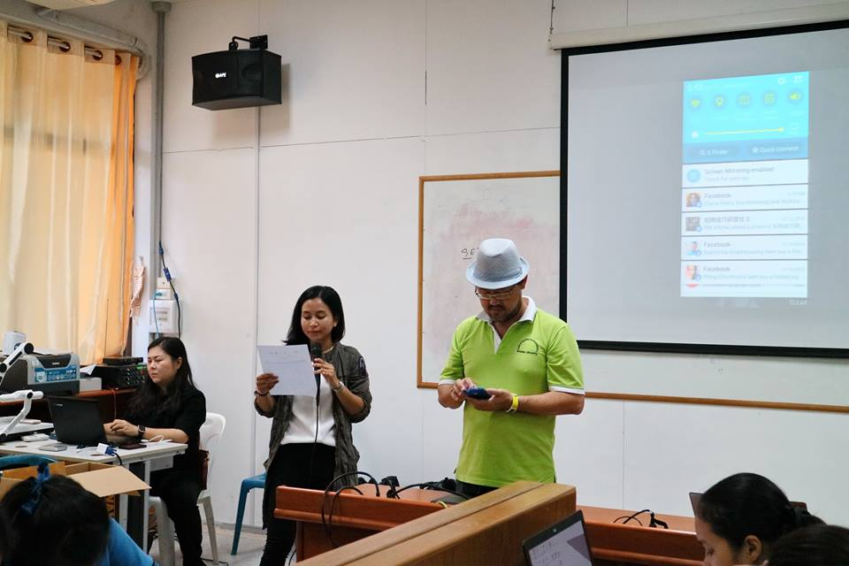
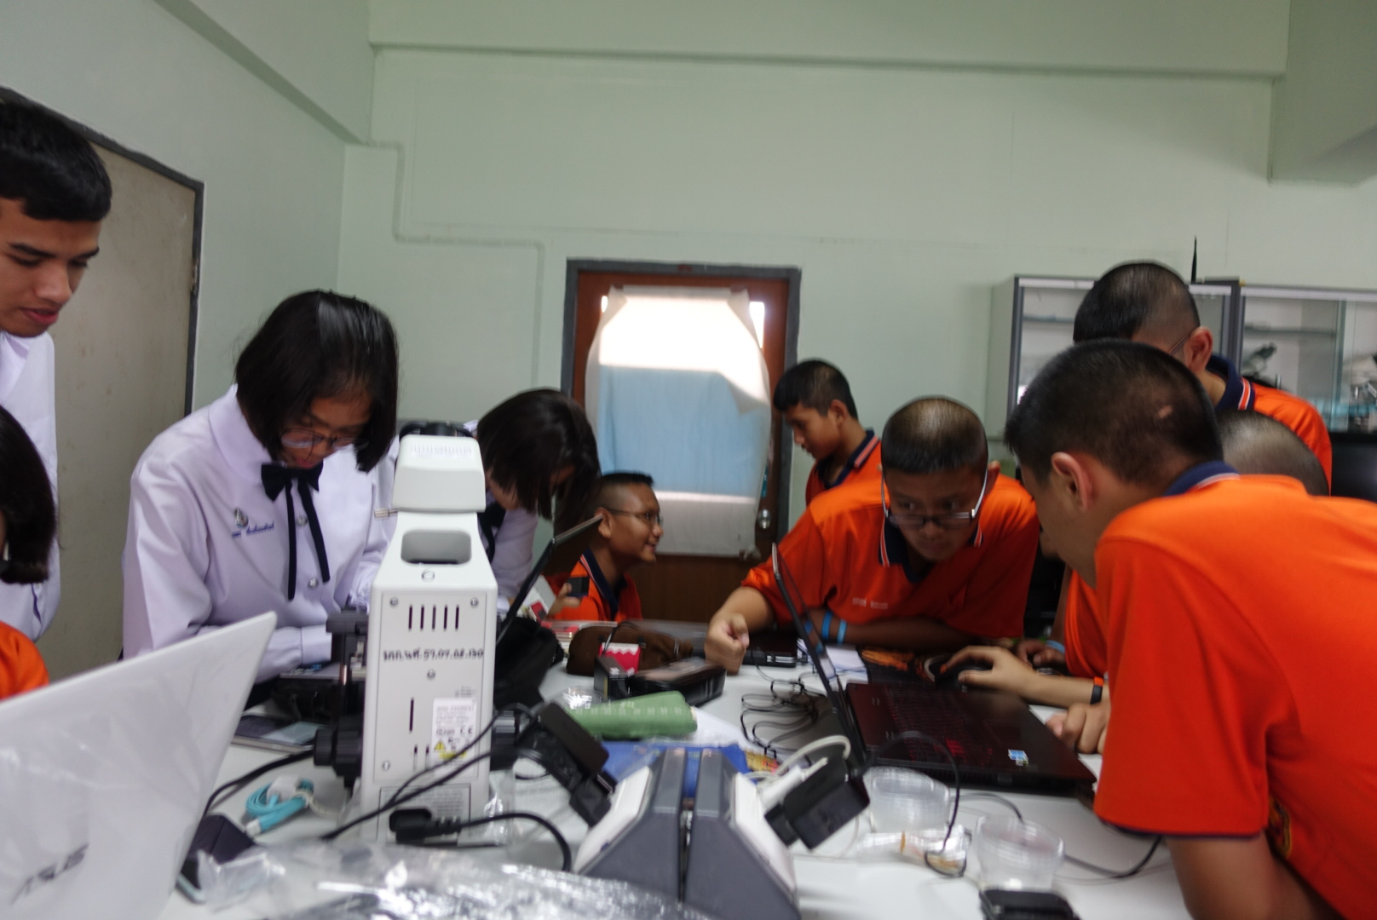
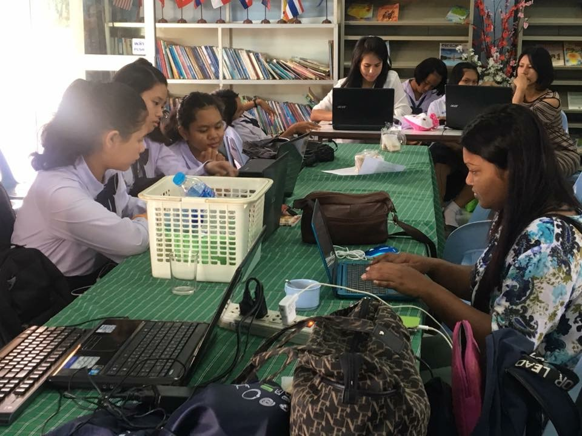
PCSHS. NST.
GLOBE
PCSHS NST’s GLOBE Training
STEM-PLC
Training by GLOBE’s Master trainer Team.
Training
Cloudsat GPM Project@PCSHS.NST
Cloudsat&GPM@SM Tower.WU
Mosquito protocol@PCSHS.NST
Research analyais and report

Slide 10
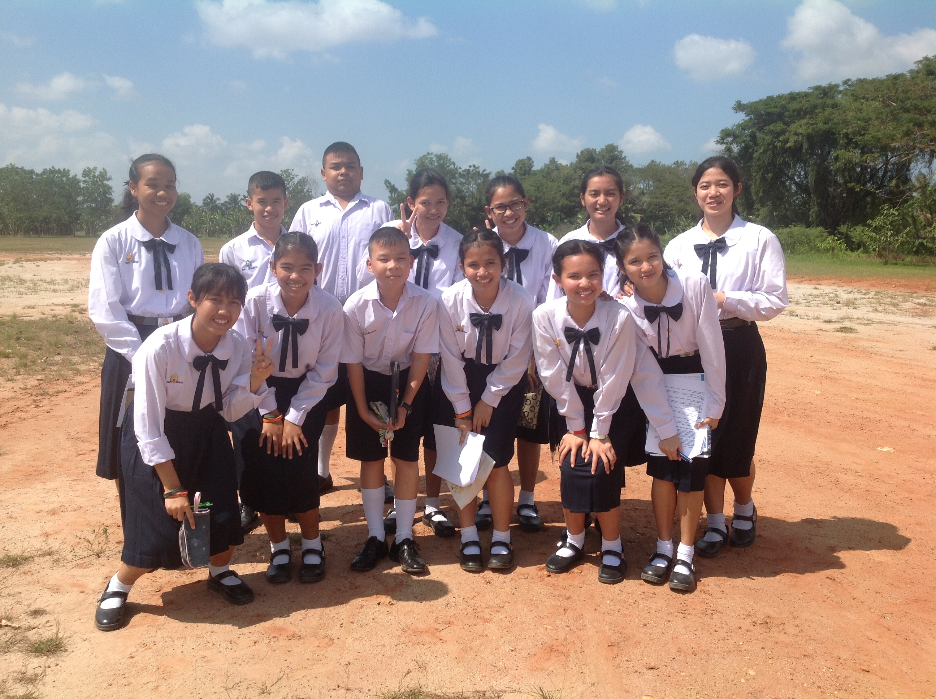
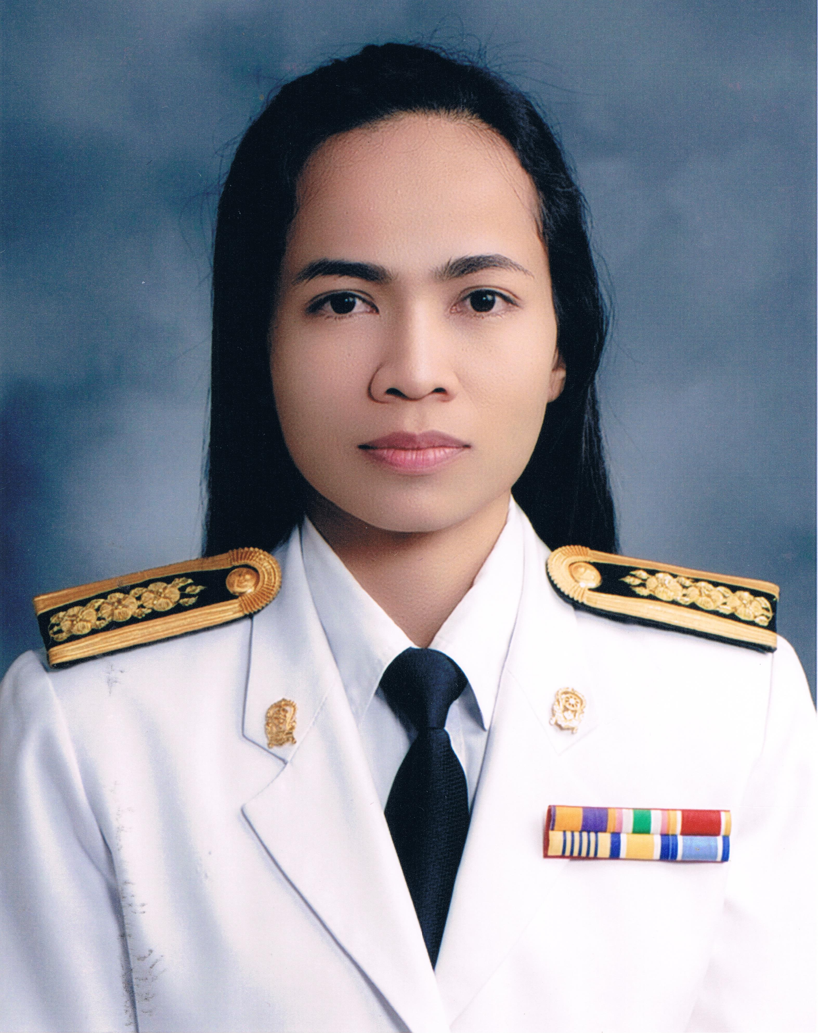
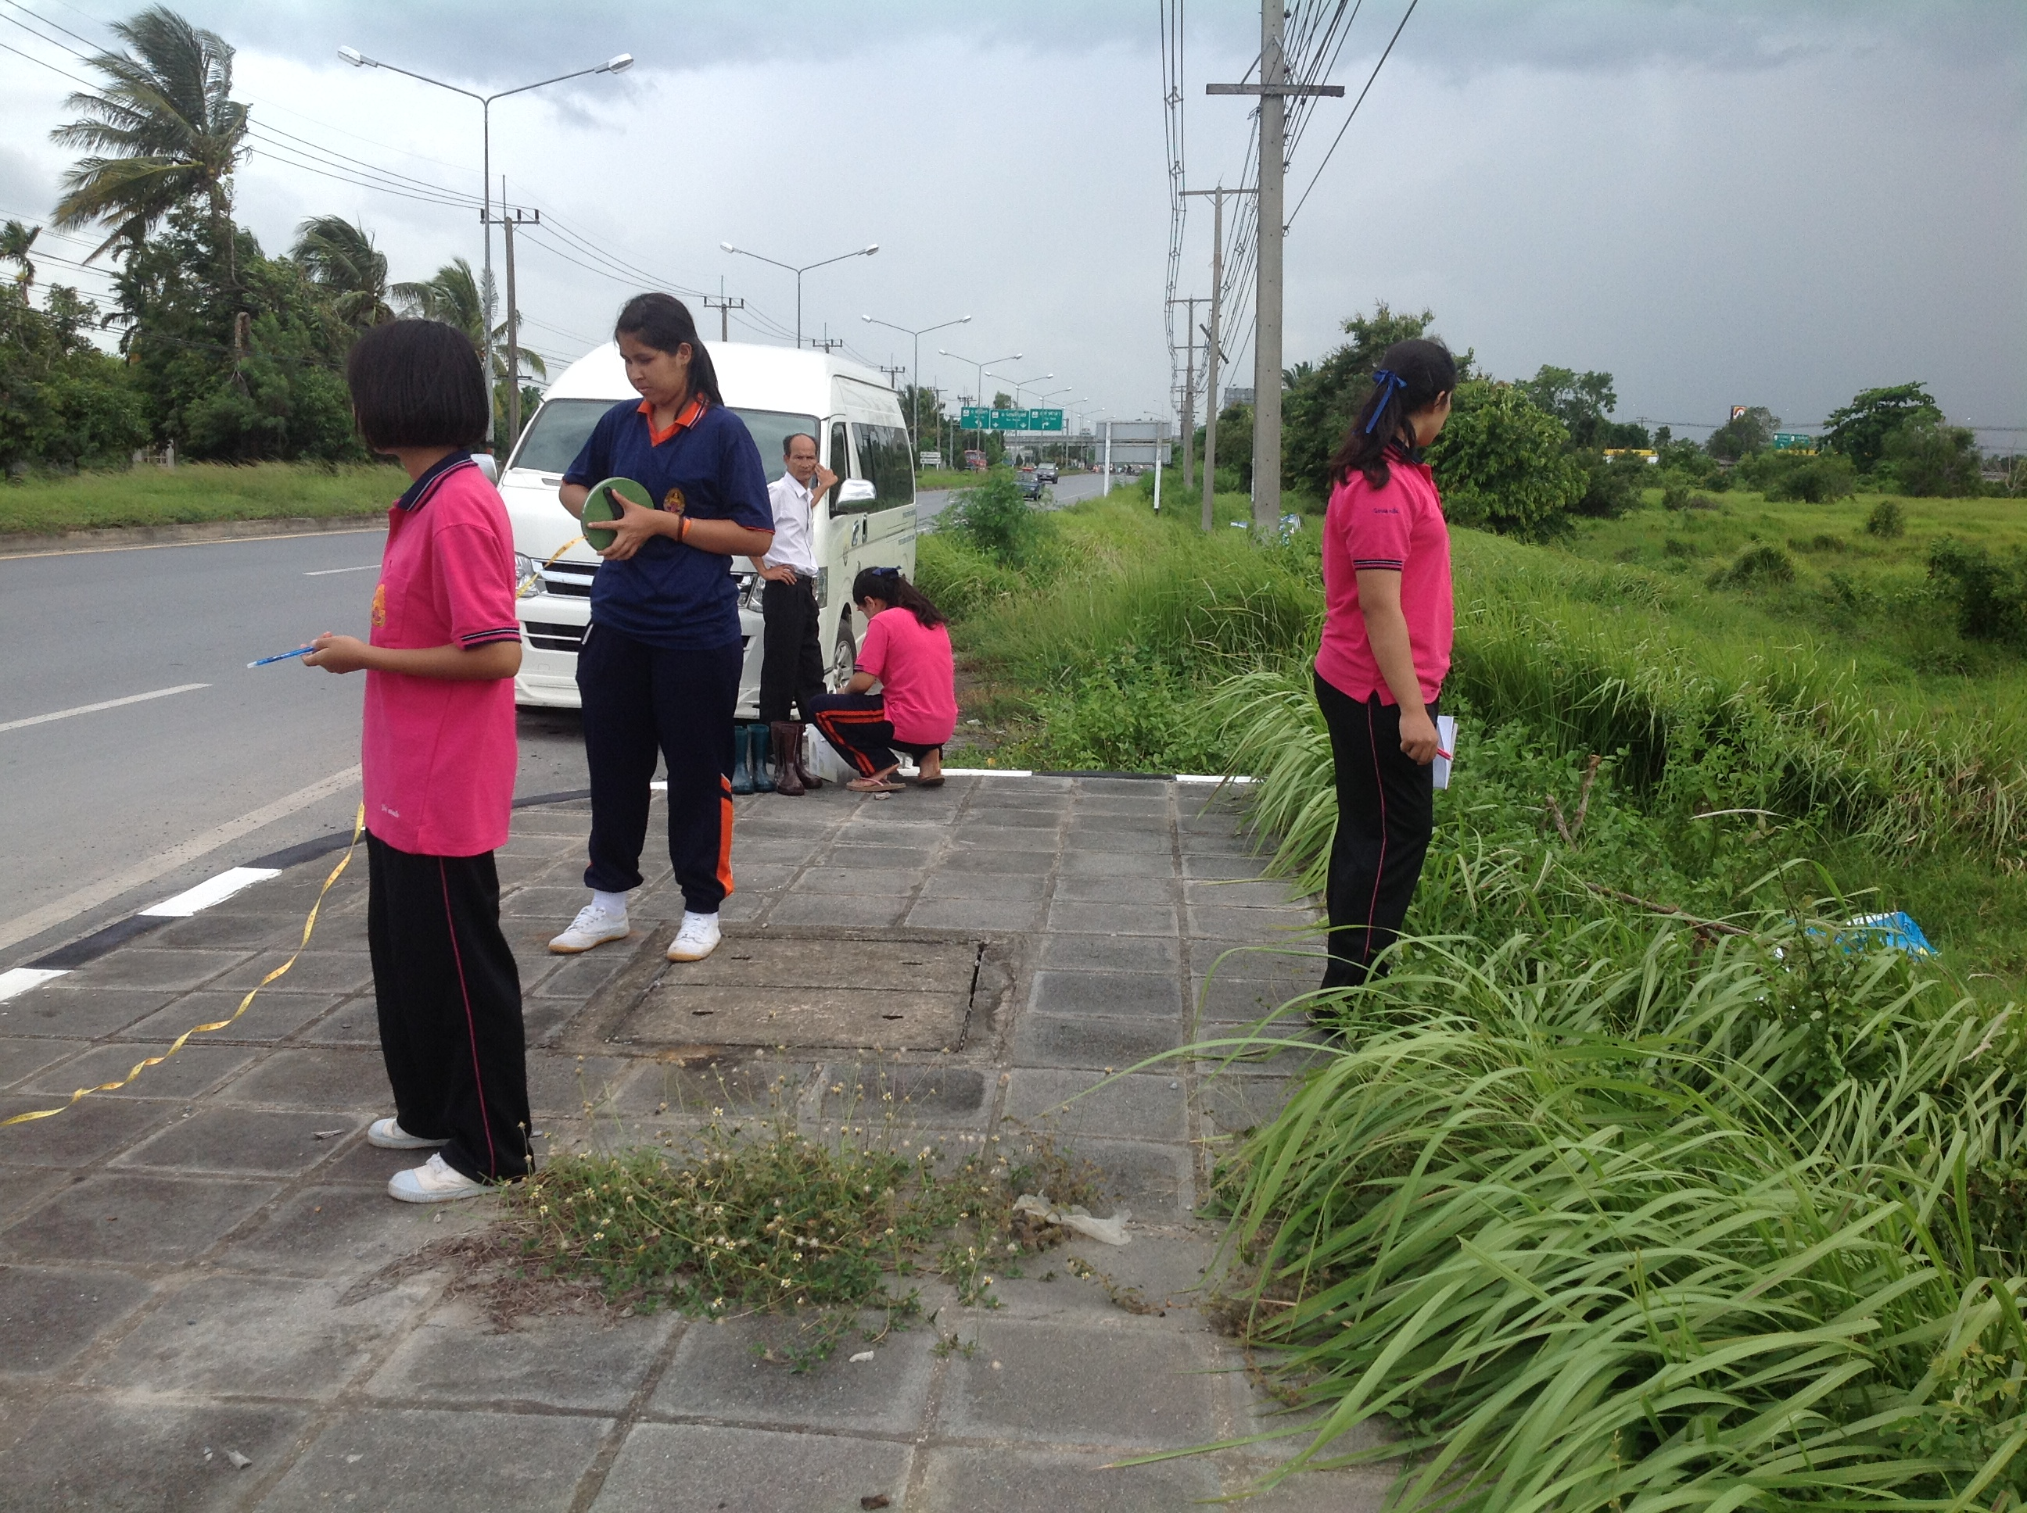
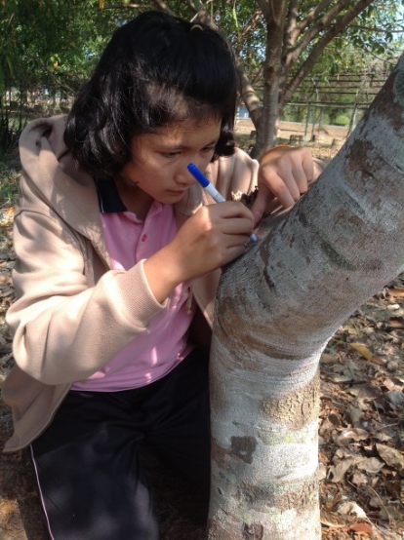
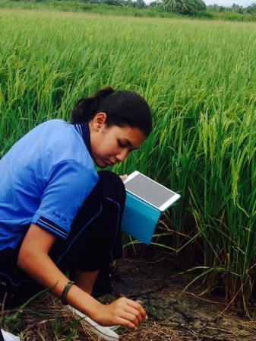
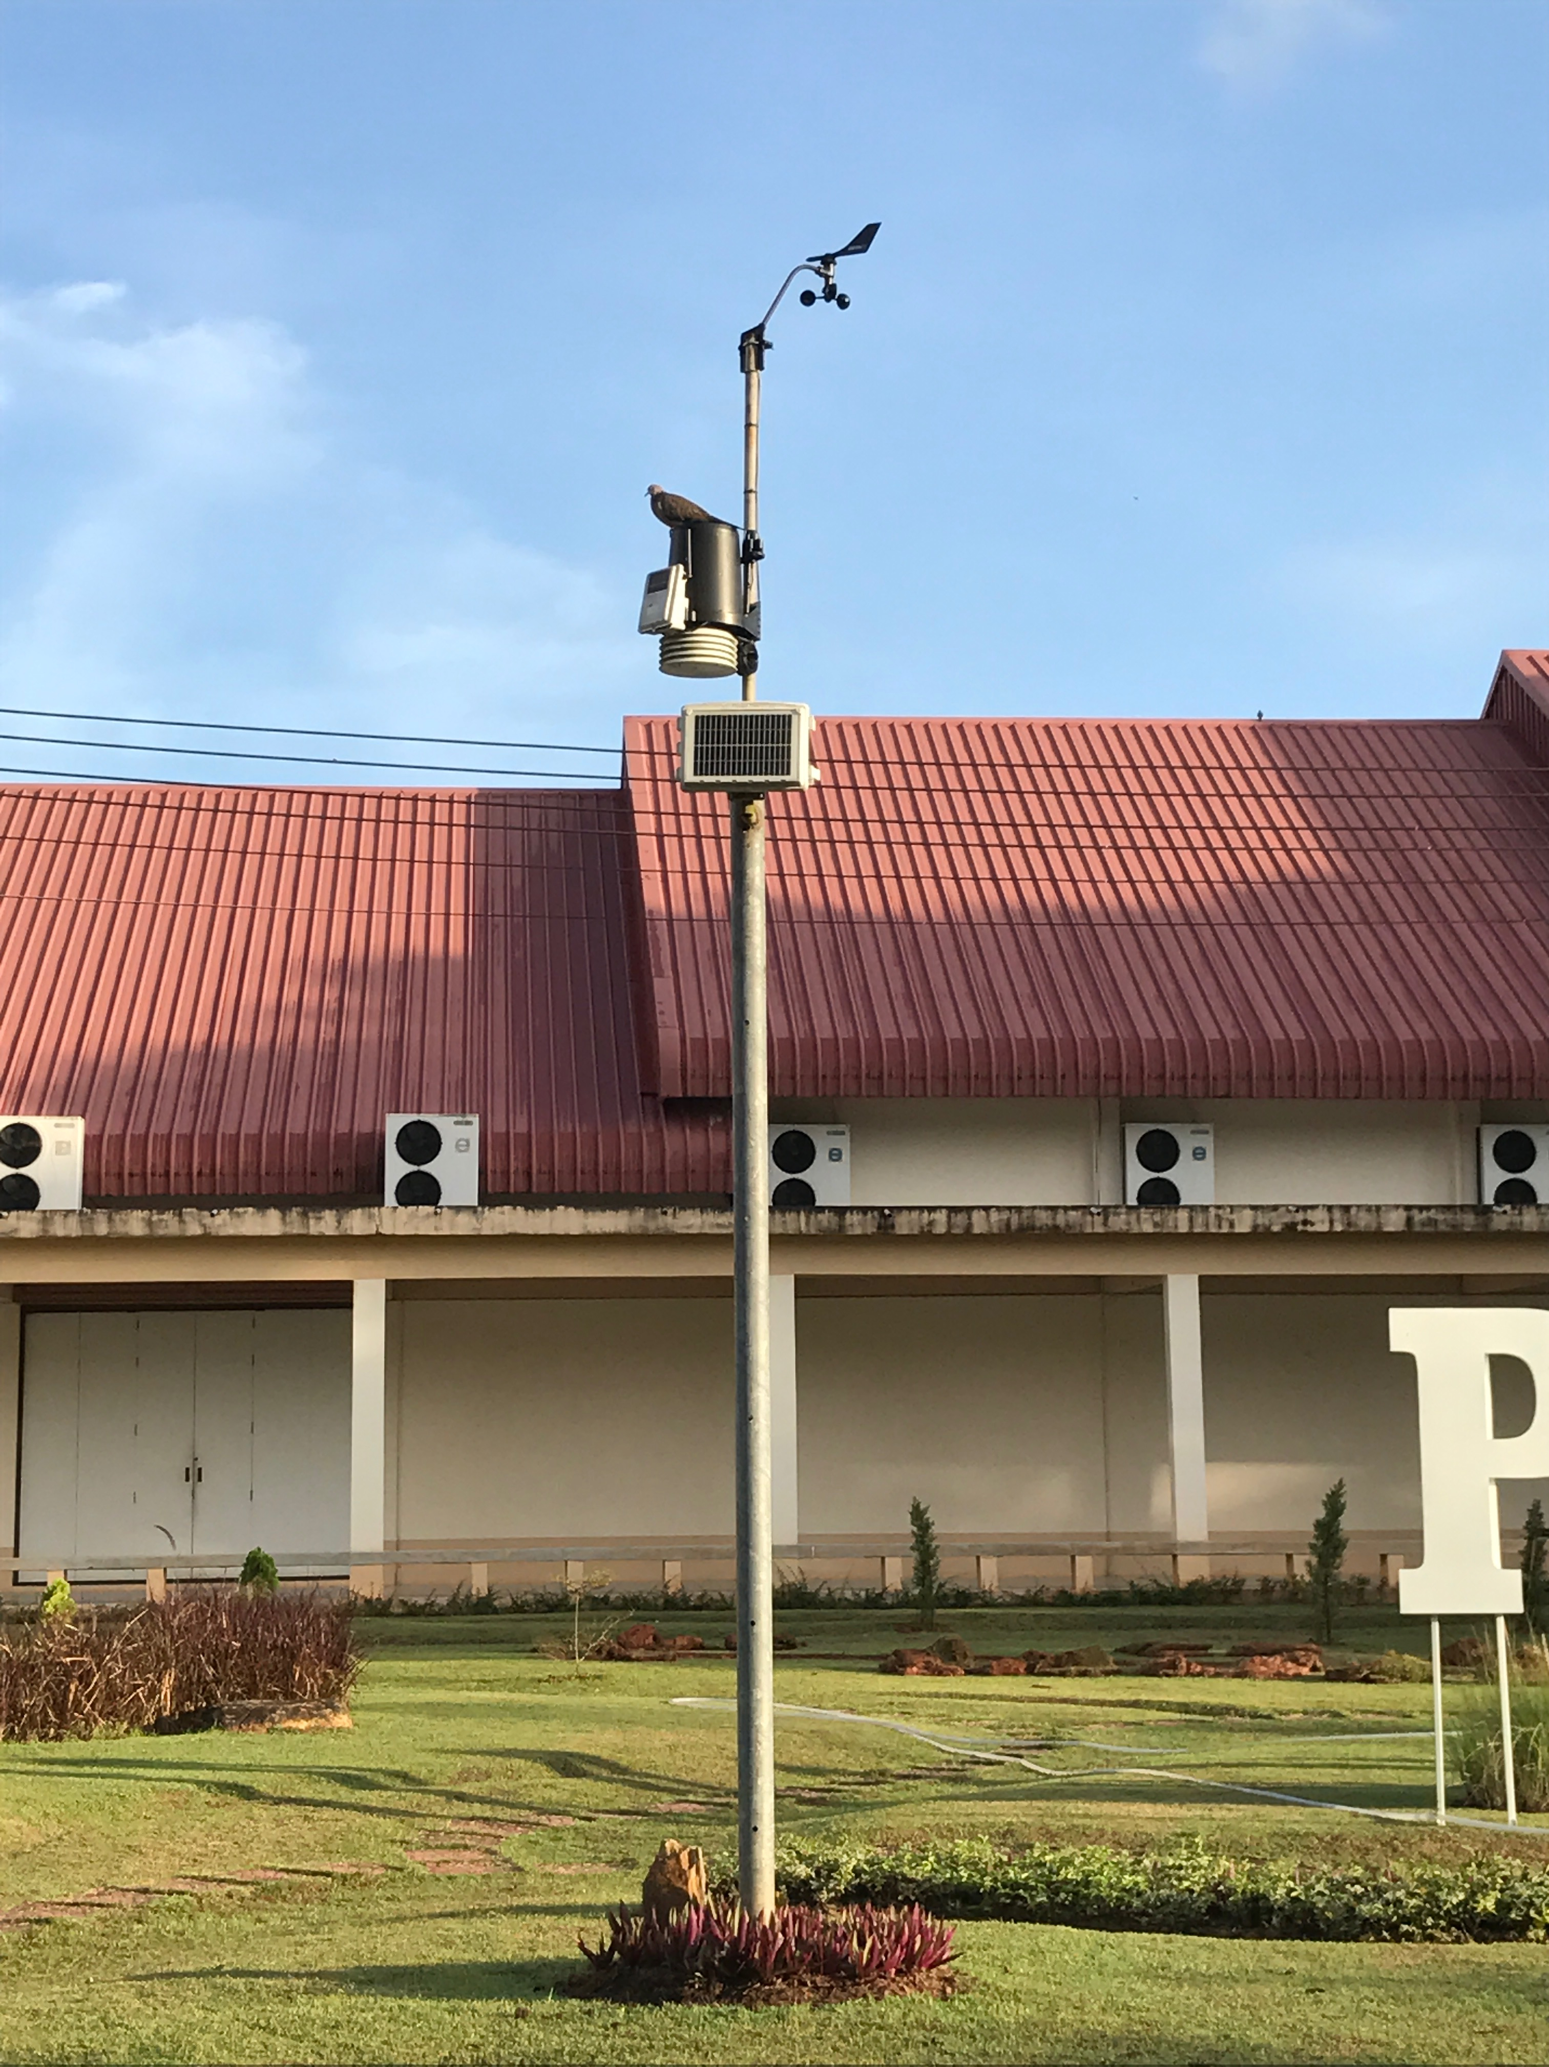
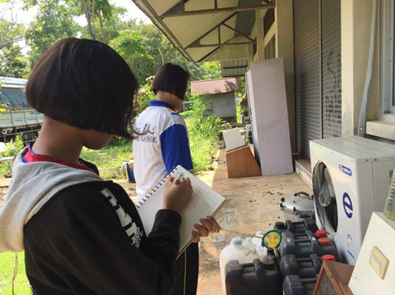
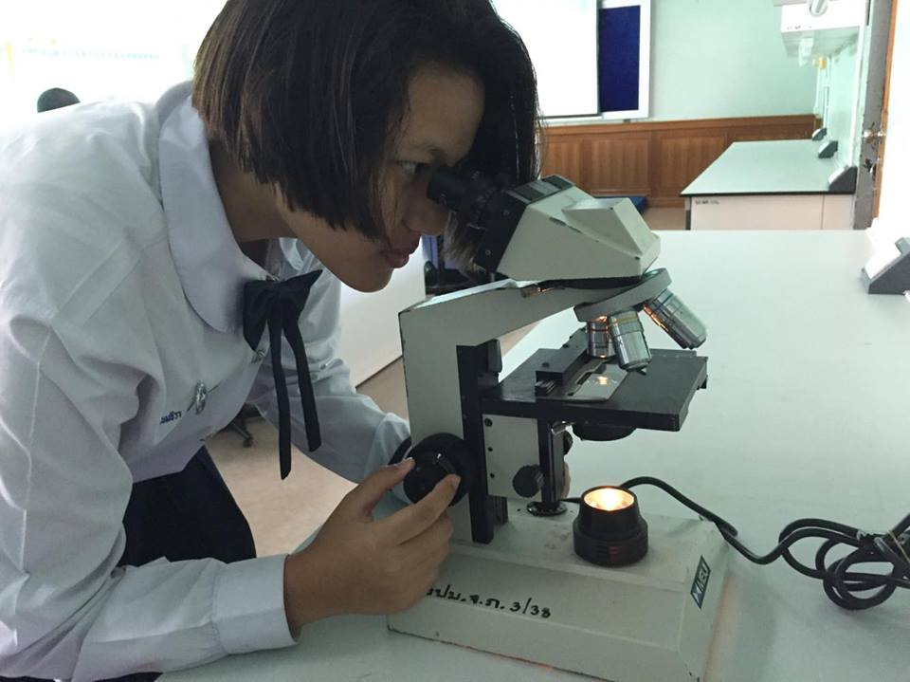
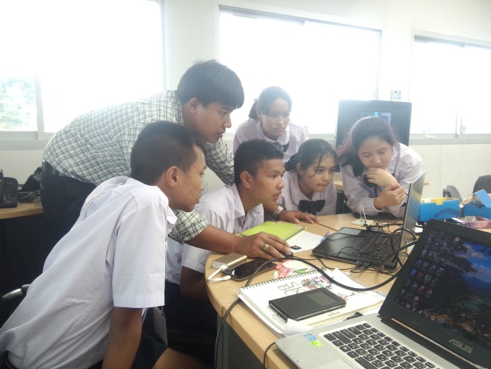
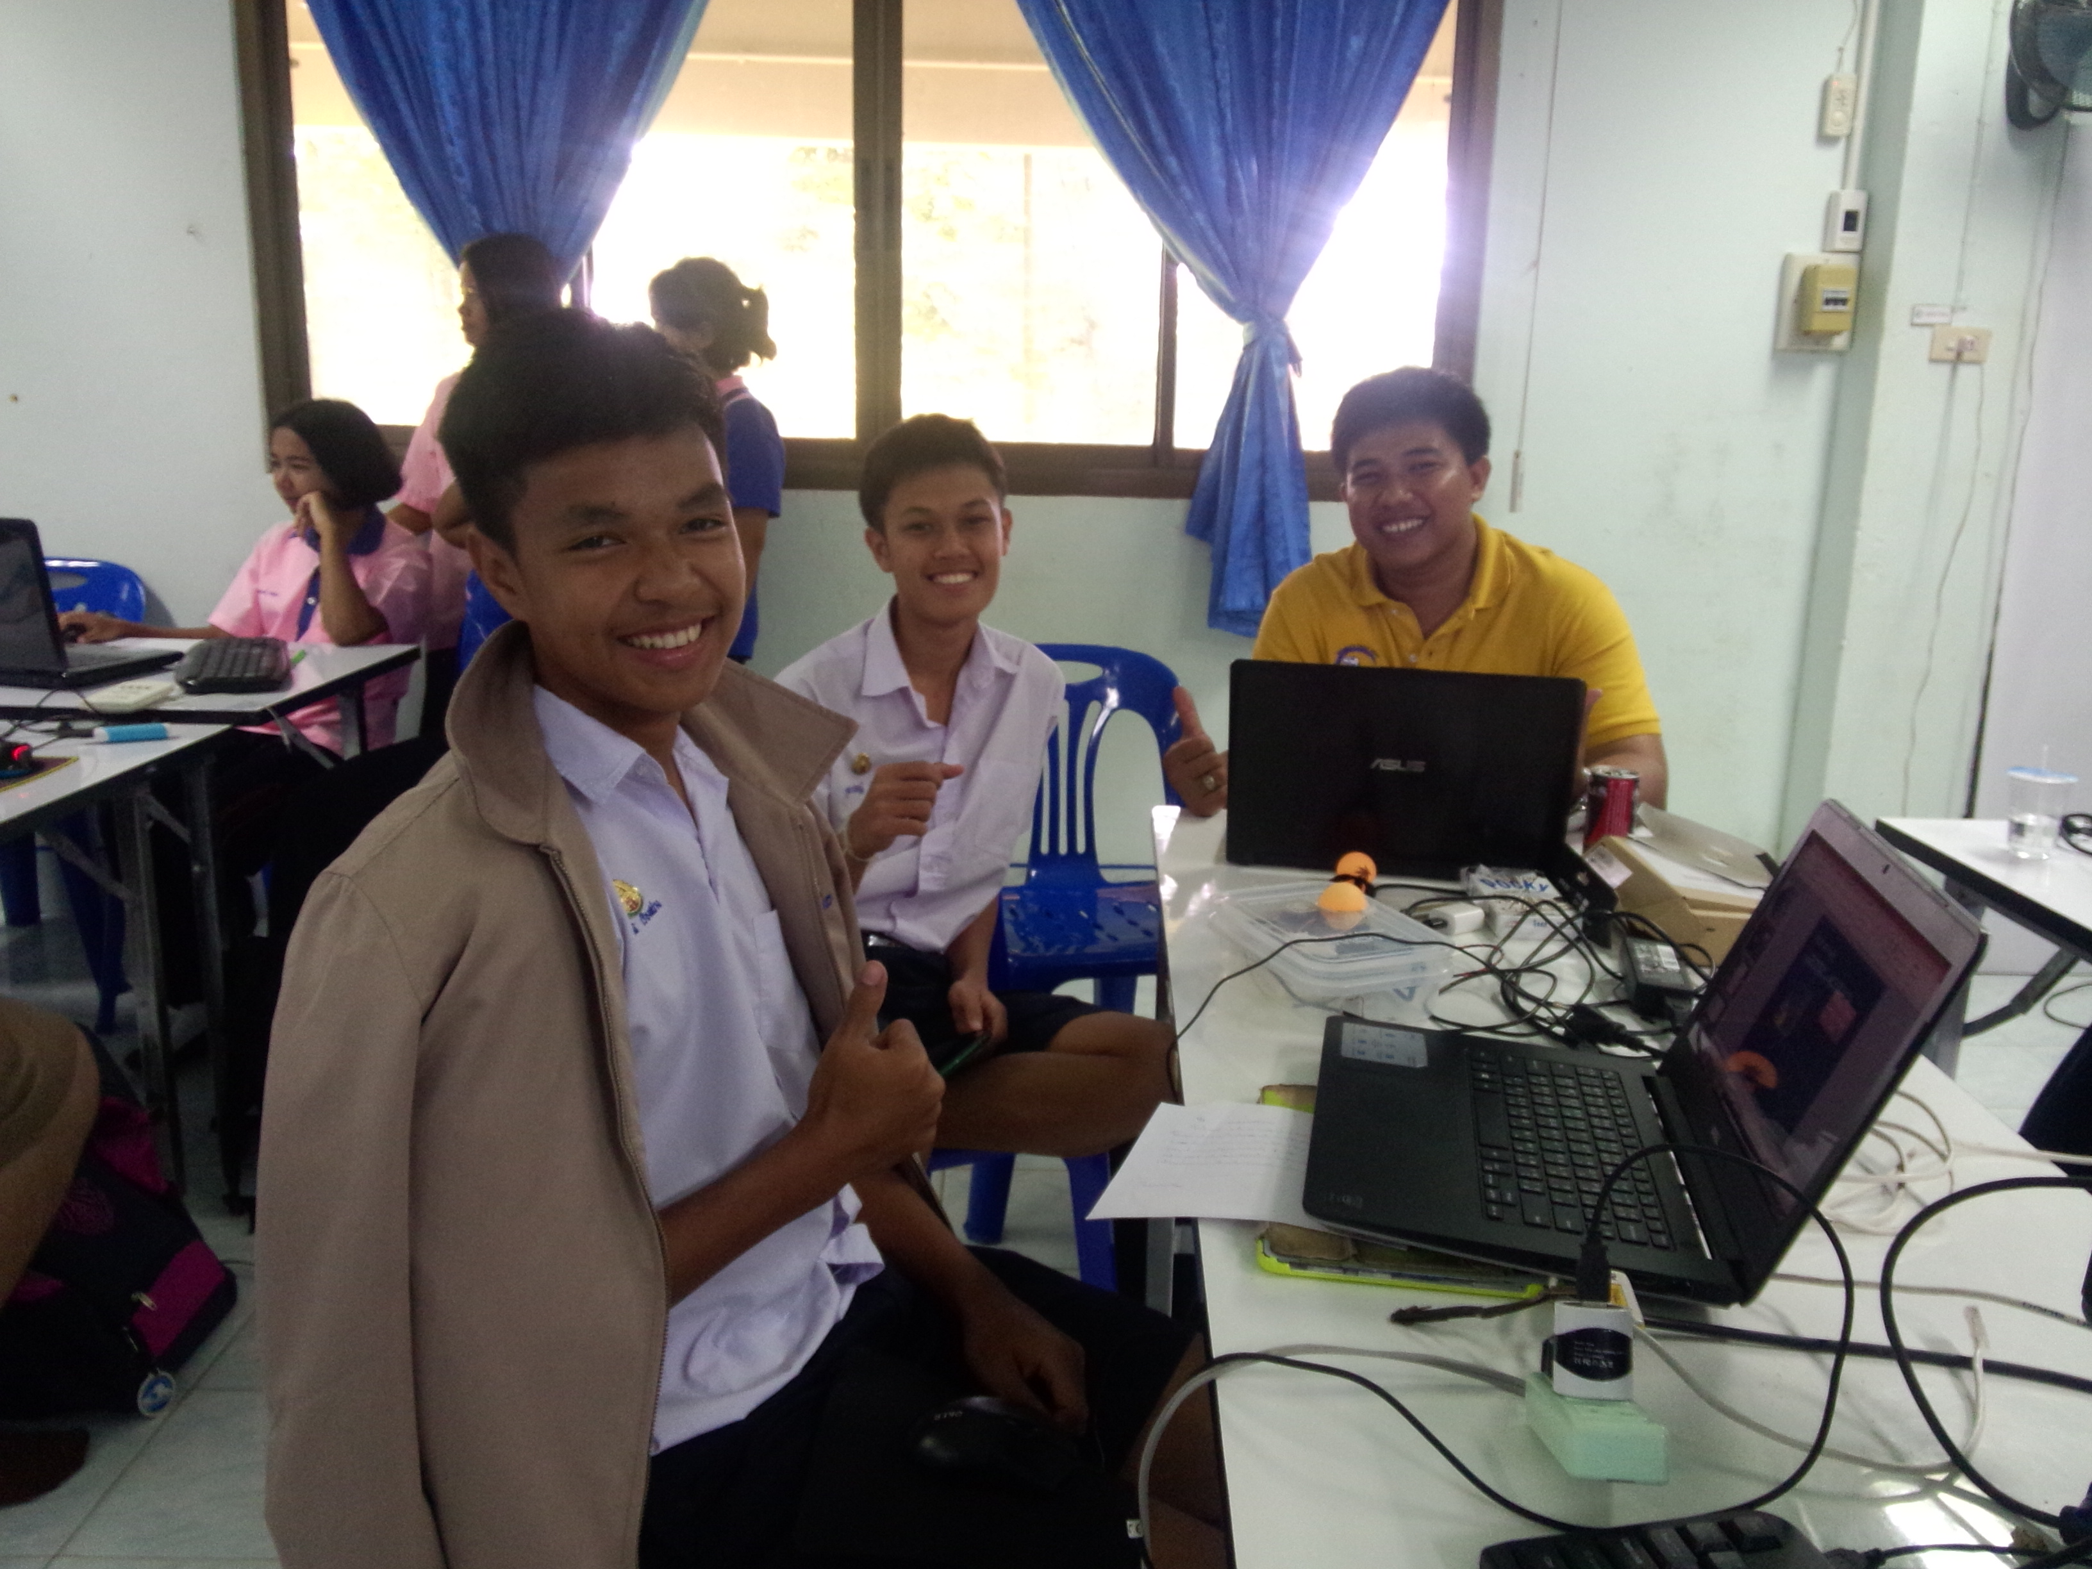
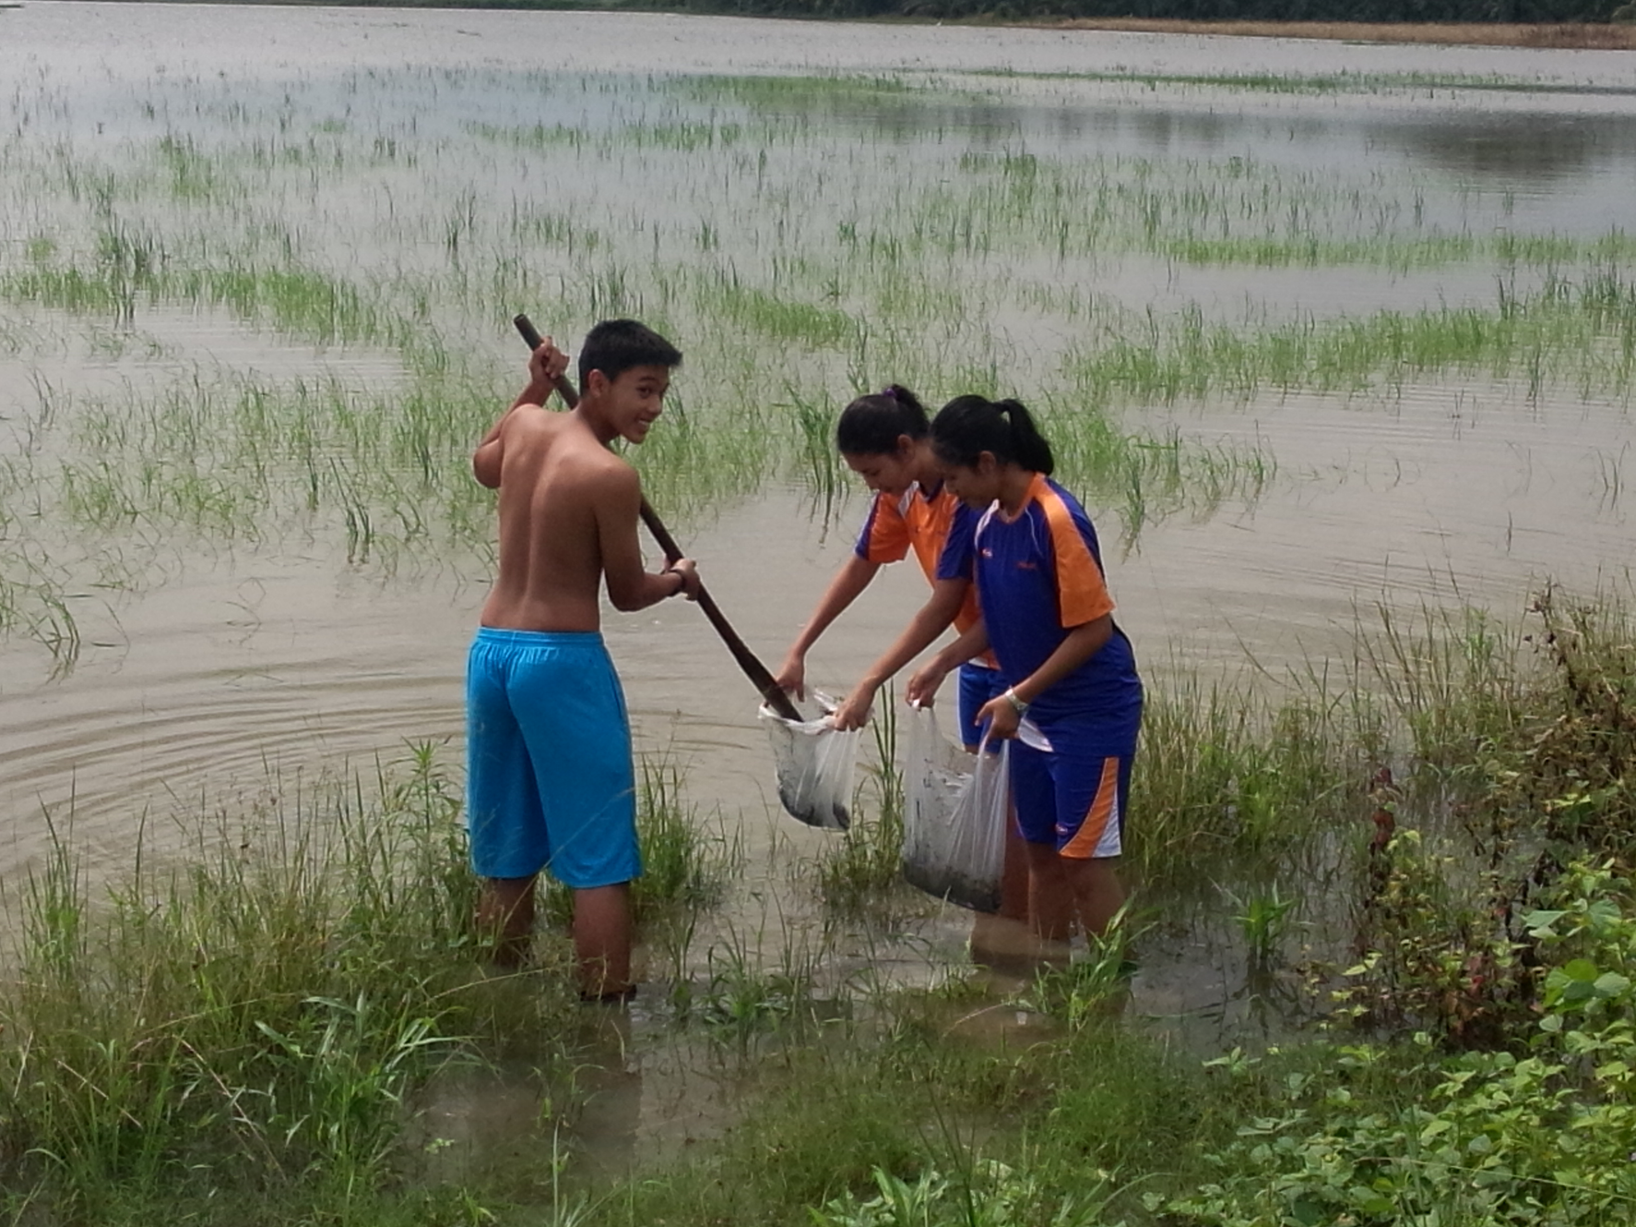
PCSHS. NST.
GLOBE
PCSHS NST’s GLOBE Training
STEM-PLC
Training by GLOBE’s Teacher trainer.
Training
GLOBE Protocols Plactice.
Integration of GLOBE Protocil in the science project.
Mosquiti Protocol Project
IoT Training and Project action

Slide 11
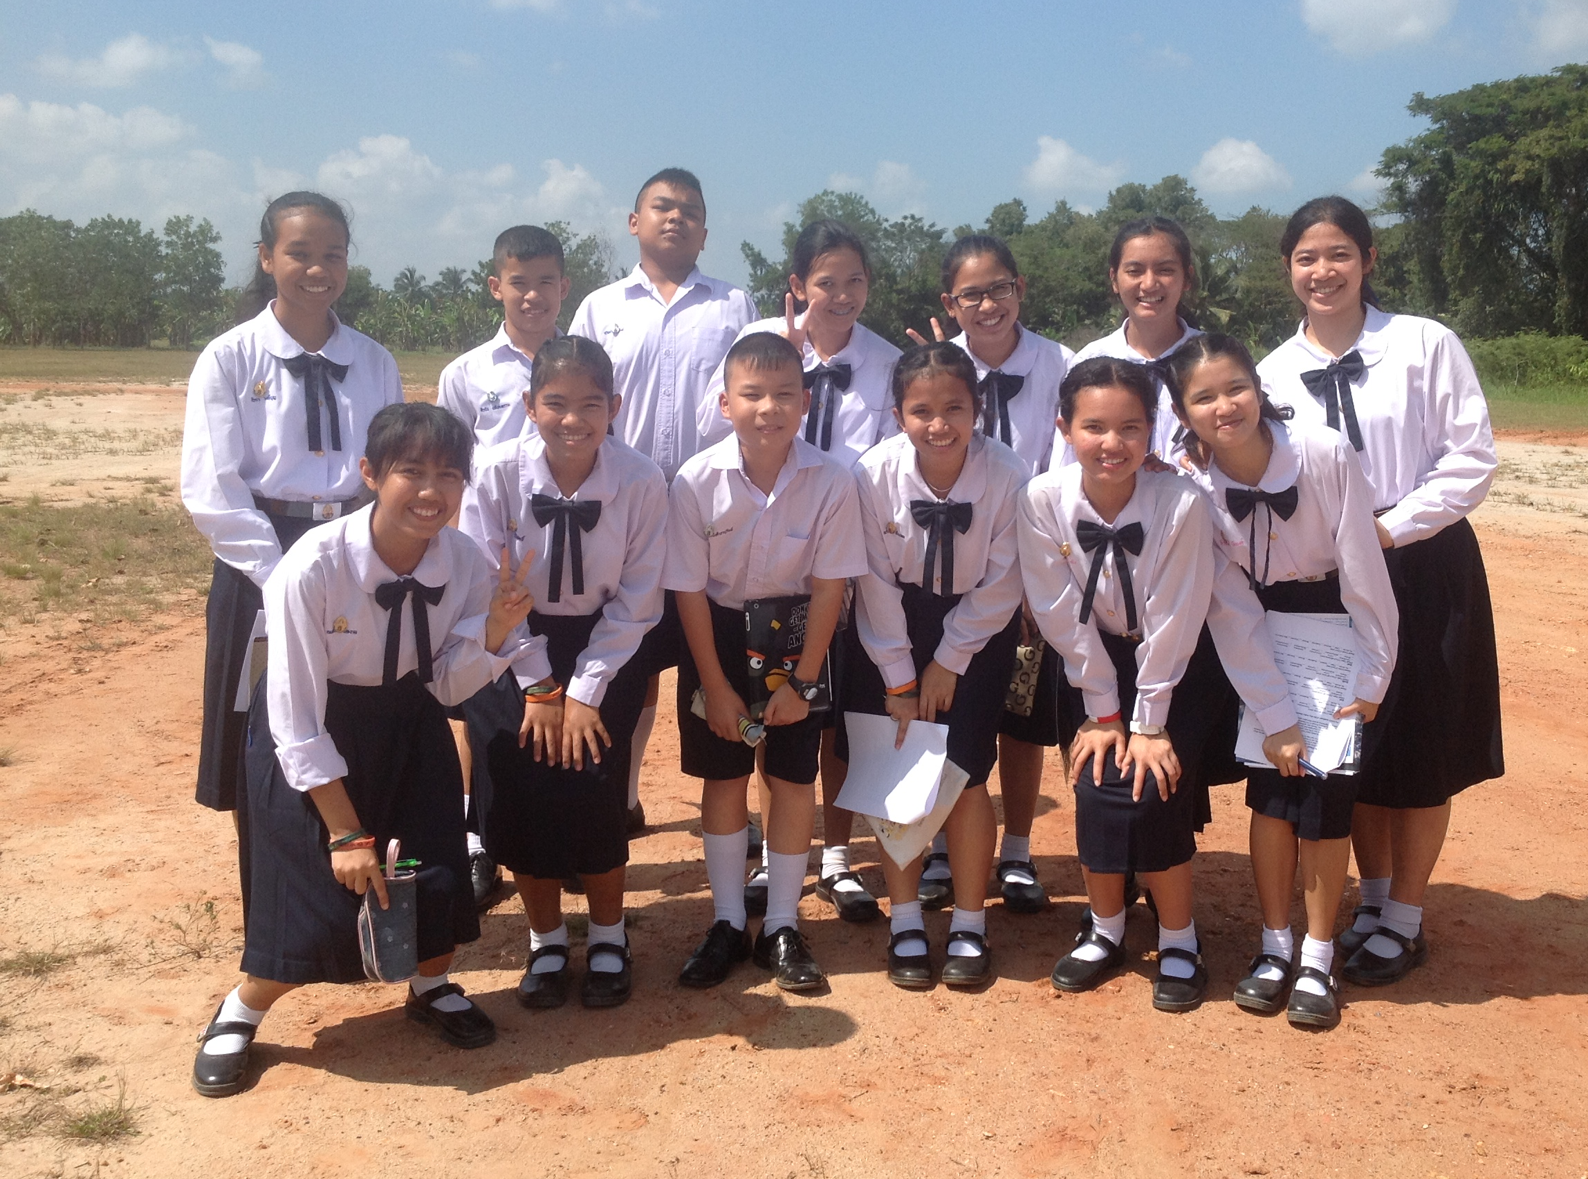
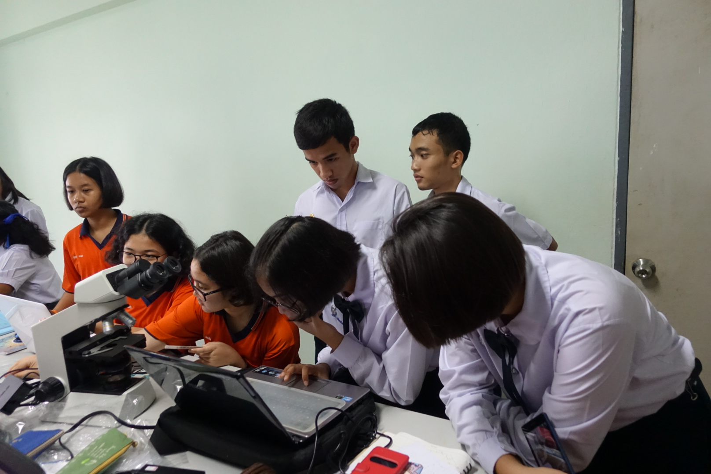
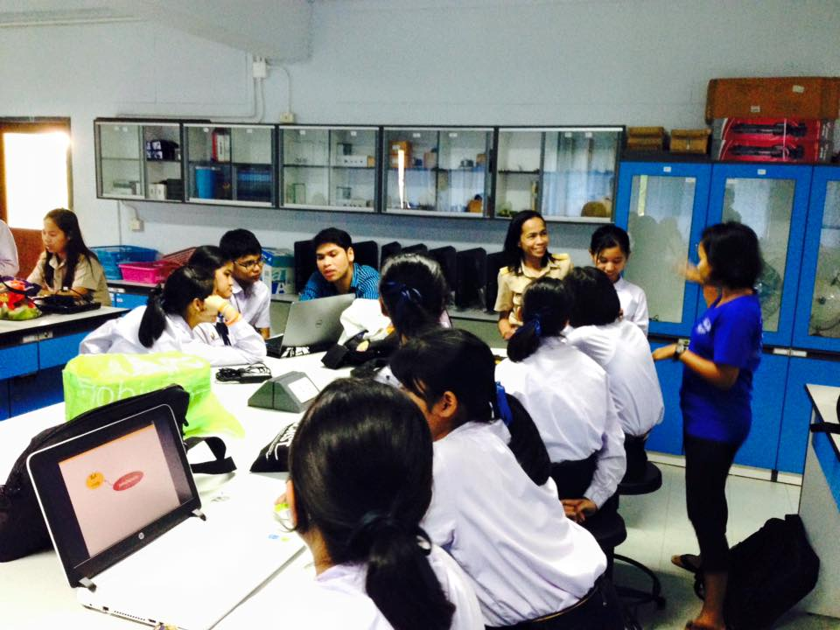
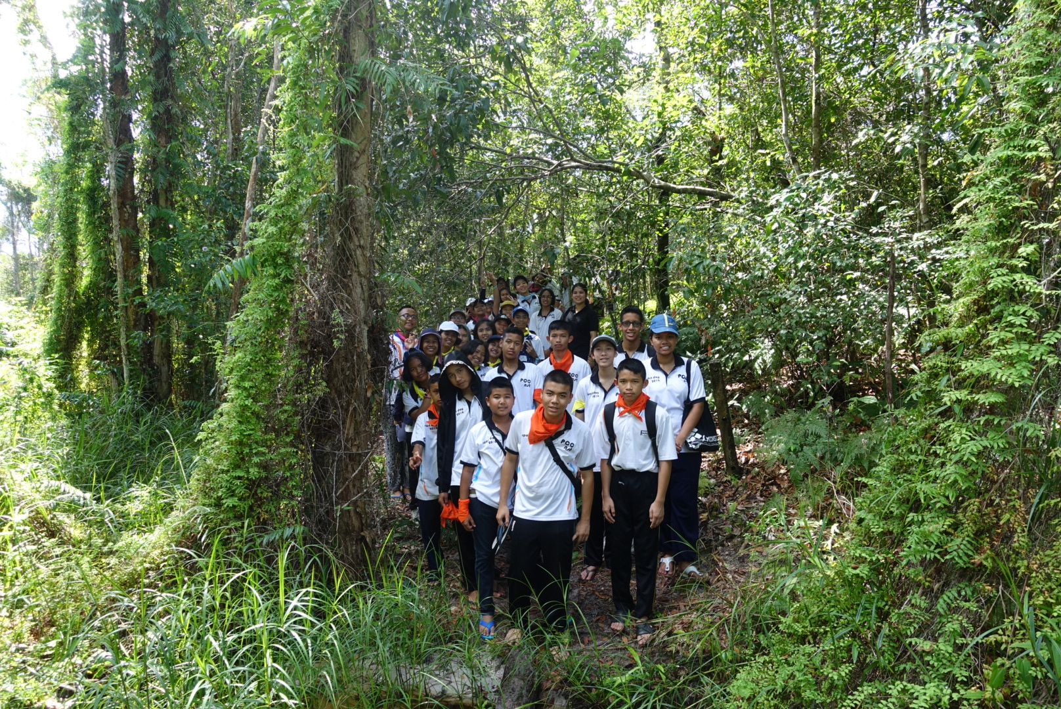
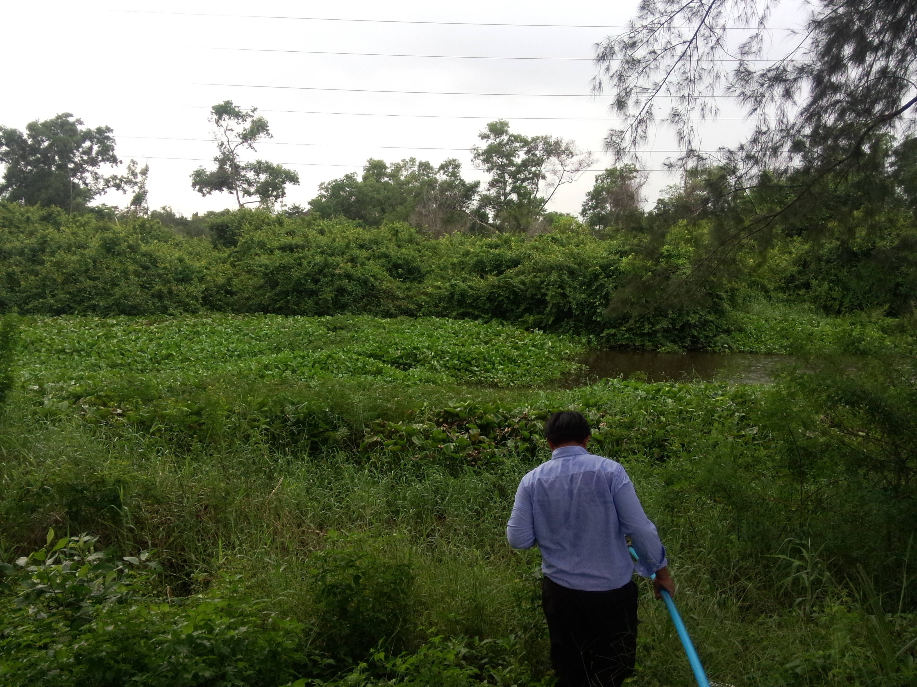
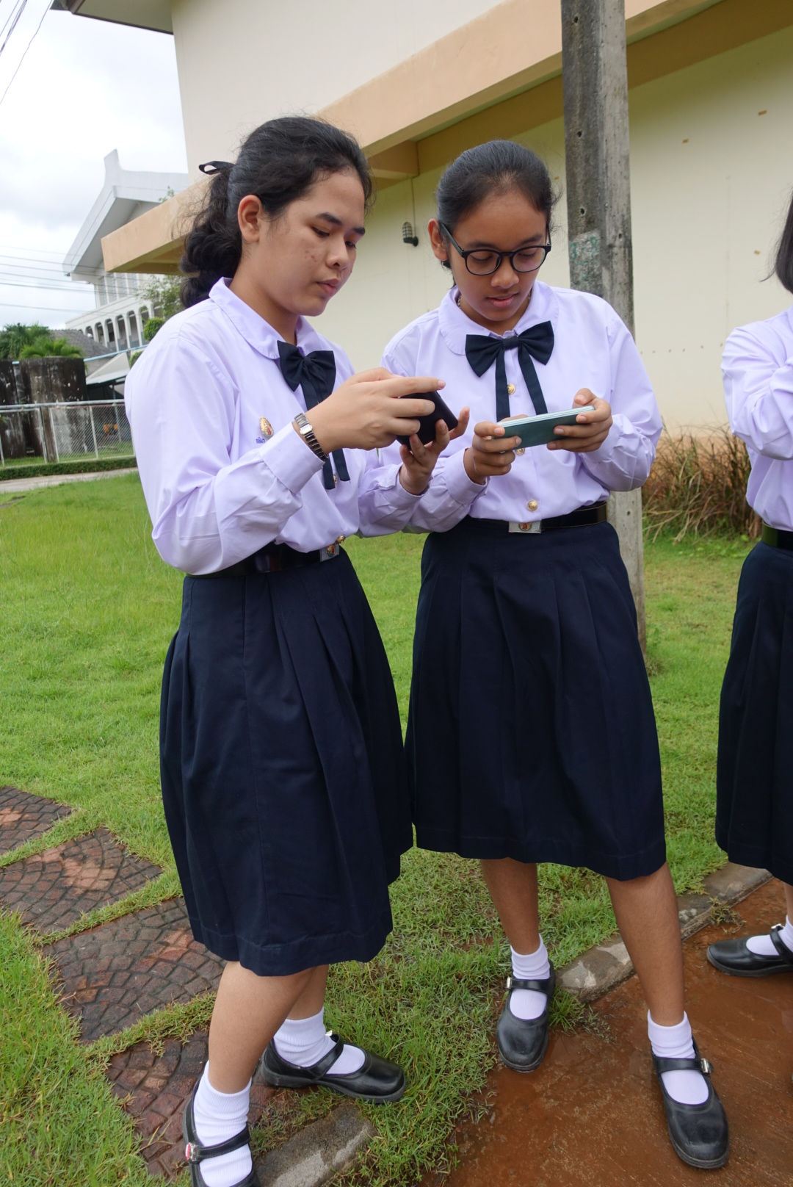
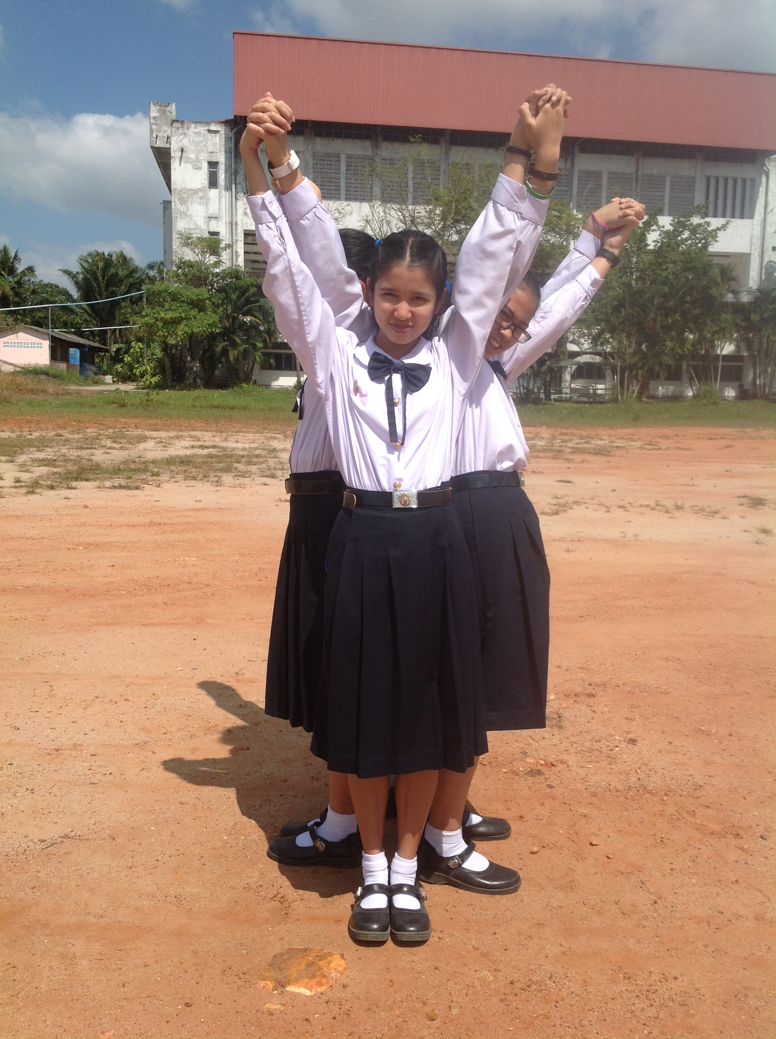
PCSHS. NST.
GLOBE
PCSHS NST’s GLOBE Training
STEM-PLC
Training by GLOBE’s Student.
Training
Senior supporting.
Experiment facility and science camp training.

Slide 12
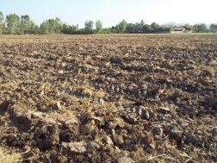
PCSHS. NST.
GLOBE
PCSHS NST Science Project & GLOBE Project
STEM-PLC
What
Published/Conference
Data analysis & report
Rice Stubble Plowing
Nutrient content in soil
Science project experiment
Independent Variable
dependent Variable
Project proposal & Project pre-study
Independent Variable
dependent Variable
Topic seminar and Project planning
Cause
Effect
Cause – Effect diagram : Project design more systematic.

Slide 13
PCSHS. NST.
GLOBE
PCSHS NST Science Project & GLOBE Project
STEM-PLC
Nutrient structure
Published/Conference
Microorganisms
Degradation of Rice stubble
Organic matter in the soil
Oxygen content in soil
Data analysis & report
Soil’s structure
Science project experiment
time
Project proposal & Project pre-study
Nutrient content in soil
Topic seminar and Project planning
Technique = Coaching & Q&A

Slide 14
PCSHS. NST.
GLOBE
PCSHS NST Science Project & GLOBE Project
STEM-PLC
Published/Conference
GLOBE Process
Data analysis & report
Science project experiment
GLOBE Experimental
Project proposal & Project pre-study
Topic seminar and Project planning
Using GLOBE Protocol for Project Experimental

Slide 15
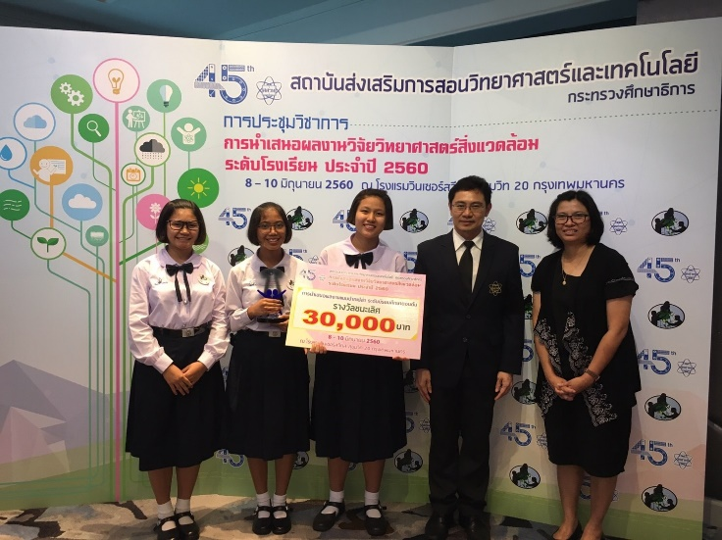
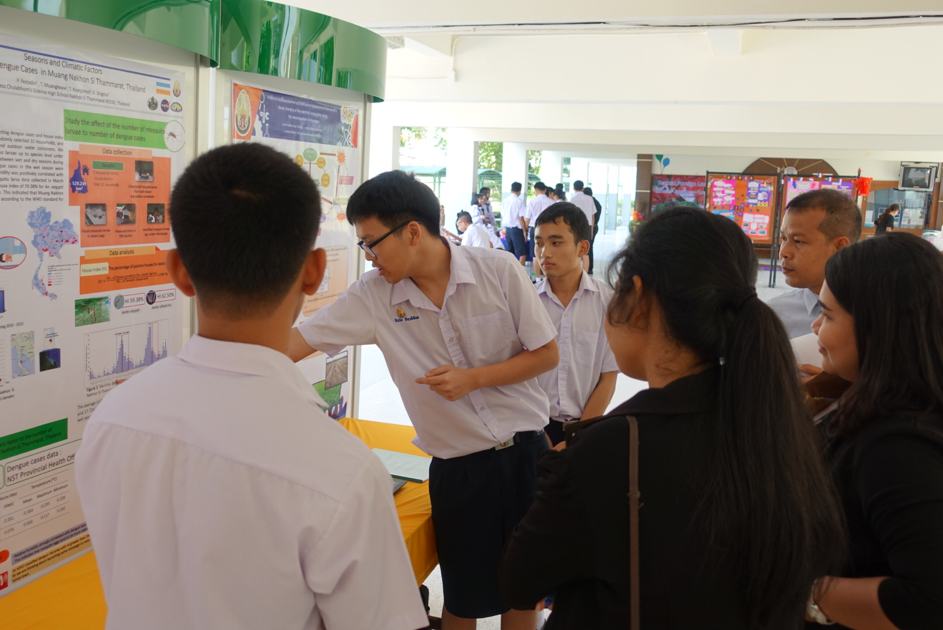
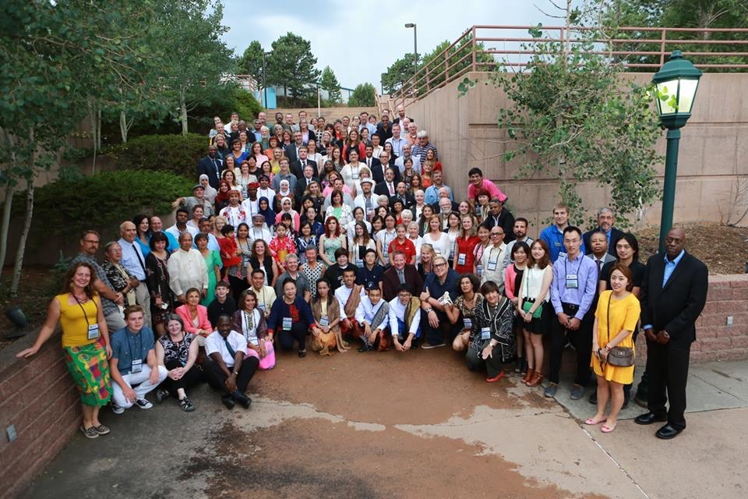
PCSHS. NST.
GLOBE
PCSHS NST Science Project & GLOBE Project
STEM-PLC
GLOBE Community
Published/Conference
Data analysis & report
GLOBE Thailand Exhibition
GLOBE Process
Science project experiment
Project proposal & Project pre-study
School Project Exhibition
Topic seminar and Project planning
GLOBE Annual Meeting

Slide 16
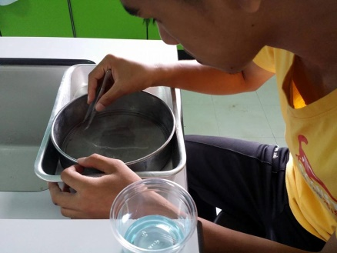
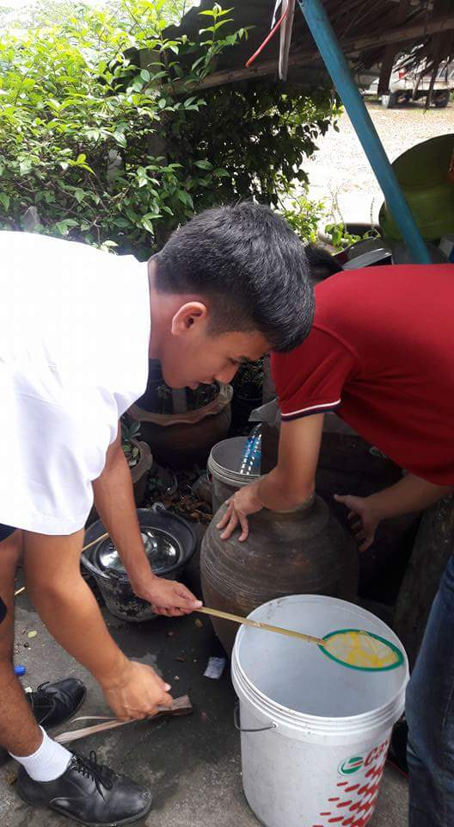
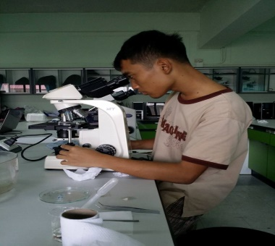
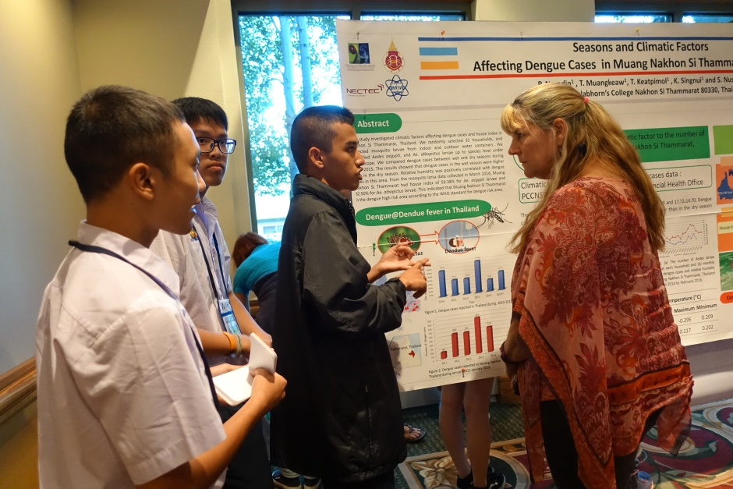
PCSHS. NST.
GLOBE
PCSHS NST Science Project & GLOBE Project
STEM-PLC
Consistent with the objectives and data supporting
Result&Report
Infographics
Presentation
project experiment
Project planning
Clearly to collect the data.
Questions
Cause & Effect Diagram
16

Slide 17
PCSHS. NST.
GLOBE
PCSHS NST Thailand.
STEM-PLC

Slide 18
PCSHS. NST.
GLOBE
PCSHS NST Thailand.
STEM-PLC

Slide 19
PCSHS. NST.
GLOBE
PCSHS NST’s GLOBE Experimental
STEM-PLC
13 topics
12 topics
10 topics
2015
2017
2014
2016
2018
12 Topics
8 topics
Best
GLOBE
Goal
GLOBE for local farming
best
Mosquitos
best
MosquitoS&ENSO
TEXT
GPM to smart farming and nature
Weather conditions effect to rice paddies : Present a science project at the Nara Shesho High Scool, JAPAN
Changing angle of banana@bangjak in bog area soil get the best project of special science project fund.
Seasons and Climatic Factors Affecting Dengue Cases get high score of virtual science fair.
Effects of weather conditions and number of larval larvae. Get the 1st award of GLOBE thailand project contest.
-GLOBE training for elementary school project.
-GPM to smart farming and nature

Slide 20
PCSHS. NST.
GLOBE
PCSHS NST Thailand.
STEM-PLC
Thank you
Princess Chulabhorn Science High School Nakhon Si Thammarat.
Center of Excellence for Ecoinformatics, the Institute of Research and Development, Walailak University and NECTEC

Slide 21
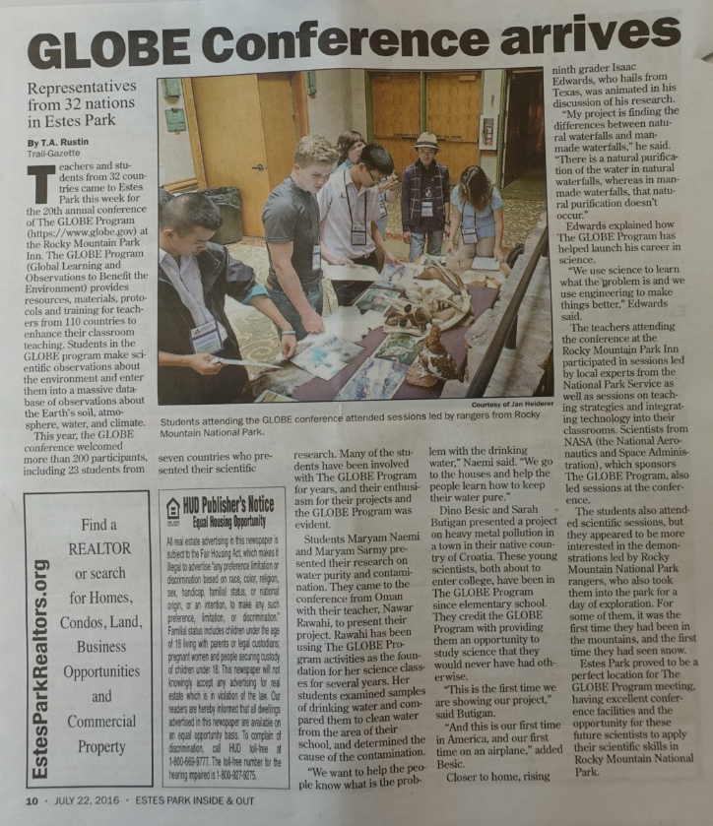
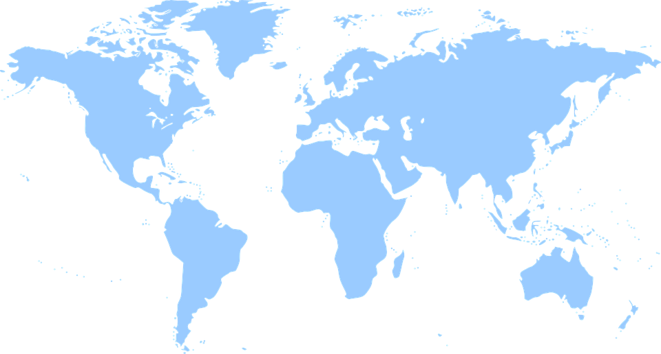
PCSHS. NST.
GLOBE
Implementing GLOBE in PCSHS NST. THAILAND
STEM-PLC
The GLOBE International Science Symposium
2016 : Estes Park, Colorado, USA (16th – 21st July 2016)

Slide 22
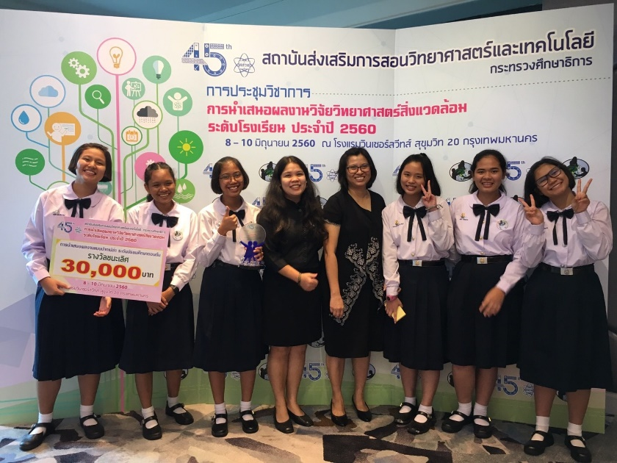
PCSHS. NST.
GLOBE
Implementing GLOBE in PCSHS NST. THAILAND
STEM-PLC
The GLOBE International Science Symposium
2016 : Estes Park, Colorado, USA (16th – 21st July 2016)
2017 : New Haven, Connecticut, USA (26th July-6th August 2017)

Slide 23
PCSHS. NST.
GLOBE
Implementing GLOBE in PCSHS NST. THAILAND
STEM-PLC
GLOBE-STEM : HSP and ENIEP Fair/Exhibition &GLOBE Asia-Pacific Science Festival (9th-16th July 2017)
Songshan Cultural and Cretive Park., Taipei City 110, Taiwan

Slide 24
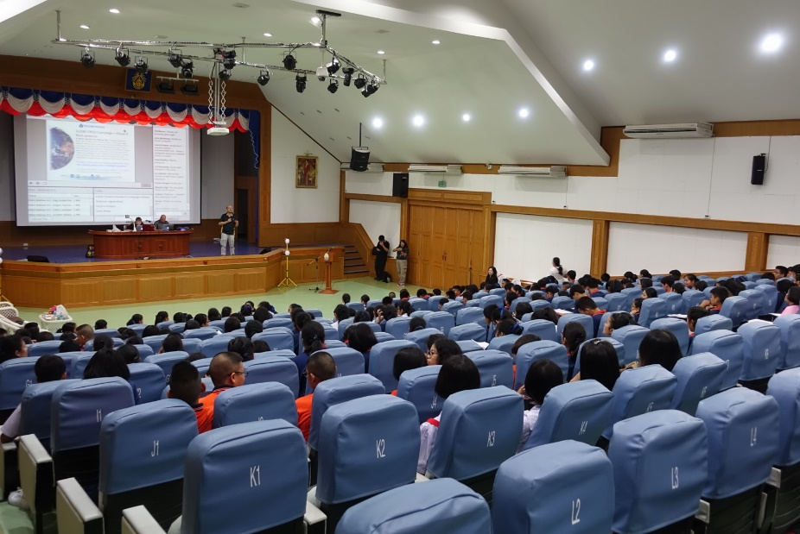
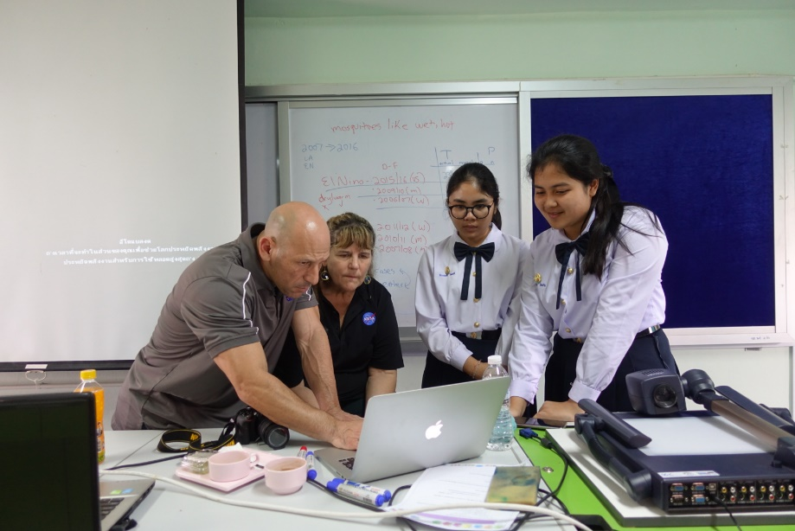
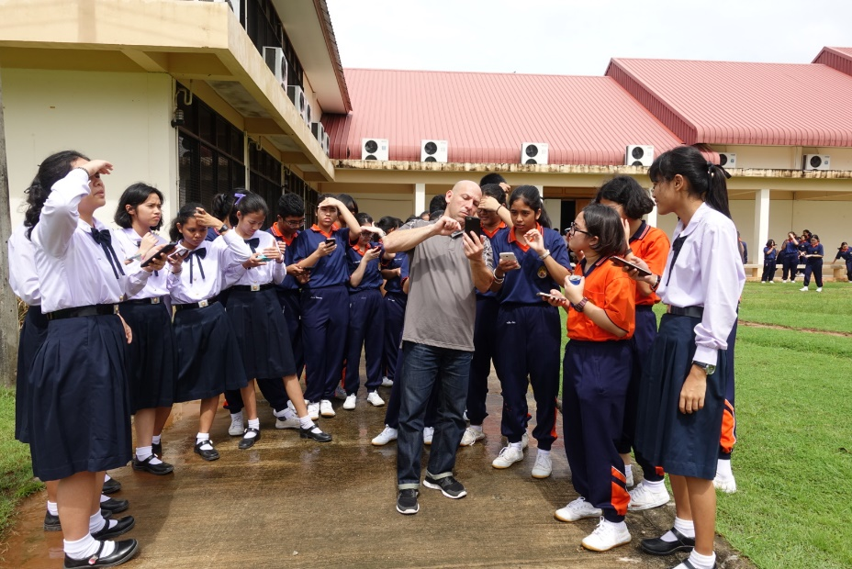
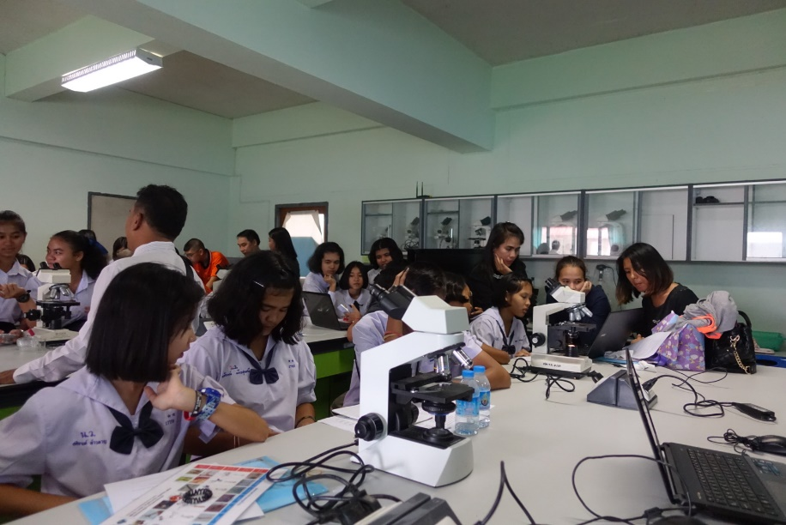
PCSHS. NST.
GLOBE
Implementing GLOBE in PCSHS NST. THAILAND
STEM-PLC

Slide 25
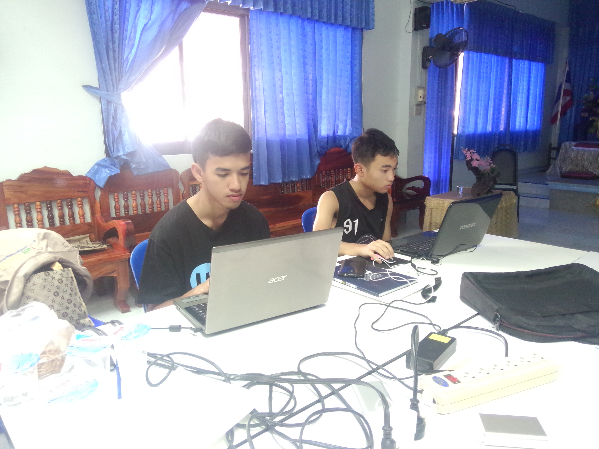
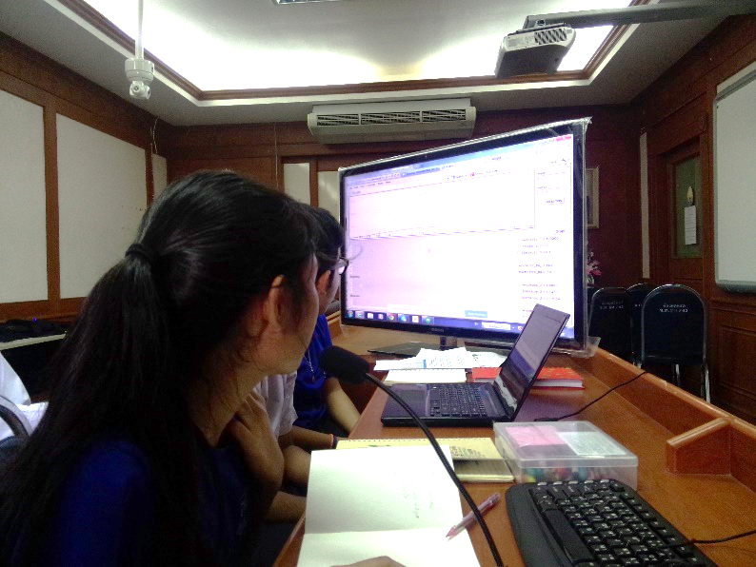
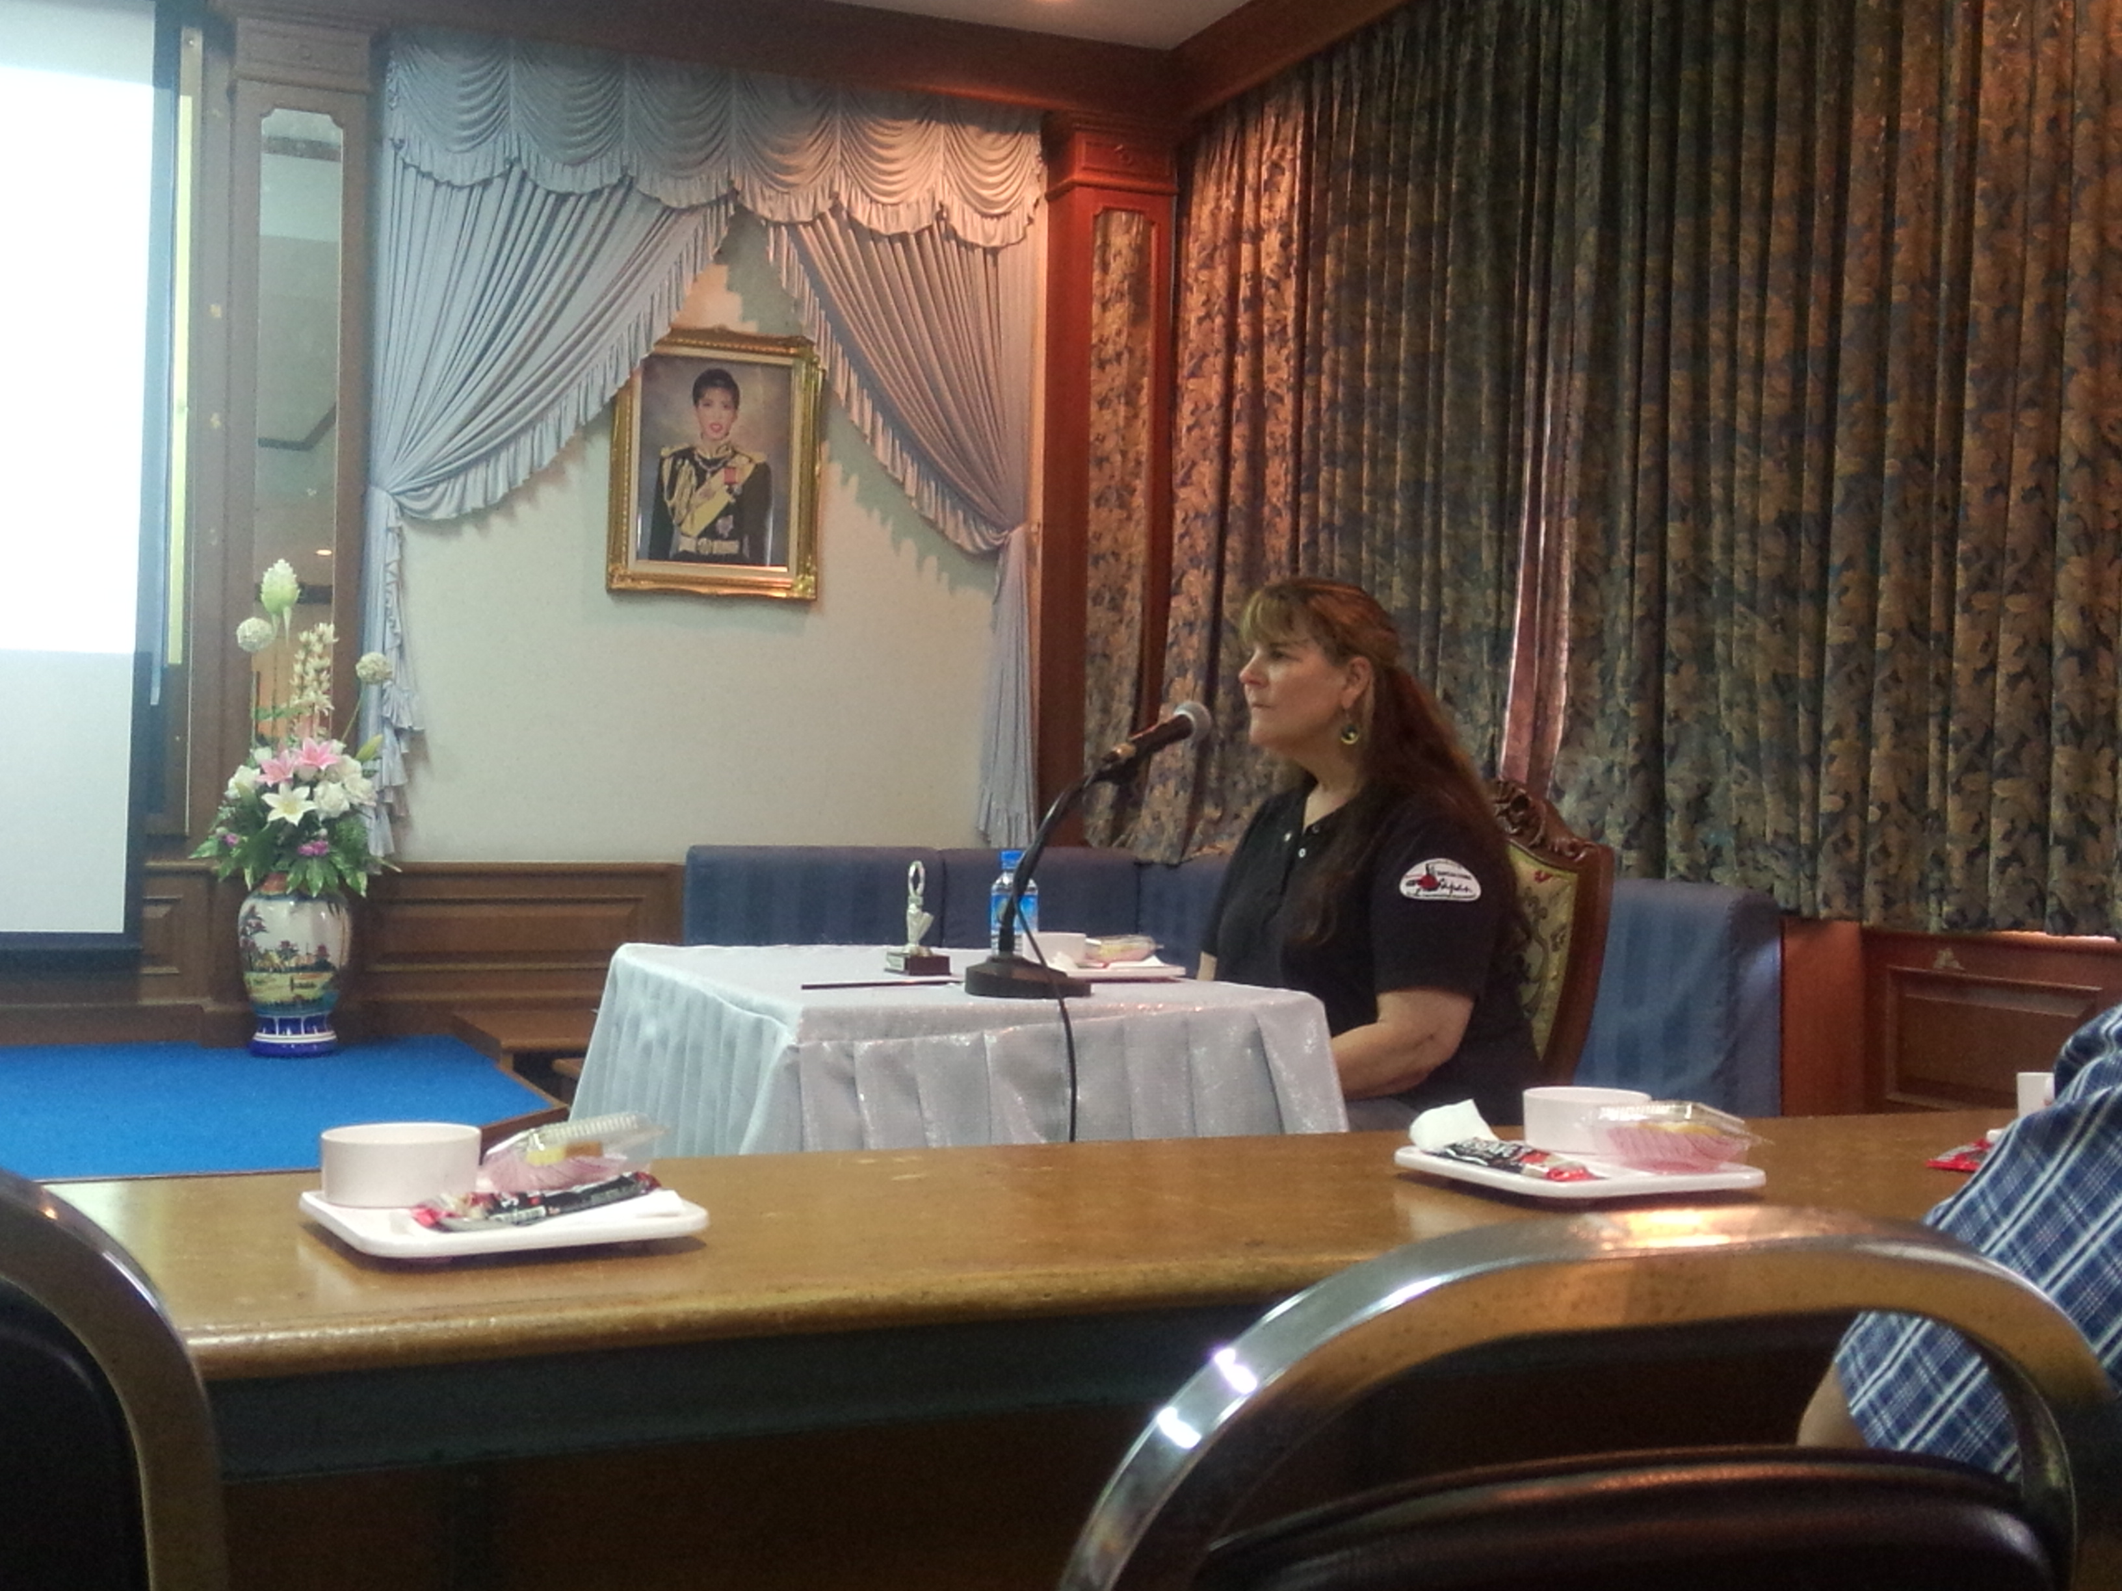
PCSHS. NST.
GLOBE
Implementing GLOBE in PCSHS NST. THAILAND
STEM-PLC
The international project for scientific education.
@The Nuclear e-Cology laboratory.

