Slide 1
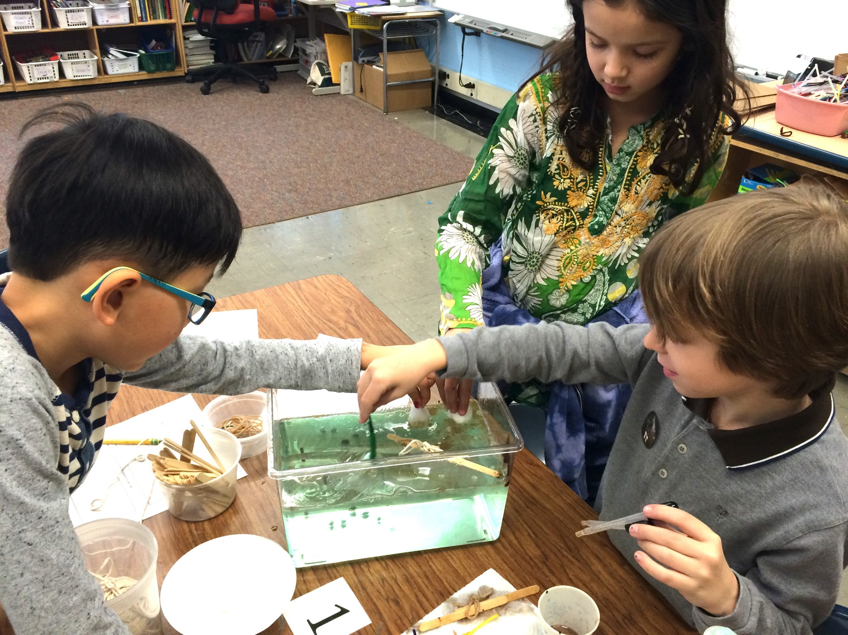




Kim Martinez, M.Ed.
National Wildlife Federation
Senior Director, K-12 Education
Eco-Schools USA National Operator
National Wildlife Federation
Eco-Schools USA
Notes:
Eco-Schools is a program of the Foundation for Environmental Education, (FEE). The Foundation for Environmental Education is partnered by some of the world's foremost organizations in the fields of education and the environment. These illustrious partners include UNESCO, the UNEP, UNWTO, ISESCO, YMP and Earth Charter.
Recognized by UNESCO as a world-leader within the fields of Environmental Education and Education for Sustainable Development, our strength comes from our members who share our convictions and execute our programs with great efficiency on a daily basis. Hand-picked by FEE for their dedication and outstanding ability, it is these local organizations who make FEE the community-focused entity that it is today.

Slide 2
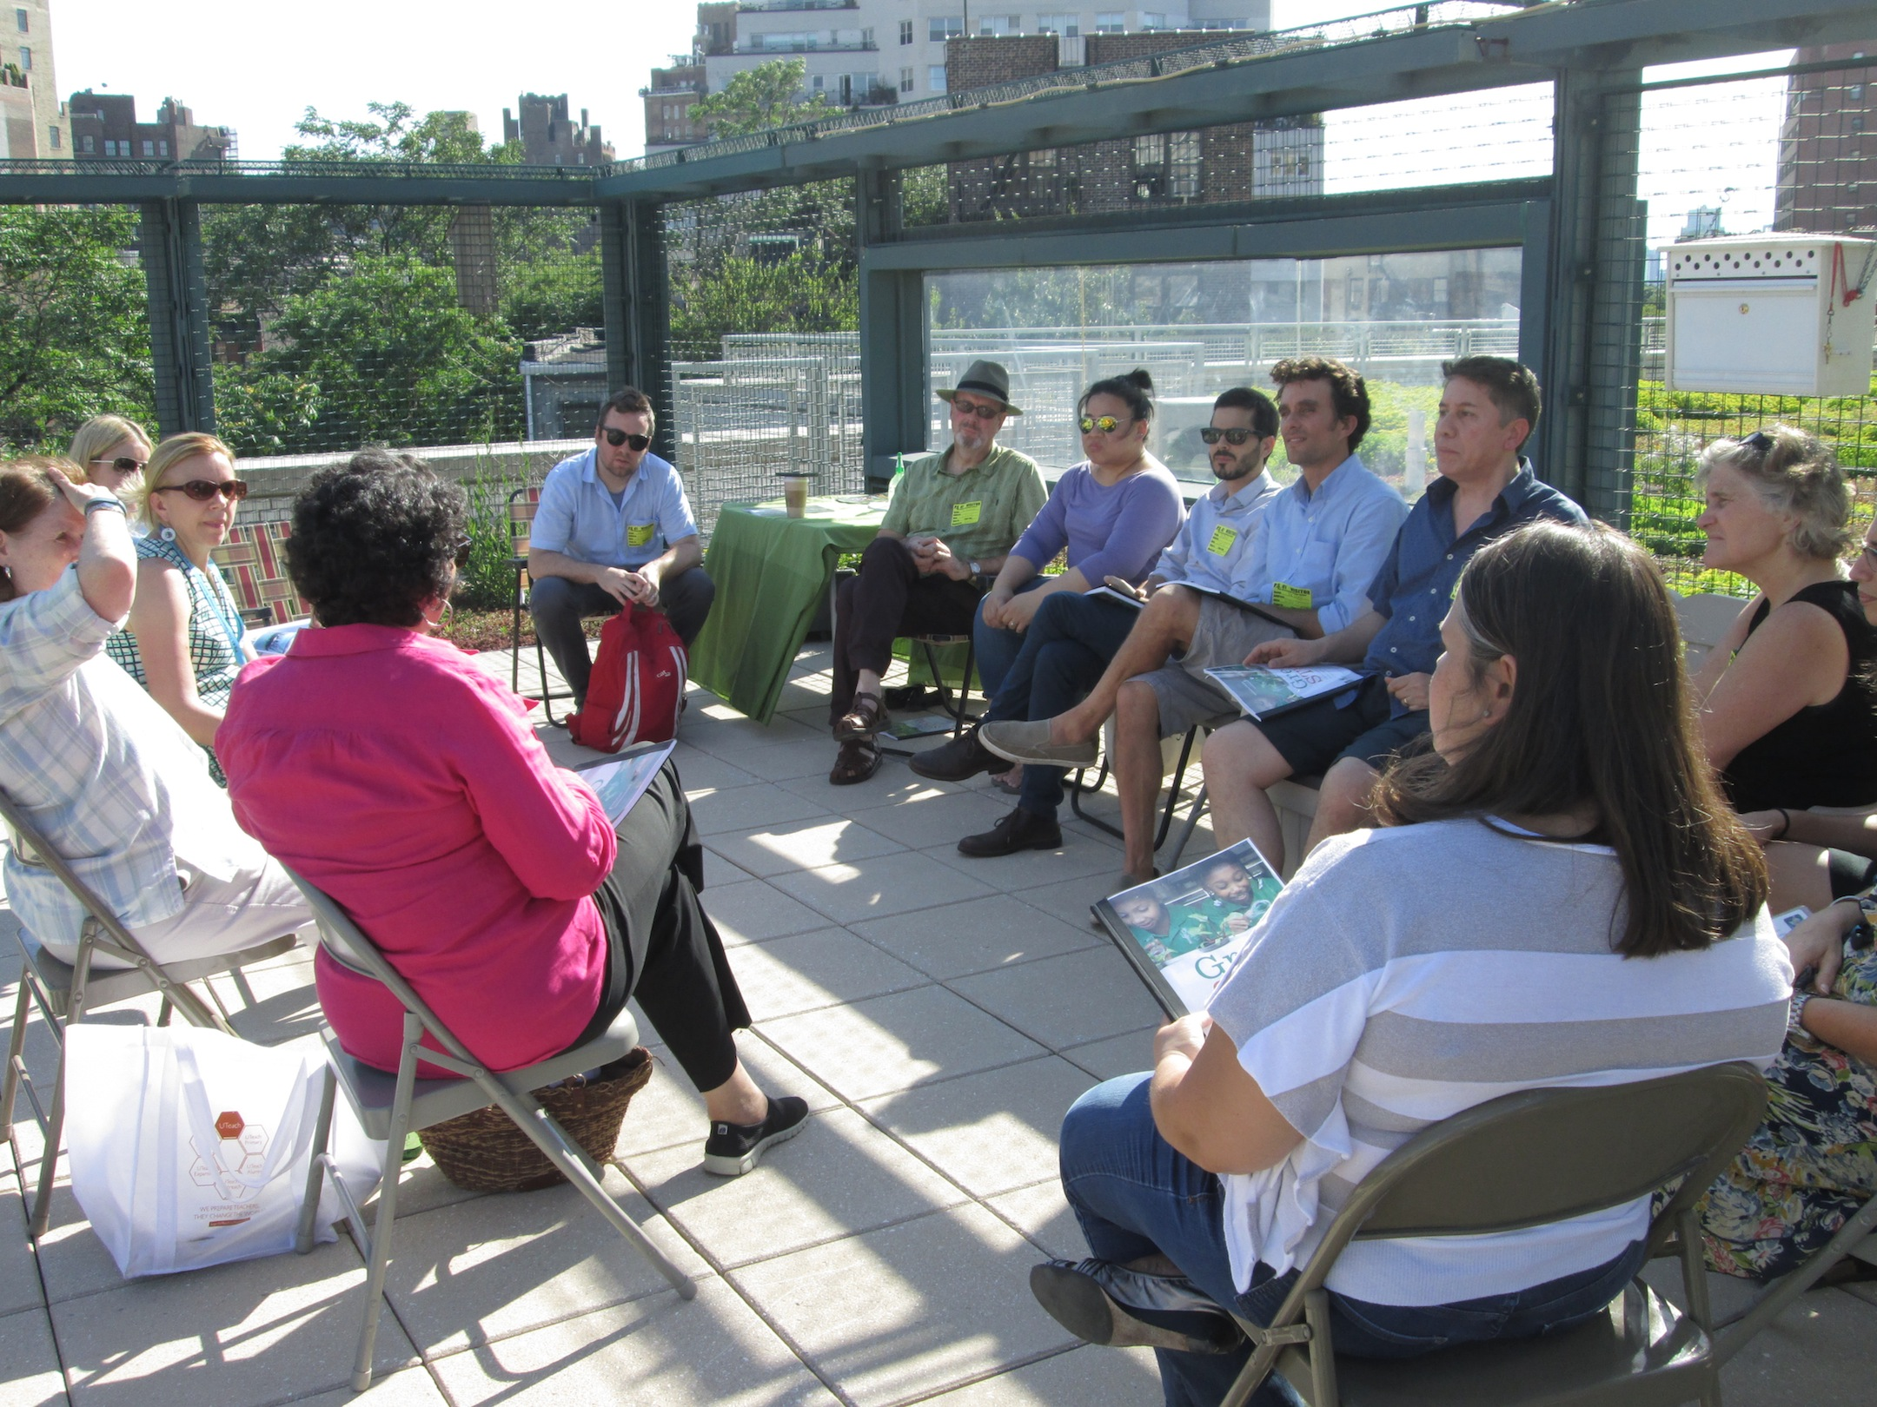
Largest and oldest green schools program in the world
64
49K
15M
Notes:
Eco-Schools encourages young people to engage with and utilize the natural world, actively working to protect the environment. It starts with a classroom, a grade level, a student, a parent or an entire district, the goal being to achieve whole school sustainability (a culture shift). Youth experience a sense of achievement at being able to drive the environmental management of their school.
Currently in 64 countries, in 49K schools reaching 15M students a year.

Slide 3
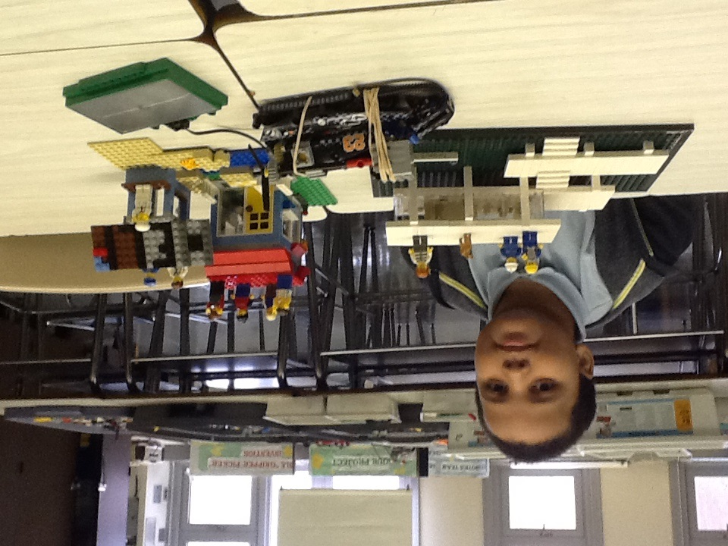
7 STEP FRAMEWORK
ESTABLISH an eco-action team
CONDUCT an environmental audit
DEVELOP an eco-action plan
MONITOR & EVALUATE progress
CONNECT to curriculum
ENGAGE the whole school and community
CREATE an eco-code
Notes:
First of three main pieces of the Eco-Schools program. This framework is universal. All countries follow this framework as each school, driven by student-led eco-action teams, develops a plan to become more sustainable.

Slide 4
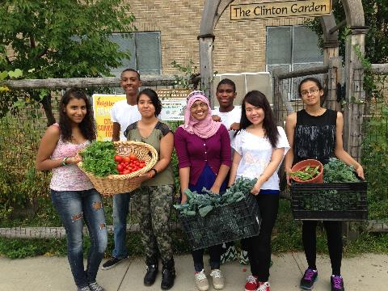
12 PATHWAYS TO SUSTAINABILITY
BIODIVERSITY
CLIMATE CHANGE
CONSUMPTION & WASTE
ENERGY
HEALTHY LIVING
HEALTHY SCHOOLS
LEARNING ABOUT FORESTS
SCHOOLYARD HABITATS
SUSTAINABLE FOOD
TRANSPORTATION
WATER
WATERSHEDS, OCEANS, WETLANDS
Notes:
The Eco-Action team will determine either by known need or environmental review which pathways to complete within a specific timeframe.
Examples – 1 per semester, 1 theme throughout the entire year etc.
Healthy Living addresses nutrition and exercise for the whole school community, not just students, when we eat better and exercise student and staff absenteeism goes down.
Healthy Schools addresses toxics inside and immediately surrounding the school, both indoor and outdoor air quality, IPM, cleaning products, etc.
LEAF- Learning About Forests (even urban forests)
Water focuses on conservation with in the school building
WOW stands for watersheds, oceans and wetlands

Slide 5
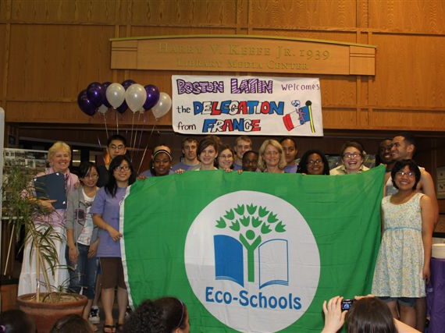



300 points
200 points
100 points
Notes:
While applying for awards is optional it is a great way to track progress and set goals. We are currently working to develop a district level dashboard so districts can aggregate their data for reporting, community communications and grant opportunities.
3-tiered awards system using a points-based scale
100 points – the school has successfully gone through the seven step framework, meeting the criteria and addressing 1 pathway.
200 points – the school has successfully completed the seven step framework, meeting the criteria and addressing 1 new or additional pathway, still maintaining or continuing to improve upon their work for the bronze award
300 – same as above, but one of the three pathway that have been addressed must be energy.

Slide 6
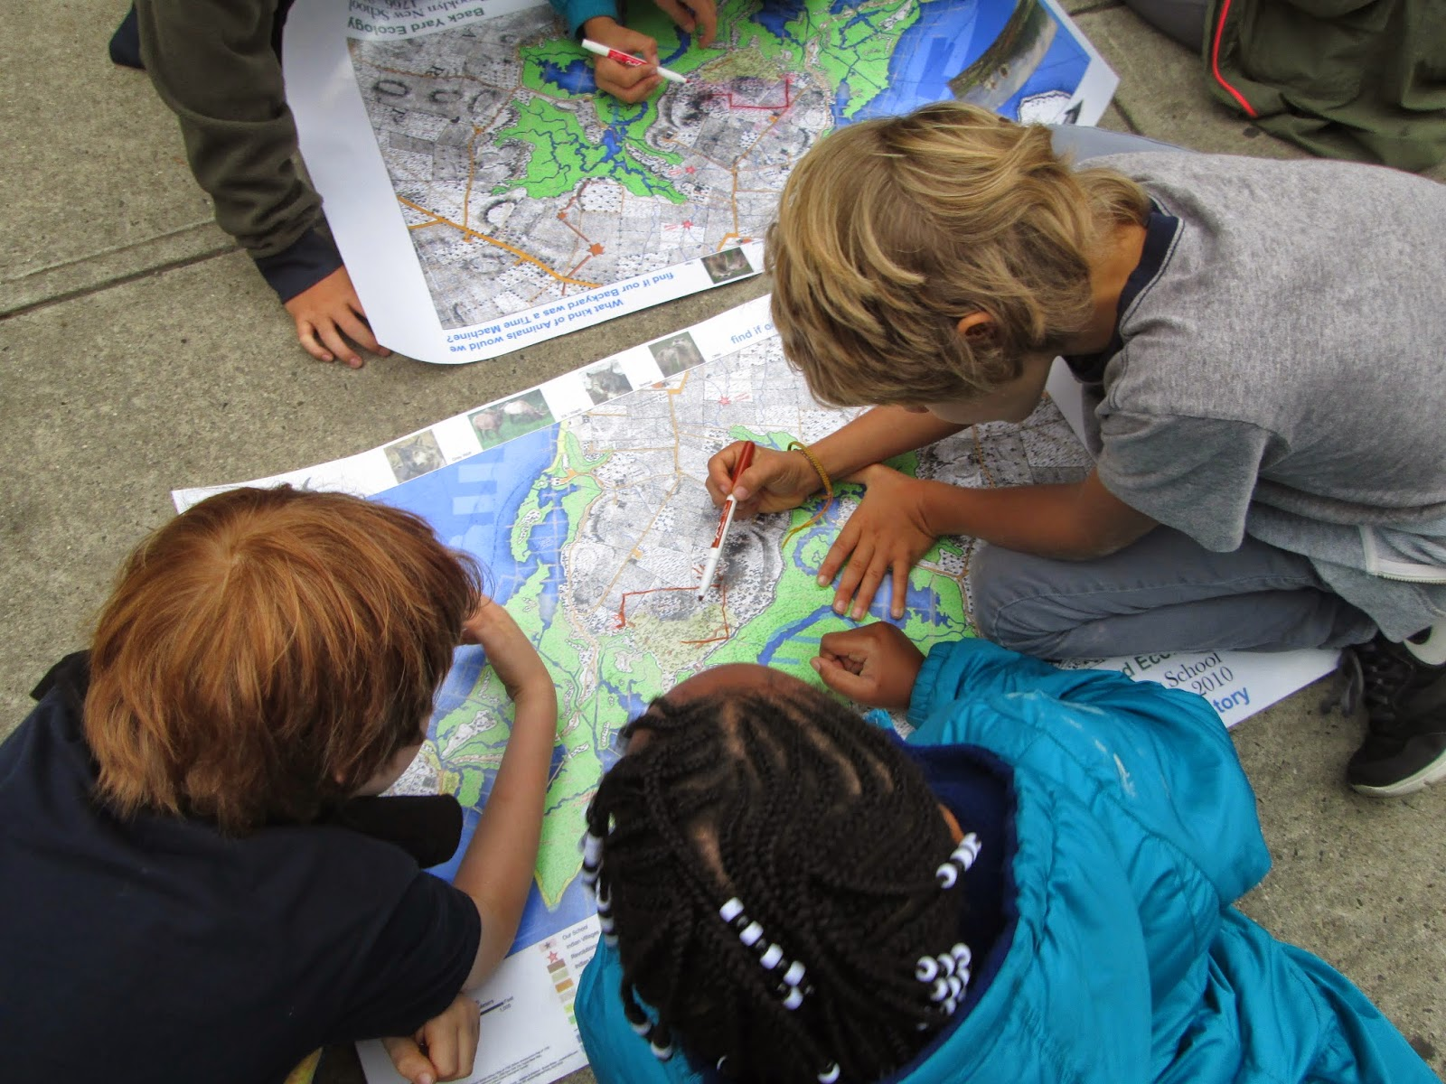


THE GLOBE PROGRAM
Global Learning and Observations to Benefit the Environment
Investigation-Based Science Education
Notes:
Improve student achievement across the curriculum with a focus on student research in environmental and Earth system science
ENVIRONMENTAL LITERACY
The ultimate goal of these efforts is to ensure that all students are provided the opportunity to develop the knowledge, intellectual skills, attitudes, experiences and motivation to make and act upon responsible environmental decisions as individuals and as members of their community while developing the critical tools necessary to succeed in a 21st century workforce.
Enhance awareness and support activities of individuals throughout the world to benefit the environment
Contribute to scientific understanding of Earth as a system
Connect and inspire the next generation of global scientists and other STEM professionals

Slide 7
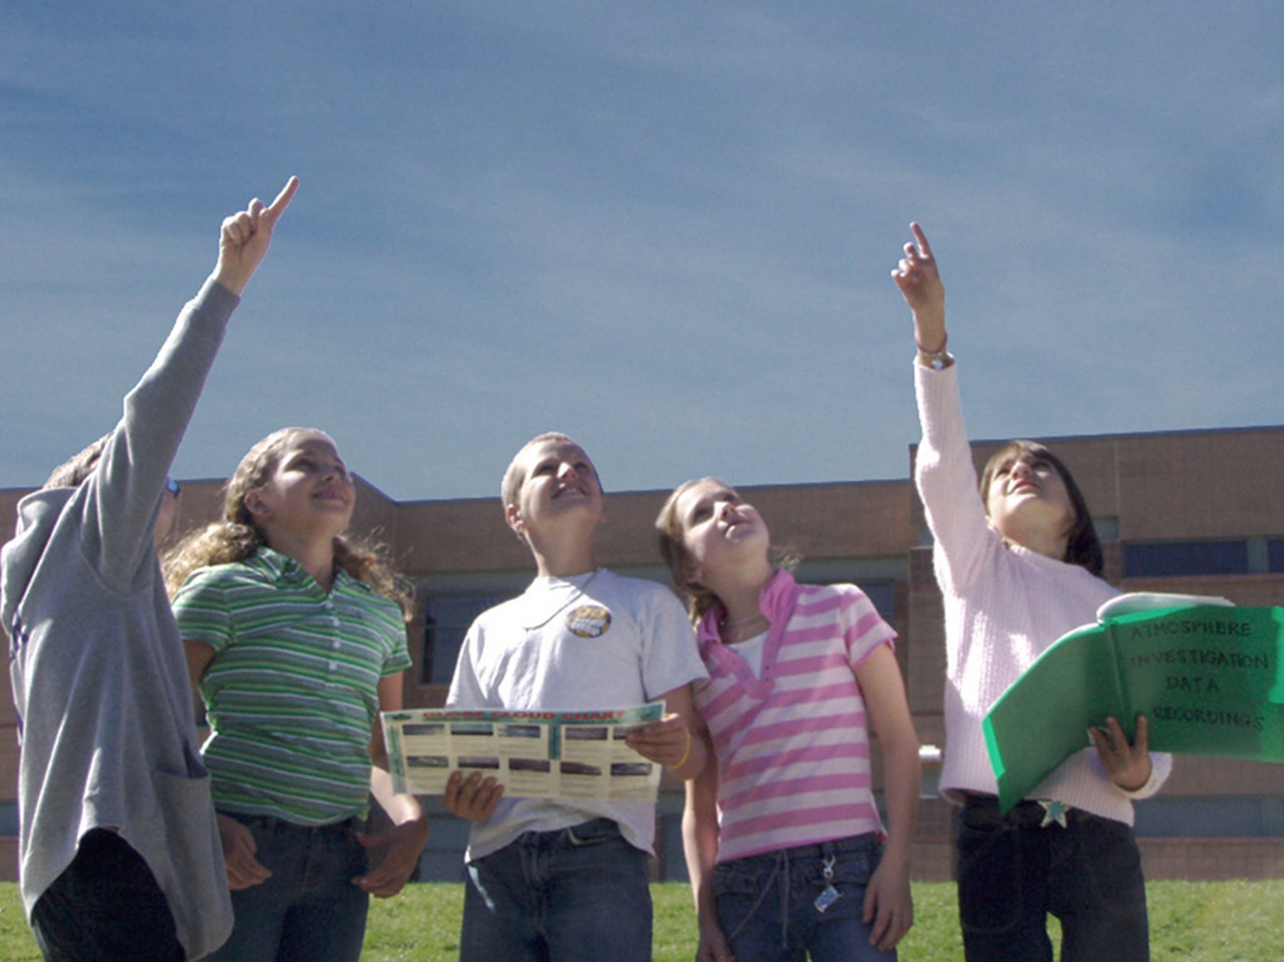
DO GLOBE
“Excite student curiosity”
Notes:
Improve student achievement across the curriculum with a focus on student research in environmental and Earth system science
ENVIRONMENTAL LITERACY
The ultimate goal of these efforts is to ensure that all students are provided the opportunity to develop the knowledge, intellectual skills, attitudes, experiences and motivation to make and act upon responsible environmental decisions as individuals and as members of their community while developing the critical tools necessary to succeed in a 21st century workforce.
Enhance awareness and support activities of individuals throughout the world to benefit the environment
Contribute to scientific understanding of Earth as a system
Connect and inspire the next generation of global scientists and other STEM professionals
Protocols
Ground-based measurement campaigns (very often matching the satellite campaigns)
Inquiry-based student research projects
Collaborative projects
Workshops
E-trainings
Teachers Guide
Webinars
Blogs
Student Conferences
Elementary GLOBE Storybooks
Data Visualization system
Advanced Data Analysis Tool
Apps
Learning activities

Slide 8
Investigation Based Science Education
Pose questions
Develop hypothesis
Plan investigation
Conduct experiments & perform observations using GLOBE protocols
Analyze data
Return to hypothesis
Present and connect findings

Slide 9
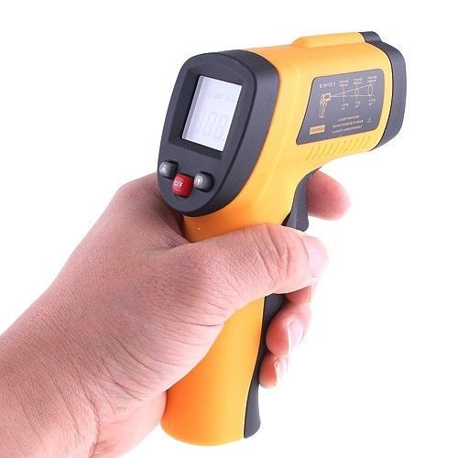
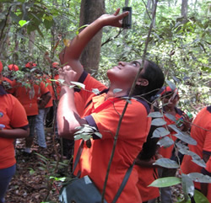
Urban Heat
Biosphere (Phenology and Land Cover)
Surface temperature
Land cover

Slide 10
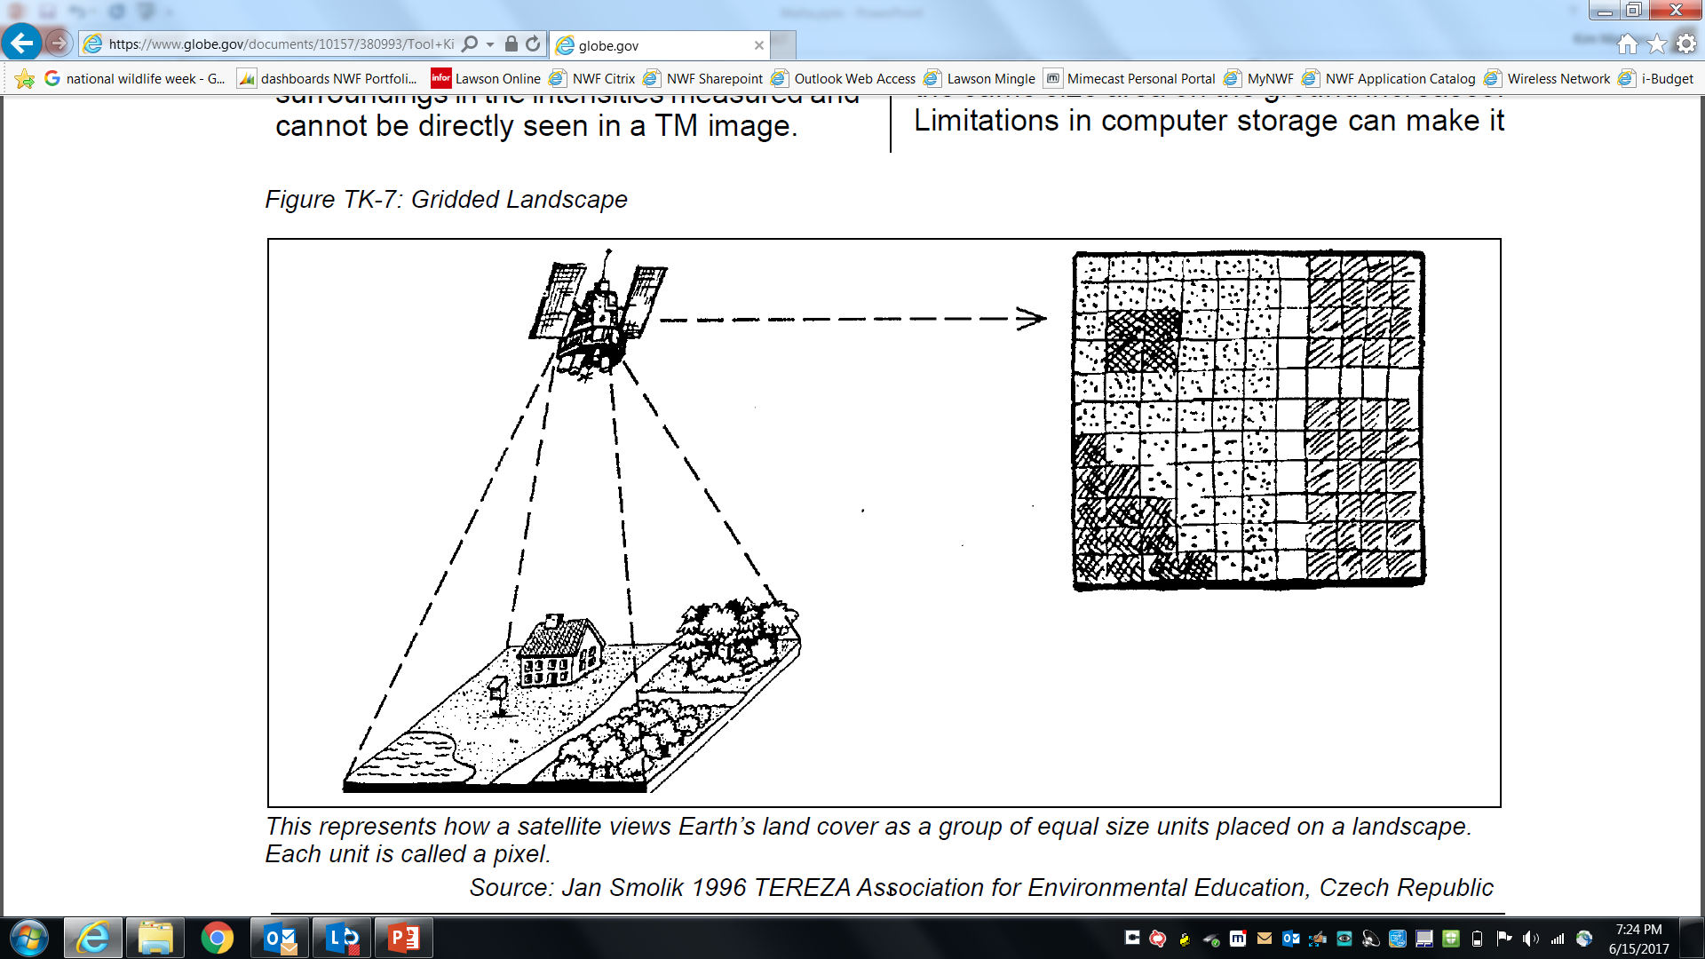

Slide 11
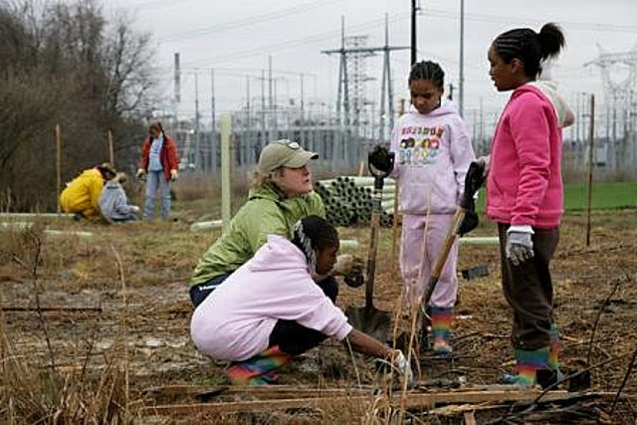

Slide 12
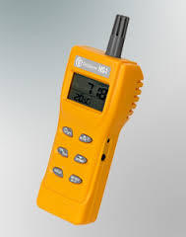
Indoor Air Quality
Pose questions
Develop hypothesis
Plan investigation
Conduct experiments & perform observations using GLOBE protocols
Analyze data
Return to hypothesis
Present and connect findings

Slide 13
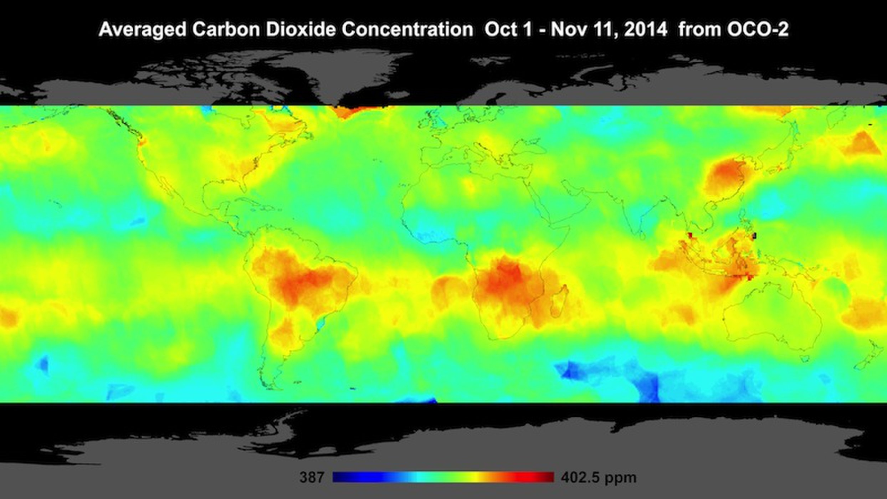
Notes:
It shows hotspots of carbon dioxide over northern Australia, southern Africa and eastern Brazil.
These carbon spikes could be explained by agricultural fires and land clearing — practices that are widespread during spring in the Southern Hemisphere, OCO-2 scientists said.

Slide 14
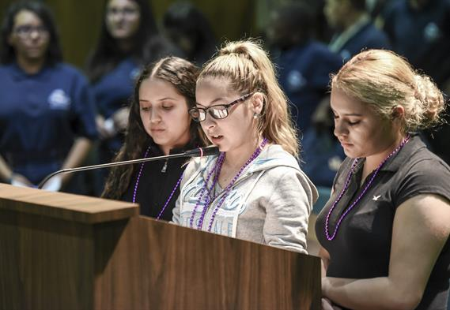
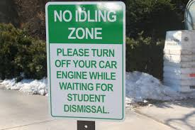

Slide 15
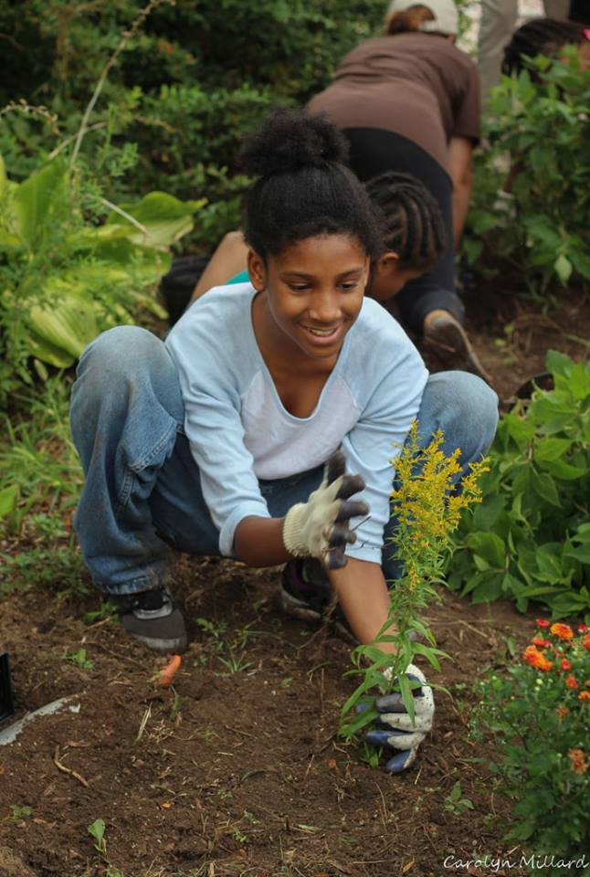
Schoolyard Habitat
Pose questions
Develop hypothesis
Plan investigation
Conduct experiments & perform observations
using GLOBE protocols
Analyze data
Return to hypothesis
Present and connect findings

Slide 16
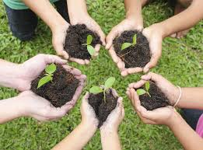
Probing Question
How does healthy soil impact schoolyard biodiversity?
Notes:
Write your hypotheses

Slide 17
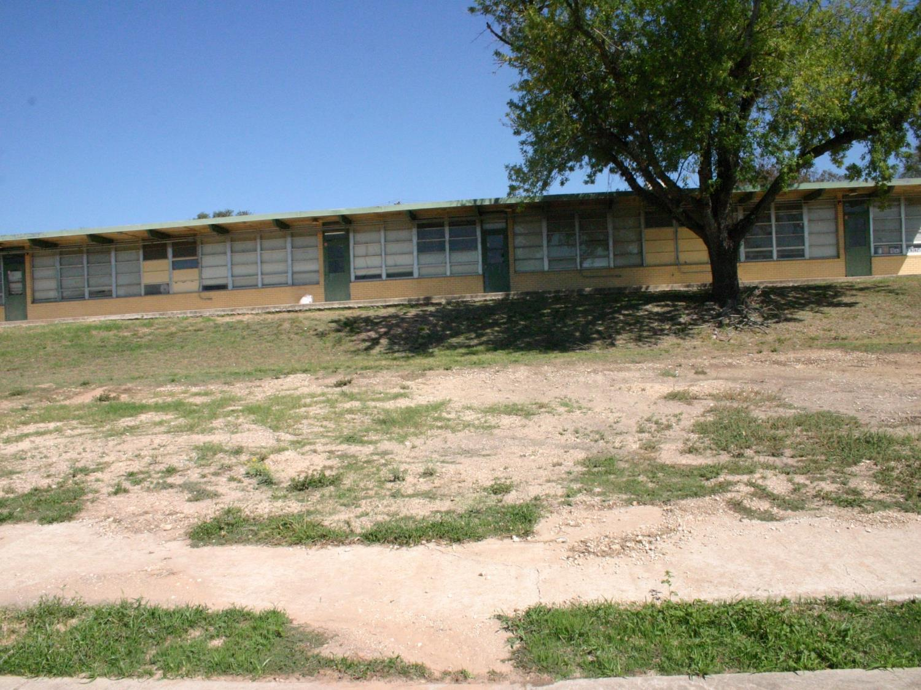
Notes:
What do we want to find out? Past attempts at gardens had failed. Why?

Slide 18
What do you want to find out?
Soil fertility
Soil pH
Soil moisture
Soil infiltration
Soil temperature
Soil characterization
Notes:
Strong acidic

Slide 19
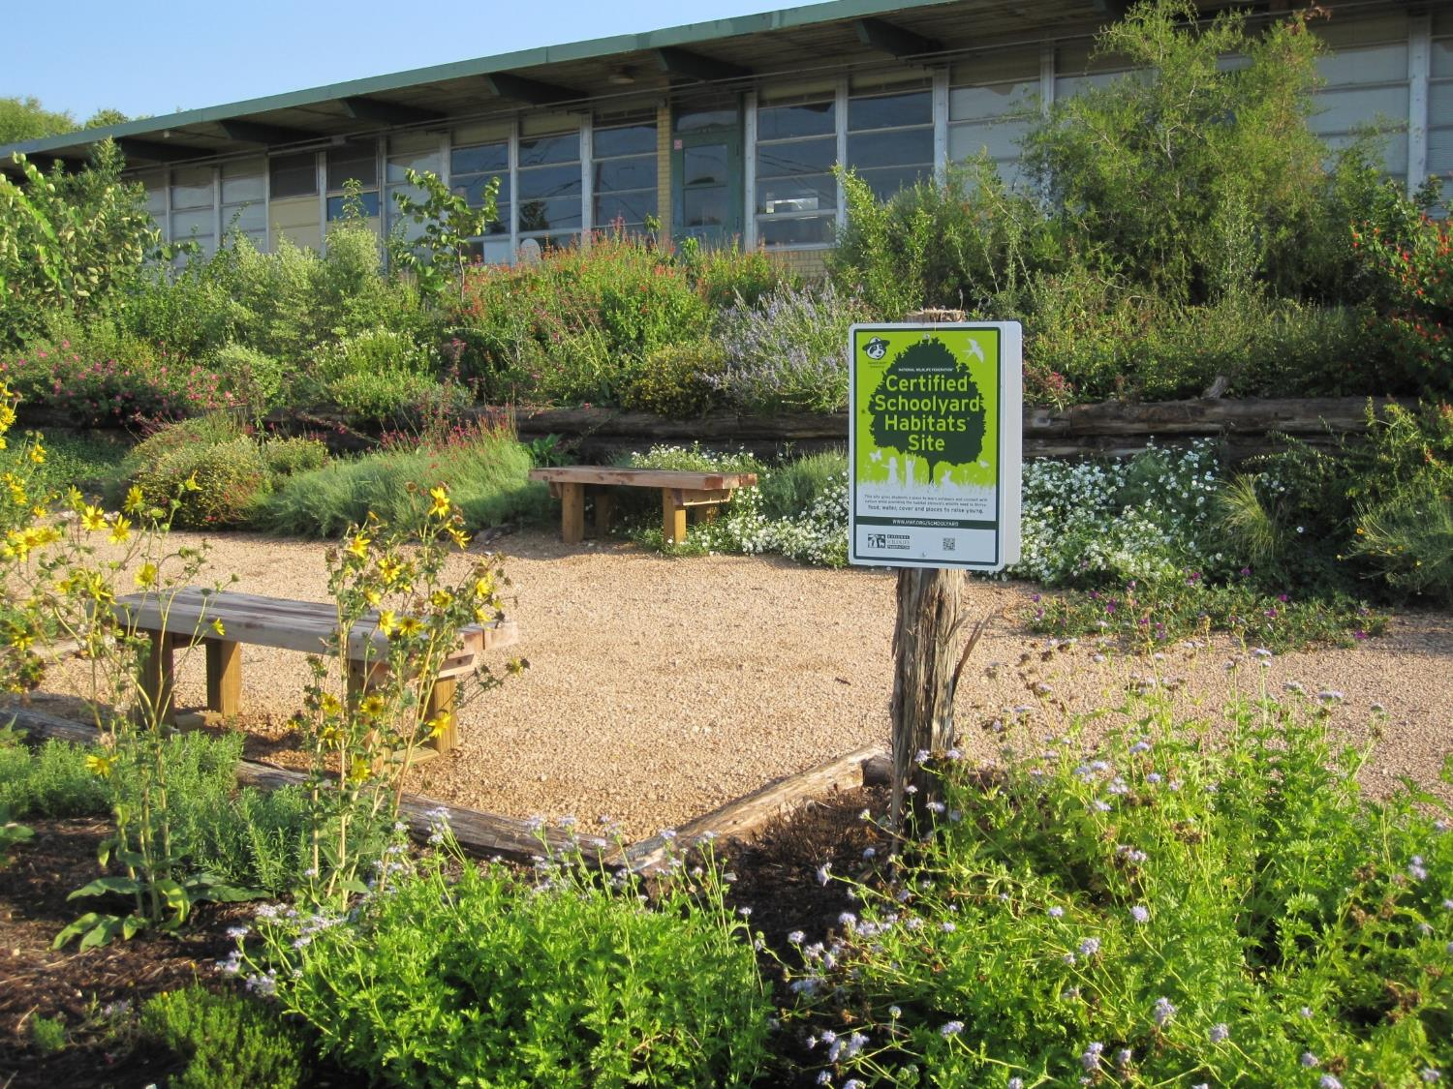

Slide 20
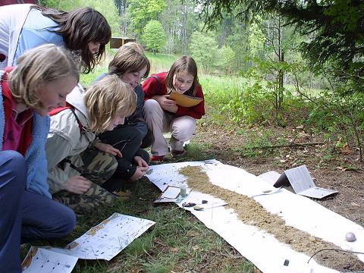
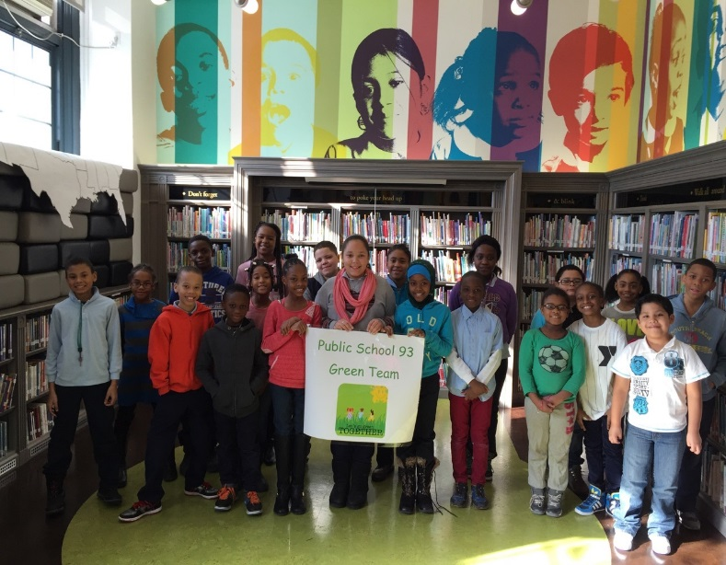
Eco-Schools and
The GLOBE Program
Eco-Schools
Framework for the integration of sustainable principles and practices
Student driven
Local and global, real-world action-based solutions
Environment-based integrated STEM education
The GLOBE Program
Suite of scientific protocols
Earth systems thinking
Citizen science
Application of real-world science tools, skills and practices
Notes:
GLOBE provides the scientific data and basis for sustainability practices to be integrated into schools

Slide 21
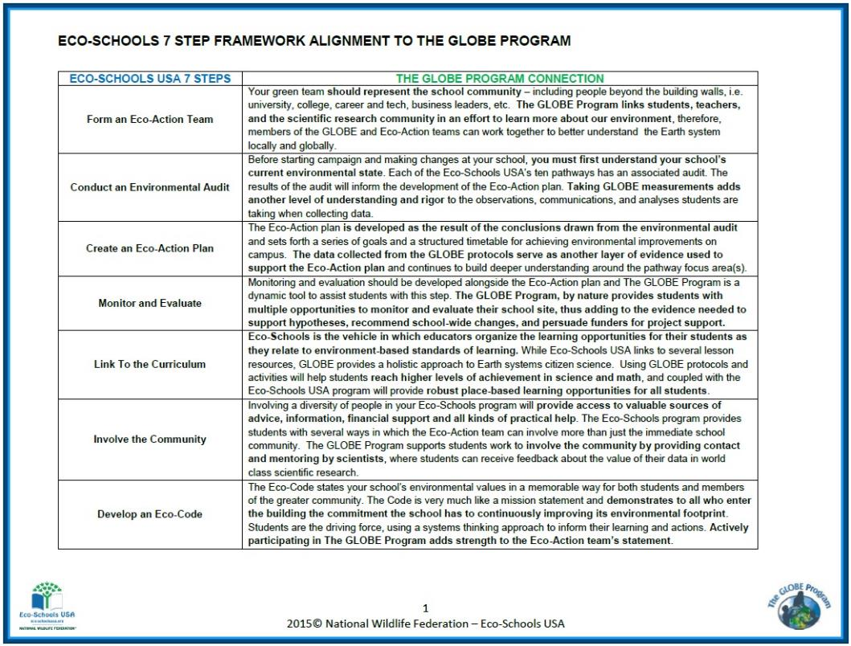
Program Alignments
Seven Step Framework & Protocol Investigations

Slide 22
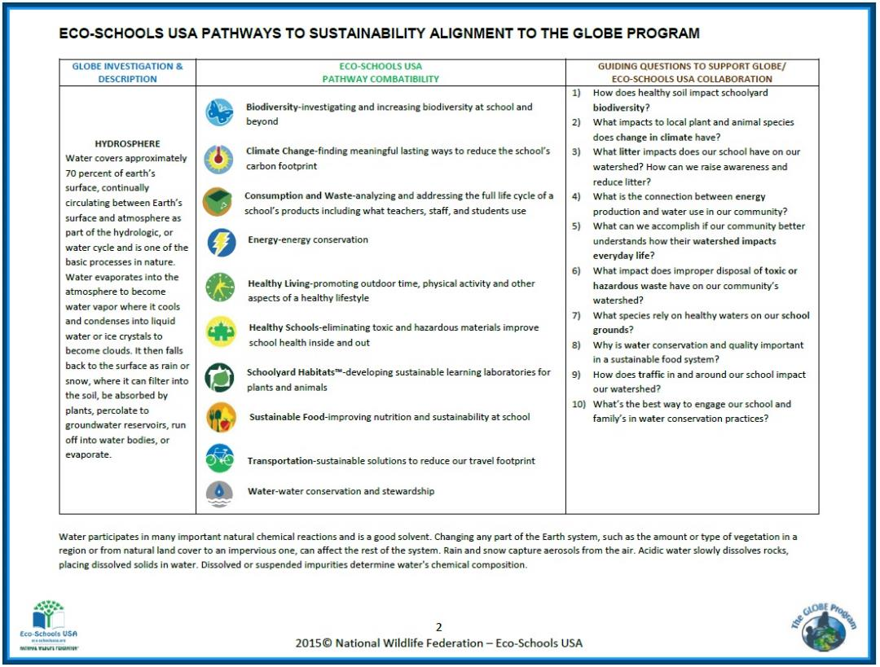
Program Alignments
Pathways to Sustainability & Protocol Investigations

Slide 23

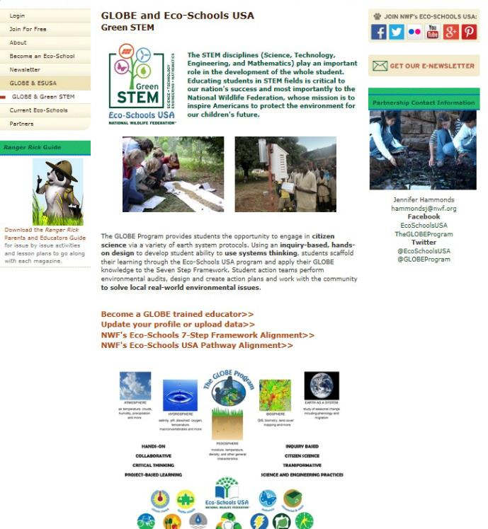
http://www.nwf.org/Eco-Schools-USA/GLOBE.aspx

Slide 24
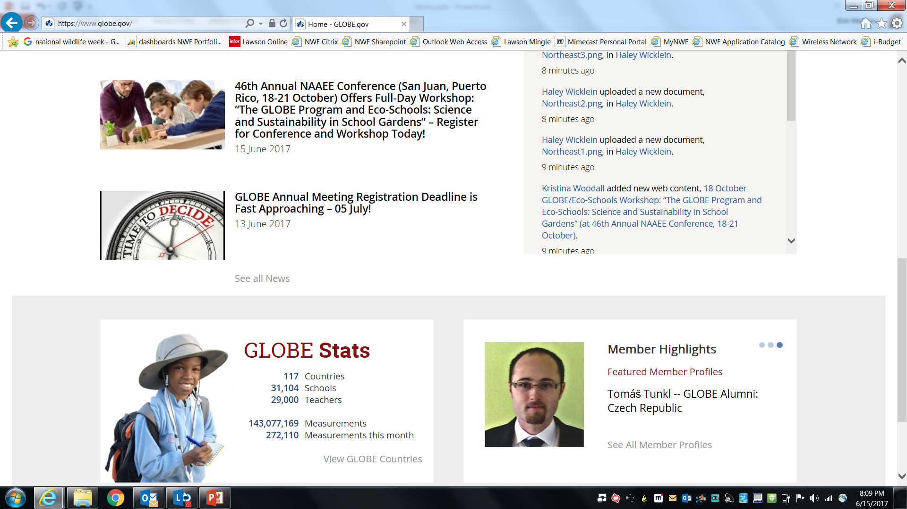

Slide 25


Slide 26
Thank You!
Kim Martinez
Senior Director of K-12 Education Programs
National Wildlife Federation

