Slide 1
GLOBE Learning Expeditions in the Region Europe and Eurasia
Dana Votapkova
Europe and Eurasia Region Coordination Office europe@globe.gov www.globe.gov/web/europe-and-eurasia
GLOBE Annual Meeting, New Haven, Connectitut, 30 July- 03 August 2017

Slide 2
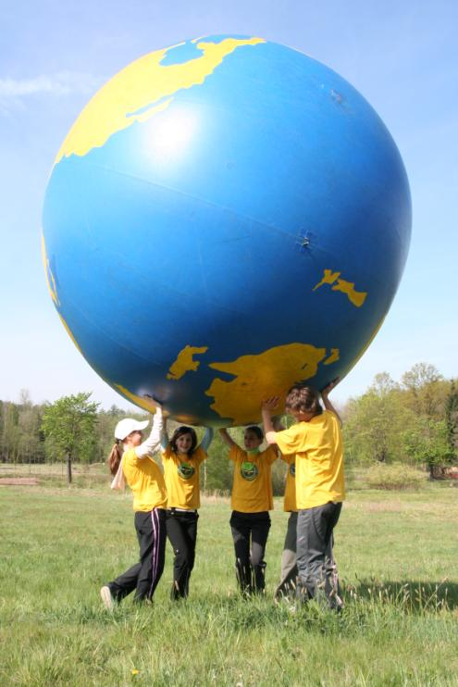
How we call them?
Europe and Eurasia region is rich in different types of student events that are usually called
GLOBE Games (GG)
GLOBE Learning Expeditions (GLE)
Student GLOBE Conferences
GLOBE Meetings
Annual Meeting Ceremony

Slide 3
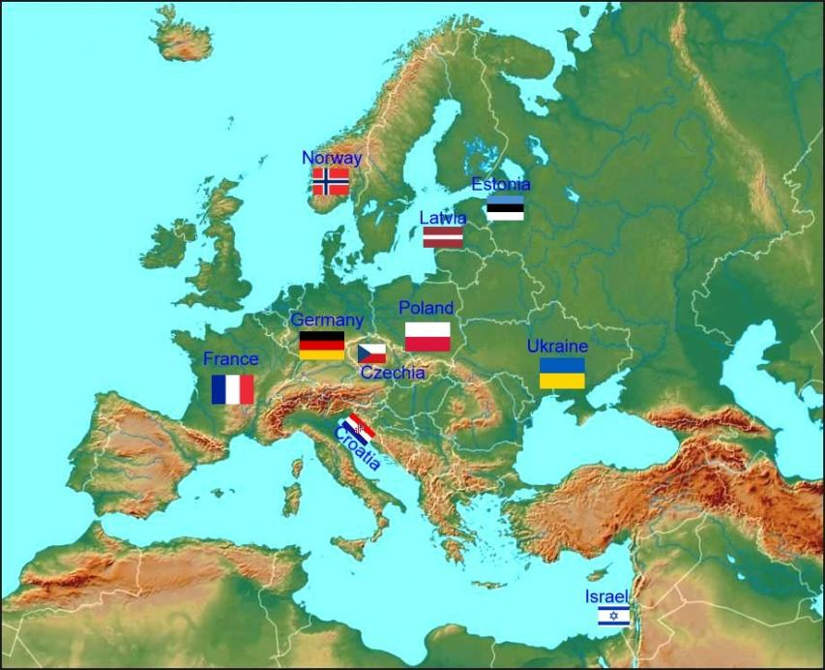
In which countries are held?
1997
The first GG was organized in the Czech Republic before international GLE in Finland.
The first Student Conference was held in Croatia.
Since that time the idea spread to many countries.
Regularly organized:
Croatia, Czech Republic, Estonia, France, Israel, Latvia, Poland, Ukraine
Started this year
Germany
Actively organized some years ago
Norway

Slide 4
International events
Regularly organized:
Croatia, Czech Republic, Estonia, France, Israel, Latvia, Poland, Ukraine
Started this year
Germany
Actively organized some years ago
Norway

Slide 5
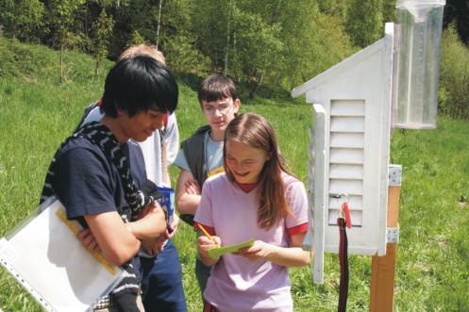
GLOBE Learning Expeditions and GLOBE Games
meeting of teachers and students, the annual culmination of the GLOBE Program
usually 2 – 4 days long
Student conference
Field Day
Festival for public

Slide 6
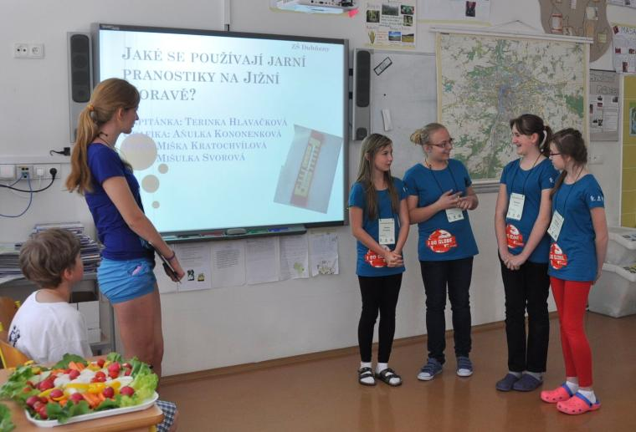
Student Conference
student present outcomes of their GLOBE research projects to the peers and expert comitee
receive feedback from audiance and expert comitee
students are encourage to use rubrics when creating their projects

Slide 7
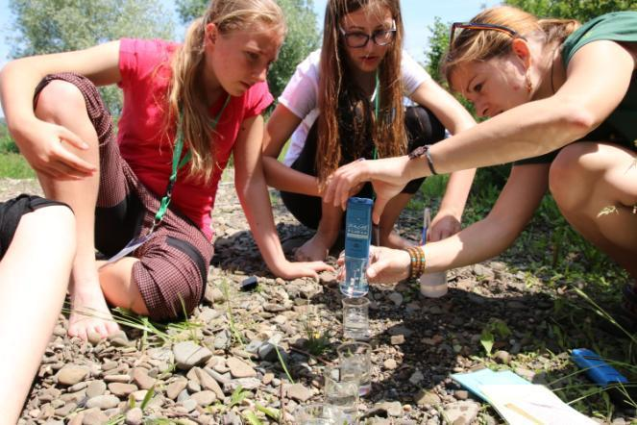
Field Day
students spend at least 1 day in
a field
Student teams
solve challenging tasks
explore and research various questions straight in the nature
cooperate in the teams
meet scientists

Slide 8
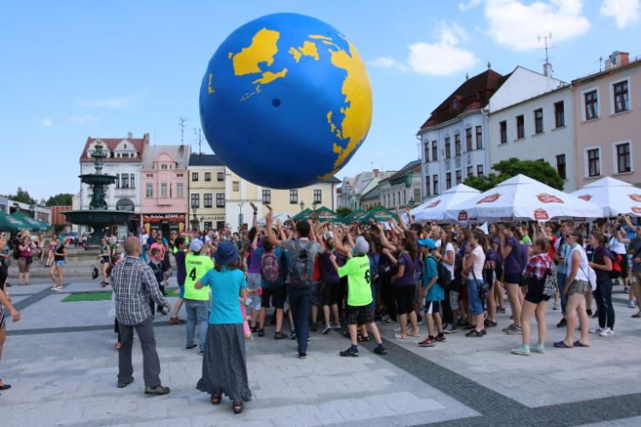
Festival
Promotion of the GLOBE Program
to public
Students prepare learning activities to present GLOBE Program
Accompanied by culture program
Rolling of Globe and parade of participants

Slide 9
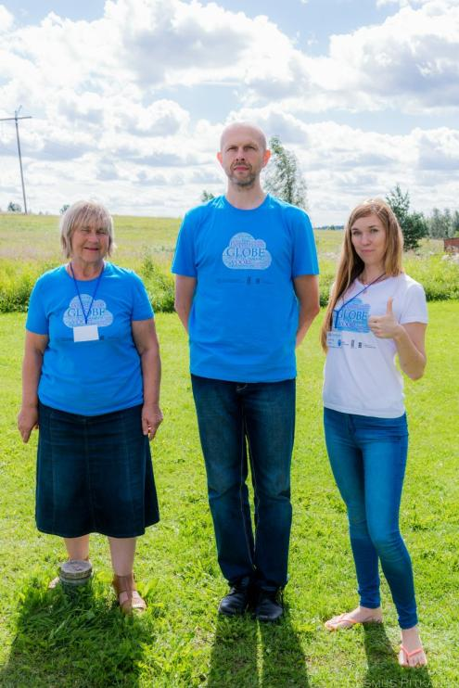
GLE in Estonia
Usually during summer holidays
2016 – celebration of 20 years of GLOBE
130 participants
US Ambassador greeted the participnats
Cooperation of CC, former CCs, scientists and Alumni
Read more at globe.gov

Slide 10
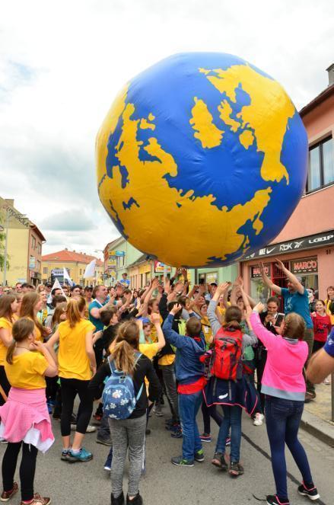
GLOBE Games in the Czech Republic
260 participants – Czech Republic, Belgium and Slovakia – participants from abroad are invited every year
Organized by TEREZA Educational Center (CC) and hosted by active GLOBE school
Volunteers – scientists and Alumni
Chargé d'Affairs of the U.S. Embassy attended the event
GG Guide (tutorial) is available in English
Read more at globe.gov
Watch video here

Slide 11
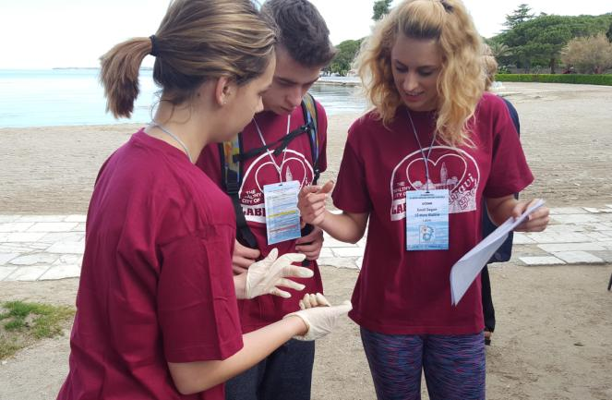
GLOBE Conference in Croatia
Organized and hosted by the Education and Teacher Training Agency (CC)
20th anniversary of the event
40 schools (3 students + teacher)
Student GLOBE projects (IBSE) – each school gets the mentorship of a scientists or expert
Over the past few years the quality of research projects increased
Read more at globe.gov

Slide 12
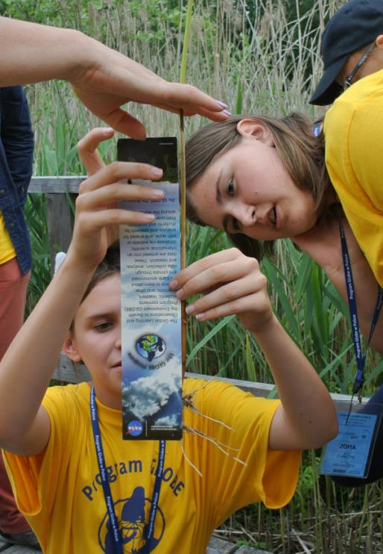
GLOBE Games in Poland
20th anniversary of GLOBE
120 participants
Supported by US Embassy and sponsors
Special guest Brian Campbell from NASA
40 research stations supported by almost 30 scientists, experts, volunteers
Read more at globe.gov

Slide 13
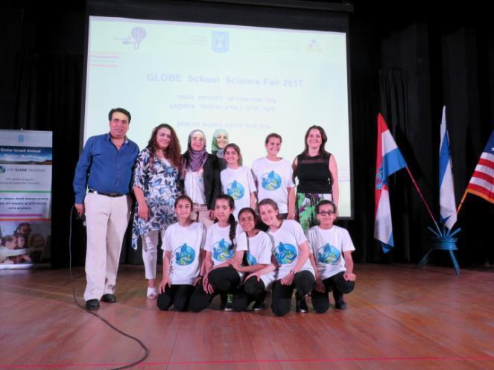
Annual Meeting in Israel
28 GLOBE schools were rewarded in various categories
150 students + school directors and inspectors
US Embassy
Presentations of GLOBE projects + music and dance performance
TV channel broadcasted a report during a main national news
Read more at globe.gov

Slide 14
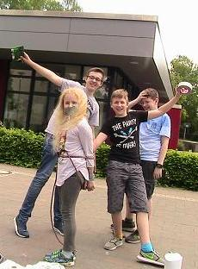
France and Germany
France
140 participants
Connected to Air quality and Aerosol campaign
Watch movie and read more at globe.gov
Germany
7 schools participated
Organized by GLOBE Germany
Student presentation + outdoor activities
Read more at globe.gov

Slide 15
GLE in Latvia
Ambassador of the USA Mark Pekala participates in learning activities on rift in the River Gauja
Frequently visited by ambassador or other representatives of the US Embassy
GLOBE protocols
Meeting with environmental experts
https://www.facebook.com/GlobeLatvija/

Slide 16
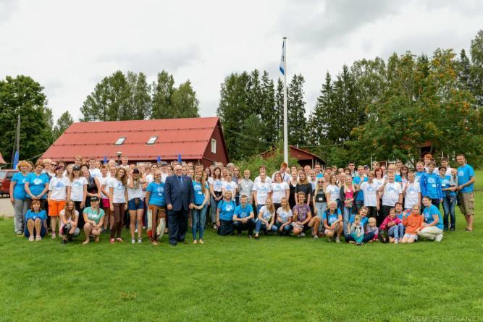
Benefits of GLE/GG/Student conferences
Meeting and interconnection of GLOBE community (meet face to face – students, teachers, scientists, CCs)
Sharing of the year´s work and personal experience
Motivation of students and teachers to enjoy the work at GLOBE and do it well
Inspiration – trying of new things, inspiration by sharing
Collaboration (teachers, students, scientist)
Promotion of GLOBE idea - What GLOBE is about, , what it means to do GLOBE?
Promotion of activities of participating schools
Meet scientists – scientist meet students and see GLOBE in practice
Cooperate with GLOBE Alumni
Celebration
Attractive for media
Opportunity to invite guests – US Embassy, donors, scientist

Slide 17
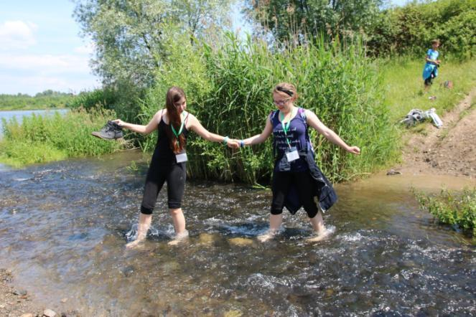
How RCO can support GLE/GG/Student conference?
Promote events and invite community (News, e-mails to CCs)
Provide guidance if required
Support by a visit to the event (help at the study sites, work with teachers, prepare activities for students..¨
Support by skype in
Report on events together with CC
(web, info to CCs by e-mail etc.)

Slide 18
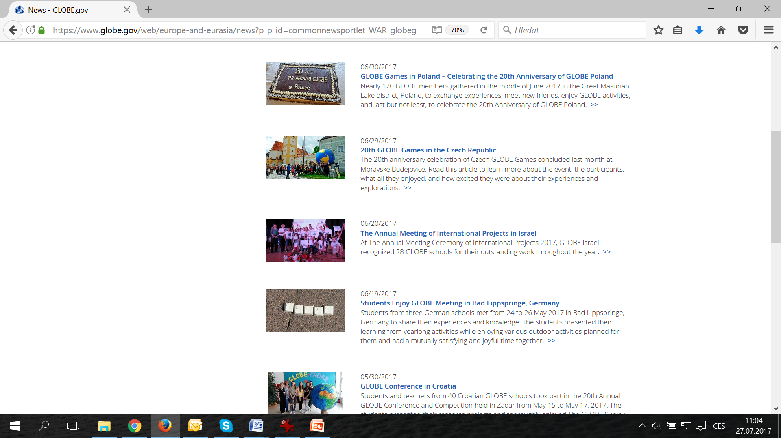

Slide 19
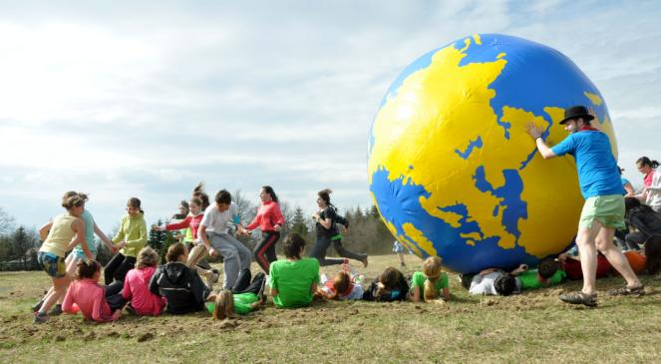
Meet the organizers !
Croatia – Diana Garasic
Czech Republic – Dana Votapkova (RCO)
Estonia – Laura Altin
France – Danielle DeStaerke
Germany – Anna Heyne-Mudrich
Israel – Farid Hamdan
Poland – Ella Wołoszyńska-Wiśniewska
Latvia – Krisjanis Liepins

Slide 20
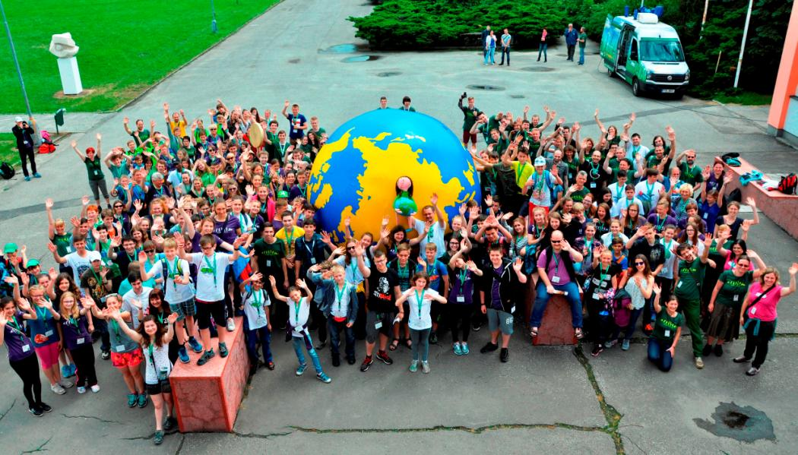
Thank you! We look forward to meet you at some of the GLE, GG or Student Conference next year!

