Slide 1
GLOBE Program Annual Meeting
August 2, 2017
Avery Waite
Program Analyst
USAID | Center for Accelerating Innovation and Impact

Slide 2

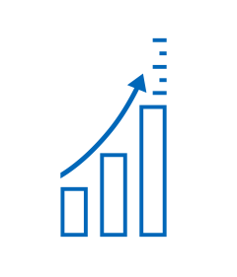

CII plays a complementary role to support innovation and scale for GH Bureau priorities
Role
Accelerate the development, introduction and scale up of priority global health interventions
Approach
Promote and reinforce innovative, business-minded approaches to address key bottlenecks in development, introduction and scale up
What we do
Catalyze Innovation
Scale for Impact
Identify Cutting-Edge Practices
Notes:
CII applies business-minded approaches to the development, introduction, and scale-up of health interventions to accelerate impact against the world’s most important health challenges.
The Center invests seed capital in the most promising ideas and applies and rigorous, market-oriented approach to cut the time it takes to transform discoveries in the lab to impact on the ground.

Slide 3
CII leverages best practices in catalyzing innovation and partnering to scale
Catalyze Innovation
We use a variety of novel approaches—from Grand Challenges to hackathons to prizes—to source groundbreaking solutions for tough and seemingly intractable health challenges.
Grand challenges
Innovator support
Scale for Impact
We partner across the bureau to support accelerated introduction and scale-up through:
Strategic planning for introduction and scale
Market shaping
Innovative financing
Identify + Apply Cutting-Edge Practices
We examine successes and failures across a range of markets and sectors to identify – and apply – state-of-the-art practices
Cutting-edge resources and tools
Digital health
Leverage and partnerships
New ways of working
Notes:
Catalyze innovation
Scale for Impact: The center supports the introduction and scale-up planning for priority health interventions, uses innovative finanzing mechanims, applies market shaping tools to address inefficiencies and barriers, and leverages the expertise and active engagement of the private sector, all to accelerate and rapidly expand health impact
Best Practices: To help improve the efficiency of the marketplace, the Center examines successes and failures across a range of markets and sectors to identify state of the art practices in innovation, introduction, and uptake.

Slide 4

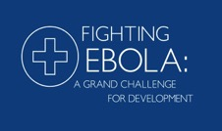

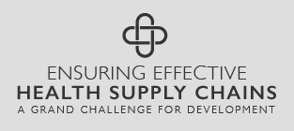
Our Innovation portfolio focuses on finding and supporting new solutions to global health challenges
With our Grand Challenges, we fund and support a broad range of global health innovators
Supporting 106 innovations aimed at saving the lives of mothers & newborns, with potential to save 150 thousand lives by 2030
Rapidly sourced 14 innovations in the midst of the Ebola crisis, developing and testing solutions to address key gaps in our outbreak response
Supporting 26 innovations aimed at curbing the spread of Zika and stopping future global health threats from becoming global crises
Recently-launched challenge in partnership with the Bill & Melinda Gates Foundation with goal of overcoming key roadblocks to more effective health supply chains

Slide 5
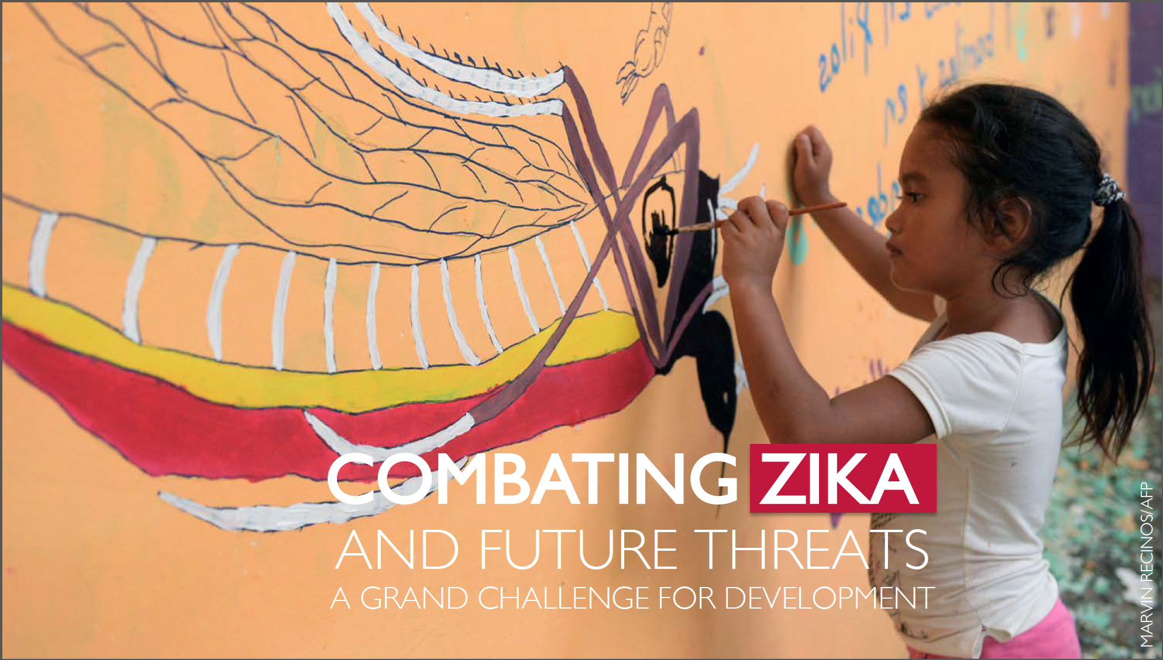
Notes:
On February 1, 2016, the World Health Organization (WHO) declared the Zika virus and associated health threats an international public health emergency. The virus, spread primarily through mosquito bites, is linked to serious birth defects in the babies of mothers who were infected while pregnant. WHO now considers Zika to be an ongoing health threat requiring intense action.

Slide 6
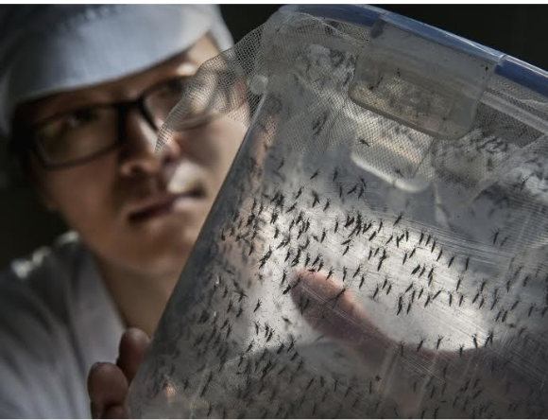
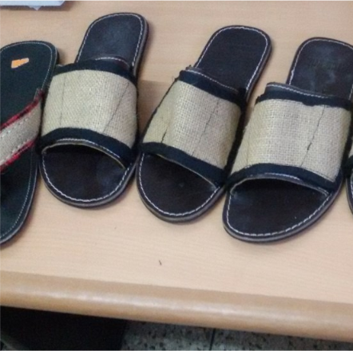
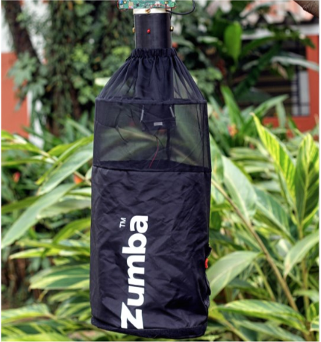

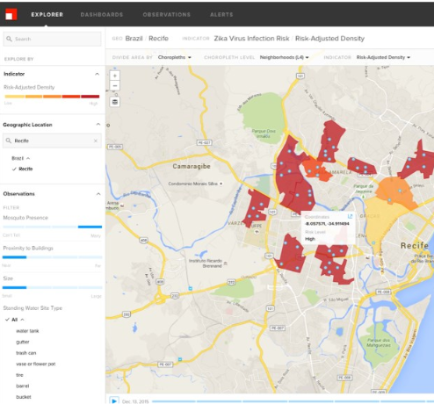
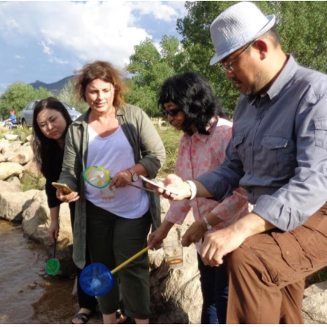
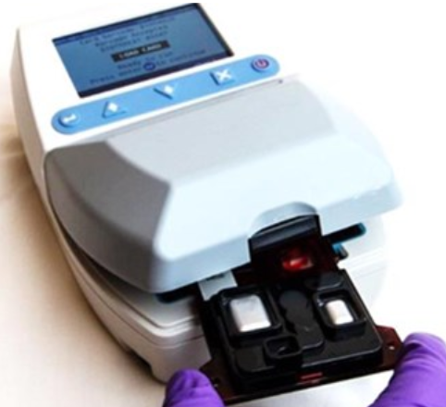
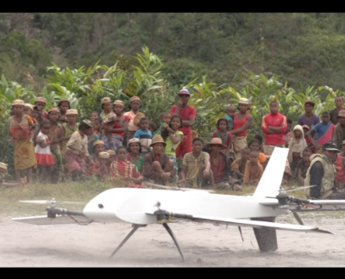






Rapidly sourced 26 innovations under Combating Zika and Future Threats Grand Challenge
Vector Control
Personal & Household
Protection
Vector Surveillance
900 ideas
26 awards
($30M)
Disease Surveillance
Community
Engagement
Diagnostics
Unmanned Aerial
Vehicles
Notes:
In an effort to better equip ourselves globally, USAID’s Bureau for Global Health issued a $30 million Grand Challenge in April 2016, which called upon the global innovator community to generate cutting-edge approaches to fight the current Zika outbreak and strengthen the world’s ability to prevent, detect and respond to future infectious disease outbreaks.
We received nearly 900 submissions, which went through several technical review panels, and the most promising innovators came to a live pitch competition in Washington, D.C.
USAID ultimately selected 26 potentially game-changing solutions to be funded for accelerated development, testing and deployment.
The projects cut across vector control, personal and household protection, vector and disease surveillance, diagnostics, community engagement, and unmanned aerial vehicles.

Slide 7

Vector Control
Monash University
Scaled deployment of Wolbachia-infected Mosquitoes to block disease transmission
(Colombia)
Michigan State University
Wolbachia-infected mosquitoes to suppress Population and block disease
(Mexico)
Trustees of Indiana University
Natural yeast-based larvicide
(Belize)
Johns Hopkins University
Chromobacterium: an environmentally friendly biopesticide
(Puerto Rico & Zambia)
Notes:
Infect mosquitoes with Wolbachia, a naturally occurring bacteria proven to block the transmission of dengue fever and Zika virus from mosquitoes to humans. The approach provides a natural, sustainable, cost-effective new tool for preventing transmission of a range of arboviruses including Zika, dengue and chikungunya. The project, which has been proven to work over long-term field tests, will now be tested in much larger populations in several Latin American communities.

Slide 8

Personal and Household Protection
Barcelona Institute For Global Health
Electric force field to repulse mosquitoes
(Guyana)
Ifakara Research Institute
Low-cost treated Sandals to prevent bites
(Brazil & Tanzania)
Liverpool School of Tropical Medicine
Low-tech treated fabric for outdoor Use
(Haiti)
QIMR Berghofer Medical Research Inst.
Low-cost treated wall hangings for indoor use
(Mexico)
Johns Hopkins University
Human scent mimic mosquito trap
(Zambia)
Notes:
These sandals release highly effective, wide-area spatial mosquito repellents, creating full-time protection against both day-biting and night-biting mosquitoes at individual and household level. The low-cost sandals provide round-the-clock protection against Dengue, Zika, Chikungunya and Malaria using hessian strips impregnated with off-patent but highly effective and safe repellent, transfluthrin. The sandals can provide protection to the feet and ankles for up to 6 months.

Slide 9
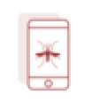
Vector Surveillance
Stanford University
MosquitoFreq: Crowdsourced detection of mosquito species
(Brazil, Madagascar, and Kenya)
Stanford University
VectorChip: pathogen
identification tools for wild mosquitoes
(Brazil, Madagascar, and Kenya)
Johns Hopkins University
VectorWEB: smart ovitrap network
(Brazil)
University of Queensland
Near infrared spectroscopy to detect transmission hotspots
(Brazil)
Sao Paolo University
Intelligent trap to enhance surveillance
(Brazil)
Notes:
ectorWEB is a novel low-cost, cloud connected system of smart ovitraps that will provide real-time mosquito surveillance data to health administrators, communities and individuals. This proposed mosquito surveillance allows for outbreak modeling, targeted resource allocation/redirection and community-driven interventions.

Slide 10

Disease Surveillance
Premise
Citizen-led disease risk mapping and vector
monitoring
(Colombia)
Dalberg Data Insights
Monitoring population movement to determine
areas prone to disease outbreak
(Brazil)
Dimagi/ Mt. Sinai
Big data and machine-based learning to identify
data cold spots to forecast disease hotspots
(Guatemala)
International Society for Infectious Diseases
Partnership for real-time mapping of disease
transmission risk from one country to another
(Senegal and Sierra Leone)
Notes:
Dalberg Data Insights team will leverage telecom data which is systematically collected, covers large pro-portions of population and is rich on information about individual and collective mobility. This data is routinely collected by mobile phone operators for billing purposes and, when aggregated to small geographical areas, can be merged with Zika incidence data. Dalberg Data Insights will develop an interactive user-friendly tool that allows for nearly real-time monitoring of population movement and related Zika risk flows, thus enabling identification of new areas susceptible to Zika introduction, and prioritizing small-scale areas where Zika interventions would have the highest impact.

Slide 11

Diagnostics
J. Craig Venter Institute
Rapid identification of peptides to speed development of Zika diagnostics
(Lab)
Abbott’s Ibis Biosciences Business
Rapid, handheld point of care diagnostic for ZIKV, DENV, and CHKV
(Lab)
BluSense
Viro-Track: Rapid point of care diagnostics for ZIKV, DENV, CHKV using blue ray technology
(Malaysia & Brazil)
SystemOne
Aspect™ IoT software to prevent future outbreaks and mobile connectivity backpack
(South Africa and Malawi)
Notes:
BluSense is developing a one-drop-of-blood quantitative POC tests for DENV and ZIKV. The solution consists of a reader, and single-use blood test cartridges, specifically designed for targeting different viruses. The VIRO-Track cartridges have been designed and developed to be the first quantitative rapid tests able to quickly and accurately diagnose dengue, zika and chikungunya, using a single drop of blood.

Slide 12
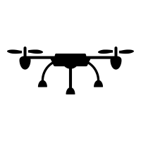
Unmanned Aerial Vehicles
Vayu
UAVs for delivery/pick-up of medical products & samples
(Madagascar)
WeRobotics
UAV mosquito release mechanism to support mosquito control
(Peru)
Notes:
The team will create an optimized, reliable, and cost-effective UAV-integrated system that can support the delivery of products to last mile facilities as well as pick up samples and other critical items from those facilities.

Slide 13

Community Engagement
Institute for Global Environmental Studies
Mosquito Challenge Community Campaign
(Peru & Brazil)
Johns Hopkins University
Rapid Habit Optimization Tool (R-SHOT)
(Honduras)
Notes:
Mosquito Challenge Community Campaign you will hear more about later

Slide 14
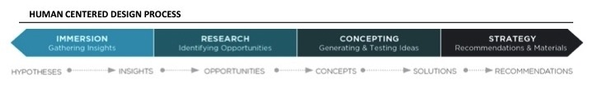
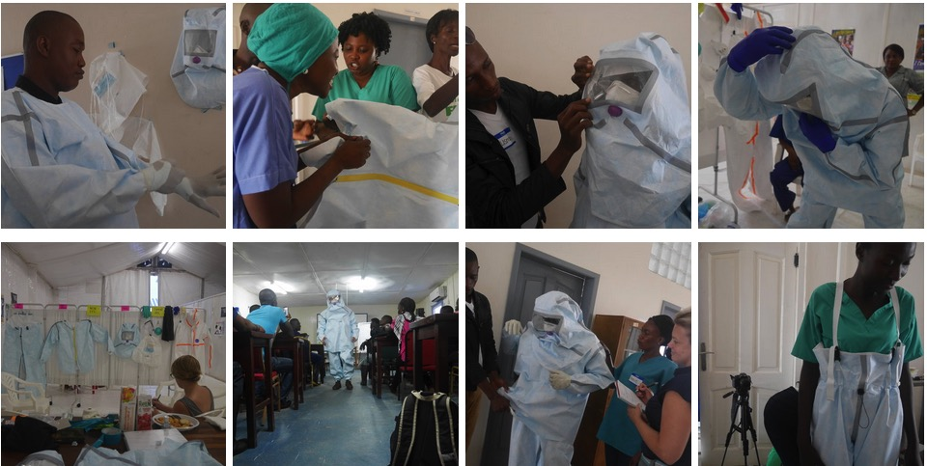
USAID will support innovators to test and scale
their innovations
        Help get critical user feedback
Notes:
DIG will provide initial high-level HCD support for the entire Zika and Future Threats portfolio, followed by a handful of deeper engagements.

Slide 15
USAID will support innovators to test and scale
their innovations
        Help get critical user feedback
        Provide expertise in product introduction and scale up
Notes:
BCG will provide high-level business strategy support across the portfolio tailored to innovator archetypes as well as targeted, deep-dive introduction and scale-up support to select innovators.

Slide 16
USAID will support innovators to test and scale
their innovations
        Help get critical user feedback
        Provide expertise in product introduction and scale up
        Connect innovators to partners, technical experts and key influencers
Notes:
IVCC will establish a scientific advisory committee to provide technical and industry expertise to the vector control and personal and household protection innovators.

Slide 17
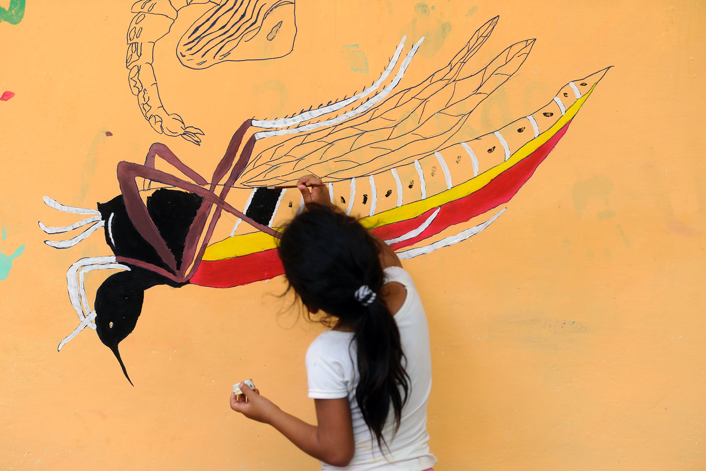
www.usaid.gov/grandchallenges/zika
Notes:
Mosquito Challenge Community Campaign
It can be difficult to source solutions that are truly novel ways of thinking about behavior change. The IGES team’s approach of engaging students as citizen scientists to participate in disease surveillance and vector control is not only unique, but it also has the potential to rapidly tap into thousands of individuals in the fight to eradicate disease risk in their communities.
Hand it over to Rusty to talk more about the Campaign and the work that they have been doing in Brazil and Peru.

