Slide 1
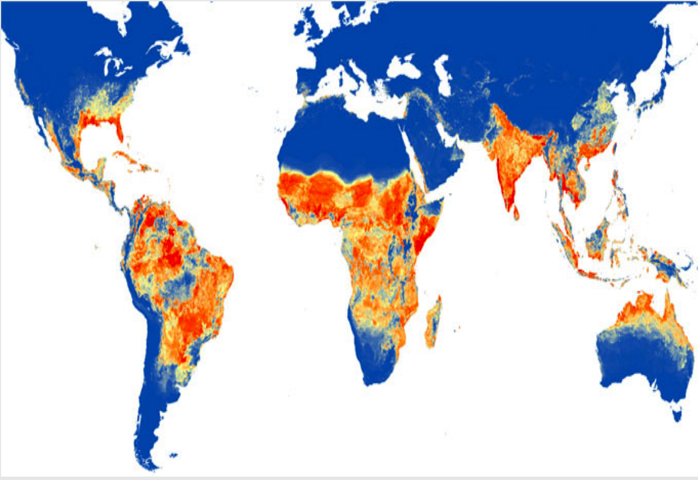



GLOBE Observer Mosquito Habitat Mapper: Partnerships, Programs, and Potential
Russanne Low and Theresa Schwerin
Institute for Global Environmental Strategies (IGES)
Avery Waite
Center for Accelerating Innovation and Impact
Jean Robert Batana Pires Ferreira
Brazilian Space Agency (AEB)
Brazil GLOBE Deputy Country Coordinator

Slide 2

Session Overview
Introduction: GLOBE Observer and the Mosquito Habitat Mapper – Theresa Schwerin
Center for Accelerating Innovation and Impact: Combating Zika and Future Threats Grand Challenge – Avery Waite
Mosquito Challenge Community Campaign (MCCC) – Rusty Low
GLOBE Brazil and MCCC – Jean Robert Batana Ferreira
Broader Impacts and Teaching/Educational Resources – Rusty Low
Q&A

Slide 3
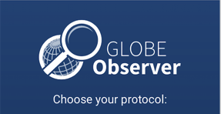
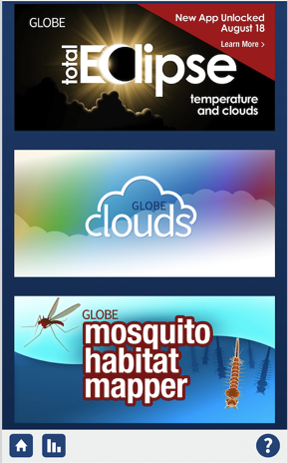
GLOBE Observer
Observer.globe.gov
NASA’s platform for citizen science engagement in Earth science research
Can citizen science make a difference to science?
Mosquito Habitat Mapper
Notes:
Soft launch May 28

Slide 4
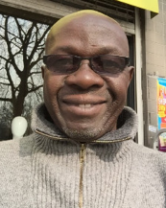
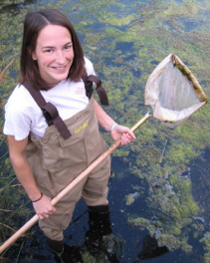
"Satellites don't see mosquitoes per se. However they provide us observation platforms from which to monitor the environmental variables that indicate where mosquito populations can flourish. This helps us identify areas where disease vectors can emerge.” Dr. Assaf Anyamba, NASA GSFC
"The mosquito data collected by citizen scientists through GLOBE Observer will be very useful for helping me to gain a more detailed understanding of how temperature and rainfall influence the beginning of the mosquito season and the risk of West Nile Virus transmission." Dr. Sara Paull, Colorado School of Public Health, University of Colorado

Slide 5
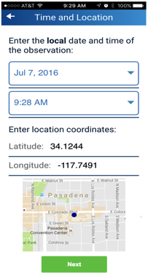
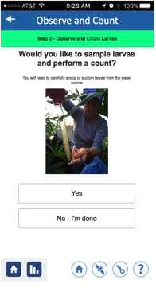
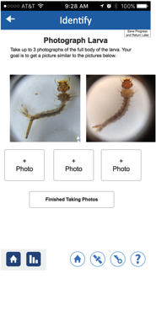
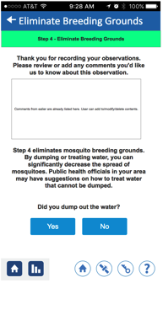
The Mosquito Habitat Mapper supports you through 4 data collection steps:
Locate Sample/Count Identify Decommission
1 2 3 4
Notes:
Can do 1, 2, 3 or all 4 steps. 1) Locate/identify/photograph; 2) Sample and count 3) using a macro lens attached to iPhone Identify whether your larva is one of 3 genera that will potentially carry mosquito-borne disease, and 4) decommission/mitigate.

Slide 6
The goals of the MHM app are to SEE increased mosquito awareness and decreased mosquito-borne disease risk through:
Scientific data collection and analysis: Identifying locations of mosquito taxa of interest to participants, communities, public health authorities
Empowerment: Actively reducing mosquito risk- by dumping containers and monitoring environment
Education: Learning opportunistic breeding habits used by Aedes aegypti/albopictus in human built environments and about vector borne disease risk communities
Notes:
Key question: demonstrate value of citsci data to public health & community action during an active Zika oubreak

Slide 7
Mosquito Challenge Community Campaign (MCCC)

Slide 8
Objectives
Engage students in scientific discovery and field observations
Promoting public health by reducing local mosquito-vector disease risk
Sharing data to the GLOBE database, which can be used by public health officials

Slide 9
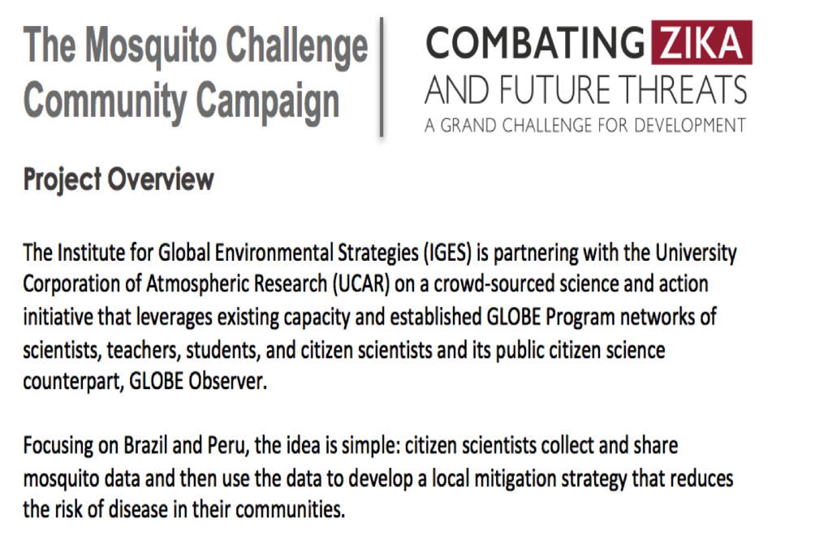

Slide 10


Mosquito Challenge Community Campaign Activities
Data Challenges and Leaderboard
Connect students to NASA and AEB science
Webinars with scientists
Biweekly data collection challenges
Special challenges like student cartoon contexts
Mosquito Challenge Virtual Science Fair in November
Prizes for classes who participate in whole project and submit a science fair project
Best projects proceed to International GLOBE Virtual Science Fair
Project evaluation

Slide 11
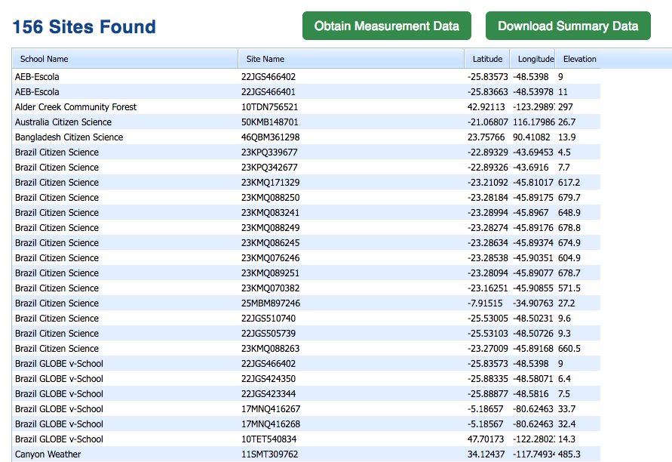
First MHM observations https://datasearch.globe.gov/

Slide 12
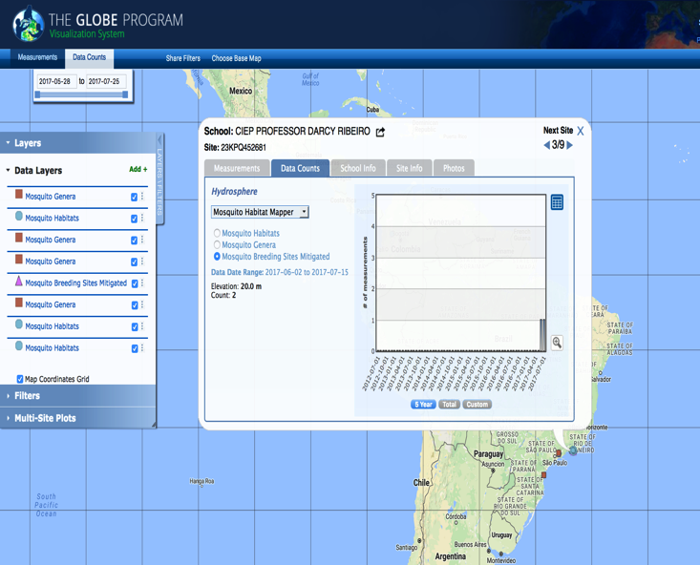
Drilling down into the data

Slide 13
Broader Impacts & Partnerships
Training & Education Resources

Slide 14
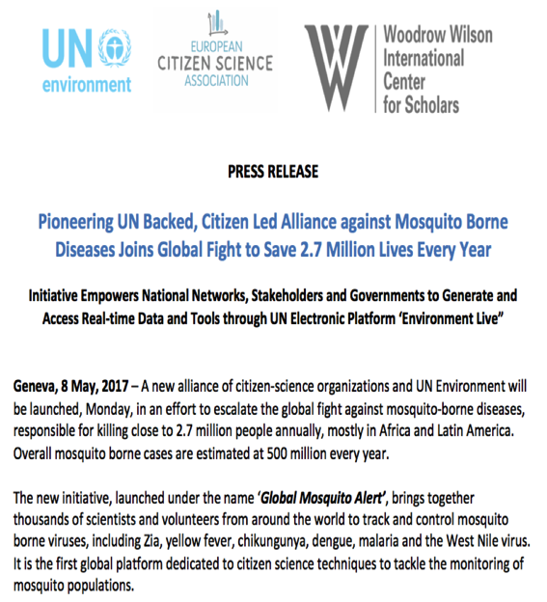
Broader Impacts of your work with GLOBE and GLOBE students
UNEP Environment Live will host GLOBE data collected by your students in an international data base used by scientists to fight mosquito-borne disease

Slide 15
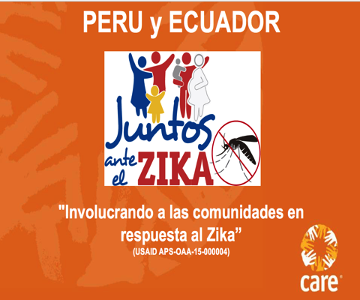
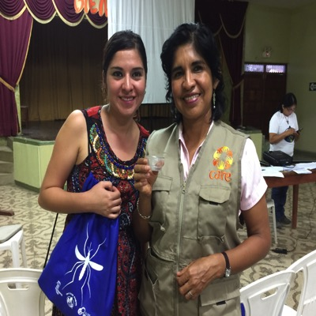
Who are the partners?
Partnerships- Public Health

Slide 16
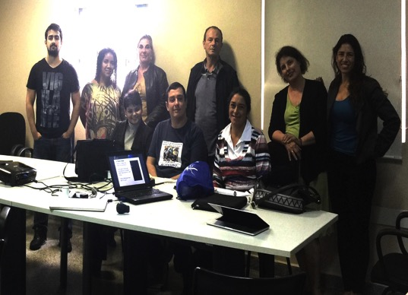
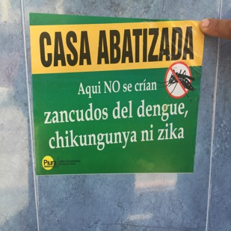
Partnerships- Public Health
School of Public Health
University of Parana, Matinhos Brazil

Slide 17
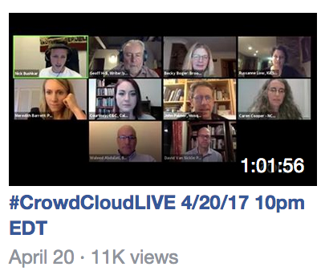

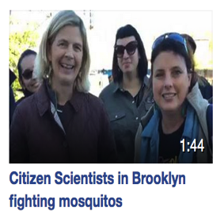
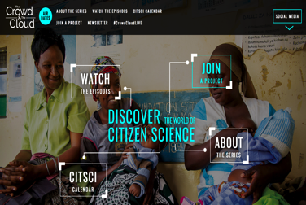
Broadcast & Social Media
http://crowdandcloud.org/

Slide 18


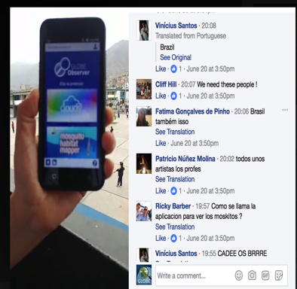
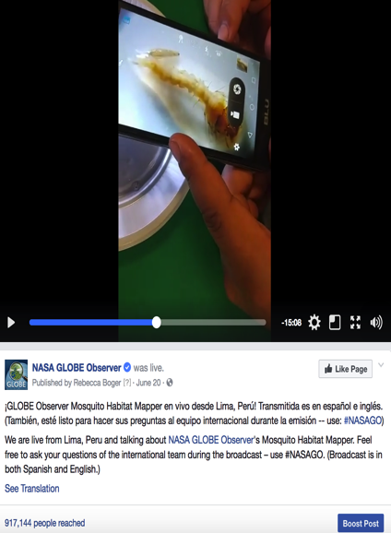
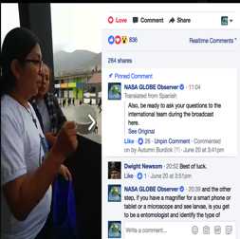
NASA Communications & Social Media
Follow us!
Observer.globe.gov
https://www.facebook.com/nasa.globeobserver/
videos/1892256911046359

Slide 19
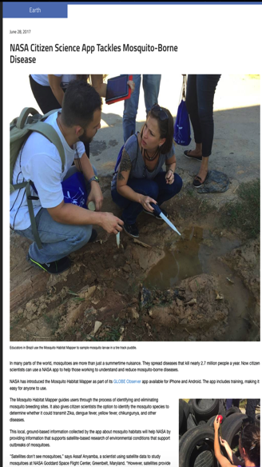
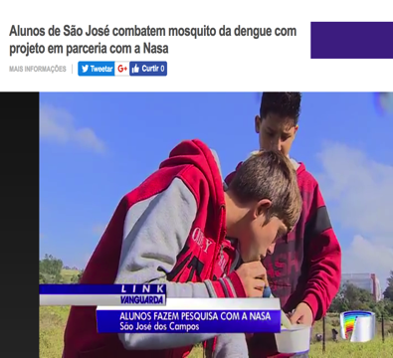
Media
http://g1.globo.com/sp/vale-do-paraiba-regiao/link-vanguarda/videos/v/alunos-de-sao-jose-combatem-mosquito-da-dengue-com-projeto-em-parceria-com-a-nasa/5957813/

Slide 20
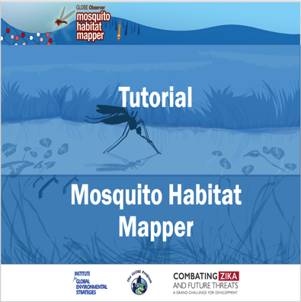
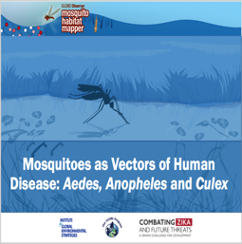
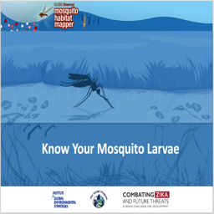
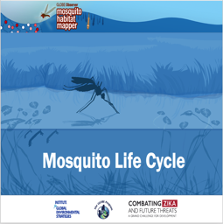
Teaching and Presentation Resources

Slide 21
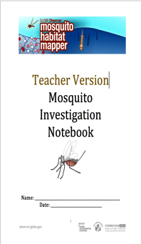
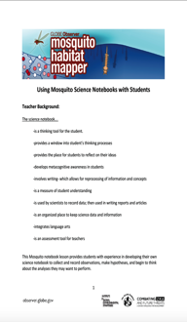
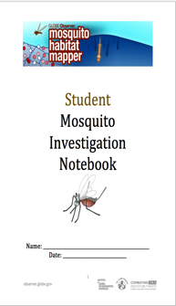
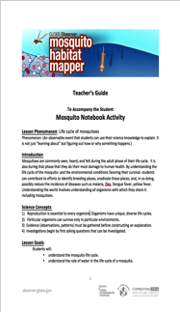
Disciplinary Core Ideas
Fosters science and engineering practices
Primary Level
(4-8)

Slide 22
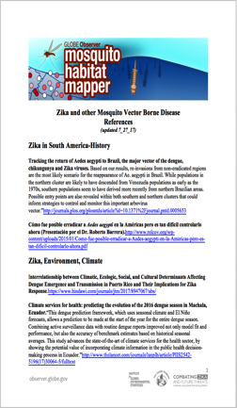
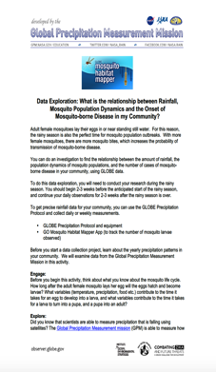
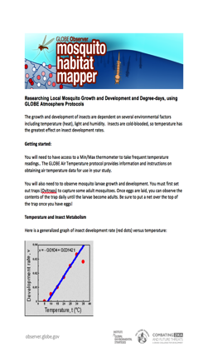
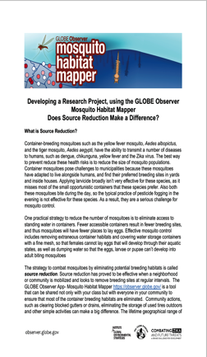
Planning a Research Project
Secondary Level
(8-12)
Bibliography &
References

Slide 23
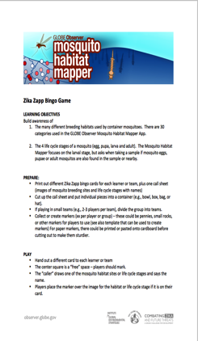
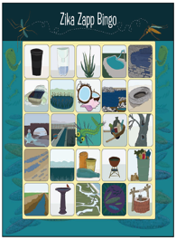
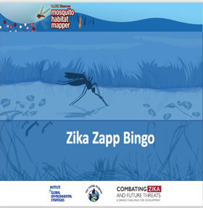
Educational activities- Zika Zapp Bingo

Slide 24
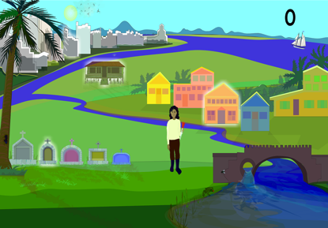
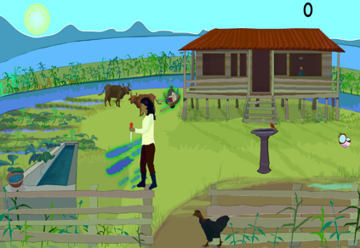
http://zebr.as/2vcRxkA
Gamification

Slide 25
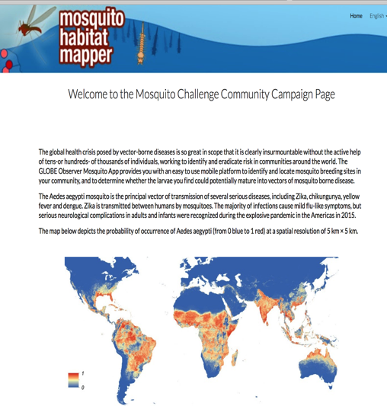
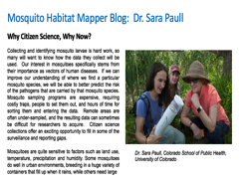
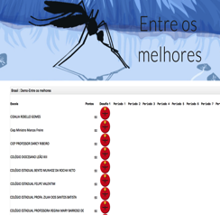
MCCC Project Website
gomhm.strategies.org

Slide 26
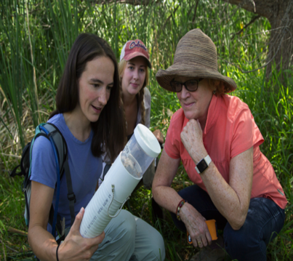
Dr. Sara Paull, Colorado School of Public Health, University of Colorado
Mosquito Habitat Mapper Blog: Dr. Sara Paull
Why Citizen Science, Why Now?
Collecting and identifying mosquito larvae is hard work, so many will want to know how the data they collect will be used. Our interest in mosquitoes specifically stems from their importance as vectors of human diseases. If we can improve our understanding of where we find a particular mosquito species, we will be able to better predict the risk of the pathogens that are carried by that mosquito species. Mosquito sampling programs are expensive, requiring costly traps, people to set them out, and hours of time for sorting them and entering the data. Remote areas are often under-sampled, and the resulting data can sometimes be difficult for researchers to acquire. Citizen science collections offer an exciting opportunity to fill in some of the surveillance and reporting gaps.
Mosquitoes are quite sensitive to factors such as land use, temperature, precipitation and humidity. Some mosquitoes do well in urban environments, breeding in a huge variety of containers that fill up when it rains, while others need large

Slide 27
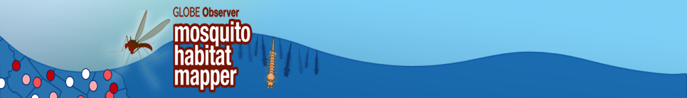
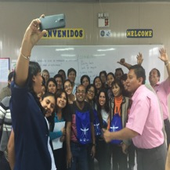
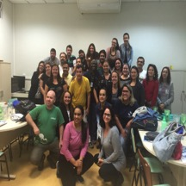
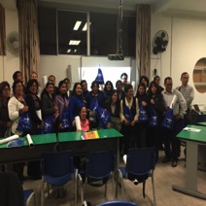

Can Public Participation be the Key to Better Understanding Our Planet?
Earth Scientists Say, “Yes.”

Slide 28
Acknowledgements
Mosquito Habitat
Mapper Team
Russanne Low, IGES
Rebecca Boger, CUNY
Holli Riebeek Kohl, GSFC
Kristen Weaver, GSFC
Theresa Schwerin, IGES
Andrew Clark, IGES
David Overoye, SSAI
Pablo Munoz, CUNY
Amber Burdick, SSAI
Dorian Janney, GSFC
NASA Mosquito Mapper
Project Scientists
Dr. Assaf Anyamba
Dr. Radina Soebiyanto
Dr. Sara Paull
GLOBE Teacher Training Team- Brasil
Mr. Jean Batana, GLOBE Country Coordinator
Dr. Aline Venoso, AEB, Brasilia
Prof. Ines Mauad, Rio de Janeiro
Prof. Renee Codsi, Salvador
GLOBE Teacher Training Team- Peru
Mr. Jose Martin Cardenas Silva, GLOBE Country Coordinator
Ms. Katrina Quinteros, Tambopata N.R
Dr. Rebecca Boger, CUNY
GLOBE Data and Information System
Travis Andersen- GIO
Roller Angel- GIO
GLOBE Observer Citizen Scientists
&
GLOBE Program Participants
For information, contact Dr. Russanne Low, IGES:
rusty_low@strategies.org

