Slide 1
GLOBE Professional Development and Training – ASC Room 308 Jessica Taylor, Education Working Group Chair
A number of years ago, GLOBE created a process for Trainer and Master Trainer Certification. The Education Working Group has been asked to review and revise the current Trainer Certification process and requirements. This session presents some of the recommendations and seeks community input on the proposed changes.
Notes:
Introductions
Tony’s request

Slide 2
Session Overview
Current Process
Review 2012 Trainer Certification Process
Review 2012 Observation Rubric
Discuss Additional Concerns and Recommendations
Leave feedback on “Good Training”

Slide 3
Current Process
In small groups, discuss the current process for Trainer and Master Trainer Certification. (The process as you currently understand it.)

Slide 4
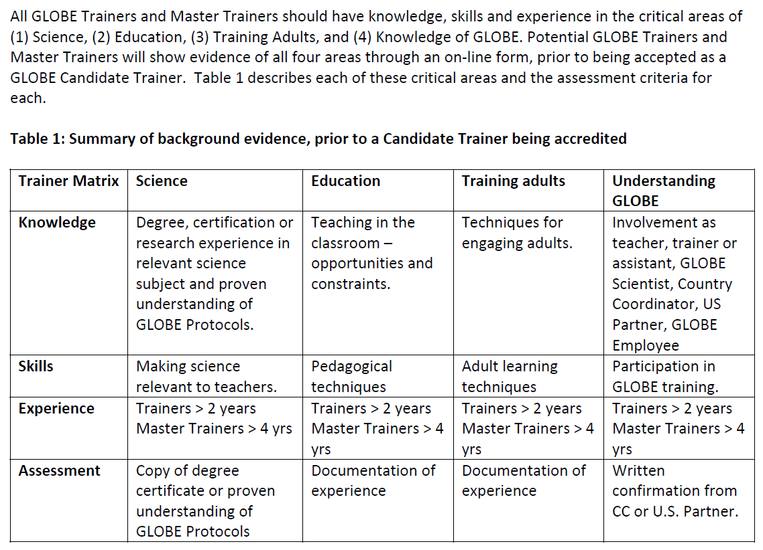
Review 2012 Certification Process

Slide 5
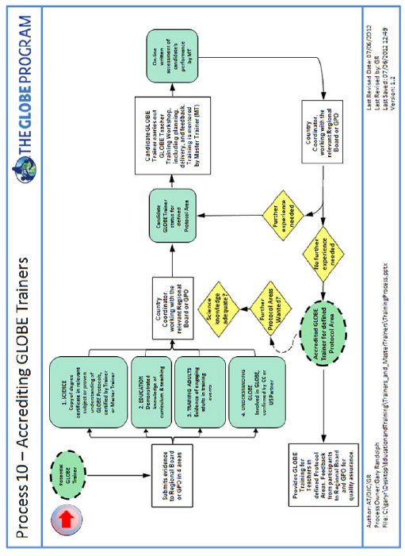
Review 2012 Certification Process - Continued

Slide 6
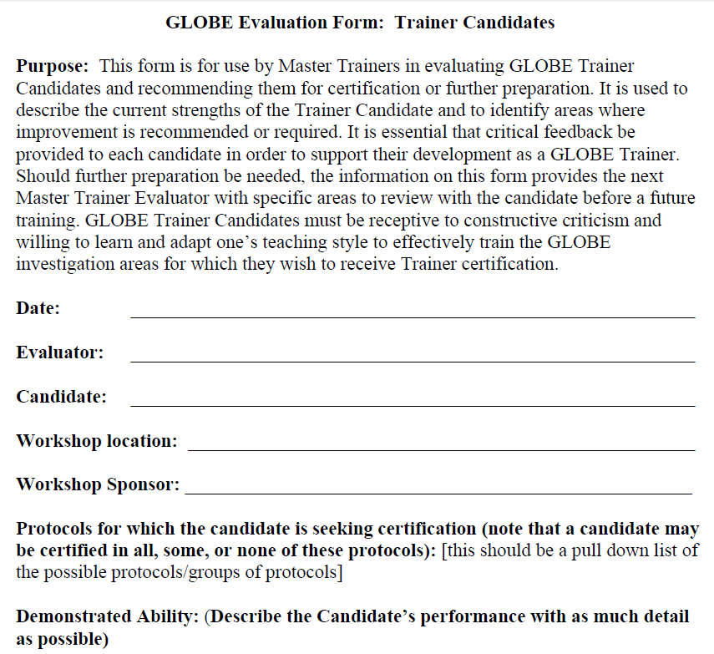
Review 2012 Observation Rubric

Slide 7
Additional Concerns & Suggestions
Can we require “Active” Trainer status
Active activities: mentoring, trainings, other activities?
Annual survey
Language concerns for observation
Are there enough Master Trainers to provide mentorship?
What else?

Slide 8
More Concerns or Feedback
Contact me at: jessica.e.taylor@nasa.gov
Or tell any of the GLOBE Education WG Members

Slide 9
Trainers
All GLOBE Trainers and Master Trainers should have knowledge, skills and experience in the critical areas of (1) Science, (2) Education, (3) Training Adults, and (4) Knowledge of GLOBE. Potential GLOBE Trainers and Master Trainers will show evidence of all four areas through an on‐line form, prior to being accepted as a GLOBE Candidate Trainer. Table 1 describes each of these critical areas and the assessment criteria for each.

Slide 10
Master Trainers
Master Trainers have substantially more knowledge, skills and experience in the same areas of (1) Science, (2) Education, (3) Training Adults, and (4) Knowledge of GLOBE. For Master Trainers this knowledge includes familiarity with how to set up and conduct a GLOBE teacher training and how to mentor Candidate Trainers. This specific knowledge may be gained through experience or through seminars given by Master Trainers for this purpose. Prior to being accepted as a GLOBE Candidate Master Trainer, evidence for all four areas shall be submitted through an on‐line form. This means that it is possible for a qualified person to become a GLOBE Master Trainer without first having to be accredited as a GLOBE Trainer, although having conducted three or more GLOBE teacher training experiences is preferred.

