Slide 1
Implementing GLOBE into College/University Courses
Kevin Czajkowski & Mark Templin
The University of Toledo
David Padgett
Tennessee State University
Notes:
Wednesday 1:45 pm Implementing GLOBE in a University;

Slide 2
Undergraduate and Graduate Courses
Engineering
Science Content
Science Education
Notes:
GLOBE Mission EARTH formed a Pre-Service Working Group where college educators share how they implement GLOBE in their university courses. This presentation encompasses all the information from that group.

Slide 3

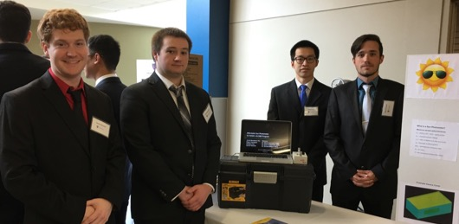
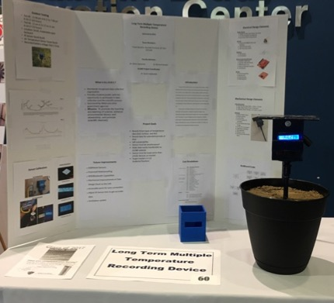
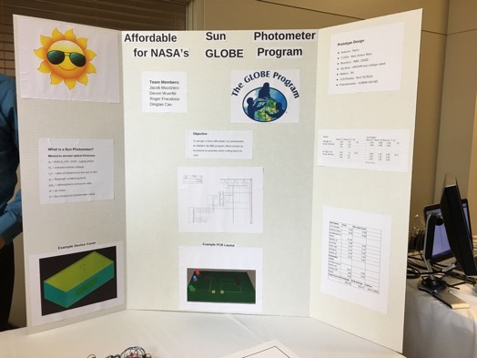
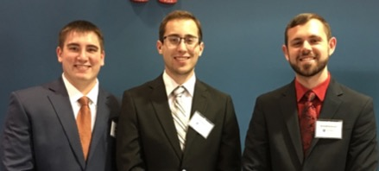
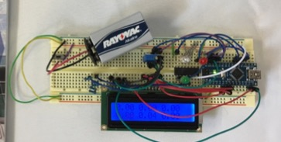
Engineering
Dr. Glenn Lipscomb
Undergraduate Research and Senior Design Engineering Project Exposition
Friday, April 28,

Slide 4
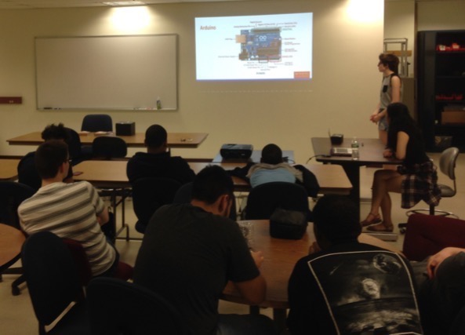
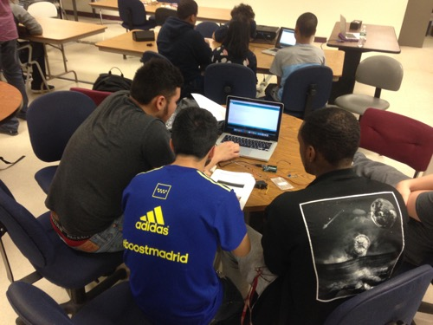
Dr. Caleb Farny
Science Day Workshop - Fenway High School
12 high school students ranging from freshmen to junior year, along with 3 science teachers
worked in teams of 3, ultimately building 4 weather stations that will be incorporated into the Fenway school’s science curriculum.
BU seniors: Chitanya Gopu, David Martinez, Hayley Walker, and Michelle Ye.
Notes:
a public school in the Boston school district. 12 high school students attended, ranging from freshmen to junior year, along with 3 of their science teachers. The students worked in teams of 3, ultimately building 4 weather stations that will be incorporated into the Fenway school’s science curriculum. The BU students who ran the workshop are all seniors: Chitanya Gopu, David Martinez, Hayley Walker, and Michelle Ye.

Slide 5

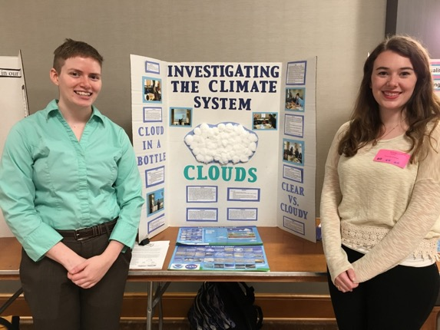
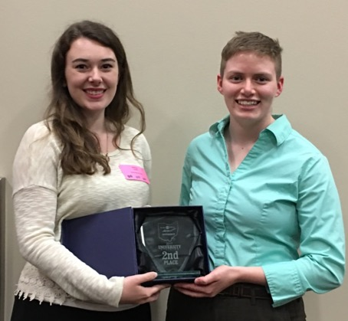
Science Content
SATELLITES CONFERENCE
May 3
Dr. Kevin Czajkowski
Weather and Climate Course
Students taught the sessions on how to do the GLOBE protocols
Students took observations and did projects on El Nino (2016 or 1998). Looked for data and did PPTs.
Students went to schools in the spring.
One group presented their pre-education project

Slide 6
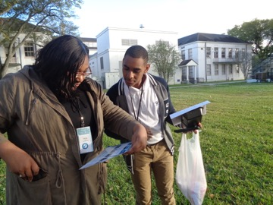
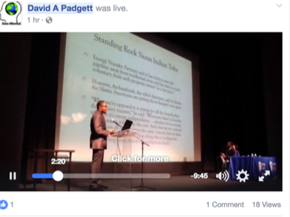
Dr. David Padgett
Students become GLOBE certified and work with high school students for 3-4 days. Trained in Atmosphere Protocols.
Uses the Climate Study Curriculum.
Facebook Live presentation on GIS Day
Approximately 30 students and faculty from Tennessee State University attended at the annual HBCU Student Climate Change Conference held from March 15-19 at Dillard University in New Orleans, LA.

Slide 7
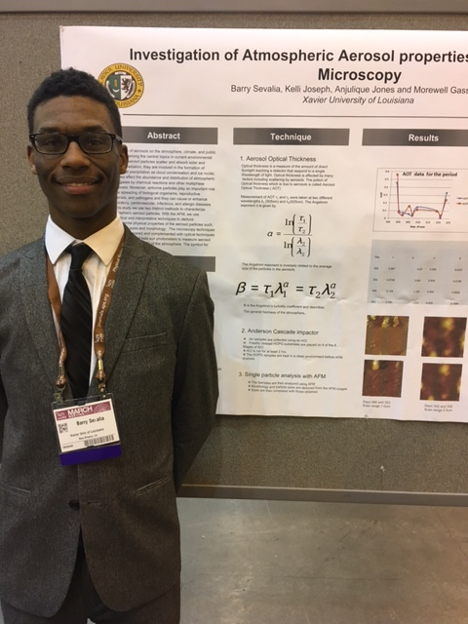
IPSC 4010 - Advanced Earth Science: GLOBE Program Compatible.@ Xavier University of Louisiana
Dr. Morewell Gassell
Course Overview
The course is designed to prepare students to teach Earth Science at the high school level. During the semester we will review major content areas in Earth Science within the context of the GLOBE.
Research projects
Assessment components:
Earth system Poster: Activities #1-Activity#5.
ORIGINAL Earth Science lesson plan on any one of the GLOBE focus areas.
Maintaining an updated log of all daily and weekly measurements of the atmospheric investigation measurements and cloud type and cloud cover log book.
Globe data entry
In-class assessments: Activities, worksheets reading assignments and other assignments during class.
Lesson presentation: You will teach all or part of your lesson plan to the whole class
Professional disposition: A professional disposition includes: regular attendance, active participation in and out of class, and contributing to a respectful learning environment.
Notes:
Morewell

Slide 8
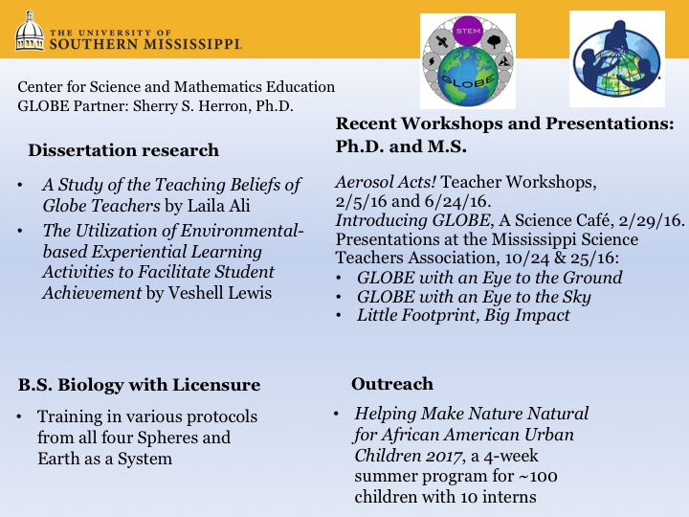

Slide 10

Science Content – Other Universities
Francis Nsubuga-South Africa
About 400 students
Climate and Society Course
Students trained in the GLOBE protocols. Do weather observations every day.
Scott Graves (presented earlier)
Environmental students both undergrad and grad
Systems Analysis approach - including “jigsaw groups” -
examines environmental phenomena and events affecting
atmosphere, hydrosphere, biosphere and geosphere.

Slide 11

Science Education - SUNY Fredonia
Dr. Michael Jabot
Large preservice teacher education program.
All candidates are trained as GLOBE Teachers through the Science Methods course(s)
Use of GLOBE helps ensure the “3D” of learning for NGSS
Strong link of preservice candidates with classroom teachers …. “GLOBE Disciples”
Notes:
Michael Jabot, Ph.D.
Professor, Science Education
US Partner - GLOBE Program
NASA Earth Ambassador
Director, Institute for Research in Science Teaching
State University of New York at Fredonia

Slide 12

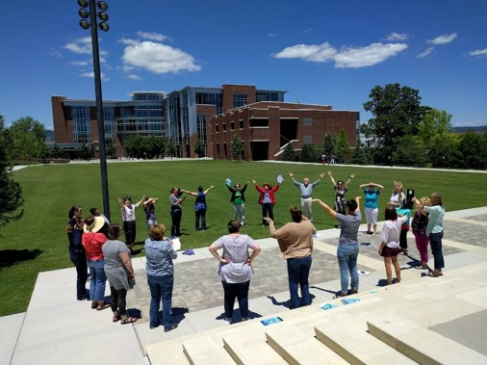
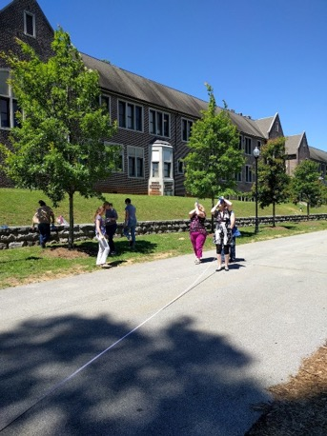
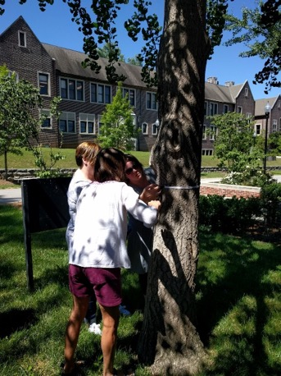
Dr. Deborah A. McAllister
Grants for GLOBE activities
Tennessee Higher Education Commission, $75,000 for inservice teachers; Atmosphere and Biosphere protocols
GLOBE mini-grant ($1,900) for Elementary Aerosols, preservice and inservice teachers; Clouds protocol
Notes:
Dr. Deborah A. McAllister, Ed.D., UC Foundation Professor
The University of Tennessee at Chattanooga

Slide 13

Science Education – Other Universities
Dr. Carol Engelman
Grad Level, online tutorial
Uses GLOBE eTraining Hydrosphere
Goal: Get students interested and then look at it globally
Dr. Mark Templin
Assisted students to design and implement a set of lessons (4th-6th grade) in a math and science magnet school
Worked with students in Dr. Czajkowski’s Weather and Climate Class to develop GLOBE projects that could be implemented with middle childhood or high school students
Supported 2 students to attend the SATELLITES Conference at UT and Ohio NASA Space Grant Consortium conference at the Ohio Aerospace Institute, Berea, OH.

Slide 14
Thank you for contributing
Kevin Czajkowski: kevin.czajkowski@utoledo.edu
Mark Templin: mark.templin@utoledo.edu
Glenn Lipscomb: glenn.lipscomb@utoledo.edu
Caleb Farny: farny@bu.edu
David Padgett: dpadgett@Tnstate.edu
Morewell Gassell: mgassell@xula.edu
Francis Nsubuga: francis.nsubuga@up.ac.za
Scott Graves: graves1@southernct.edu
Sherry Heron: Sherry.herron@usm.edu
Jodi Haney: jhaney3@mac.com
Michael Jabot: jabot@fredonia.edu
Deborah McAllister: Deborah-Mcallister@utc.edu
Carol Engelmann: cengelmann@unomaha.edu

Slide 15
Questions
Are you a GLOBE partner at a university?
What obstacles do you face to implement GLOBE in your curriculum?
How can GLOBE fit into your university courses? What courses?
Some professors suggested to create a GLOBE MOOC class. What are your thought on this?

