Slide 1
Website Report - 2017
What’s New (since last July) and What’s Coming
Dave Overoye / Cornell Lewis
Science Systems and Applications, Inc.

Slide 2
Introduction
Last Year’s annual meeting we discussed many goals and needs
Attended regional meetings and received input from partners, country coordinators and teachers
Received Support and ideas from the Technology Working Group
  Scott Graves
  Kris Jaroensutasinee
  Charles Mwangi
  Nadhira al-harthi
  Matthijs Begheyn
  Maria Portuguez
  Elżbieta Wołoszyńska-Wiśniewska
Meet weekly with GIO and NASA
  NASA (Nargess Memarsardeghi, John Moses, Lisa Dallas)
  GIO – Travis Andersen, Julie Malmberg
  Dixon Butler

Slide 3
Last year’s annual meeting - What’s Coming?
GLOBE Observer app
  New Mosquitoes app
  Expanded amount of cloud data collected
  GLOBE Observer sub-site to support the app
New Web Capabilities
  Partner / CC Dashboard
  Improved Search / Go to menu
  Better integration with social media platforms
Data Entry
  Data Entry Upgrade to allow sites to be created in the field without an internet connection
  Lilacs Phenology
  Frost-Tube Protocol
Vis/ADAT
  Save visualization/ADAT filters to reuse and share
  View Summary Data Layers – to view specific monthly climate values

Slide 4
2016-2017 - Accomplishments
GLOBE Observer app
  New Mosquitoes app
  Expanded amount of cloud data collected
  GLOBE Observer sub-site to support the app
New Web Capabilities
  Partner / CC Dashboard
  Improved Search / Go to menu
  Better integration with social media platforms
Data Entry
  Data Entry Upgrade to allow sites to be created in the field without an internet connection
  Lilacs Phenology
  Frost-Tube Protocol
Vis/ADAT
  Save visualization/ADAT filters to reuse and share
  View Summary Data Layers – to view specific monthly climate values

Slide 5
2016-2017 - Accomplishments
GLOBE Observer app
  New Mosquitoes app
  Expanded amount of cloud data collected
  GLOBE Observer sub-site to support the app
New Web Capabilities
  Partner / CC Dashboard
  Improved Search / Go to menu
  Better integration with social media platforms
Data Entry
  Data Entry Upgrade to allow sites to be created in the field without an internet connection
  Lilacs Phenology
  Frost-Tube Protocol
Vis/ADAT
  Save visualization/ADAT filters to reuse and share
  View Summary Data Layers – to view specific monthly climate values
Vis re-design (beta version)
New Organization Contacts Management Tool
Improved News/Event Posting-Distributing Capabilities
GLOBE Calendar
And more…

Slide 6
What’s New - Mobile?

Slide 7
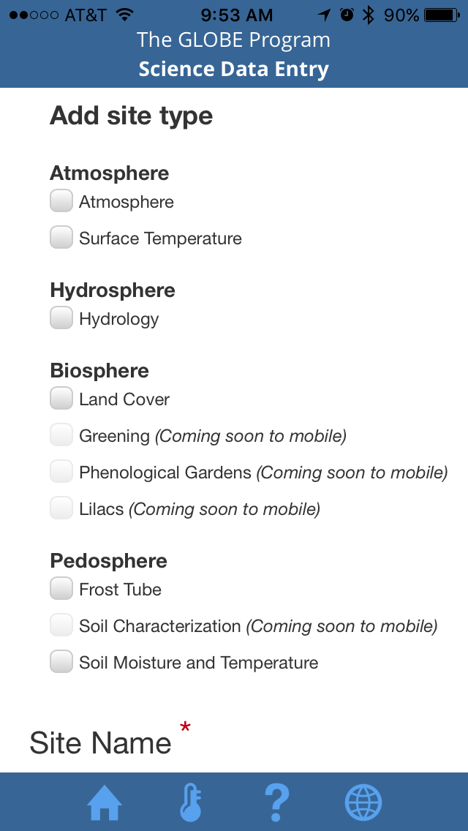
GLOBE Data Entry App 1.2 and 1.3
Updated for site creation and editing
  Support for Atmosphere, Surface Temperature, Hydrology, Land Cover, Frost Tube, Soil Moisture and Temperature sites
Adds ability to take site photos
Updated to accommodate S’COOL needs
Improved layout of desktop forms on mobile

Slide 8
GLOBE Observer App - Clouds Observations
Added Expanded the measurement fields to allow for more detailed cloud observations
Added language support
Added satellite flyover alarm (notification)
Added Google map lat/long confirmation
Added the ability to update app without a version release
Added the ability to provide different content for different user types (Observer versus GLOBE-trained)
Setup the framework to add additional apps
Added Spanish and French translations

Slide 9
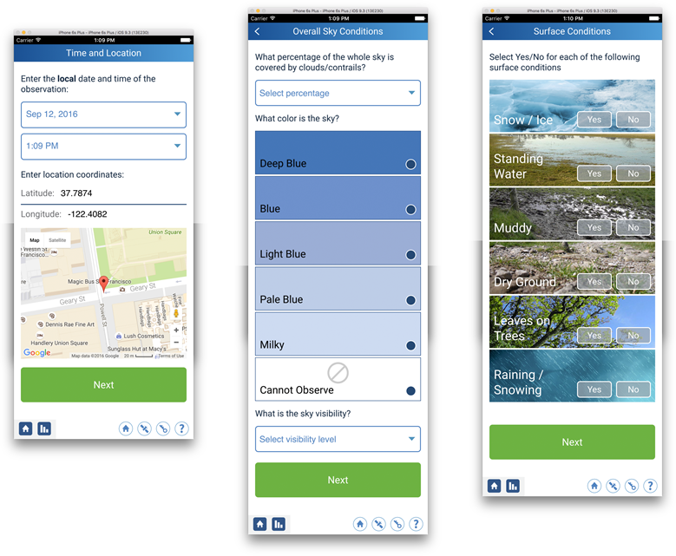
GLOBE Observer App - Clouds Observations

Slide 10
GLOBE Observer App - Mosquito Habitat Mapper
App includes a new protocol for mapping the location of, and optionally identifying mosquito larvae. A new visualization capability was delivered which adds larvae identification and breeding grounds information to the GLOBE visualization system. A new language option for Portuguese was also included in this delivery.

Slide 11
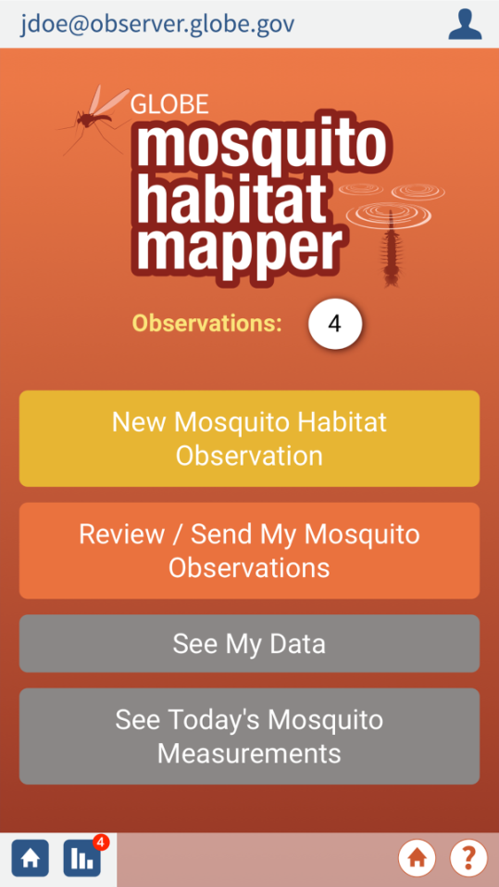
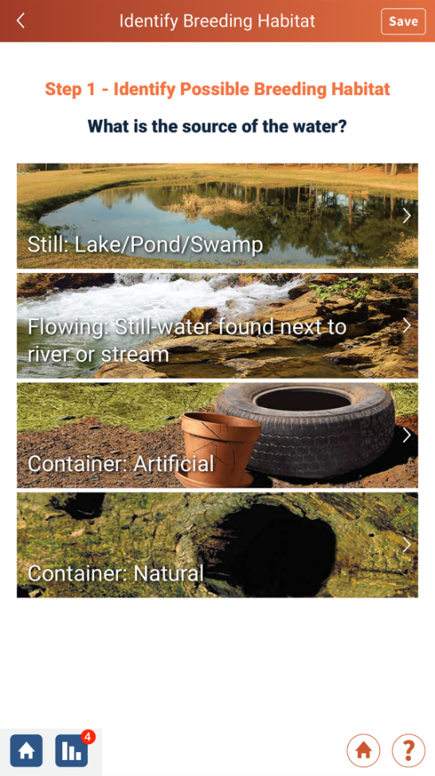
GLOBE Observer App - Mosquito Habitat Mapper

Slide 12
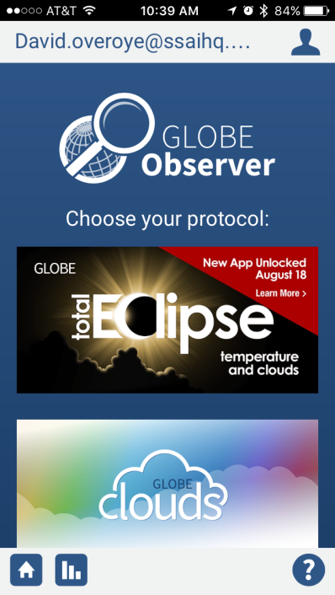
GLOBE Observer App – Eclipse mini app
Total Eclipse (Mini app) - Short term addition to GLOBE Observer
  Allows user to enter temperature measurements and cloud measurements on regular intervals during the eclipse
  Possibly re-usable for other regions for future eclipses
Released an early version to the public with a ‘app to be unlocked on August 18^{th’} placeholder

Slide 13
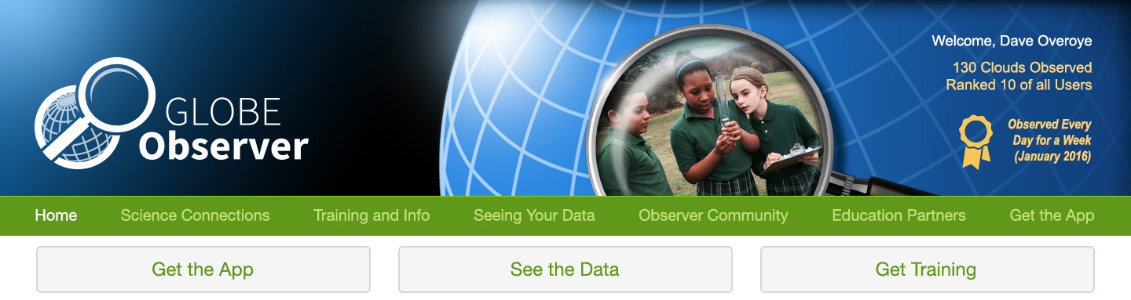
GLOBE Observer Sub-site
Sub-site to support the GLOBE Observer app and the citizen science community.
Unique URL but lives within the GLOBE.gov website

Slide 14
Data Entry Enhancements
  Improved layout for mobile devices
  9 Languages now supported
  Added a map interface to select your site’s lat/long
  Delivered the Aerosols Data Entry modifications as requested by the Aerosols PI. Updates simplifies data taking for users
  Modified “weatherbug” API to use new Earth Networks API
  New precipitation protocol set (on staging)
  Modifications to Biometry protocol to support ICESat mission (on staging)

Slide 15
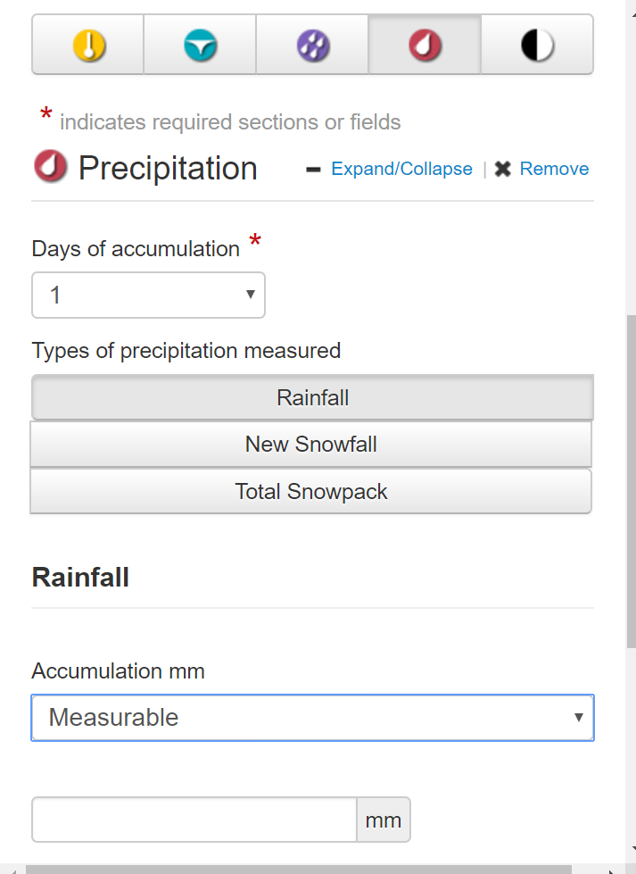
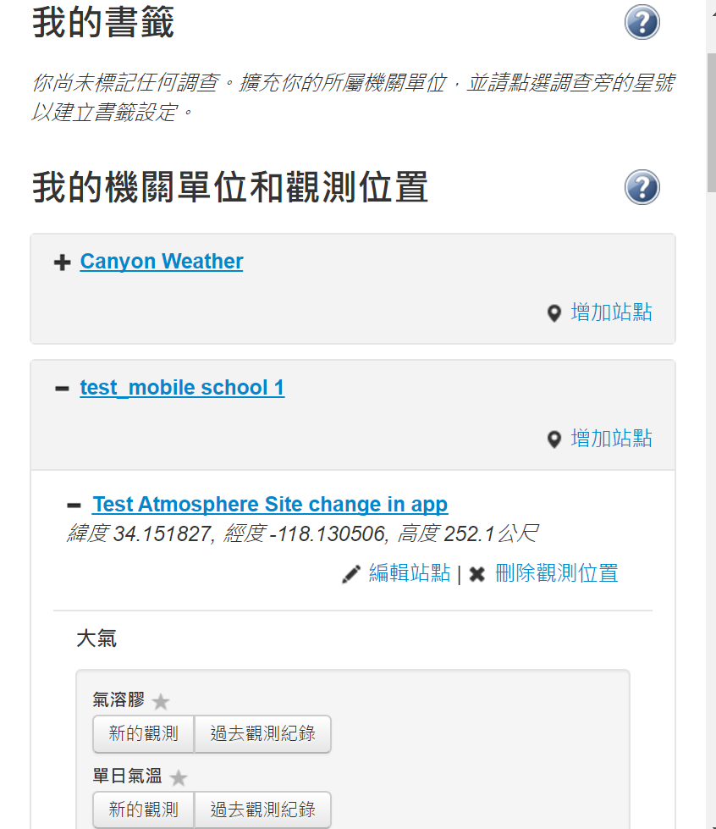
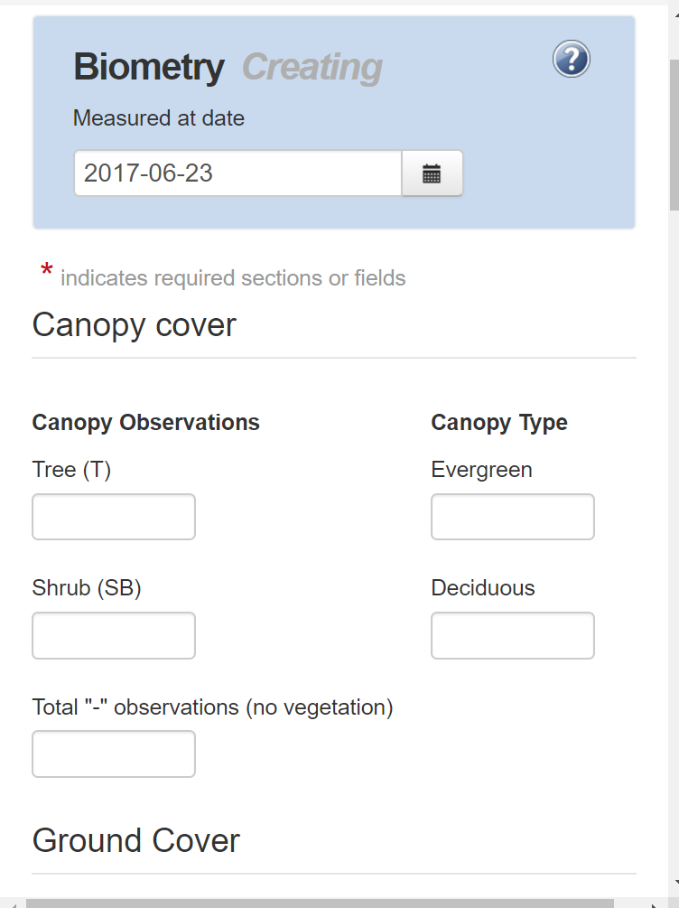
Data Entry Enhancements

Slide 16
What’s New - Website?

Slide 17
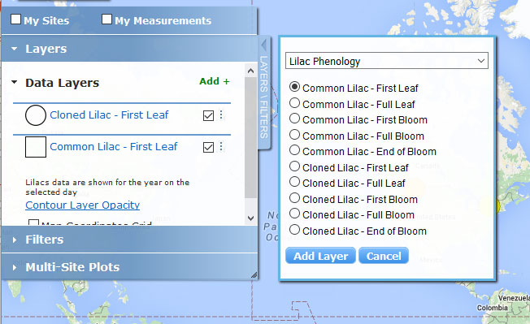
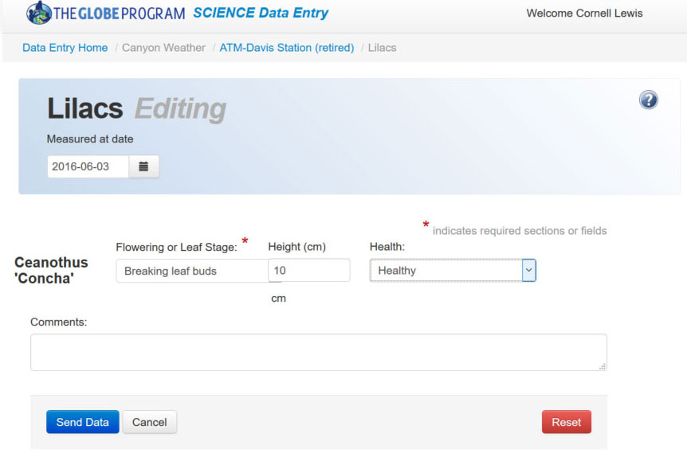
Protocol: Lilacs Phenology
Data Entry
Visualization

Slide 18
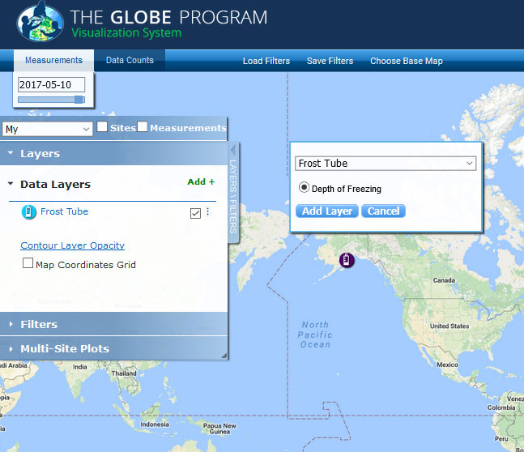
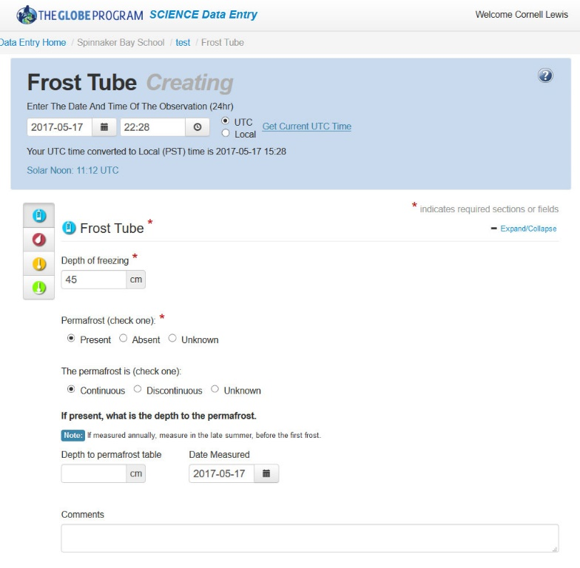
Protocol: Frost-Tube
Data Entry
Visualization

Slide 19

Website Enhancements
eTraining
  Added the soil characterization module
  GLOBE Observers can take GLOBE etraining.
News/Events Publishing
  U.S. Partners and Country coordinators can publish news and events which can be distributed up to their region or the main GLOBE section and the new GLOBE Calendar
Improved search capabilities – now uses Google search
Integrated Facebook/Google Log-In into the GLOBE website

Slide 20
Website Enhancements
Partner Dashboard - management tool for partners and country coordinators to better manage their teachers. See what’s going on in your organization by viewing a summary of user activity.
  How many people in my country/partnership have requested to join?
  How many were recently trained?
  How many were in a workshop that’s over, but didn’t get credit?
  How many citizen scientists are in my country/partnership?
  How many workshops haven’t been properly closed?
  Send out bulk emails to various group members (approved, newly trained, etc.)

Slide 21
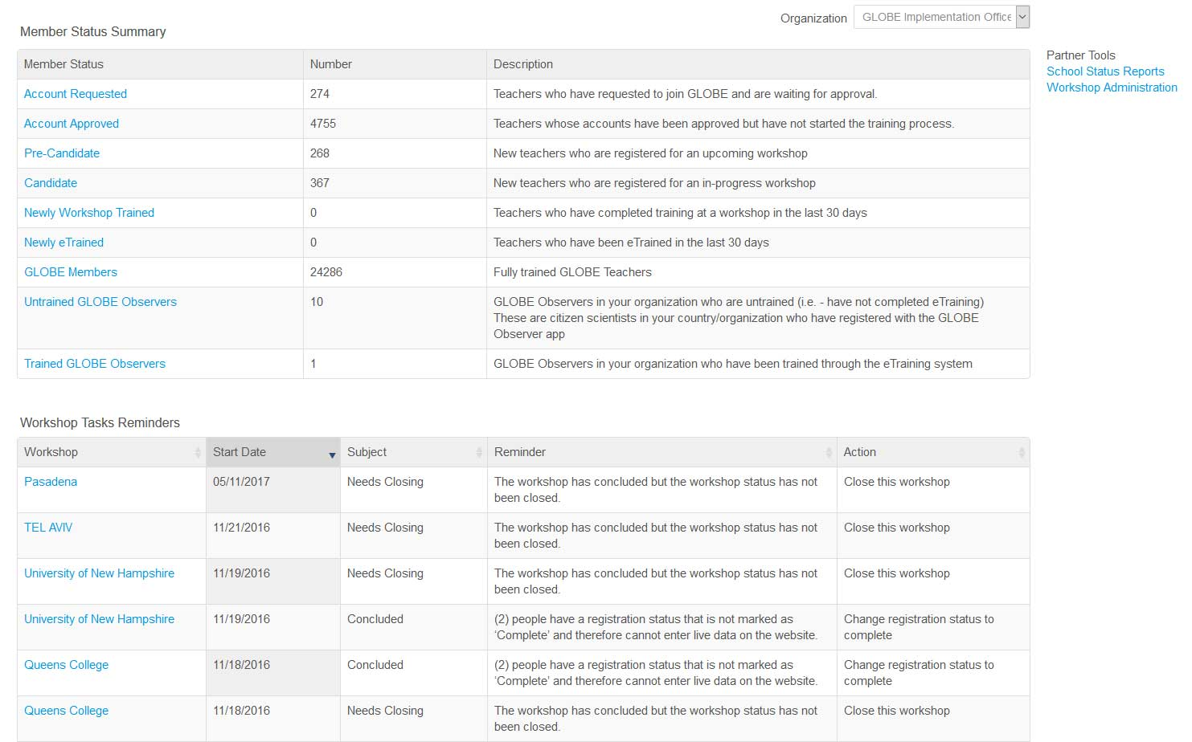
Partner Dashboard

Slide 22
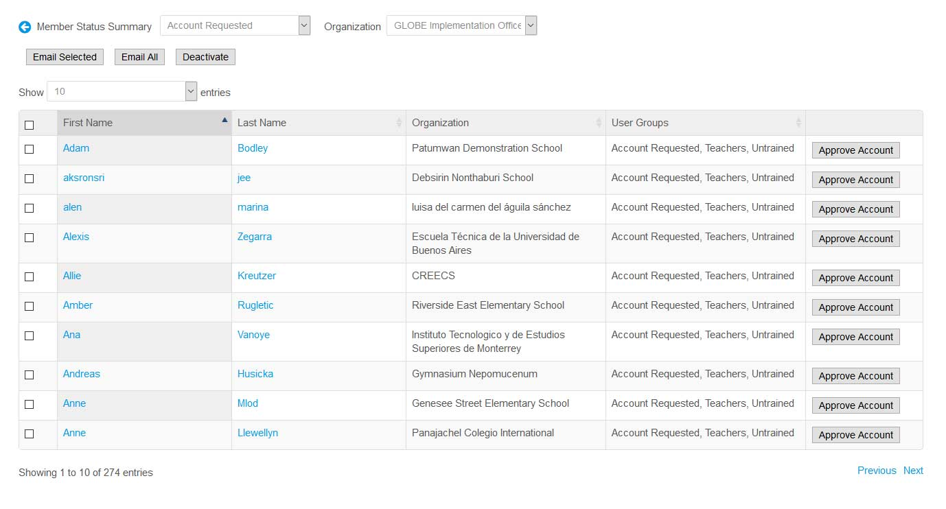
Partner Dashboard

Slide 23
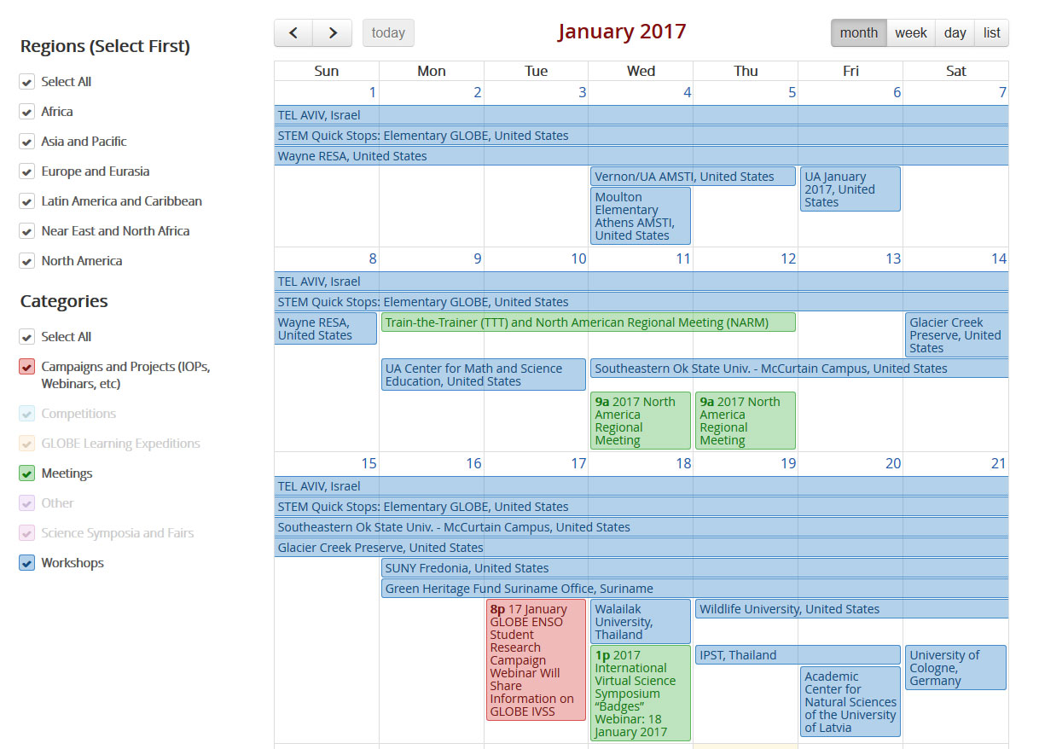
GLOBE Calendar

Slide 24
Website Enhancements cont.
Replaced captcha with Google’s new “no captcha” to further simplify user verification
Added ability to share content on social media sites
Implemented Improved ‘Go to Menu’
Created new community blog page – Find blogs by user type: Alumni, Country Coordinator, GISN/Scientists, Partner, Regional Coordinator, Teacher or Trainer
A new contacts management tool to display the main contacts for regions, countries and US partners.

Slide 25
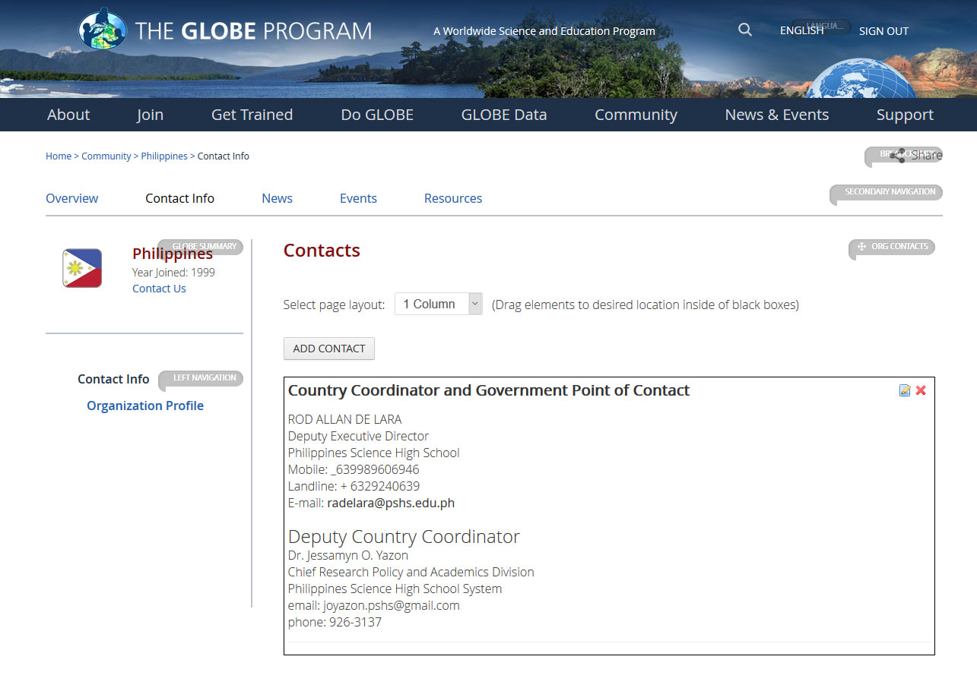
New Organization Contacts Management Tool

Slide 26
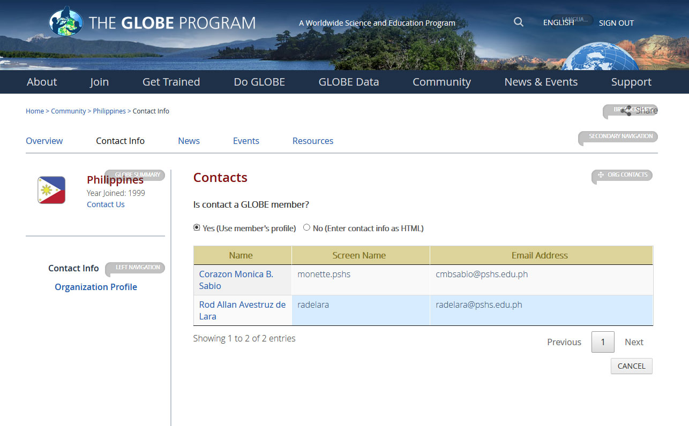
New Organization Contacts Management Tool

Slide 27
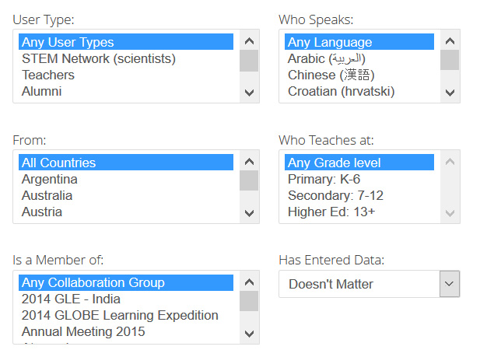
Find a Project Collaborator Enhancements
Modified the Project Collaborator Tool to allow users to search for STEM Network, scientists, alumni and other community members

Slide 28
Vis Enhancements
  New protocol layers added – Lilacs, Phen Gardens, Freshwater Macro Invertebrates, Soil Characterization
  Save filter settings to reuse and share
Additional filtering options
  See just your or your organization sites and measurements
  By lat/long range
  By Trained versus GLOBE Observer
“Stacking Plot” option available

Slide 29
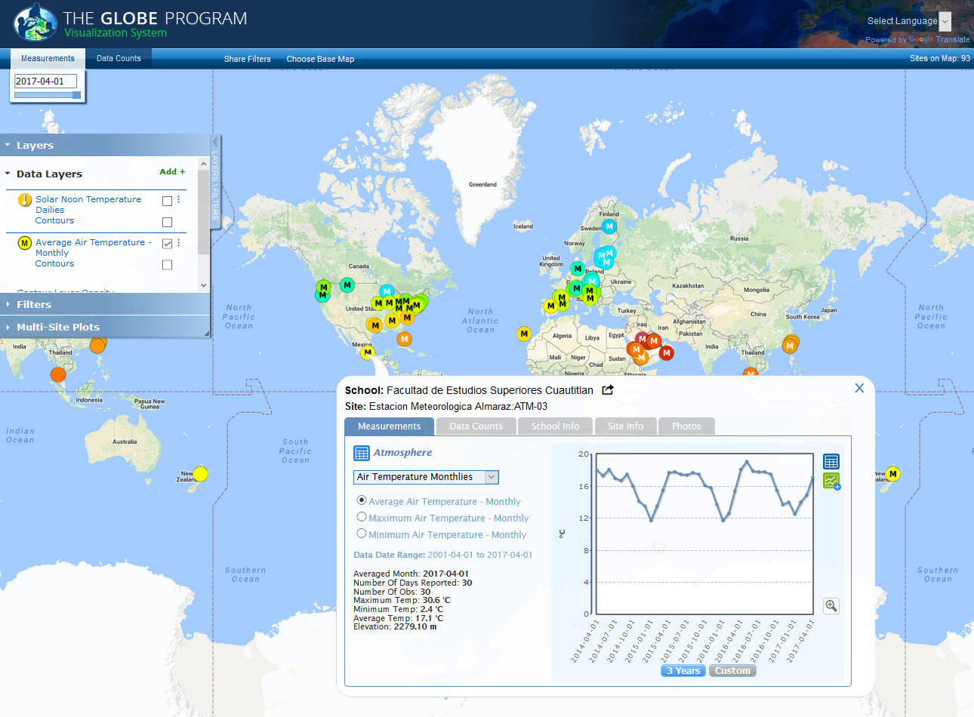
Vis Enhancements
Monthly Summary Layers – to view specific monthly climate values

Slide 30
Vis Enhancements – cont.
Added species filtering, plotting capability and improved visualization (data displayed by weekly intervals) for Green-up/Green down to support the European Phenology Campaign
Species Filtering for Phenology Gardens added
Added ability for museums (and other organizations) to enter a URL with their code number, protocol, etc. to see just their data.

Slide 31
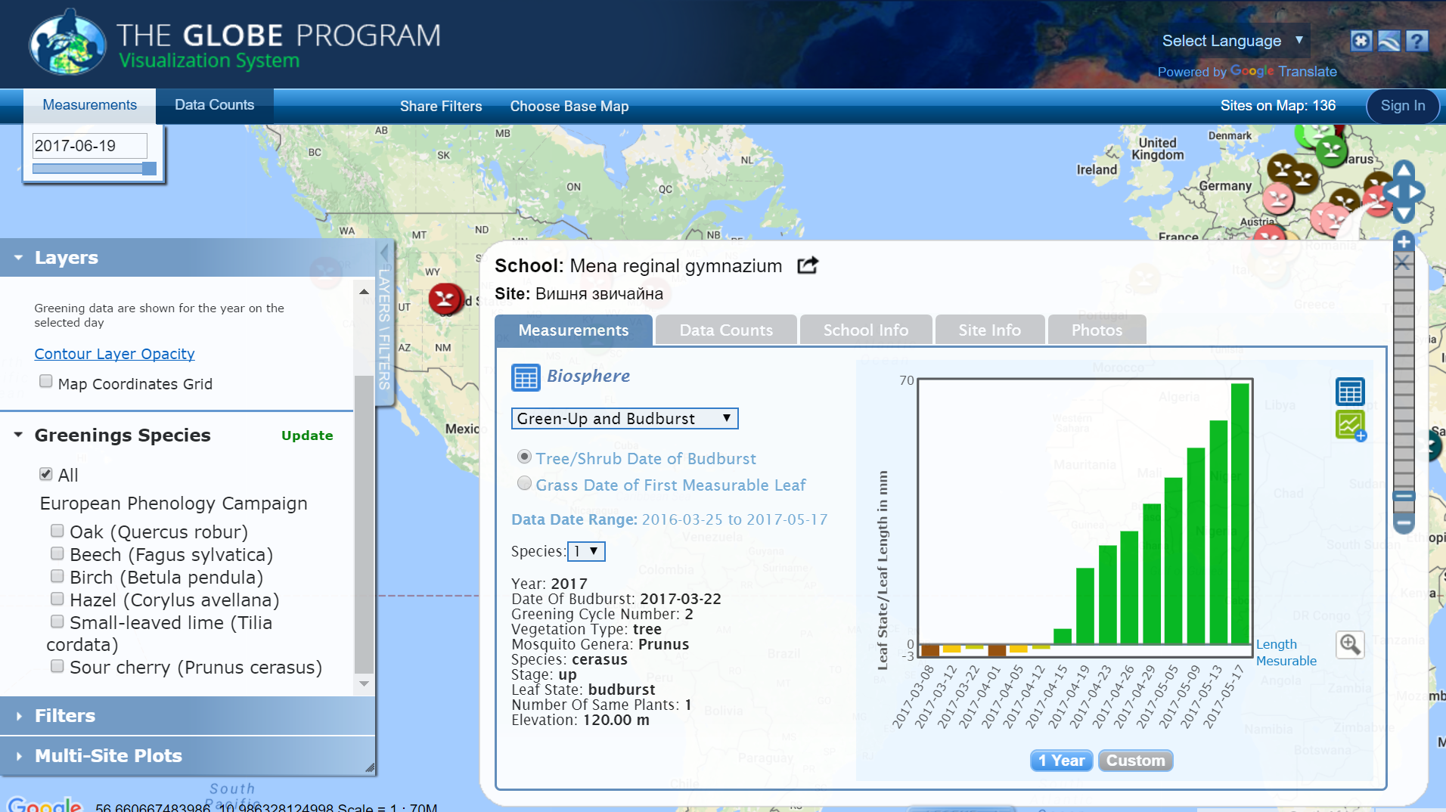

Slide 32
Future Enhancements

Slide 33
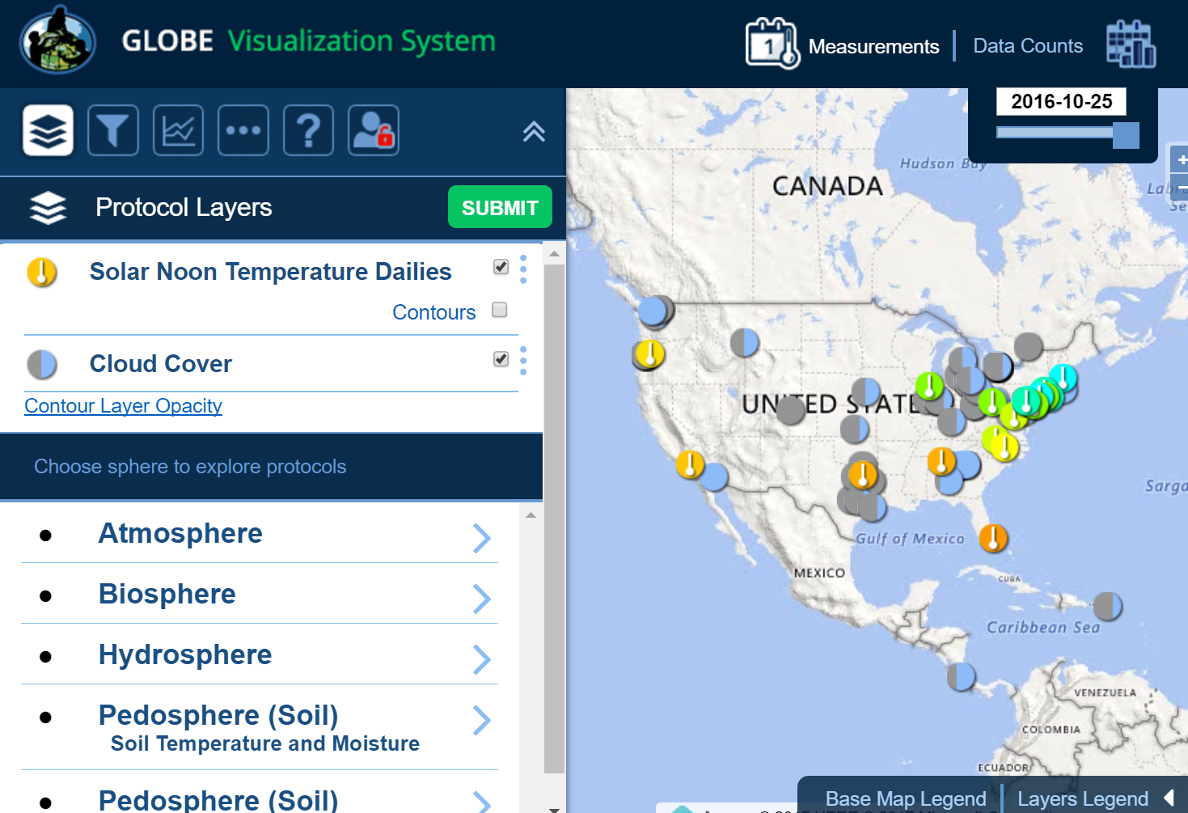
Vis Enhancements – New Vis Design
  Major upgrade and changes to the vis system to accommodate mobile devices
    Mobile friendly menu and selection
    Mobile friendly maps and interactions

Slide 34
Vis Enhancements – New Vis Design
  The new visualization system is in beta release at https://visbeta.globe.gov - we would like your feedback..
  Live data can be visualized on the beta site.
  The current system at https://vis.globe.gov will remain live while the new system is being finalized.
  Please submit your comments at: https://www.globe.gov/web/community-feedback-forum/overview/-/message_boards/category/26438085

Slide 35
Vis / ADAT – additional plans
Vis - Time Lapse/animation to see data measurements over time
ADAT - Ability to filter using the ‘And’ Boolean for protocols. 'Only show me sites that have measurements of Aerosol AND Air temp' (Partner request) - (PROTOCOLS ONLY)
ADAT - Improved performance and reliability

Slide 36
New Website Design
  A new design of the website is in progress
  The site structure will remain as-is but the home page, and organization pages are being enhanced.
  The home page has been redesigned to better convey community and activity around the world.
  The home page features new maps/graphs to show recent measurements to better promote data entry.
  ‘Active’ GLOBE members are highlighted.
  A calendar showing events for the month is available and campaigns are displayed more prominently.
  A community map showing the GLOBE countries by region has been added.

Slide 37
New Website Design – For organizations
Based on feedback from the community
  New ‘landing page’ design for regions, countries and partners
  Improved map and school search
  Better management and control of content for organization managers

Slide 38
New Website Design
Phase 2 of the new website roll-out – October
  Enhanced My Pages
  Enhanced School Pages
  New Sphere-Landing Pages
    Central landing page/portal for each sphere that contains content and resources specific to the protocols in the sphere

Slide 39
New Website Design
  As with the vis system, we’d like to get your feedback and comments on the new design before it goes live.
  Screenshots of the new website have been created and are located at https://www.globe.gov/news-events/meetings_symposia/annual-meetings/21st-annual-meeting/images
  Please submit your comments at: https://www.globe.gov/web/community-feedback-forum/overview/-/message_boards/category/26437344.

Slide 40
Future Enhancements – Data and Systems

Slide 41
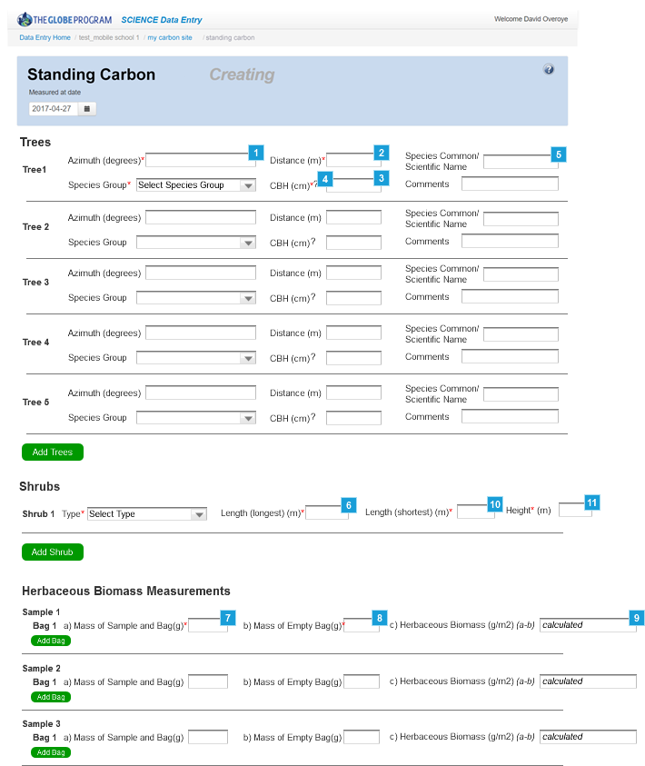
Data Entry
Review Data Entry forms and process
“New” Standing Carbon Protocol
Enhance grid system with polar coordinates

Slide 42
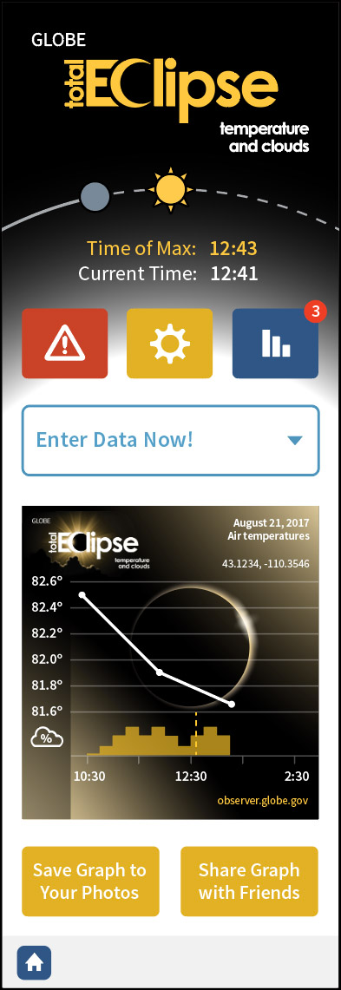
GLOBE Observer App –
Total Eclipse (Mini app) - Short term addition to GLOBE Observer
  Possibly re-usable for other regions for future eclipses
Land Cover Protocol

Slide 43
Data Entry Mobile App
GLOBE Data Entry Mobile App 1.4
  Support for all site types for site creation
  Support for other languages
  Inclusion of key GLOBE Observer app features

Slide 44
Data Standards
Working to support others to connect to GLOBE Data
  Establishing standard interface to “pull” GLOBE data
  Establish standard API to submit (“push”) data to GLOBE
  Establish API for other app developers to submit data to GLOBE

Slide 45
Systems
Upgrade database and associated server
Maintain all patches
Migrate environment to latest Amazon instances
Review possibility of upgrading to latest version of Liferay

