Slide 1

AREN, GLOBE and NASA Resources
http://www.globe.gov/web/aren-project
NASA Science Mission Directorate Science Education
Cooperative Agreement Notice (CAN)
Solicitation: NNH15ZDA0044C
Award Number: NNX16AB95A
Principal Investigator: David Bydlowski, Wayne RESA, Wayne, MI

Slide 2
AREN Partners
(Attendees at GLOBE Conference Listed)
Anasphere, Inc.
Chesapeake Bay Environmental Center
Goddard Space Flight Center — Geoff Bland, Brian Campbell and Sallie Smith
Montana State University — Kelly Boyce
Public Lab — Jeff Warren
University of Maryland Eastern Shore — Willie Brown
University of South Florida
Washington College
Wayne RESA — David Bydlowski and Andy Henry
Evaluation — Anil Aranha

Slide 3

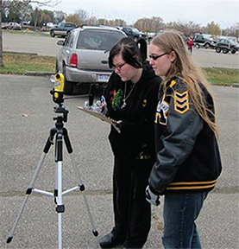
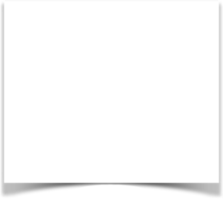
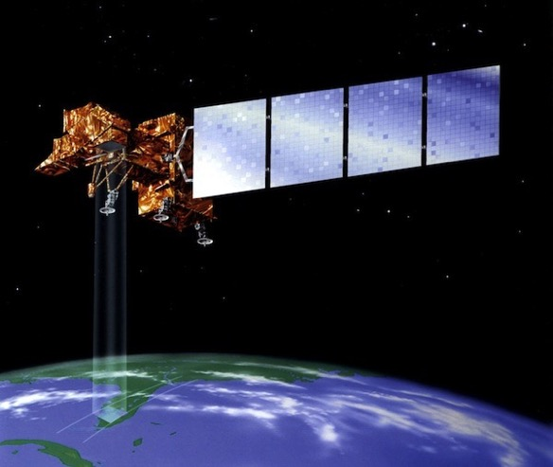

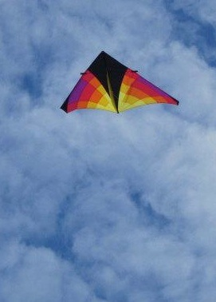

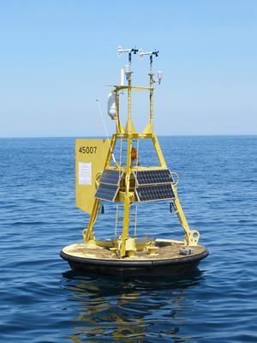

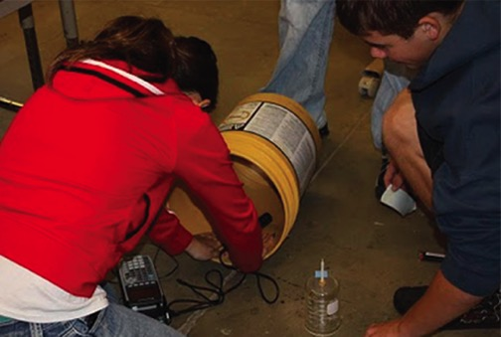

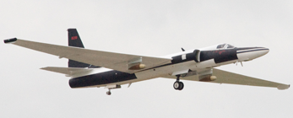
HOW DO WE MAKE OBSERVATIONS?
In situ (on site) measurements
Remote sensing
Observing or measuring phenomena in place, often with direct physical contact.
Observing or measuring phenomena without direct physical contact, often from a distance.

Slide 4

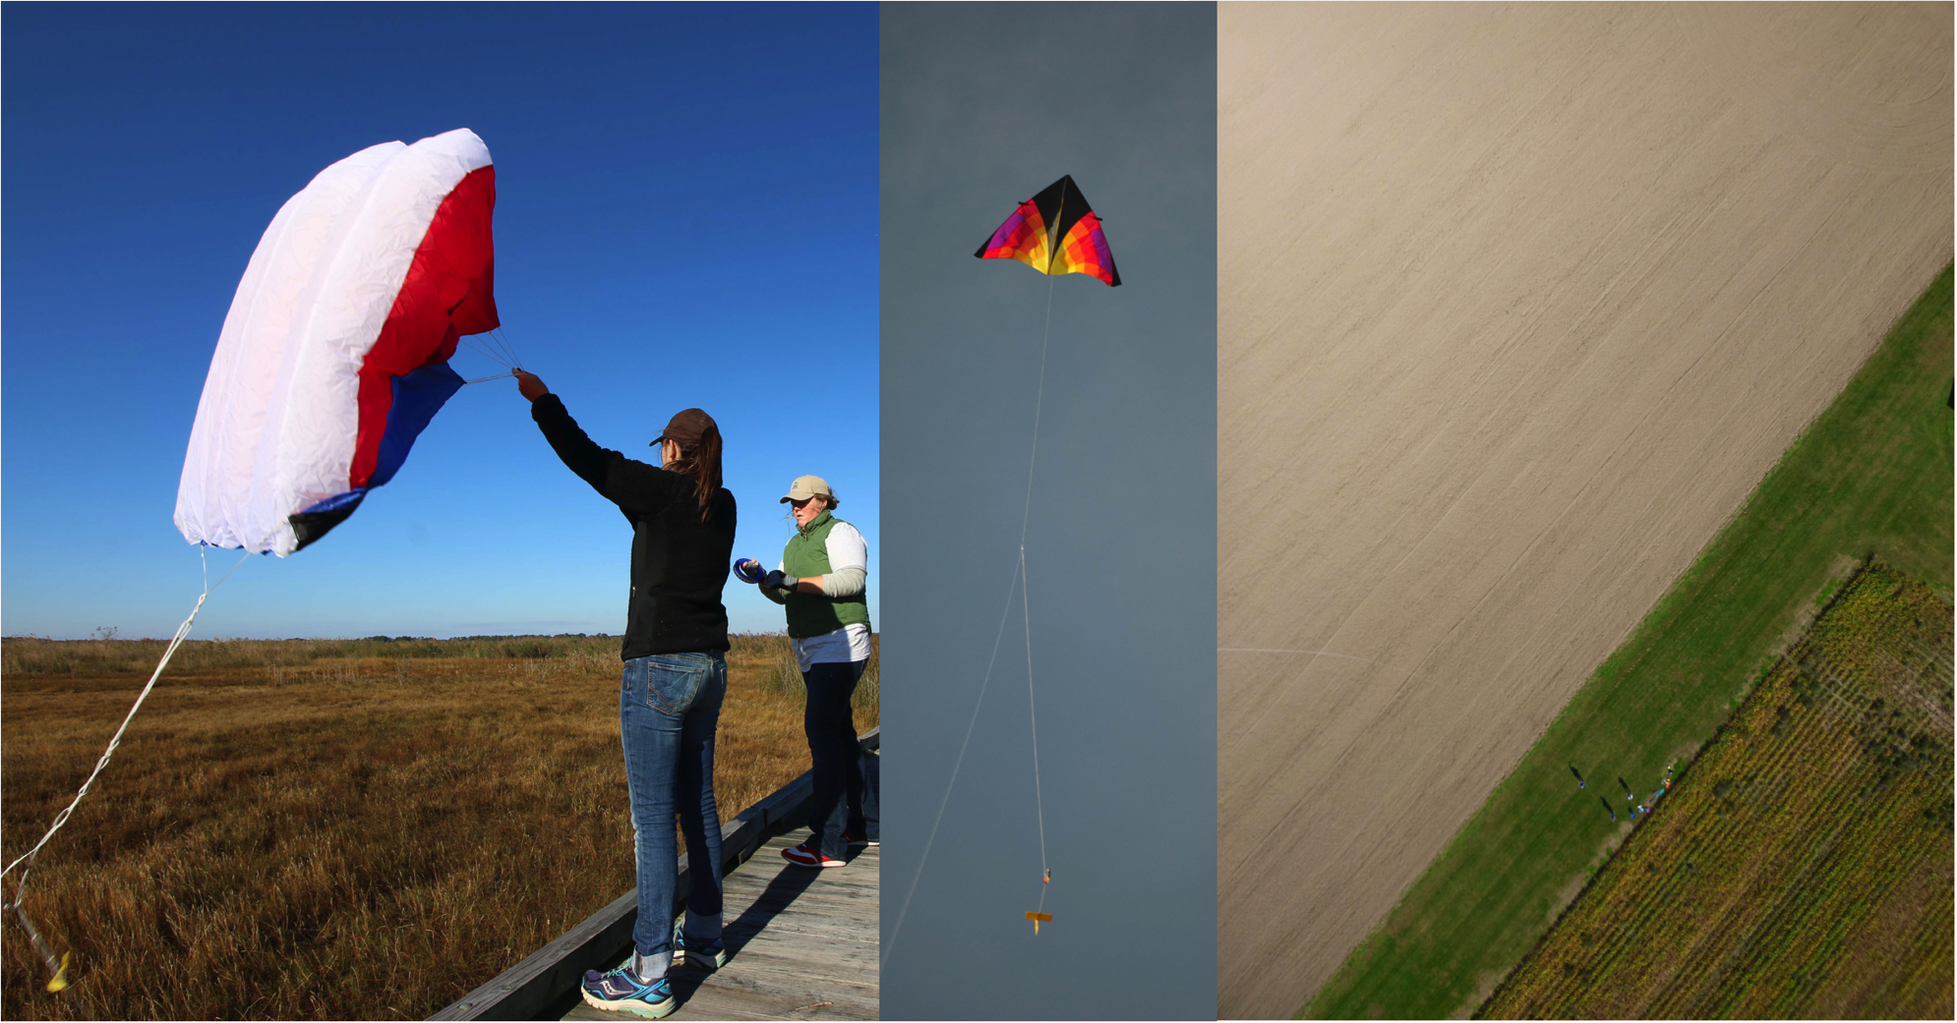
Local scale remote Sensing:
What can we observe from Kites?

Slide 5

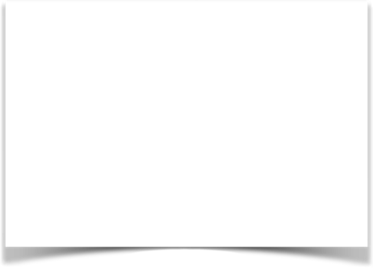
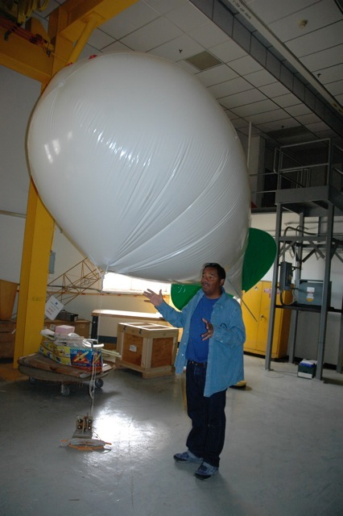
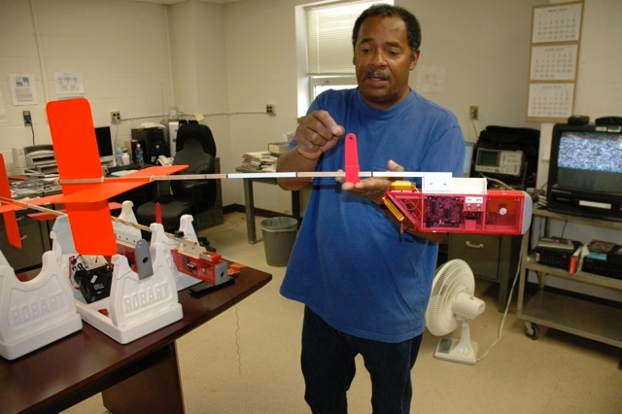
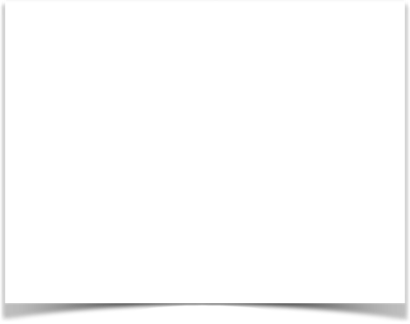
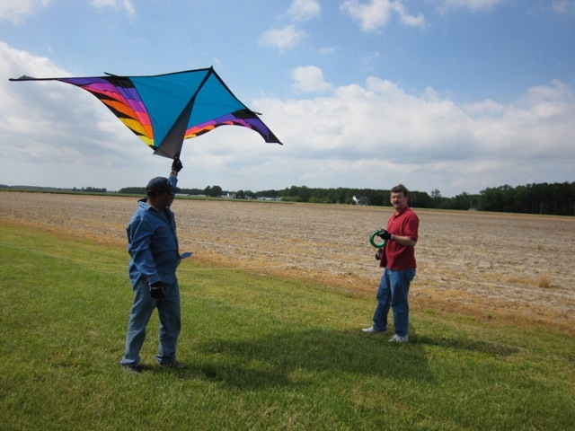
AEROKATS
Advancing Earth Research Observations with Kites and
Atmospheric/Terrestrial Sensors
Using NASA’s kite based Aeropod systems to capture remotely sensed imagery and in-situ atmospheric data for use in the classroom
Geoff Bland - NASA Aero-Engineer
Geoff Bland
Geoff Bland and NASA Technician, Ted Miles

Slide 6
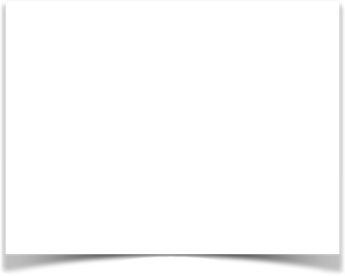
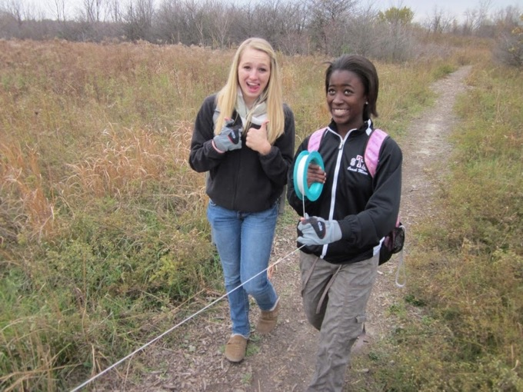
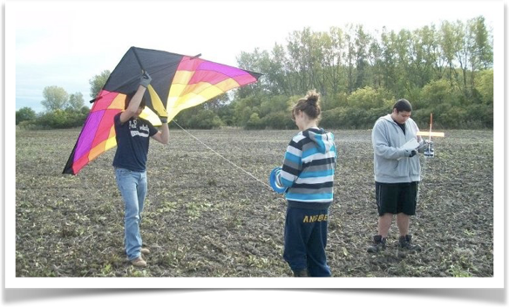
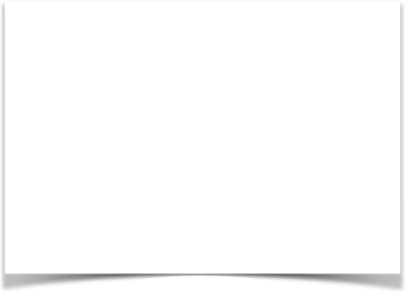
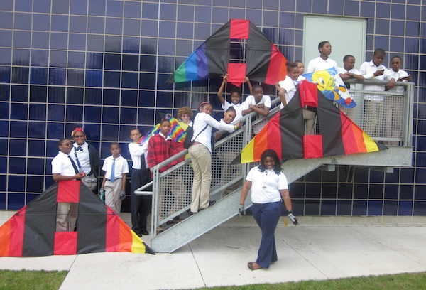
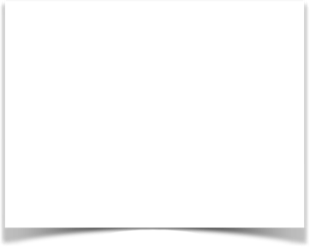
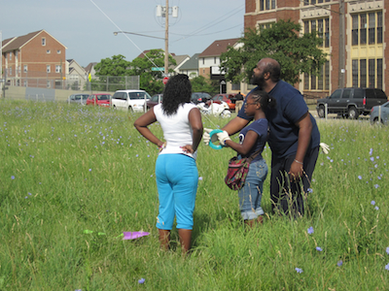
Kite based Aeropods allow students to:
collect and process real data about their environment,
learn image processing and data analysis skills,
validate the remote sensing process.

Slide 7

Aligning with GLOBE Data Collection
Global Learning and Observations to Benefit the Environment
Protocols and Learning Activities
Site Definition Sheet
Name, time, location, type
Atmosphere – air temperature, barometric pressure, precipitation, relative humidity, wind
Surface temperature
Soil moisture and temperature
Site photos
Land cover sample site
Biosphere investigation instruments - MUC
Computer-Aided Land Cover Mapping
Discovery Area Post-Protocol
Do You Know Your MUC
Getting to Know Your Satellite Imagery and GLOBE Study Site
Land Cover Change Detection
Manual Land Cover Mapping
Odyssey of the Eyes (Beginning and Intermediate Levels)
Using GLOBE Data to Analyze Land Cover

Slide 8
Aeropods are the result of development efforts at NASA’s Goddard Space Flight Center
Monopods, aka Monocam: Single, low cost camera used for aerial imaging.
Procam: High resolution single camera
Twincam: Multiband/multicamera for image processing
Thermocam or Thermopod: Thermal imaging system
Profiler: Atmospheric (air-column) profiling

Slide 9
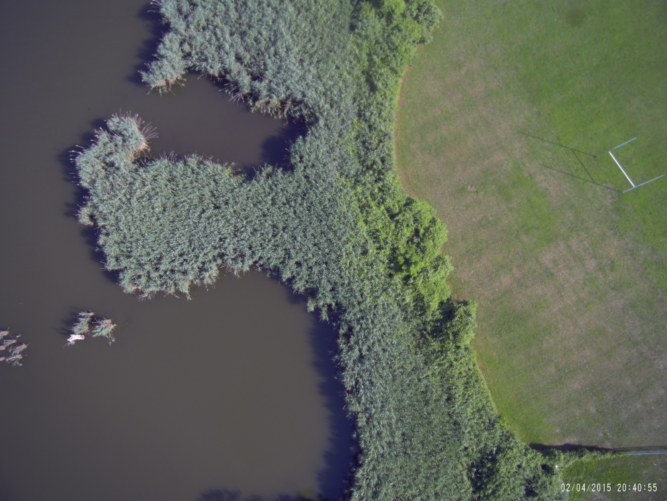
Aerial Imaging

Slide 10
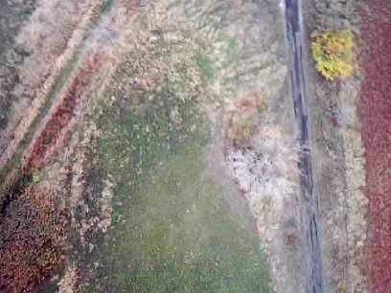
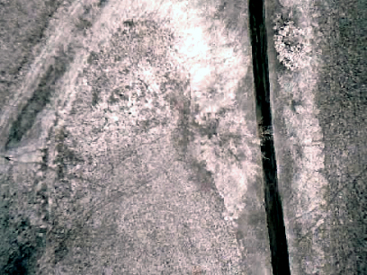
Image Processing
Working with TwinCam Image data
Example using TwinCam visible and near infrared imagery
TwinCam - Visible Light Image
TwinCam - Near-Infrared Image

Slide 11
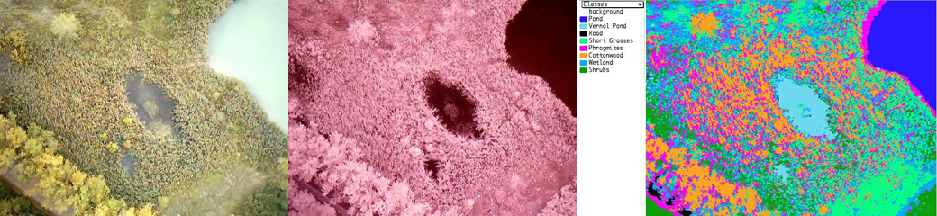
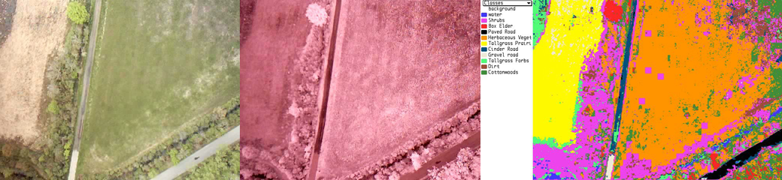
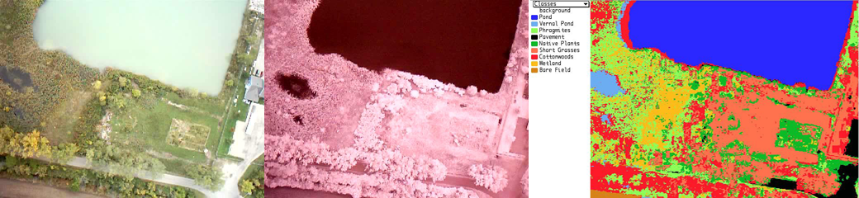
TwinCam Examples - Knabusch Center for Science and Mathematics

Slide 12
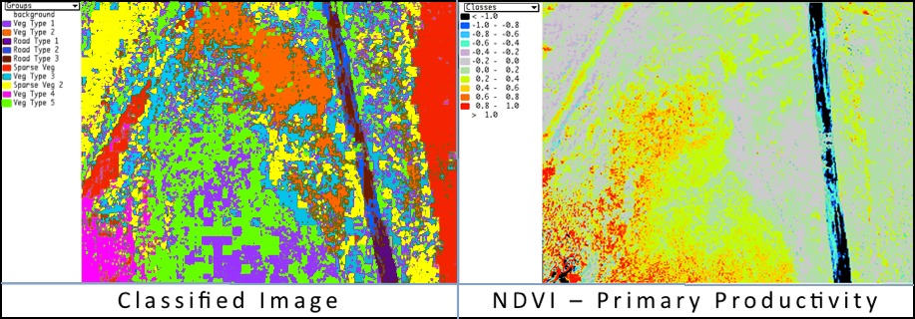
Use MultiSpec to produce classified image and vegetation indices

Slide 13
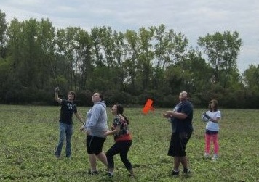
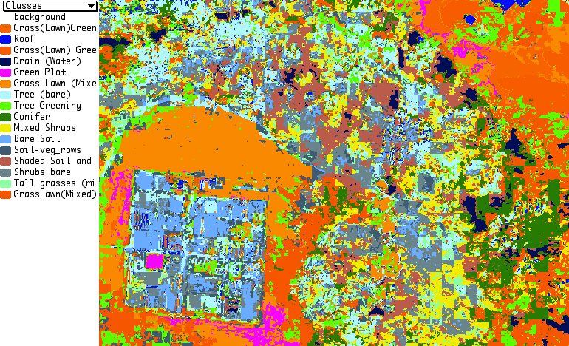
The numbers behind the imagery - quantifying the data
CLASS DISTRIBUTION FOR SELECTED AREA
Number
Class Samples Percent
1 Grass(Lawn)Green 5,300 1.8
2 Roof 3,479 1.2
3 Grass(Lawn) G Shdw 8,360 2.8
4 Drain (Water) 6,310 2.1
5 Green Plot 4,241 1.4
6 Grass Lawn (Mixed) 36,889 12.4
7 Tree (bare) 26,951 9.1
8 Tree Greening 19,617 6.6
9 Conifer 21,020 7.1
10 Mixed Shrubs 29,286 9.8
11 Bare Soil 14,946 5.0
12 Soil-veg_rows 16,959 5.7
13 ShdSoil and Grasses 23,493 7.9
14 Shrubs bare 27,718 9.3
15 Tall grasses (Mixed) 12,176 4.1
16 GrassLawn(Mix)Shd 40,903 13.7
Total 297,648 100.0
Average likelihood probability is 46.7%.
Maximum likelihood classification
TRAINING CLASS PERFORMANCE
(Re-substitution Method)
OVERALL CLASS PERFORMANCE ( 10940 / 16080 ) = 68.0%
Kappa Statistic (X100) = 64.5%. Kappa Variance = 0.000016.
+ (100 - percent omission error); also called producer's accuracy.
* (100 - percent commission error); also called user's accuracy.
Project Reference Number of Samples in Class
Class Class Accuracy+ Number 1 2 3 4 5 6 7 8 9 10 11 12 11 14 15 16
Name Number (%) Samples GrsLn(G) Roof GrsLn(GS) Water GrnPlot GrsLn(M) Tree(B) Tree(G) Conifer MixShrbs BareSoil Soil-VgRw ShdSoil Shrbs(B) TallGrs GrsLn(M)
Grass(Lawn)Green 1 96.3 652 628 0 0 0 0 23 0 0 0 0 0 1 0 0 0 0
Roof 2 98.7 159 0 157 0 0 0 0 0 1 0 0 0 1 0 0 0 0
Grass(Lawn) Green Shadow 3 100.0 422 0 0 422 0 0 0 0 0 0 0 0 0 0 0 0 0
Drain (Water) 4 98.6 276 0 0 0 272 0 0 0 0 0 0 0 0 4 0 0 0
Green Plot 5 98.3 233 0 0 0 0 229 3 0 1 0 0 0 0 0 0 0 0
Grass Lawn (Mixed) 6 81.9 3348 171 0 0 0 230 2742 0 127 0 0 0 13 0 0 0 65
Tree (bare) 7 64.3 1205 0 47 0 0 0 33 775 38 16 92 16 67 7 18 57 39
Tree Greening 8 26.8 1799 0 2 0 0 0 466 218 482 1 32 16 118 0 15 47 402
Conifer 9 93.0 812 0 4 0 0 0 0 8 0 755 20 0 0 4 0 0 21
Mixed Shrubs 10 46.3 1887 0 0 0 0 0 0 124 25 117 874 11 2 122 268 271 73
Bare Soil 11 81.8 782 0 0 0 0 0 5 66 8 0 0 640 6 0 57 0 0
Soil-veg_rows 12 21.4 327 0 1 0 0 2 28 53 29 1 21 12 70 1 74 21 14
Shaded Soil and Grasses 13 89.1 976 0 0 0 64 0 0 0 0 7 19 0 7 870 4 5 0
Shrubs bare 14 61.3 711 0 2 0 0 0 0 32 0 0 54 83 14 5 436 84 1
Tall grasses (mixed) 15 21.8 596 0 0 0 0 0 0 63 12 17 168 0 37 19 143 130 7
GrassLawn(Mixed)Shadow 16 76.9 1895 0 0 0 0 7 15 15 217 64 35 0 52 0 0 32 1458
  TOTAL 16080 799 213 422 336 468 3315 1354 940 978 1315 778 388 1032 1015 647 2080
Reliability Accuracy (%)* 78.6 73.7 100.0 81.0 48.9 82.7 57.2 51.3 77.2 66.5 82.3 18.0 84.3 43.0 20.1 70.1

Slide 14
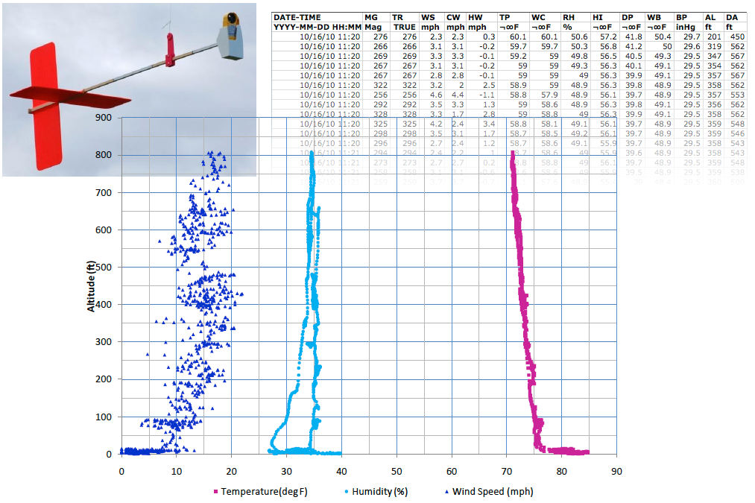

DIRECT (IN-SITU) observATIONS from Kite-Borne Sensors
Air Column Profiler (Why is this in-situ?)
Image Courtesy of Geoff Bland

Slide 15


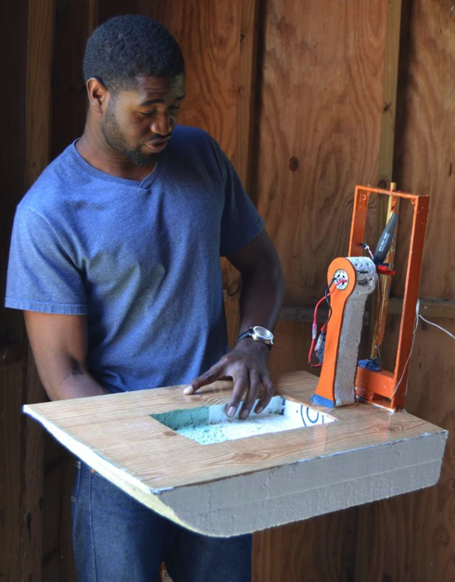
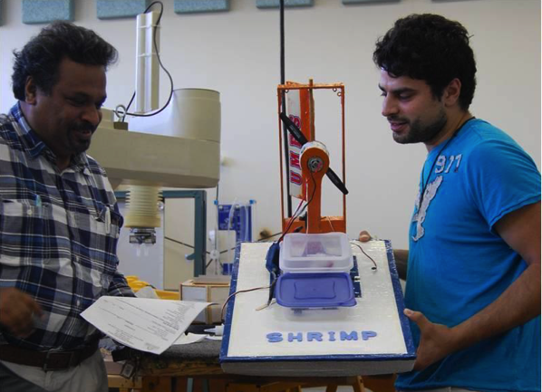
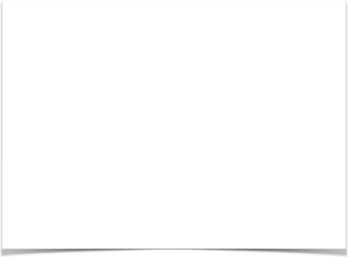
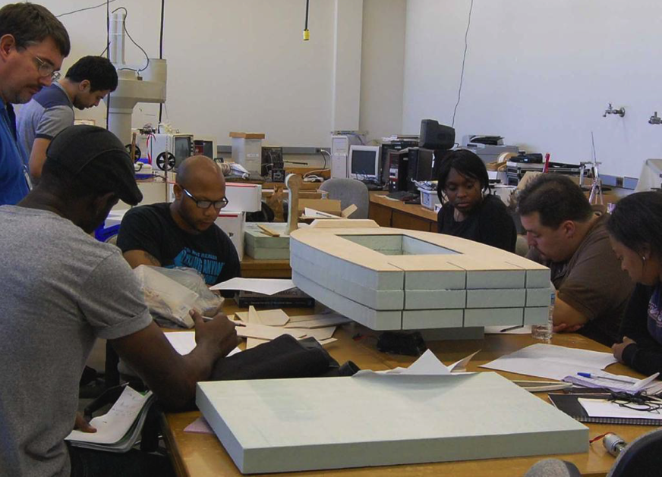
Engineering focus: Prototyping New Systems and
Re-designing Existing Systems
Engineering is a systematic and often iterative approach to designing objects, processes, and systems to meet human needs and wants.

Slide 16
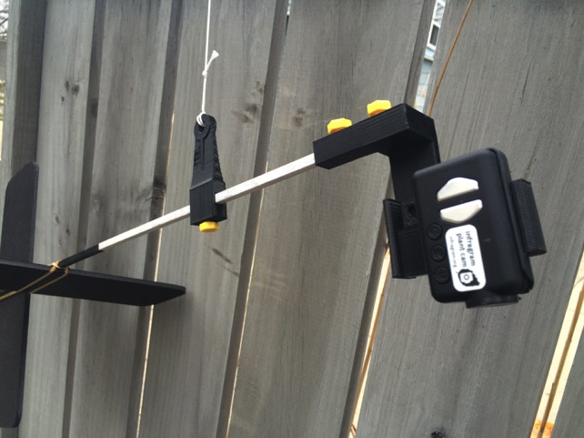
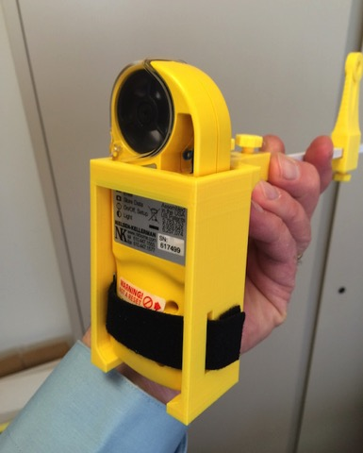
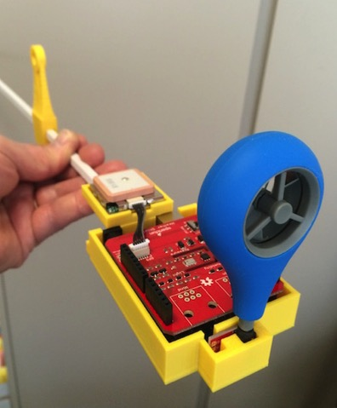
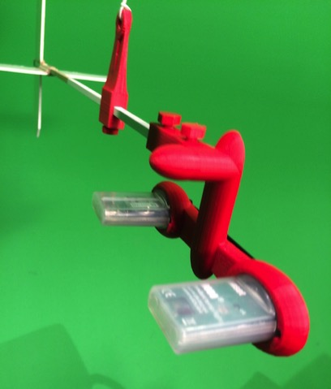
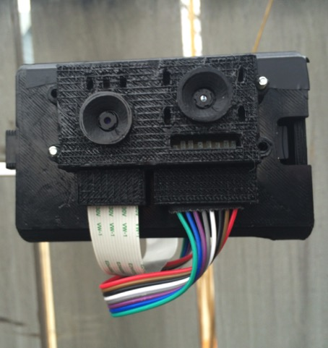
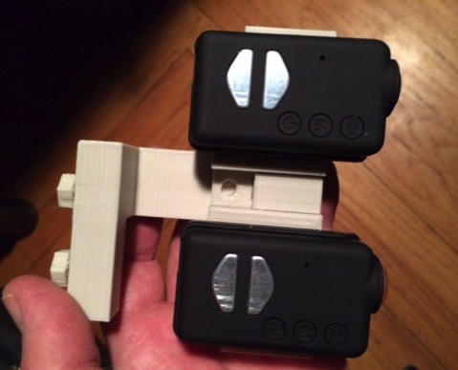
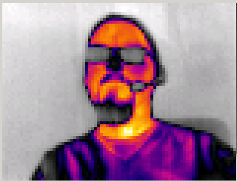
Engineering focus: New Aeropods
MonoCam HD and TwinCam HD
New Air-Column Profiler (w/ Kestrel)
New Arduino based Air-Column Profiler
HoboPod - Using Hobo Data Loggers
ThermoPod-TC
Aerosol Sampler

Slide 17


Engineering focus: New Aeropods
Air-Column Profiler Arduino
Arduino Uno rev3
Sparkfun weather shield
GPS chip
WeatherFlow Anemometer
Records:
  Wind speed
  Temperature
  Humidity
  Barometric Pressure
  Light sensor
  Position (Longitude/Latitude)

Slide 18
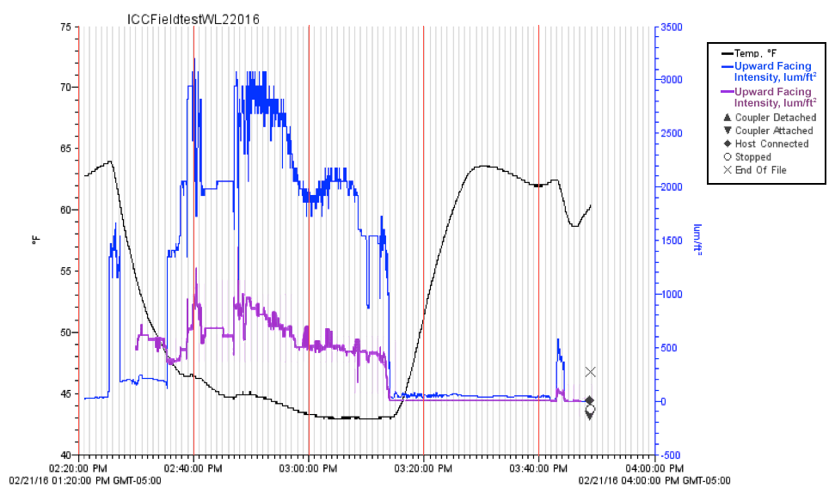


Engineering focus: New Aeropods
HoboPod - Using Hobo Data Loggers

Slide 19

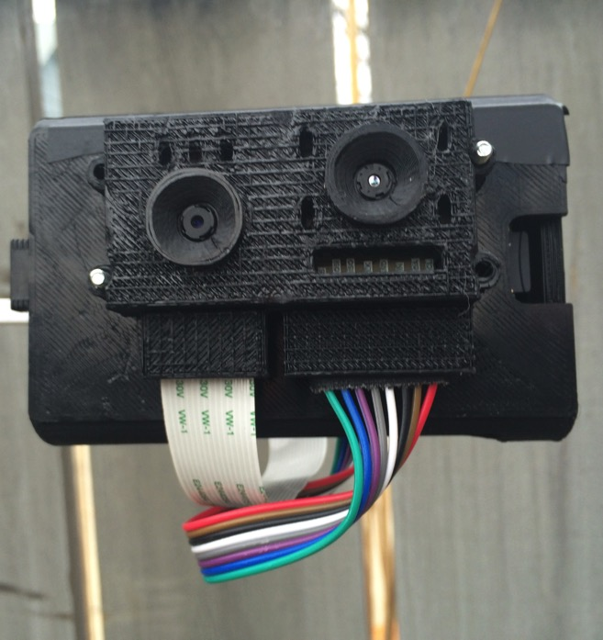
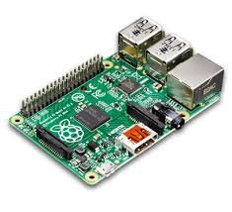
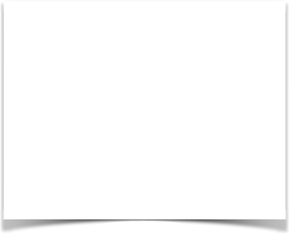
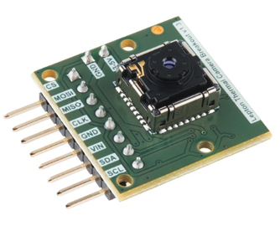
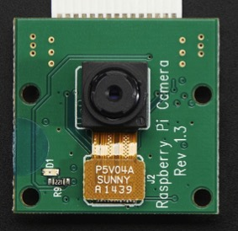
Engineering focus: New Aeropods
TwinCam ThermalPod
Raspberry Pi based
Includes Raspberry Pi Camera (5mp)
Flir Lepton thermal imager
and other stuff to make it work…
(Thermal-guy)

Slide 20


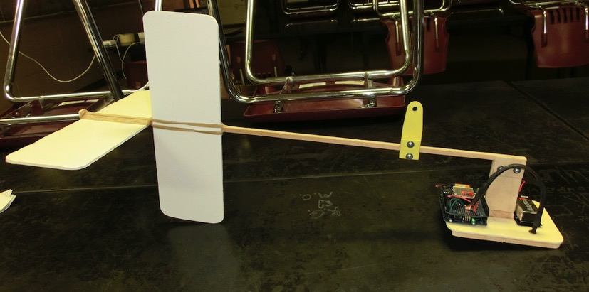
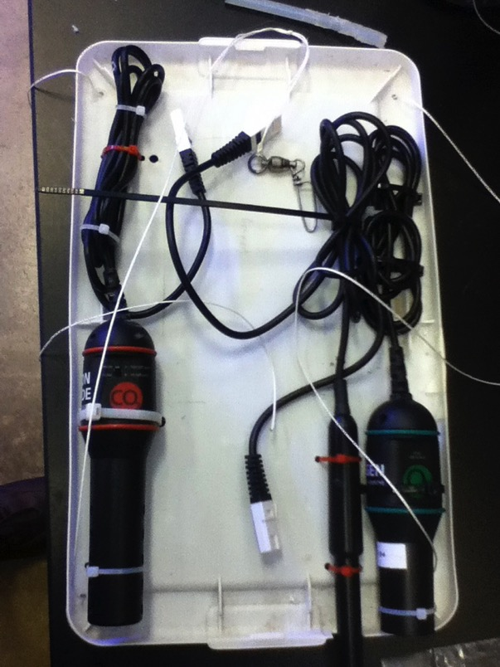

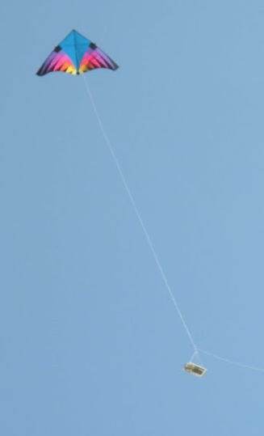





Engineering focus: Student Designed Systems

Slide 21

AEROKATS and Rover Education Network globe.gov/web/aren-project
THE AREN Project

Slide 22
additional resources:
Please visit:
http://www.globe.gov/web/aren-project
The AEROKATS program was developed by Geoff Bland at the NASA/GSFC Wallops Flight Facility. Aeropods and the Aeropod concept are the Intellectual Property of NASA and are considered competition sensitive. Aeropods or other aerodynamically stabilized tethered remote sensing systems based on the Aeropod concept may not be produced without the express consent of NASA through a formalized Space Act Agreement. Please contact Andy Henry at Wayne RESA henry@resa.net with questions.

