Slide 1

NASA STEM Activation Projects & GLOBE
27 Projects
7 Earth Focused
4 (7?) GLOBE Connections
Began 2016
5-10 year projects (sustained support)
New approaches
Diverse implementation
Rigorous evaluation
Products that will benefit GLOBE community

Slide 2

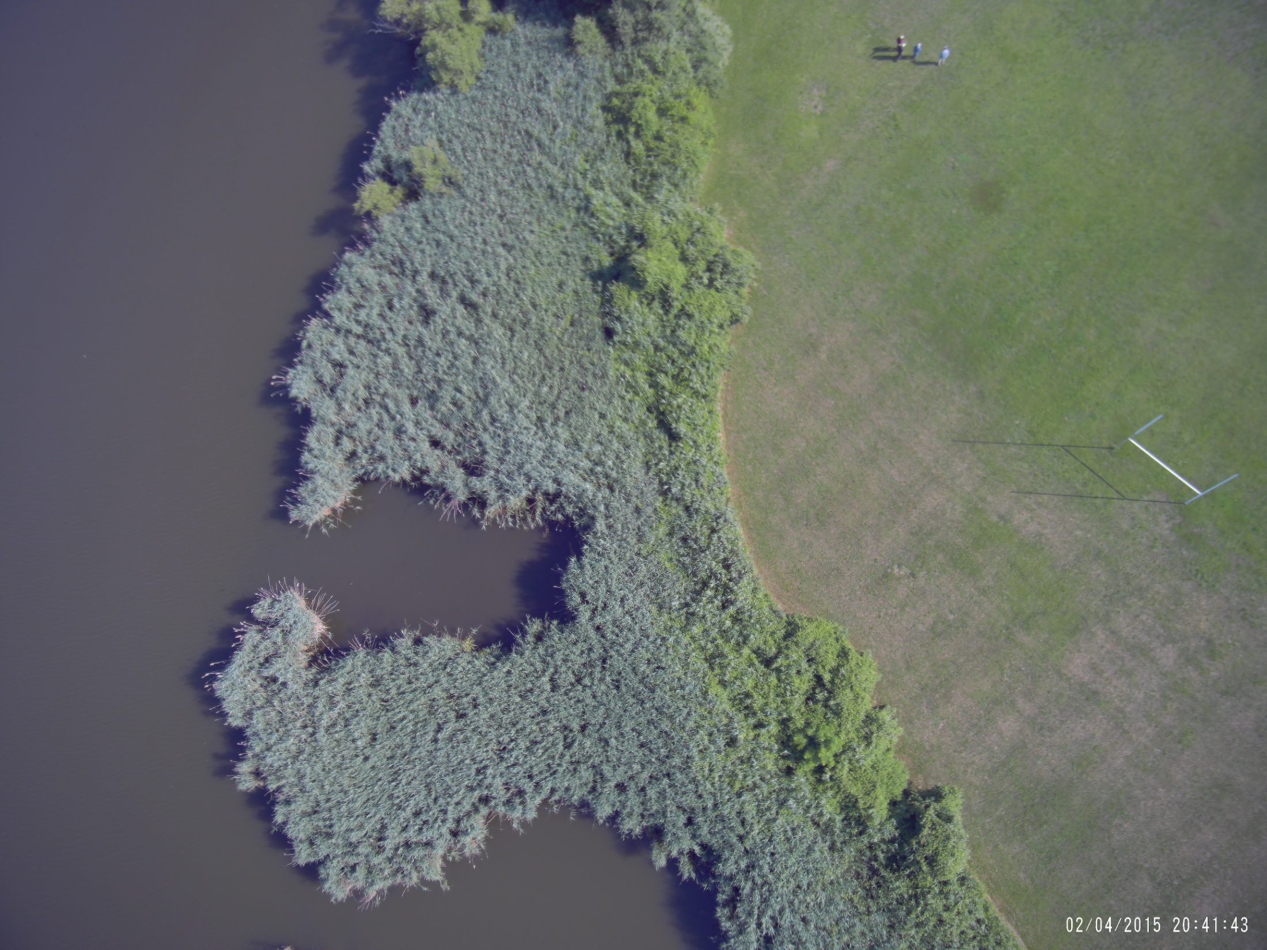


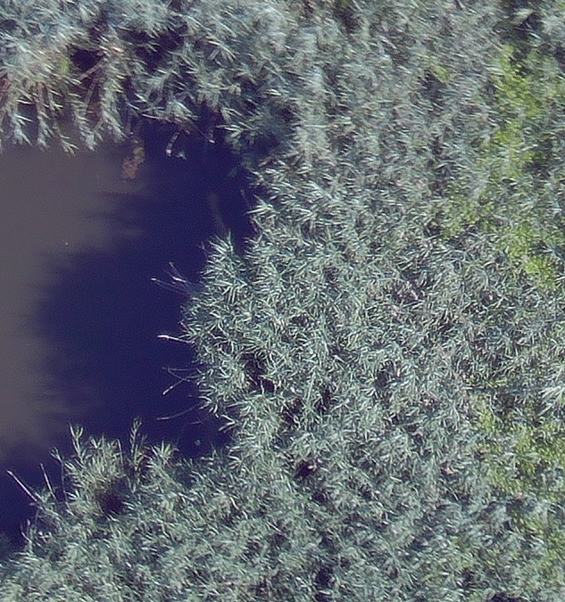
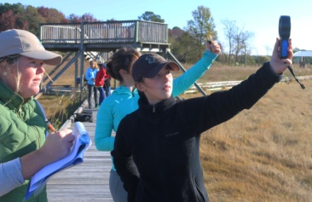
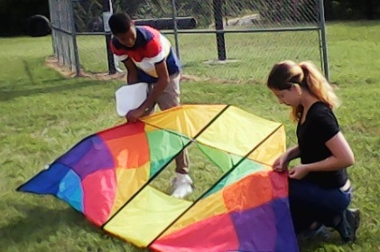
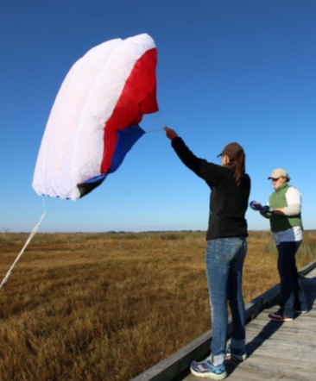
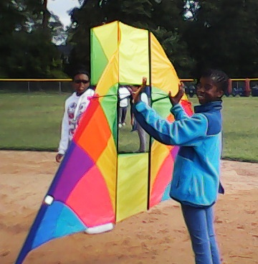
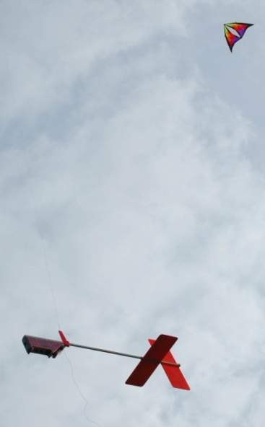
AEROKATS & Rovers
Project

Slide 3
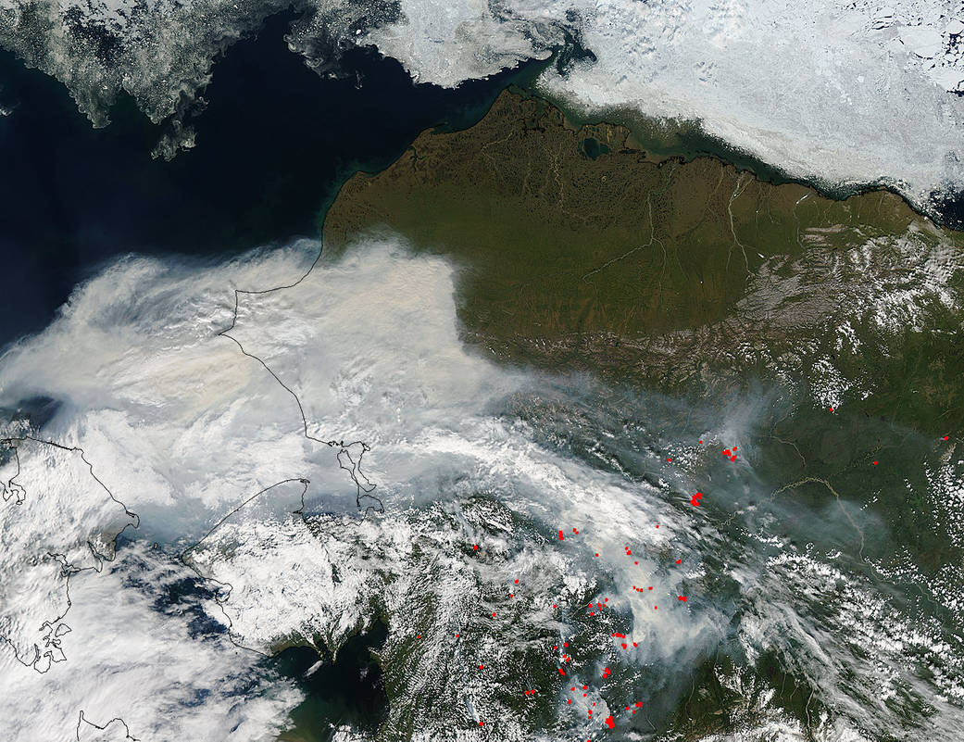
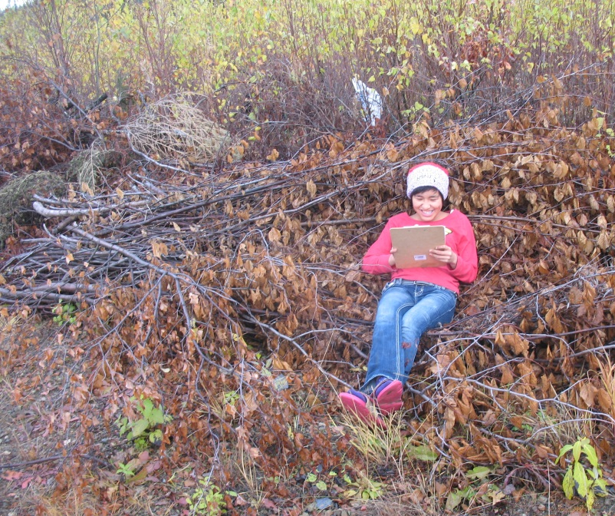

Arctic and Earth SIGNs Project
Engages learners in STEM using GLOBE and
NASA
Provides opportunity for climate learning
from local to global scale, using braided
multiple ways of knowing
Helps youth make an impact in their
community
Shageluk village 8th grader organizes data in a brush pile near the school’s GLOBE post-fire succession monitoring site.
Exploring impacts & feedbacks of a warming Arctic
Background- Jeff Schmaltz, MODIS Rapid Response Team; Inset- Katie Spellman, UAF
Elena B. Sparrow PI
Katie L. Spellman, Co-I
MODIS image taken by the Aqua Satellite captures smoke filled skies throughout Alaska in July 2015.

Slide 4
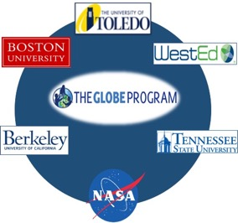
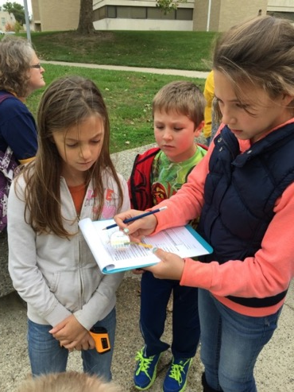

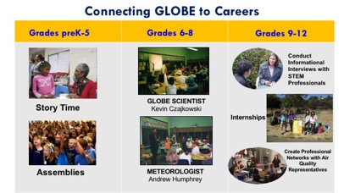
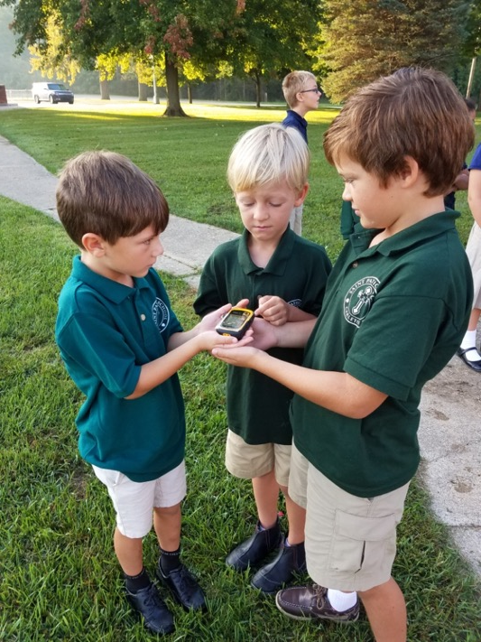
Mission Earth: Fusing GLOBE with NASA Assets to Build Systemic Innovation in STEM Education
Vertical Integration of GLOBE across school levels
Support STEM career development
Example of a Learning Progression
For GLOBE Clouds Protocol
And More…
Models of educational professional development
Sustainable infrastructures in schools for use of NASA/GLOBE learning
Collaborate & build capacity with district and state agencies
Infuse NASA/GLOBE learning into higher education
Notes:
Engaging teachers and students K-16 with GLOBE and NASA assets to understand Earth System Science. Focus is on real science, project-based science, and vertical integration of the program.
Our goals are the following: (read from the slide

Slide 5


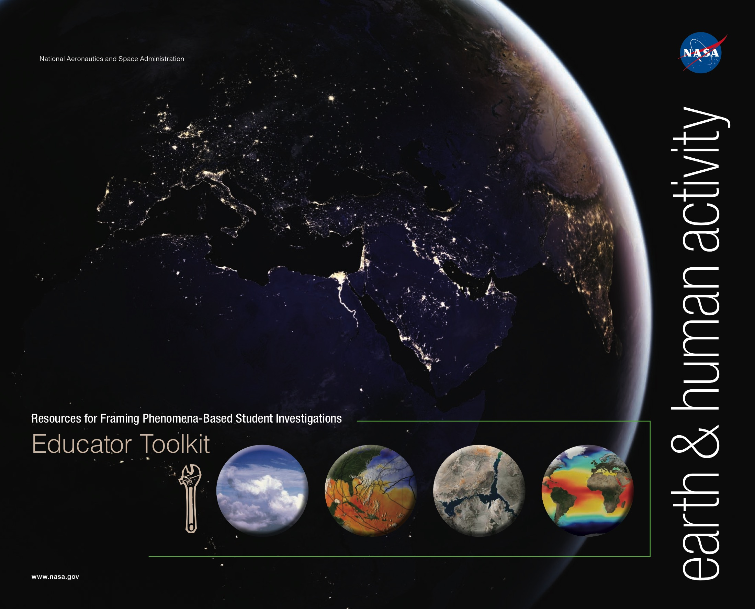
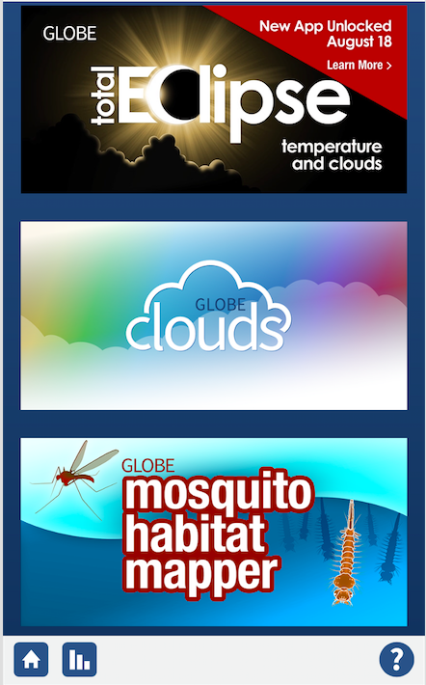
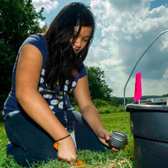
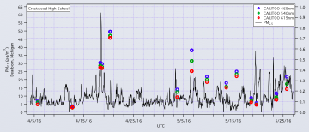
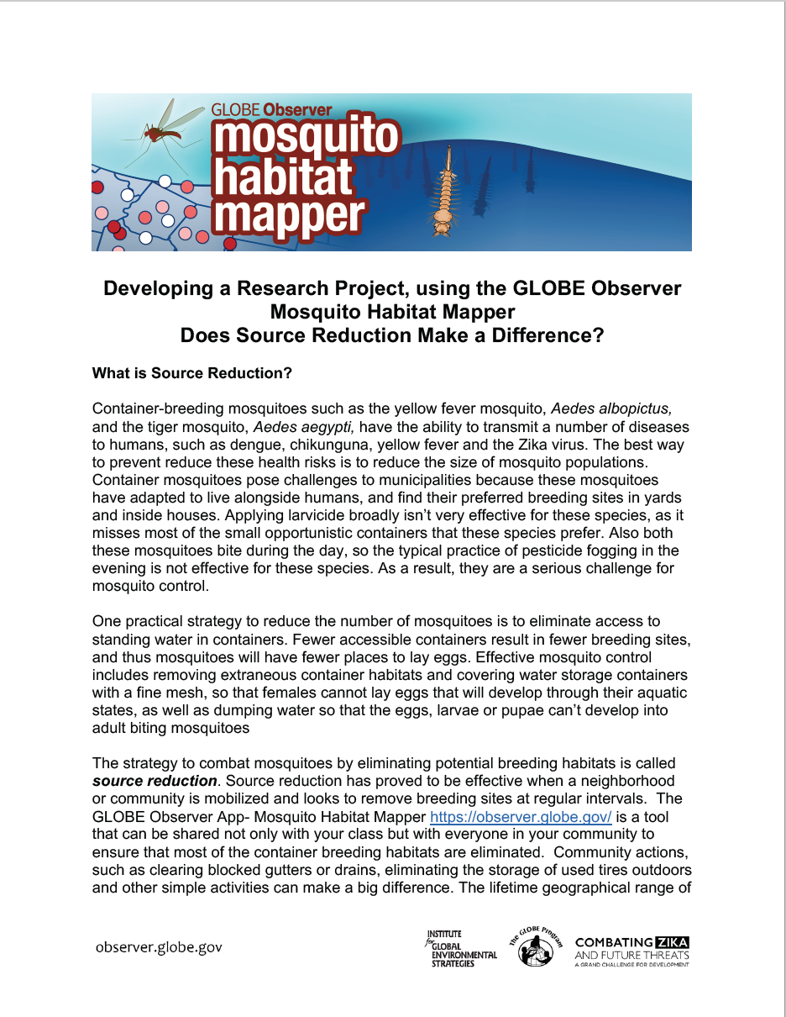


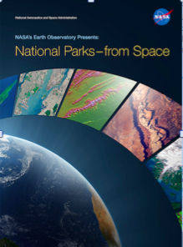


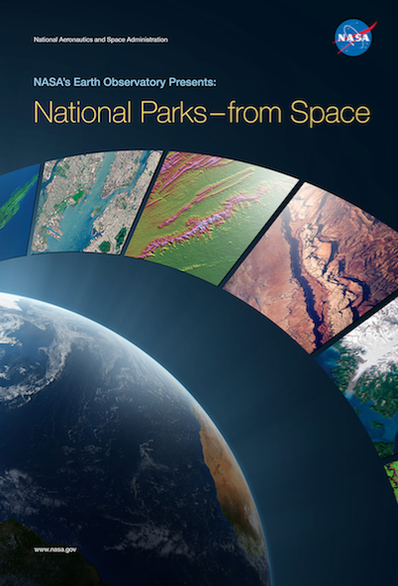
NASA Earth Science Education Collaborative (NESEC) http://bit.ly/EarthCollaborative
Citizen Science
GLOBE Student Field Campaigns
Resources
Data Collection, Analysis, Collaboration
El Niño-Southern Oscillation (ENSO)
U.S. Air Quality
Strategic Partnerships & Collaborations
Coming: Land Use/Cover
(Late 2017)
NASA Science Education
“Collective”
Notes:
GLOBE Observer (GO)
Support use of current GO protocols and data (Clouds and Mosquito Habitat Mapper)
Launch GO Eclipse limited edition to collect cloud and air temperature data during the August 21 total solar eclipse; data available for research
Develop and launch GO Land Cover/Land Use protocol (late 2017)
Develop and strengthen strategic partnerships to engage out-of-school audiences (4-H, libraries, and science centers/museums) in authentic STEM experiences.
GO evaluator (Oregon State University) will be observing and holding focus groups with key communities to assess needs
Global Experiment: Collaboration with Association of Science Centers (ASTC) leading up to Nov., 10, 2017 International Science Center and Museum Day (GO Mosquito Habitat Mapper)
Engage GLOBE community to use and provide feedback on new education and presentation resources for Mosquito Habitat Mapper
GLOBE Field Campaigns and NASA Connections
Continue and support U.S. Air Quality and ENSO, with focus on data analysis and collaborations
Long-Range planning for thematic approaches and connections to NASA Earth science
NESEC is a NASA Science Mission Directorate-funded partnership between the Institute for Global Environmental Strategies and the Earth science divisions at NASA Goddard Space Flight Center, Jet Propulsion Laboratory, and NASA Langley Research Center.
NESEC is enhancing STEM teaching and learning by creating engaging, meaningful, and authentic STEM experiences and resources that are: 1) based on NASA Earth science; 2) tailored to specific audiences’ needs; 3) as a whole, reaching diverse learners throughout their lifetimes; and 4) delivered broadly through strategic partnerships.

Slide 6
Other NASA Earth Projects
Texas Space Grant Consortium (https://science.nasa.gov/stem-activation-team/texas-space-grant-consortium)
High school summer research experiences
Slot reserved for GLOBE student
WGBH (https://science.nasa.gov/stem-activation-team/wgbh)
Digital resources for education
Earth focus release this month
GMRI (https://science.nasa.gov/stem-activation-team/gmri)
Middle school experience

Slide 7
Citizen Science for Earth Systems Program (CSESP)
2016
~100 Proposals
Now
16 Prototype Projects
2018-2020
2-5 Projects
GLOBE connections:
Soil Moisture Sensor
Snow ++
Aerosol ++
Cloud
Mosquito
Precipitation
Drought (No Precip)
GLOBE connections?
Announced in early 2018

Slide 8

NOAA Opportunities
B-WET (http://www.noaa.gov/office-education/bwet)
Explicit GLOBE connections
Environmental Literacy Program (http://www.noaa.gov/office-education/elp)
GLOBE connections welcome

Slide 9

This Week
Invigorated
Learning
Tired

Slide 10
See you in the Field See you next year

Slide 11
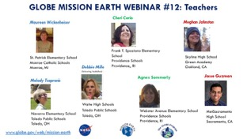
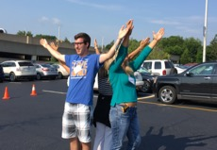
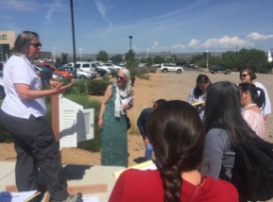
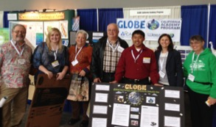
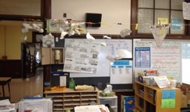
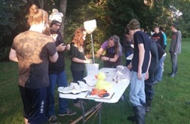
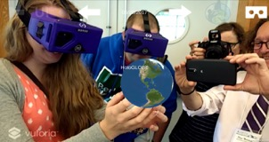
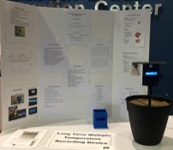
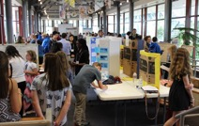
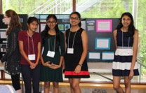
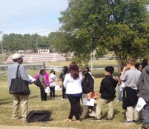
Mission Earth: Fusing GLOBE with NASA Assets to Build Systemic Innovation in STEM Education
Models of educational professional development
Collaborate & build capacity with district and state agencies
F2F Training
Bi-weekly
Webinars
Curricular materials vertically integrated in K-12 learning progression fusing NASA learning assets with GLOBE
Scaffolding Into
Classroom Instruction
Tracy Ostrom training teachers at the New Mexico STEM Conference
Connecting Teachers/ Students/Scientists
Infuse NASA/GLOBE learning into higher education
Sustainable infrastructures in schools for use of NASA/GLOBE learning
Example of a Learning Progression
For GLOBE Clouds Protocol
Engineering
Project
Support STEM career development
Dr. Padgett’s pre-service teachers with 9th grade students
GLOBE Northeast/Mid-Atlantic Student Research Symposium
Notes:
Engaging teachers and students K-16 with GLOBE and NASA assets to understand Earth System Science. Focus is on real science, project-based science, and vertical integration of the program.
Our goals are the following: (read from the slide

