Slide 1

Educator Toolkit: Data and Resources for Student Research and Investigations
Theresa Schwerin, IGES
Cassie Soeffing, IGES
Tina Harte, NASA LaRC
Brian Campbell, NASA GSFC/WFF

Slide 2
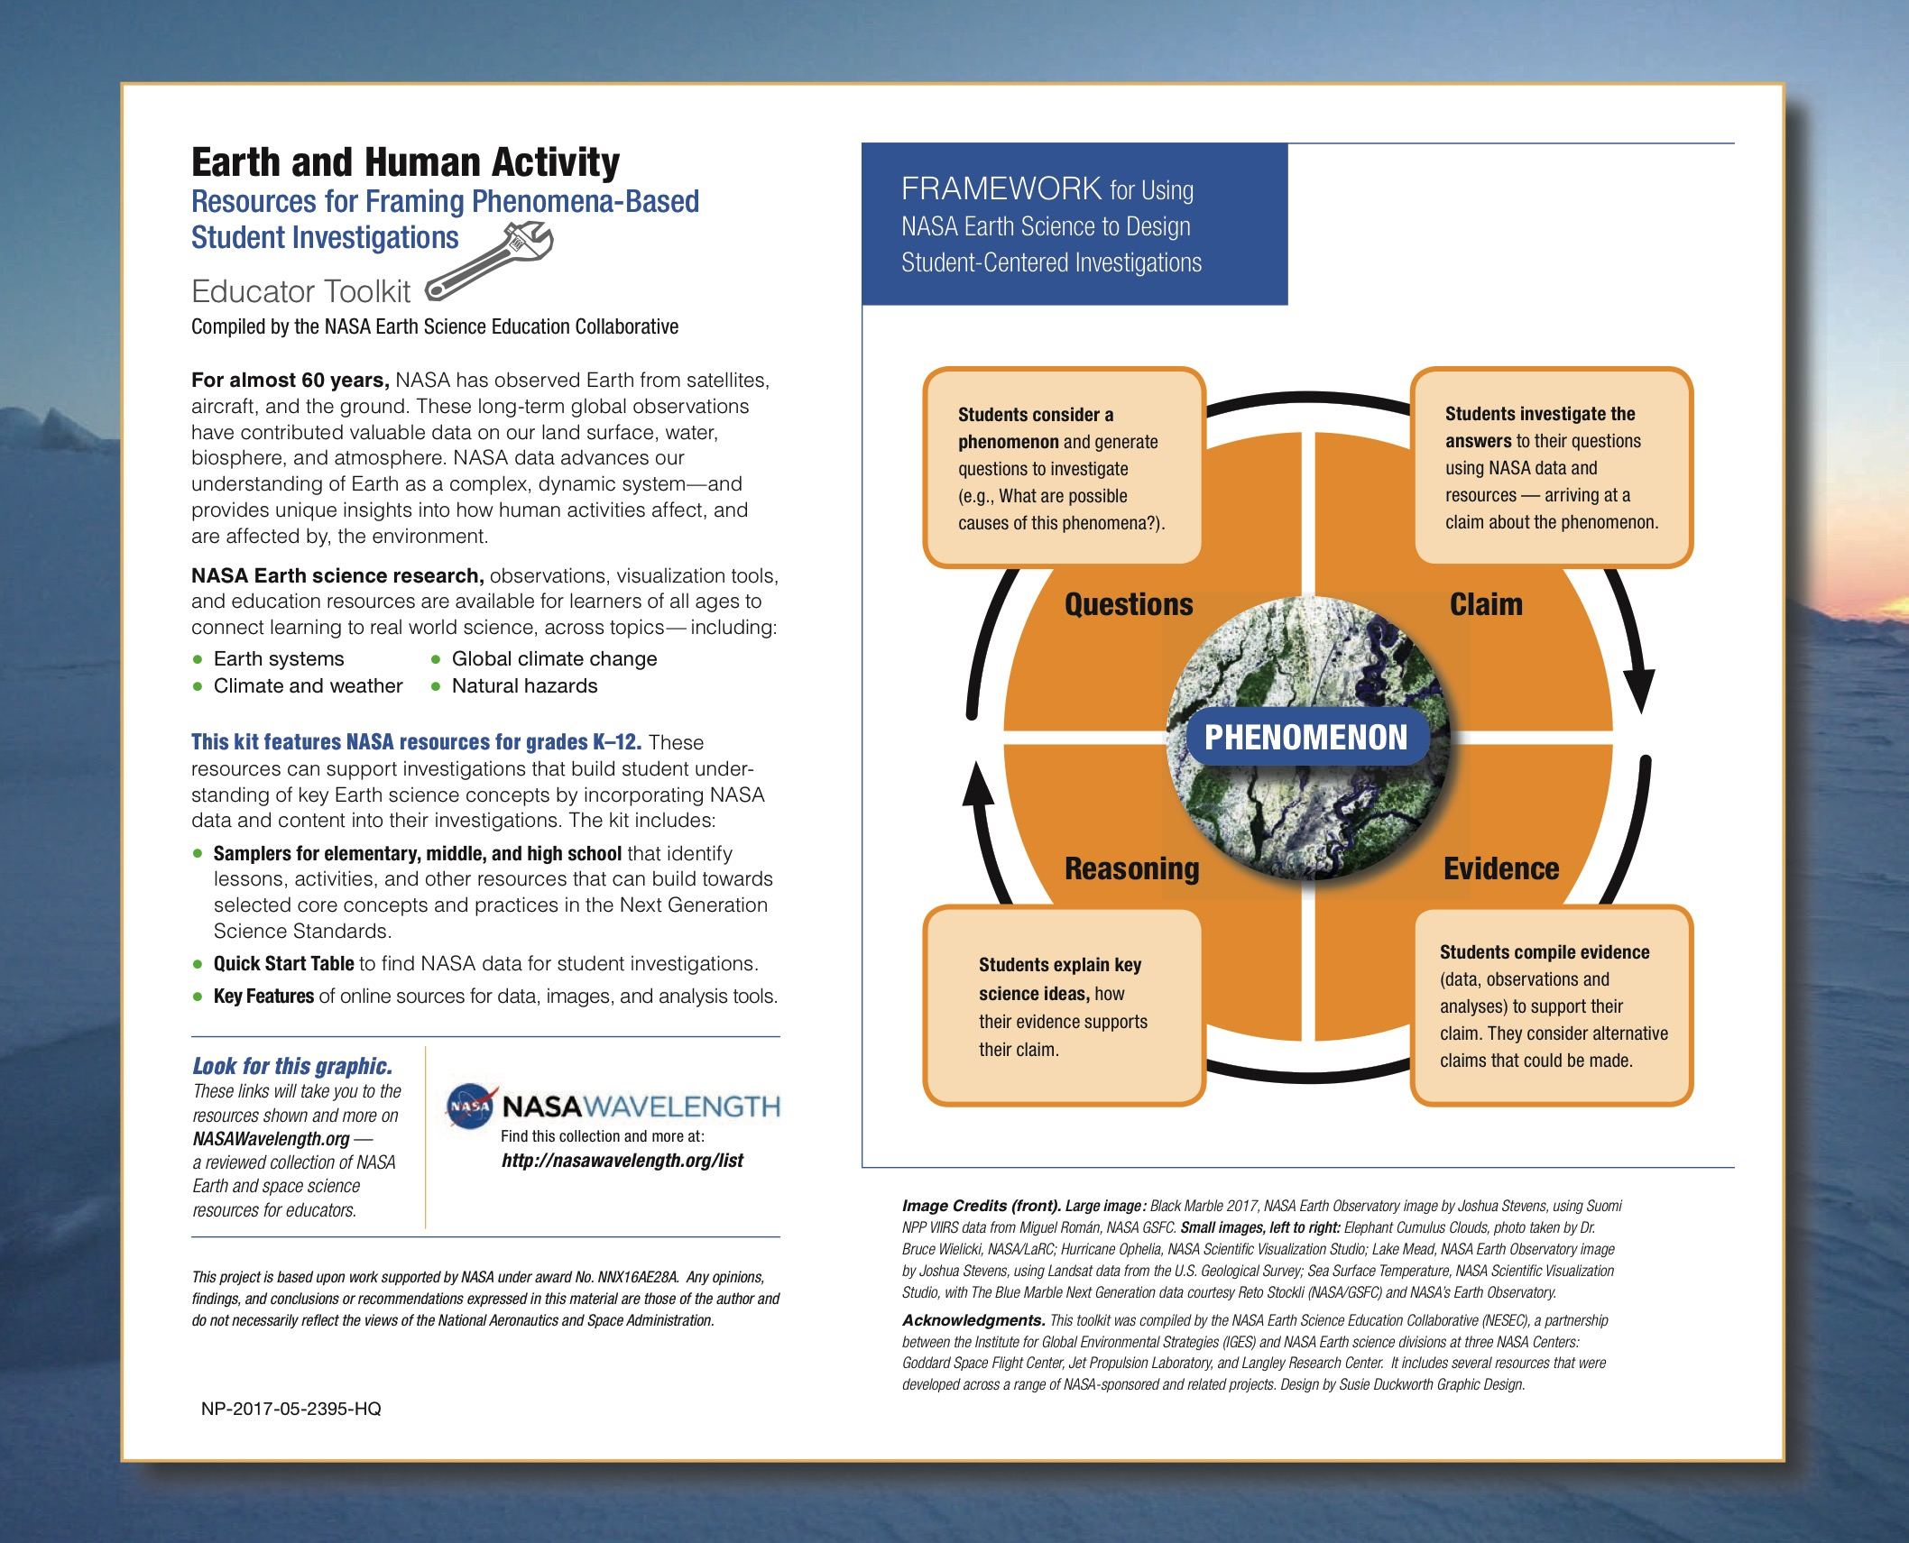
Notes:
Backside: info on what’s in the kit. Two things in particular: 1) NASA Wavelength logo – NASA digital library for Educators of all levels (Earth & Space science).where you see this; and 2) a General framework for designing student centered investigations – at the center – natural phenomena that drives students questions, that they can investigate with NASA and other data sources, and use that data as evidence to support their explanations of science concepts.

Slide 3
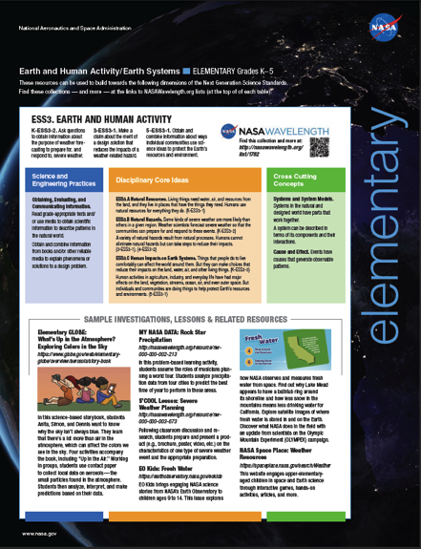
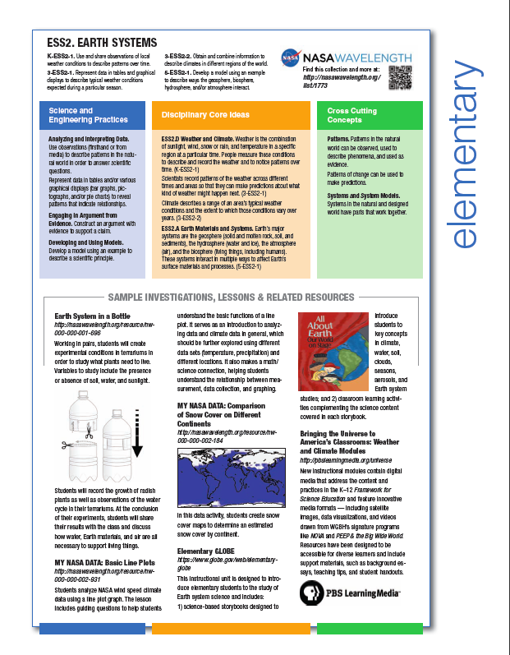
Samplers of Lessons & Investigations by Grade Band
Notes:
Samplers, with electronic versions on Wavelength (NASA digital library of Earth and Space science education resources. Register for free account can make your own copy of this list.

Slide 4

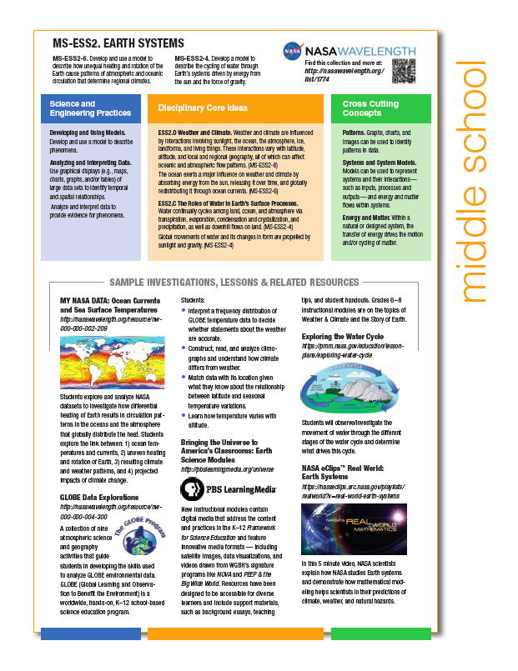
Samplers of Lessons & Investigations by Grade Band
Notes:
Middle school…

Slide 5
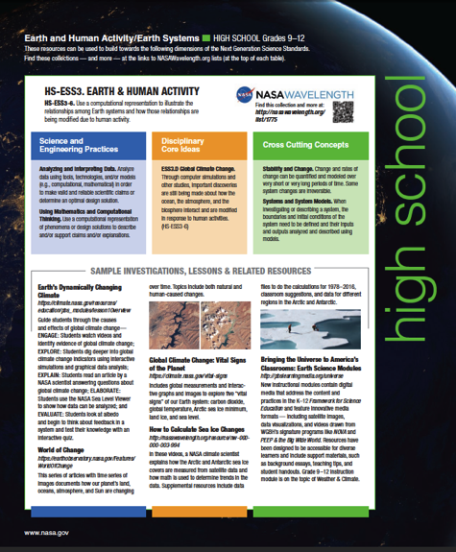
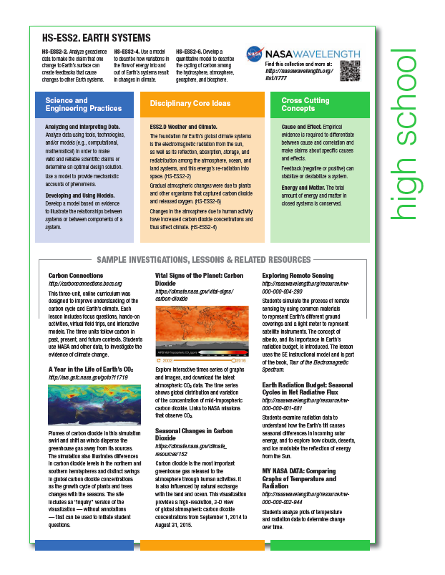
Samplers of Lessons & Investigations by Grade Band
Notes:
High school

Slide 6
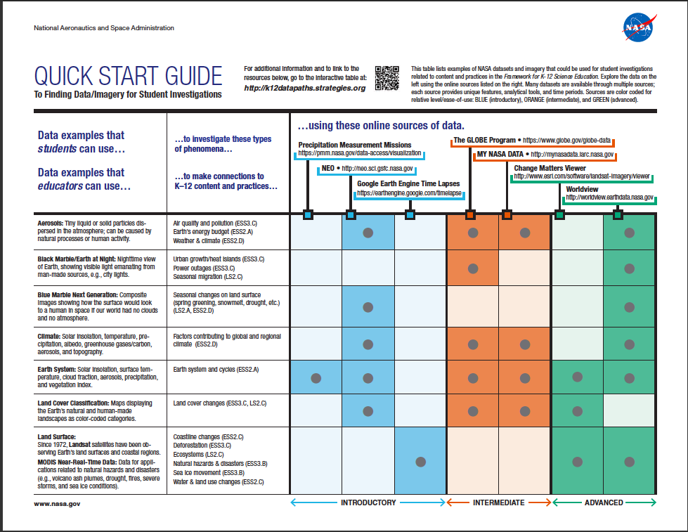

Slide 7
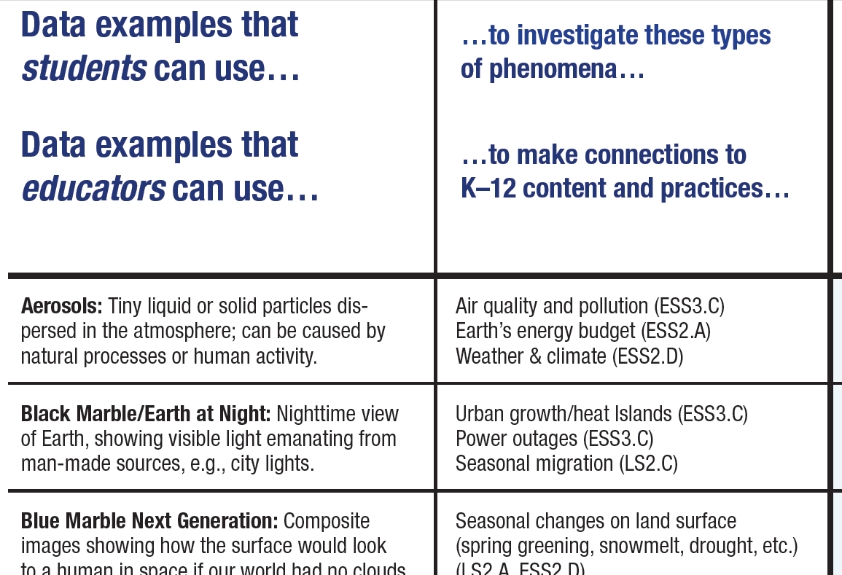
Notes:
1st column are examples of data (e.g., aerosols, black marble/Earth at night, land surface temperature, land cover, precipitation, climate, etc.)
2nd column identifies examples of natural phenomena that can be investigate in order to understand and explain k-12 science content (at end of column is NGSS topic code)

Slide 8
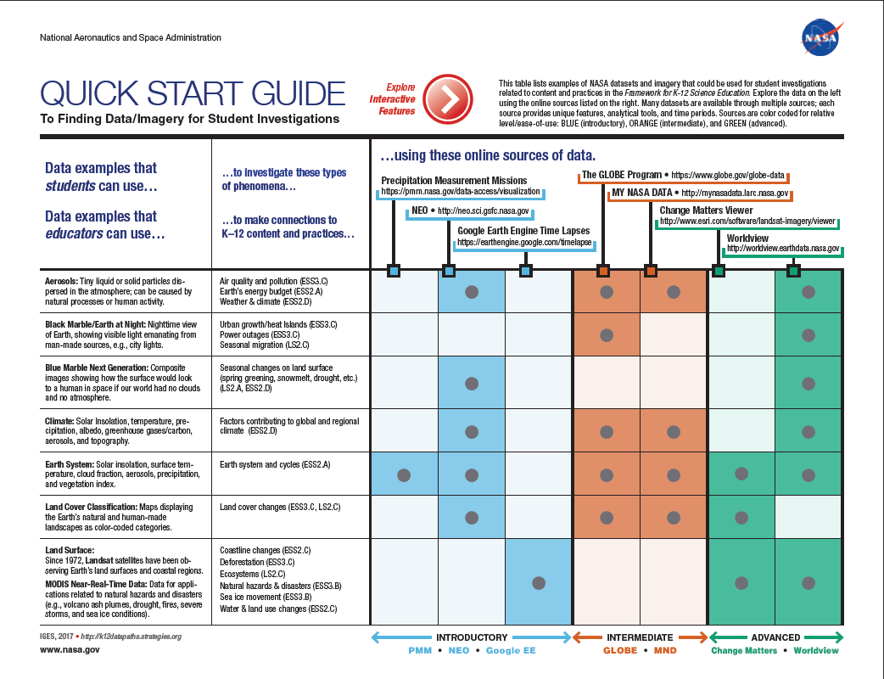
k12datapaths.strategies.org/
Notes:
There is an online, interactive version of this PDF – go to k12datapaths.strategies.org. IMPORTANT – need to download the PDF to use most of the interactive features
Clicking the red button on the interactive PDF – at the top of the table – “Explore Interactive Features” toggles back and forth between this version an version with callouts explaining what the interactive features are.

Slide 9
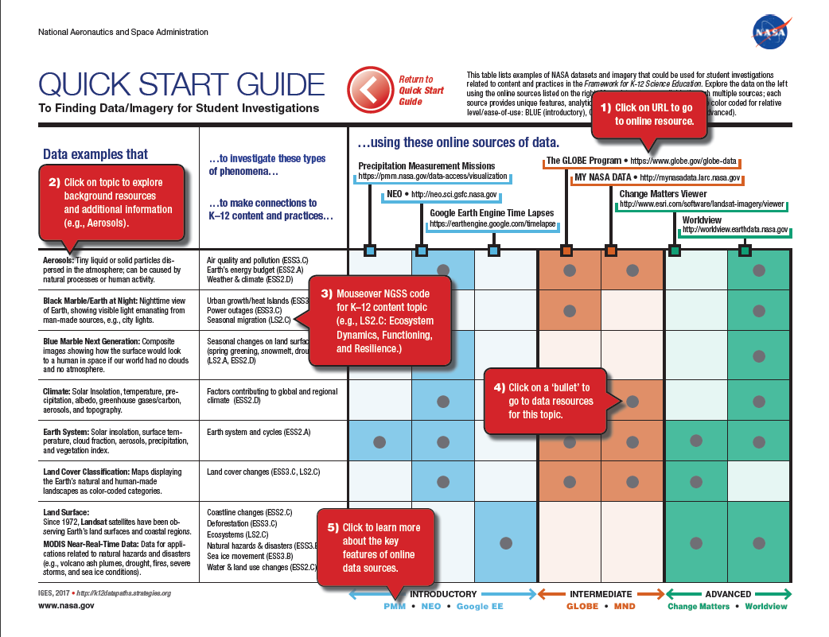
Notes:
1 – click on URLs at the top of each column to go to the online data source. There are 7 in this table (color coded by relative difficulty/learning curve)
2 – click on data examples in first column to go to a google sheet with additional background resources on topics
3 – Mouseover text for NGSS code
4 – Click on bullets to go to data resources for the topics
5 – Intermediate, Beginning and Advanced – relative level of difficulty/learning curve to get started. These link to one-page infographics…

Slide 10
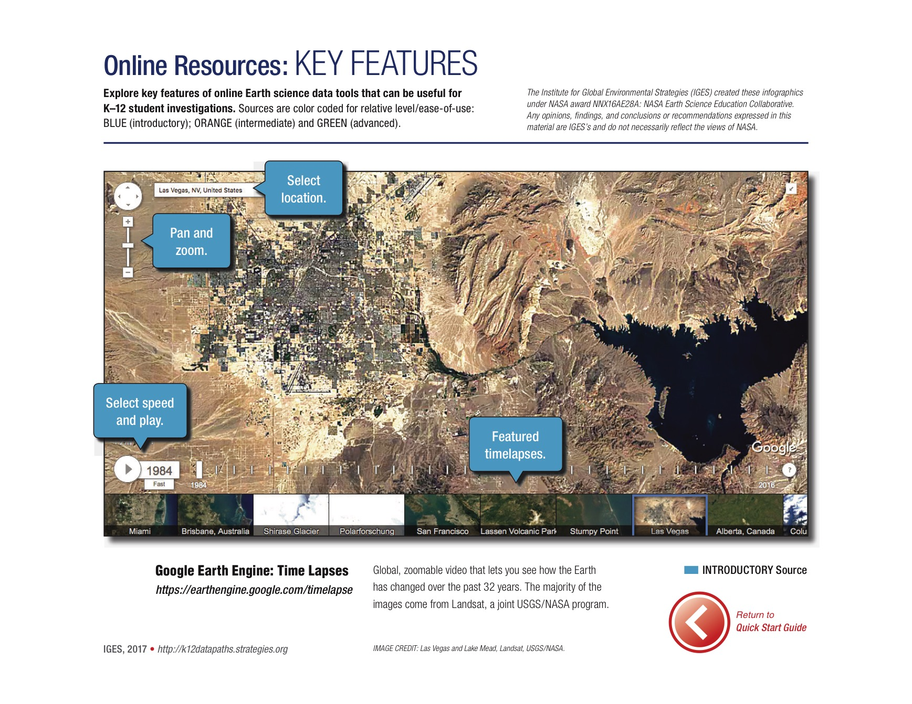
Notes:
Infographics – one pagers that show in 4-5 steps a quick start to using a data resource

Slide 11
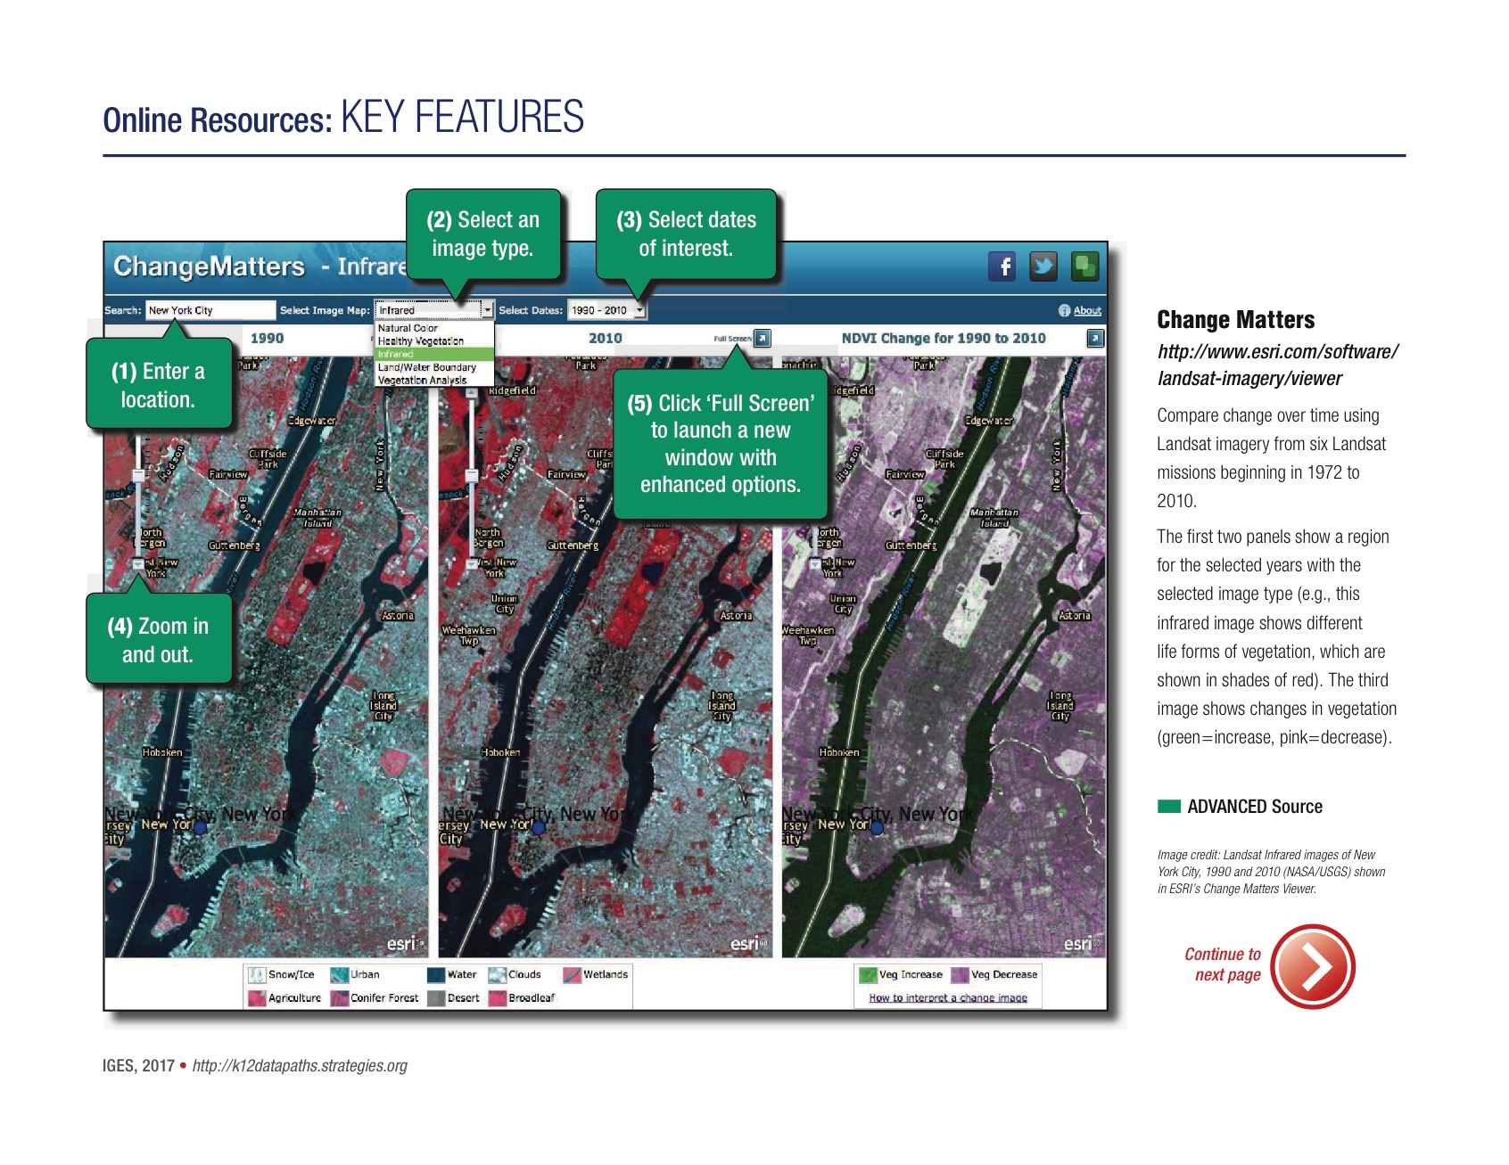
Notes:
Advanced features – Change Matters – Landsat viewer….

Slide 12
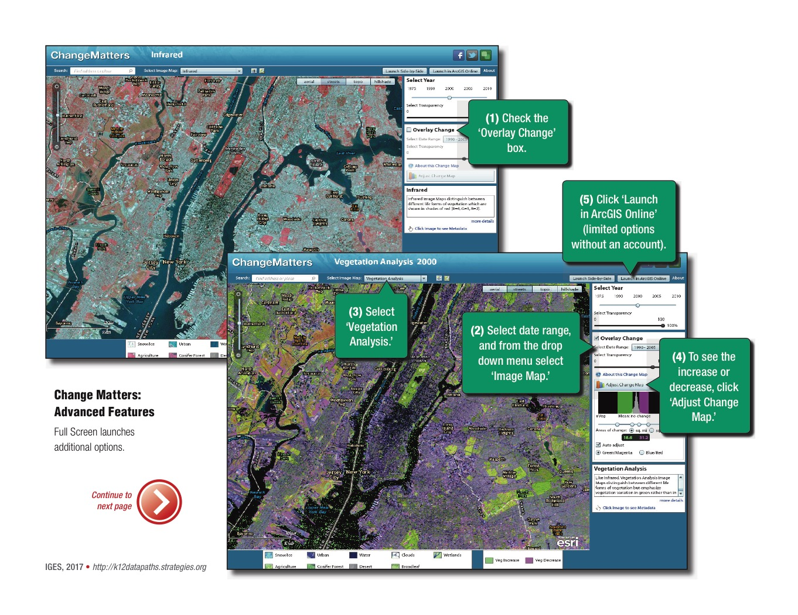

Slide 13

Questions

Slide 14
Phenomena
Qualities of a Good Anchor Phenomenon for a Sequence of Science Lessons
Instructional sequences are more coherent when students investigate compelling natural phenomena (in science) or work on meaningful design problems (in engineering) by engaging in the science and engineering practices. These phenomena and design problems are referred to as ‘anchors.’
Penuel, William R., and Phillip Bell. "Qualities of a Good Anchor Phenomenon for a Coherent Sequence of Science Lessons: StemTeachingTools." NSF, Mar. 2016. Web. 05 Oct. 2016.
Notes:
Penuel, William R., and Phillip Bell. "Qualities of a Good Anchor Phenomenon for a Coherent Sequence of Science Lessons: StemTeachingTools." NSF, Mar. 2016. Web. 05 Oct. 2016.
"Using Phenomena in NGSS-Designed Lessons and Units." (2016): 1-3. 2016. Web. 1 Dec. 2016.
“Criteria for Evaluationg Phenomena.” (2016):1. 2016. Web. 1 Dec. 2016.
Cassie – discuss

Slide 15
Phenomena
Qualities of a Good Anchor Phenomenon for a Sequence of Science Lessons
A good anchor …
builds upon everyday or family experiences: who students are, what they do, where they came from. It is important that it is compelling to students from non-dominant communities (e.g. English language learners, students from cultural groups underrepresented in STEM, etc.)
requires students to develop understanding of and apply multiple NGSS performance expectations while engaging in acts of reading, writing, communication, and mathematics.
is too complex for students to explain or design a solution for or after a single lesson.
  The explanation is just beyond the reach of what students can figure out without instruction.
  Searching online will not yield a quick answer for students to copy.
Penuel, William R., and Phillip Bell. "Qualities of a Good Anchor Phenomenon for a Coherent Sequence of Science Lessons: StemTeachingTools." NSF, Mar. 2016. Web. 05 Oct. 2016.
Notes:
Penuel, William R., and Phillip Bell. "Qualities of a Good Anchor Phenomenon for a Coherent Sequence of Science Lessons: StemTeachingTools." NSF, Mar. 2016. Web. 05 Oct. 2016.
"Using Phenomena in NGSS-Designed Lessons and Units." (2016): 1-3. 2016. Web. 1 Dec. 2016.
“Criteria for Evaluationg Phenomena.” (2016):1. 2016. Web. 1 Dec. 2016.
https://sites.google.com/site/sciencephenomena/criteria

Slide 16
Phenomena
Qualities of a Good Anchor Phenomenon for a Sequence of Science Lessons
A good anchor …
is observable to students. Observable can be with the aid of demonstrations, video presentations, scientific procedures (e.g. in the lab) or technological tools and devices to see things at a very large and very small scales or to surface patterns in data.
can be a case study (pine beetle infestation, building a solution to a problem) or something that is puzzling (why isn’t rainwater salty?) or a wonderment (how did the solar system form?).
Has relevant data, images, and text to engage students in the range of ideas students need to understand. It should allow them to use a broad sequence of science and engineering practices to learn science through first-hand or second-hand investigations.
Has an audience or stakeholder community that cares about the findings or products.*
*Penuel, William R., and Phillip Bell. "Qualities of a Good Anchor Phenomenon for a Coherent Sequence of Science Lessons: StemTeachingTools." NSF, Mar. 2016. Web. 05 Oct. 2016.
Notes:
Penuel, William R., and Phillip Bell. "Qualities of a Good Anchor Phenomenon for a Coherent Sequence of Science Lessons: StemTeachingTools." NSF, Mar. 2016. Web. 05 Oct. 2016.
"Using Phenomena in NGSS-Designed Lessons and Units." (2016): 1-3. 2016. Web. 1 Dec. 2016.
“Criteria for Evaluationg Phenomena.” (2016):1. 2016. Web. 1 Dec. 2016.

Slide 17
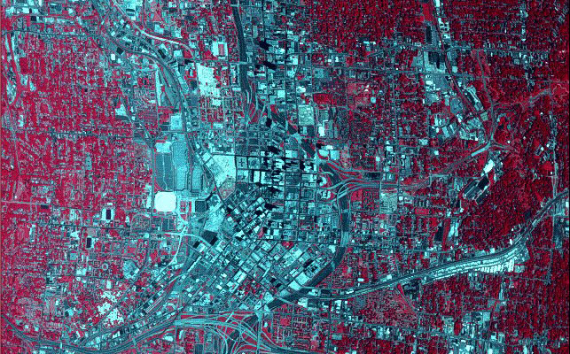
Urban Heat Islands
Atlanta, Georgia
Credit: NASA/Goddard Space Flight Center Scientific Visualization Studio
Notes:
This is an Urban Heat Island. What features can you see and identify. Why is this a heat island?
Discuss the key features: color red = vegetation and gray = urban buildings
Urban areas with high concentrations of buildings, roads and other artificial surfaces retain heat, creating urban heat islands.
Satellite data reveal that urban heat islands increase surface temperatures compared to rural surroundings.

Slide 18
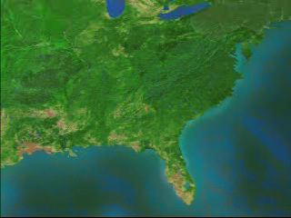
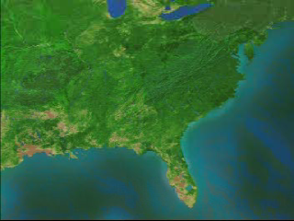

Atlanta, GA -- Phenomena
Daytime Thermal color
Nighttime Thermal color
Credit: NASA/Goddard Space Flight Center Scientific Visualization Studio
Notes:
Urban areas with high concentrations of buildings, roads and other artificial surfaces retain heat, creating urban heat islands.
Satellite data reveal that urban heat islands increase surface temperatures compared to rural surroundings.
This animation of Atlanta shows how cities retain heat from day to night. (Credit: NASA/Goddard Space Flight Center Scientific Visualization Studio) DISCUSS

Slide 19
What do we know about
Urban Heat Islands?
Urban growth-heat islands is an example of human interactions with the planet’s natural systems and process.
Heat islands are areas significantly warmer than the surrounding rural areas due to human activities.
Human activities include building roads and buildings replacing areas that were once open land with vegetation.
Notes:
For discussion on the phenemena

Slide 20
Detecting Urban Heat Islands
Think of the closest large large city to you.
What do you know about this city? Talk amongst yourselves…..
  Population,
  parks,
  buildings,
  event centers, …
Using the Quick Start Guide, what data examples would you use to begin your investigation of ‘Urban Heat Islands’?
Notes:
Think of the closest large large city to you. What do you know about this city? Population, parks, buildings, event centers, …
Using the Quick Start Guide, what data examples would you use to begin your investigation of ‘Urban Heat Islands’?

Slide 21
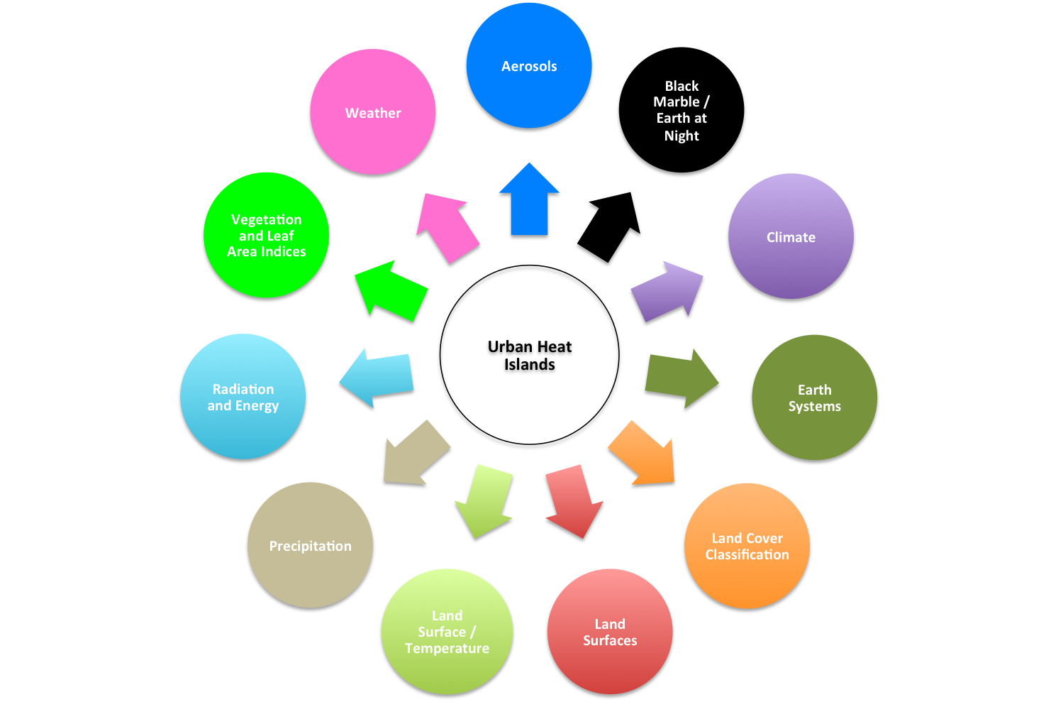
Notes:
Urban Heat Islands has a connection to the NASA topics and their associated ‘phenomena’ using the Quick Start Guide.

Slide 22
Questions

Slide 23
MY NASA DATA
Looking at variables associated with the phenomena of Urban Heat Islands.
NASA uses satellites to observe variables from space associated with indicators of Urban Heat Islands.
One of those indicators is increased surface temperature which is influenced by surface CO, which is in turn influenced by aerosols.
MY NASA DATA is a tool that can be used to look at Surface Temperature Data.
Urban Heat Islands
Aerosols
Carbon Monoxide
http://mynasadata.larc.nasa.gov
Earth System Data Explorer:
https://mynasadata.larc.nasa.gov/EarthSystemLAS/UI.vm
Land Surface
Temperatures

Slide 24
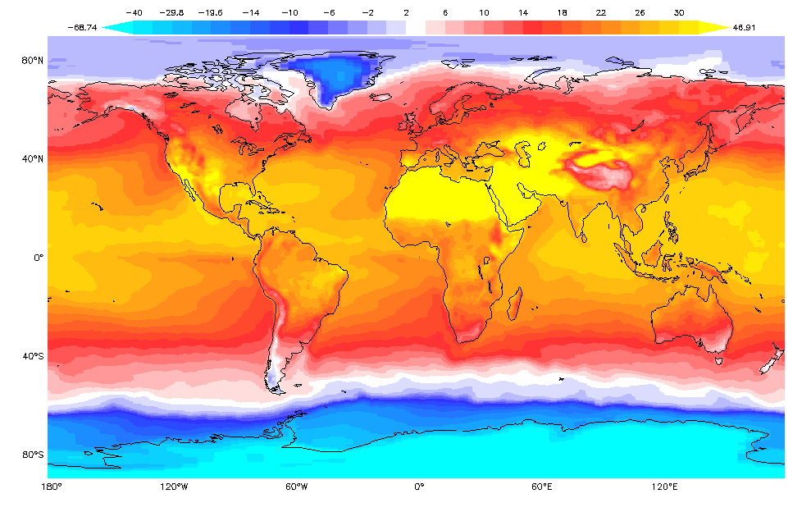
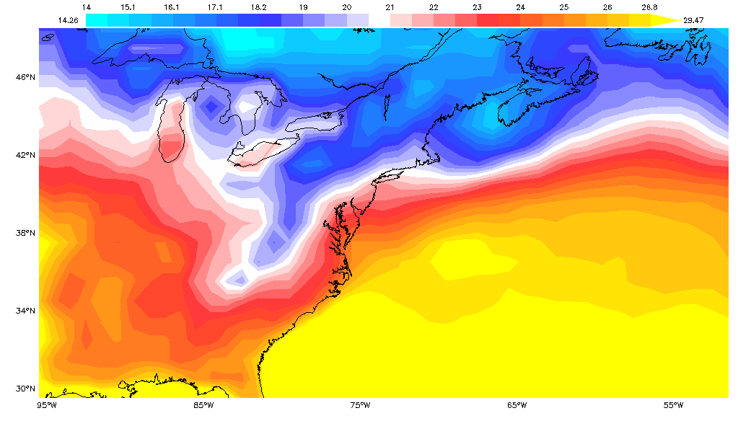
Using MY NASA DATA to Look at Surface Temperature
Globally: August 2014
Regionally: August 2014
Tina R Harte NASA Langley Research Center, SD Education Outreach Task Lead/Senior Education Specialist, 2017

Slide 25
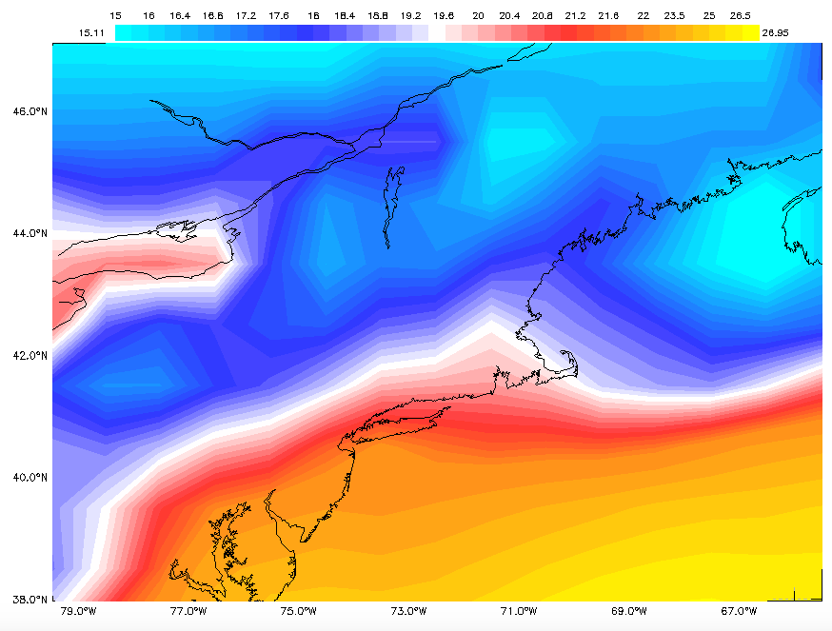
August 2014 On a More Localized Level …
Using MY NASA DATA to Look at Surface Temperature
Tina R Harte NASA Langley Research Center, SD Education Outreach Task Lead/Senior Education Specialist, 2017

Slide 26
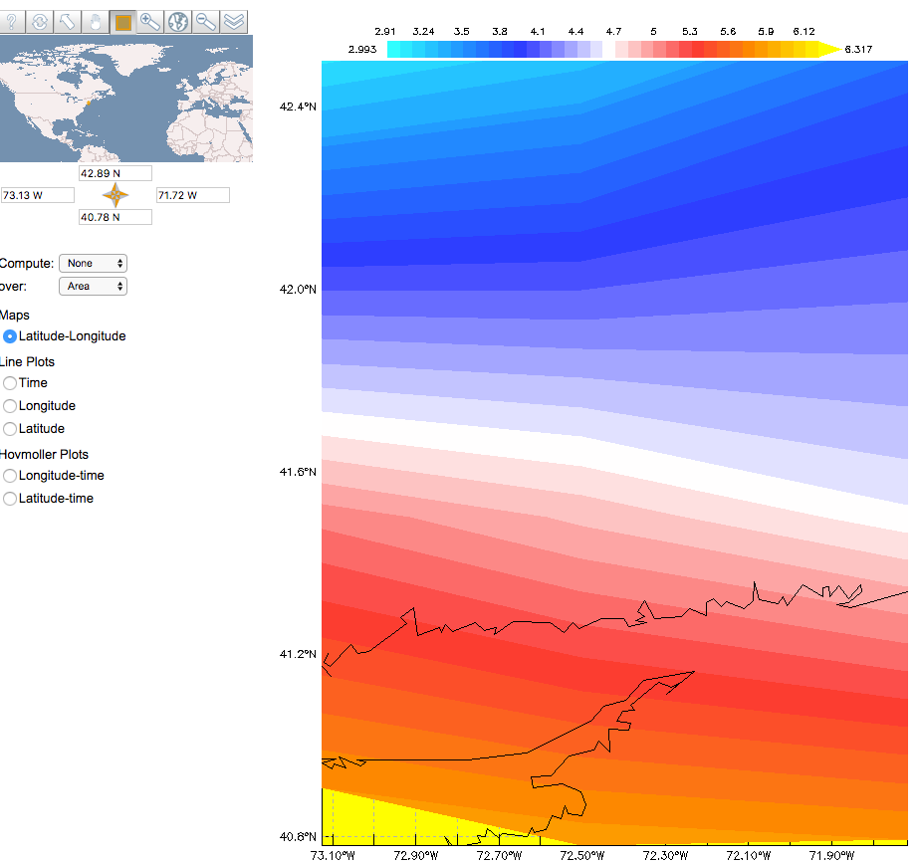
And Even Closer …
New Haven, CT
41.31 N
71.92 W

Slide 27
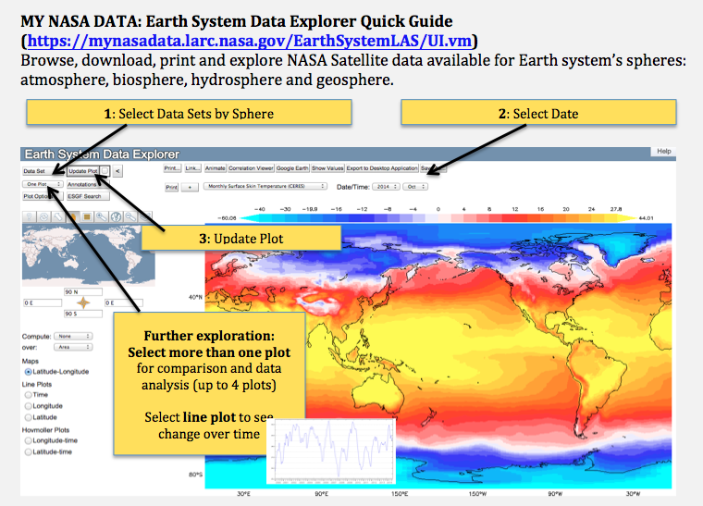
MY NASA DATA: Earth System Data Explorer Quick Guide

Slide 28
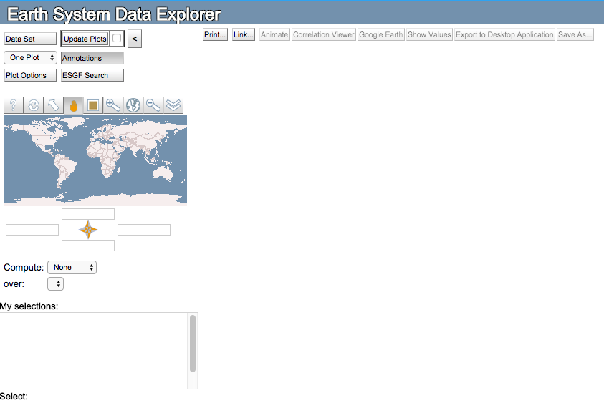
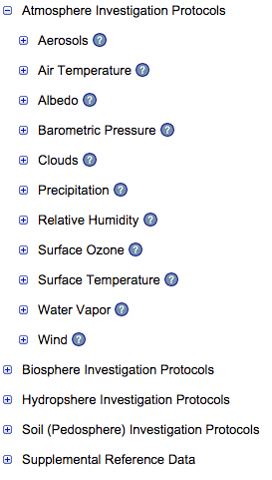
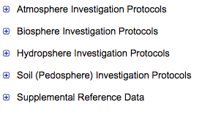
Step #1
Step #2

Slide 29
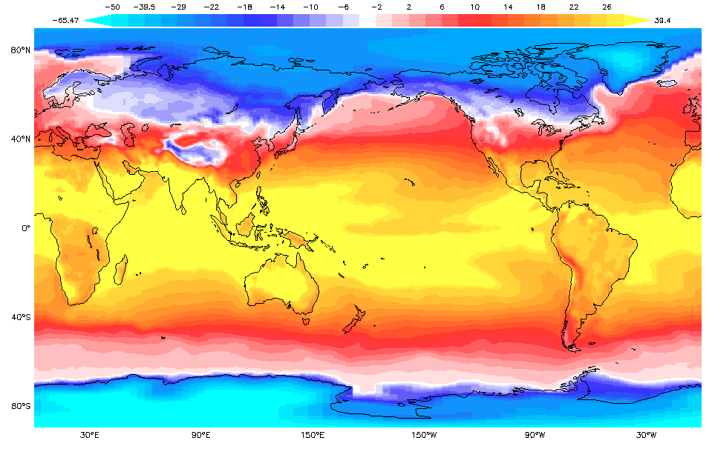
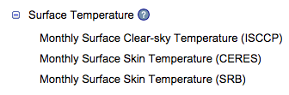
Step #3

Slide 30
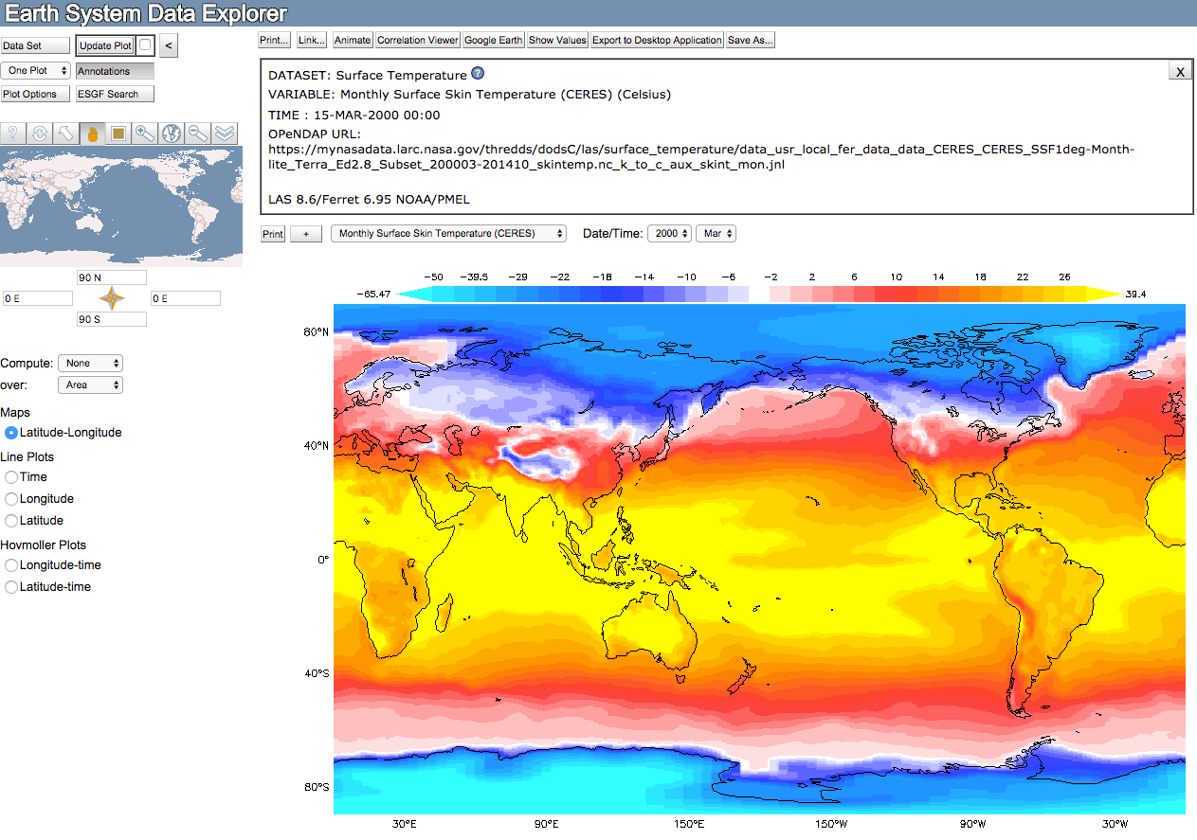
Notes:
Following those steps brings us to this data set . . . One key item to remember will be the Update Plot button ☺

Slide 31
Let’s Explore https://mynasadata.larc.nasa.gov/EarthSystemLAS/UI.vm
Remember to Update the Plot Each Time You Make a Selection
Map Orientation
Date/Time
Line Plot (Time, Longitude, Latitude)
One Plot: 2014
Two Plot: March 2000/March 2014
Four Plot: 2014 Jan, Mar, June, Sept
Zoom Function (Globally, Regionally, Locally)
Tina R Harte NASA Langley Research Center, SD Education Outreach Task Lead/Senior Education Specialist, 2017

Slide 32
Let’s Practice https://mynasadata.larc.nasa.gov/EarthSystemLAS/UI.vm
Remember to Update the Plot Each Time You Make a Selection
Orient your map
Select your location
Select your date
Select line plot
Return to maps
Select two plots to compare
Explore on your own
Tina R Harte NASA Langley Research Center, SD Education Outreach Task Lead/Senior Education Specialist, 2017

Slide 33
Questions

Slide 34
Looking at, and understanding Urban Heat Islands, requires a look at several environmental variables like Land Surface Temperature, Soil Moisture, and Carbon Monoxide data through data conduits like GLOBE Vis and NASA Worldview
Brian Campbell
NASA Senior Earth Science Specialist
GLOBE ENSO SRC Lead
NASA Wallops Flight Facility
Wallops Island, Virginia USA

Slide 35
Urban Heat Islands and Measureable
Environmental Variables
Urban Heat Islands
The GLOBE Program Visualization System
https://vis.globe.gov/GLOBE
NASA Worldview
https://earthdata.nasa.gov/labs/worldview/
Land Surface
Temperatures
Soil Moisture
Carbon Monoxide

Slide 36
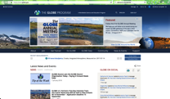
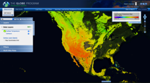
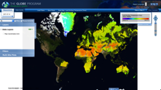

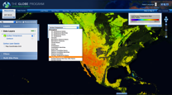
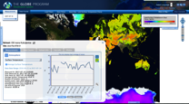
Land Surface Temperature Data Layer in GLOBE Visualization Map
Go to: https://vis.globe.gov/GLOBE/
Click on Visualize Data
Click on Choose a Base Map, scroll down to Land Surface Temperature (Terra)
Under Measurements at the top left of page, select a day you would like to view the Land Surface Temperature
Add Land Surface Temperature Data Layer
Find your school and your land surface temperature measurements and compare them to the Terra satellite data layer and the color bar legend at the top right

Slide 37
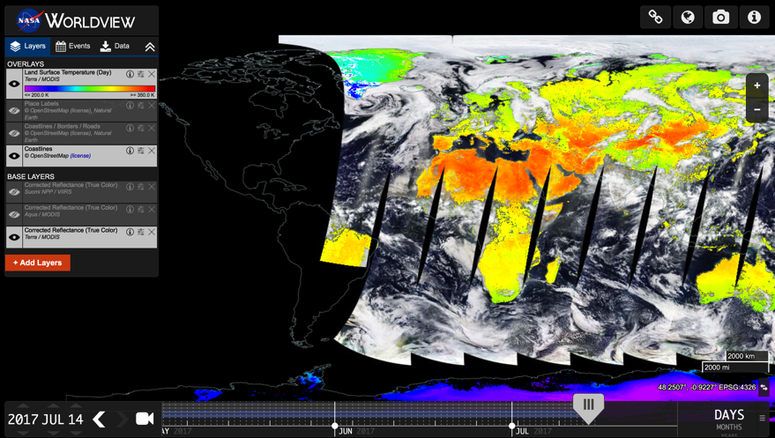
Land Surface Temperatures in
NASA WorldView
https://earthdata.nasa.gov/labs/worldview/

Slide 38
Land Surface Temperatures in
NASA WorldView
How To:
Open https://earthdata.nasa.gov/labs/worldview/
Click on the red “+Add Layers” box on left
Scroll down to “All” section and click on ”All”
Scroll down and click on “Land Surface Temperature” and check the box marked “Land Surface Temperature (Day)” or “Land Surface Temperature (Night) Close the “+Add Layers” box.
Now, choose a day from the bar on the bottom of the page and it will show you where the Land Surface Temperature data was taken for that day.
Scroll over you location and the color bar on the left will give you the range of land surface temperatures for that location.

Slide 39
Now, a Test!
Let’s do this same thing for SMAP soil moisture working on your own computers.
Date to choose: April 22, 2017 (Earth Day)
Find SMAP soil moisture data on GLOBE Vis Map
    https://vis.globe.gov/GLOBE/
Find SMAP soil moisture data on NASA Worldview
    https://worldview.earthdata.nasa.gov/

Slide 40
Looking at SMAP Soil Moisture Data with GLOBE

Slide 41

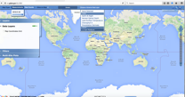
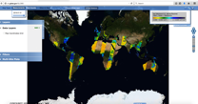
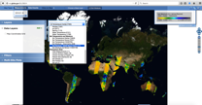
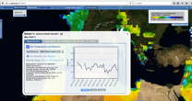
SMAP Data Layer in GLOBE Visualization Map
Go to: https://vis.globe.gov/GLOBE
Click on Visualize Data
Click on Choose a Science Data Layer, scroll down to L3 Soil Moisture under SMAP
Under Measurements at the top left of page, select a day you would like to view the SMAP satellite soil moisture data
Add SMAP Pattern Data Layer
Find your school and your volumetric soil moisture measurements and compare them to the SMAP satellite data layer and the color bar legend at the top right

Slide 42
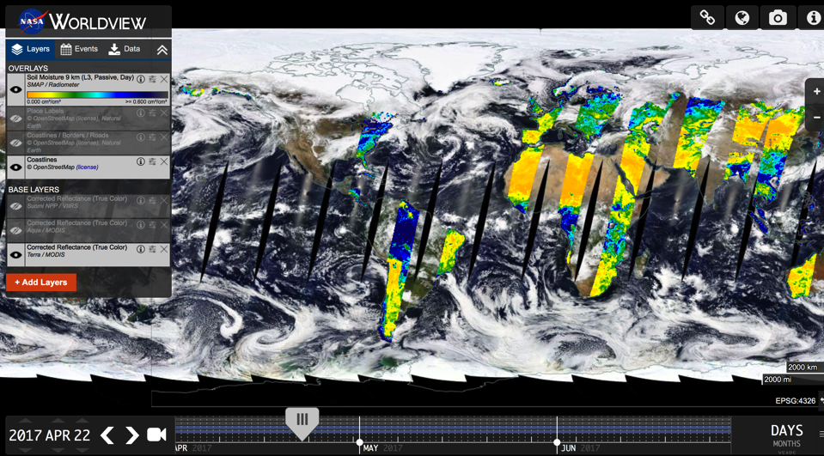
SMAP Soil Moisture in NASA WorldView
https://earthdata.nasa.gov/labs/worldview/

Slide 43
SMAP Soil Moisture in NASA WorldView
How To:
Open https://earthdata.nasa.gov/labs/worldview/
Click on the red “+Add Layers” box on left
Scroll down and click on ”Soil Moisture”
Click on “SMAP/Radiometer” and check the box marked “Soil Moisture 9 km (L3, Passive, Day | Day)
Close the “+Add Layers” box.
Now, choose a day from the bar on the bottom of the page and it will show you where SMAP data was taken for that day.
You will have to estimate the soil moisture, based on the color over your area, using the color bar.
If you want to look at the actual raw data, it can be obtained from the National Snow and Ice Data Center at the following URL: https://nsidc.org/data/SPL3SMP/versions/3. Please not that this is the raw data and will be difficult to use.

Slide 44

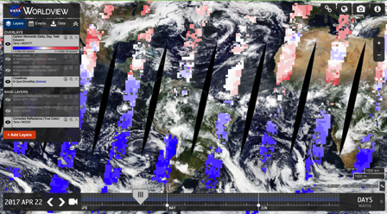
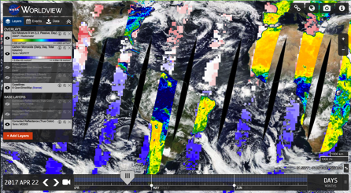
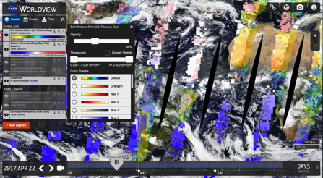
Combining Data Overlays for Data Comparisons
SMAP Soil Moisture
Carbon Monoxide
Combined SMAP Soil Moisture and Carbon Monoxide
Visual Opacity Change in SMAP Soil Moisture

Slide 45
Questions

Slide 46
Interactive QuickStart Guide
Go to the online interactive version of the QuickStart Guide has additional topic information, links and resources and link to send feedback.
http://k12datapaths.strategies.org/
Send us your feedback and suggestions!
http://bit.ly/k12datapaths
Notes:
Bit.ly link instead?

Slide 47
Rooftop green spaces
Link to video
Notes:
NPR video on green roof-top gardens

