Slide 1
Celebrating 20th anniversary of GLOBE Program in Poland
Towards new strategy for GLOBE implementation
Ela Wołoszyńska-Wiśniewska
GLOBE Country Coordinator for Poland
UNEP/GRID-Warsaw Centre
ela@gridw.pl

Slide 2
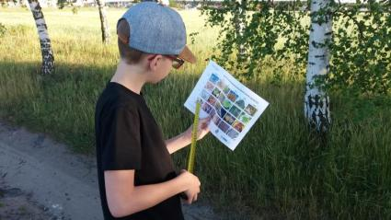
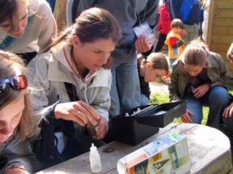
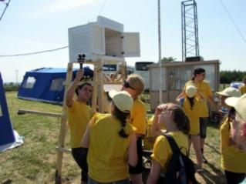
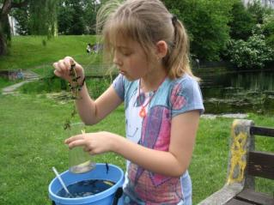
GLOBE Program in Poland in a nutshell
180 schools;
222 trained teachers;
over 4000 students each year;
948 honor rolls,
almost 3,3 mln records in the database,
implemented by UNEP/GRID-Warsaw Centre
Photo credits: UNEP/GRID-Warsaw

Slide 3
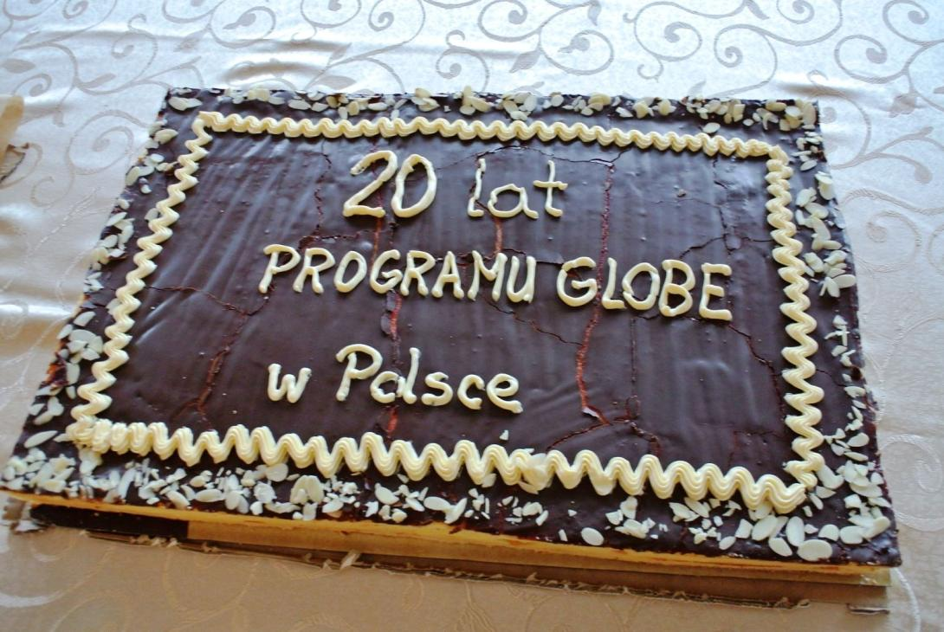
1997-2017
20th anniversary of GLOBE Program in Poland
Photo credits: Bara Semerakova

Slide 4
GLOBE in Poland 1997-2017
trainings for GLOBE beginners and advanced users;
meetings for GLOBE teachers and principals;
Student’s Science Seminars GLOBE Games;
active participation in GLOBE campaigns;
implementation of interdisciplinary projects on national level;
support for national and international school collaboration;
active participation in GLOBE at European and international level

Slide 5
GLOBE in Poland 1997-2017
trainings for GLOBE beginners and advanced users;
meetings for GLOBE teachers and principals;
Student’s Science Seminars GLOBE Games;
active participation in GLOBE campaigns;
implementation of interdisciplinary projects on national level;
support for national and international school collaboration;
active participation in GLOBE at European and international level

Slide 6
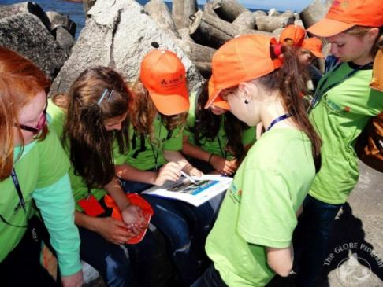
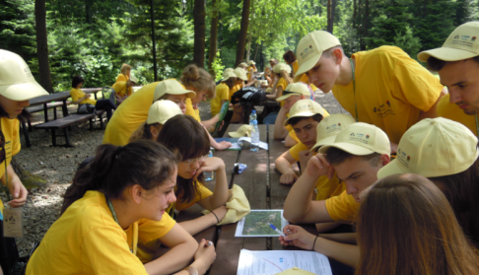
Student’s Science Seminar GLOBE Games
3-day event,
addressed to the most active GLOBE students and supporting teachers,
organized in some most beautiful locations in our country,
in collaboration with scientists, nature protection authorities, local governments and media,
Photo credits: UNEP/GRID-Warsaw

Slide 7
Student’s Science Seminar GLOBE Games
3-day event,
addressed to the most active GLOBE students and supporting teachers,
organized in some most beautiful locations in our country,
in collaboration with scientists, nature protection authorities, local governments and media,
AWARD for students
Photo credits: UNEP/GRID-Warsaw

Slide 8
What is included in the agenda?
field game „Science around us” as the main part of the events – COMPETITION!
specially designed educational routes,
research stations – investigation of local environment, culture and history;
accomplished task awarded with points.
Photo credits: UNEP/GRID-Warsaw

Slide 9
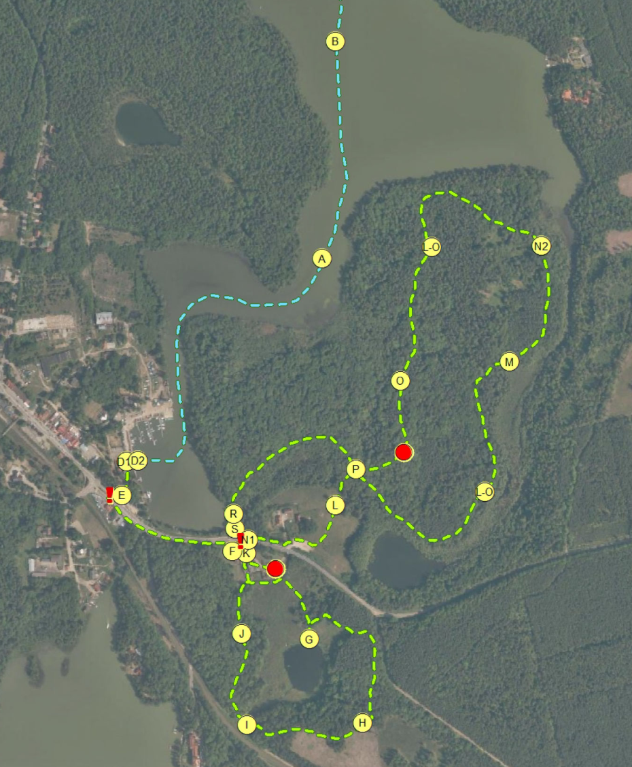
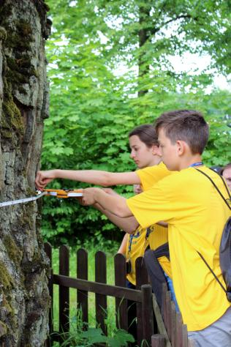
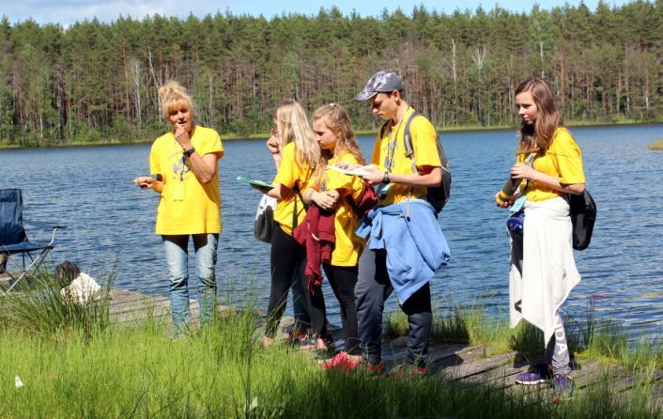

Slide 10
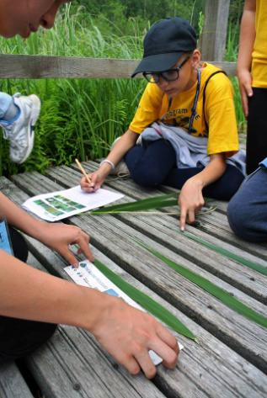
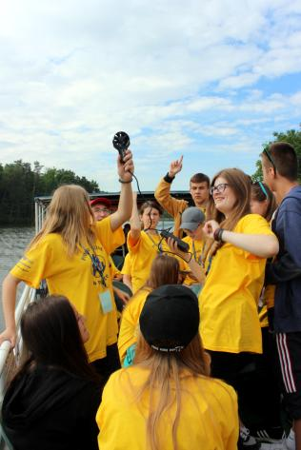
Photo credits: UNEP/GRID-Warsaw / Bara Semerakova

Slide 11
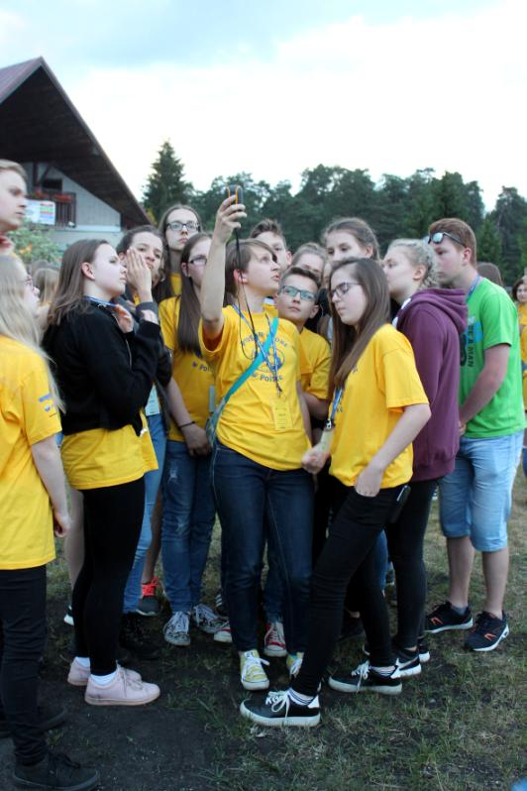
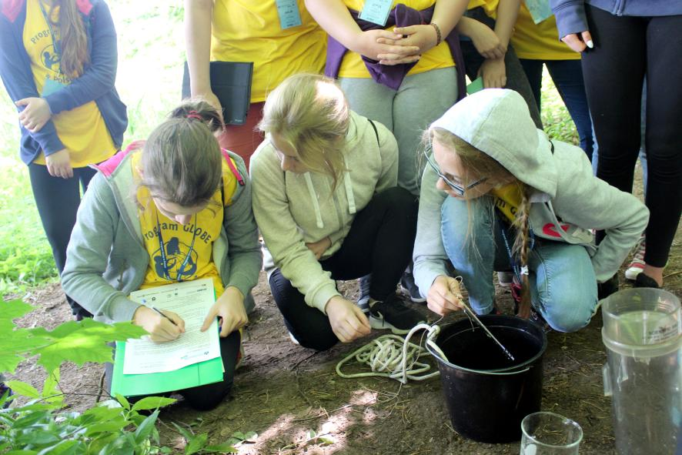
Photo credits: UNEP/GRID-Warsaw / Bara Semerakova

Slide 12
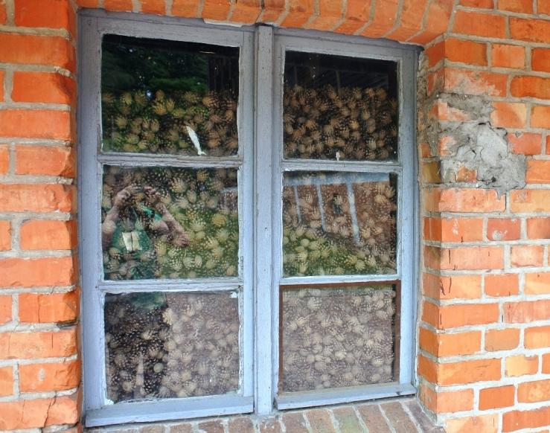
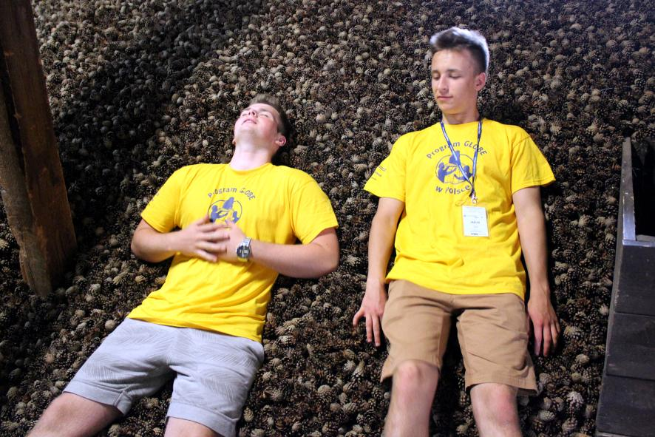
Photo credits: Bara Semerakova

Slide 13
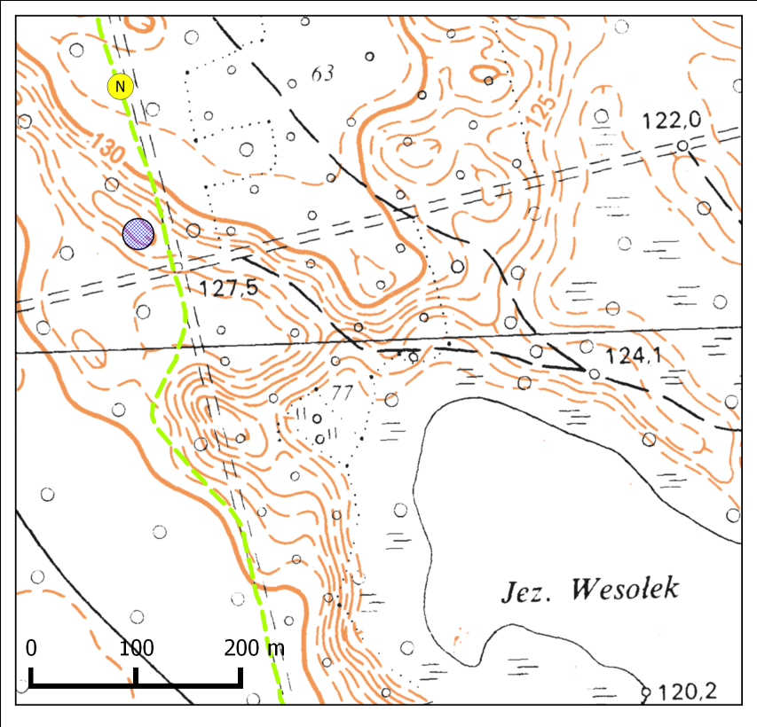
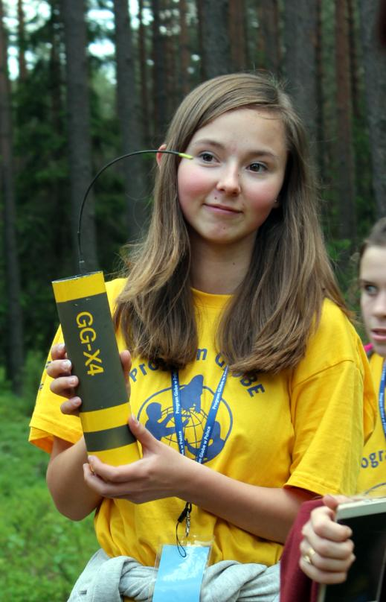
Photo credits: UNEP/GRID-Warsaw

Slide 14
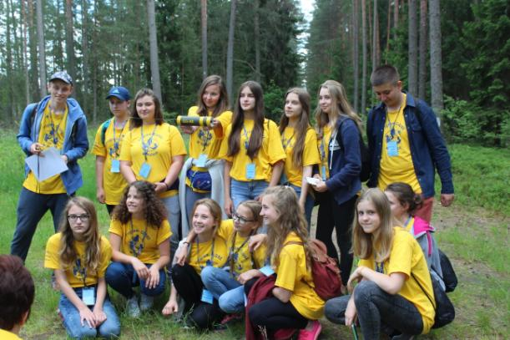
Photo credits: UNEP/GRID-Warsaw / Bara Semerakova

Slide 15
What is included in the agenda?
field game „Science around us” as the main part of the events – COMPETITION!
meetings with scientists/STEM experts;

Slide 16
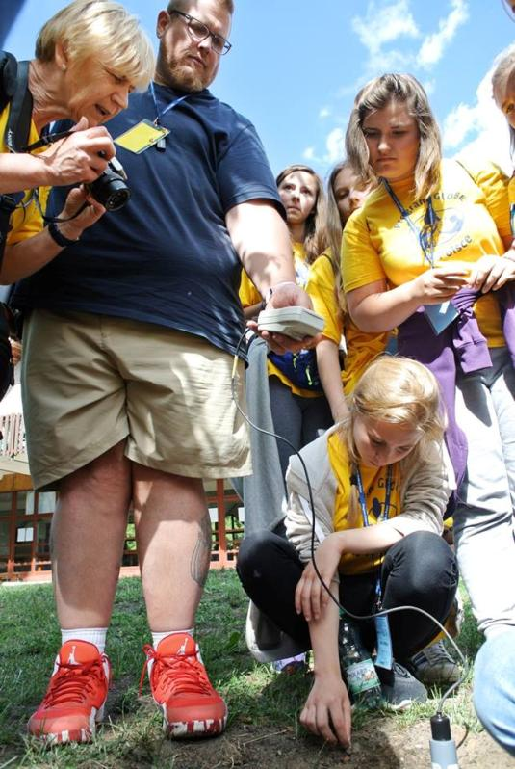
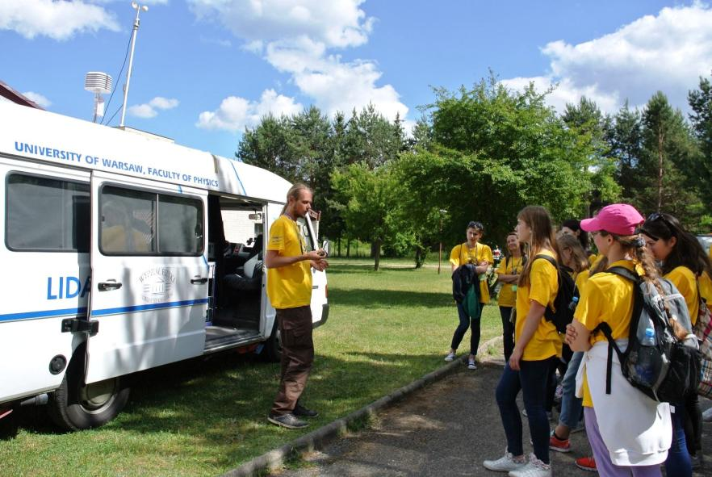
Photo credits: Bara Semerakova

Slide 17
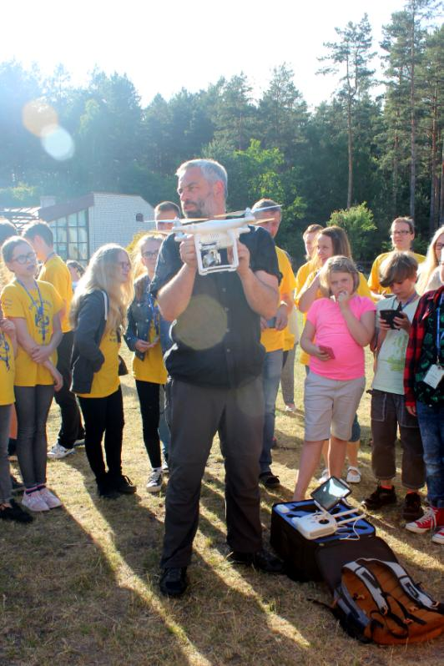
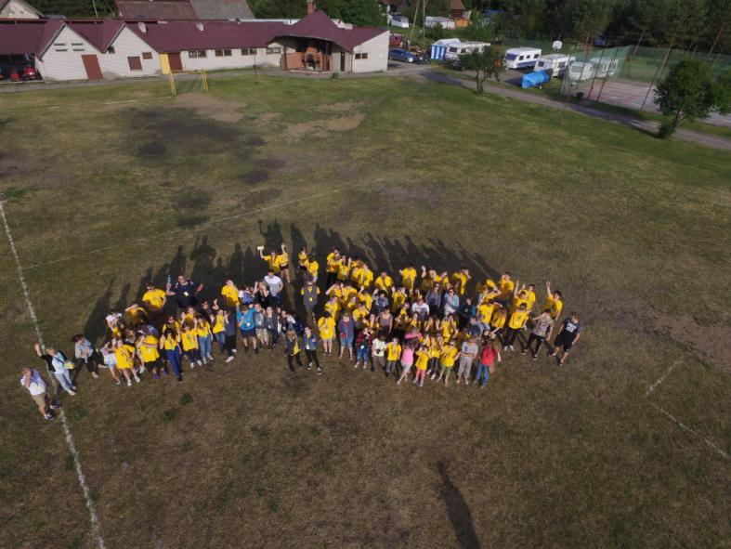
Photo credits: UNEP/GRID-Warsaw

Slide 18
What is included in the agenda?
field game „Science around us” as the main part of the events – COMPETITION!
meetings with scientists/STEM experts;
student’s mini-conference;
closing ceremony organized in cooperation with local governments and community – AWARDS!

Slide 19
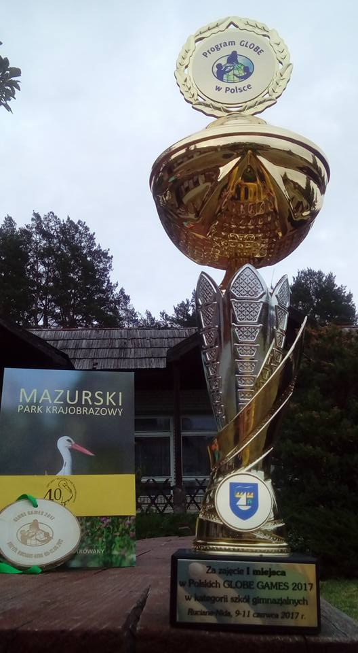
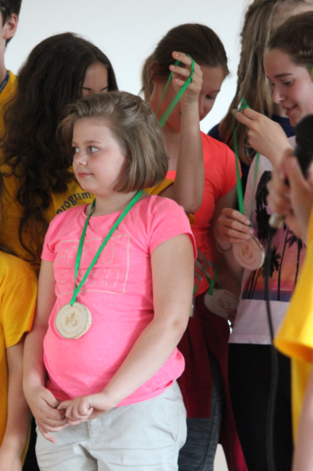
Photo credits: UNEP/GRID-Warsaw

Slide 20
What is included in the agenda?
field game „Science around us” as the main part of the events – COMPETITION!
meetings with scientists/STEM experts;
student’s mini-conference;
closing ceremony organized in cooperation with local governments and community – AWARDS!
fieldtrips

Slide 21
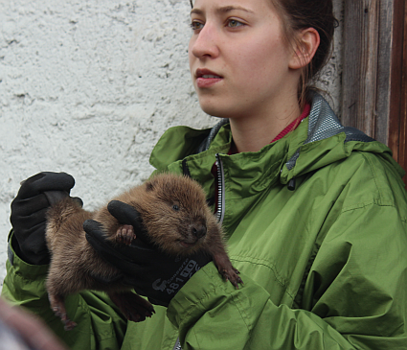
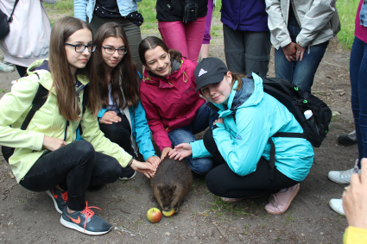
Photo credits: UNEP/GRID-Warsaw

Slide 22
GLOBE Games 2017
9-12th of June (4-day event),
over 120 students and teachers,
field game „Climate, Water, Forest – Science around us”:
15 km of educational routes – on land and on water,
almost 40 research stations,
15 hours spent in the field,
ca. 30 scientists, experts and volunteers involved.

Slide 23
Why GLOBE Games are so special?
Meeting creates great opportunities for:
fostering students investigation and personal skills;
integration of the GLOBE young scientists community;
shaping environmental awareness of the members of local communities and representatives of local governments;
promotion of the newest scientific and technological achievements.
Photo credits: UNEP/GRID-Warsaw

Slide 24






Long list of success stories…
ideas
people
resources
Icon credits: flaticon.com

Slide 25
Long list of success stories…
and a little bit shorter list of challenges since 2014
ideas
people
resources
Icon credits: flaticon.com

Slide 26
How to cope with the challenge?
Let’s offer GLOBE
to business sector (companies)
to get money

Slide 27
How to cope with the challenge?
Let’s offer GLOBE
to business sector (companies)
to get money

Slide 28
How to cope with the challenge?
Let’s do GLOBE
with business sector (companies)
to get money and non-financial support as well as
real engagement

Slide 29
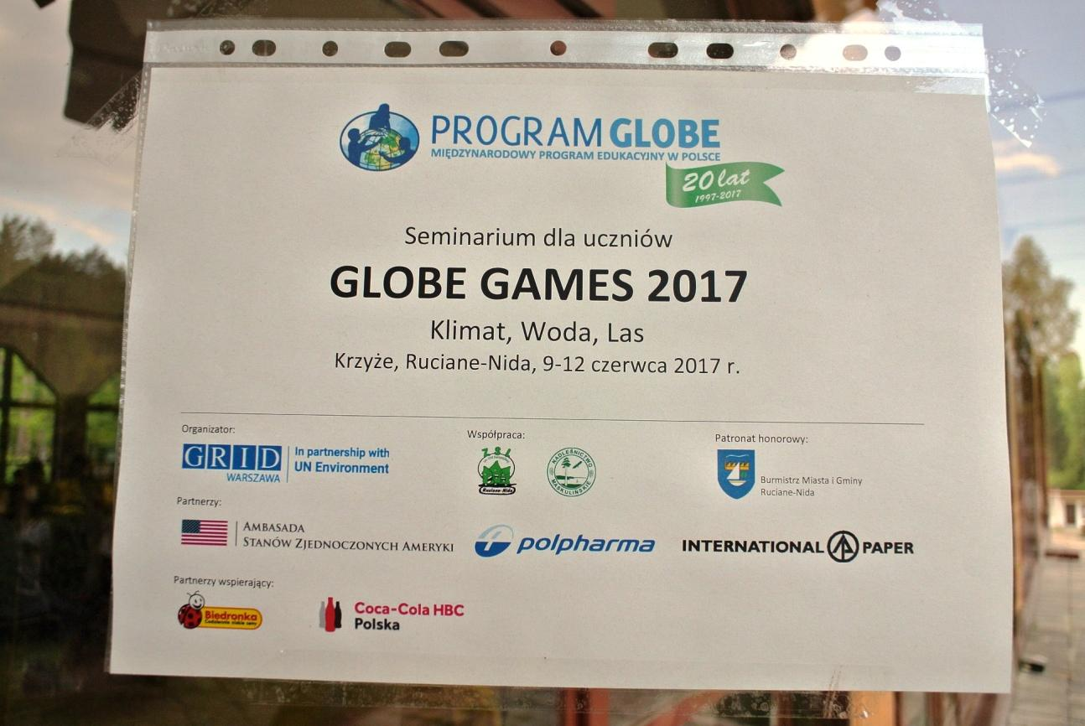
Photo credits: Bara Semerakova

Slide 30
How to encourage companies to support GLOBE?
Their target group should become yours…
GLOBE Games award for the most active GLOBE students + opportunity for NEW SCHOOLS to get to know GLOBE better
New teachers attracted to GLOBE become your ambassadors in communication with the company.

Slide 31

How to encourage companies to support GLOBE?
You should try to look the same direction and speak the same language…

Slide 32
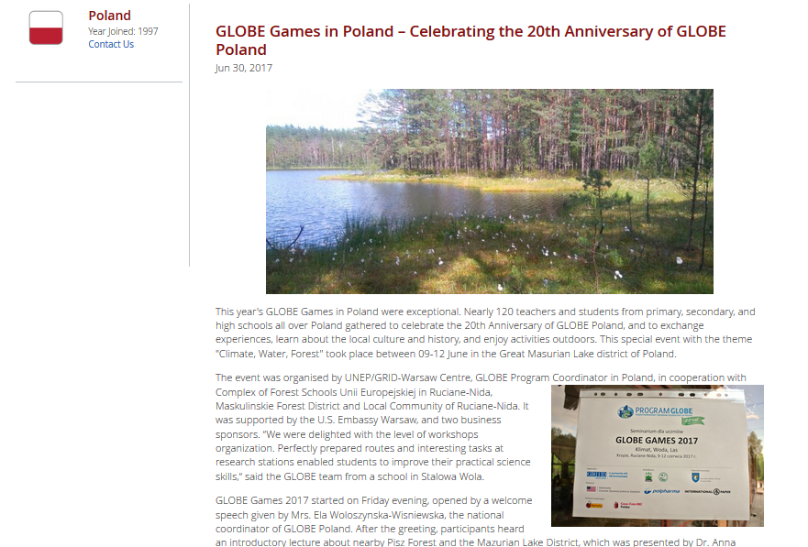
www.globe.gov/web/poland/news

Slide 33
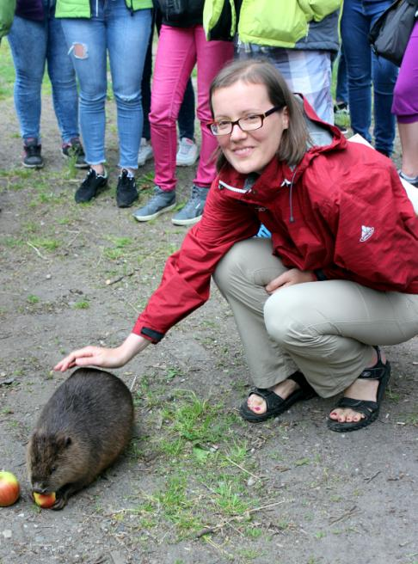
Ela Wołoszyńska-Wiśniewska
GLOBE CC in Poland
ela@gridw.pl

