Slide 1
How to use DAVIS weather station’s data with Pivot Table in excel ?

Slide 2
First step: "an overview of number of data collected"
Just for the first day:
There are 96 values per day and for one month?
2976 values for one month ... and for one year?
More than 31000 ...

Slide 3
Here we will use the functionality of excel to calculate in two times: The minimum daily temperature with a first pivot table The average of the minimum monthly temperatures with a second pivot table. NOTE: These two operations must be separated because excel returns a "false" calculation if both are performed simultaneously because of "priority of functions and calculations on the data set". Here is what we want (table 1): first extract the minimum daily temperature THEN do the monthly average of the minimum temperatures. Excel calculates the average on the set of values and not on the minimum value, so 2 steps are necessary.
Tableau 1 | Jour 1 | Jour 2 | Jour 3
Température à 8 h | 2 | 5 | 5
Température à 9 h | 4 | 9 | 2
Température à 10 h | 6 | 10 | 8
Température minimale du jour | 2 | 5 | 2
Moyenne des minimales |  | 3
Tableau 2 | Jour 1 | Jour 2 | Jour 3
Température à 8 h | 2 | 5 | 5
Température à 9 h | 4 | 9 | 2
Température à 10 h | 6 | 10 | 8
Température minimale du jour | 2 | 5 | 2
Moyenne des minimales |  | 5,666

Slide 4
How to use the large amount of data ? With excel it's not so complicated with a ...
pivot table
Steps : Paste at least the columns date, time and a parameter for example the minimum temperature 1. Check format date : 01/01/2016 Check format time: 15:30 Check format number. (dot here, coma in FRANCE) 2. Insert PivotTable and make the selection by default (in another sheet) or
3. choose to place your table in the same sheet by checking "Existing Worksheet" and then clicking in a cell. 4. In the PivotTable field list: check date, time (note: date and time are automatically entered in the line label) 5. Drag and drop for example temperature in the box sum of values 6. Then, in the "sum of values" box, click on "number of temperatures" and click on "value field parameter" 7. In the Value Field Settings window: choose for example min and validate 8. Right click in the label of lines then choose "Group" 9. then choose "day" uncheck all the rest and validate 10. In the PivotTable fields list clear time 11. Select the two columns WITHOUT THE LEGEND and copy them into a new sheet or on the same sheet with a special paste "only the numerical values", add the labels (date-T min here) ATTENTION if the software modifies the date format (01-Jan for example it MUST absolutely submit the format 01/01/2016! 12. Select both columns then Insert - PivotTable - validate the default selection - check "Date" in the PivotTable field list. And drag "T min" into the sum of values ​​box 13. Then, in the "sum of values" box, scroll down the menu "number of T min" and
14. in the line Parameters of the value fields: choose "average" and validate 15. Select average temperatures and reduce decimals to one!

Slide 5
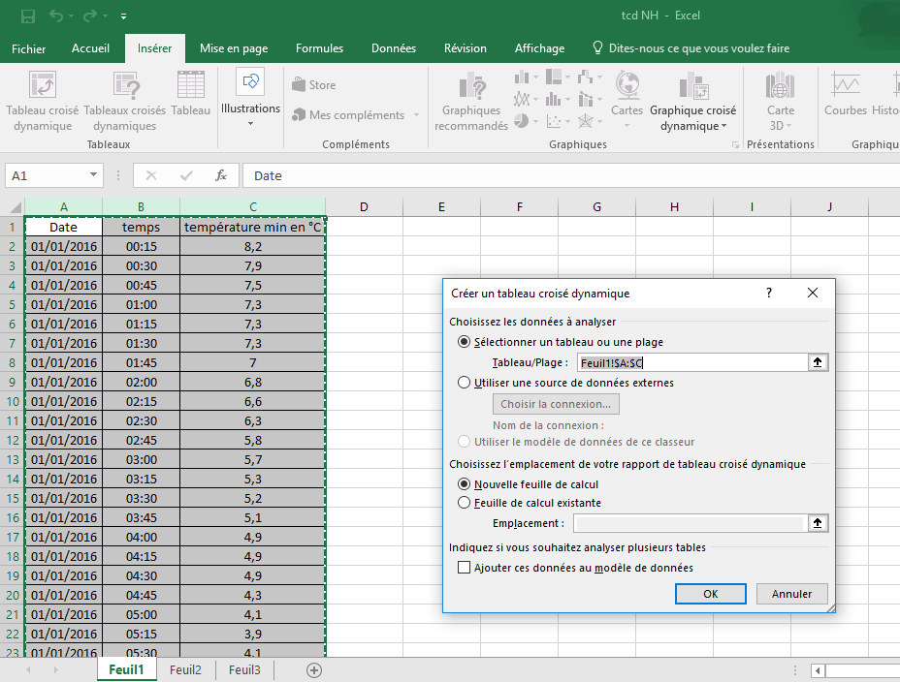
Some pictures to explain…
step 2
Then click in the cell
step 1
Check format
step 3

Slide 6
Step 4
check
Step 6
Drag and drop
Step 5
Step 7

Slide 7
Step 9
Step 8
Step 10

Slide 8
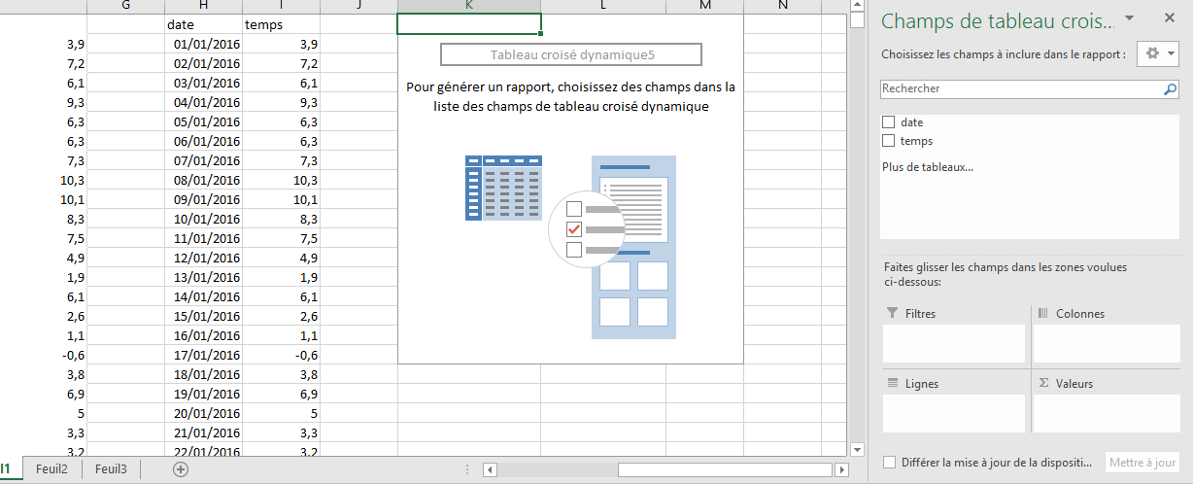
Step 11
check
Step 12
Drag and drop

Slide 9
Step 14
Step 13
Step 15
Final result : in a few clicks more than 30000 data synthesized in 12 values, here, the minimum monthly average temperatures collected with the Palissy high school’s weather station in Agen for the year 2016.

Slide 10
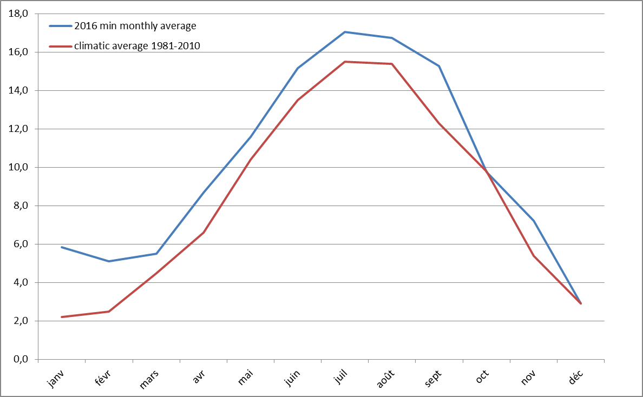
Température en °C
9 months out of 12 were warmer than climatic average ...
only one was below the climatic average

