Slide 1
Implementing GLOBE to Enrich Student Learning
Marcy Burns - Grade 5 Teacher
Main Street Intermediate School
Norwalk, Ohio USA

Slide 2
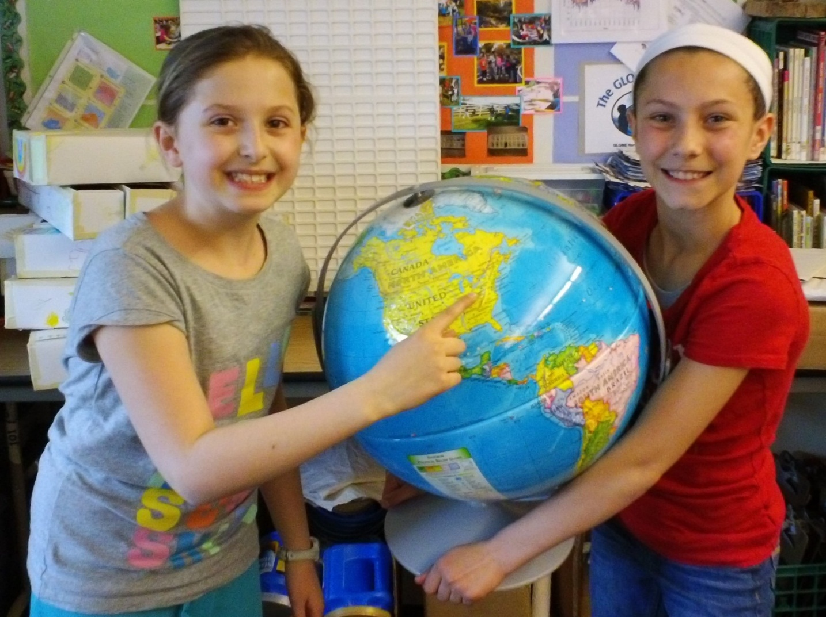
Main Street Intermediate School
Norwalk, Ohio USA
N 41.24375 W- 082.6116
Grades 5 & 6 = 500 Students

Slide 3
I use GLOBE with my students because it is an excellent platform that supports the learning standards for science process skills.
GLOBE has evolved in my 5th grade classroom since 2006.
I started by introducing one protocol to my students until we all got really good at it before adding another.
Field Campaigns and collaboration give purpose to doing the protocols.
I seek out to provide opportunities for students to share what there GLOBE science learning with others.

Slide 4
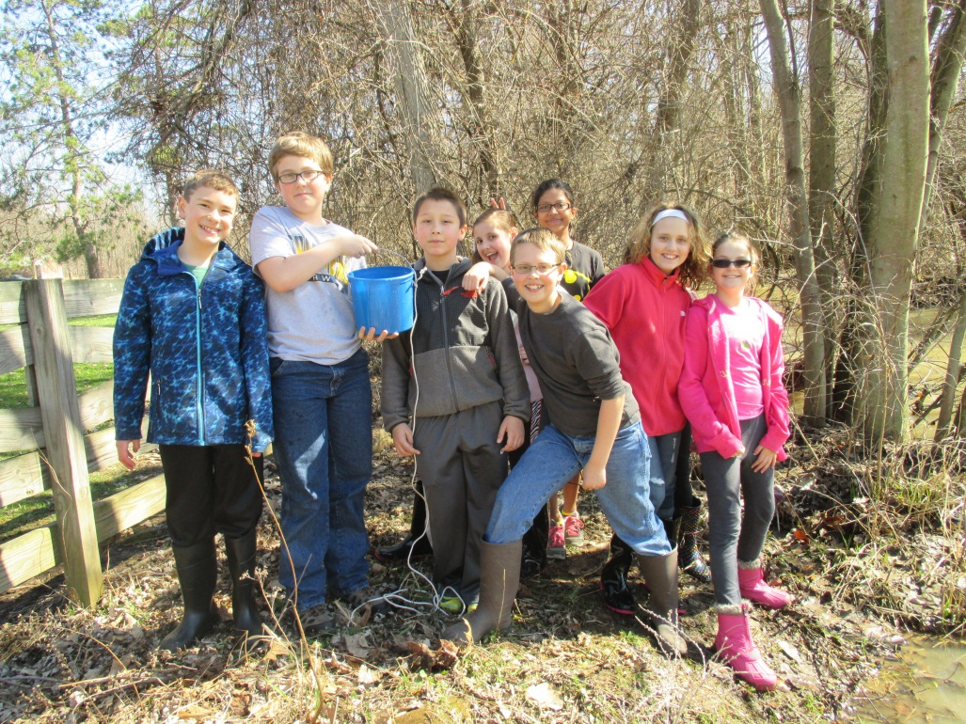
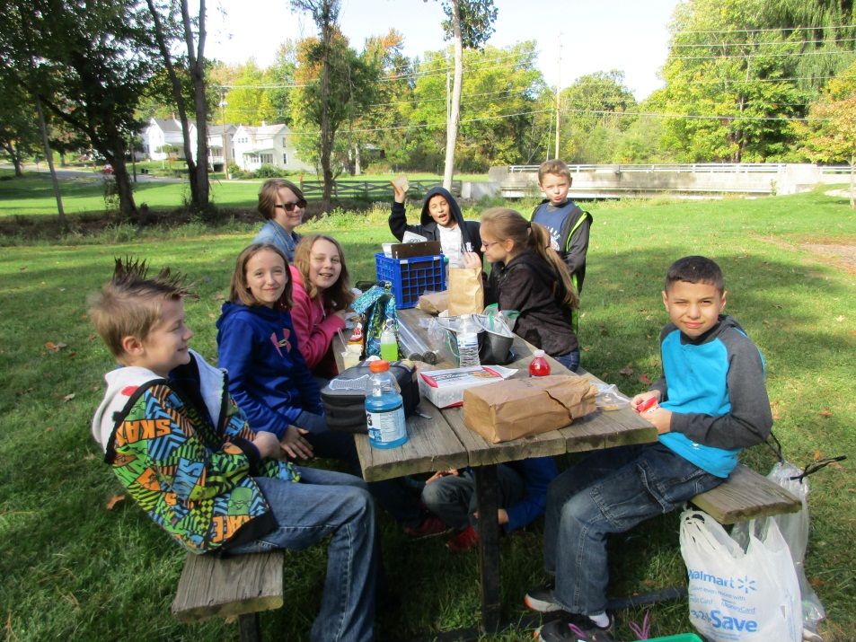
This presentation will share the timeline that I use for introducing and practicing GLOBE protocols and data entry with my students.
***First, you will need a group of enthusiastic students

Slide 5
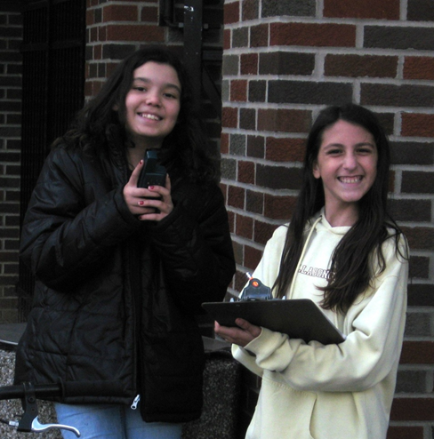
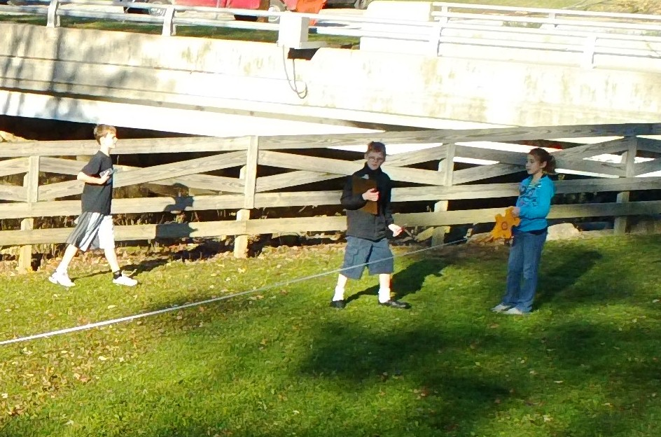
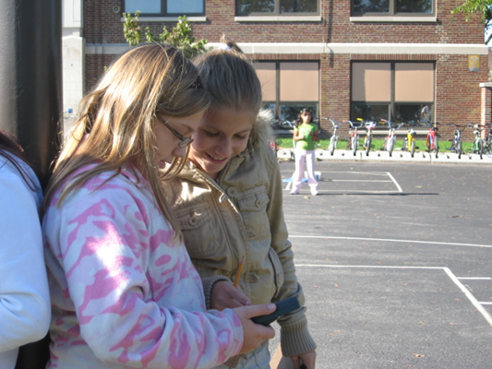
GPS and Site Definition
(Train students within first three weeks of school)
Students learn about GPS, and how to set up a study site.
“Testing” established study site definitions each year gives the new kids a sense of ownership for protocols.

Slide 6
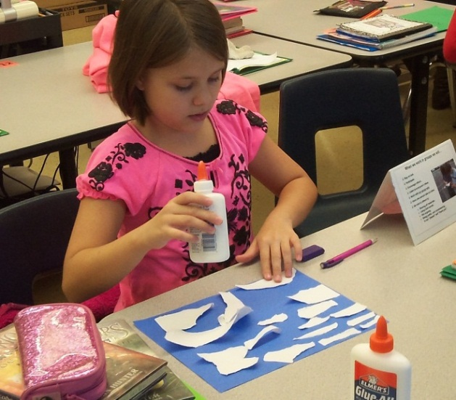
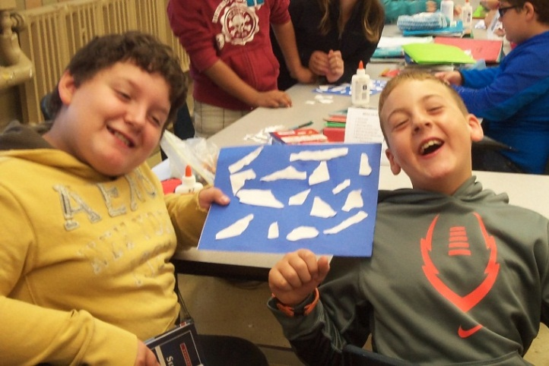
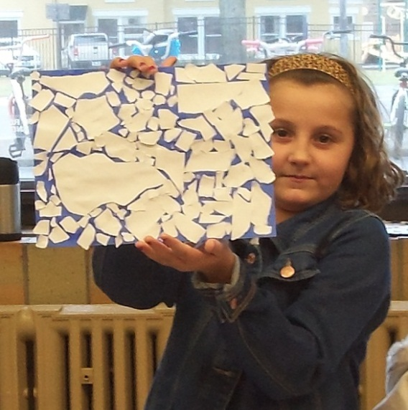
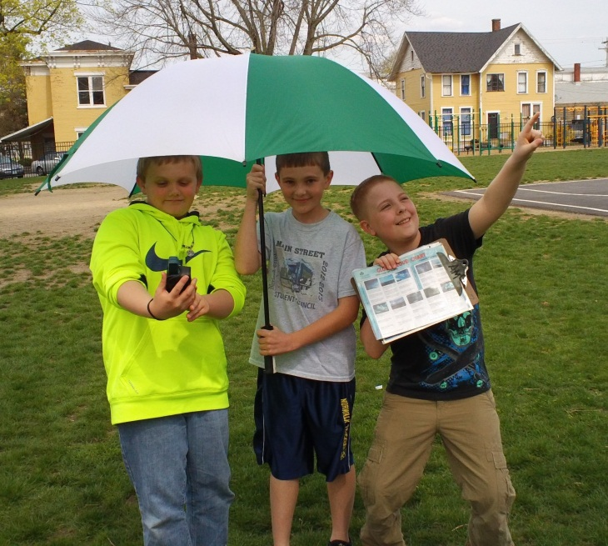
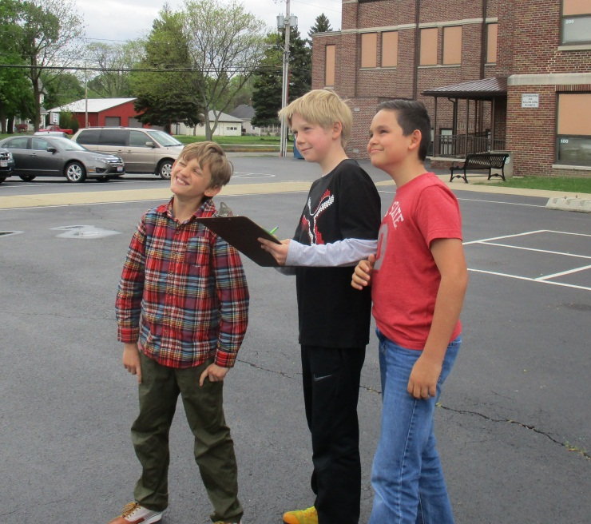
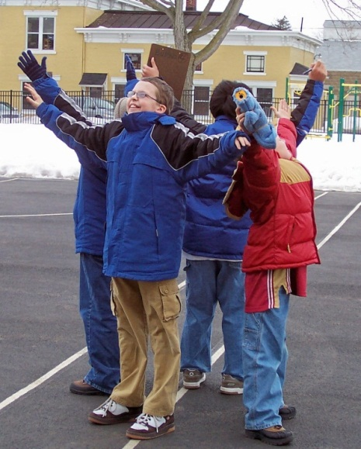
Train students
in September
Practice, practice practice!
Began in

Slide 7
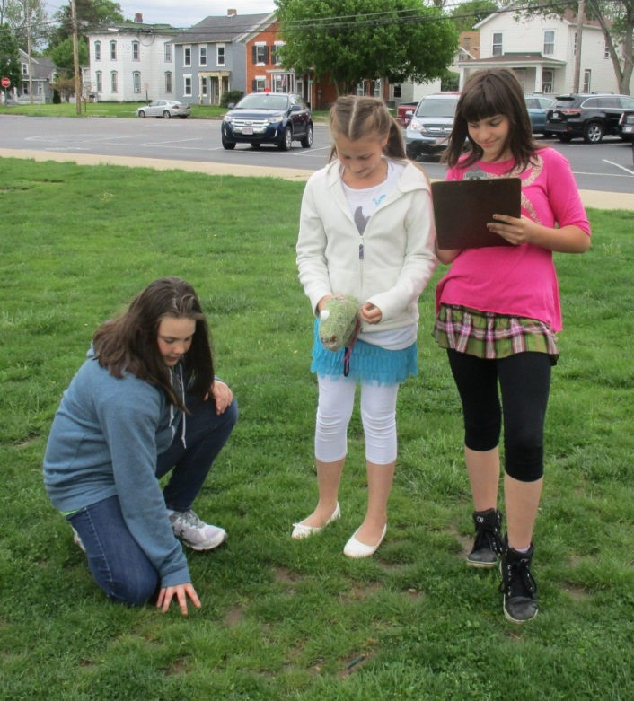
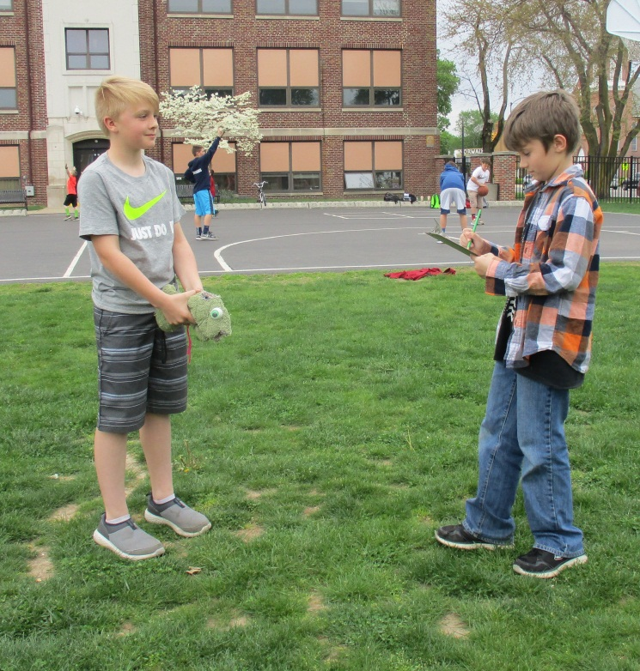
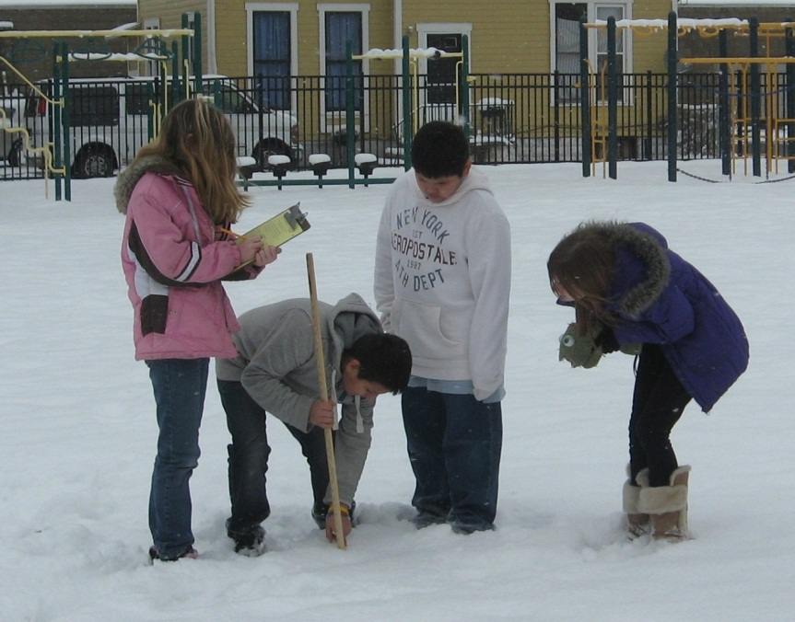
Surface Temperature
(Started in 2006)
Students are divided into crews with an assigned day each week. They come to class with coats, boots, hats, etc. on their day.
Train students in the
beginning of October

Slide 8
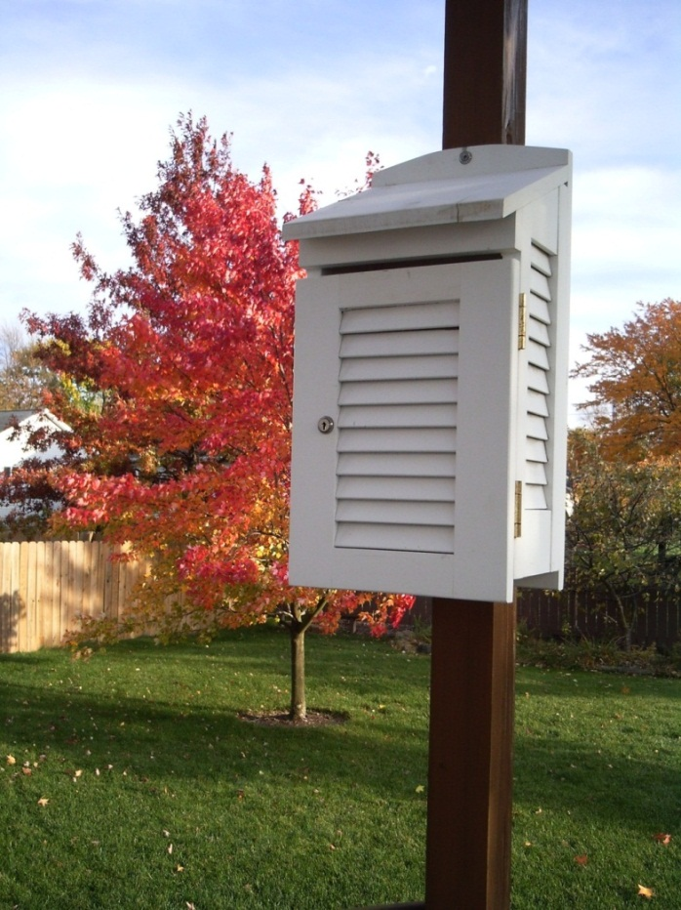
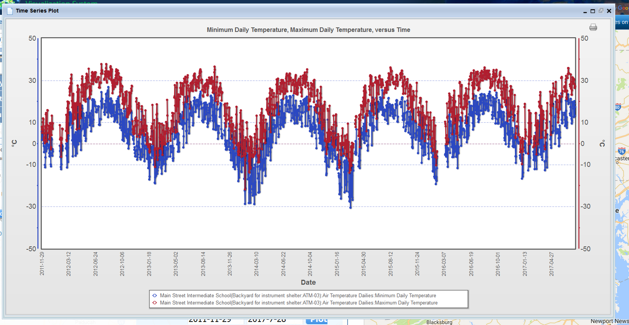
Min./Max. Air Temperature
(Implemented in 2011)
Students look for air temperature patterns in the data they collect.
Vandalism was an initial challenge. The instrument shelter site was moved to my backyard. Students enter the data.

Slide 9
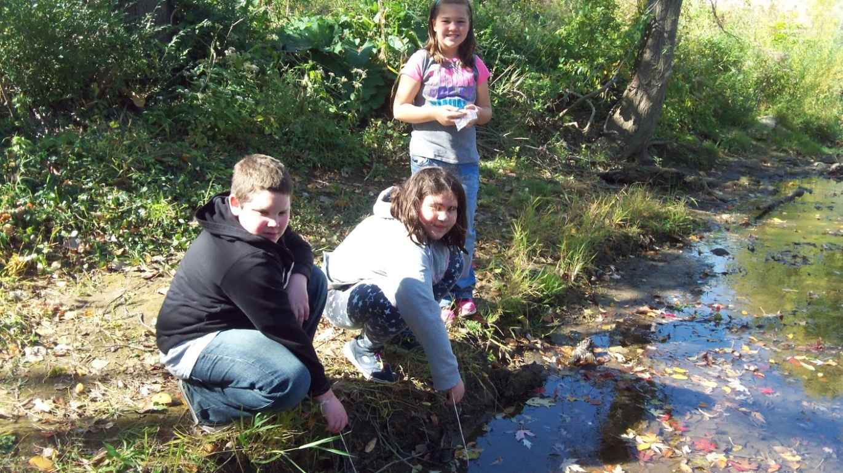
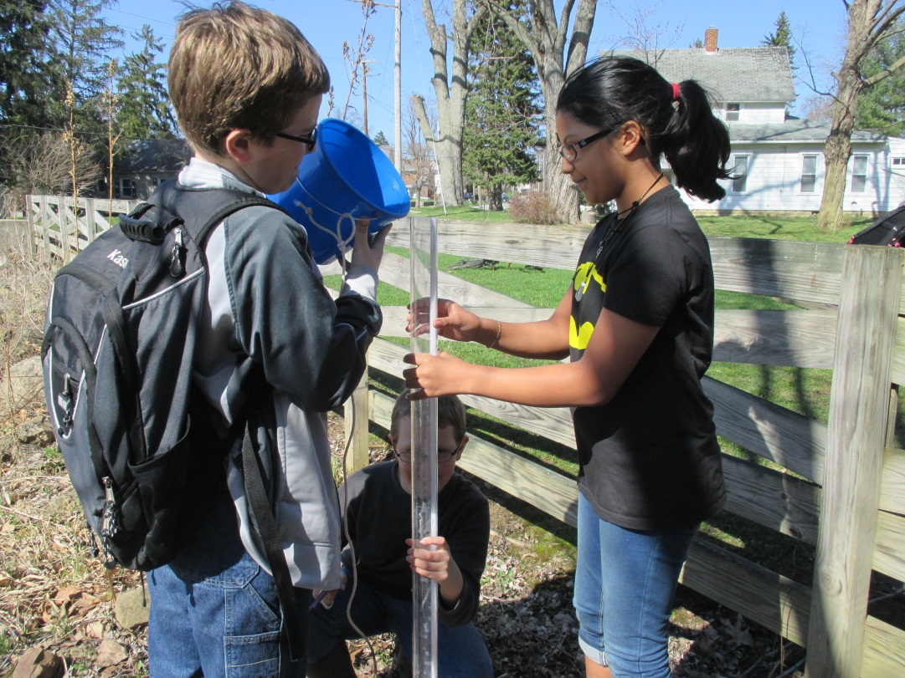
Water quality data and macroinvertebrate samples at two locations along Norwalk Creek
(Started in 2011)
Train students in October and visit the creek for Fall sample.
Spring sample is completed with students after school

Slide 10
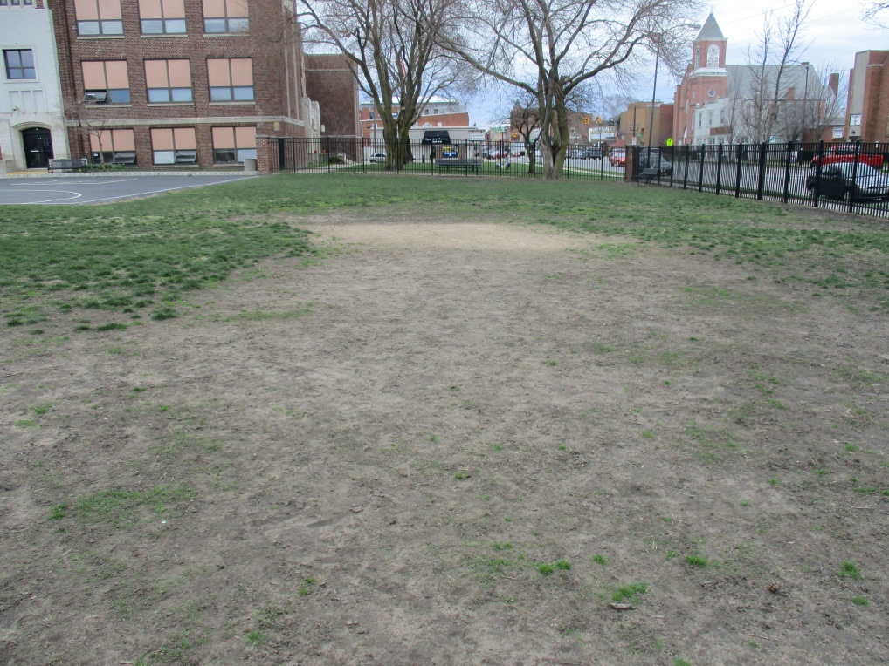
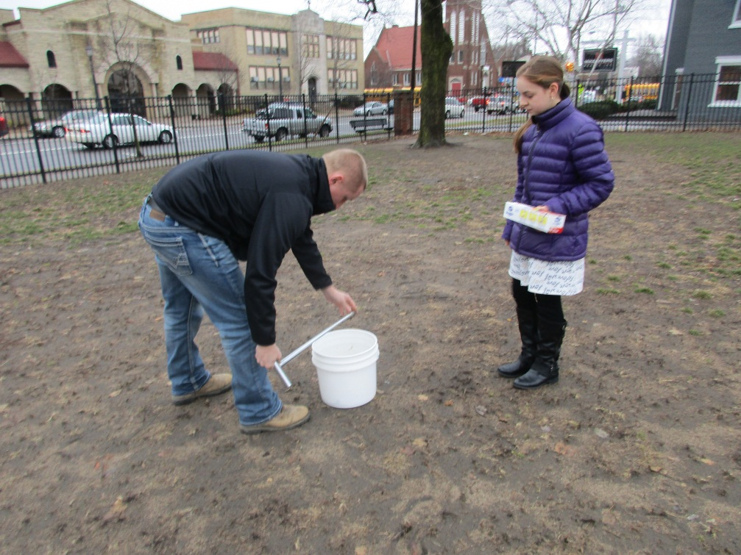
Soil
Began implementing in 2016 as a response to student interest in solving a problem at our school.
Working with a small group of students on a new protocol makes it easier to train a whole class the following year.

Slide 11
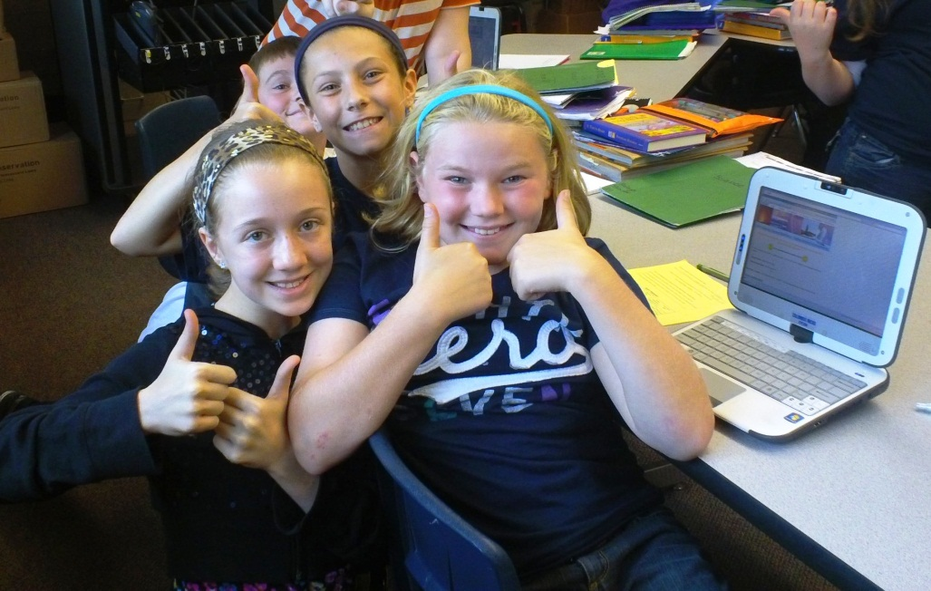
Lots of data is easy to enter into GLOBE!
Train students to enter data into GLOBE in October.
Every two or three weeks the computer cart is reserved and students spend 15 minutes entering accumulated data sheets. Students always work in partners for quality control.
Fact: Special Education students and ELL students collect the most accurate protocol data. They also make the least amount of errors when entering data into GLOBE.

Slide 12
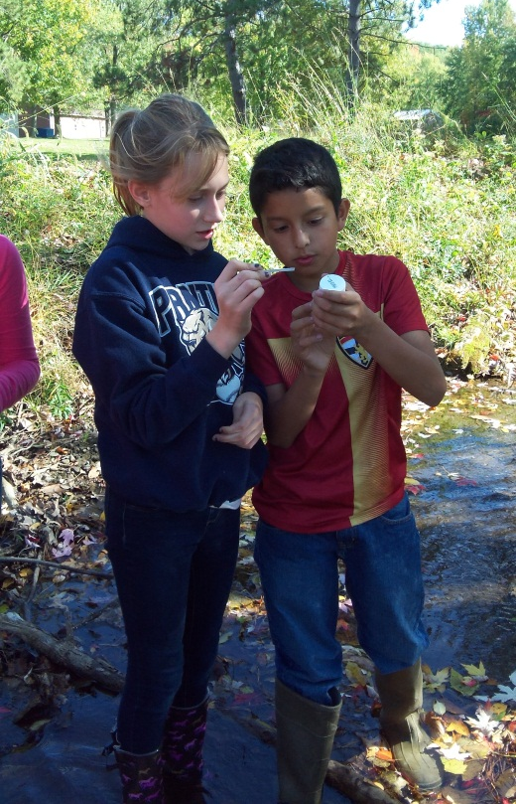
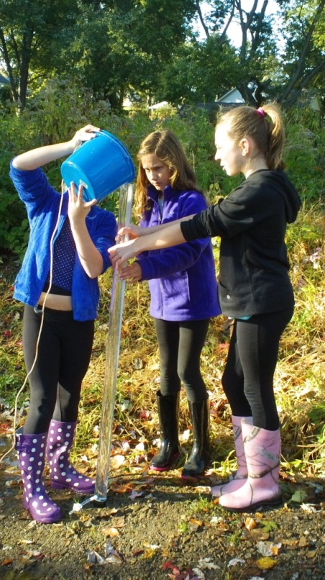
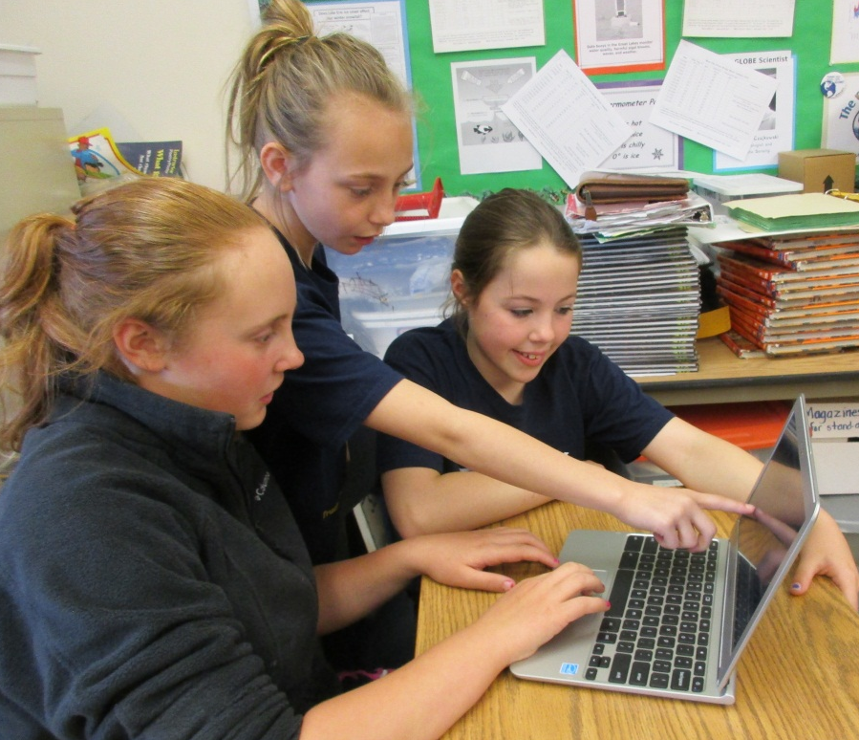
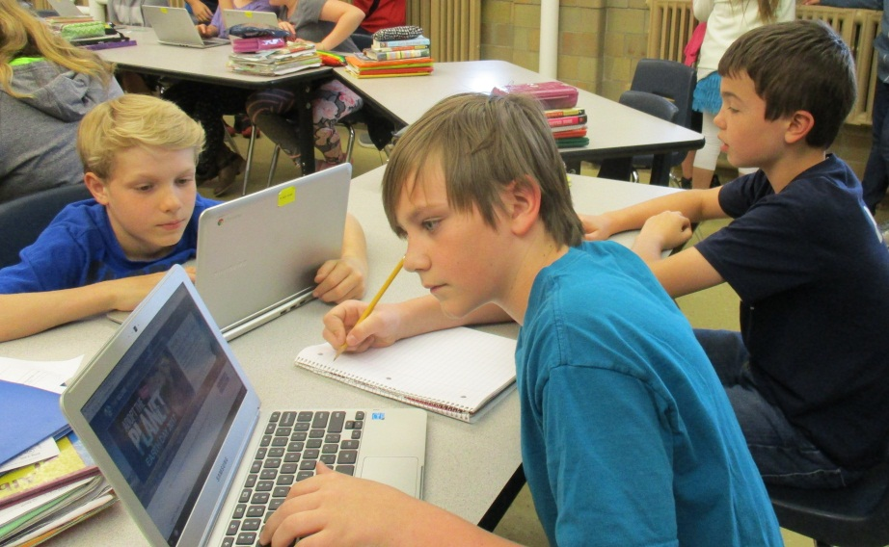
By mid-November the students start thinking about research questions.
Students begin to collaborate with other schools.
Students usually look for help in finding and understanding their data

Slide 13
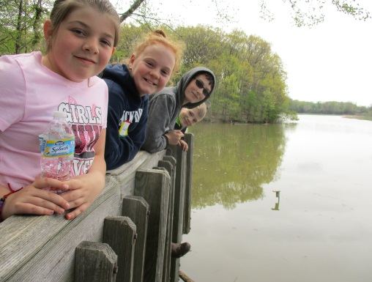
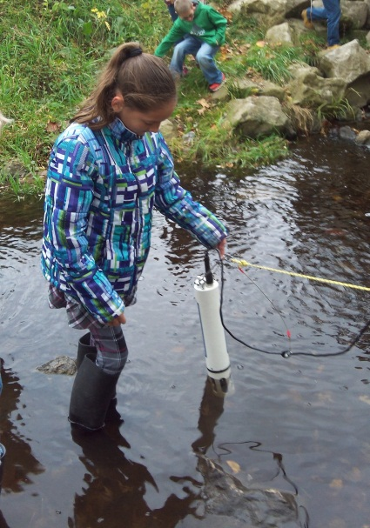
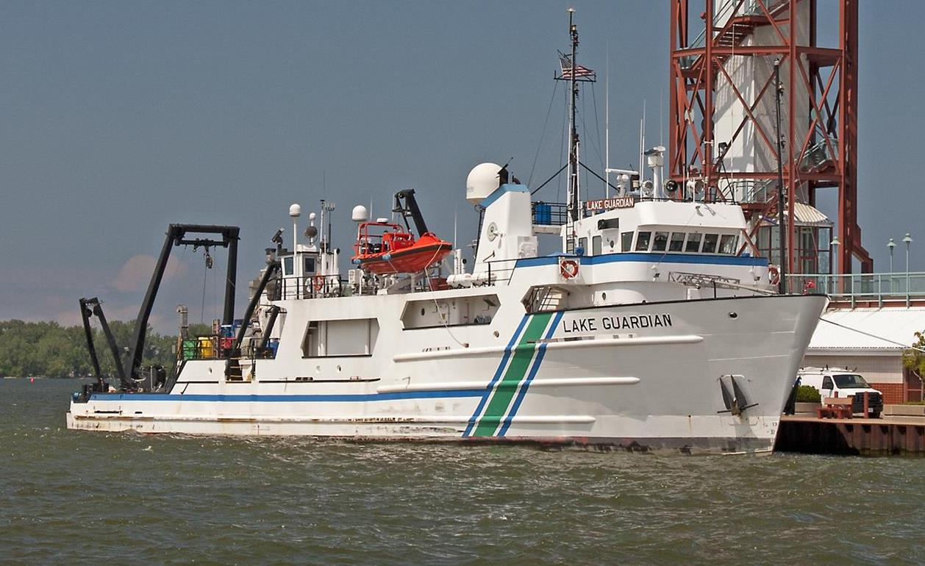
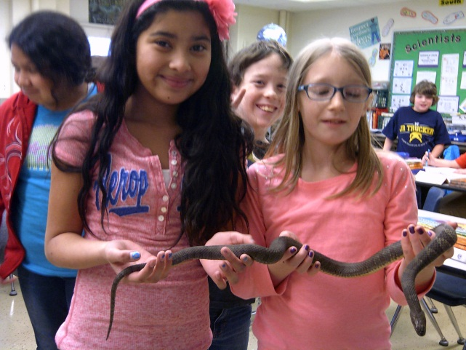
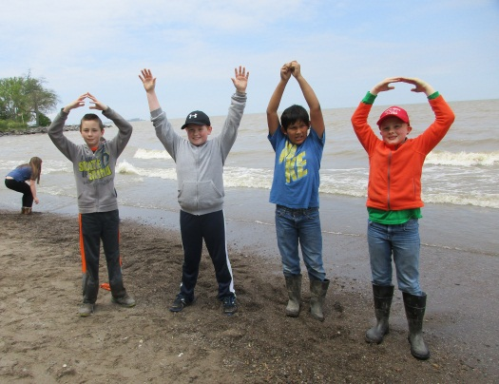
Resources and Mentors Nearby
(With scientists that like to assist students)
Soil and Water Conservation Districts of Huron and Erie Counties staff.
Stone Lab scientists and staff - Ohio State University and Ohio Sea Grant.
Old Woman Creek National Estuary Research Reserve scientists.
US EPA Lake Guardian R/V scientists and crew

Slide 14
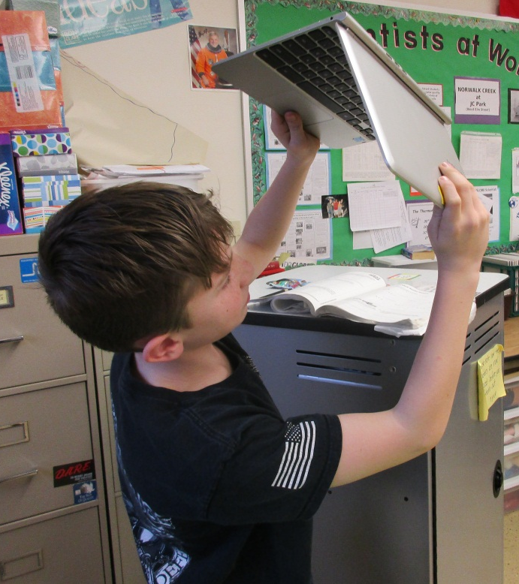
Finding GLOBE Data.
Easy to enter. Tricky to get out.
The biggest challenge for my students is finding comparable data on globe.gov when doing an inquiry project.
NOAA.gov provides comparable consistently reported by national weather service stations for atmosphere data.
Collaborate with another school to compare short term data.

Slide 15
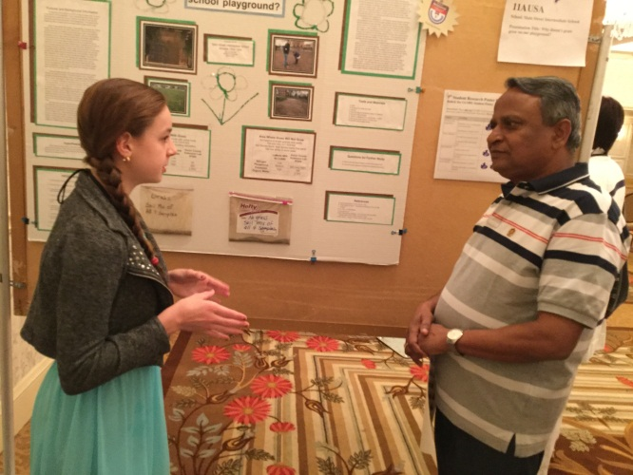
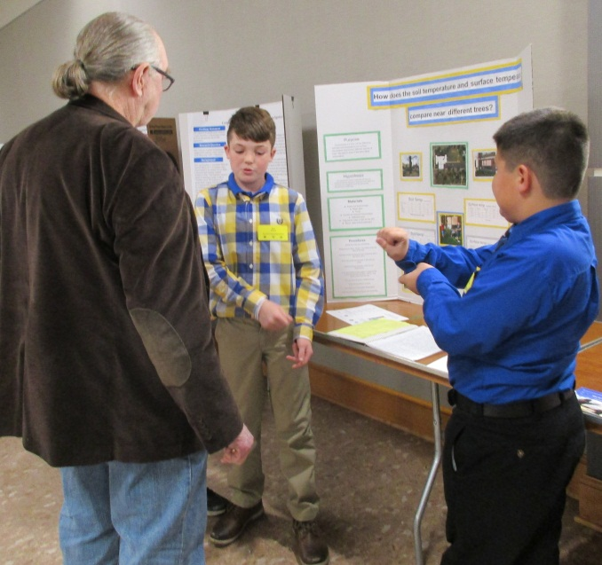
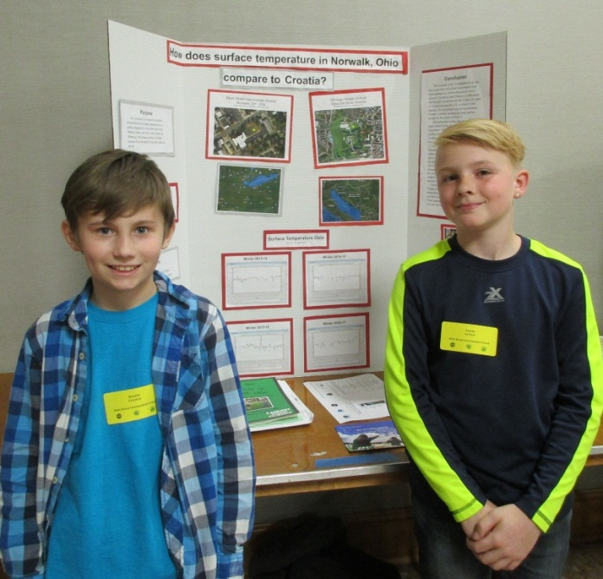
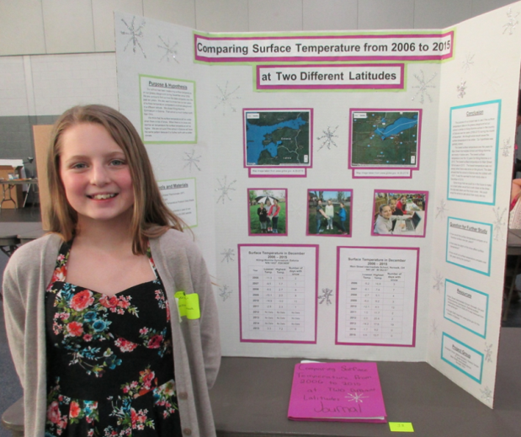
Sharing projects and talking about Science with others is an essential step.
Classmates
Local school open house
Kiwanis, Lions, Rotary Clubs
GLOBE Virtual Conference
Ohio SATELLITES Conference
The GLOBE Program Annual Meetings

Slide 16
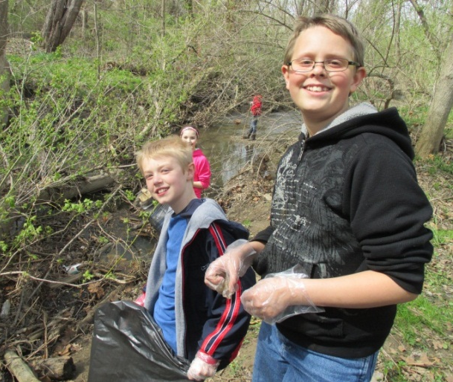
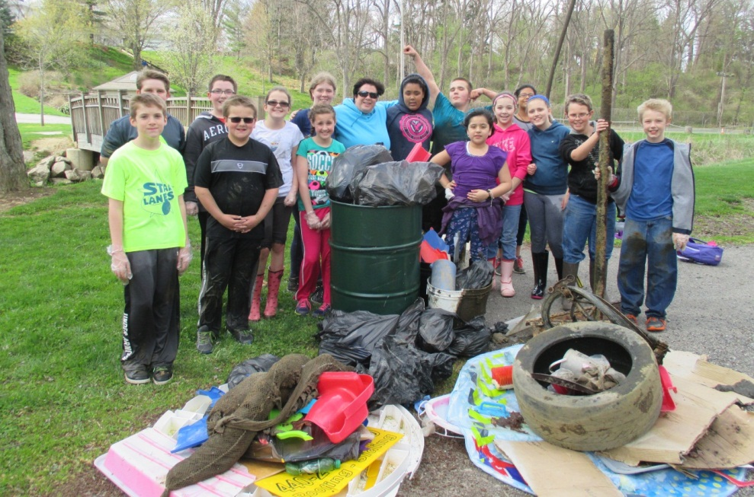
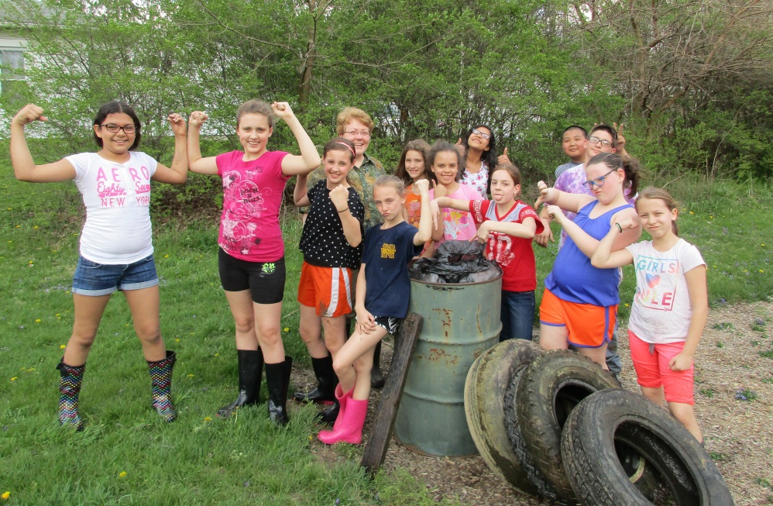
One effect of doing GLOBE protocols—
Students organized
a creek clean-up
on Earth Day,
and has
become an
annual event.

Slide 17
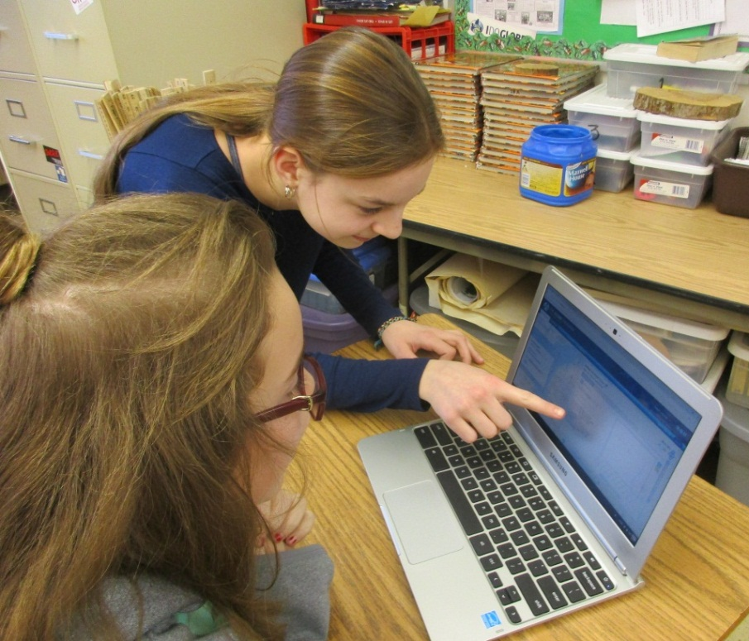
Final Thoughts ………..
-- Teach your students to do one new protocol at a time.
--Participating in field campaigns and using GLOBE data helps students to feel connected to the rest of the world.
--Be Brave!
--My students are always happy to collaborate with your students!
Marcy Burns – grade 5
Main Street Intermediate School
Norwalk, Ohio USA
burnsm@norwalktruckers.net

Slide 18
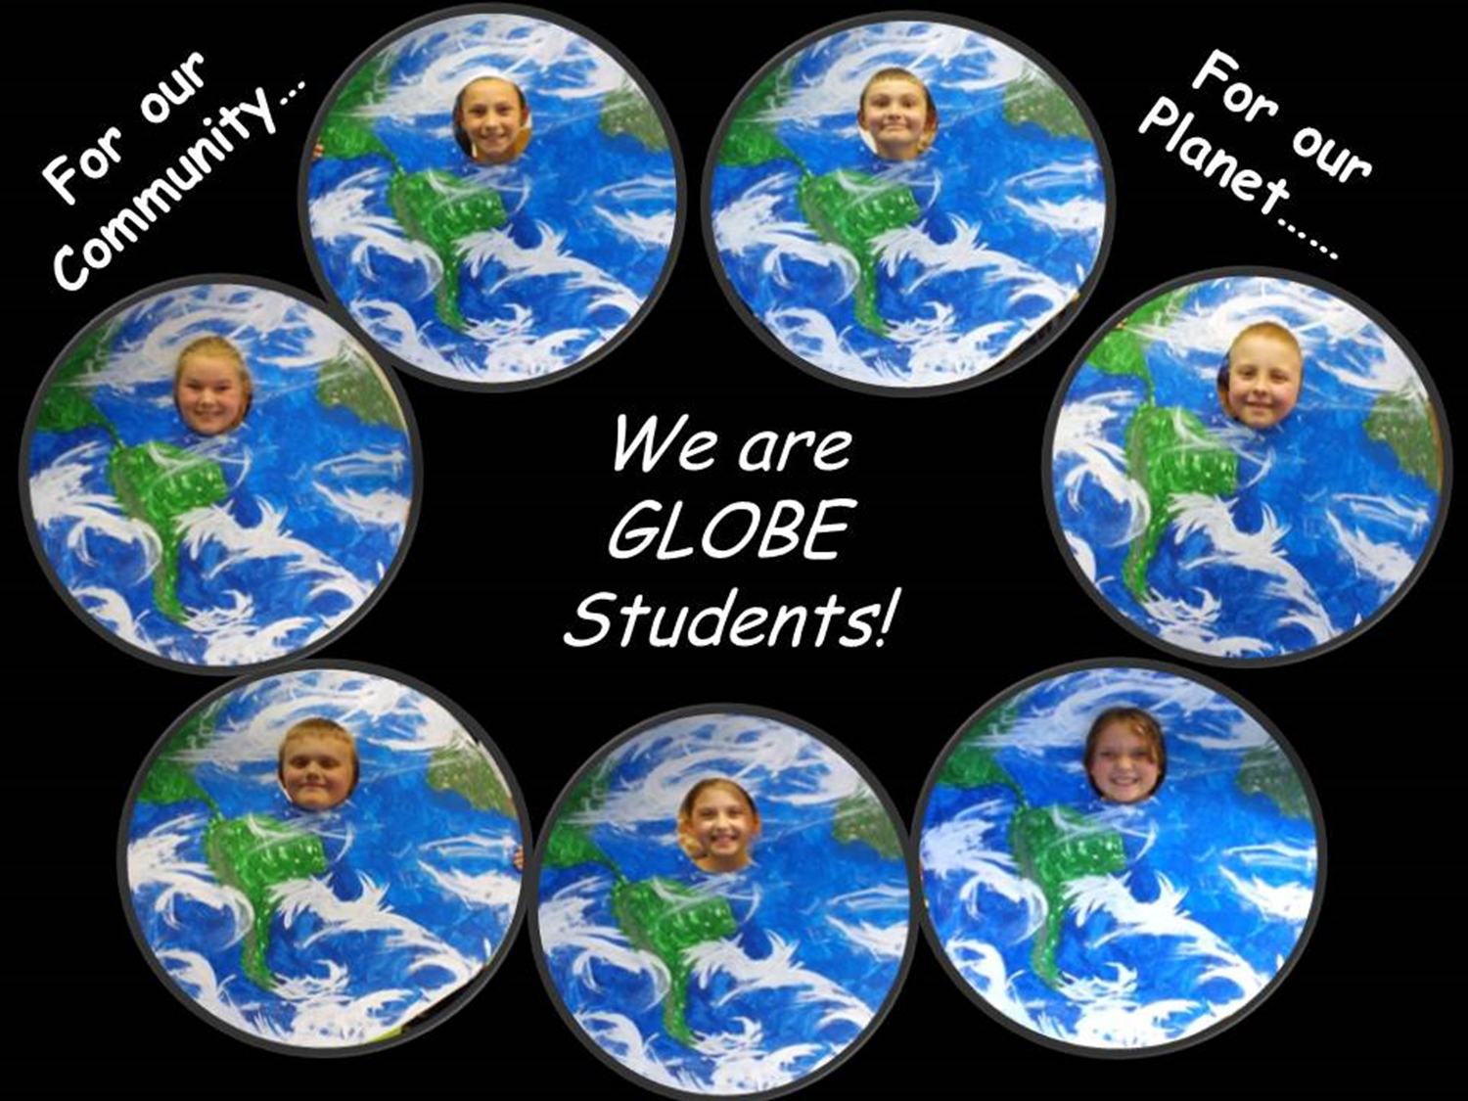
For our Creek...

