Slide 1
Present and Future Collaborations Integration of GLOBE and Eco-Schools in the Czech Republic
Dana Votapkova
Europe and Eurasia Region Coordination Office europe@globe.gov www.globe.gov/web/europe-and-eurasia
GLOBE Annual Meeting, New Haven, Connectitut, 30 July- 03 August 2017

Slide 2
GLOBE and Eco-Schools in the Czech Republic
Czech Republic – TEREZA, Educational center – coordinator for both programs
GLOBE (since 1995)
Eco-Schools (since 2005)
RCO carried out a survey among 27 schools in 2015 – 2016
The findings were summarized into a report and 7 case studies were completed in collaboration with GIO and Eco-schools network
https://www.globe.gov/web/national-wildlife-federation/resources

Slide 3
Management of the Survey
We contacted teachers that are active in GLOBE and participating in Eco-Schools
Veryfying wheather they are doing both programs actively (questionaire, phone calls)
7 schools from 27 were chosen – to set up a diverse sample of schools
Elementary/High schools
small / big schools
located in the town / in the village
Detailed questionnaire form, phone calls, recommendations, photos

Slide 4
Areas of the Survey
Coordination of the program at school
Curriculum and implementation
Human resources and financial management
Students involved in G and E
Informing about programs and networking
Challenges and barriers

Slide 5
Kadan High School: Using Eco-Schools to take care of a local stream
the spring is located under the church from the 13th century and has been a source of water for locals
the surroundings of the spring were neglected for a long time, overgrown by vegetation and covered by litter
the school completed the first cleanup and restoration in April 2013 – the students collected litter, cleared off bushes and dug the streambed deeper to lead water from the stream to a nearby pool

Slide 6
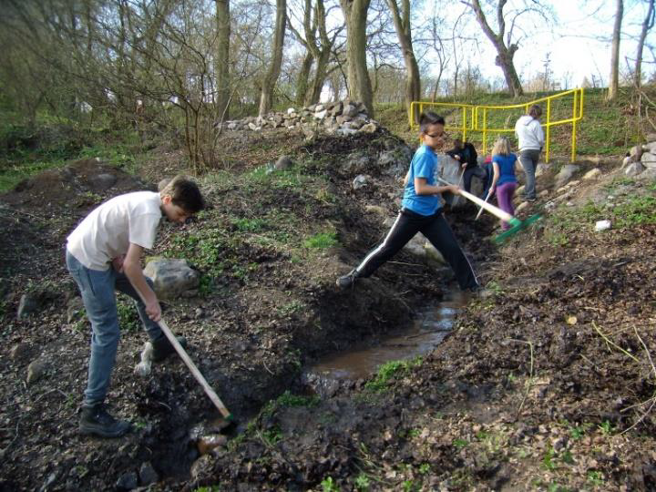
Kadan High School: Using Eco-Schools to take care of a local stream
Each April and October students check the place and keep it tidy
Cooperate with local municipality – built a roof above the spring and information board about the history of the church

Slide 7
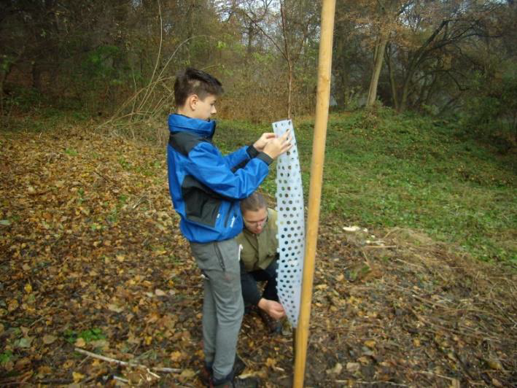
Kadan High School: Using Eco-Schools to take care of a local stream
Next year students decided to restore nearby area of
a former pear orchard
Nowadays the place is tidy, clean and attracting local residence

Slide 8
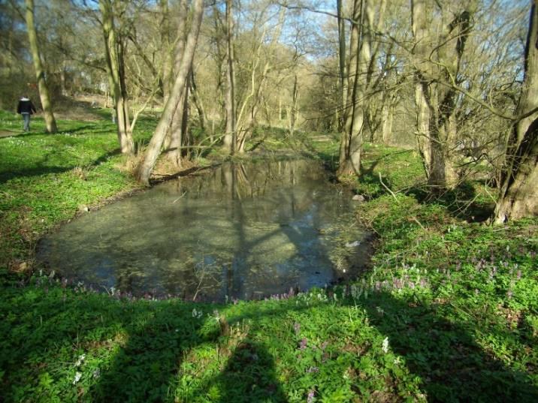
Kadan High School: Using Eco-Schools to take care of a local stream
In 2015 students started a research project for GLOBE Games conference
Research questions:
How the water quality changes from the spring to the pool?
How the water organisms are influenced by changes?
Used GLOBE hydrology protocols and IBSE methodology

Slide 9
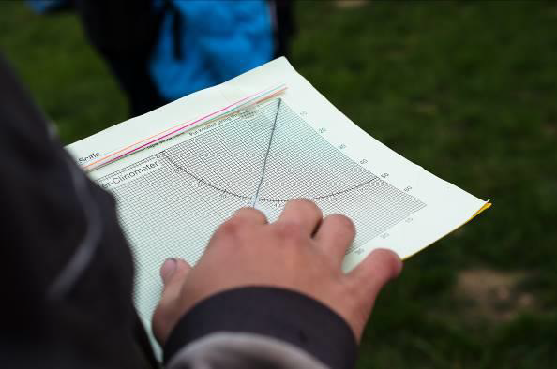
Kadan High School: Using Eco-Schools to take care of a local stream
Future plans – Green Up, Green Down and biometry protocols on the pear trees

Slide 10
Interconnection
Eco-Schools Steps: Step 1 (Team), Step 2 (Audit), Step 3 (Action Plan)
GLOBE: Science Practices (Asking Questions; Monitoring Environmental Changes; Planning and Carrying out an Investigation using GLOBE protocols, Analyzing and Interpreting Data; Obtaining, evaluation, and communicating information) and hydrology protocols

Slide 11
Interconnection – report from teachers
Interconnection between GLOBE and Eco-Schools programs is beneficial
Two teachers – coordinate G and E, cooperate also with collegues
Support from the school management
Long –term cooperation with the local municipality
Eco-schools and GLOBE Programs are the part of the School Program
Students can attend a Seminar on Ecology

Slide 12
More examples is available at https://www.globe.gov/web/national-wildlife-federation/resources Thank you!

