Slide 1
Alexander Dawson School
Colorado, USA
GLOBE Program

Slide 2
Integrate Protocols into the Curriculum
Green Down / green up
Weather
Surface water
Soil
climate

Slide 3
I begin the year with Stream Study and
Green Down Procedures
Green Down is a nice opportunity to teach data collection and involve younger students
https://youtu.be/qVQ_MWBdk08

Slide 4
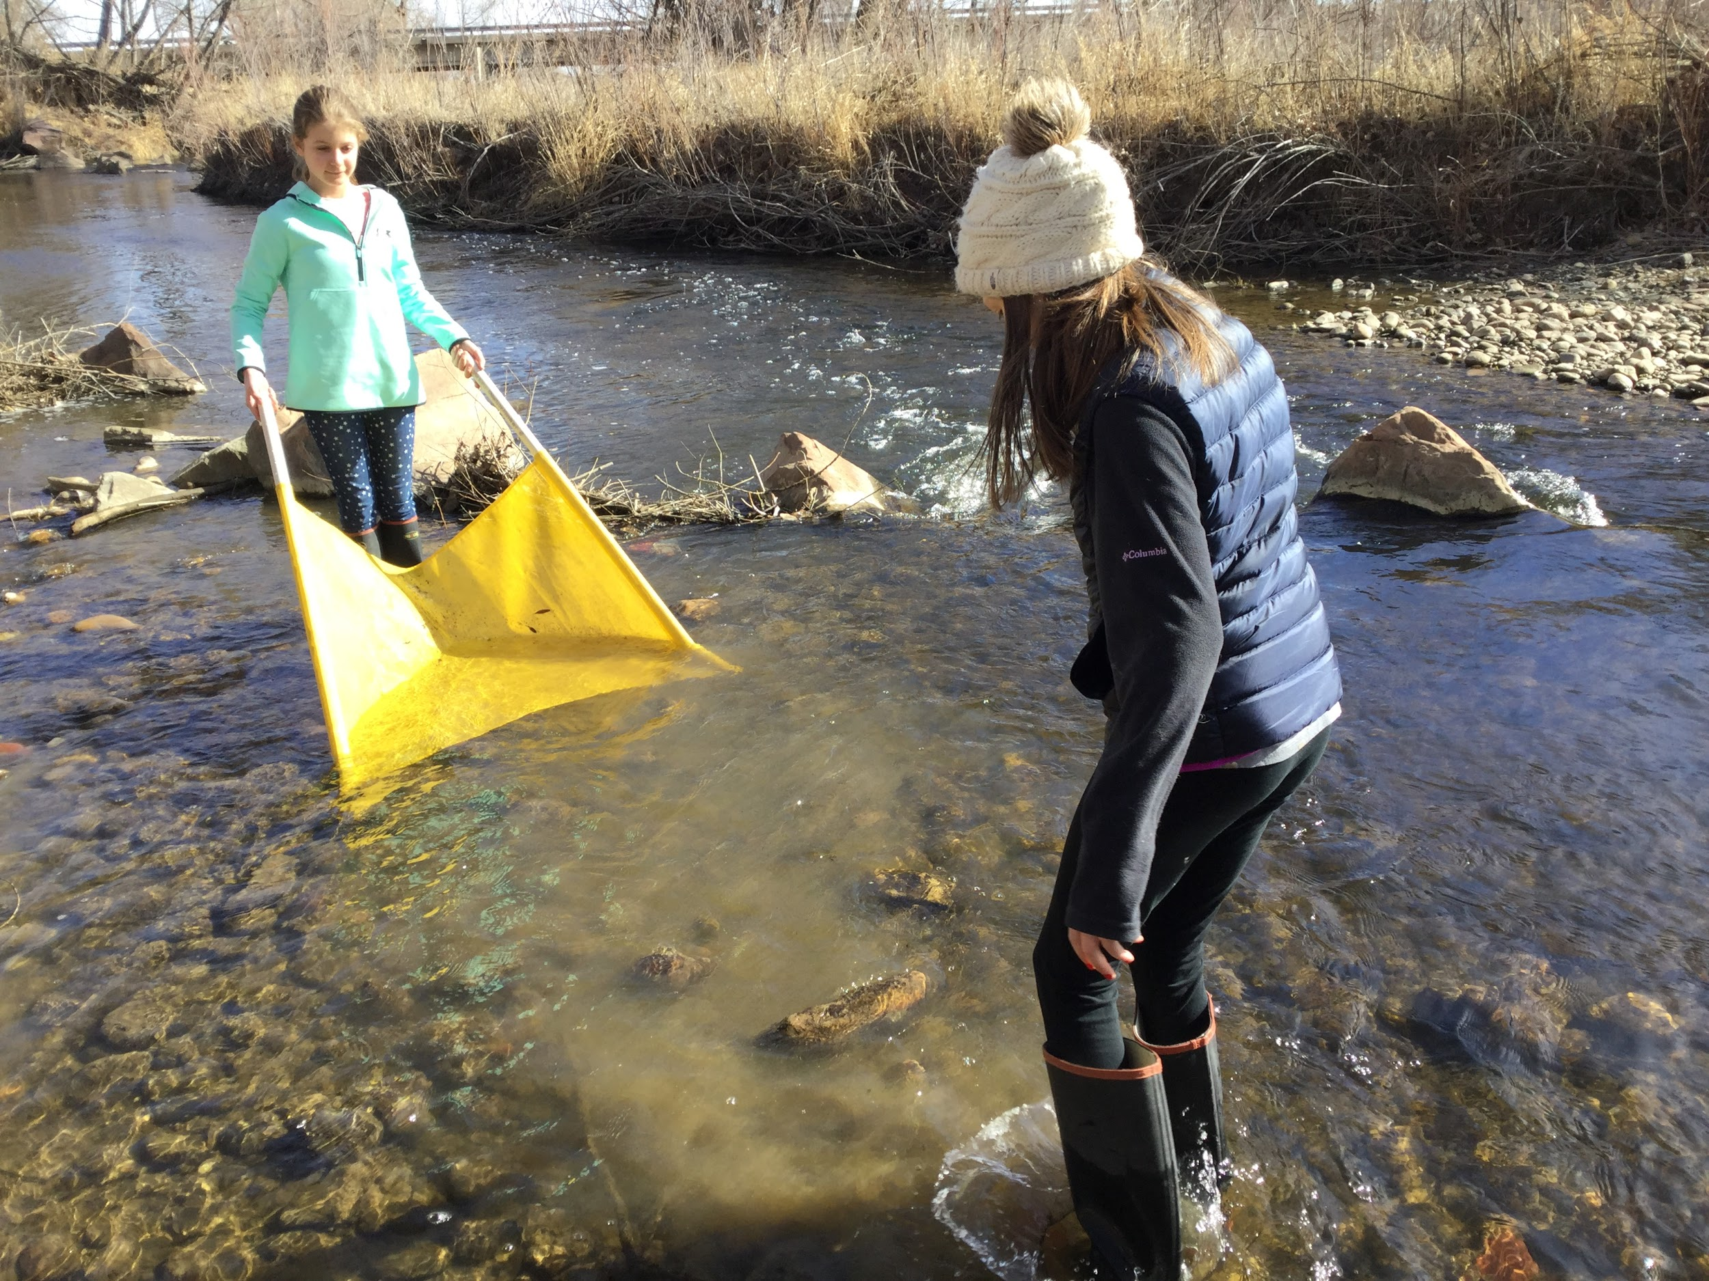
Science Symposium
Chance for motivated students that are looking for “more” to work on independent projects
We start at the
Beginning of the
year

Slide 5
How to pick a research topic?
What are you interested in that relates to a GLOBE Protocol?
Can you collect this Data?
What equipment is required?
How much time / week is required?
How many people will be required to work on this?
Let’s write out the Purpose and Procedure
If this looks good, let’s get started!

Slide 6
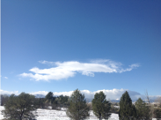
Weather Protocols
Cloud Identification
Cloud Coverage
Record Daily for 1-2 weeks

Slide 7
Design Rain Gauges
https://youtu.be/au2qCGmvLEY

Slide 8
Symposium students - still working!
Set up artificial deadlines
Begin to analyze data
Follow Globe guidelines for the final report

Slide 9
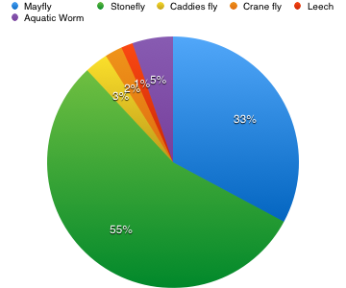
Graphs

Slide 10
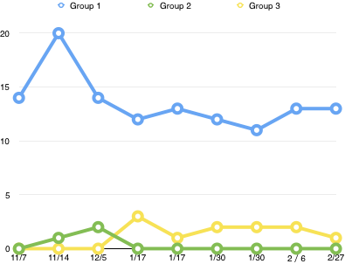
More Graphs
Be creative!

Slide 11
Students finalize and submit the report
Macro-invertebrates and water chemistry in Boulder Creek
Abstract:
This science project was done to learn more about the macroinvertebrates in the Boulder Creek, and how the numbers and species fluctuate according to alkalinity, temperature, D.O. and pH. Before collecting data, we hypothesized that the warmer the water got, the more pollution tolerant species would be present. This….

Slide 12
Students finish the year discussing climate change
https://youtu.be/t9S2bYOB8ho

