Slide 1
Evaluation Working Group
Year 3
Nektaria Adaktilou
31 July 2017

Slide 2
Evaluation Working Group
Purpose: Find out how the Program works in schools, identify evaluation resources and practices, build on the existing experience and provide suggestions that can help GLOBE’s implementation and outcomes.
Monthly
Via zoom

Slide 3
Our activities this year
Evaluation related webinars
For: teachers, US partners, Regional Coordinators and Country Coordinators.

Slide 4
Our activities this year
Collaboration with the Education Working Group
Start with US partners: Water cooler
Organized by Jen Bourgeault

Slide 5

Water cooler

Slide 6
Report based on the 2015-2016 teacher survey
The report includes:
The current status of GLOBE at schools: successes, barriers and challenges,
Valuable aspects of the Program,
Fit of the Program in the curriculum- Incorporation in the instruction process,
Evaluation tools used,
Outcomes teachers want to be able to document,
Outcomes that teachers have seen from implementing GLOBE,
Types of support needed to better implement GLOBE,
Types of support needed to better assess the effectiveness of GLOBE,
Demographic data about the teachers.

Slide 7
Our request to the community
Existing student assessment and program evaluation tools that can be shared with other members of the GLOBE community.
Existing data that partners have from their studies on Program effectiveness:
I) short-term results (student gains in learning, interests, motivation, social-emotional development, or teacher outcomes).

Slide 8
ii) longitudinal studies (for example, related to improved graduation rates, entry to postsecondary education, and career-related outcomes).

Slide 9
Collaboration with other working groups
Technology Working Group
Suggestions as to what be useful for our group.
i. Dedicated space on the website for our materials.
ii. Get notifications when blogs are posted.
iii. Evaluation questions pop-up when people upload data.

Slide 10
Questions
1. Do you use evaluation tools to assess student learning and GLOBE implementation in your school? If yes, which types? Can you share your results with the evaluation group and the community?
2.What are the outcomes you have seen from the participation of your students in GLOBE? Please describe.

Slide 11

Communication with US partners
NARM
January 2017

Slide 12
Communication with regional offices
Meeting notes
Participation (in person or virtual) it the regional meetings,
Participation in Board meetings.

Slide 13
Communication with others involved in evaluation
Valerie Williams at GLOBE Strategic Planning Meeting.
Ann Martin

Slide 14
Invited speaker
Matt Silberglitt - WestEd (rubrics).

Slide 15
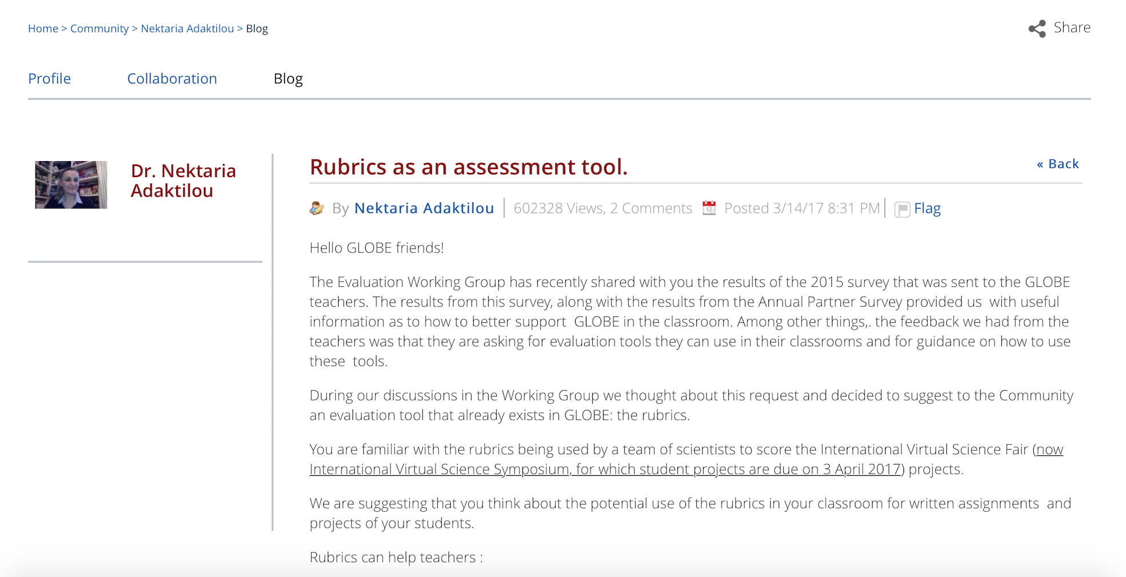
Blog
Rubrics as an assessment tool

Slide 16
Contribution in the Annual Partner Survey
1.Among the following evaluation tools, please select the ones you use to assess student learning in your GLOBE-based science lesson. If you do not assess learning of your GLOBE-based lessons, please respond with N/A.
2. Based on your use of assessment tools, please describe any change you have observed in learning outcomes, attitude toward science and/or career choices in your students.
3. Which of the following types of student outcomes is the MOST important for you to be able to document. Please select only one.
4. In order to assess the effectiveness of using GLOBE materials and resources in your classroom, which of the following areas would you need the MOST support in? (please select only one)

Slide 17

One pager for funders

Slide 18
Future goals
Webinar for the teachers-pre-recored to be used at the users’ convenience- Invited speakers.
Reach out to the community again for the identification and collection of existing resources.
Look into validated evaluation tools that could be modified to fit the purposes of GLOBE.

Slide 19
Strengthen the collaborations with the other working groups.
Maintain and strengthen communications with the regional offices.

Slide 20
Groups
For example: review protocols, get initial feedback on activities being planned…
Evaluation of e-training modules with a set of questions after their completion.
Reg. Offices
Share notes, participate in regional meetings…

Slide 21
Our Group’s plans for the meeting include you!
Collect your feedback after your experience in the field on Tuesday and Wednesday.

Slide 22
Poster session
Meet us during the poster session. You will provide the content for our poster.

Slide 23

The Evaluation Working Group
Africa: Ylliass Lawani
Africa: Lawrence Kambiwoa
Asia and Pacific: WT Tuder Senarathna
Europe and Eurasia: Nektaria Adaktilou
Latin America and Caribbean: Andrea Ventoso
Near East and North Africa: Siham Salman
North America: Kevin O’Connor
North America: Tina Cartwright
Our liaison to the GIO: Kristin Wegner

Slide 24

Τhank you!

